Slide 1
Project Management Convention for GN4-3 & GN4-3N
Network Technologies and Services Development - WP6
Current Status
Ivana Golub, WP6 Lead, PSNC
Tim Chown, WP6 Lead, Jisc
As part of the GÉANT 2020 Framework Partnership Agreement (FPA), the project receives funding from the European Union's Horizon 2020 research and innovation programme under Grant Agreement No. 856726 (GN4-3).​​​

Slide 2
Agenda
Current status of the WP6 activities
What went well
What can be improved

Slide 3
Network Technologies and Services Development Work Areas
T2: Network Services Evolution and Development
Service Management Platform
Orchestration, Automation and Virtualisation (OAV)
Architecture
Training
Wiki with the Community Portal
Campus Network Management as a Service (CNaaS)
Data Transfer Node Infrastructures (DTN)
Terminology
T1: Network Technology Evolution
Low Latency networking (LoLa)
Optical Time and Frequency Networking (OTFN)
White box networking
CPE Normandy, RENATER
Internet Exchange Point (IXP), RENATER
CPE, FUNET
Data centre, GRNET
White box performance testing, PSNC
Router for Academia, Research and Education (RARE)
Data Plane Programming (DPP)
Quantum Key Distribution (QKD)
T3: Monitoring and Management
perfSONAR
perfSONAR Consultancy
Performance Measurement Platform (PMP)
Network Management as a Service (NMaaS)
WiFiMon
Network Telemetry
WP6 umbrella page: https://wiki.geant.org/display/NETDEV

Slide 4
Task 1: Network Technology Evolution Task Leader: Xavier Jeannin (RENATER)
Low Latency Networking
LoLa
GÉANT network jitter weather-map prototype: https://timemap.geant.org/
User and uptake engagement in progress
Optical Time and Frequency Networking OTFN
Testing in progress: in GÉANT, NREN interconnectivity
White paper published; infoshare in preparation
White Box
for R&E networks
RENATER CPE and IXP in production
FUNET CPE and GRNET Data Centre solutions in deployment
Performance testing in progress, white paper in preparation
Router for Research and Academia RARE
Continued development: new features, new platform, the GÉANT P4 Lab
Increase in interest continues – Connection with the international P4 testbed
Data Plane Programming DPP
INT testing environment running across production NREN infrastructure
Evaluation of the NRENs' interest in progress
Quantum Key Distribution QKD
Collaboration and knowledge sharing – white paper, infoshares
Technology evaluation; planned proof of concept with Toshiba

Slide 5
Task 2: Network Services Evolution and Development Task Leader: Roman Lapacz (PSNC)
Service Provider Architecture
SPA
Continued development and support to the GCS service
Service promotion – wiki, events
Migrated to the new production and testing infrastructure
Orchestration, Automation, Virtualisation OAV
Led by Maria Isabel Gandia Carriedo (CSUC/RedIRIS)
OAV focus groups status:
Architecture – NREN-ODA mapping in progress, more white papers to come
Training – regularly publishing new modules
Wiki – new content, updating, enhancing
Campus Network management as a Service (CNaaS) – coordination and promotion of individual NRENs’ efforts
Completed OAV focus groups:
Data Transfer Nodes (DTN) – reported in a white paper and an infoshare
Terminology – accepted by the GNA-G Automation WG, new version published

Slide 6
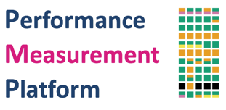
Task 3: Monitoring and Management Task Leader: Pavle Vuletić (UoB/AMRES)
perfSONAR
Continued development and support in the Global team; RNP – new partner
2nd European perfSONAR User Workshop preparation in progress
perfSONAR Consultancy
Providing support to the GÉANT community
RENATER, Jisc
Consultancy and Expertise
Performance Measurement Platform
PMP
Continued maintenance and support
Node replacements in preparation
Network Management as a Service
NMaaS
Continued development and maintenance: new features, new tools
User support, uptake increase due to the collaboration with RARE
WiFiMon
New installations in preparation in RASH, GRENA, UoB
Collaboration with eduroam initiated
new!
Network Telemetry
In-band Network Telemetry (INT) testing for network service monitoring
New testbed is being built on GTS

Slide 7
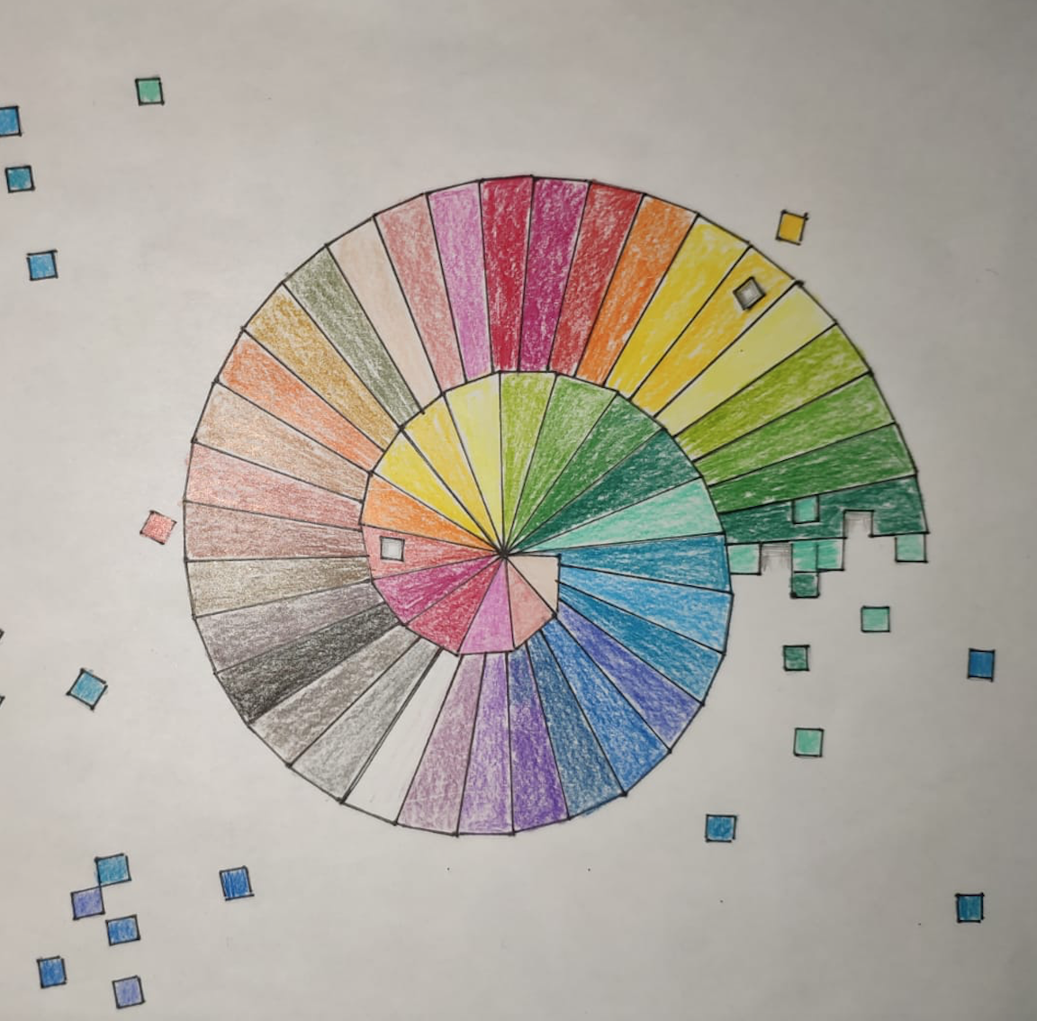
What went well
WP6 team members engagement and collaboration
Positive approach and strong engagement of most of the team members: 82 persons, 34 organisations, 23 countries, 21 partner
6 Deliverables and 7 Milestones delivered on time
(Mostly) Recovering from staff leaving
All KPIs exceeded
Dissemination:
12 white papers/documents published
46 events, out of which 20 are organised and 3 co-organised by WP6

Slide 8
Areas for improvement
Recovering NREN underspend - enabling agility in work items
Total projected WP6 underspend estimated to be approx 500.000 EUR
BUT no or slow response from NRENs when contacted about the underspend
NREN engagement - improving uptake and increasing value
Attendance at the infoshares is good, however
Solicitation for use cases and invitations for participation mostly end up with silence
Promotion to NREN institutions (user sites) and individuals; particularly for WiFiMon and NMaaS
Help needed!

Slide 9
Thank you
Any questions?
As part of the GÉANT 2020 Framework Partnership Agreement (FPA), the project receives funding from the European Union's Horizon 2020 research and innovation programme under Grant Agreement No. 856726 (GN4-3).​​​

Slide 10
Project Management Convention for GN4-3 & GN4-3N
Network Technologies and Services Development - WP6
Looking ahead 2021
Ivana Golub, WP6 Lead, PSNC
Tim Chown, WP6 Lead, Jisc
As part of the GÉANT 2020 Framework Partnership Agreement (FPA), the project receives funding from the European Union's Horizon 2020 research and innovation programme under Grant Agreement No. 856726 (GN4-3).​​​

Slide 11
Agenda
Y3 plans for the WP6 activities
What we need help with

Slide 12
Network Technologies and Services Development Work Areas – Looking ahead
T1: Network Technology Evolution
Low Latency networking (LoLa)
Optical Time and Frequency Networking (OTFN)
White box networking
Internet Exchange Point (IXP), RENATER
CPE, FUNET
Data centre, GRNET
White box performance testing, PSNC
Router for Academia, Research and Education (RARE)
Data Plane Programming (DPP)
Quantum Key Distribution (QKD)
T2: Network Services Evolution and Development
Service Management Platform
Orchestration, Automation and Virtualisation (OAV)
Architecture
Training
Wiki with the Community Portal
Campus Network Management as a Service (CNaaS)
T3: Monitoring and Management
perfSONAR
perfSONAR Consultancy
Performance Measurement Platform (PMP)
Network Management as a Service (NMaaS)
WiFiMon
Network Telemetry
WP6 umbrella page: https://wiki.geant.org/display/NETDEV

Slide 13
Task 1: Network Technology Evolution Task Leader: Xavier Jeannin (RENATER)
Low Latency networking
LoLa
Continue the work on the weather-map
Working with GÉANT and NRENs for uptake in their environment
Optical Time and Frequency Networking OTFN
Continue testing: in GÉANT, NREN interconnectivity
More infoshares and collaboration
White Box
White box evaluation and performance verification
Finalising use cases (FUNET, GRNET, RENATER IX) and white papers; dissemination
Router for Research and Academia RARE
Continued development: new features, new platform, the GÉANT P4 Lab
User engagement and promotion
Data Plane Programming DPP
Tests extended in scope: protocol, platform; release code publicly
Evaluation of NREN interest to extend work
Quantum Key Distribution QKD
Collaboration and knowledge sharing – white paper, infoshares
Technology evaluation; proof of concept with Toshiba on GÉANT fibre

Slide 14
Task 2: Network Services Evolution and Development Task Leader: Roman Lapacz (PSNC)
Service Provider Architecture
SPA
Continued development and support to the GCS service
Service promotion – wiki, events
Stand-alone software as a service
Orchestration, Automation, Virtualisation OAV
Led by Maria Isabel Gandia Carriedo (CSUC/RedIRIS)
OAV focus groups in Year 3:
Architecture – continue NREN-ODA mapping, white papers
Training – Complete two phases (by June 2021) and evaluate continuation
Wiki – new content, updating, enhancing
Campus Network management as a Service (CNaaS) – evaluate logging aggregation work (T3); determine FG’s future
Start new FGs and/or re-activated completed if a clear need arises.

Slide 15
Task 3: Monitoring and Management Task Leader: Pavle Vuletić (UoB/AMRES)
perfSONAR
New major version; development and support in the Global team
Ongoing engagement, including 2nd European perfSONAR User Workshop
perfSONAR Consultancy
Continue to provide support to the GÉANT community
Consultancy and Expertise
Performance Measurement Platform
PMP
Continued maintenance and support for the production PMP
Evaluate additional measurement tools, use of AI for analysis
Network Management as a Service
NMaaS
Continued development and maintenance: new features, new tools
User engagement; securing and onboarding new users
WiFiMon
Continued development, maintenance and collaboration with eduroam
User engagement; securing and onboarding new users
Network Telemetry
Complete testbed deployment to support INT network service monitoring
Follow up community interest in sharing large scale network telemetry data

Slide 16
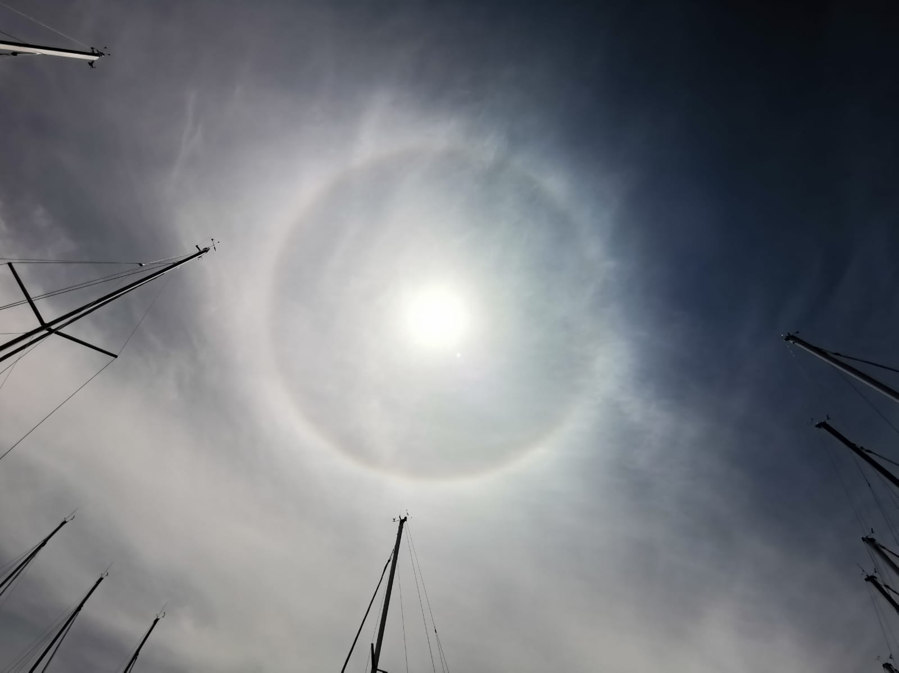
We need help with
Licencing and IPR
Defining and aligning within the WP, the project and with NRENs
User engagement
Confirming ongoing NREN commitment to work items
Increasing uptake of production services
Recovering underspend from NRENs
To support greater agility in extending / starting new work items

Slide 17
Thank you
Any questions?
As part of the GÉANT 2020 Framework Partnership Agreement (FPA), the project receives funding from the European Union's Horizon 2020 research and innovation programme under Grant Agreement No. 856726 (GN4-3).​​​

