Slide 1
Project Management Convention for GN4-3 & GN4-3N
Maria Ristkok, WP4
Where are we now?
As part of the GÉANT 2020 Framework Partnership Agreement (FPA), the project receives funding from the European Union's Horizon 2020 research and innovation programme under Grant Agreement No. 856726 (GN4-3).​​​

Slide 2
Work Package 4 – Achievements of all project work
Work completed in 2019-2020
Online services delivery (T1)
Services development (T2 and T3)
Services adoption support (T4)

Slide 3
2019-2020 Work Completed
5/8* deliverables and 8/10** milestones completed of all the project work
*D4.5 published just this week
**M4.4 and M4.5 merged due to changes in the tender and
M4.10 postponed for 6 months because of OCRE delay (ca 1 year)
WELCOME
New Services:
Oracle as Preferential Quotation
Zoom as Preferential Quotation
eduMEET (as production grade software)
GÉANT Cloud Flow (as Pilot)
LMS tender bundle for NRENs

Slide 4
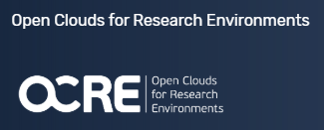
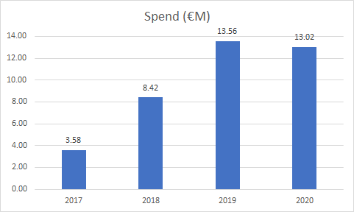
Achievements: Services Delivery (Task 1)
Consumption of the IaaS Framework (2016) has increased to 375 R&I institutions consuming together EUR38.5 M by M24
The tender and the contract management system scaling up by the OCRE tender was launched in Q2 (M4.3, M8, 2019)
Cloud tender solutions were prepared in Q2
COVID-19 cloud services offerings were gathered and disseminated to the community
Collaboration with the OCRE project, SIG-MSP, TF-EDU, etc.

Slide 5
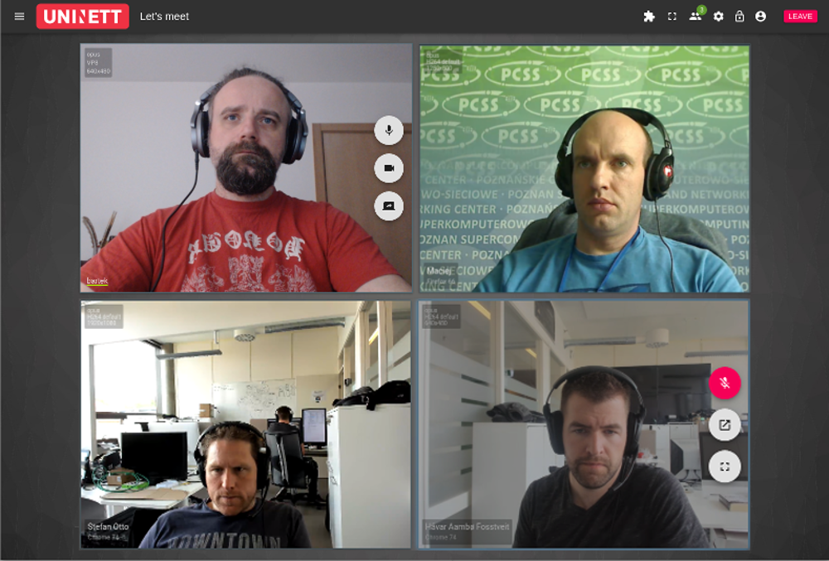
Achievements: Development of Videoconferencing Infrastructure (Task 2)
Successful eduMEET Beta Gate Reviews in
P1Q3 (2019) entering Pilot and
Production Transition Gate Review in P2Q2 (2020)
eduMEET significant development and installations during COVID-19 pandemic. Release 3.4.0 by October 2020.
The Beta Test results and the Operational Service Plan published as Deliverable D4.4
Interest all over the world.
Community of developers established
Collaboration with eduTEAMS (WP5), SIG-Multimedia, TF-EDU, OpenUp2U, Moodle

Slide 6
Achievements: Development of Joint Community Offers (Task 3)
3 Deliverables published:
D4.1 Community Clouds Delivery Plan. Services Selection, Business Models and Development Roadmap (M6)
D4.2 Multi-Cloud Management System: Business Case and Delivery Plan (M15)
D4.3 Review of Community Clouds Delivery (M16)
3 Milestones met:
M4.2 Community Clouds, Launch Joint Development Efforts (M7)
M4.7 Multi-Cloud Management System, Launch Development (M16)
M4.9 Community Clouds, Launch First Service Offering (M22)

Slide 7
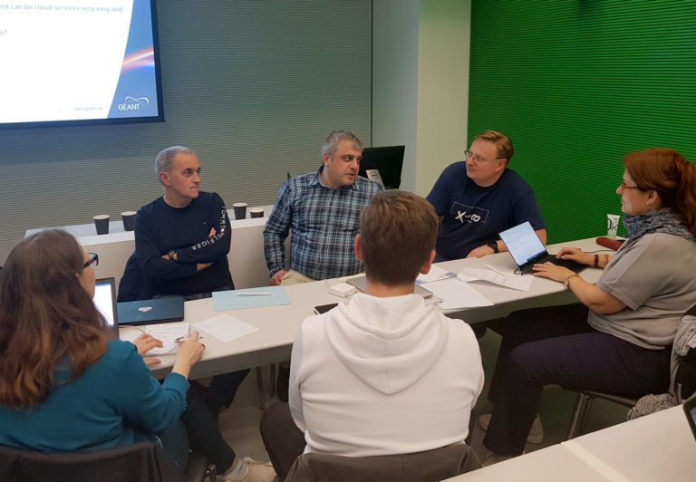
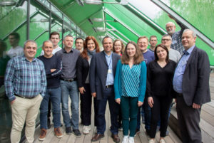
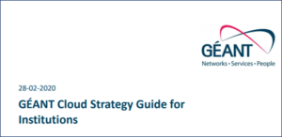
Achievements: Services Adoption Support (Task 4)
121 events, incl 50 bi-weekly forums for NRENs
27 news items added to the GÉANT cloud website and 4 GÉANT Cloud Newsletters
Trainings: 2 two-day GÉANT cloud trainings and an online Cloud Security Workshop for NRENs
Cloud Strategy Guide for institutions
Developed tools for cloud adoption - Button and chatbot
Collaboration with GN4-3 teams, Special Interest Groups, Global NRENs, cloud providers, other e-infrastructures and projects (EGI, OCRE)

Slide 8
Thank you
Any questions?
As part of the GÉANT 2020 Framework Partnership Agreement (FPA), the project receives funding from the European Union's Horizon 2020 research and innovation programme under Grant Agreement No. 856726 (GN4-3).​​​

