Slide 1
Project Management Convention for GN4-3 & GN4-3N
Service Delivery and Uptake
Ivana Golub, WP6 Lead, PSNC
Marina Adomeit, WP5 lead, SUNET
Beatrix Weber, WP3T1 TL, GÉANT
As part of the GÉANT 2020 Framework Partnership Agreement (FPA), the project receives funding from the European Union's Horizon 2020 research and innovation programme under Grant Agreement No. 856726 (GN4-3).​​​

Slide 2
Agenda
Service Delivery Analysis
What do we know from NRENs?
Introduction to the break out sessions
Break out session

Slide 3
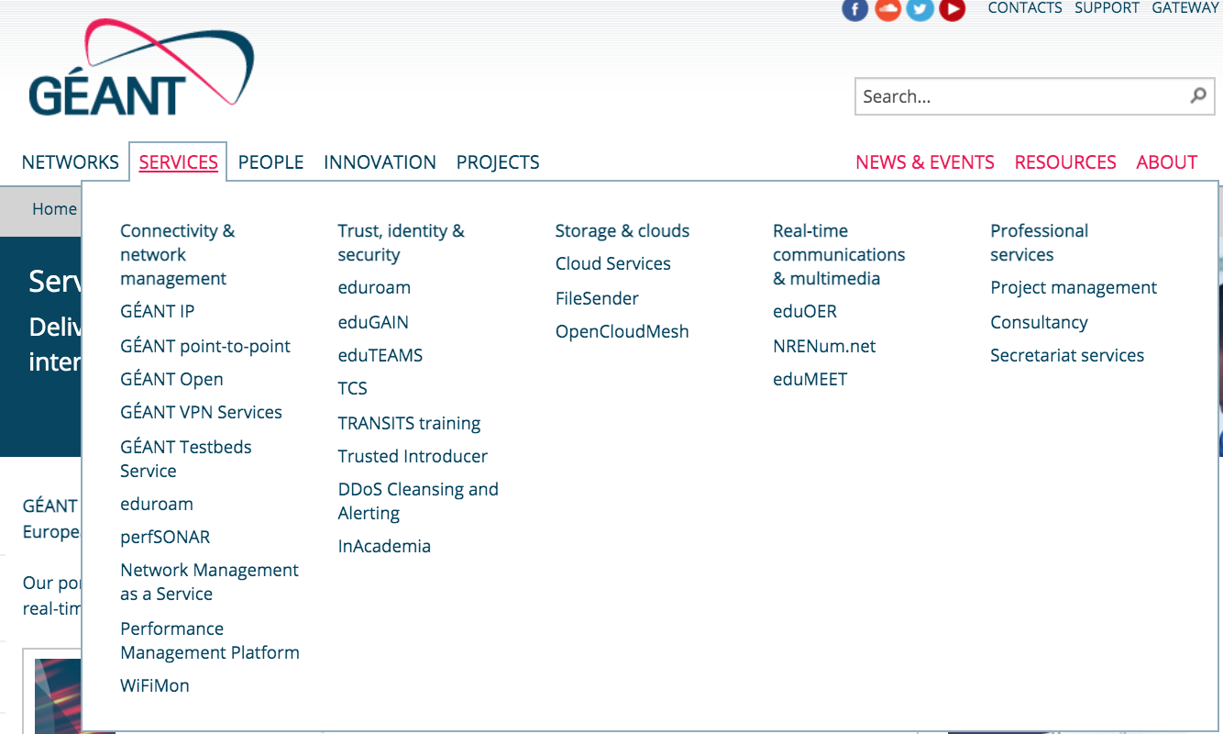
GÉANT Services

Slide 4
For each service...
Do we know?
What is the service?
Who are the users?
What is the value of the service? Or: Why would a user use the service? Or: Why would someone pay for the service?
Is it clearly defined and transparently presented?
Notes:
Someone in this case being EC

Slide 5
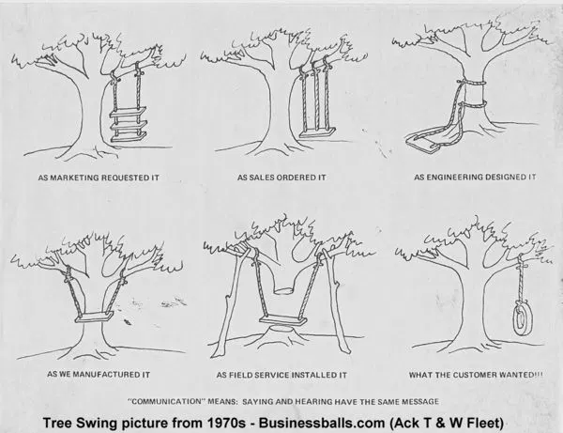
Answers to previous questions:
Determine
Are we delivering what we are offering?
Are we targeting the right audience?
Are we promoting the services correctly?
And impact:
Promotion
Uptake
Users' satisfaction
...
https://boingboing.net/2013/03/14/history-of-tree-swing-draw.html https://www.businessballs.com/amusement-stress-relief/tree-swing-cartoons-new-versions/

Slide 6
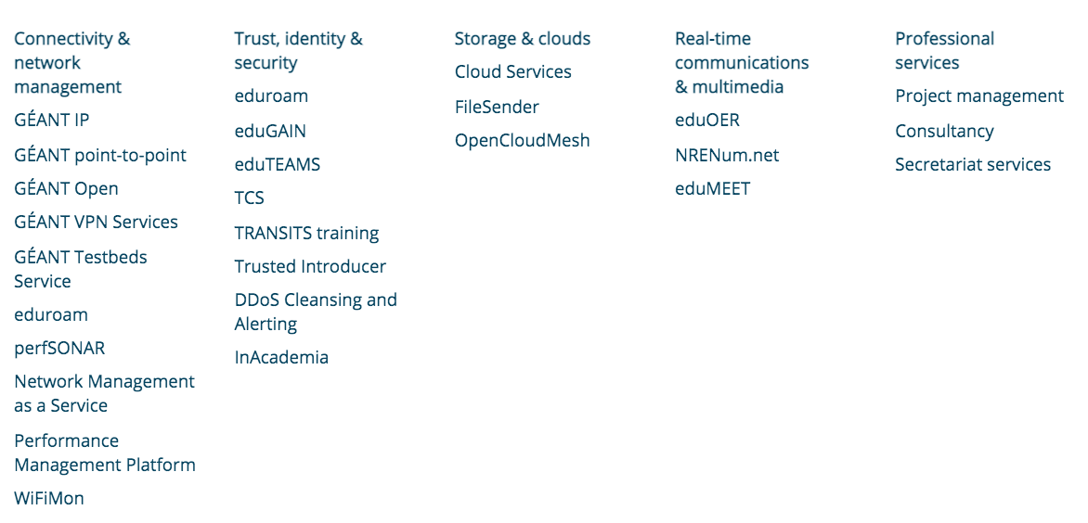
We present services per technology
Can we easily say
whom each service is for?
Can our users?

Slide 7
Service Analysis Perspective
A set of current production services
analysed from the following perspectives:
User groups
Production delivery and operations
Delivery chain
Uptake measurement
Governance model

Slide 8
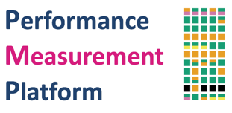
Service Delivery Analysis
Production services
14 (Not all) services took part in this analysis
All WP5 (4) and WP6 (5) production services
2 WP4 services and 3 WP7 services (Thanks Maria, Toby, Akil, Mian)
Participation on a voluntary basis
Some development work
4 WP6 candidates for new services
Not all aspects defined or fixed yet (work in progress)
GTS
GÉANT Lambda
Consultancy and Expertise
GÉANT IP
Notes:
The development work is taken into consideration to check if it follows the same direction as current production services

Slide 9
Service delivery questions
What is the service?
Who are the users?
What is the delivery model?
How is the production delivery organised?
How is the uptake measured?
What is the governance/steering model?
Notes:
I will go through the service analysis. The purpose is to provide an overview of the ways that we deliver geant services.
Geant service portfolio is developing for many years, and this exercise trys get basic information if there are certain trends in the way we deliver services. This can be usefull when we design new services, but also help us understand where we can improve, where are the risks or gaps in the models we employ.
Important also to say that these analysis shows stats that we should really take as an indication. These questions are not always easy to answer, there are a lot of deatils that lay in context of each service, and some answers start with: yes, but
I will show you the statistics and give you my interpretation of those, sometimes also to challenge our thinking and perception

Slide 10
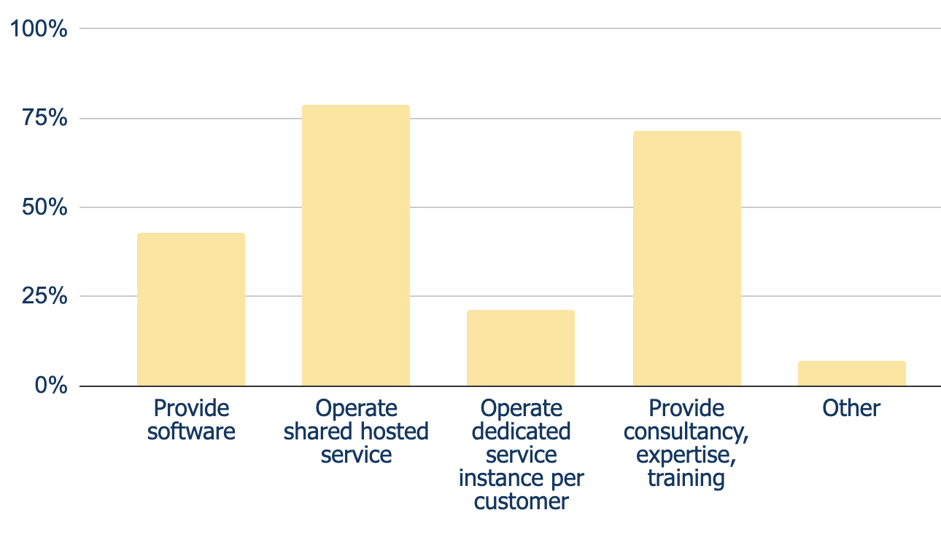
What is service offering?
Notes:
So to start with the first question - what is the service offering ? - we identified the categories you can see it the slide - an the category other to catch what we didnt predict
Worth mentioning is that options don't exclude each other - as our services grow and become more complex, we provide service in multiple service offering dimensions

Slide 11
What is service offering?
🙆 Dominantly provide shared hosted service
👆 Providing software, expertise and training usually not as standalone service offering
Notes:
We dominanty provide a shared hosted service- such as inacademia, nmaas or gts
To smaller extent, we provide dedicated service instance per customer - eduteams, faas
As i indicated before, some of our service offerings however are complex, so that as part of the service we also provide software (such as campus idp toolkit for edugain )or and we provide trainings and consultancy and expertise as part of majority of services we provide.
There are however some services such as wifi mon and edumeet where providing software and consultacy is the service offering itself.

Slide 12
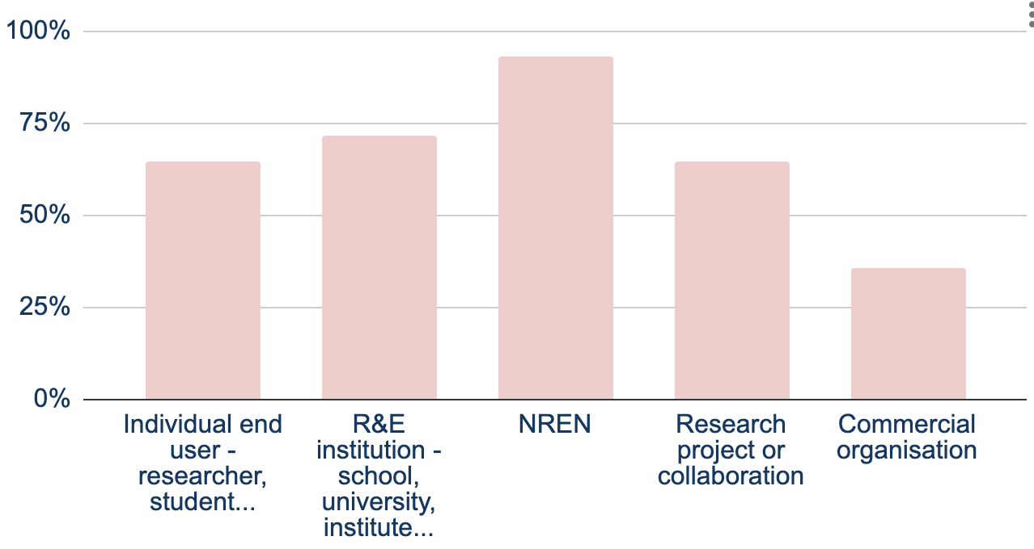
Who are service users?
Notes:
Next important question to answer for every service is who are service users, and this question often time causes a lot of discussion for our services.
We wanted to capture both who are the customers and who are the users of the service.
A customer is someone who can help negotiate and agree to service level agreements,
A user is anyone who is entitled to one or more IT services.

Slide 13
Who are service users?
👫👬👭Most services reach individual users
🔗 NRENs participate in delivery chain technically or distribute the service
Notes:
NRENS really stand out here - this is because they are usually the customers , as geant as a rule doesnt have direct relationships with institutions or end-users. NRENs participate in the delivery chain technically and organisationally (edugain, eduroam) or they are an important actor to promote and distribute service to their constituency such as in eduMEET, IaaS framework, NMaas and GTS.
Other big user group are r&e institions and reasearhc projects- and they similarly would also present customers in relationship of individual users using the service.
And finally, most of our services reach end -users
There are however some services that are not available to the individual users, but where geant actually delivers service to NREN or institutions such as Perfsonar consultancy and expertise.
To a smallre extent, we have commercial organisation using our services - in case of eduroam wifi providers, edugain various SPs, InAcademia, perfsonar users

Slide 14
What is service delivery chain
GÉANT Project
Faculty, Campus,
University
NREN
GÉANT Project
NREN
Individuals
Faculty, Campus,
University
Direct
Hierarchical
Research
Communities
Individuals
Research Projects
Notes:
Now actually, the previous question of customers/users can be viewed from the perspective of service delivery chain.
Delivery chain caon take one or both of these forms:
- direct - when service is delivered directly users
- in the hierarchical model, there can be multiple hops in the service distribution chain and many possible paths
the image shows some of the most expected ones

Slide 15
What is service delivery chain
GÉANT Project
Faculty, Campus,
University
NREN
Individuals
First hop for GEANT is an NREN or a Research project
Services are delivered to Individuals mostly by their Institution or a Research Project
Research Projects
Commercial Organisation
Notes:
In the analysis we were exploring what is the service delivery chain for services, and this image shows them stacked with the purpose to visualise what are the busiest paths.
First hop from GEANT perspective are NRENs or Research Projects.
So this also visualizes where GEANT mostly invests or should invest when it comes to outreach and business development.
And then Services are delivered to Individuals mostly by their Institution or a Research Project.
For the service delivery to be sucessfull the whole chain needs to function. So it is question for geant services is also how we can support all of the parties in the chain.

Slide 16
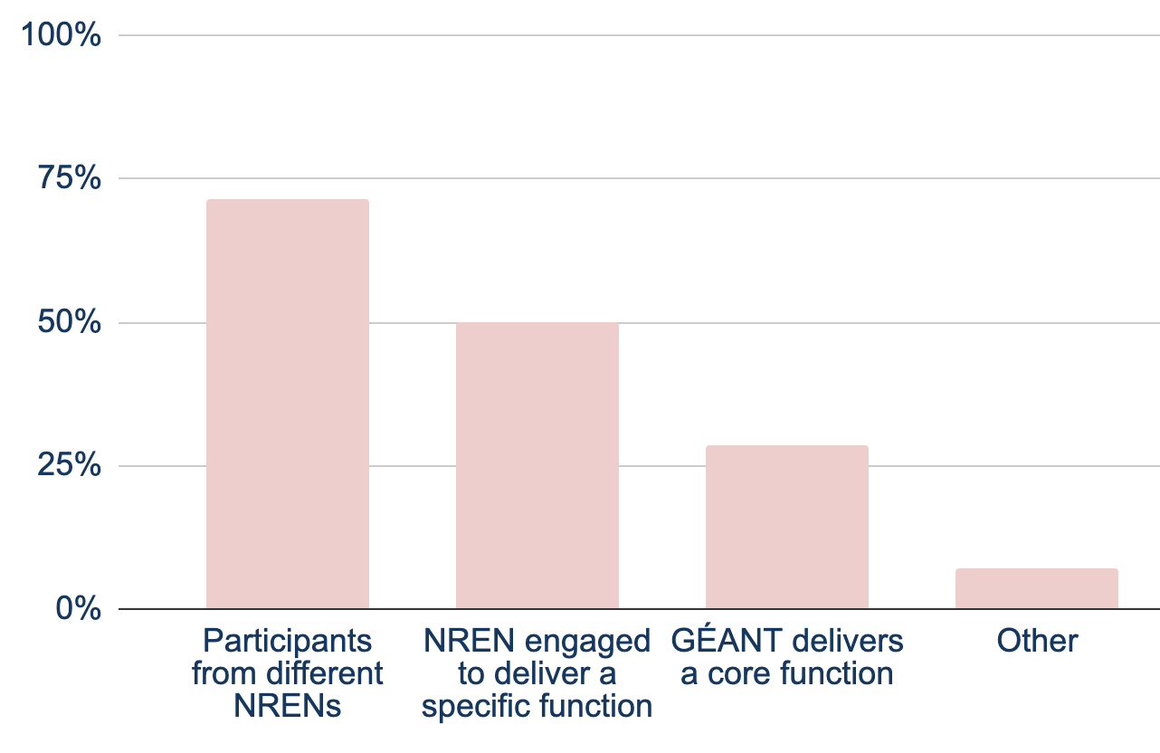
Production service delivery - Operations team
Notes:
Now we move to set of questions in the area of service delivery, starting with how do we engage the teams that operate a service.
I can say that this can be difficult to set up for new services where there is no natural operator to inherit from service poc of pilot. If there is no obvious interest or capacity in NRENs or GEANT, we really dont have a framework for this on the project level. I know that Tryfon will say there are job calls, but this doesn't really work in our experience at least.
Still we identified some common options….
Important also to say is that for some services it can really be a combination of these options

Slide 17
Production service delivery - Operations team
🙆 NRENs play significant role, either in an multi-NREN team, or taking a dedicated function
Notes:
So the most common option is when operations teams are build from different NRENS, and although it seems like sustainable option and the way to pull skills from different NRENs there are some challenges. It is surely difficult to setup OLAs for such teams and also to have clear cut in responsibilities. So IMHO these teams function very well when they are build from a number of skilled, self driven and motivated individuals.
Other two models by popularity are:
Nren engaged to deliver specific function - InAcademia, eduGAIN core operations
Geant delivers core function - eduteams core team, PMP, geant ip, geant lambda
These are certainly models where it is much easier to define responsibilities and conclude OLAs, but it is also when we rely on internal processes of and capabilities of NREN and GEANT OCs, such as monitoring, devops practices employed etc
Other - cloud providers
So as i already indicated, Here an interesting question can also be opened - and this is how sustainable our service operations are - what happens in staff turnover in NRENs or GEANT, do we have documentation, do we have OLAs in place -

Slide 18
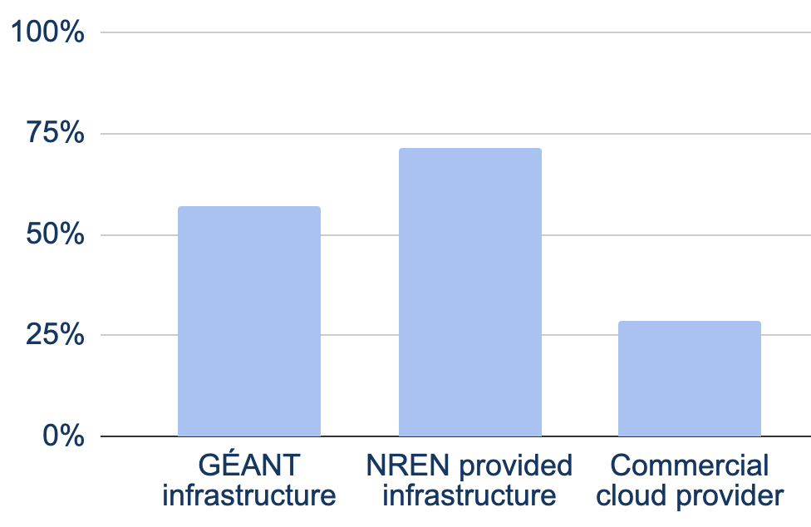
Production service delivery - Infrastructure
Notes:
Next question is also about service delivery, but which infrastructure do we use.

Slide 19
Production service delivery - Infrastructure
🙋 These stats show usage of infrastructure providers and not absolute numbers of VMs provided
😎 NRENs play significant role, usually combined with providing service team
Notes:
Usage if NRENs provided infrastructure is dominant, which is expected as NRENs also dominantly provide their service teams so these are usually coupled.
Also these figures dont show the absolute usage in the numbers of VMs which i think would be also interesting to analyuse but more diffucult to collect the data.
Some of the services heavily rely on some options while the others are really only smaller part of the all infrastructure.
For example GTS fully relies on geant infra, while edugain and eduroam mostly relay on nren provided infra and rely on geant infra at smaller extent.
Commercial providers are here used by services that have demanding requirements and that need to deliver agilly, such as eduteams that need to provide for a number of deployments.

Slide 20
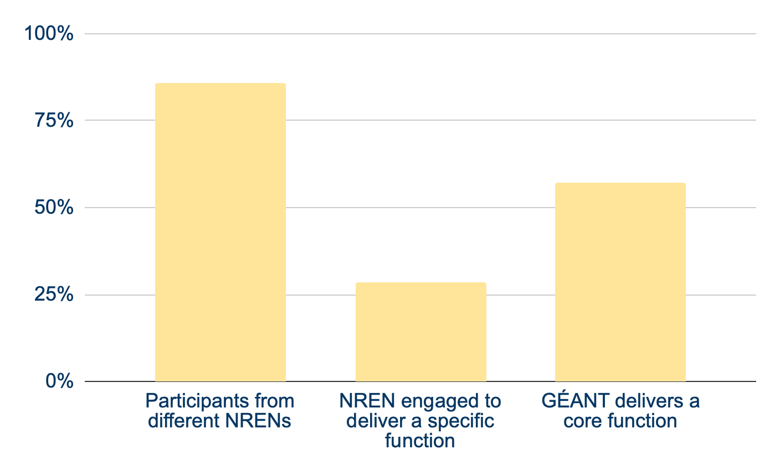
Production service delivery - Support
Notes:
And the final question about how we organise our support in service delivery.
And under support we mean all there levels - they can be fulfilled by different teams.

Slide 21
Production service delivery - Support
Notes:
Most dominant option is when support teams are build by participants by different NRENs
Followed by GEANT delivering core function - such as eduroam l1 support, secretariat function for edugain, and support for network services
Same questions remain here like for service operations teams- about sustainability and division of responsibilities in teams with different participants.
. I would like to pull out an good example that is close to me and this is how edugain l1 team is organised from participants from different NRENs. There is a weekly rota, regular meeting with the whole team to discuss any outstanding issues and also clear escalation path, and i think that this works very well

Slide 22
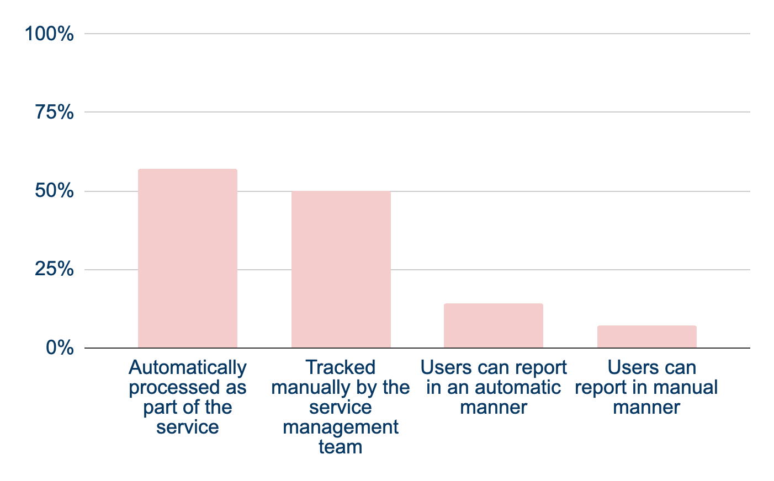
Uptake measurement - HOW
Notes:
Now, moving to questions about uptake measurement - do we think about this during the design of the service? Or it comes as an afterthought ? Certainly gets more difficult to implement in later stages.
One important aspect to think when we design for uptake measurement is user privacy and making sure that we do this under GDPR and privacy legislation

Slide 23
Uptake measurement - HOW
😲 Uptake measurement as part of service design? Perhaps not always possible
Notes:
Certainly the option to have stats automatically processed is the preferable so it is good that this the most dominant one.
To a large stake, uptake is also tracked by the service management team, and this is a necessity when we dont have technical means to track adoption - such as in cases where servie offering is a software suchs as in perfsonar or edumeet
Finally, we do rely in some cases for the users to report usage stats- such as in edugain and eduraom fticks, where we rely on NRO or federations to send us statistics about authenticaitons.

Slide 24
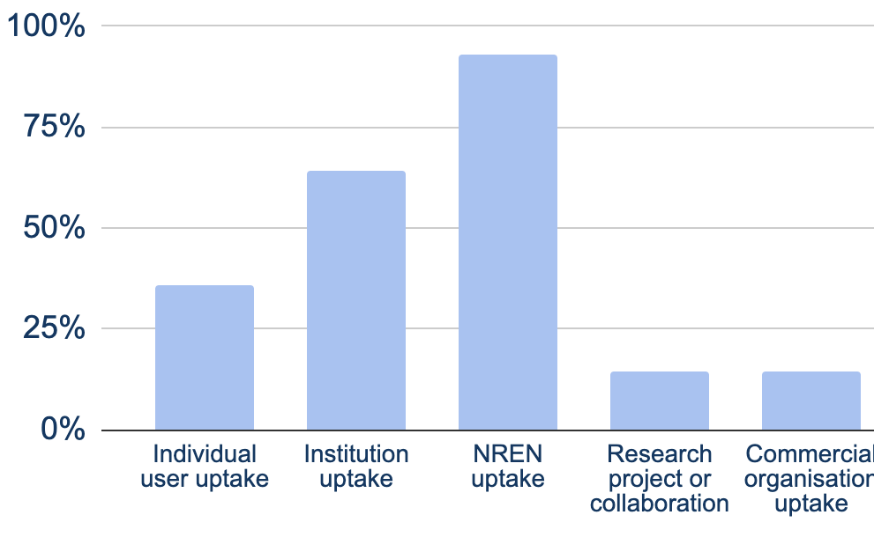
Uptake measurement - WHAT
Notes:
Next question is what can we measure when it comes to user uptake.
And reflecting back to the stast about who is user of the service - can we measure uptake of each individual user category ?

Slide 25
Uptake measurement - WHAT
🙌 NREN and Institution uptake is well tracked
😕 End users and research collaborations uptake is difficult to measure - price of running privacy preserving services, something else?
Notes:
And here are the results. The pink dotted boxes represent the difference between the percentage of services claiming the user group and those claiming measuring the uptake from the user group
As you can see - we can do that very well when it comes to NRENs and Institutions
However individual user uptake and upatke by researcher project or collaboration is more difficult to measure.
Certainly so for the end users - and in some cases this is also part of the service design as we make privacy perserving services.

Slide 26
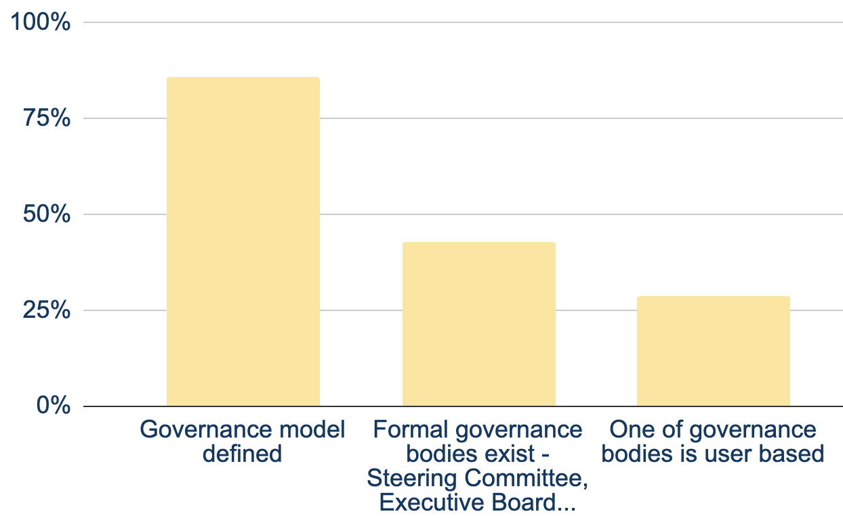
Service Governance/Steering
Notes:
Final question is regarding governance and steering of the service
Do we have the governance model defined ?
Do we have formal governance bodies ?
And do we have representation of users in one of the governance board ?

Slide 27
Service Governance/Steering
🙌 Most services have governance model defined
🙋 Users formally participate in governance only for some
Notes:
Loosk good as services mostly have governance model defined
For less half of the services however there is no formal bodies, nor representation of the user communities.
Of course the applicability of this depends of the servcie itself, but again i can say from serivices that are close to me that for T&I governance is important aspect and we design for community governance from the beginnig.

Slide 28
Development Work Snapshot
RARE, LoLa, DPP and OAV training WP6 work in scope
They all follow the similar pattern as production services:
Most of them include software development and consultancy
All are targeting the same user groups: NRENs, institutions, individuals, projects
They all have direct and hierarchical delivery chain model
The hierarchical delivery chain model is the same: GÉANT project -> NREN -> end institution -> end user
Operations team come from NRENs
Infrastructure: GÉANT and NRENs
Uptake depends on NRENs, institutions, individuals
Notes:
Development work follows the same pattern as production service - targeting same users, with the similar delivery chain, production model and governance structure

Slide 29
NRENs' Have Key Roles in Service Delivery
Service development and operation
Create and develop services
Provide infrastructure, support
Service delivery chain
Direct users
First point of contact Towards institutions, users, projects
Image credit: Jean-Philippe Frimat
Notes:
Do NRENs see the importance of their roles the way how we see it?
How are we making sure that bigger changes in NRENs will not impact service sustainability?
NRENs play the key role in service development, operations, delivery and thus sustainability of services

Slide 30
The analysis raises even more questions
Services address several user groups:
Have we adjusted the approach per user group?
Have we adjusted the value proposition per user group?
How are we addressing the individual links in the hierarchical delivery chain?
Importance of NRENs:
Are NRENs aware of all their roles
Do we work with NRENs around each of their roles:
development, operations, delivery and sustainability
How are we ensuring service sustainability wrt NREN participation
How are we making sure that bigger changes in NRENs do not impact service sustainability?

Slide 31
Summary
Per-user and service delivery segmentation emphasises different actors
Services are targeting a broad audience - profiling is needed
NRENs play key roles in service development, operations, delivery and sustainability
Ensuring NREN commitment for all 4 aspects is crucial
8 out of 14 services have hierarchical delivery chain with NRENs as 1st PoC
Without NREN engagement - service might not reach the user
Service uptake measurement should be considered in the design phase
Service governance structure defined with less than 50% of them with hierarchical structure
The results call for further analysis...

Slide 32
Thank you
Any questions?
As part of the GÉANT 2020 Framework Partnership Agreement (FPA), the project receives funding from the European Union's Horizon 2020 research and innovation programme under Grant Agreement No. 856726 (GN4-3).​​​

Slide 33
Project Management Convention for GN4-3 & GN4-3N
Beatrix Weber, WP3 T1 TL, GÉANT
As part of the GÉANT 2020 Framework Partnership Agreement (FPA), the project receives funding from the European Union's Horizon 2020 research and innovation programme under Grant Agreement No. 856726 (GN4-3).​​​

Slide 34
The NREN view - What is the NREN perspective on service uptake?
How do our services fit into NRENs' portfolio?
How do NRENs promote GÉANT services?
What are influencing Factors and resulting challenges on GEANT Service Uptake from NREN perspective?
What do we do so far?
WELCOME
Notes:
WP3 T1 Partner Relations and Engagement experience based on feedback from NREN Engagement
Feedback we receive at NREN Service Reviews, NREN Consultations, Service specific meetings

Slide 35
How do our services fit into NRENs' portfolio?
Complementary
Value for money
Provide non-commercial, GDPR/Privacy compliant solutions
Allow NRENs to offer richer service portfolio with small/no development resources
Cater for niche use cases
Offer R&E tailored features/services that
would not be possible to develop nationally
are not available on commercial market
Notes:
This is in line with EC expectations and GN4-3 objectives

Slide 36
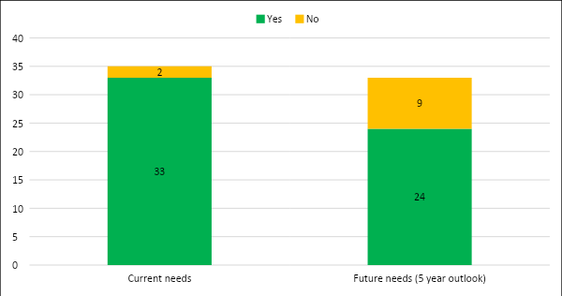
Reminder: NREN Satisfaction Survey Feedback
No survey in 2020 due to COVID
Next satisfaction survey due Feb 2021
Does GÉANT’s service portfolio meet your NREN’s needs …
At start of the project, large majority of NRENs agrees that Service Portfolio meets their needs
NRENs comments demanded more activity in
new network technologies,
5G, ICT Infra & Media support
Cybersecurity
and commercial cloud offerings
(🡪 which would largely be in line with planned project activities)
Notes:
Survey conducted 2Q19

Slide 37
How do NRENs promote GÉANT services?
Services are usually not promoted as “GEANT” services
Absorbed into own outreach and marketing activities
Differs by: NREN set up, relationship with constituencies, remit, resources, service type
Observe shift since GN4-2:
more involvement of GN4-3 to promote services on behalf of or in collaboration with the NRENs
Notes:
WP6 – need numbers to define if service worth to keep

Slide 38
Influencing Factors and resulting Challenges on GEANT Service Uptake from NREN perspective
General Influencing Factors
”internal”
Available funding and staff resources
Access to additional funding sources
NREN service scope
Active service promotion and engagement
“mix”
NREN user base
National delivery chain
Formal and informal relationship between national stakeholders
“external”
Large science user groups or facilities in country
Maturity of R&E sector (level of digitisation)
Service related challenges
Business related
Lack of resources/ business urgency
Lack of known national use cases
Lack of skills in NRENs to deploy/ adopt services
Lack of outreach staff in NRENs to promote service
Service related
Unclarity about use cases, adoption and operational costs
Commercial solutions preferred by constituencies
Service development not fast enough
Concern about longevity and reliability
Different technical approach to same service
Notes:
That’s a text heavy slide, I know! Won’t go through each item
Main take away:
A diverse NREN landscape results in a wide range of influencing factors and challenges that NREN face
Not one size fits all, multi-dimensional approach to target and support different NREN set ups/scenarios
NRENs need to be able/willing and capable to support different delivery models based on service
🡪Limiting factor: resolution of many challenges lies within responsibility outside of GEANT, so we can influence but cannot make decision

Slide 39
What do we do so far?
WP2 and WP3 Activities, dedicated Service WP Outreach Tasks, GLAD
Annual Project Plan, GN4-3 Stakeholder Engagement Plan, Marketing Plan and Training Plan
Develop NREN by NREN/ Service by Service understanding
multi-channel/ multi-tier engagement
Engagement on technical and management level
work together across WPs
Tailored adoption support solutions
NREN consultations, Insights Studies, User surveys
Infoshares open to general public
Tailored trainings , e,.g, T&I training for SEE NRENs
Community Engagement with Specialists via TF/SIGs and STF
Bilateral engagement with NRENs, large science users,
Subject Matter Experts (e.g. Cloud Forum, STF)
and much more...
Notes:
Are we doing enough?
Where do we have gaps?
Are we focusing on the right thing?

Slide 40
Thank you
Any questions?
As part of the GÉANT 2020 Framework Partnership Agreement (FPA), the project receives funding from the European Union's Horizon 2020 research and innovation programme under Grant Agreement No. 856726 (GN4-3).​​​

Slide 41
Project Management Convention for GN4-3 & GN4-3N
Introduction to the Breakout sessions
As part of the GÉANT 2020 Framework Partnership Agreement (FPA), the project receives funding from the European Union's Horizon 2020 research and innovation programme under Grant Agreement No. 856726 (GN4-3).​​​

Slide 42
Introduction to the break out session
What we discussed at the PMC 19 – value proposition
What was recommended by EC Reviewers
Questions for the break out session

Slide 43
Service Value - PMC19 Discussion
As a reminder... the discussion from the PMC19
Value definition depends on the stakeholder
Value for Money - Why would someone pay for the service (EC, NREN...)
Established service; uptake defines the value
Ensure ‘it’ delivers what stakeholders want/need
Ensure ‘it’ delivers VFM, user satisfaction, ROI (not always easy to measure)
This definition should be re-assessed periodically
Also these values need to be promoted and communicated
Sometimes NRENs and users are not aware of all the services

Slide 44
5. EC Recommendations
Run a business model analysis prior to new service development
Make a benchmark analysis for the main services provided by GÉANT
Indicate the total cost of running the main services
Promote use of own services and use internal services whenever possible
Find and develop new services that enhance and put in value the GÉANT network.
Notes:
2. Run a business model analysis prior to new service development
SWOT analysis, market analysis, understand needed investments
Use it to justify and prioritise the work and the investment
5. Make a benchmark analysis for the main services provided by GÉANT
To explain why to use GÉANT services instead of other commercial services
Include pricing as one of the elements in the value proposition
Disseminate the service value proposition through services’ website
8. Indicate the total cost of running the main services
A key metric of operational excellence could be the total cost of running each service
10. Promote use of own services whenever possible.
11. Find and develop new services that enhance and put in value the GÉANT network.

Slide 45
Breakout sessions
5 questions for 45 minutes:
How can we determine and measure the value of our services?
How to increase the uptake?
What should be improved in the delivery chain and how?
How to ensure sustainability of service operations?
How to better incorporate EC Recommendations?

Slide 46
Thank you
Any questions?
As part of the GÉANT 2020 Framework Partnership Agreement (FPA), the project receives funding from the European Union's Horizon 2020 research and innovation programme under Grant Agreement No. 856726 (GN4-3).​​​

Slide 47
Project Management Convention for GN4-3 & GN4-3N
Breakout sessions
As part of the GÉANT 2020 Framework Partnership Agreement (FPA), the project receives funding from the European Union's Horizon 2020 research and innovation programme under Grant Agreement No. 856726 (GN4-3).​​​

Slide 48
Breakout sessions
5 questions for 45 minutes:
How can we determine and measure the value of our services?
How to increase the uptake?
What should be improved in the delivery chain and how?
How to ensure sustainability of service operations?
How to better incorporate EC Recommendations?

Slide 49
How to Determine and Measure Service Value
When is the value proposition aligned with the stakeholders:
Which PLM process phase?
Which project preparation phase?
How often is the alignment process repeated?
How does the process from the value proposition to the service uptake measurement look like?
How should it look like?
How is the value proposition expressed
In the project preparation phase
In the service development phase
In the production phase

Slide 50
2. Service Uptake and Usage Accuracy
How to get the exact numbers about the uptake and get it fast?
What do we measure, and what does it say about the service uptake?
What can we measure vs. what we need to measure to get the exact result?
How can we improve the process of gathering the information about the service usage
How to know if a service is used?
Uptake <> usage
Site visit <> software download <> software installed <> software used

Slide 51
2. Service Uptake / Usage Improvement
How to increase service uptake / usage
Increase the number of users from the current user groups?
New user groups from the current community?
New communities / countries / regions?
What do we need...
What do we need more of?
What do we need but currently do not have?

Slide 52
3. Service Delivery Chain (SDC)
What should be improved and how?
Are all elements of the SDC in place?
Do we have a direct delivery from our service team to the user?
Does it work?
Do we have a hierarchical delivery chain?
Does the hierarchical delivery chain work?
Do all the links and all the nodes: know their role, do their role well, collaborate together?

Slide 53
4. How to Ensure Service Sustainability?
Stabile teams
Knowledge and expertise
Infrastructure
Promotion
Delivery chain
Operations and development
Uptake
Sustainability
Governance
Community engagement
Governance structure
Funding
Strategy and roadmap
Service visibility
Value transparency
User input

Slide 54
Thank you
Any questions?
As part of the GÉANT 2020 Framework Partnership Agreement (FPA), the project receives funding from the European Union's Horizon 2020 research and innovation programme under Grant Agreement No. 856726 (GN4-3).​​​

