Slide 1
Project Management Convention for GN4-3 & GN4-3N
Toby Rodwell, WP9 “Operations Support”
As part of the GÉANT 2020 Framework Partnership Agreement (FPA), the project receives funding from the European Union's Horizon 2020 research and innovation programme under Grant Agreement No. 856726 (GN4-3).​​​

Slide 2
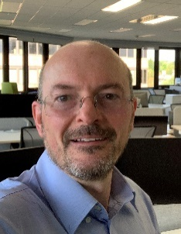
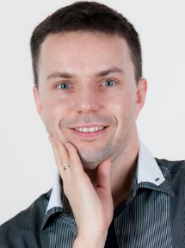
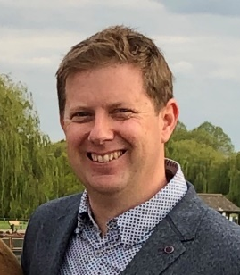
Who we are and what we do
Technical and operational support to service-related work packages (WP5-WP8)
Work Package Leader
T1: Operations Centre
T2: Software Governance and Support
T3: Service Management
T4: Software Development and Operations
WELCOME
Toby Rodwell GÉANT
Tony Barber
GÉANT
Marcin Wolski PSNC
Craig Volp GÉANT
Mandeep Saini GÉANT
Partners
University of Belgrade

Slide 3
Key Achievements and Statistics – Network Operations Support
OC Performance maintained
Office re-location followed by remote working …
98.6% of incident tickets opened and updated within target (4,635)
Planned and delivered major upgrades to OTRS ticket system and backbone router Junos
Leased lines and hardware support contracts procured
€500k saved on Infinera support over 3 years
€650k saved on Juniper support over 3 years
New joint-owned 100G link to Singapore implemented
Framework Agreements
For OTE (4 vendors) and netflow analysis (1 vendor)
MS ExpressRoute service improved
Direct connections to MS in 3 locations
Additional router in Ams for diverse primary and backup paths

Slide 4
Key Achievements and Statistics – Software Dev & Support
New and upgraded OSS/BSS delivered
Dashboard v3 – incident detection for GÉANT Operations Centre
Internal systems monitoring (Sensu & Grafana) introduced
Indico-based GÉANT Events Management System (replaced Eventr)
Software Development Support Service extended
All SWD tools SSO-enabled
Software Catalogue entered production
New JIRA based support desk introduced
New IPR compliance tool (“WhiteSource”) introduced
Software Dev Training and Governance continued
Secure Code Training and School of Software Eng continue online
‘Common Best Practices’ derived from Software Maturity Model [more on which later]

Slide 5
Thank you
Any questions?
As part of the GÉANT 2020 Framework Partnership Agreement (FPA), the project receives funding from the European Union's Horizon 2020 research and innovation programme under Grant Agreement No. 856726 (GN4-3).​​​

