Slide 1
Project Management Convention for GN4-3 & GN4-3N
WP1 – Where are we now?
Project achievements so far
Tryfon Chiotis, GÉANT
As part of the GÉANT 2020 Framework Partnership Agreement (FPA), the project receives funding from the European Union's Horizon 2020 research and innovation programme under Grant Agreement No. 856726 (GN4-3).​​​

Slide 2
Successful EC Review
“The GN4-3/GN4-3N Projects have fully achieved its objectives and milestones for the period”.
Virtual meeting with pre-recorded presentations plus short recaps and lots of Q&A in real time
EC and the reviewers recognised the significant progress and complimented us on the achievements.
The EC Project Officer said the review was ‘excellent especially in relation to ongoing operations’
A highly satisfactory result in these testing times.

Slide 3
Deliverables/milestones first 24 months
38/38 deliverables!!!
(even the M25 deliverables are either delivered or with QASPER)
Well done all!
One month late on average an improvement compared to GN4-2!
Let’s do even better in Period 2.
Two outstanding milestones because of Covid (TNC related).

Slide 4
Manpower contributed (MMs) M01-M24
156.4FTEs
WELCOME
Budget
158.1FTEs

Slide 5
350 participants every month ➔ 0.44 FTEs – 2.2 days a week 588 participants in total ➔ 0.26 FTEs – 1.3 days a week
351
participants

Slide 6
Manpower contributions per WP – 97%
Well done to WP4 for December, 122%, no holidays?
Overall WP2, WP9 overspend

Slide 7
Funding M24 – 94%
WP1, WP3, WP5 overspend because of the 15% overhead claim for GÉANT manpower
WP5, WP9 overspend because they do more (or their budget was underestimated)
WP4, WP7 underspend, is it true for WP7? WP4 of the OCRE work in Period 1
2.2m of variance after 24 months, almost 100k per month

Slide 8
GN4-3 underspend forecast

Slide 9
Some underspends but these should be reduced
Costs so far (funding): 34,714KEUR
Avg. cost M21,M22,M23,M24: 1,723KEUR/month (no travelling)
For the rest 24 months: 24*1,723=41,360KEUR
Underspend: 77,500-41,360-34,714=1,425KEUR
Add 12 months of travelling in 2022: 12*100KEUR=1,200KEUR
Underspend: 225KEUR

Slide 10
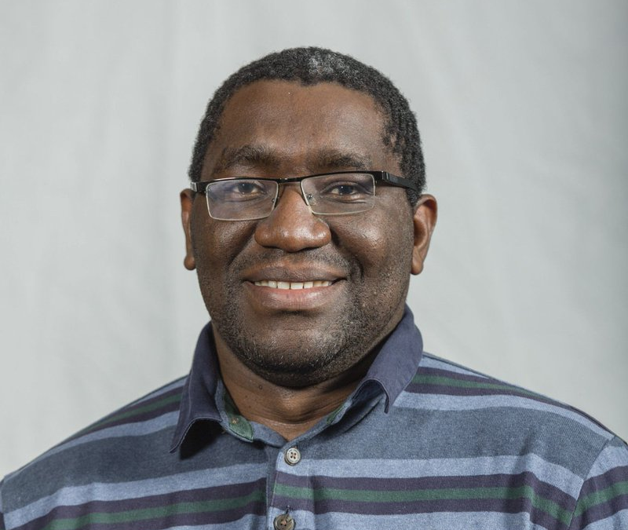
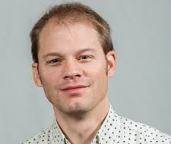
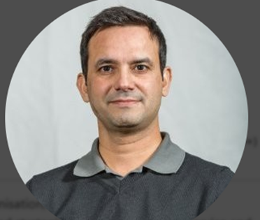
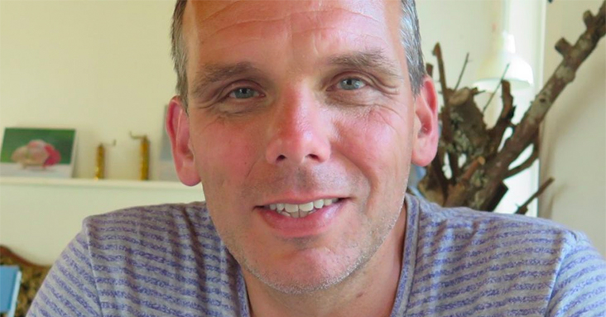
Many thanks to a great team

Slide 11
Challenging but interesting 24 months with successful results

Slide 12
Thank you
Any questions?
As part of the GÉANT 2020 Framework Partnership Agreement (FPA), the project receives funding from the European Union's Horizon 2020 research and innovation programme under Grant Agreement No. 856726 (GN4-3).​​​

