Slide 1
Harmonising Observations from Multi-hazard Environments in Research for Open Science EOSC EU Node services for Researchers - Expectations and examples
Funded Project
HOMEROS
Presenters:
Angeliki Adamaki, Uppsala University, Sweden
Vassilis Anagnostou, Aristotle University of Thessaloniki, Greece
Ion-Anastasios Karolos, Aristotle University of Thessaloniki, Greece

Slide 2

Who we are!

Slide 3
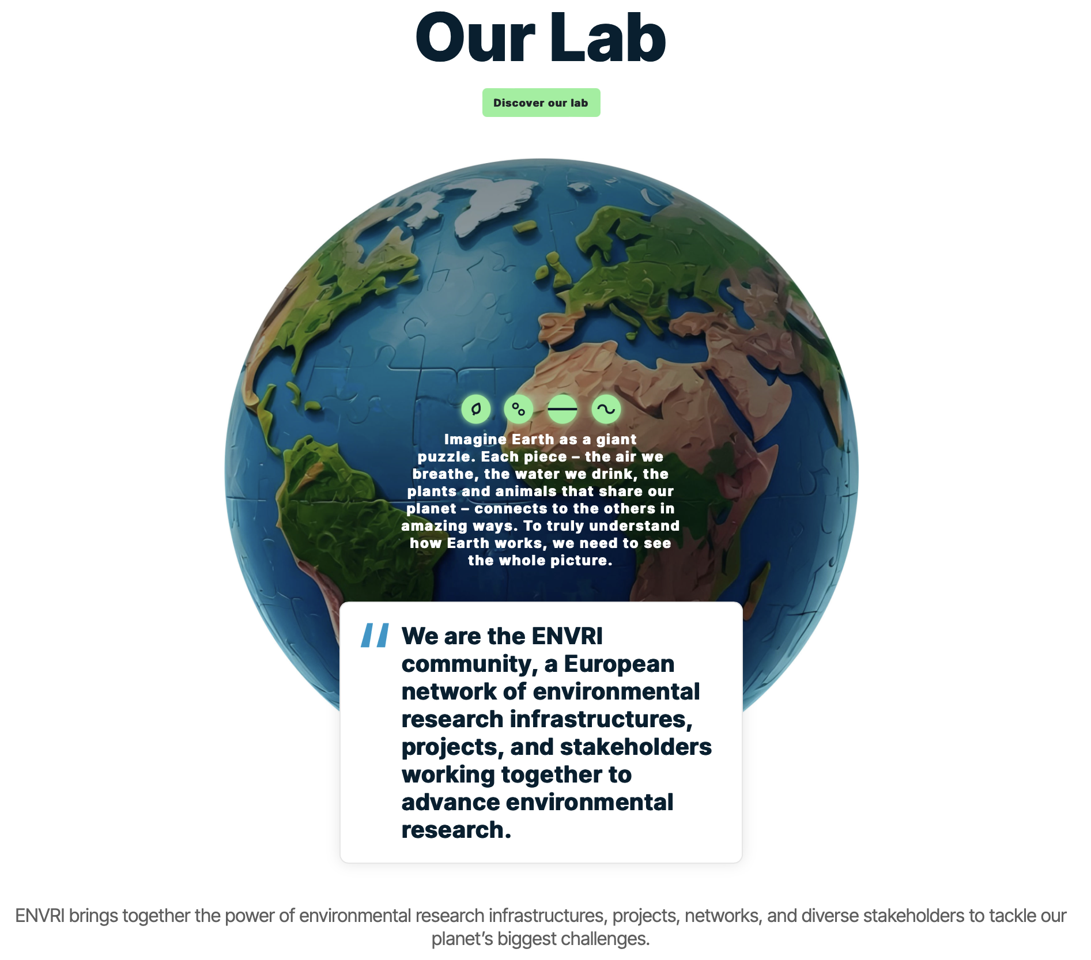
Who we are!

Slide 4
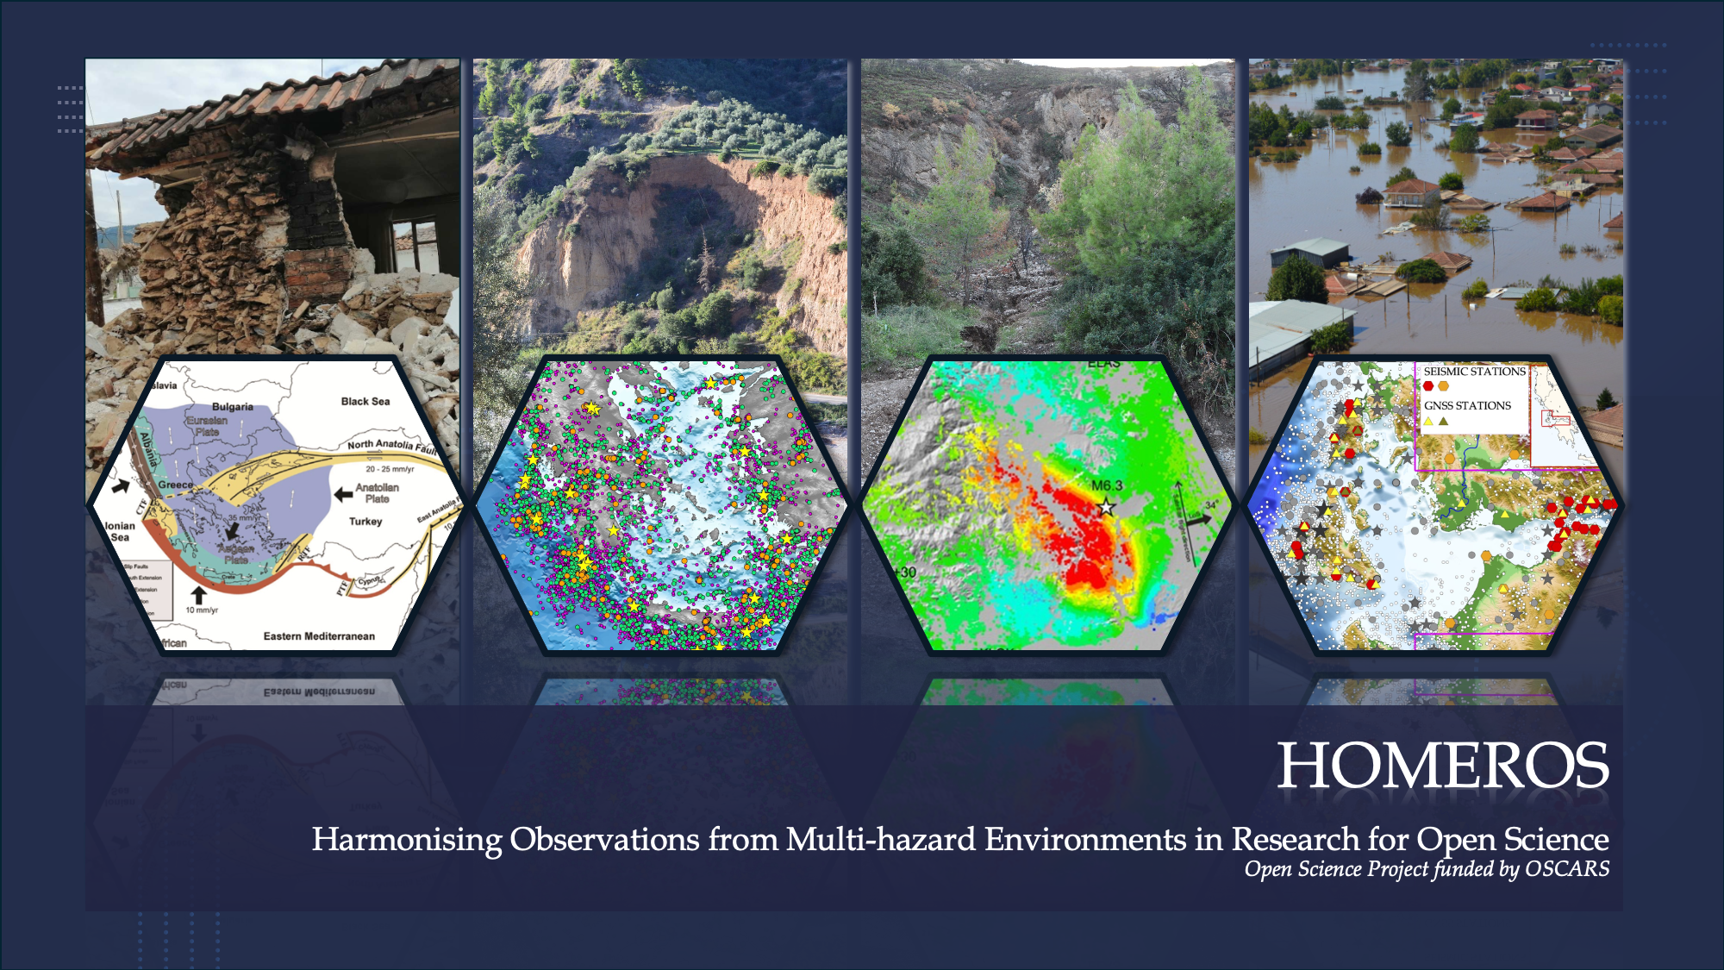
Project Objectives
Geohazard Assessment
Focus on high-risk areas in Greece
High-quality data gathered by our institutions and Research Infrastructures
Earthquakes, ground movements, floods, landslides

Slide 5
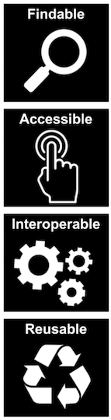
Project Objectives
Open Science Goals
Make research accessible and collaborative
Improve the way we conduct research
Οpenly share FAIR project outputs
Εnable communities to collaborate

Slide 6
Enabling Open Science in Academic Research
(Some) Digital Infrastructure Requirements
File management, storage and sharing services
Virtual Research Environments
Advanced computational resources and technologies
Data analysis with ML/AI techniques
Collaborative environment for research and teaching
Common workspace for distributed research groups
Transfer/harvest/share/store datasets from various data sources
For scientists with/without advanced technical skills
Open Science practices and FAIR workflows
FAIR RDM tools and services
DMP tools, PID services, Repositories
Community Vocabularies and Metadata standards
Services to document/share code

Slide 7


Enabling Open Science in Academic Research
(Some) Digital Infrastructure Requirements
File management, storage and sharing services
Virtual Research Environments
Advanced computational resources and technologies
Data analysis with ML/AI techniques
Collaborative environment for research and teaching
Common workspace for distributed research groups
Transfer/harvest/share/store datasets from various data sources
For scientists with/without advanced technical skills
Open Science practices and FAIR workflows
FAIR RDM tools and services
DMP tools, PID services, Repositories
Community Vocabularies and Metadata standards
Services to document/share code

Slide 8
Next Steps and Expectations
Regular use of File Sync & Share and Interactive Notebooks
Observe credit needs for diverse tasks
Collect (technical and other) user requirements (bigger storage, more credits, features and functionalities)
Investigate interoperation of systems including thematic and national EOSC Nodes and relevant RIs/Institutions
Follow platform updates and utilise upcoming features and functionalities
EU Node - Current environment
Future Steps - Expectations
Contribute to continuous community-provided feedback on EOSC services usability!
Completed the test on Virtual Machines services

Slide 9


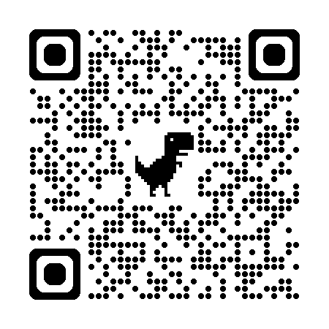
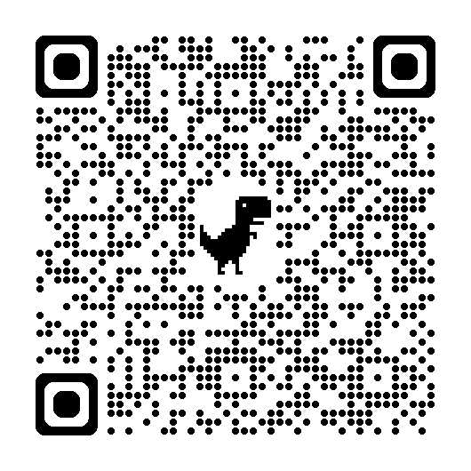
Access the EOSC EU Node
Learn more about HOMEROS

