Slide 1
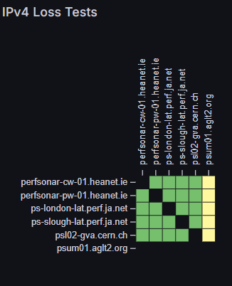
Time Synchronisation and perfSONAR
Christopher J. Walker
Raul Lopes
Duncan Rand
Tim Chown

Slide 2
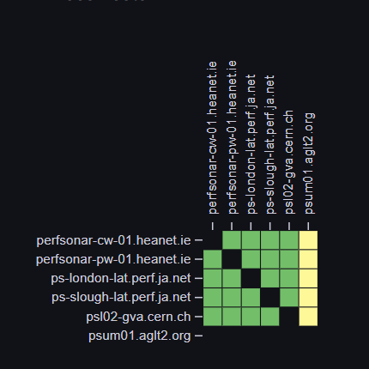
Overview
Time synchronisation mesh: motivation
What can Latency tell us?
  Do we need bandwith tests to all?
Why is clock drift a problem?
How can we improve clock drift
  NTP (Jisc)
    Accurate clock
    Hardware Timestamping
  PTP (HEANET, CERN, AGLT2)
OWAMP
  Will hardware timestamping make a difference

Slide 3
Motivation for accurate timing
Measure Network Performance
1 way Latency
Congestion
Asymmetric routes
Accurate Clock
HW timestamp
Buffers filling

Slide 4
What accuracy is required
Consider 1250 Byte=10,000bit packet
Packet quantisation time
  10Gbit : 1µs
  100Gbit : 0.1µs
Clock stability:
  ~ 500µs (0.5ms)
    500 packets at 10Gig
    5000 packets at 100Gig
What accuracy do we need?

Slide 5
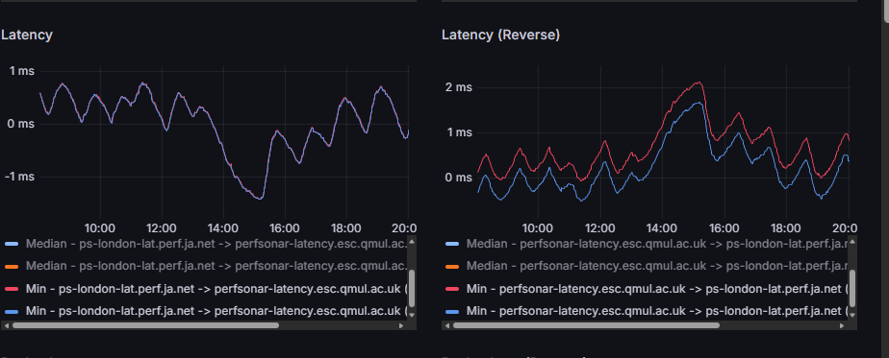
One Way Latency - Effect of clock drift
Jisc(London) -> QMUL
  a mirror image of
QMUL –> Jisc(London)
Clock Drift
IPv4 and IPv6 different routes

Slide 6

Effect of clock offset
Latency = T_2 – T_1
Observed latency
  = T_2(B) – T_1()
  = T_2-T_1 +Clock offset.
Bristol Corn exchange dual time clock

Slide 7
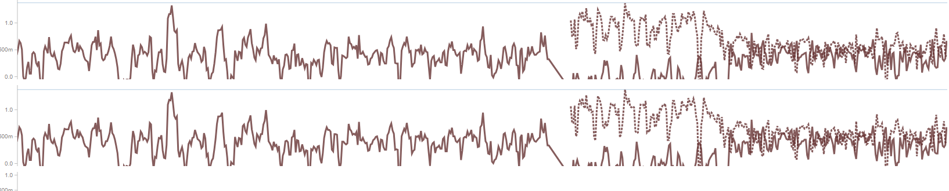
Perfsonar one way latency measurements
HW timestamping enabled
Jisc London to/from Slough (1 month)
London -> Slough ~0.6 ms

Slide 8
Network Card timestamping
ethtool -T eth0
RHEL 9 “Basic System Settings - Chrony”
Network card support?
Output
# ethtool -T enp175s0f0np0
Time stamping parameters for enp175s0f0np0:
Capabilities:
hardware-transmit
hardware-receive
hardware-raw-clock
PTP Hardware Clock: 0
Hardware Transmit Timestamp Modes:
off
on

Slide 9
Network Card timestamping (2)
ethtool -T eth0
Enabling in /etc/chrony.conf
Checking
# Enable hardware timestamping on all interfaces that support it.
hwtimestamp *
# chronyc ntpdata
…
Offset : -0.000132777 seconds
Peer delay : 0.005870986 seconds
Peer dispersion : 0.000003835 seconds
Response time : 0.000374075 seconds
…
TX timestamping : Hardware
RX timestamping : Hardware

Slide 10
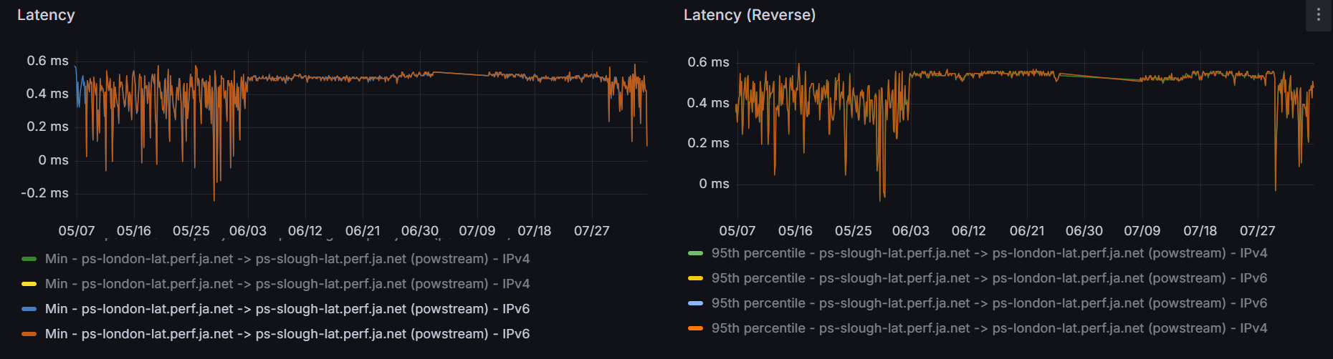
Chrony changes
A
B
server ntp5.ja.net minpoll 5 maxpoll 5 iburst
server ntp6.ja.net minpoll 5 maxpoll 5 iburst
lock_all
# 2^5 = 32s
vm_swappiness=1 # sysconfig
Vm.swappiness
server ntp5.ja.net iburst
server ntp6.ja.net iburst
# default 2^10s = 1024s (2

Slide 11
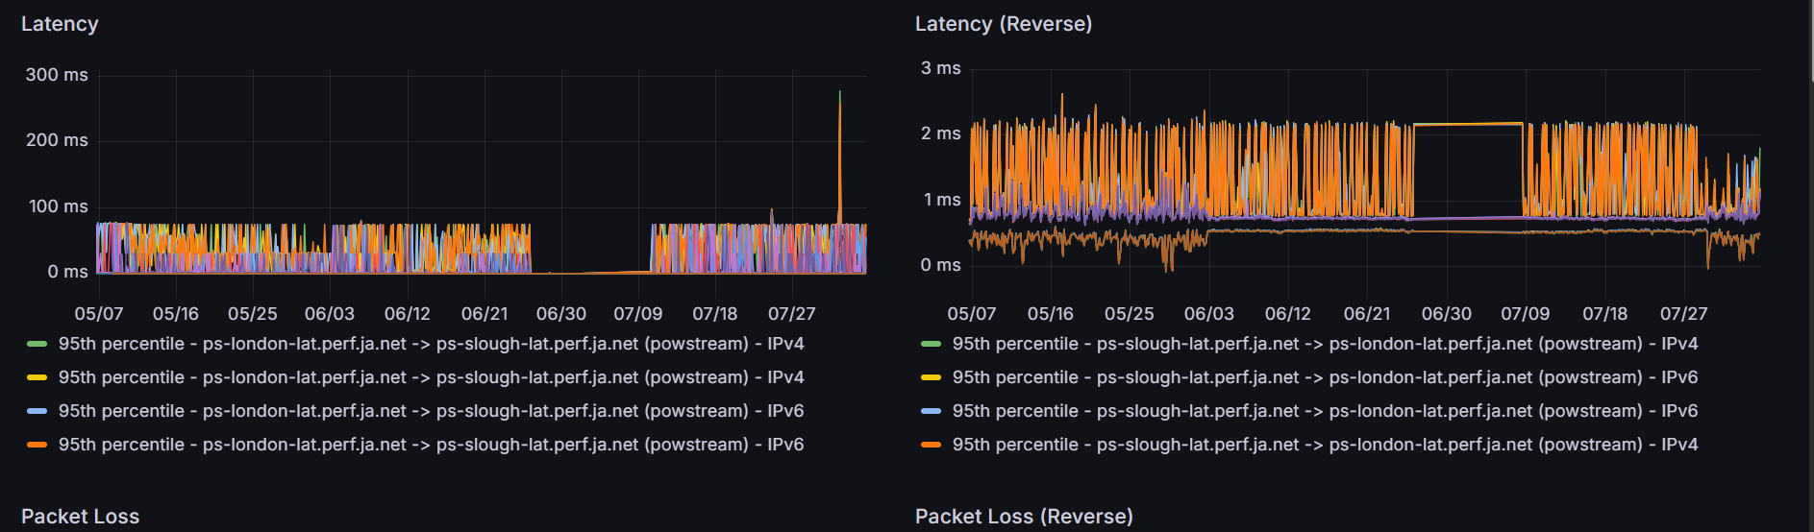

Slide 12
Minimum latency
 | Mean | Stdev
Set 1 | 0.407605 | 0.149712
Set 2 | 0.512782 | 0.01399
Set 3 | 0.456567 | 0.086595

Slide 13
HEAnet
Pw-01 -> cw-01
  No indication of congestion
QMUL –> Jisc(London)

Slide 14
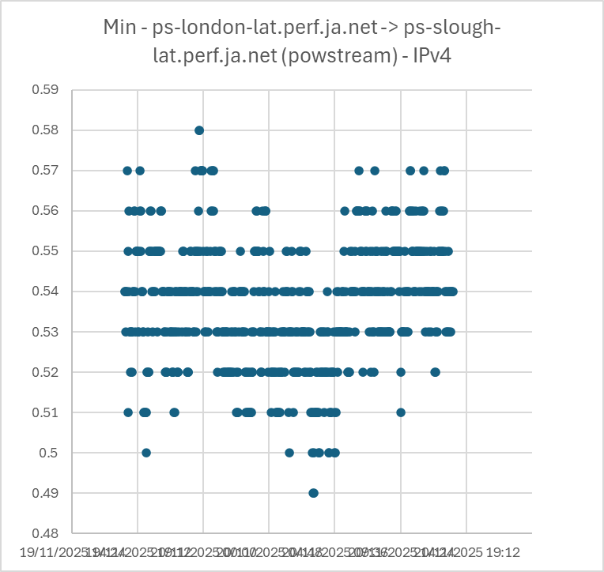
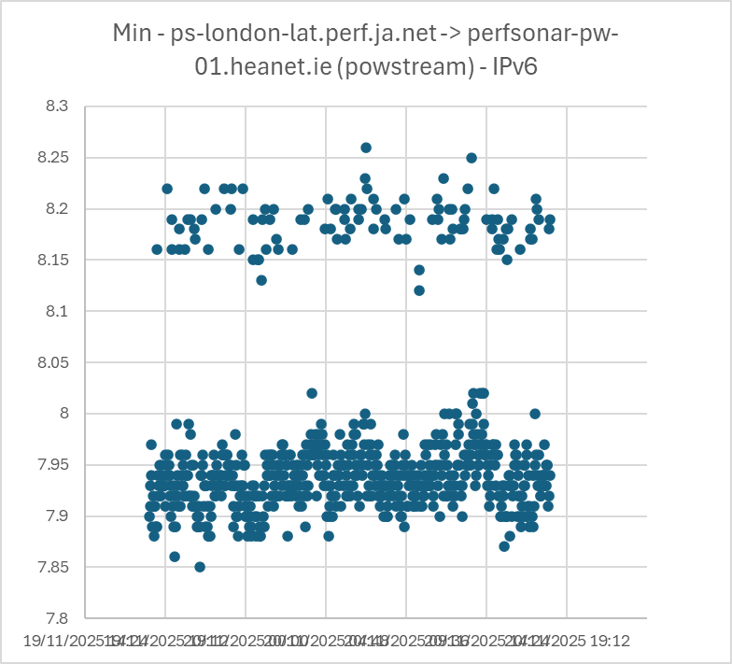
Latency and consistency of latency
7.972448
London->Slough (IPv4)
0.536 ± 0.015 ms
Stdev 0.015
London -> HEAnet
7.97 ± 0.091 ms

Slide 15
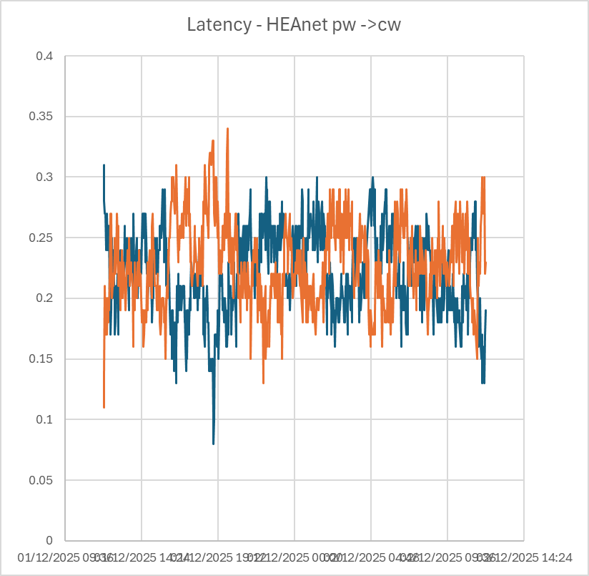
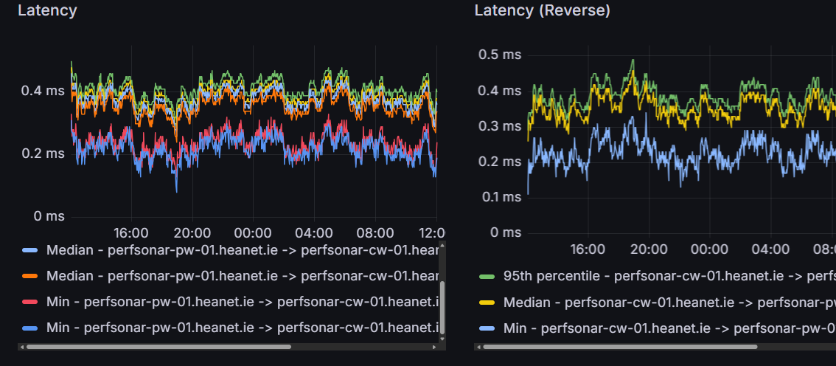
HEAnet latency
perfSONAR pw ->cw
Latency pw ->cw 0.220+-.034ms

Slide 16
Conclusions
Accurate time synchronisation needed for one way delay measurement
Latency spikes (likely due to buffers filling
  London (100G) -> Slough (10G) ~75ms
  Slough (10G) -> London (100G) ~ 2ms
  Is bufferbloat an issue?
    Does it impact performance
Time synchronisation
  Chrony
    Increasing polling frequency increases stability
    Hardware timestamping – makes a difference (probably)
  PTP
    How much will it improve things?

Slide 17
What next?
What next?
Measurements
PTP
  Can it give better synchronisation
Chrony
  What advice can we give
    Is 32s polling acceptable
      Out to edge networks?
      How to roll out?
OWAMP
  Is hardware timestamping necessary?
Measurements possible?
  With current synchronisation
    Network music performance
  With better synchronisation
    What accuracy do we need?
Are we measuring the right thing?
  Is min / 95th percentile the right measurement?

Slide 18
Christopher J. Walker
Research Support Senior Manager
Christopher.Walker@jisc.ac.uk

Slide 19
Polling options - chrony – chrony.conf(5)
Minpoll poll
Maxpoll poll
This option specifies the minimum interval between requests sent to the server as a power of 2 in seconds. For example, minpoll 5 would mean that the polling interval should not drop below 32 seconds. The default is 6 (64 seconds), the minimum is -7 (1/128th of a second), and the maximum is 24 (6 months). Note that intervals shorter than 6 (64 seconds) should generally not be used with public servers on the Internet, because it might be considered abuse. A sub-second interval will be enabled only when the server is reachable and the round-trip delay is shorter than 10 milliseconds, i.e. the server should be in a local network.
This option specifies the maximum interval between requests sent to the server as a power of 2 in seconds. For example, maxpoll 9 indicates that the polling interval should stay at or below 9 (512 seconds). The default is 10 (1024 seconds), the minimum is -7 (1/128th of a second), and the maximum is 24 (6 months).

Slide 20

Effect of Clock offset
Latency
= T(Host B) – T (Host A)
Measured latency
= T(Host B) – T(Host A) + Clock offset
Bristol Corn exchange dual time clock

