Slide 1
From awareness to structured solutions
Helping organisations develop successful behavioural cybersecurity solutions.
Dr Tommy van Steen - Leiden University

Slide 2
Awareness
Attitude
Intention
Behaviour
Habits
Culture
Skills
Support
Past Experiences
Context

Slide 3
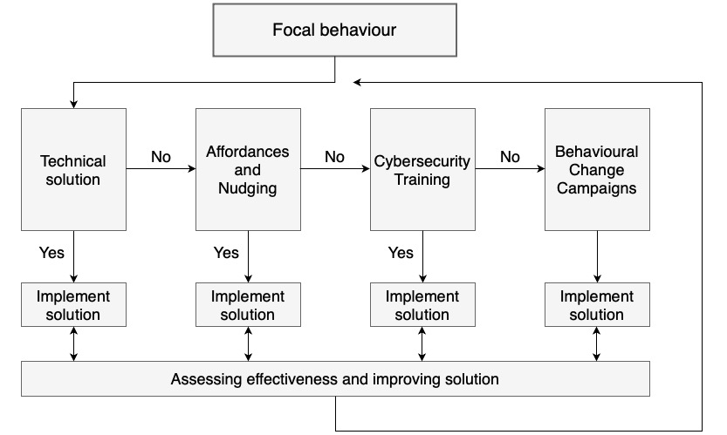
Behavioural cybersecurity strategy

Slide 4
Affordances and Nudging
Influencing individuals’ behaviour by restructuring the choices that are presented to them (choice architecture)
Having a preferred option that is presented in a way that makes that option more favourable for the end-user
Upside: people can still decide differently
Downside: people can still decide differently

Slide 5
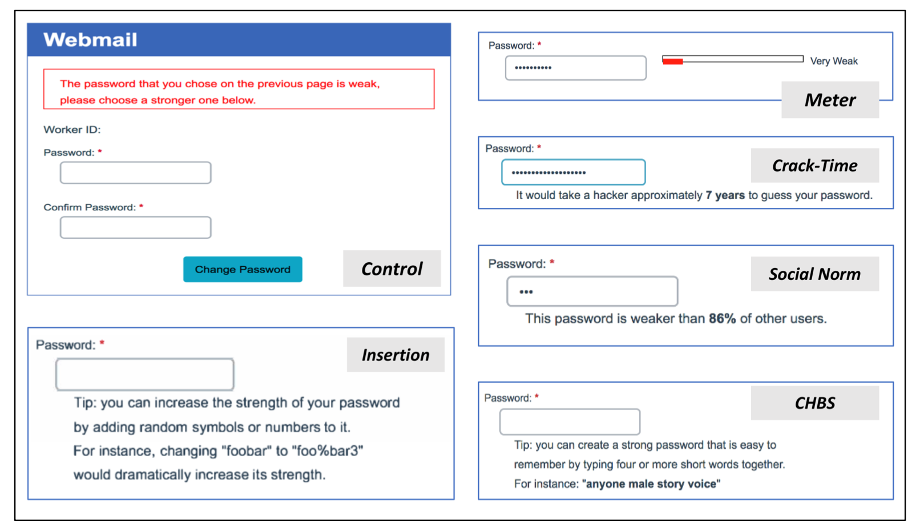

Slide 6

Cybersecurity training and behavioural change
E-learnings
Videos
(Wall of) text
Simply informing?

Slide 7
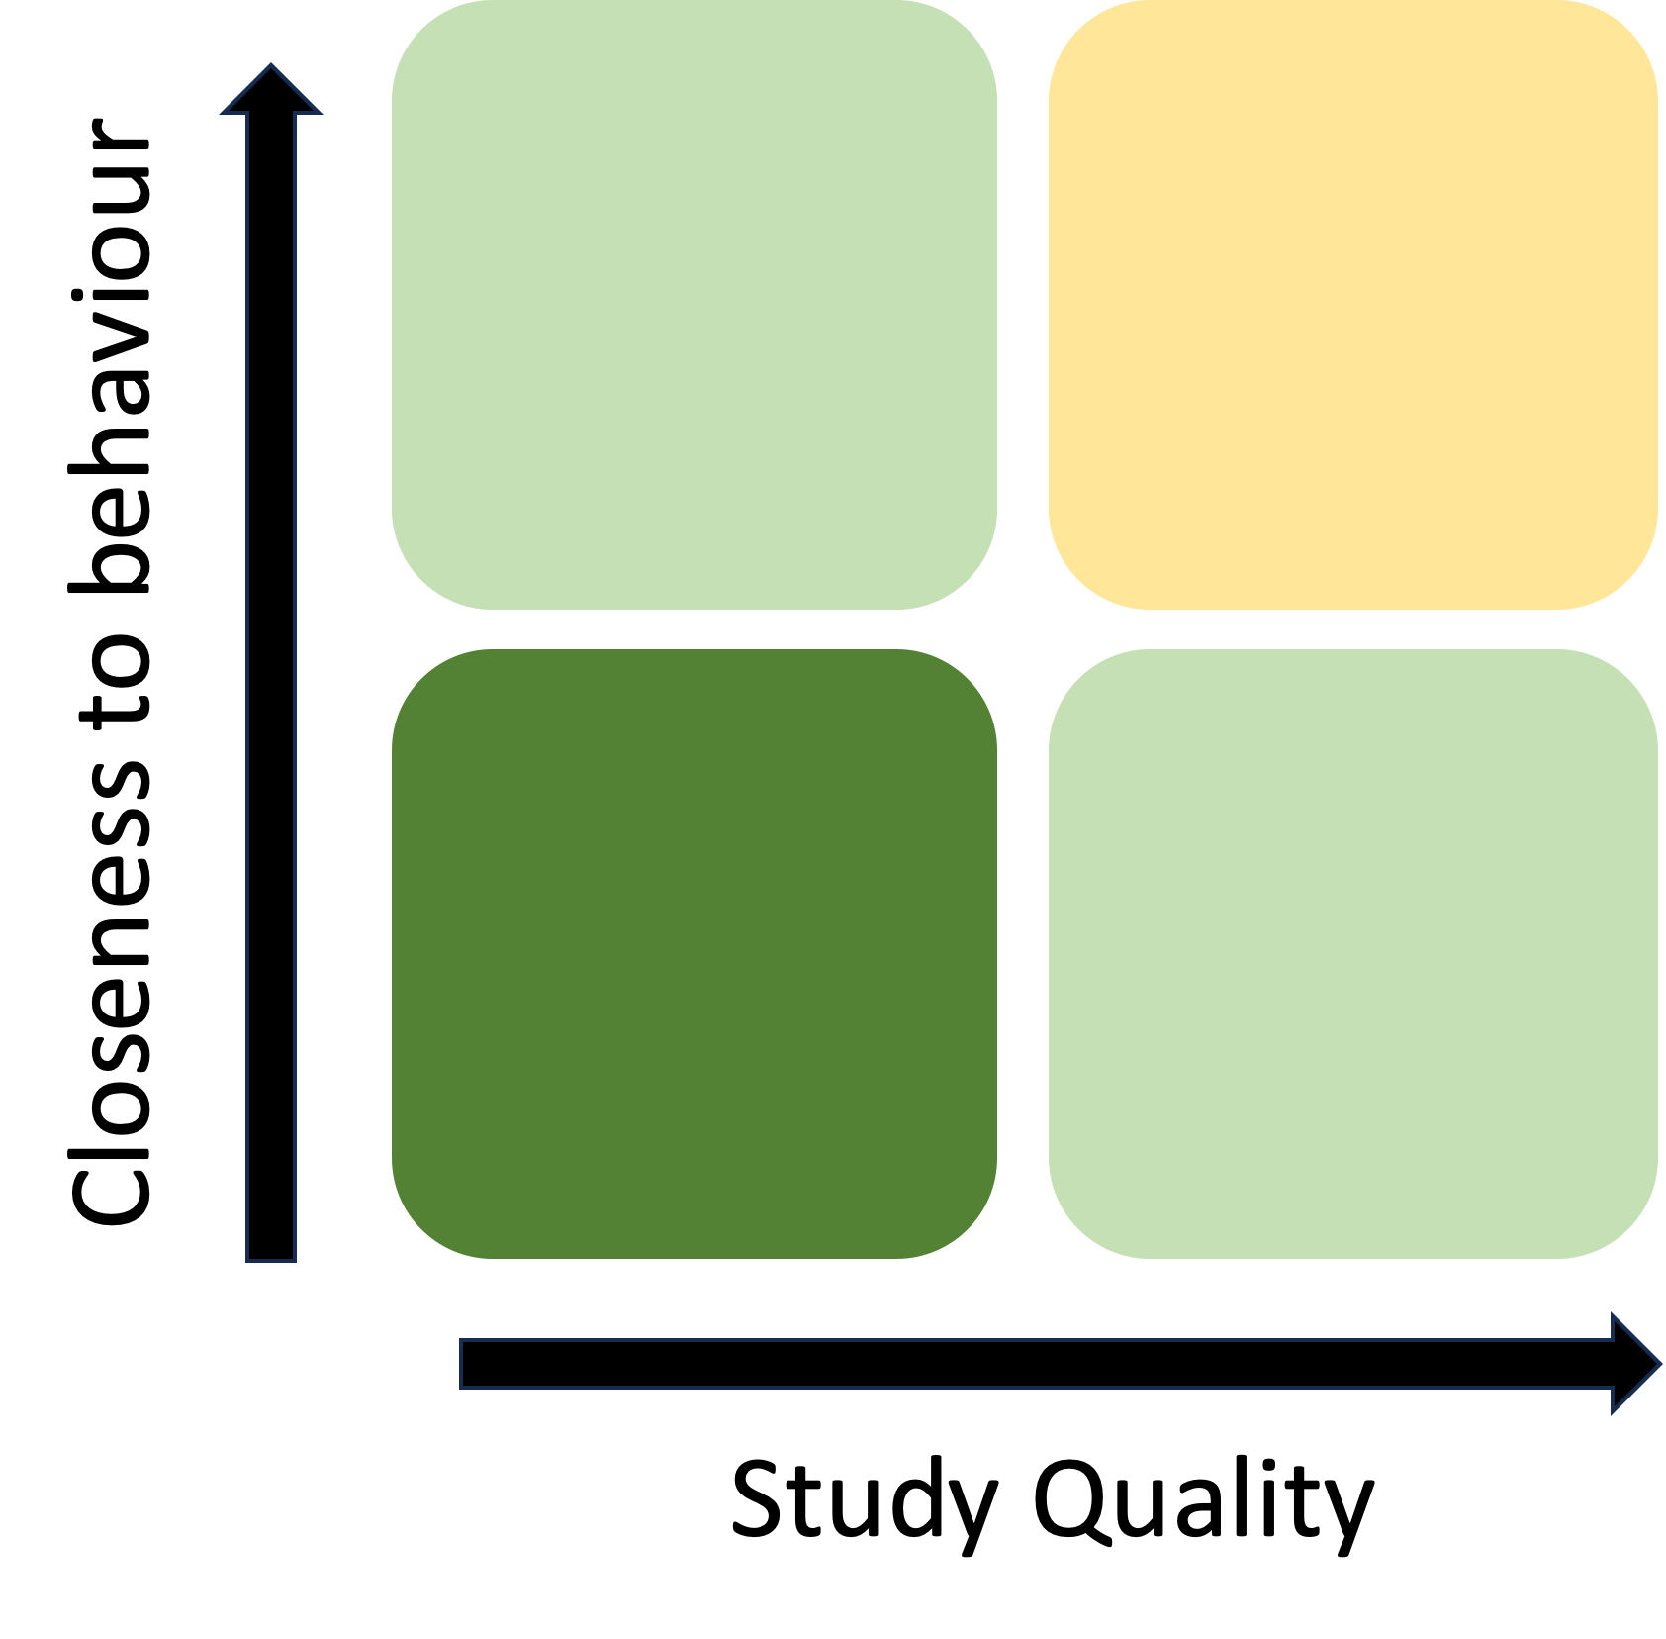
Do existing training initiatives work?

Slide 8

What to do?
Using behavioural aspects to develop solutions
Not just risk perception, also skills, attitudes
For example: Gamification

Slide 9
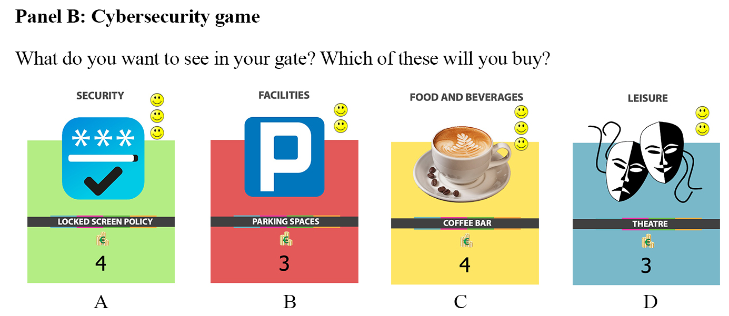
Gamification

Slide 11
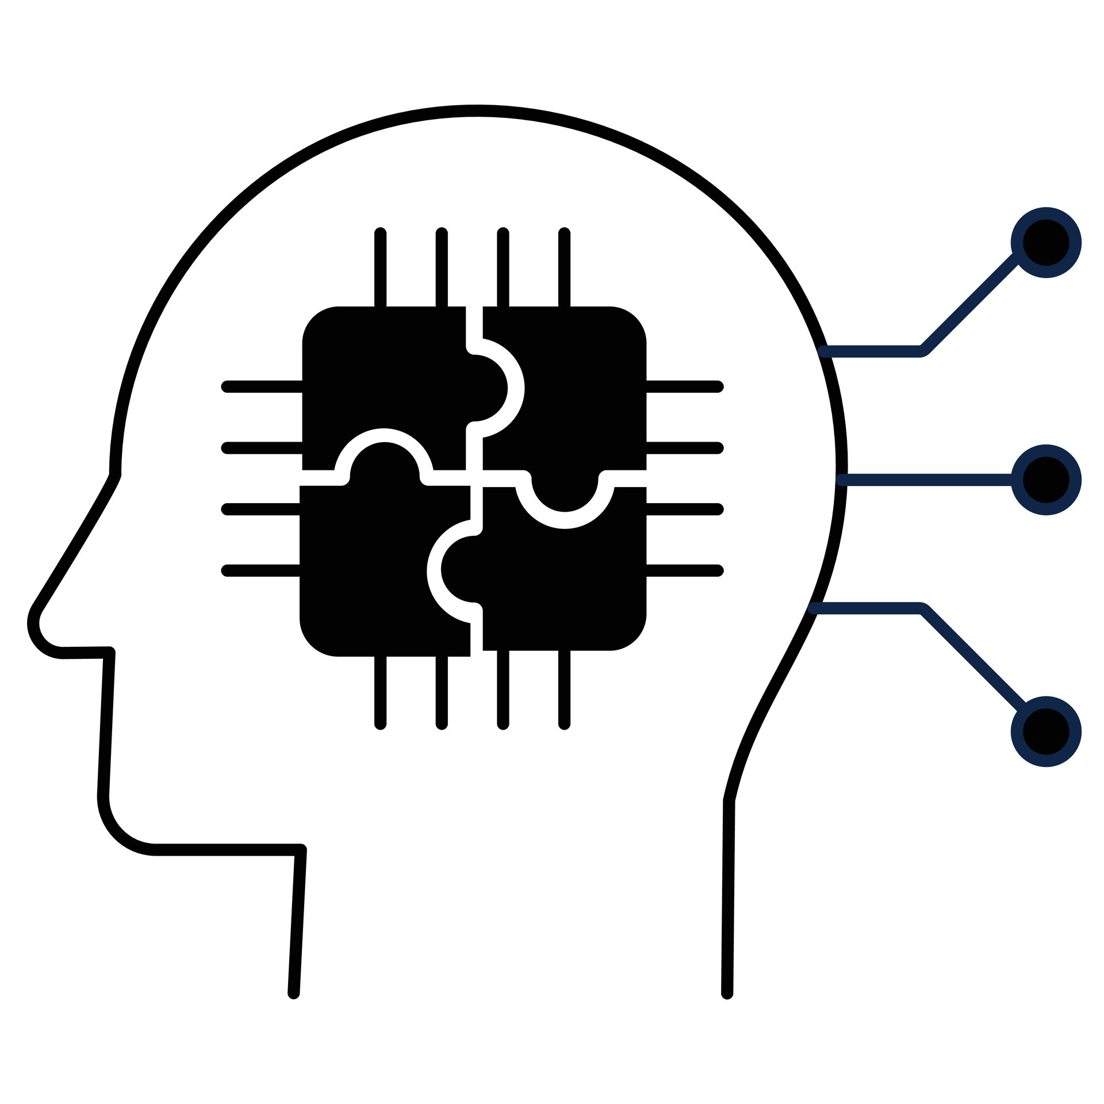
But also: Behavioural change techniques
Self-persuasion
Social norms
Implementation intentions

Slide 12

Measuring success?
Determine what success looks like
System measurements vs behavioural measurements
Adjust and update

Slide 13
Behavioural cybersecurity strategy

Slide 14
Key Takeaways
We need to focus on what behaviour we really want to change.
Why is this behaviour happening in the first place?
Balance technical solutions and behavioural ones.
Determine success and accept the effort/failure.

Slide 15
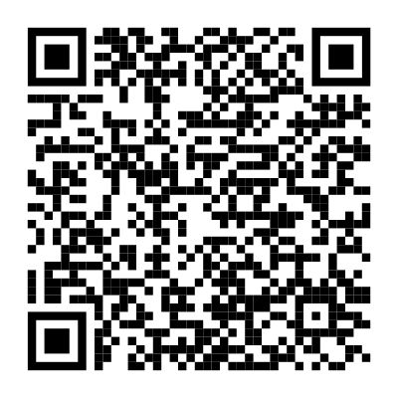
Q&A
Dr. Tommy van Steen
Leiden University
t.van.steen@fgga.leidenuniv.nl

