Slide 1


Drowning in Policies
Nicole Harris
Senior Trust and Security Manager
Security Days 2026
9th April 2026
Public

Slide 2
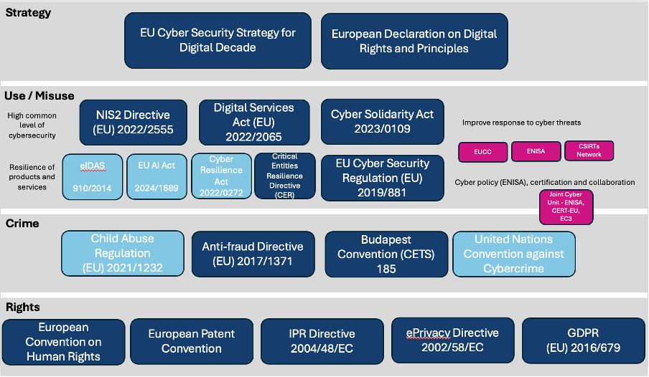
Overview of Security Legislation

Slide 3
Focal Points
Online Safety Initiatives
Cyber Resilience Act
Digital Services Act / Digital Markets Act
Legislation and Encryption

Slide 4
Online Safety
www.geant.org

Slide 5

Photo by Rafik Wahba on Unsplash

Slide 6
Online Safety = Age Verification
Notes:
This shouldn’t be true, but it is. It’s easier to ban than educate and support.

Slide 7
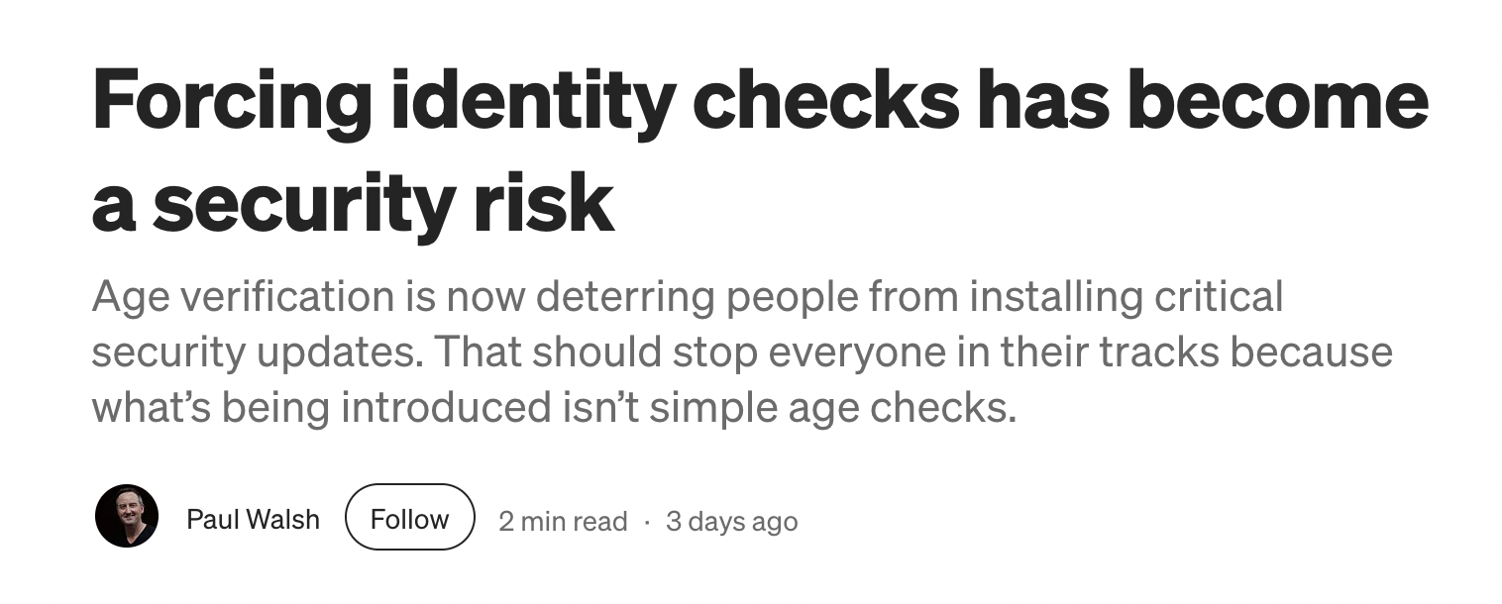
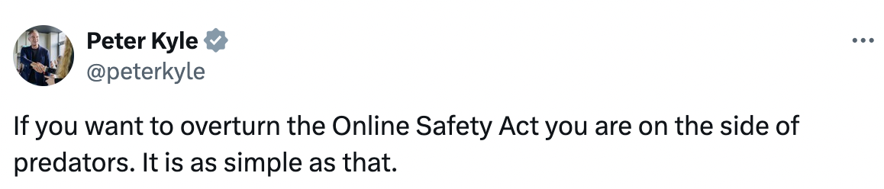
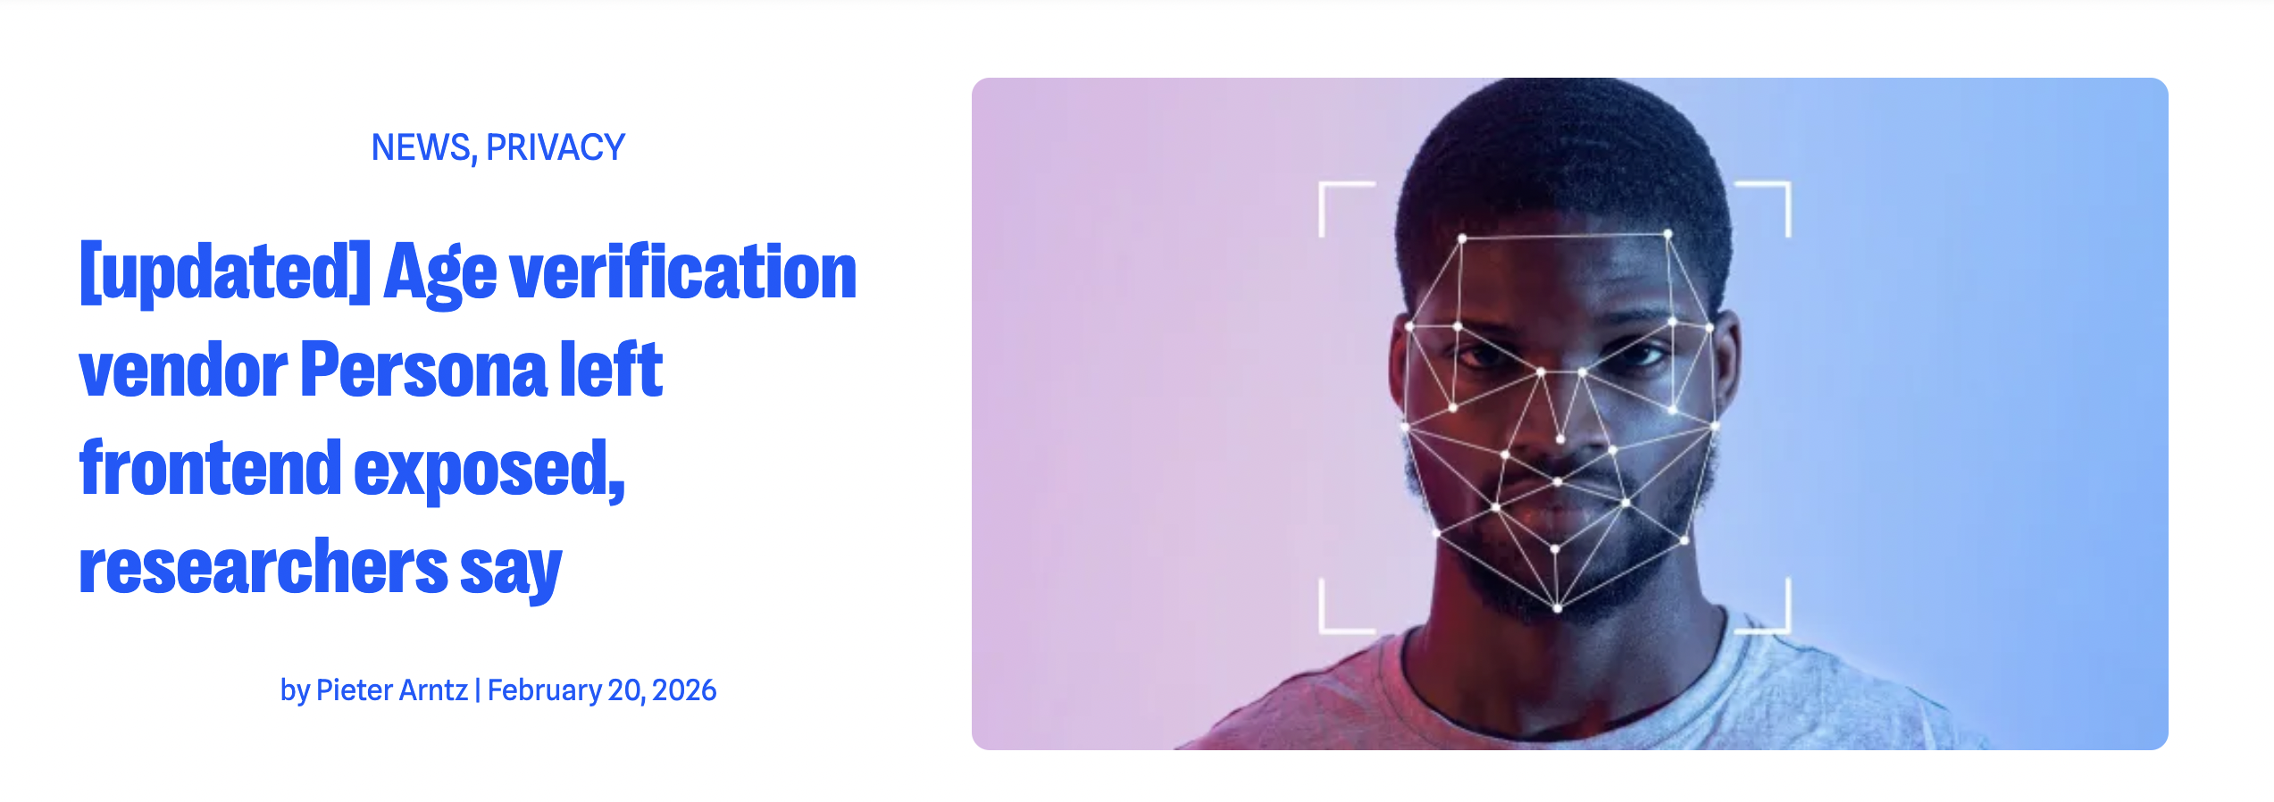
Notes:
https://paul-walsh.medium.com/forcing-identity-checks-for-software-updates-has-become-a-security-risk-ffc74d18dcaf
the Secretary of State for Science, Innovation and Technology in the UK
Thought terminating cognitive dissonance

Slide 8
What are the issues?
Defining what is harmful to a child
Covers all content creation: including small hobby groups using facebook to organise
No say on the identify verification system that is used
Meaningfully managing age verification for specific types of content is hard. Is NSFW automatically bad?
Helpful content blocked: LGBTQ+ groups
Measures easily bypassed
Notes:
Defining what is “harmful to children” is not an easy task. The Act of course has to make a good attempt at a list of what is considered harmful and does so in sections 60-62, but this both opens up a lot of questions and creates a large list of content types than need searching and restricting. Is an emoji harmful? Do ACME cartoons depicting violence count? How do you distinguish between posts that encourage suicide or self-harm from helpful support group discussions on the topic?
All content creation is in scope, no matter how small the fora – so small hobby groups now must undertake quite extensive risk assessments and active content moderation. There is some attempt to distinguish large platform providers, but this only really impacts potential fines and punitive measures. It’s also worth noting that many small hobby groups will be using large platforms such as Facebook and Reddit.
Age verification is being forced on users, but the user has no say over which company is used and will have to hand very personal data to multiple different age verification services with no real consent and no real understanding of who those organisations are and what they do. This takes away any sense of digital autonomy and the robustness of the data collected speaks against data minimisation principles for privacy. At just a current check, Spotify and X-Box are using Yoti for age verification, Reddit is using Persona, and Discord is using K-ID. That’s a lot of new service providers to trust with your personal data.
In theory, age verification should only happen for specific content types but the reality of implementing that in a meaningful way doesn’t scale, so it is likely that many users will be asked to verify their age as part of general service use.
Age verification approaches have already been shown to be easily bypassed by savvy internet users, with VPN sales increasing (this currently only applies in the UK, so simply appear as not in the UK!) and use of faces from video games to “prove” age.
Identifying specific traits of user generated content to flag as harmful is complex and fraught with difficulties, as anyone who has battled content moderation policies will know. There’s a danger that common internet approaches such as the NSFW tag could be misappropriated, and a perhaps more concerning danger that AI will be heavily used to make nuanced decisions bringing with it all the bias that AI has built in.
There’s a larger danger of content helpful to young people being blocked – this can apply to anything from young people accessing LGBTQ+ information to young hamster owners asking about healthcare for their pets. Can we really effectively distinguish harmful conversations from helpful conversations in the automated way that the Online Safety Act seems to take for granted?
Users will be more frequently asked to identify themselves to consume any content, effectively ending anonymous interactions with information and requiring more personal data to be shared with more services.
Finally, as mentioned above, this is a UK specific act and the enforcement will share all of the extraterritorial enforcement issues that we see with GDPR (see my previous article).

Slide 9
Why should we care?
Privacy
Security
Academic Freedom
Inevitability

Slide 10
Cyber Resilience Act
www.geant.org

Slide 11
What is the Cyber Resilience Act?
“the making available on the market of products with digital elements to ensure the cybersecurity of such products”
NIS2: Securing Organisations and Infrastructures
CRA: Security Products produced by organisations

Slide 12
What is the Cyber Resilience Act?
Identity management systems, VPNs, SIEMS and Network management systems are included
Products supplied in the course of a commercial activity are in scope
Open Source broadly out of scope

Slide 13
What Do You Need To Do?
ensure that your product meets the essential cybersecurity requirements laid out in the annexes of the document
carry out a risk assessment for your product and include in documentation
create technical documentation
ensure you have undergone a conformity assessment. The conformity assessment can be self-assessed for most products
Add a CE mark to your digital product.

Slide 14
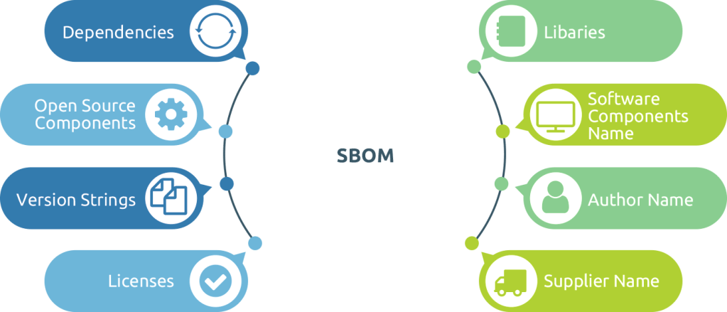
Software Bill of Materials

Slide 15
Digital Services Act / Digital Markets Act
www.geant.org

Slide 16
Digital Service Act
Focus on online platforms
Creating a safer platform for users
Must remove illegal products and services
Must be transparent to users.
Must ban targeted advertising to minors
Must prevent children from being exposed to harmful content
Must provide anti-addictive design

Slide 17
VLOP
VLOSE

Slide 18
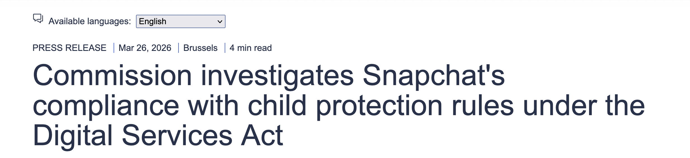
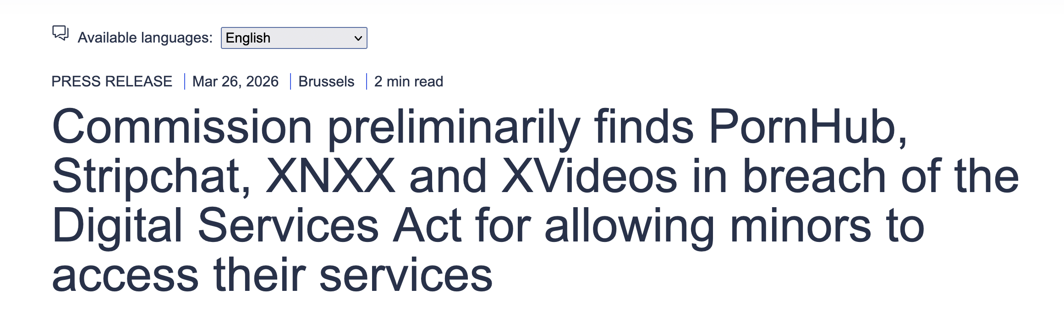

Slide 19
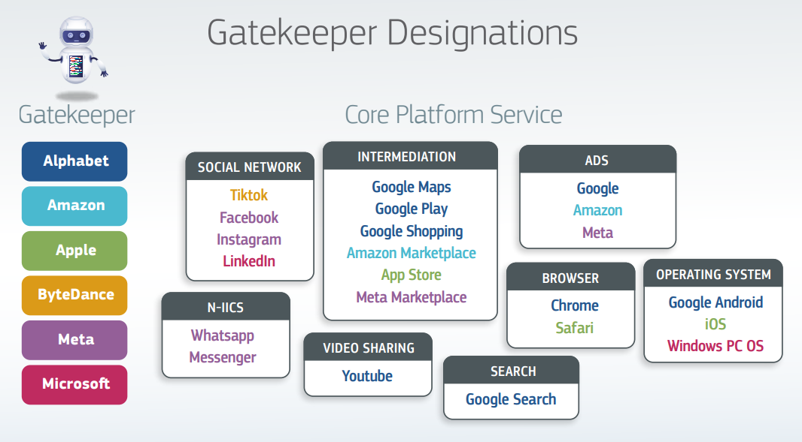
Digital Markets Act: Fair Competition
Image from: https://www.maverick-law.com/en/blogs/webshops-and-the-digital-markets-act-be-aware-of-your-rights.html

Slide 20
Legislation and Encryption
www.geant.org

Slide 21
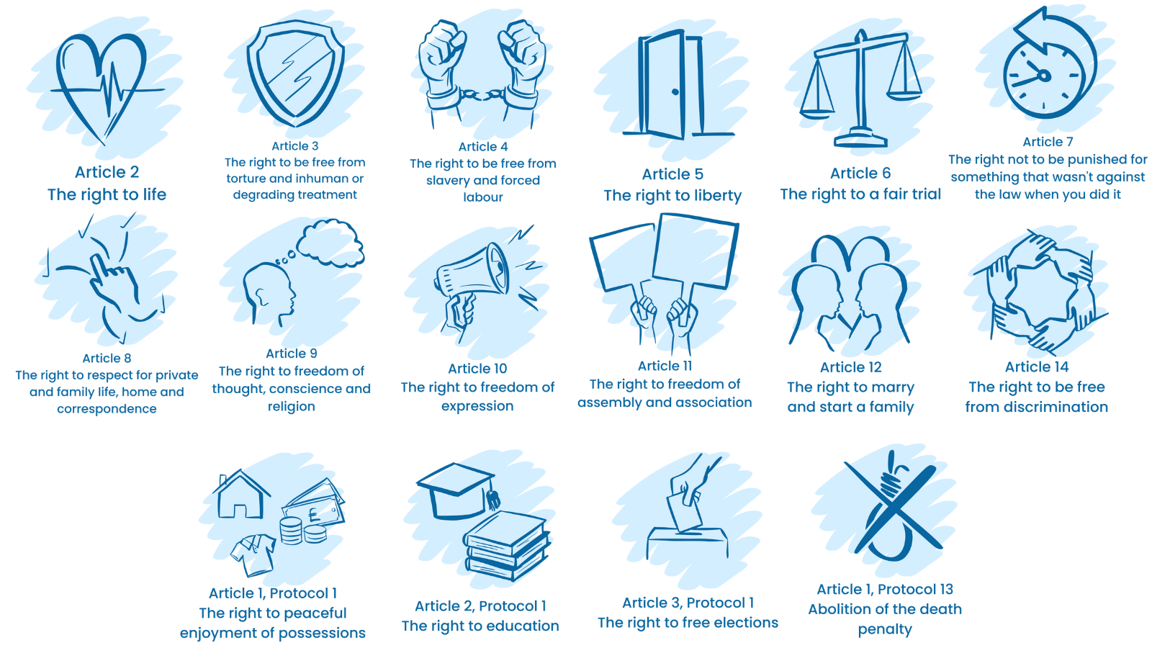

Slide 22
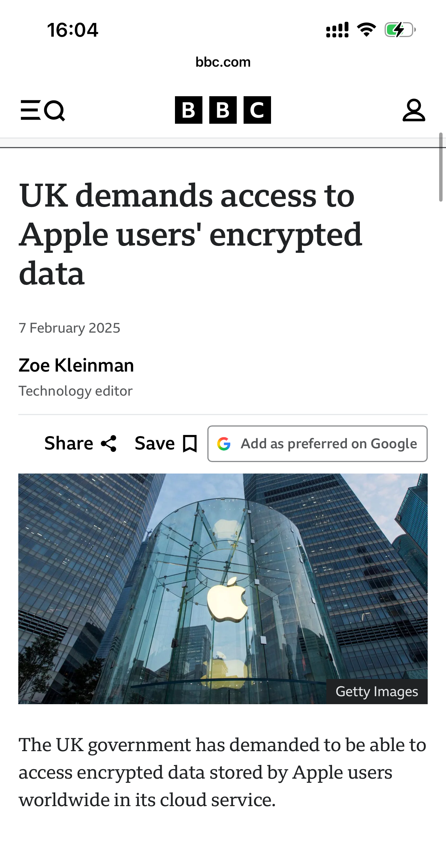
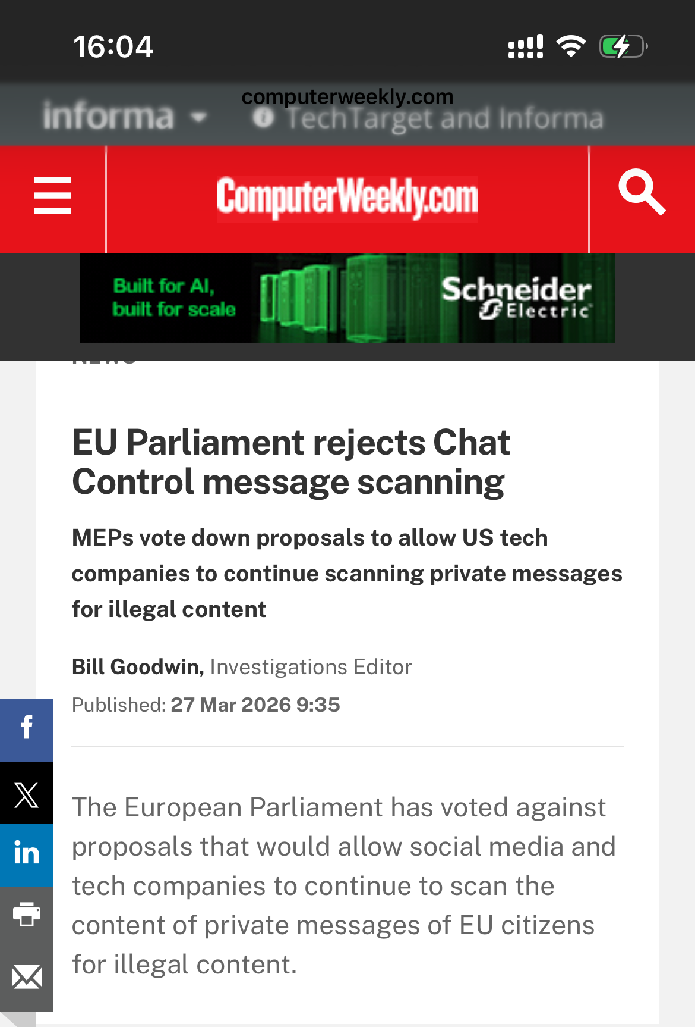
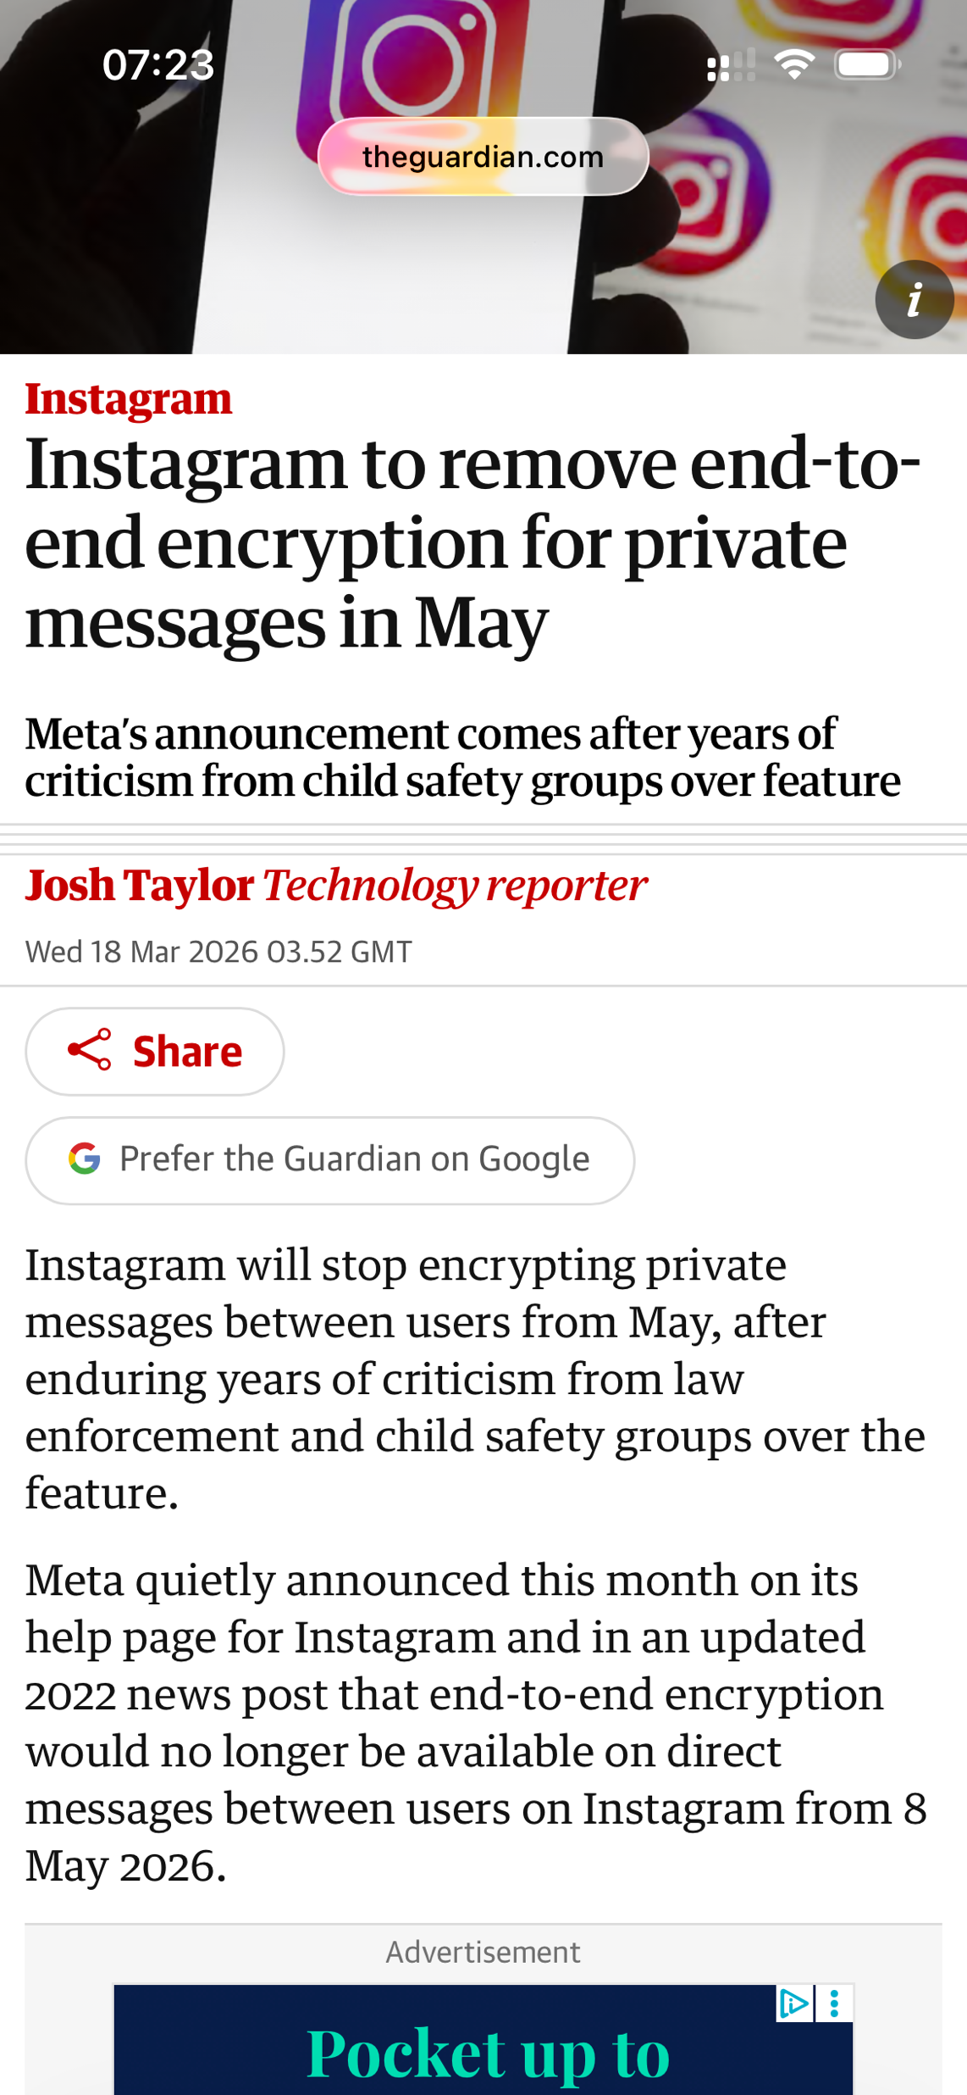

Slide 23
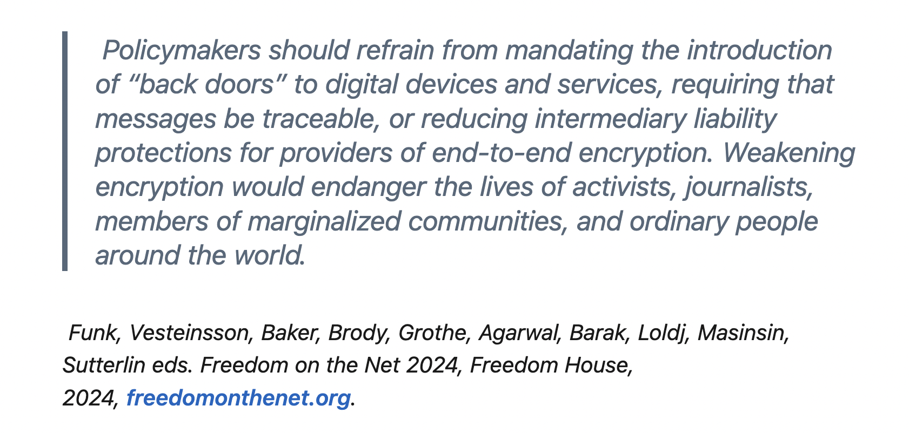

Slide 24
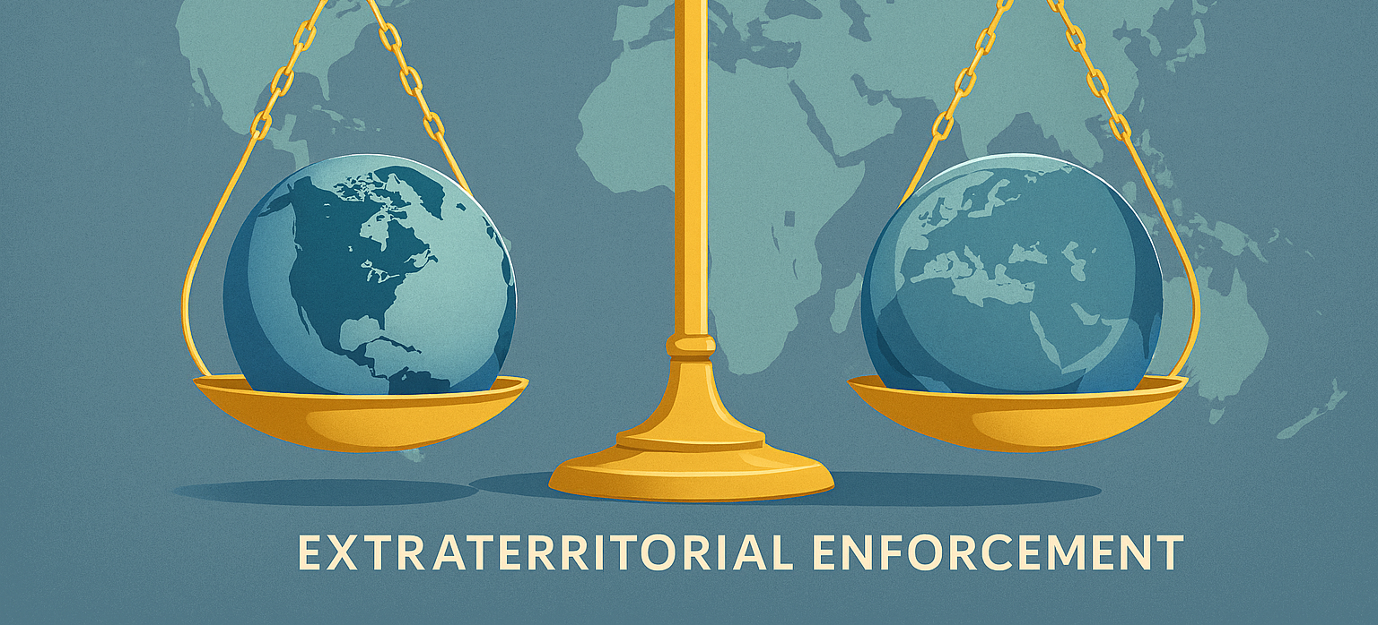

Slide 25
Who Can Tell Who, What To Do?
Extraterritorial regulation: under the norms of the public international law one state cannot perform any official action on a territory of another state without the consent of the latter
My data is in Europe – so that’s all good right?
US CLOUD (Clarifying Lawful Overseas Use of Data Act) can compel a US company to release data regardless of location
Can legislation really compel? Irish DPC collects only €19.9m of €3.26bn in GDPR fines up to end 2024

Slide 26
Takeaways
Regulation is unavoidable but poorly aligned with our environment. Security and safety legislation is expanding faster than it can reflect how research, education, and federated infrastructures operate
Online safety measures risk collateral damage. Blunt age‑verification approaches undermine privacy, restrict legitimate academic and community work, and fail to address harm effectively
The Cyber Resilience Act makes security a product responsibility, but we do not necessarily have a product development mindset to our work
Data location ≠ data control. Extraterritorial laws and uneven enforcement challenge assumptions about sovereignty, trust, and jurisdiction in global research collaboration

Slide 27
Thank You
Any questions?
www.geant.org

