Slide 1
Beyond IT
Why Cyber‑Physical Security Matters for Education
Floris Dankaart-Chang
Lead Product Manager Fox-IT/NCC Group
Commercial.Public

Slide 2
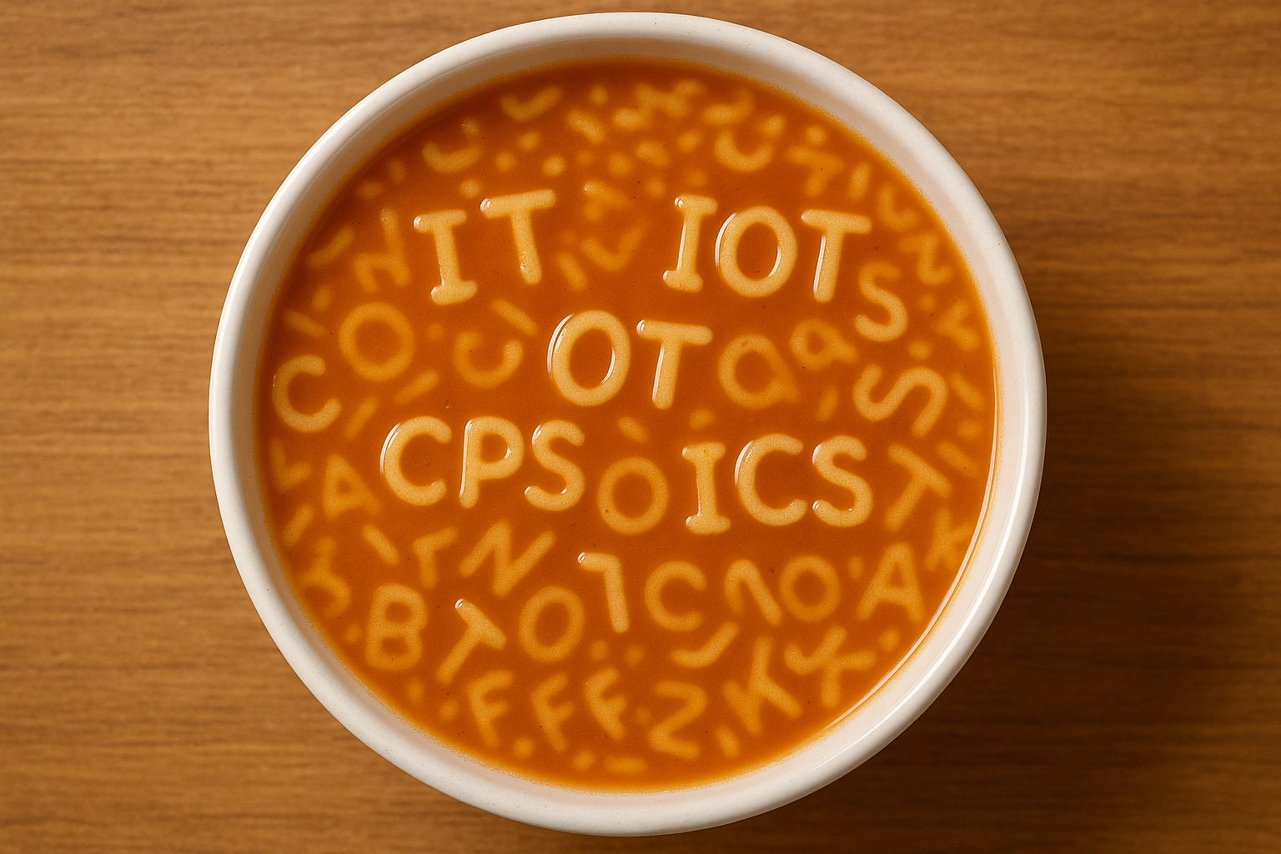
IT, IoT, OT, CPS, ICS?

Slide 3

Why Cyber‑Physical Security Is Different on Campuses
Why do we have a problem?
What is the positive news?
“Our BMS is separated from our IT”
Changes in the threat landscape - AI
Specific TI
AI/Machine learning works better for us!
Remote maintenance
What makes it so difficult?
What should I do?
Legacy technology
Test!
Skills gap
Ask yourself: do I have a complete and accurate list of ALL my assets?
Open nature of campuses
Notes:
OT –often- allows us to build a defensible architecture as physical boundaries often coincide with logical boundaries.
IEC 62443 Zones & Conduits
Identify the zones and conduits. The conduits will be valuable later for monitoring!

Slide 4







Managed IT/OT SOC tech stack
On-prem sensors, centralised correlation
Client Environment
Fox-IT
1. Network Sensor
Enrichment sources
(incl Asset list)
7. Datadiode
2. SIEM (log monitoring)
Connector layer
Service
now
Automation engine
3. Agents
4. Canaries
5.Identity
6. Managed (OT) Firewall
Detection logic
Commercial.Public

Slide 5
Thank you.
Together we're creating a more secure digital future
© 2025 NCC Group. All rights reserved.
Please see www.nccgroup.com for further details. No reproduction is permitted in whole or part without written permission of NCC Group.
This content is for general purposes only and should not be used as a substitute for consultation with professional advisors.

