Slide 1
A mental model for better security
Cornelia Puhze, Switch

Slide 2

Notes:
A mental model is the internal map we use to understand how something works. It allows us to predict outcomes, see connections, and make better decisions, especially in complex environments. Without a mental model, we rely on isolated rules ("use a strong password," "don't click links); with one, we can reason, adapt, and develop a stronger sense of self-efficacy. What’s your mental model of planet earth? How did you learn?

Slide 3

A mental model to understand the world
Data
Devices
Networks
Software
Notes:
three-dimensional model of the world that you can hold and turn in your hands. With that object, a child can understand why there are time zones, why some countries are neighbours and others aren’t
As practitioners we’ve realised, that many people don’t have a coherent mental model of the digital world we live in, which has considerable consequences not just for their safety, their organisations security but also to digital citizenship and our collective future.
That led us to a collaborative, card-based workshop format built around four pillars >security risks and user behaviours. Fresco Workshop By making the system visible, including its hidden layers, the workshop enables participants to better understand why security practices matter and how they can be safer online.

Slide 4
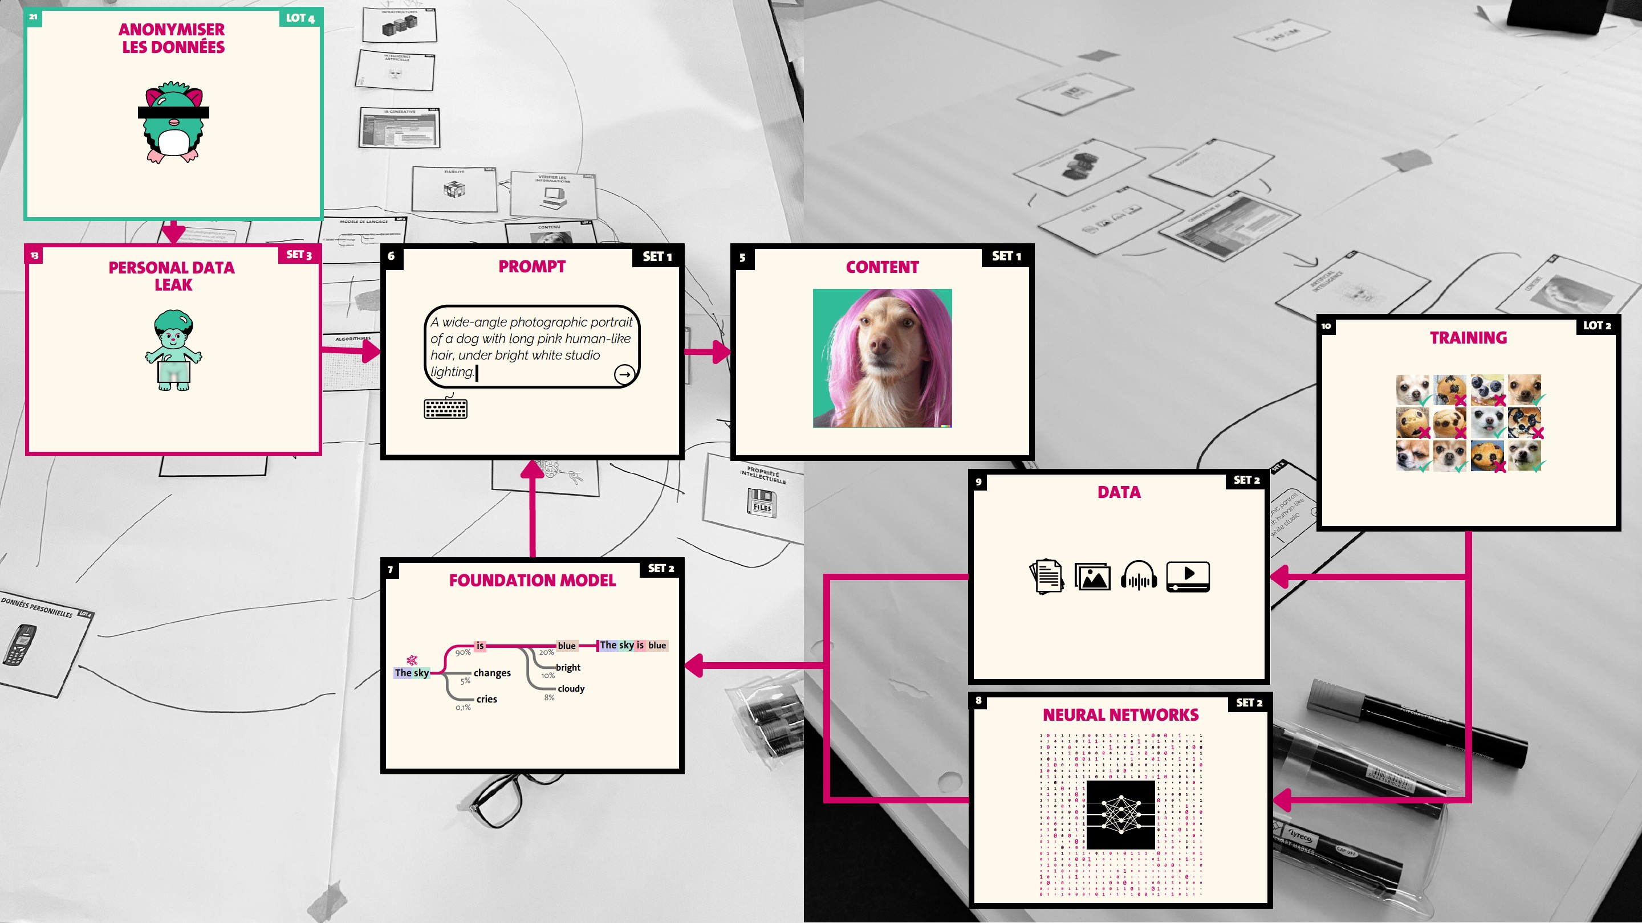
https://www.unige.ch/transformation/en/actualites/nos-projets/fresque-ia
Notes:
Inspired by the AI Mosaic (https://www.unige.ch/transformation/en/actualites/nos-projets/fresque-ia) developed at the University of Geneva, this approach raises awareness by giving participants a holistic understanding of the digital environment, enabling safer behaviours and better alignment with security standards.

Slide 5
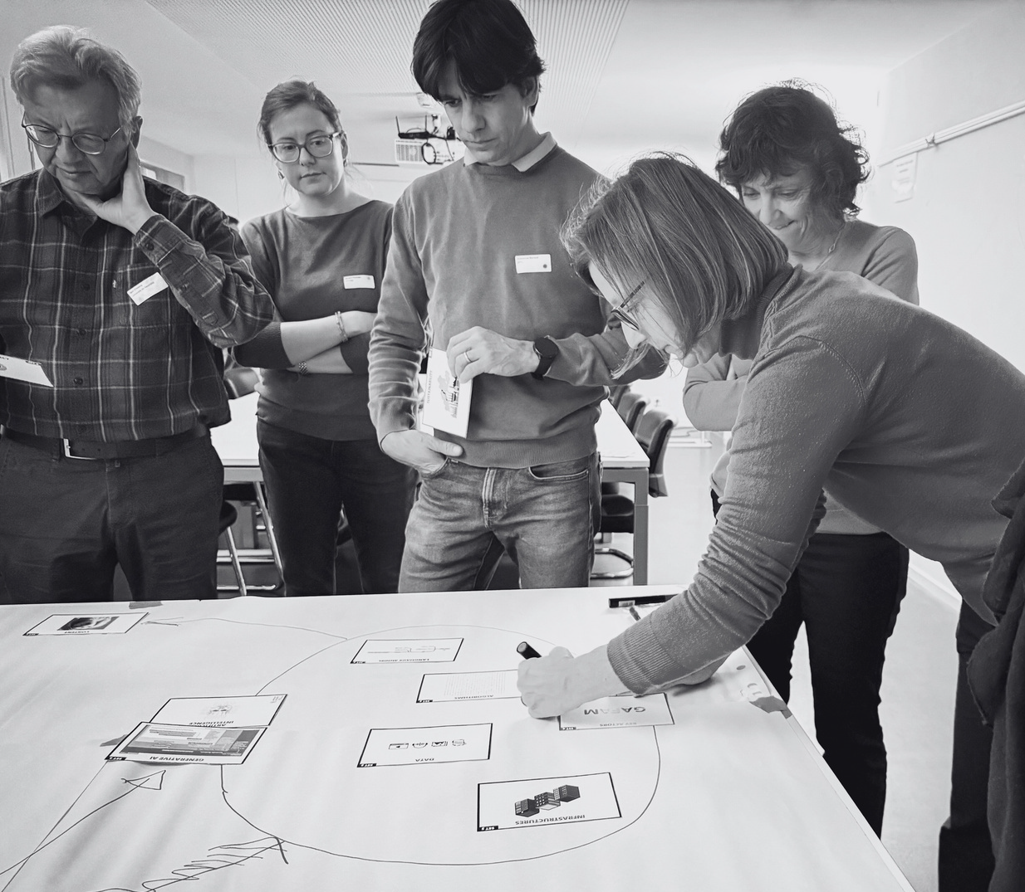
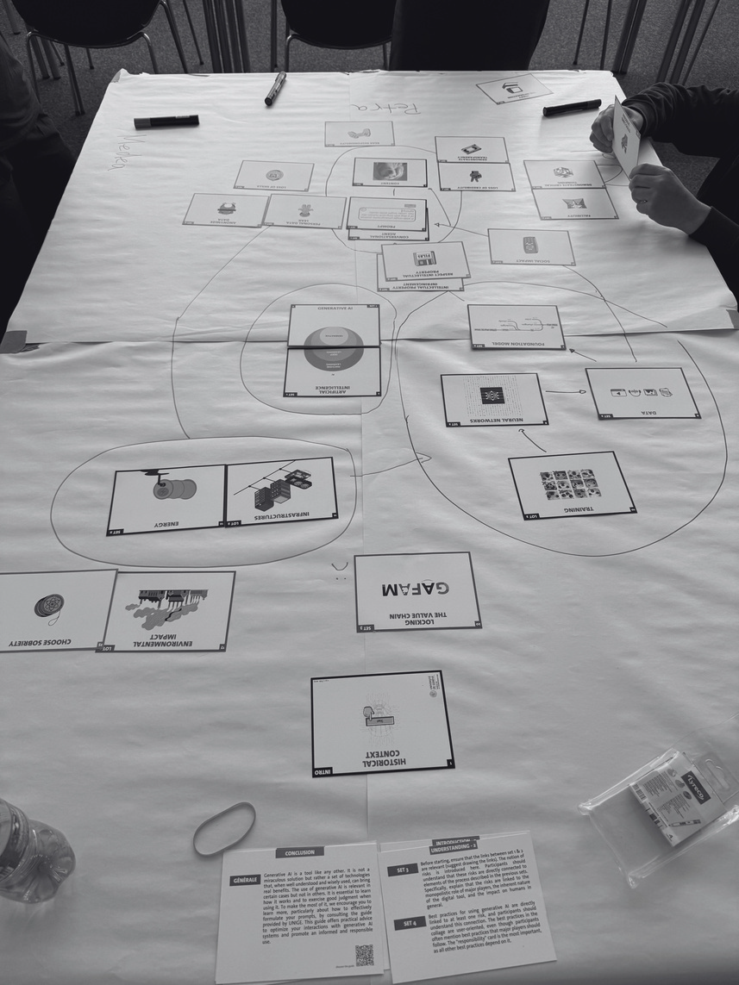
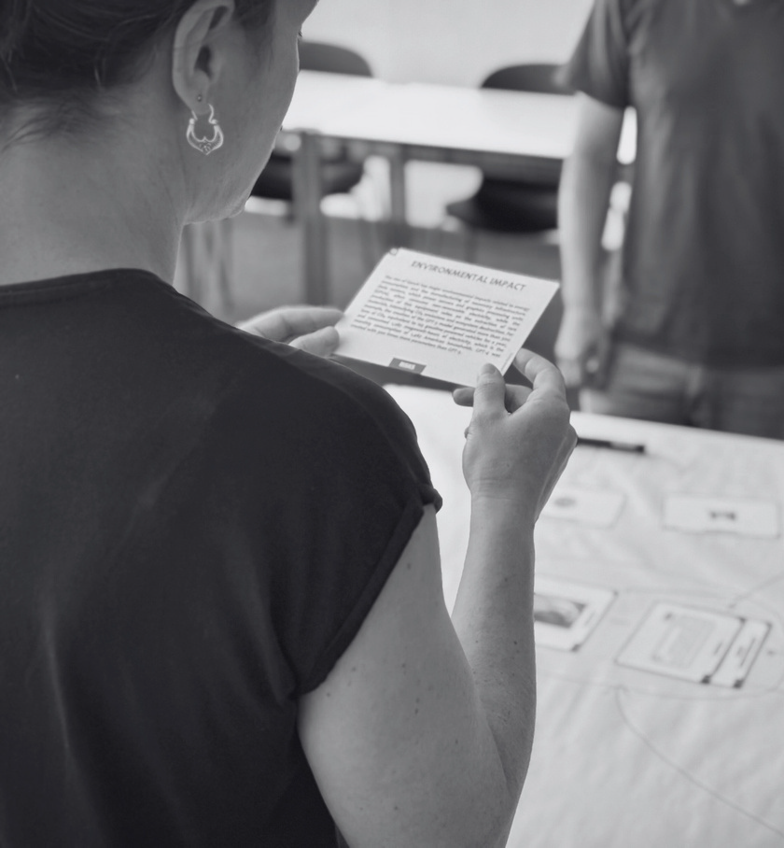
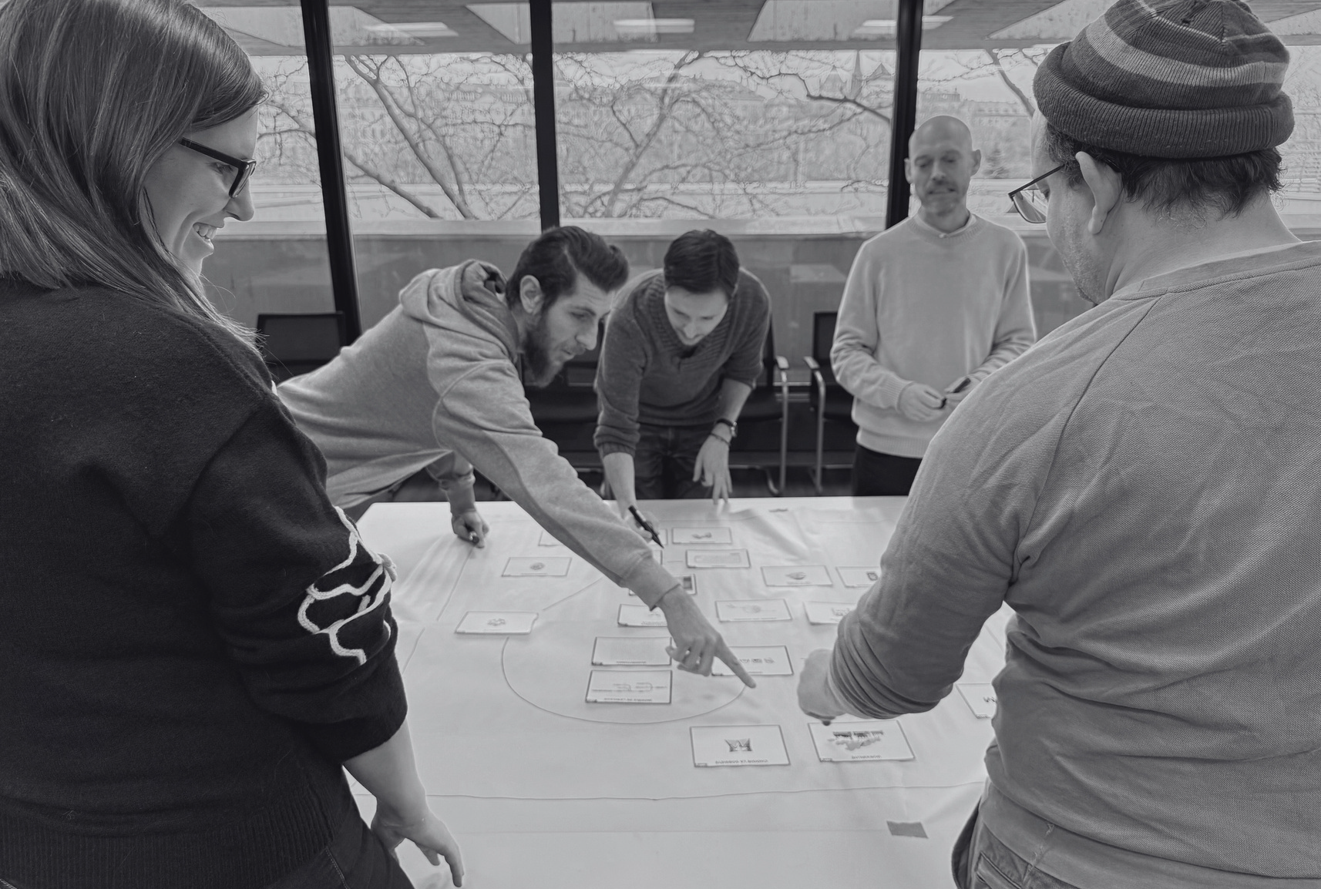
Notes:
The Fresco makes the system visible — including its hidden layers. Participants build the model together, through conversation and cards, which creates shared understanding rather than passive reception. Non-technical audiences can engage fully. And because they construct the model themselves, they remember it better.
The target insight for every participant: "Now I can see why these practices matter."

Slide 6
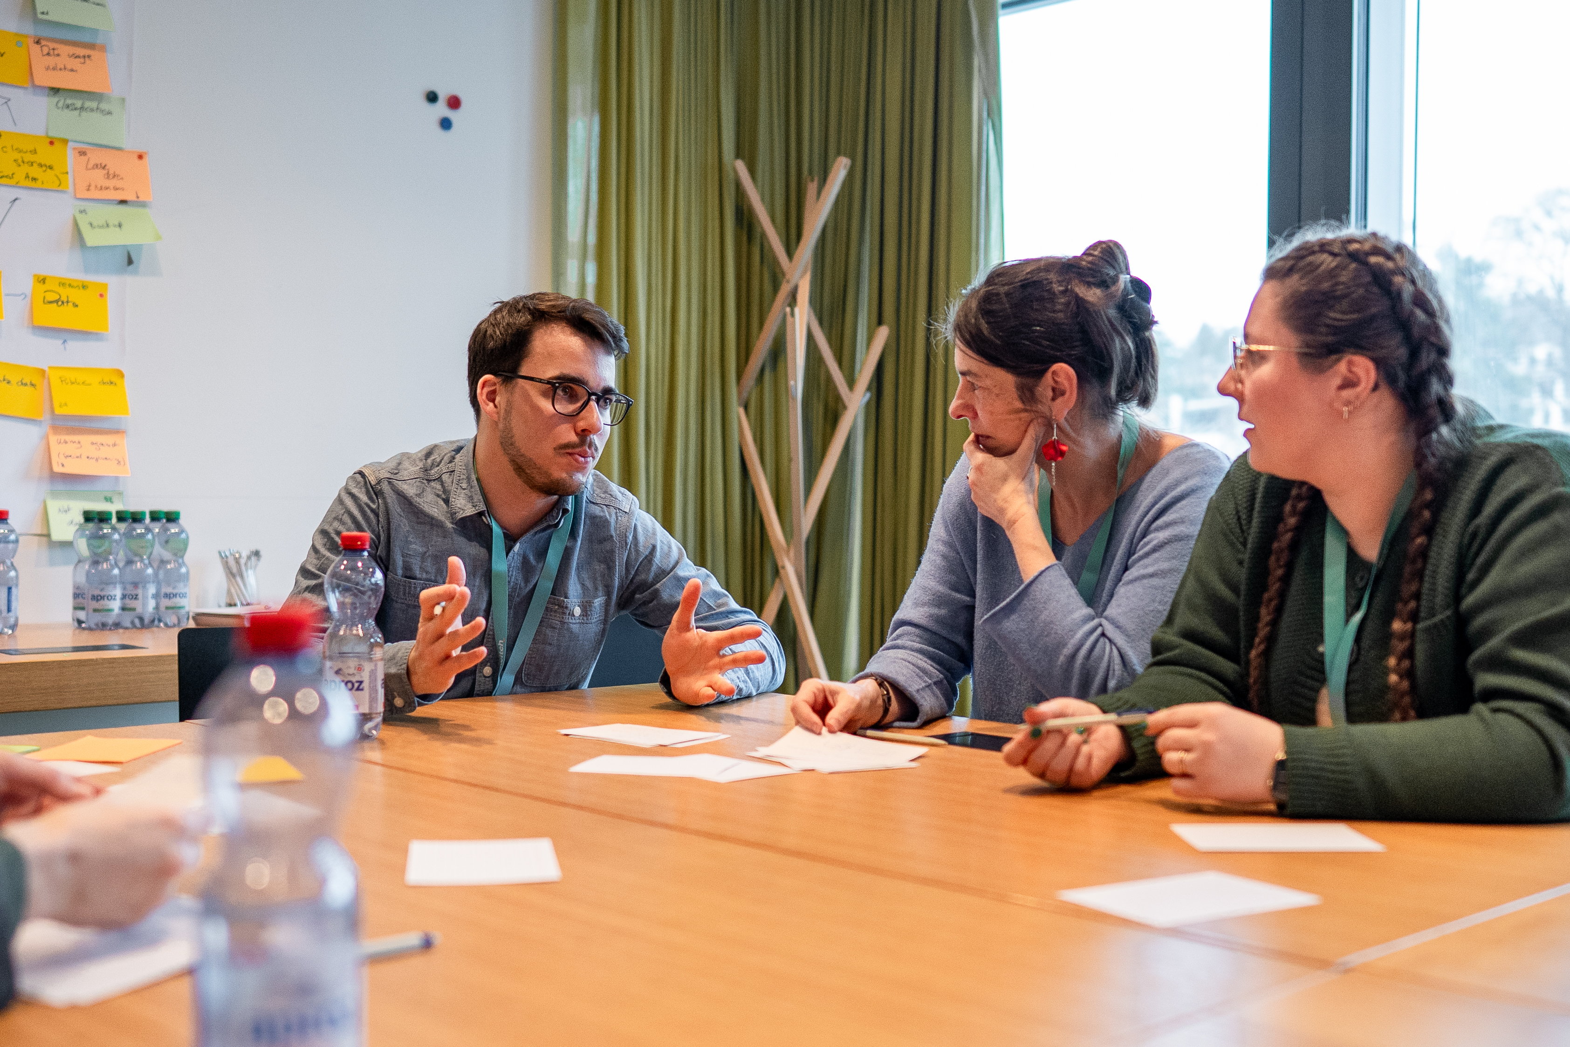
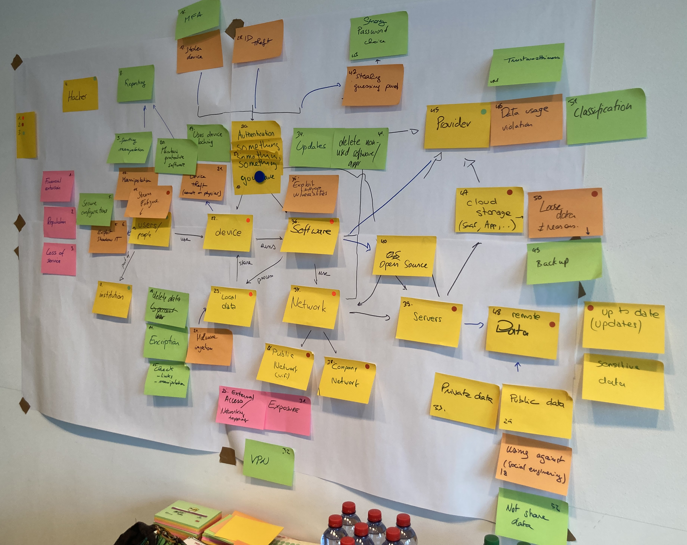
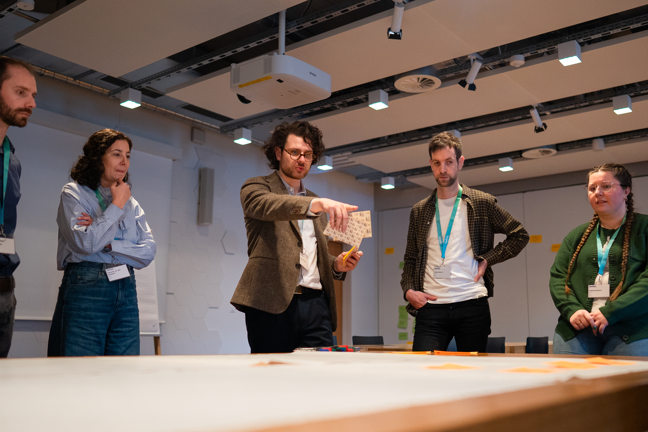
Security Communications and Learning Community Workshop
Notes:
It was co-created through the Swiss Security Communications and Learning Community together with the GÉANT Awareness Task Force

Slide 7
How to use the GÉANT Digital Safety Workshop
Finished workshop (set of cards) will be available Q2 2026
GÉANT branding with white labeled space for individual branding
cc-licence
customise to your needs (e.g. link to your intranet, translations)
Sign up for the Security Awareness Community and access the Resources Hub: https://security.geant.org/awareness/
Notes:
The materials are open. Anyone working with a community — whether that's students, staff, researchers, or citizens — can run this workshop. You don't need to be a security expert to facilitate it.

