Slide 1
Censys Briefing

Slide 2
OUR MISSION
The one place to understand everything on the Internet

Slide 3







Our History
2012
2017
2018
2019
2020
2022
2023
Invented ZMap and fast Internet-wide scanning
Founded
Censys, Inc
Launched
Censys Search
& Attack Surface Management
Built a new, proprietary Internet Map replacing ZMap
Raised
$15.5M
Series A
Raised
$35M
Series B
Raised
$50M
Series C

Slide 4
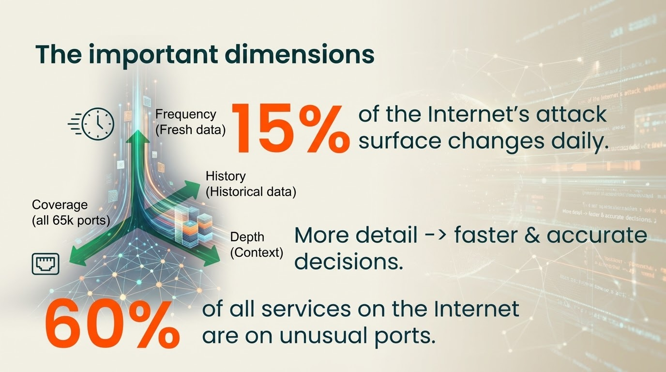

Slide 5
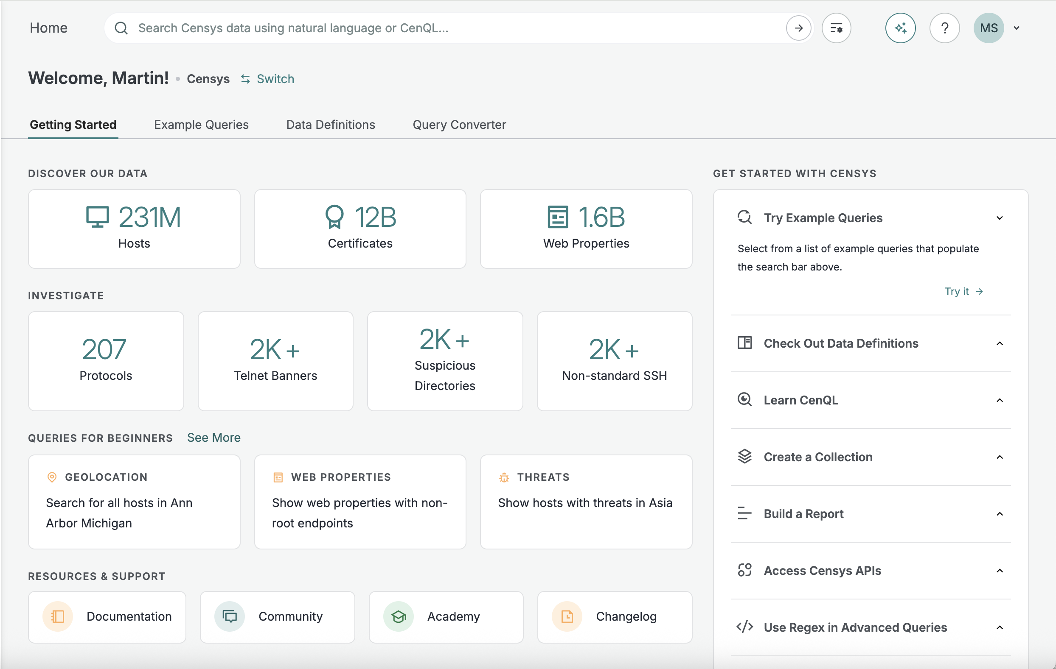
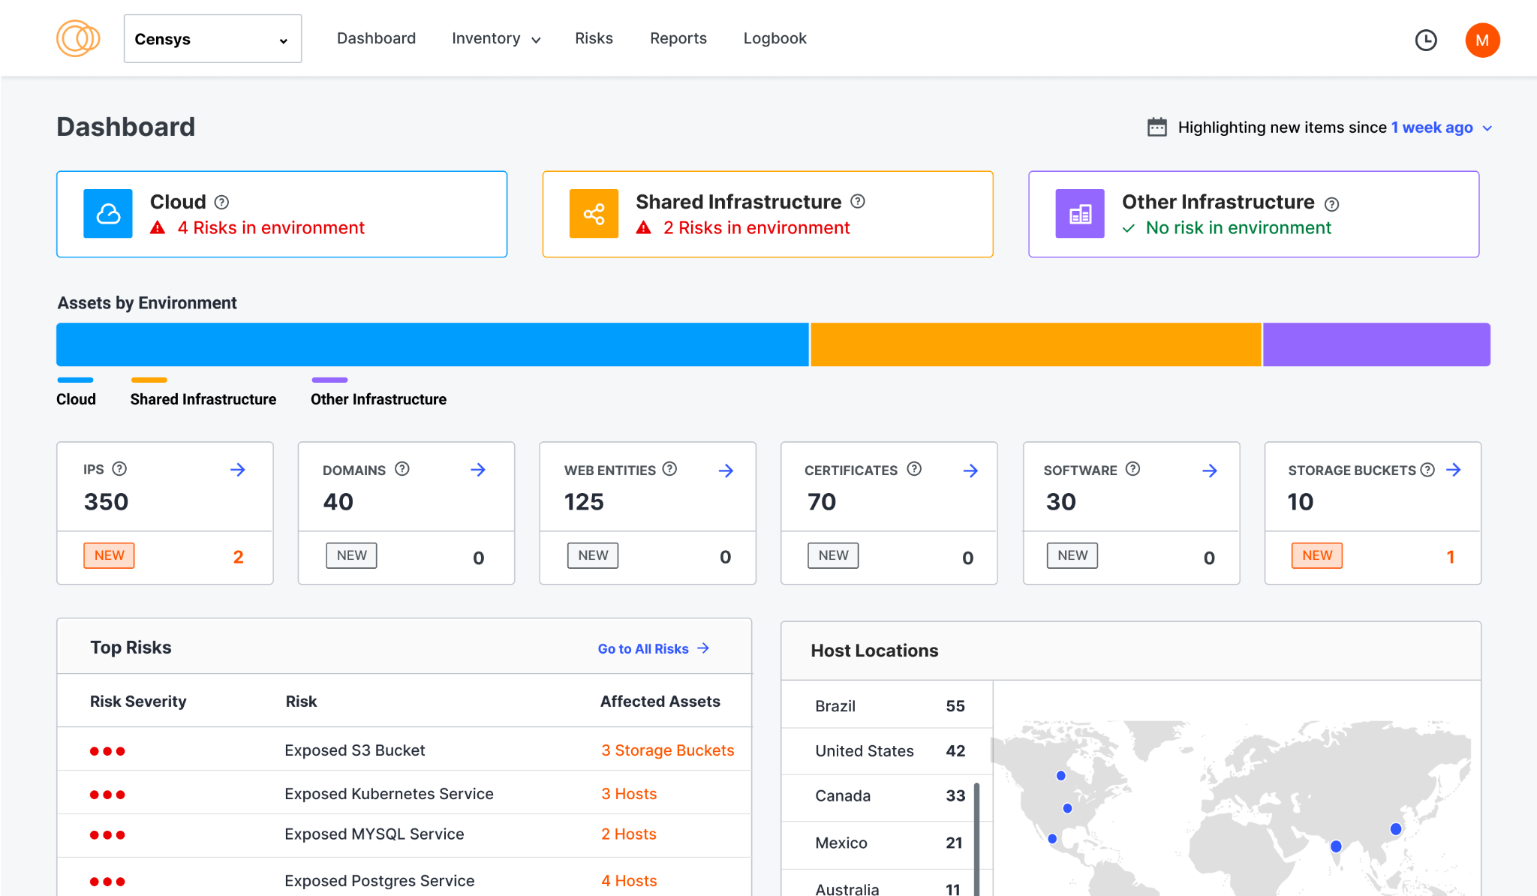

Censys Internet Intelligence Platform
The One Place to
Understand Everything
on the Internet
Search
Internet Map
Exposure Management
Threat hunting, incident response, and threat intel-related workflows
Accurate data about context, ownership, history
Continuously refreshed “Outside-in” external attack surface with risk context
SOAR
SIEM
IDS/IPS
Enhances existing tooling
VM
CSPM
CASB

Slide 6
Delivering Value to Multiple Groups
Threat Hunting
Proactively identify, profile and detect threats with the most comprehensive set of internet intelligence available
Security Operations
Prioritize and triage security events and mitigate threats to your network with ground-truth infrastructure data
Incident Response
Quickly and confidently go back in time to investigate and mediate security incidents with an attacker’s perspective
Pentesting
Identify potential exposures, gather information for reconnaissance and conduct vulnerability assessments
Cloud Asset Discovery
Easy to use, flexible, and secure hosted cloud connectors with daily asset ingestion and big 3 CSP, and Wiz support
Exposure & Risk Management
Discover known and unknown exposures to mitigate risks and reduce breaches by up to 50%
Security Framework & Compliance
Stay ahead of the curve and up to date with evolving standards, such as NIST and the Biden Executive Order
Manage Acquisition & Subsidiary Risk
Eliminate the need for special asset discovery projects and shorten due diligence by 40%
Example Teams Served (13): Red Team, Perimeter Intel, Vuln Management, M&A, SPT (M&A Pretesting), Hunt Team, Bug Bounty, Cyber Intel, Vendor Management, IOT, Strike, F5/Networking Team, UEBA (User behavior analytics)

Slide 7
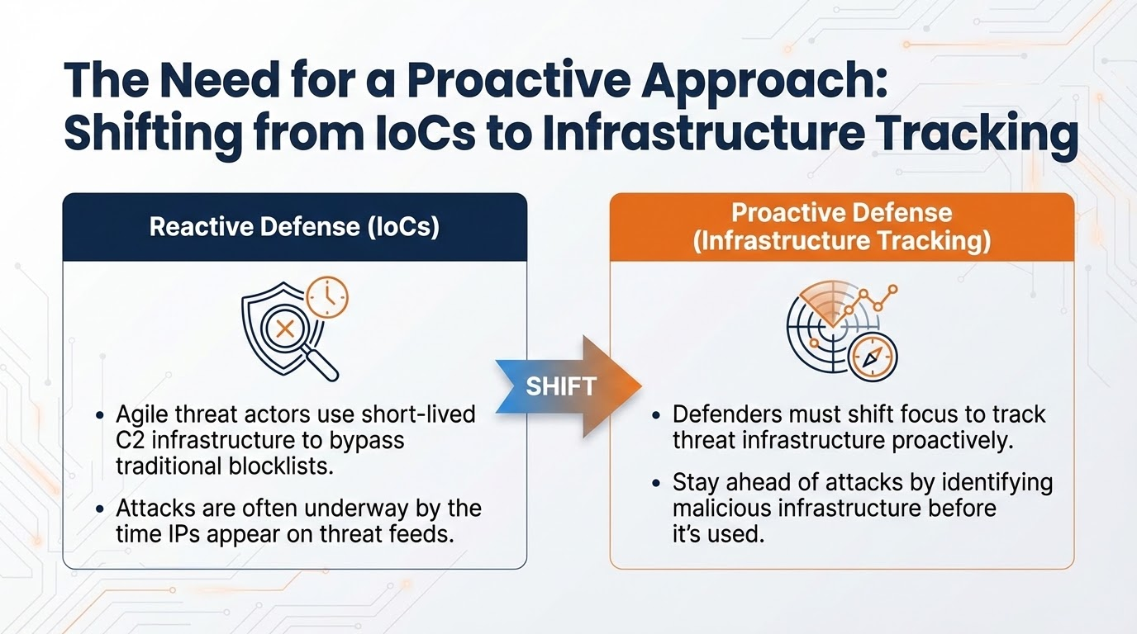

Slide 8

Thanks for listening!

Slide 9
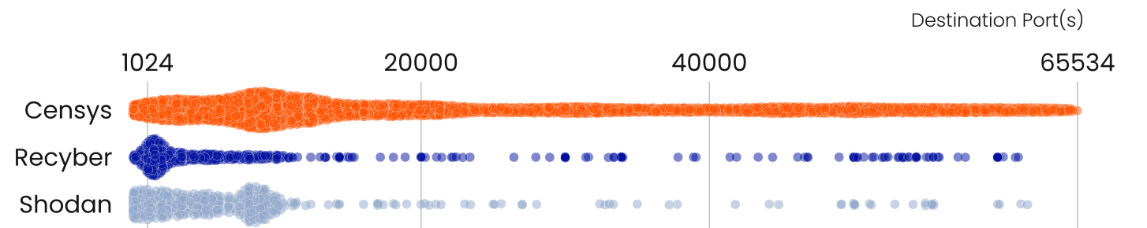
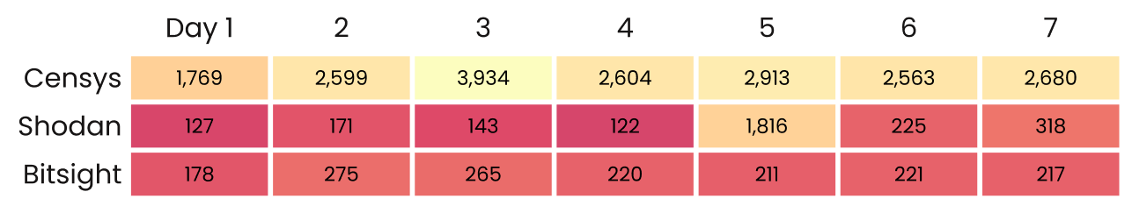

Mapping the Internet: Comparing Scan Results
Depth of Coverage
>
63% More Services
Freshness of Signals
>
Continuous Scanning
From the article Life of an Internet Scanner

