Slide 1
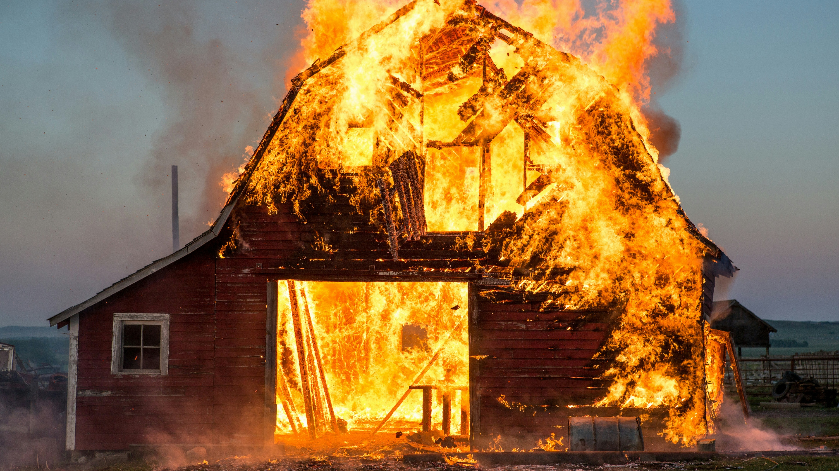
Title slide
What are our greatest fears?

Slide 2

Scenarios

Slide 3
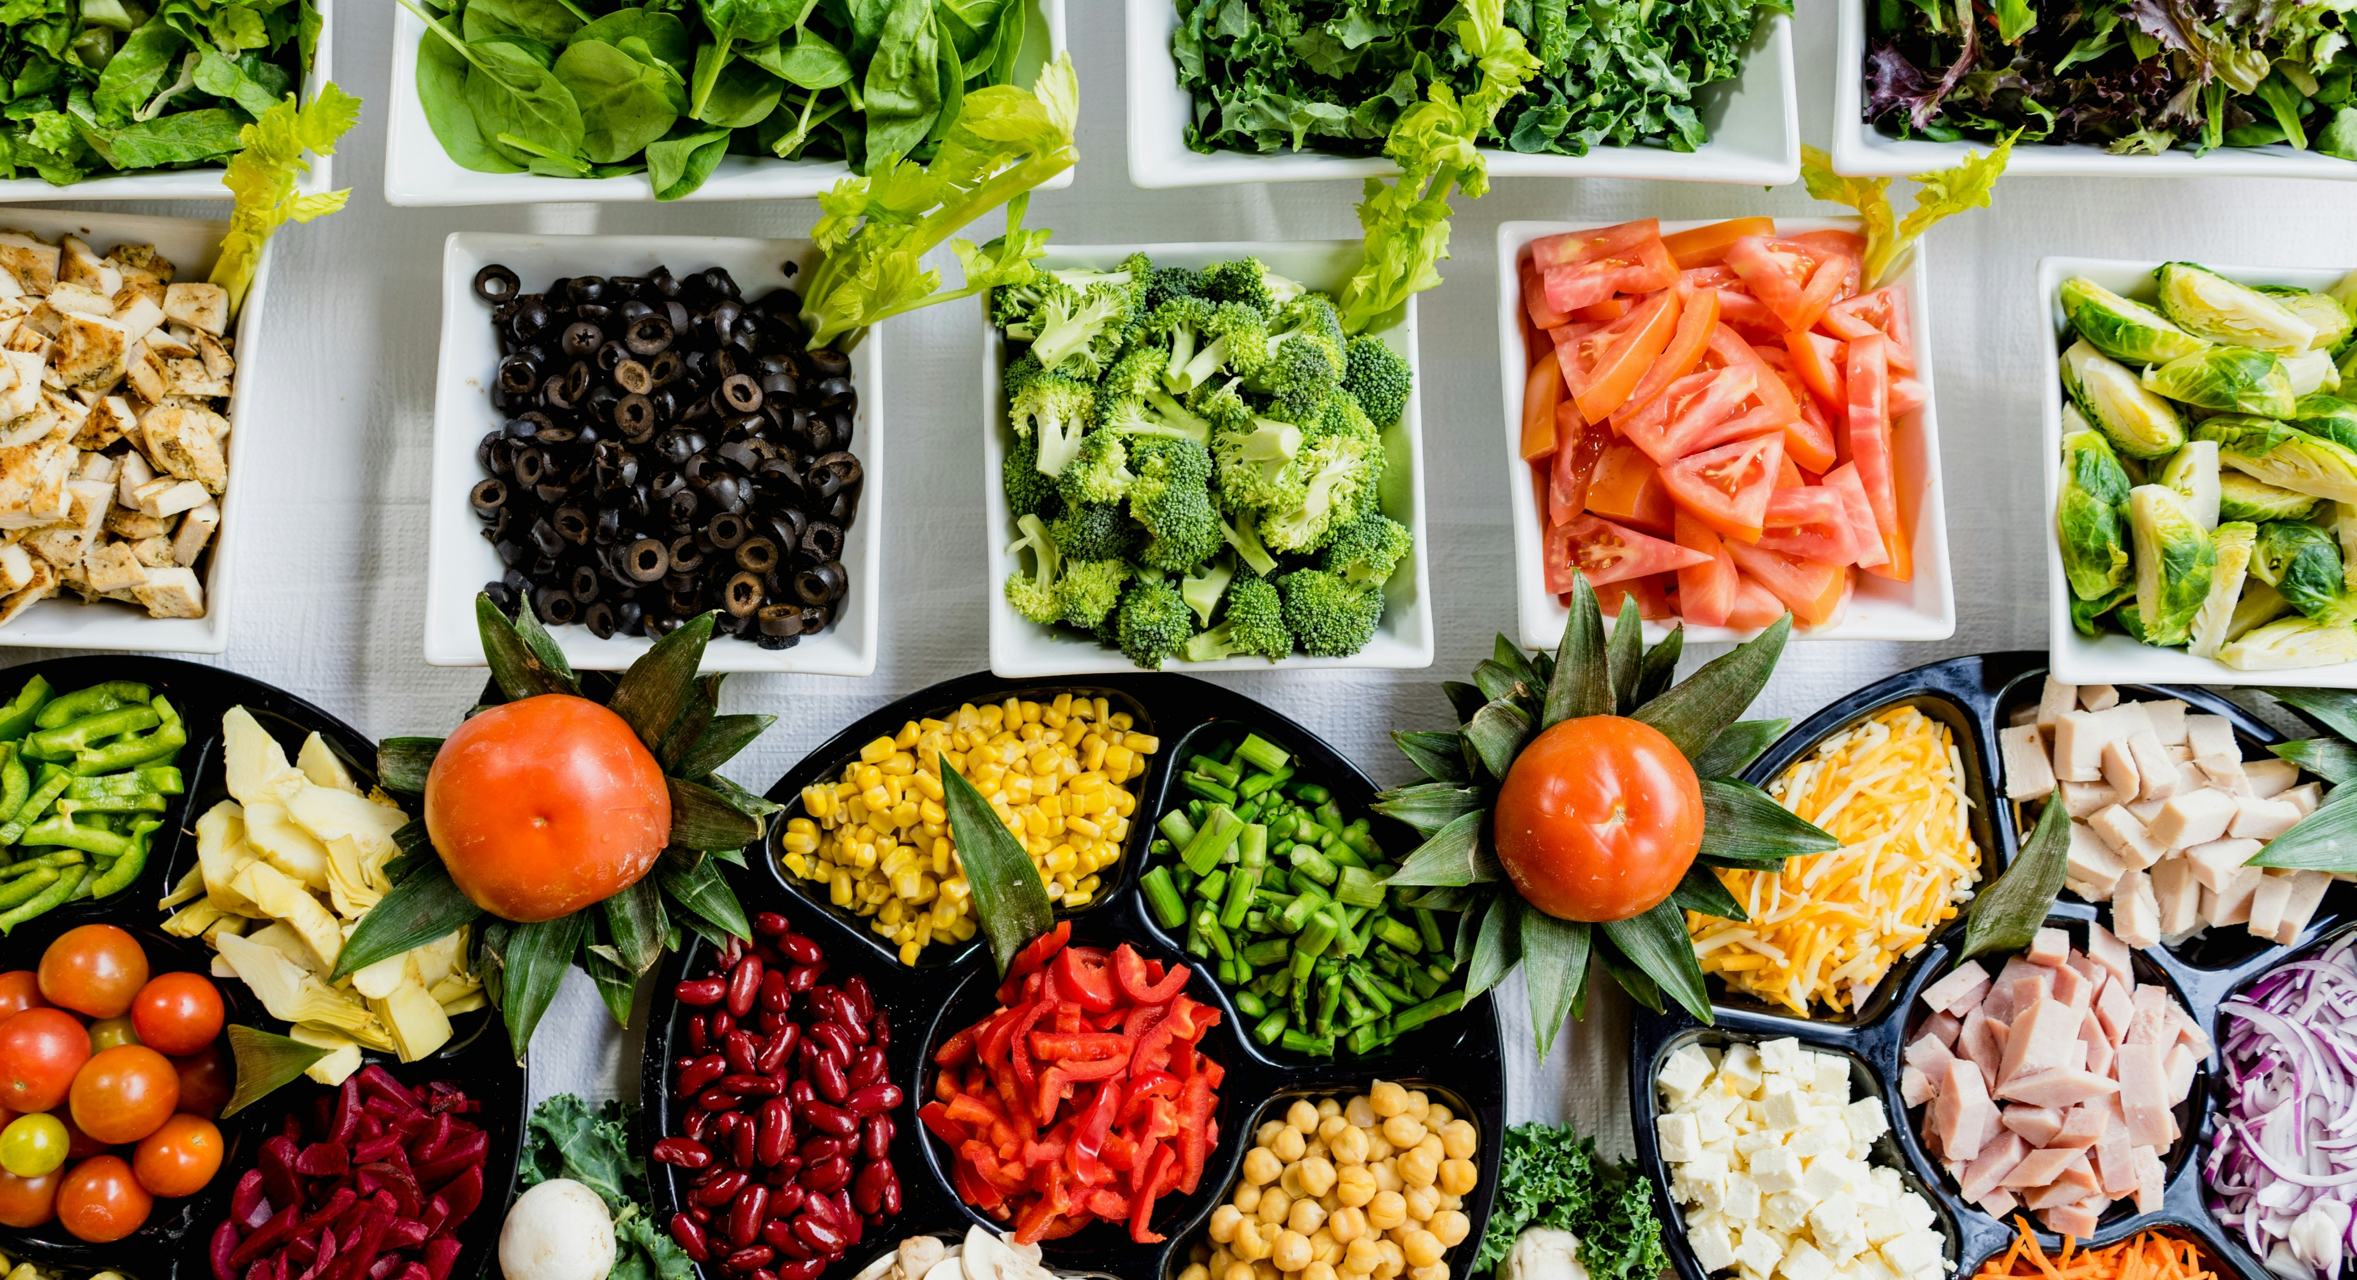
Mitigations?

Slide 4

Community Award

Slide 5

Timeline
Nominations open since January
Deadline April 17
Selection criteria open for everyone to consult
Selection by GCC + Chair GÉANT Board and GÉANT CEO in May

Slide 6
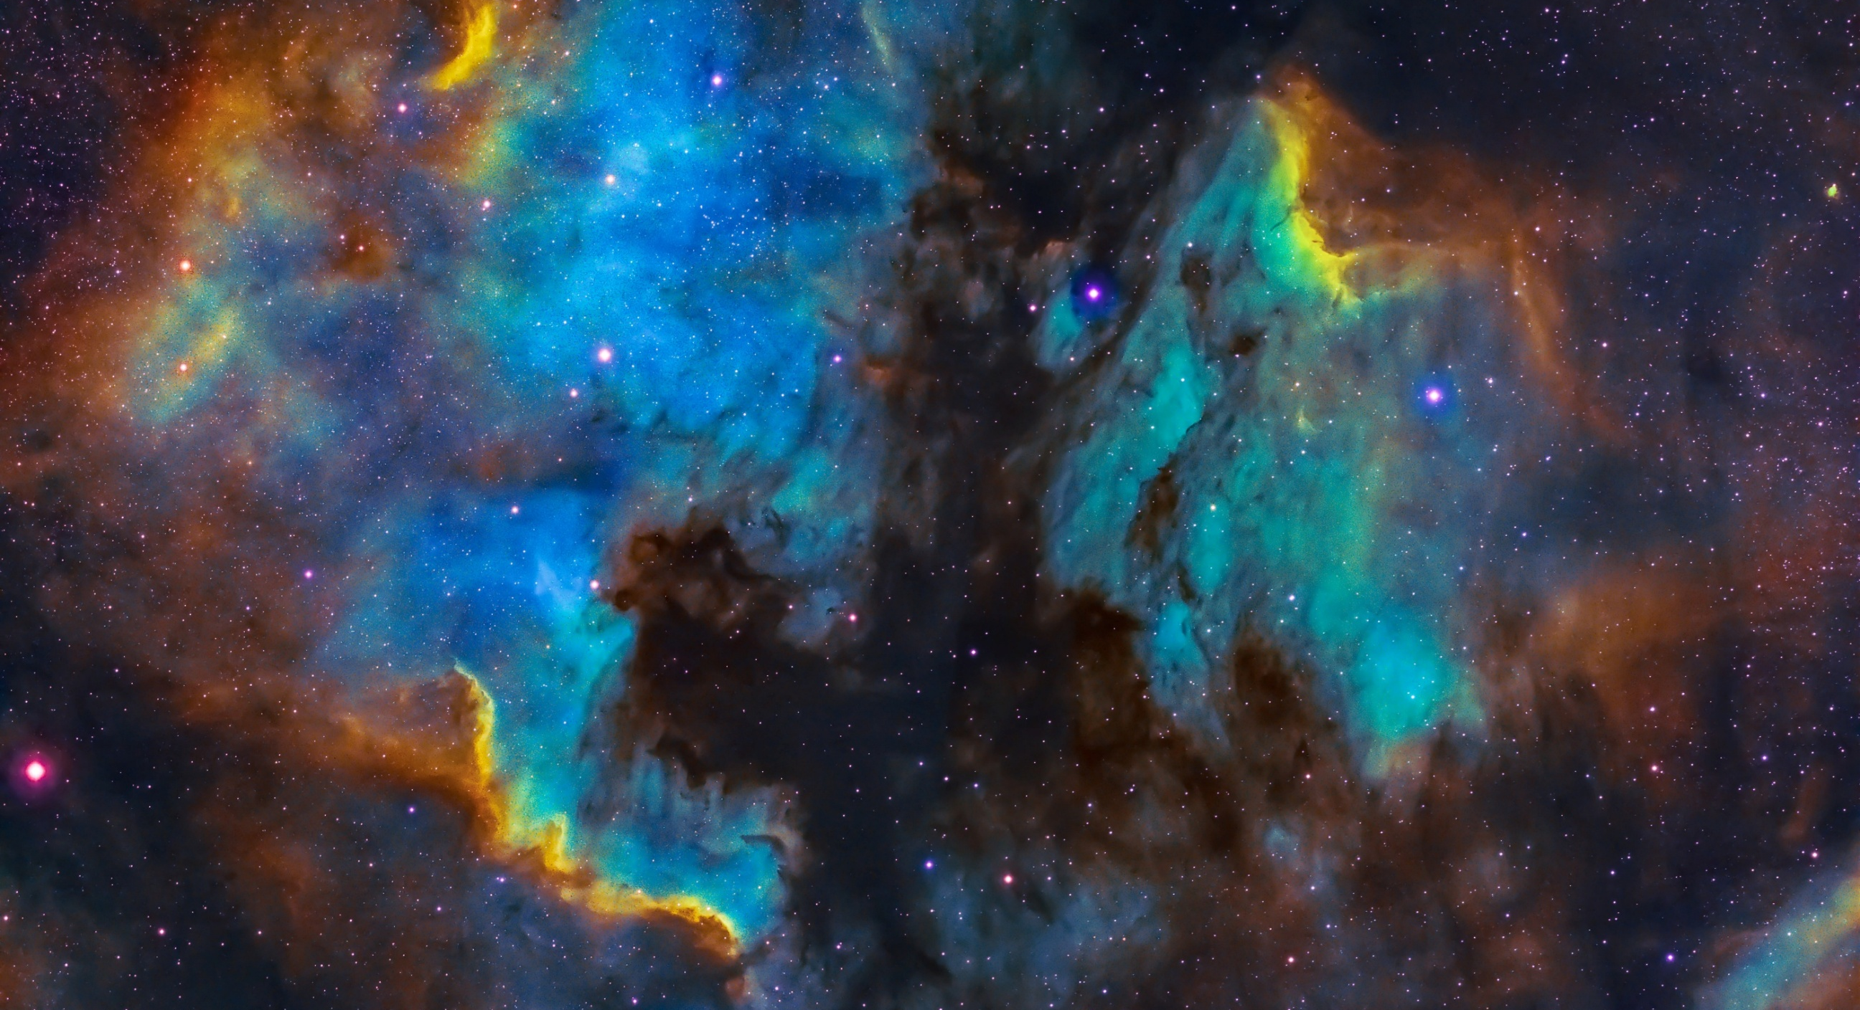
Humanitarian Support Group

Slide 7
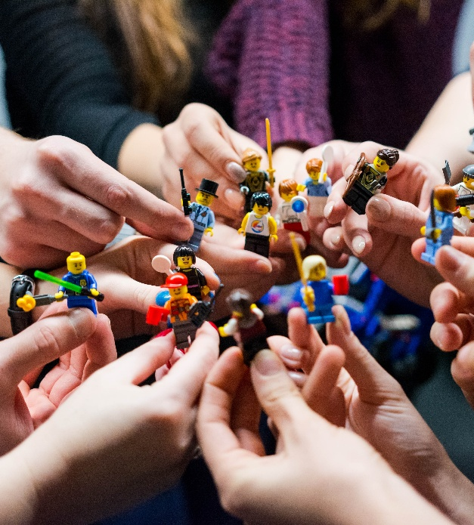
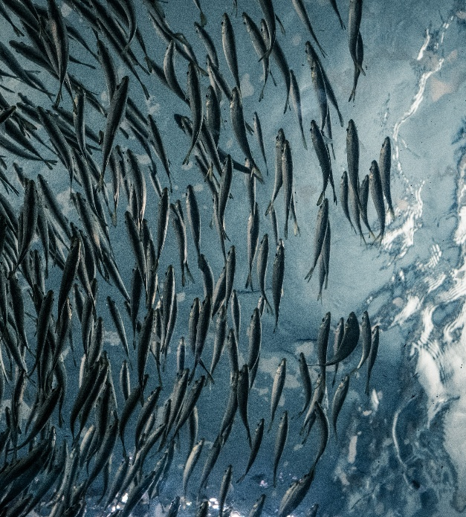

Focus
Now: Supporting URAN
Medium term: distributing lessons learned from URAN to community
Long term: linking pin between any European NREN and community during calamity
Notes:
Initiative from URAN, pitch last TNC, started December 2025

Slide 8




First initiatives
‘I support URAN’ campaign during TNC
URAN online day + webinars to learn from URAN
End of year initiatives: prepping for winter
Basics in place for long term support of any European NREN

Slide 9
Current members
Charlie Van Genuchten Chair
Tetiana Preobrazhenska URAN
Irina Matthews GÉANT
Anna Desaunois GÉANT
Rosanna Norman GÉANT
Raimundas Tuminauskas PCSS
John Dyer/ Erik Huizer Vietsch Foundation
Michel Wets SURF
Brian Nisbet Asiera
Olga Popcova RENAM

Slide 10
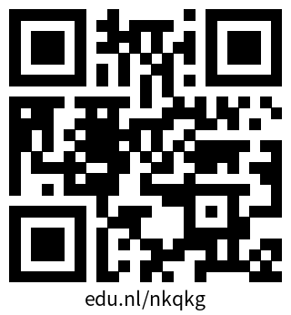
More information
Humanitarian Support Group Wiki

