Slide 1
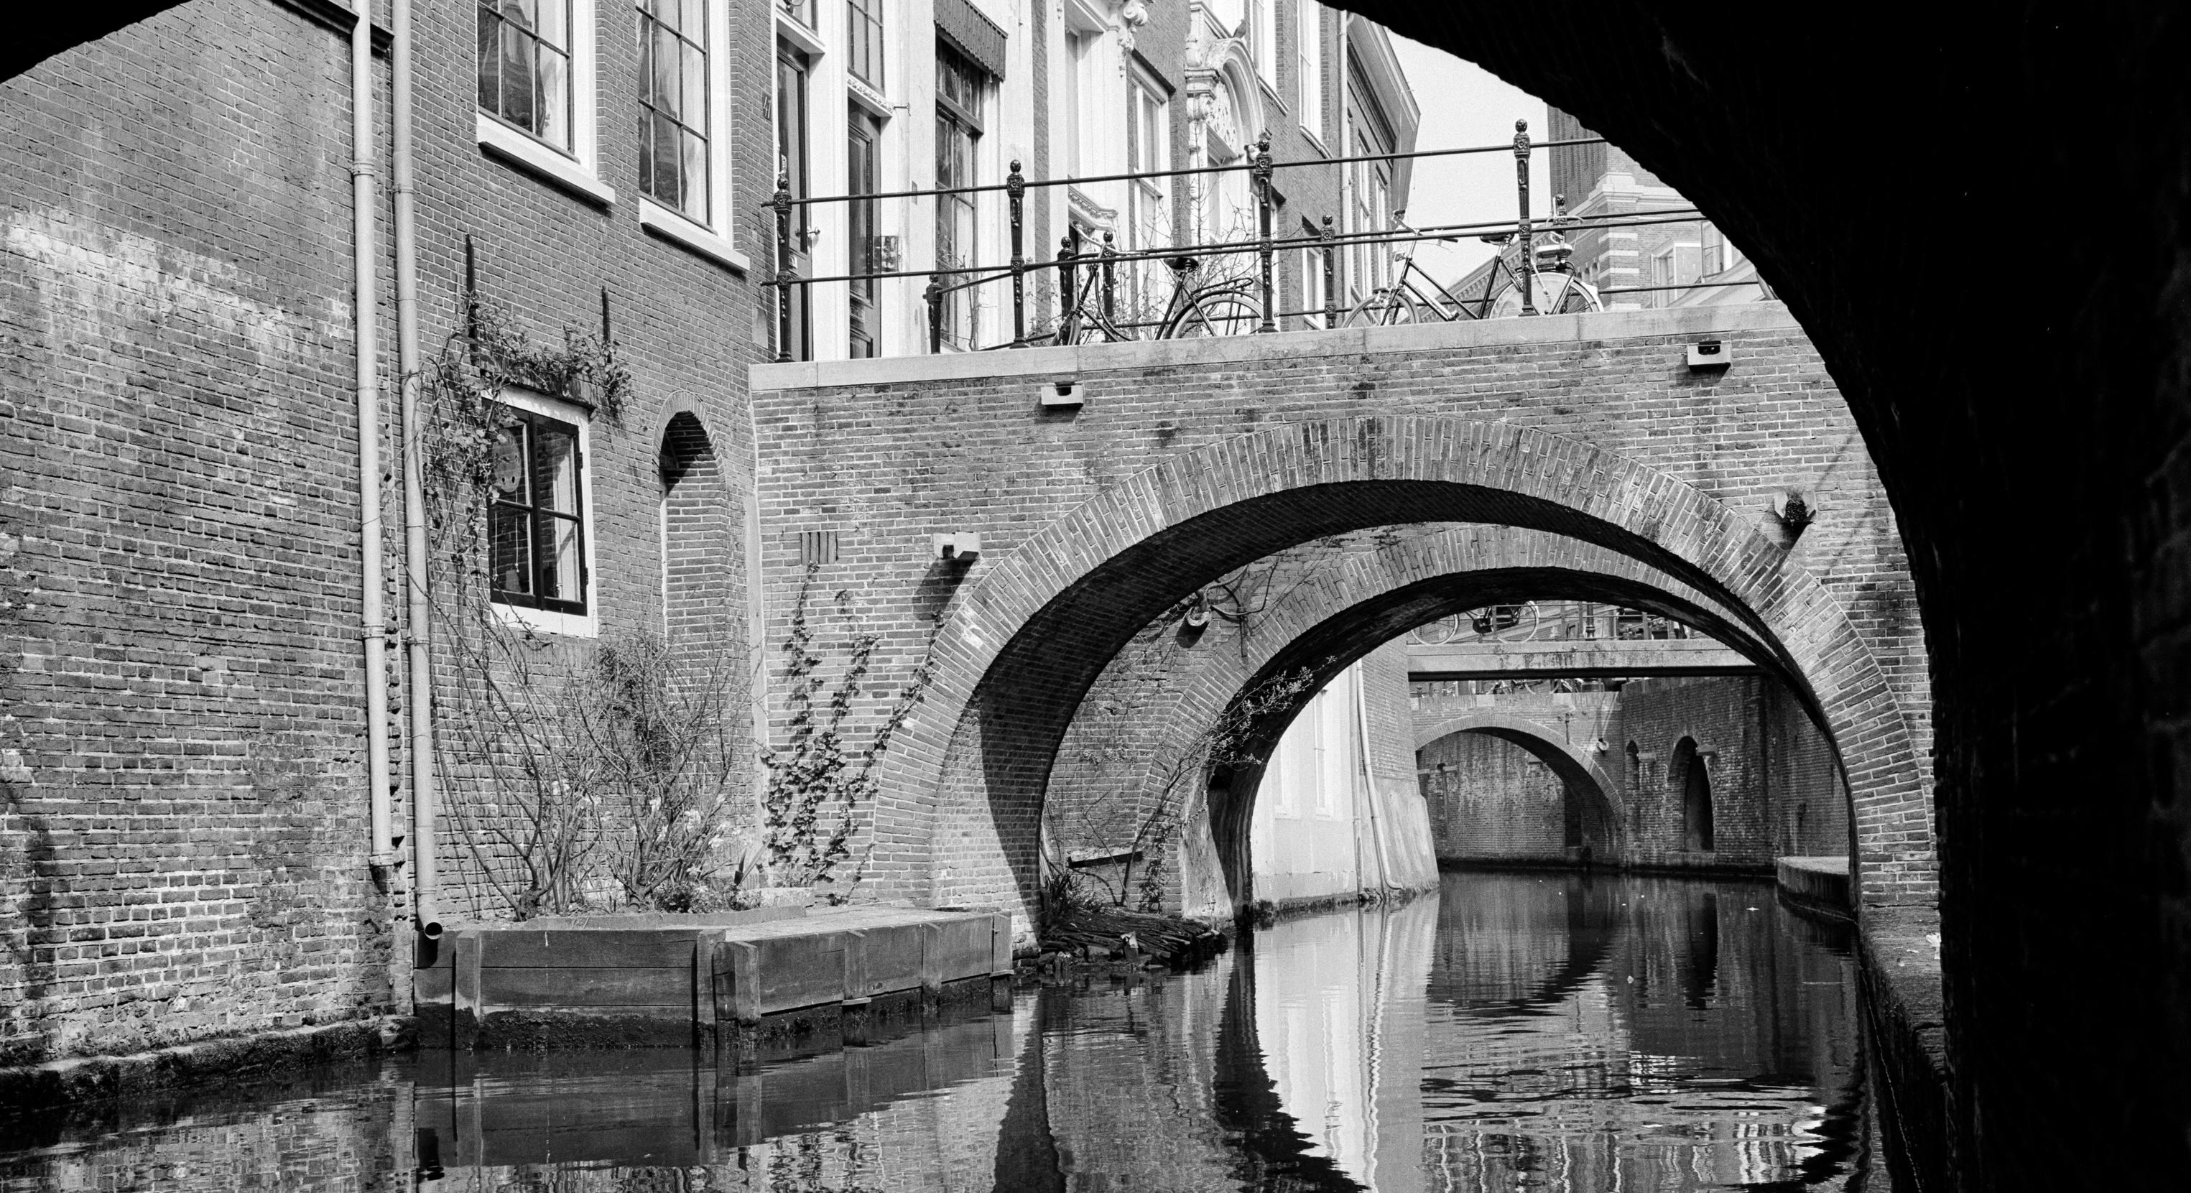
Title slide #3
GEANT Security Days
2026
Floor Jas
Head of Trust & Security

Slide 2
What we do
        We organise collective purchasing under the best conditions
        In costs, but also in public values
        We share knowledge and coordinate collaboration
        in education, research
        and innovation
        We provide IT services
        (50+ and very diverse)
        to make IT accessible, easy and safe
        We innovate
        To make sure we are ready
        for the future
        We are
        the not-for-profit collaborative organisation in IT for Dutch education & research

Slide 3
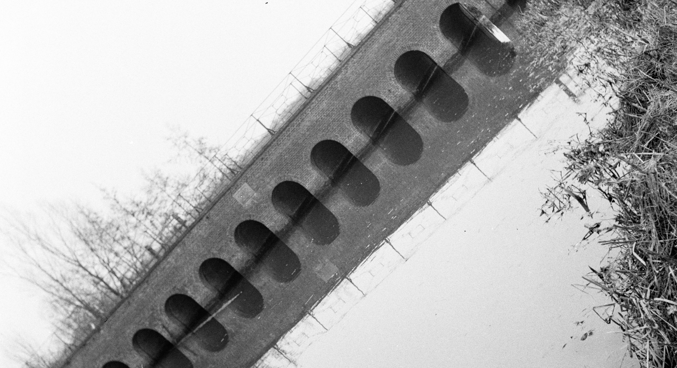
SURF and
the TAO of cybersecurity

Slide 4
three cybersecurity aspects that reinforce each other
    Technology
    Awareness
c
    Organisation

Slide 5

Other ways...
Technology, Awareness, Organisation
Identify, Protect, Detect, Respond, Recover
Service delivery, Service development, Innovation, Research
Strategical, Tactical, Operational

Slide 6
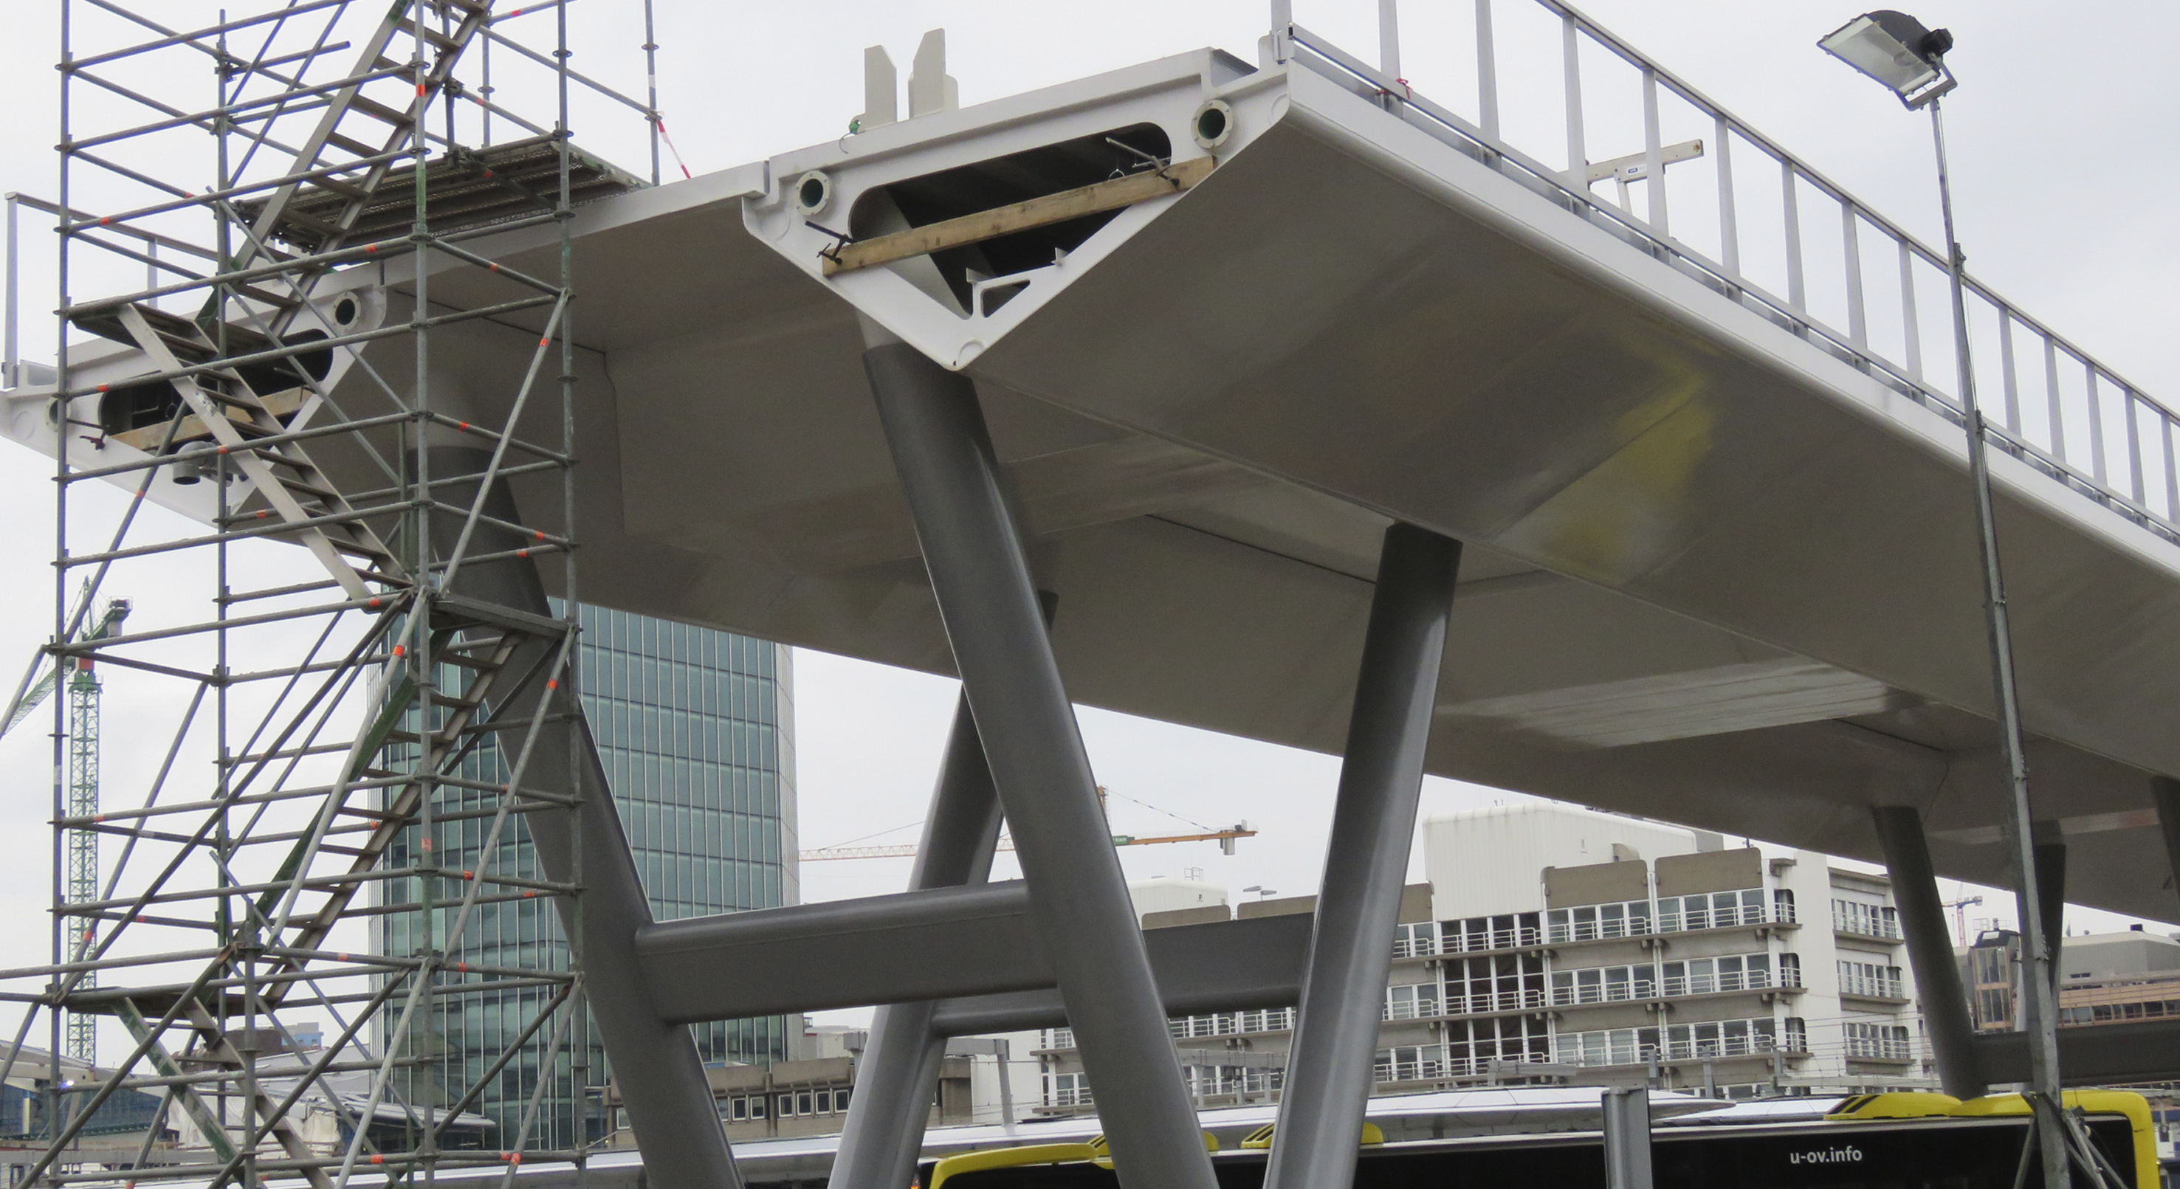

Slide 7
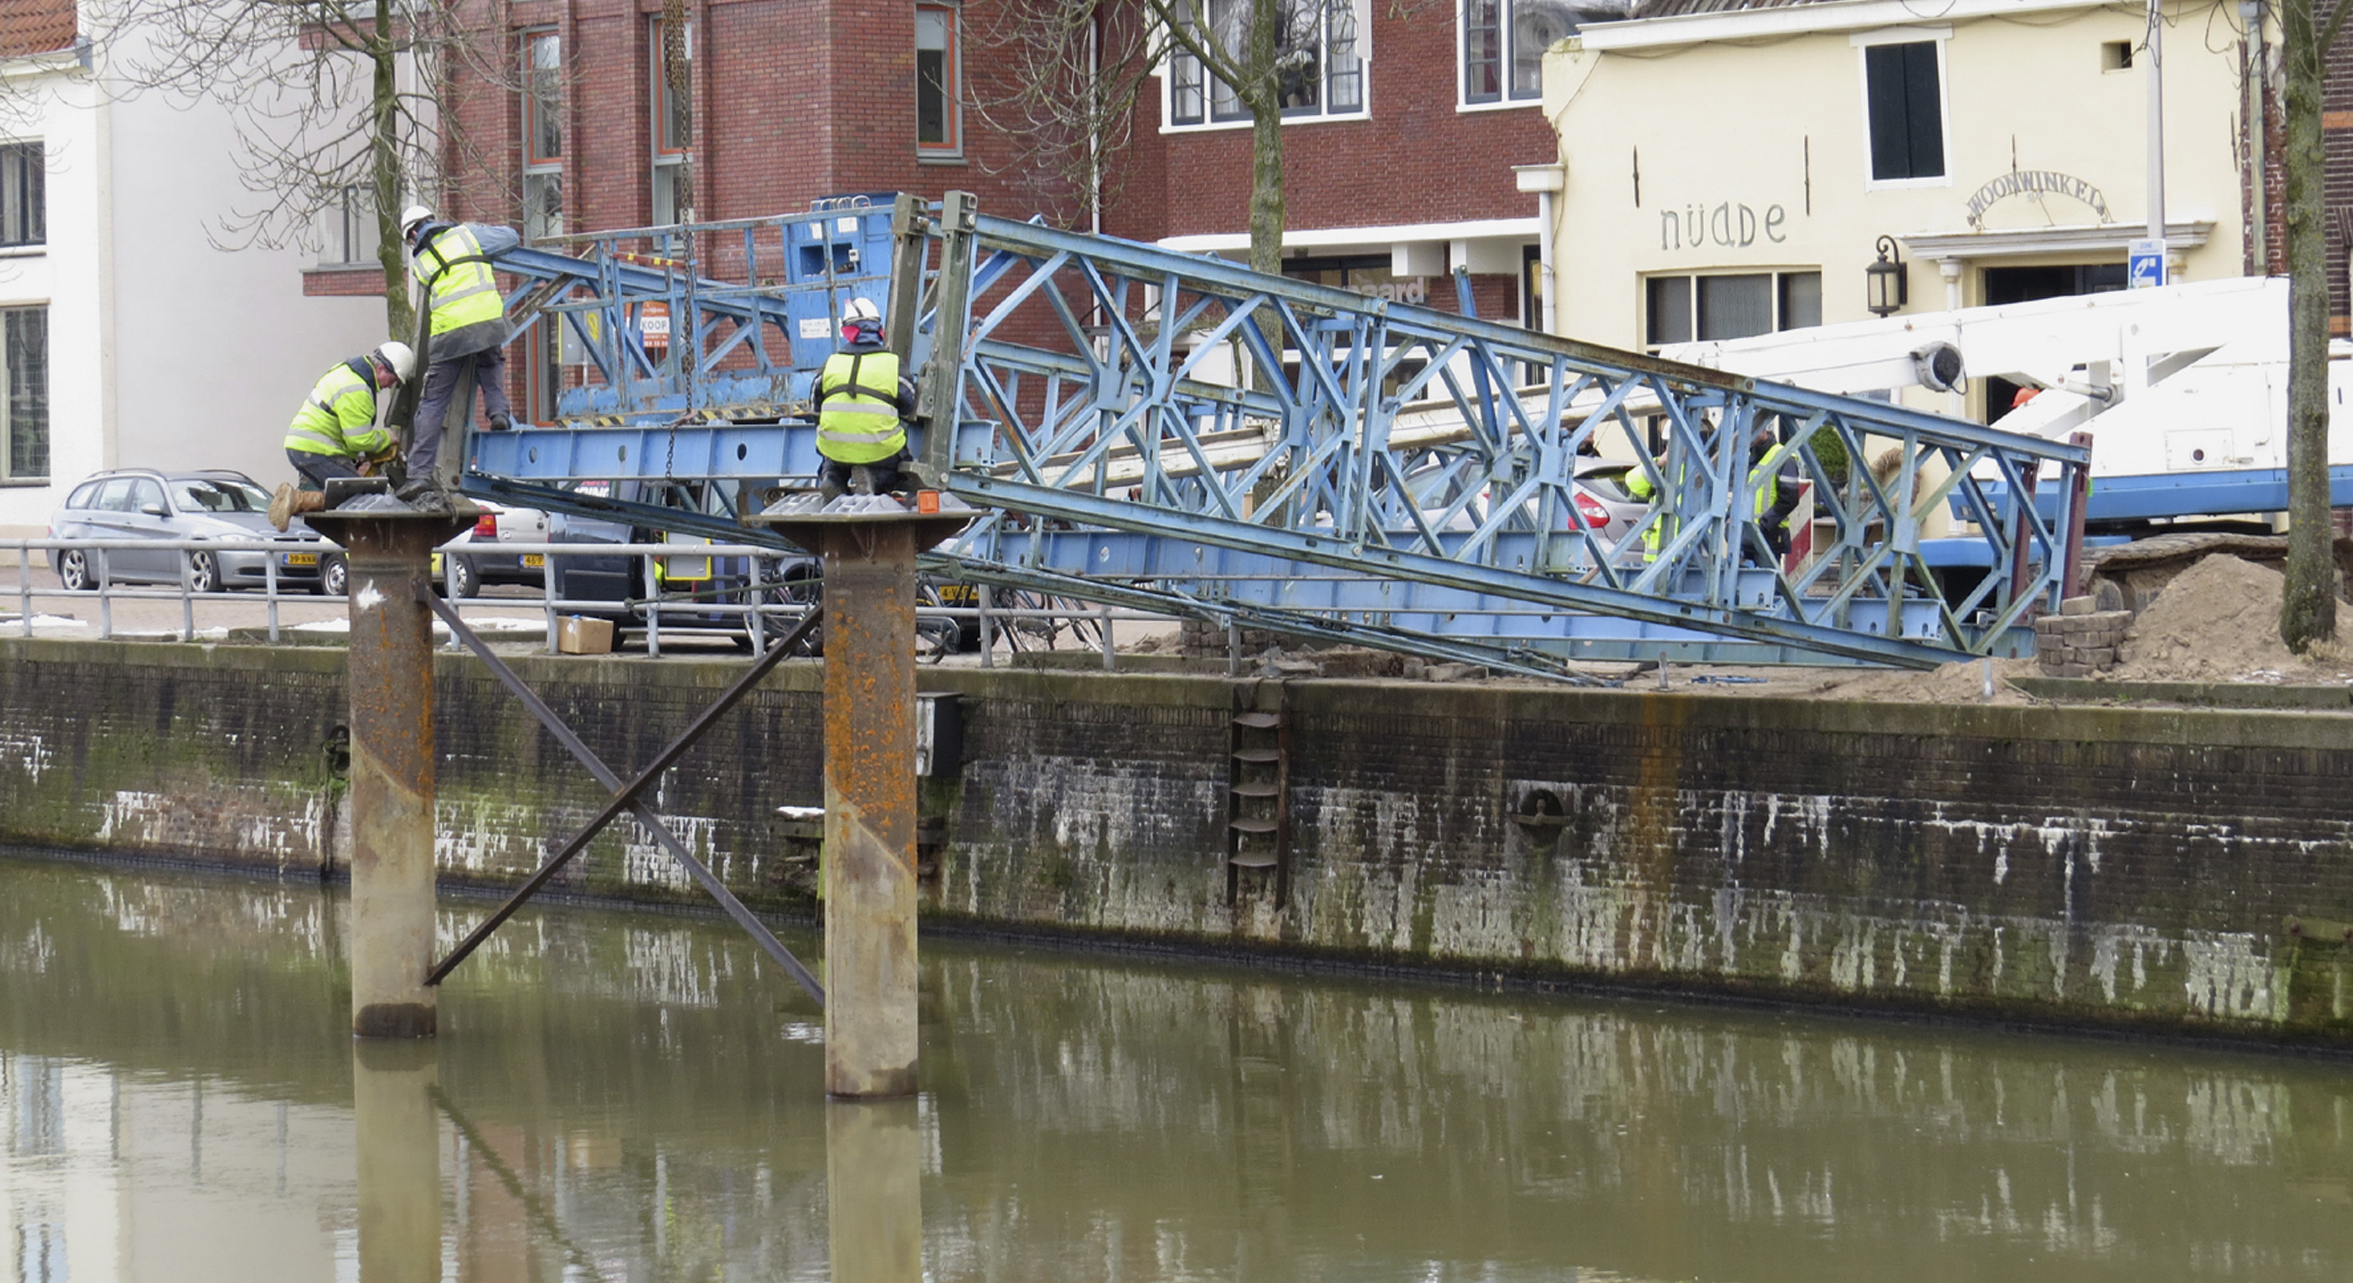

Slide 8
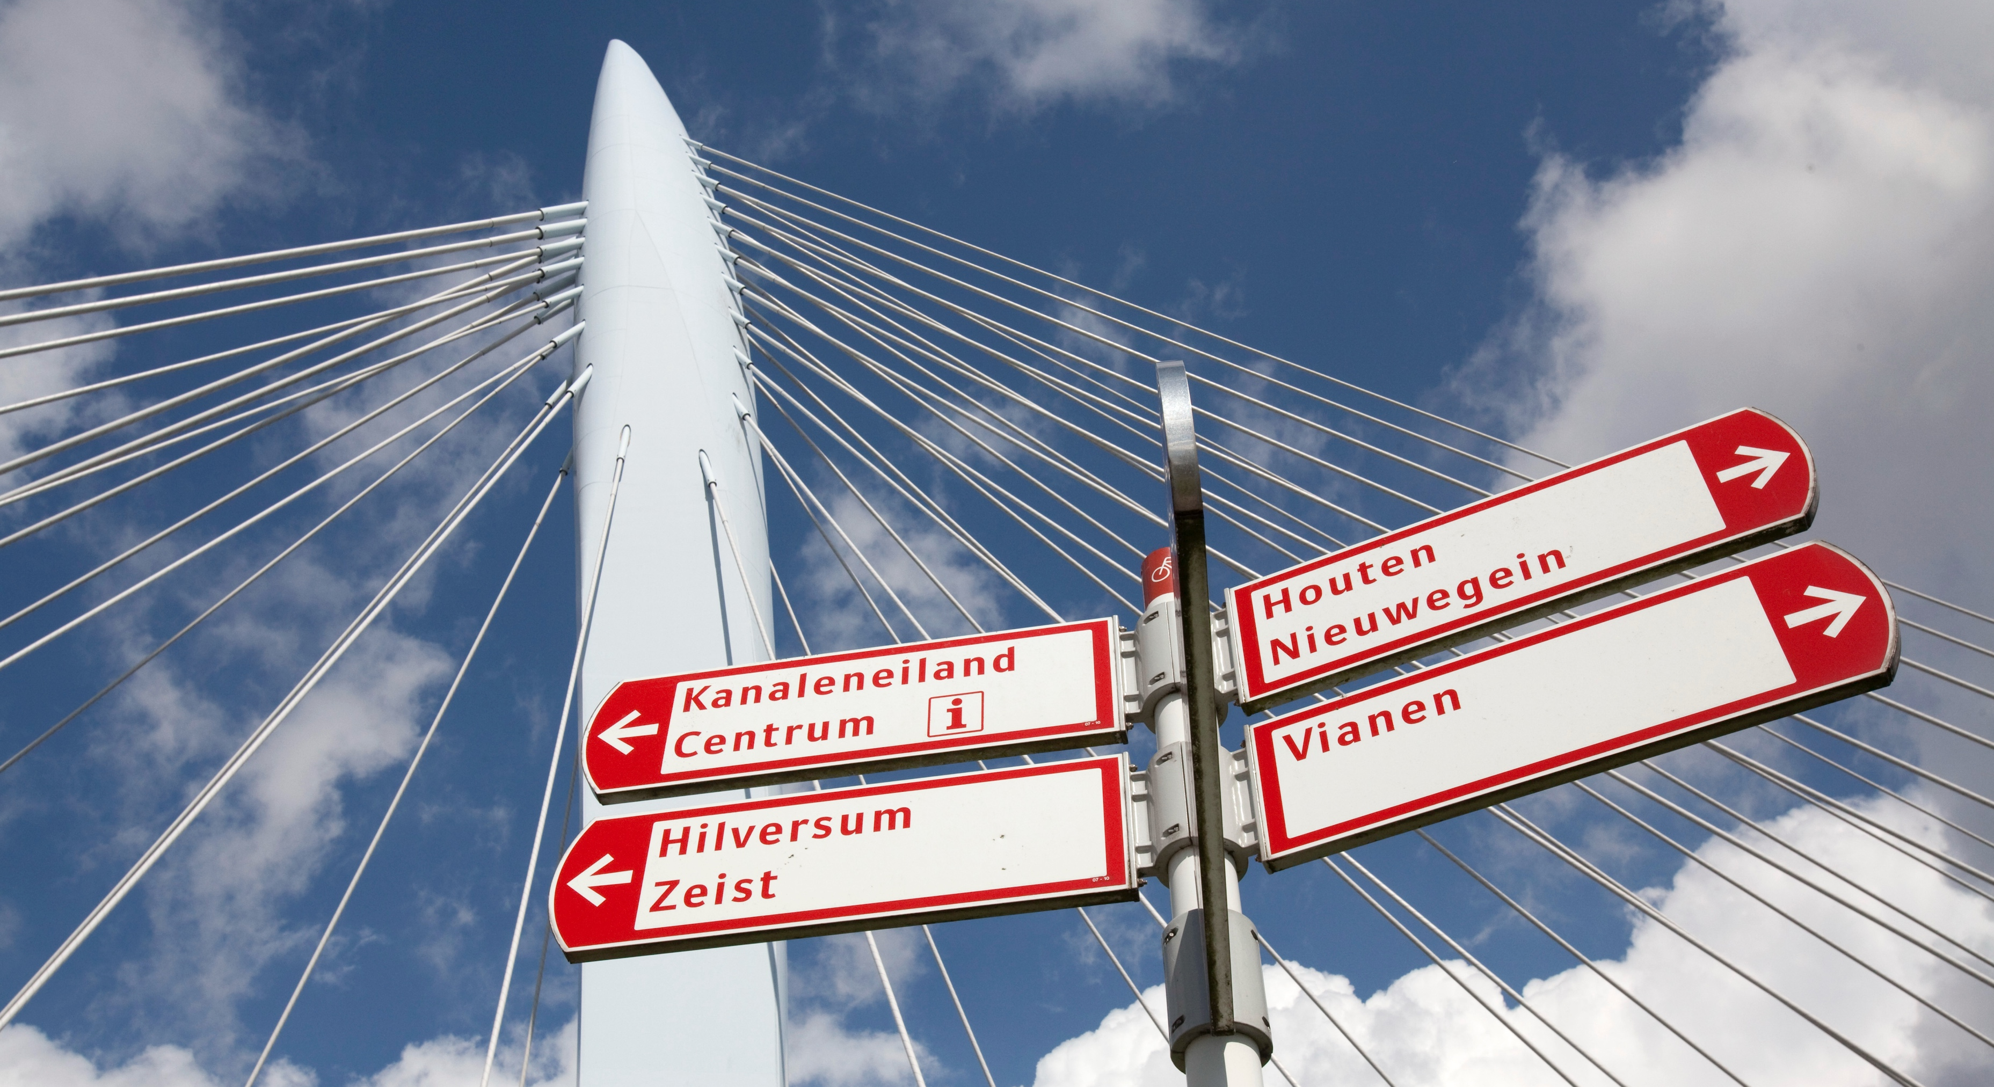
Pictures: Het Utrechts Archief

