Slide 1
Security Days 2026
Alf Moens

Slide 2

Conference Opening
Welcome
GN5-2
Security Days 2026 - facts
CTO workshop – security strategy
Mentorship program- GEM

Slide 3
GN5-2 and beyond: WP8 focus areas (2025 – 2027)
GN4-3 (48 M)
2019 – 2022
160 PM/year
Security Management
Bootcamps
Security baseline
Peer review / audit
The Human Factor
Security.Days
Awareness
Crisis Training/CLAW/TALON
GN5-1 (24 M)
2023 – 2024
170 PM/year
Security Tooling
FoD and NeMo (DDos protection)
eduVPN
Protective DNS
Cyber Threat Intelligence
CTI sharing/Quarterly trend reports threat landscape report
External Feeds / MISP
GN5-2 (30 M)
2025 – 2027
240 PM/year
Research
Securing High Speed Networks
Security Innovation Lab
Incubator
Testbed for security tools
GN5-3 (30 M?)
2027 – 2029?
?? PM/year

Slide 4




Slide 5


Slide 6
CTO Workshops 2025 – Outcome
Strategic Cybersecurity Leadership Themes
Capacity Building
Governance and Compliance
Intelligence Sharing
Security Tooling

Slide 7
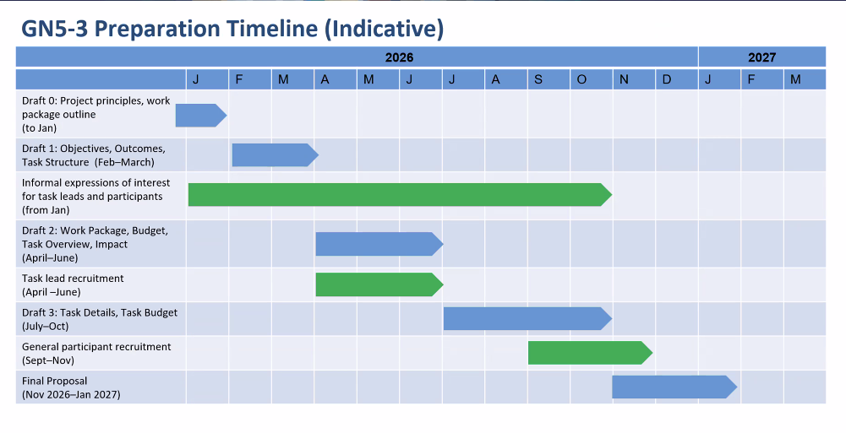


Slide 8
Security Days 2026 statistics
167
Participants
60
Organisations
31
Countries
30
GÉANT members

Slide 9

​
THE GÉANT MENTORING PROGRAMME
Cybersecurity specialists are in high demand!
Join now and make a real impact!
Open to mentors, mentees and peers from the R&E community.
Find out more: https://edu.nl/fhnjt

