Slide 1

Preventative Security –
Blocking at the DNS Level
Arnie Bjorklund
CEO, SecurityZones
AMTSO | 3 October 2023

Slide 2


Threat Intelligence Providers
Leading Independent Security Research Organizations
20+ Years Experience
Key members of internet ecosystems
Providers of IP / Domain Blocklists
AMTSO | 3 October 2023
Notes:
Work with all the leading security technology companies, law enforcement, etc

Slide 3
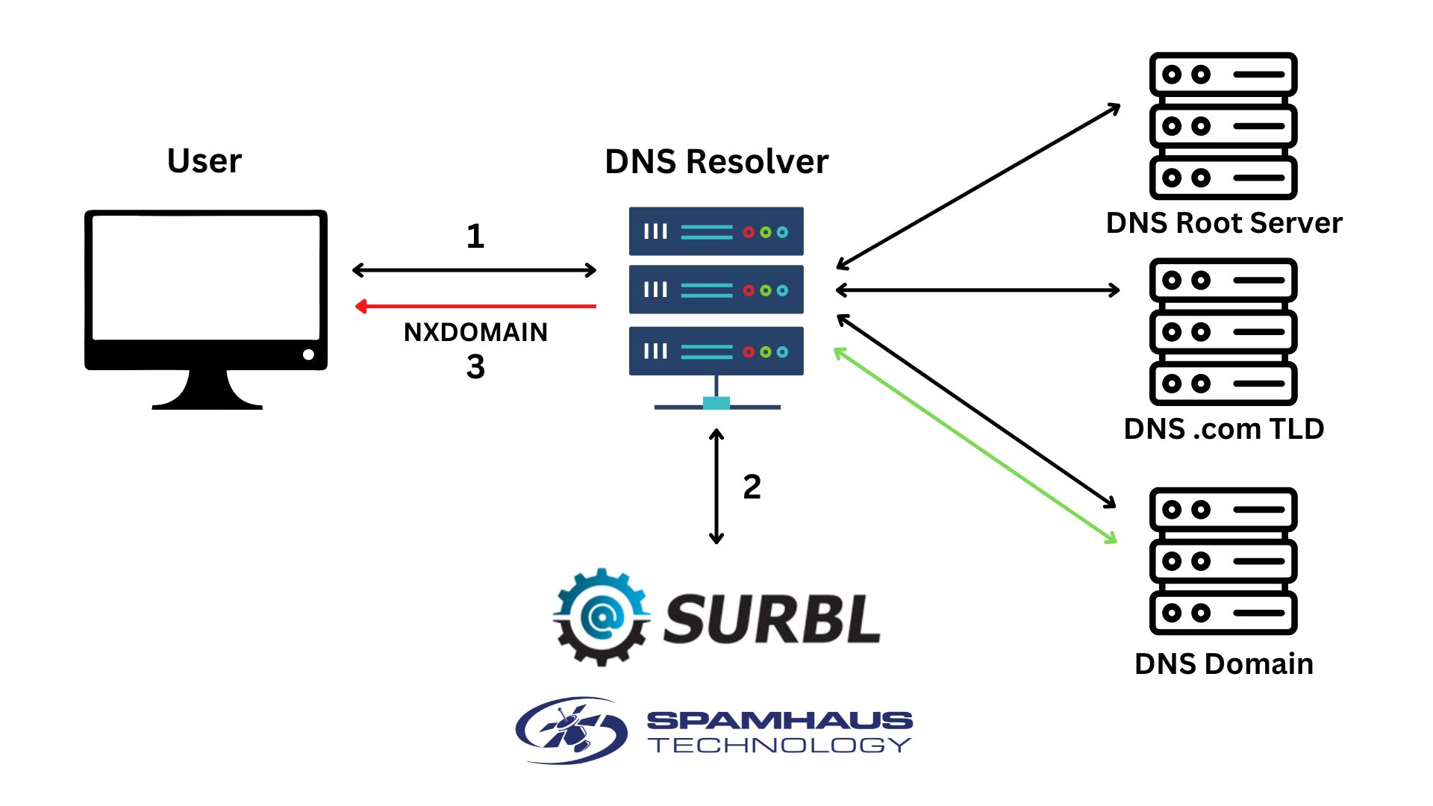
How does DNS Firewall work?
User clicks on a URL link and queries the local DNS resolver;
The DNS resolver checks against the DNS Firewall Threat Feeds;
A) If the domain is listed in one of the data feeds, the resolution of that link is blocked / redirected.
B) If it is not listed, the user can access the link destination.
Notes:
Compatible with BIND, Power DNS and pretty much any DNS appliance that accepts third party data, including Infoblox, Efficient IP, etc
Set and forget technology
- Listings are added and removed every 1-2 minutes, no work needed on your end to keep datasets up to date
Define Policy – if domain is listed, blocked (nxdomain) or walled garden

Slide 4





How the datasets are created
Research techniques
TRACK
Datasets
Machine
Learning
3 million domains assessed & 18,000 malware samples processed every day
Global, comprehensive coverage
Highly dynamic – updated every 1-2 minutes
Highly, accurate & actionable
ANALYSE
13.4 billion SMTP connections analyzed daily
+
SCORE
Manual
Investigations
100’s of heuristics are used to identify the safe from the potentially malicious
LIST
12 million botnet nodes listed daily
Heuristics
PROTECT
Data
Partnerships
3 billion+ mailboxes are protected globally
Notes:
Spamhaus was dealing with ‘big data’ before ‘big-data’ became the buzzword we know it as today.
The industry and beyond shares data with Spamhaus, from hosting companies to Internet Service Providers (ISPs) and internet governing bodies. Of course, in addition to this Spamhaus runs its own spam traps and honeypots.
Through manual investigations, machine learning, and heuristics, the Spamhaus researchers analyze this data to make listings. The listings are not subjective, but based on policies, carefully defined over years with the wider industry.
This approach means that in a single day, Spamhaus can process:
3 million domains assessed
18,000 malware samples processed
9 billion SMTP connections analyzed
100’s of heuristics used
12 million botnet nodes
3 billion+ mailboxes protected
All of this tracking, processing, analyzing, scoring and listing provides you with Threat Data that is:
Affordable – you don’t require additional hardware.
Actionable – you are guaranteed to block malicious activity
Carefully researched – you have the experience of a company that has been threat hunting for over 20 years.
Based on well defined policies – There is a low false positive rate

Slide 5
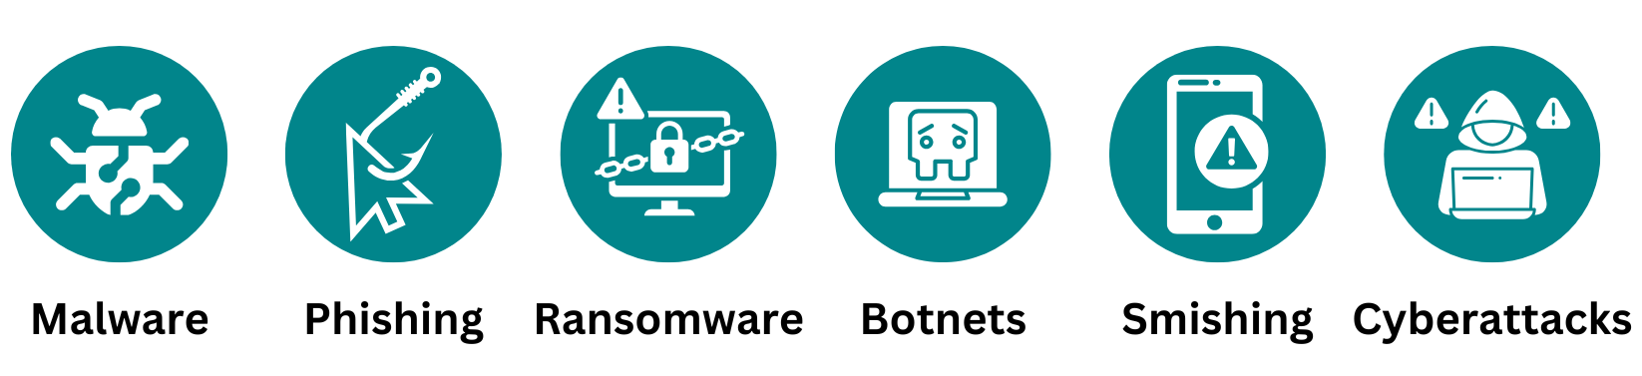
Protects against:
Protects all users, all devices, all applications on the educational network
“Nearly all users use DNS. It is a critical chokepoint to protect users from connecting to ”badness”
These types of criminal activity rely on DNS to access to malicious websites / domains
Block malicious cybercriminal activity, not ethical decisions

Slide 6
Key Trends & Insights
Researchers have seen rises in cyberattacks associated with:
Chinese Phishing / Smishing Gangs
TDS / Parked Domains
Fast Flux Domains
Notes:
Huge uptick in Phishing domains
-

Slide 7

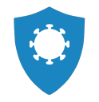
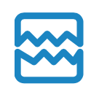



SURBL DNS RPZ DATA FEEDS
MALWARE
CRACKED SITES
Protection against sites that host or are associated with malware.
Cybercriminals steal credentials or abuse vulnerabilities in CMSs, like WordPress or Joomla, to break into websites and add malicious content. Often, cracked pages will redirect to spam sites or to other cracked sites. Cracked sites usually still contain the original legitimate content and may still be used for legitimate purposes.
PHISHING
Protection against phishing sites.
ABUSED SITES
FRESH*
Data feed of general spam sites (pills, counterfeits, dating, etc). Most of domains are found using SURBL internal, proprietary research. Abused sites feed is also supplemented with data from Internet security, anti-abuse, ISP, ESP and other communities.
Cyber criminals cycle through domains in attempt to evade filters. As result, vast majority of new domains engage in malicious activity. SURBL's FRESH data feed identifies newly-registered domains before they can establish their domain reputation.

Slide 8

DNS Firewall Zones | Standard Feeds | Edited Feeds | Hacked Feeds
Bad Reputation Hosts | ✓ | ✓ | ✓
Botnet CC Hosts | ✓ | ✓ | ✓
Botnet Hosts | ✓ | ✓ | ✓
Botnet CC IPs | ✓ |  | ✓
Phishing Hosts | ✓ | ✓ | ✓
Malware Hosts | ✓ | ✓ | ✓
Adware Hosts | ✓ | ✓
Bad Nameserver IPs | ✓
Bad Nameserver Hosts | ✓
Bogons | ✓
Domain Generated Algorithms | ✓
Coinblocker | ✓
Tor Exit Nodes | ✓
Zero Reputation Domains | ✓*
DROP (Do not Route or Peer) | Free

Slide 9
Security Posture Designed for Education Community
Suggested Configurations for NRENs
SURBL Zones
Spamhaus Zones
Phishing
Malware
Cracked
Abuse
Fresh (7 day)
Adware Hosts
Bad Reputation Hosts (Edited)
Botnet Hosts (Edited)
Zero Reputation Domains
Botnet CC Hosts
Malware Sites (Hacked)
Phishing Sites (Hacked)
Malware Hosts
Phishing Hosts
To minimize false positives and maximize protection for end users and network

Slide 10





Proven Success in GEANT Community
Universities worldwide, including:

