Slide 1
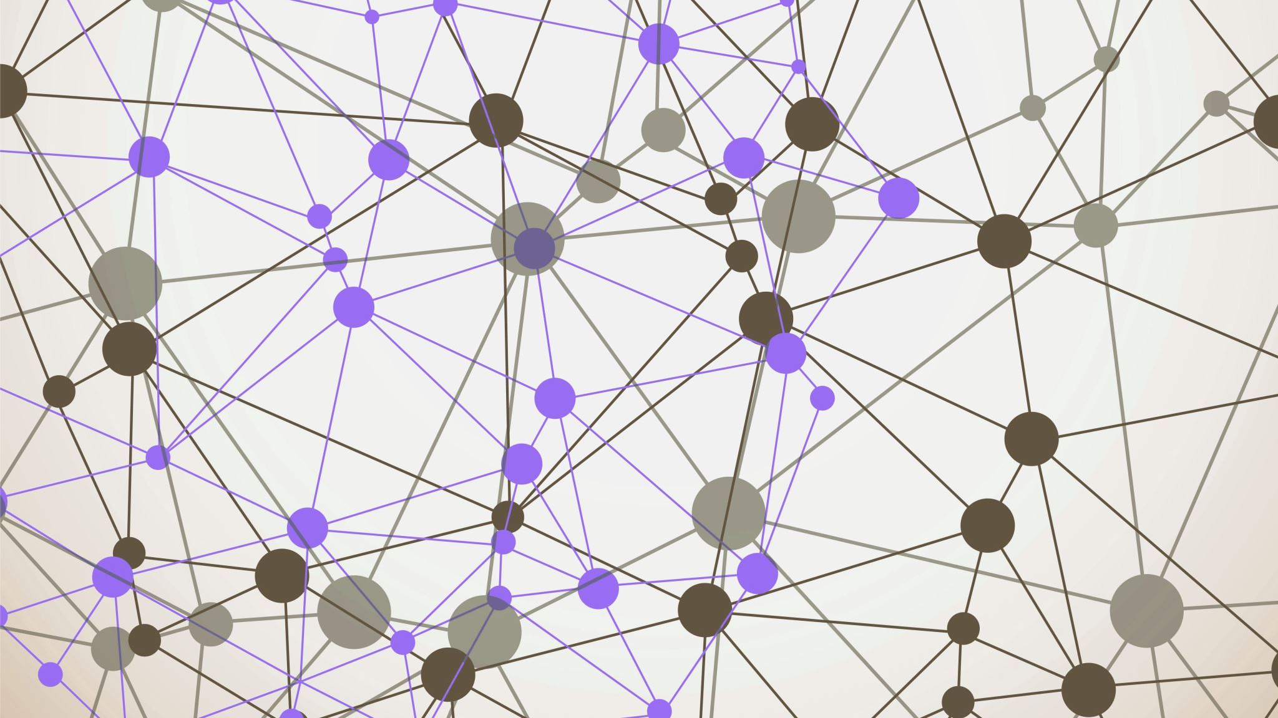
Zero Hour Domain Abuse: Live Signals from Zonestream
Raffaele Sommese – University of Twente
GÉant Security Days 2026

Slide 2
DNS: An ever-changing ecosystem
Domain names are created and removed continuously, every second.
Traditional detection of newly registered domains relies on zone files and passive DNS data.
Zone files are typically published daily, leaving up to 24 hours of blind spots
Passive DNS only captures what is already being used, missing dormant or pre-positioned domains

Slide 3
Zonestream: observing DNS in real-time
In 2023, we investigated this visibility gap in an academic publication [1], showing that using CT logs can shrink the gap to just minutes
We then consolidated these results into a public resource for Internet users and operators
We built Zonestream, a system that enables real-time observation of the DNS
With support from GN5-2-T5 WP, we have further developed and expanded this infrastructure
[1] DarkDNS: Revisiting the Value of Rapid Zone Update - Raffaele Sommese, Gautam Akiwate, Antonia Affinito, Moritz Muller, Mattijs Jonker and kc claffy – IMC 2024 - Madrid

Slide 4
Zonestream: how it works?
We detect newly registered domains (and FQDNs) using multiple signals:
  Zone Files (daily diff)
  Real-time certificate issuance (CT logs)
  IXFR feeds from enabled zones (.se, .ch, .li, .nu)
For each newly observed domain, we perform an RDAP query to verify its existence and registration date
We publish this information as a confidence interval indicating how likely the domain is newly registered!
Data at: zonestream.openintel.nl and kafka.zonestream.openintel.nl

Slide 5
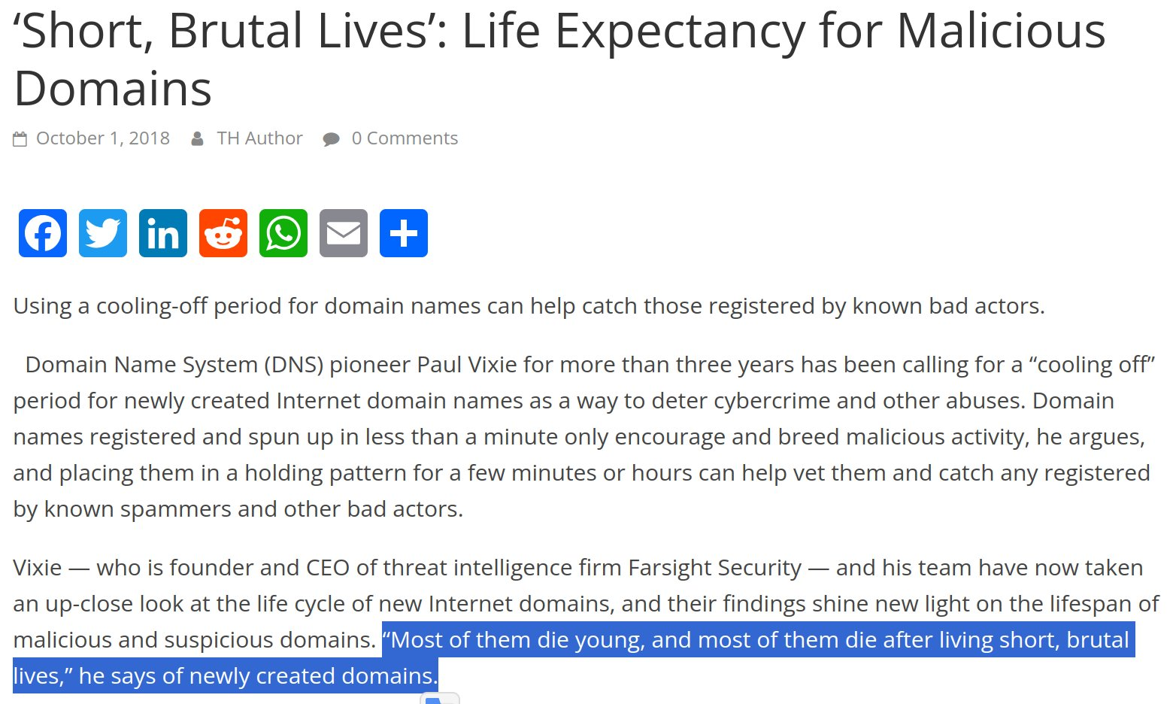
Why care about newly registered domains?

Slide 6
Zonestream: a tool for NREN CERTs?
Identifying newly registered domains enables several use cases:
Protective DNS
  Filter queries during the first 48 hours to prevent users from reaching potentially malicious domains
Detection & Observability
  Trigger alerts on suspicious query patterns toward newly registered domains
Spam Prevention
  Use domain age as a signal for email address trustworthiness
  Already used in production by SURFnet

Slide 7
Zonestream: Just names?
We do not simply collect newly observed domains, we measure them:
  For the first 48 hours of their lifetime, across A / AAAA / NS / MX records
  Tracking infrastructural changes and suspicious patterns
  Making this data openly available to the community
Using these measurements, we identify early-dying domains, which we call transient domains
  Domains that are quickly removed from the DNS, often by registrars or registrants
  They disappear quickly, but not before they can be used
  And despite their short lifetime, they can still pose a security risk after

Slide 8
Zonestream: a Blocklist?
Even after being removed from the DNS, transient domains may persist in caches of recursive resolvers worldwide
Abusers can leverage cache priming techniques to keep these domains reachable
To address this, we detect transient domains in near real time and publish a rolling 24-hour blocklist:
https://blocklist.dacs.utwente.nl/transient-domains
This blocklist is currently deployed by Quad9
Telemetry shows continuous activity on these domains, indicating residual traffic that could still be harmful

Slide 9
What's next?
Early observations show that blocked domains resemble phishing, C&C DGAs, and banking fraud campaigns
These domains exhibit patterns that could be learned in advance, enabling registries and registrars to act proactively
We are developing new methods for early identification based on the measurement data we collect
  Moving from detection to prediction
More results coming soon...

Slide 10
Can I use Zonestream data in production?
Yes
We operate on a best-effort basis with an open, fail-safe design
Zonestream is a university-led, non-profit research infrastructure
In the worst case, data may temporarily stop flowing, but no incorrect or misleading data is introduced
Commercial use requires prior agreement

Slide 11
How can you help?
Share your use cases with us
  It helps us improve and keeps the infrastructure relevant
Consider sponsoring the project
  It directly supports sustainability and further development
Contribute telemetry data
  (e.g., queries observed for newly registered or transient domains)
  Helps us improve proactive detection capabilities

Slide 12
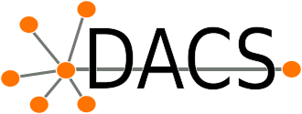

Questions?
Raffaele Sommese
r.sommese@utwente.nl
https://zonestream.openintel.nl
https://kafka.zonestream.openintel.nl
https://blocklist.dacs.utwente.nl/transient-domains

