Slide 1
Onboarding as a Security Process
How new employees are introduced to information security in a welcoming and comprehensive manner.
Fabio Greiner
Géant Security Days 2026, Utrecht
Notes:
Mich vorstellen.
Thema vorstellen.

Slide 2
Introduction

Slide 3
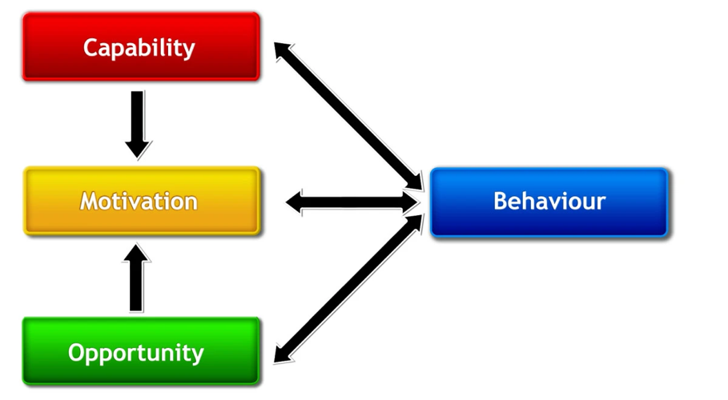
The Art of Behaviour Change: COM-B Model
Michie, S., van Stralen, M.M. & West, R. The behaviour change wheel: A new method for characterising and designing behaviour change interventions. Implementation Sci 6, 42 (2011). https://doi.org/10.1186/1748-5908-6-42
Notes:
An established method for characterising and designing behaviour change interventions
COM-B: capability (the knowledge & skills, digital security skills), opportunity (tools&processes), and motivation

Slide 4
Awareness
-
Raise awareness and interest for a topic
Education & Training
-
(New) skills and the theory behind them
Processes & Tools
-
Enable and support secure behaviour
Notes:
Passwords: most people know that 123456 isn’t the best idea, they’re aware but do they know and understand why? knowledge & digital security skills to use MFA, form a secure password AND the tools, the PW manager?

Slide 5
Processes for Human Centred Security
    Sharing files
    Communicating with externals
    Reception desk & welcoming guests
    Security protocols in phone calls or digital communication
    Reporting processes (incidents, phishing, ...)
    Recruiting
    Onboarding
Notes:
What processes come to your mind that are relevant for Human Centred Security insight an organisation?

Slide 6
Onboarding Process
Notes:
Warum wähle ich den Onboardingprozess?
Betrifft alle
Neue Leute sind wichtig für die Security Kultur
Sie bringen vielleicht Vorwissen oder Annahmen mit, die bei uns nicht stimmen
Sie bringen neue Perspektive in bestehende Teams - im Besten Fall eine neue Security Perspektive
Zukunftsorientiert
Involviert viele wichtige Stakeholder
Wer ist involviert?
Welche Touchpoints?

Slide 7
How can Onboarding Contribute to Information Security?
Adress prior knowledge and assumptions
Can set positive attitude
Future oriented
Involves important stakeholders
Can bring new perspectives into existing teams
Give information security
«a face»
Connect new staff with information security culture

Slide 8
Relevant Topics
    Relevance of information security for organisation
    Specific topics: password policy, rules in the office, rules for mobile working
    Recognising Social Engineering & Phishing
    Incident reporting
    Relevant tools: password manager, VPN
    ISMS and governance
    Relevant contact persons (CISO, ISO, DPO, …)
    Responsibility as employees or leadership role

Slide 9
Goals of the Onboarding Process
People who start at Switch…
💡 …understand the relevance of information security for Switch
❤️ …have a positive attitude towards information security
💪 …learned about relevant skills, rules and guidelines
🔧 …understand how to use relevant tools
🙋 …know who they can contact with questions regarding information security and where to find further information
Notes:
Warum wähle ich den Onboardingprozess?
Betrifft alle
Neue Leute sind wichtig für die Security Kultur
Sie bringen vielleicht Vorwissen oder Annahmen mit, die bei uns nicht stimmen
Sie bringen neue Perspektive in bestehende Teams - im Besten Fall eine neue Security Perspektive
Zukunftsorientiert
Involviert viele wichtige Stakeholder
Wer ist involviert?
Welche Touchpoints?

Slide 10
Communication Channels

Slide 11
Timetable
Welcome Letter
Welcome Letter
Channel
Welcome letter after contract is signed
Existing
Info: Prepare two important passwords
Planned
Revise password info in welcome letter
Send a password flyer
FIRST DAY OF WORK

Slide 12
Timetable
Welcome Day
Welcome Letter
Channel
Introduction to work device by IT Help Desk
Existing
Password rules and password manager
VPN
Handing out screen protector
Planned
Revise presentation
Add a slide on relevance of information security for Switch
FIRST DAY OF WORK
Welcome Day

Slide 13
Timetable
Intranet Landing Page
Welcome Letter
Newly built topic structure
Passwords
Work devices
Physical security
Data classification
Social engineering
FIRST DAY OF WORK
Welcome Day
Intranet Landing Page
Notes:
At this point, you also build a connection between the hiring team leads and information security

Slide 14
Timetable
Onboarding Training
Welcome Letter
Channel
Mandatory onboarding meeting series
Existing
Presentation on: Relevance of InfoSec, VPN, Passwords, Social Engineering, Working Devices, Physical Security
Escape Room to create positive attitude
Planned
Completely revise presentation to match exisiting topic structure in intranet
FIRST DAY OF WORK
Welcome Day
Onboarding Training +
Escape Room
Intranet Landing Page
Notes:
At this point, you also build a connection between the hiring team leads and information security

Slide 15
Timetable
Onboarding in the Team
Welcome Letter
Channel
Onboarding checklist for supervisors
Existing
Bullet point on “Security Policy“
Planned
Revise checklist
Create extensive guide for managers (hiring and new) which explains responsibilities
Introductory meetings with CISO/ISO/DPO for certain roles
FIRST DAY OF WORK
Welcome Day
Onboarding Training +
Escape Room
Onboarding in the Team
Intranet Landing Page
Notes:
At this point, you also build a connection between the hiring team leads and information security

Slide 16
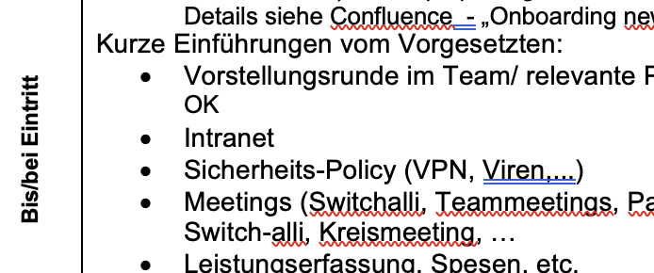
Timetable
Onboarding in the Team
Welcome Letter
Channel
Onboarding checklist for supervisors
Existing
Password rules and password manager
VPN
Handing out screen protector
Planned
Revise presentation
Add a slide on relevance of information security for Switch
FIRST DAY OF WORK
Welcome Day
Onboarding in the Team

Slide 17
Timetable
E-Learning
Welcome Letter
Channel
E-Learning platform from SoSafe
Existing
Modules on all relevant topics
Planned Wish 🦄
Custom/in-house created modules that correspond to existing tools and processes and match topic structure
FIRST DAY OF WORK
Welcome Day
Onboarding Training +
Escape Room
Onboarding in the Team
E-Learning
Intranet Landing Page
Notes:
At this point, you also build a connection between the hiring team leads and information security

Slide 18
Take Home 🏡

Slide 19
Take Home
Tools & processes are an integral part of Human Centred Security.
The onboarding process can contribute to information security culture and behaviour change.
Working on it gets you in contact with important stakeholders.
💡
Formulate learning objectives for new staff.
Map existing communication events and channels in a timeline.
Check if your timeline is aligned with learning objectives.
Plan improvements and collaborate with relevant stakeholders.
🚀
Notes:
Warum wähle ich den Onboardingprozess?
Betrifft alle
Neue Leute sind wichtig für die Security Kultur
Sie bringen vielleicht Vorwissen oder Annahmen mit, die bei uns nicht stimmen
Sie bringen neue Perspektive in bestehende Teams - im Besten Fall eine neue Security Perspektive
Zukunftsorientiert
Involviert viele wichtige Stakeholder
Wer ist involviert?
Welche Touchpoints?

