Slide 1

Building a cybersecurity capability from scratch in Academia
Łukasz Faber

Slide 2
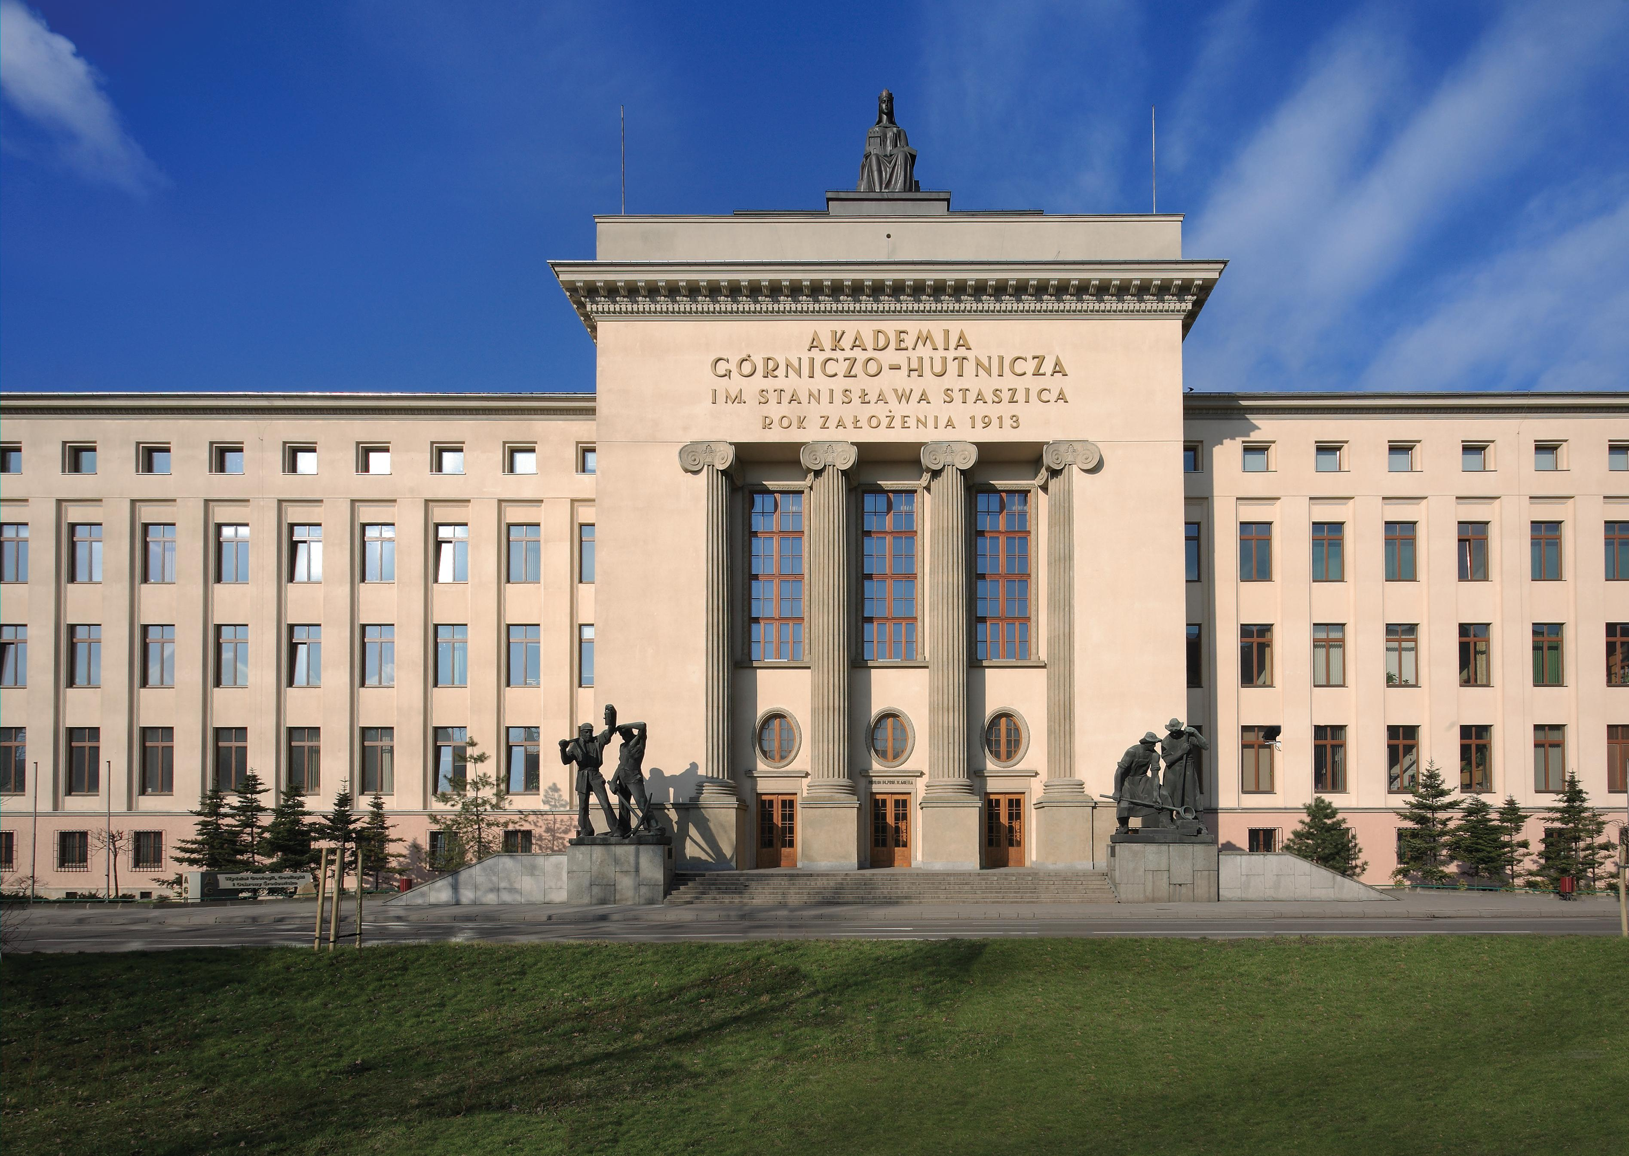
AGH University of Krakow
Technical university
Over 100 years
18 faculties (like small companies)
Countless administrative departments
Almost 20 000 students and nearly 2000 postgraduate students
Over 4,500 staff members (counting FTE only)

Slide 3
Academia uniqueness
Openness culture
A wide range of stakeholders
Limited (mostly financial) resources
Decentralised management

Slide 4

WAKE UP SAMURAI
WE HAVE A CYBERSECURITY
CAPABILITY TO BUILD

Slide 5
We started with…
Good but “opinionated” IT
No separate security function
Scattered monitoring
Scattered responsibilities
Scattered ownership
Local information security administrators
No awareness building
Risk management… having issues
Lack of understanding of what is needed for security processes to function

Slide 6
Then we set goals…
A more ‘state-of-the-art’ approach to security
A team covering all practices comprehensively
A shift in the way information security is managed
A strong link to academic research
Providing external services

Slide 7
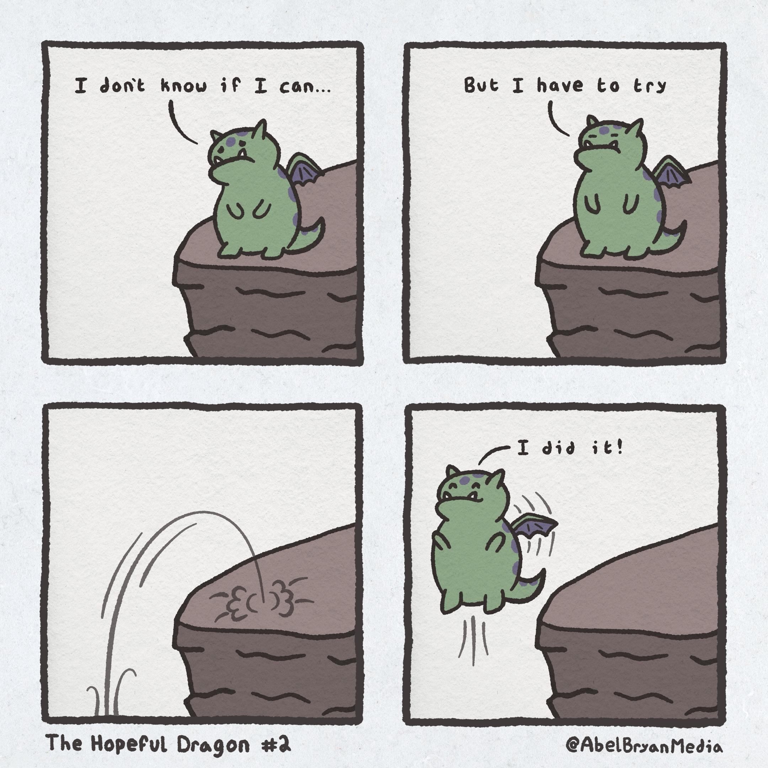
Then we made a plan and started working…
Two people at the beginning
And a hopeful timeline of one year

Slide 8
And then…
Management support
IT happy that they can do less
Budget for everything
Changes welcome and easily introduced

Slide 9


Slide 10
In reality…
Management does not even remember you
IT hides incidents from you
You can buy anything if you find money outside
You can deploy anything as long as it won’t be doing anything
And no one even understands why you are needed

Slide 11
Timeline
Specialized Cybersecurity Monitoring Unit
Centre for Information Security
Centre for Information Security
2021
IT Sector
2024
IT Sector
Security and Defence Sector
2025
And in 2026 we are large enough to develop an internal structure…
Notes:
Change to Centre is important – more independence.

Slide 12
And now some insights…

Slide 13
Hiring
People from outside, not internal recruitment
Broad and wide knowledge especially for the first employees
Students are ok, but ethics and conflict of interest issues arise
For SOC, we went with untiered model
We've made some mistakes, but in general most of our choices were great

Slide 14
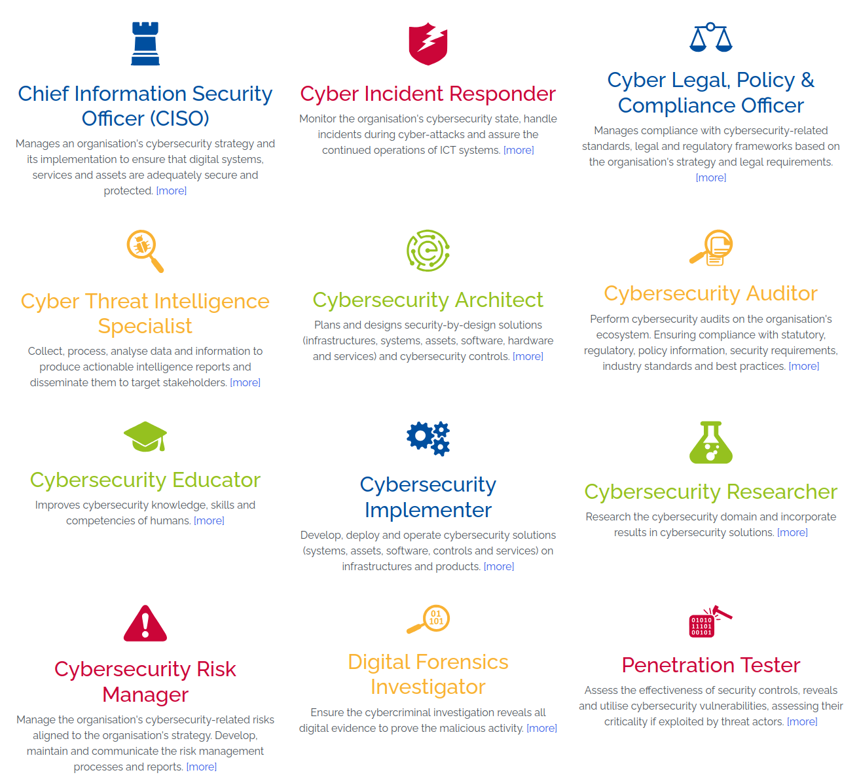
Team development
We match our team to European Cybersecurity Skills Framework
  https://mta-sts.enisa.europa.eu/ECSF/
Whole SOC Staff went through BTL2 and a basic forensic training
CTFs and similar are encouraged
Freedom to participate in responsibilities and projects outside normal scope

Slide 15
Some of our tools & resources
SIEM – initially went with well-known American brand, now evaluating national and open-source solutions
Surface management – Nessus, Shodan, moje.cert.pl
Vulnerability management – Nessus, DefectDojo
CTI – ShadowServer, Connect2Trust

Slide 16
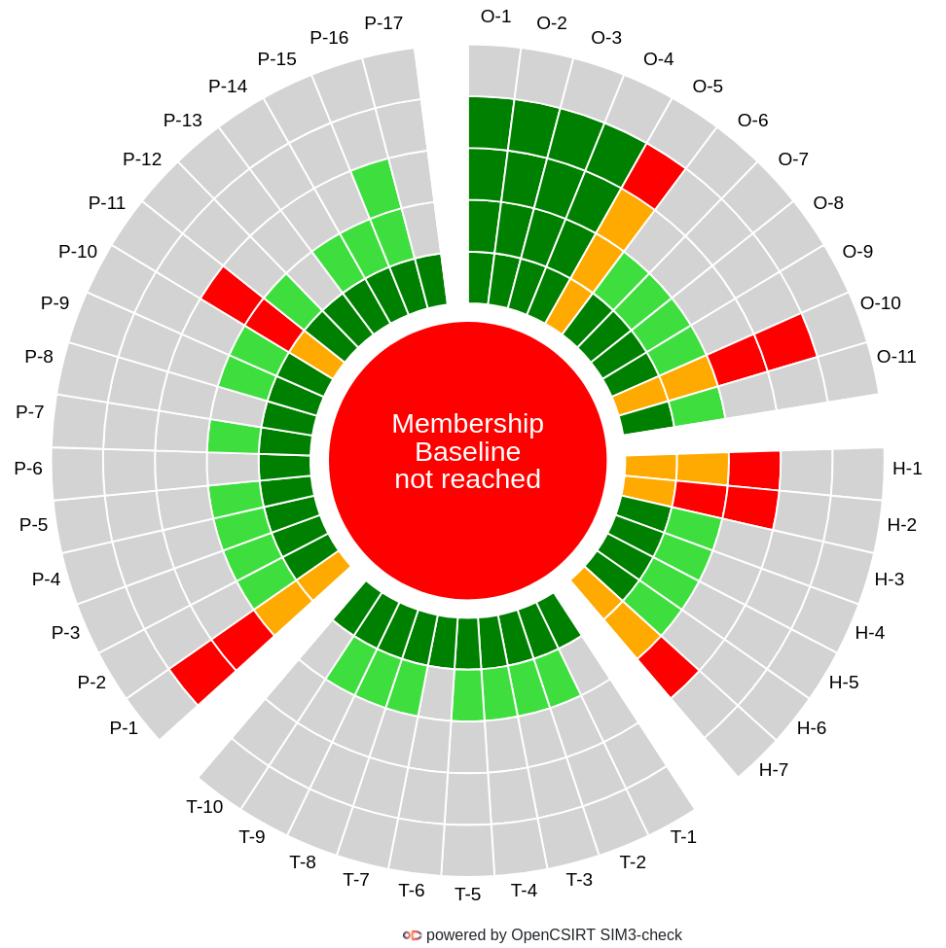
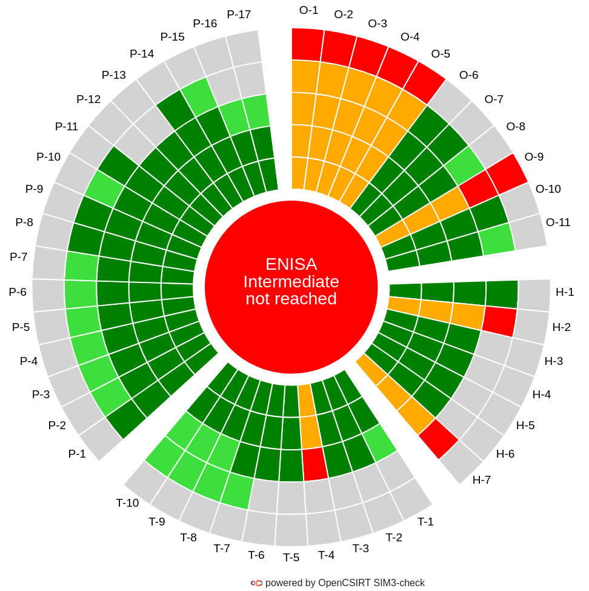
SOC Maturity
Starting point
18 months
Notes:
We

Slide 17
Incidents in 2025

Slide 18
Awareness training
First ever cybersecurity awareness trainings for employees and students
„Cyber-secure work at AGH!”
  Real fundamentals of IT and data security
  Authentication
  Remote work
  Phishing & malware
  Incident reporting
43% of faculty and staff finished the first (voluntary) edition
Phishing campaigns

Slide 19
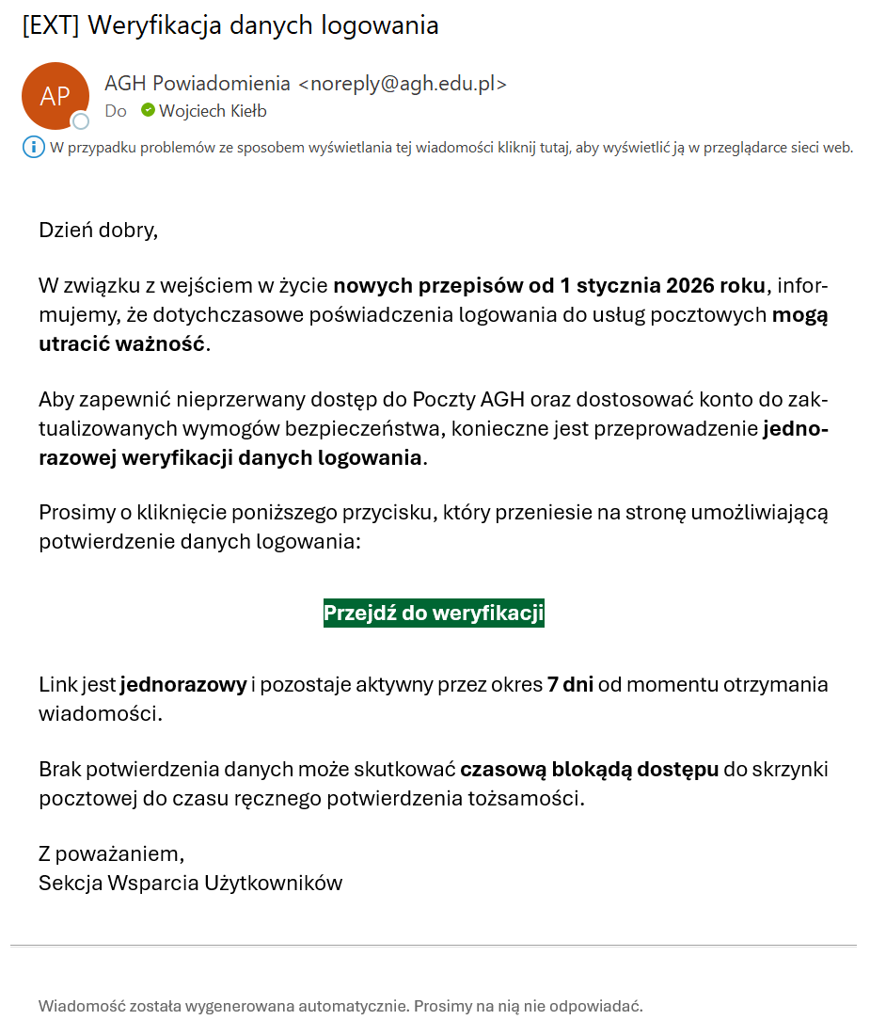
First ever phishing campaign
Notes:
The second one was smaller – only random 500 users.
We got scolded for including pensioners.

Slide 20
Application security
AGH produces a lot of internal and external software
How to convince developement teams that they need SSDLC?
Legwork, presentations
In 2025 alone, 17 applications were tested
  Including these bought from external provider

Slide 21
Biggest challenges (up to today)
Cooperation with central IT
Reworking risk-management
Working without backing policies
Navigating internal politics
Integration of security into processes (like vendor management)
Underestimation of time needed for changes in Academia

Slide 22
Why just not outsource?
Universities are quite unique
Everyone sells „NIS 2 ultimate solver” nowadays which gives false sense of security
It would be easier, but no value for the academia mission

Slide 23
What was important?
SOCCER project
ECSO membership
  https://ecs-org.eu/
Very good cooperation with some key players: DPO, Rector’s office
Great team

Slide 24


About the SOCCER project
SOCCER – Security Operation Centre in Central-Eastern Europe Region
  https://soccer.agh.edu.pl/
Main objectives of the project:
  Supporting the creation of SOCs or readiness to have them in participating universities
  Creating the SOC4Academia Toolbox (instructions on how to create SOC in Academia)
  Creating a threat intelligence sharing ecosystem (CTI) for the academic community

Slide 25
What don't we have?
24/7 SOC – only regular working hours
Widespread monitoring in faculties – requires more resources and some coercion
Integrated physical security – a siloed responsibility area

Slide 26
Where are we standing?
Over 20 employees in the security capability alone
  SOC, AppSec, Pentesting, GRC, Training and awareness
Just days before new ISMS
Helping other universities (as NIS 2 implementation in Poland included universities as a essential/important sector)
7 DEP and Horizon grant applications with strong consortia

Slide 27
What was important?
You cannot just act as a service provider but as a partner in research actions
You need sympathetic and forgiving staff
People-oriented approach: valuing individuals, fostering teamwork, and prioritizing team building

Slide 28

Biggest challenges in future?
Being noticed by management
Balancing tight budgets with big cybersecurity ambitions
Keeping up with IT updates before they update us first
Chasing cyber threats faster than students find new ways to break the rules
Turning alerts into actions before coffee runs out
Running a university SOC... and staying sane

Slide 29
Thank you!
faber@agh.edu.pl https://www.linkedin.com/in/faberlukasz/

