Slide 1

Prevention, Detection, Reponse & Deception?
On Canaries, horses and honey
Floris Dankaart-Chang
Lead Product Manager Fox-IT/NCC Group
Commercial.Public

Slide 2

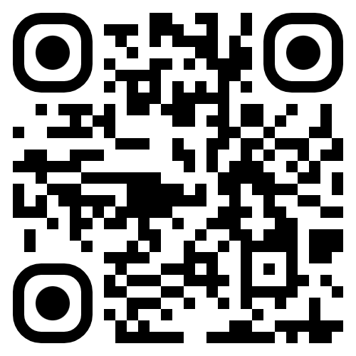
First, a poll

Slide 3
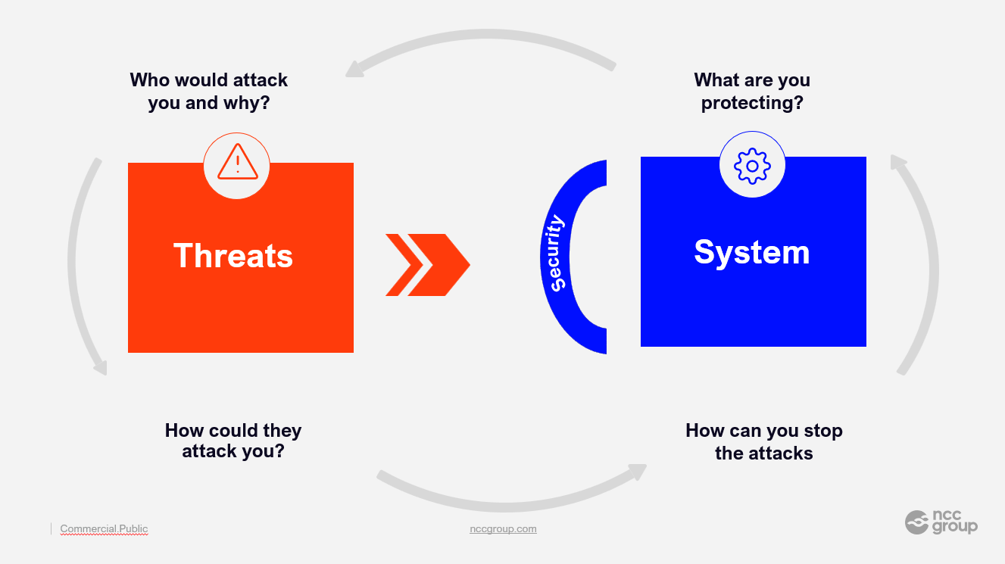

Slide 4
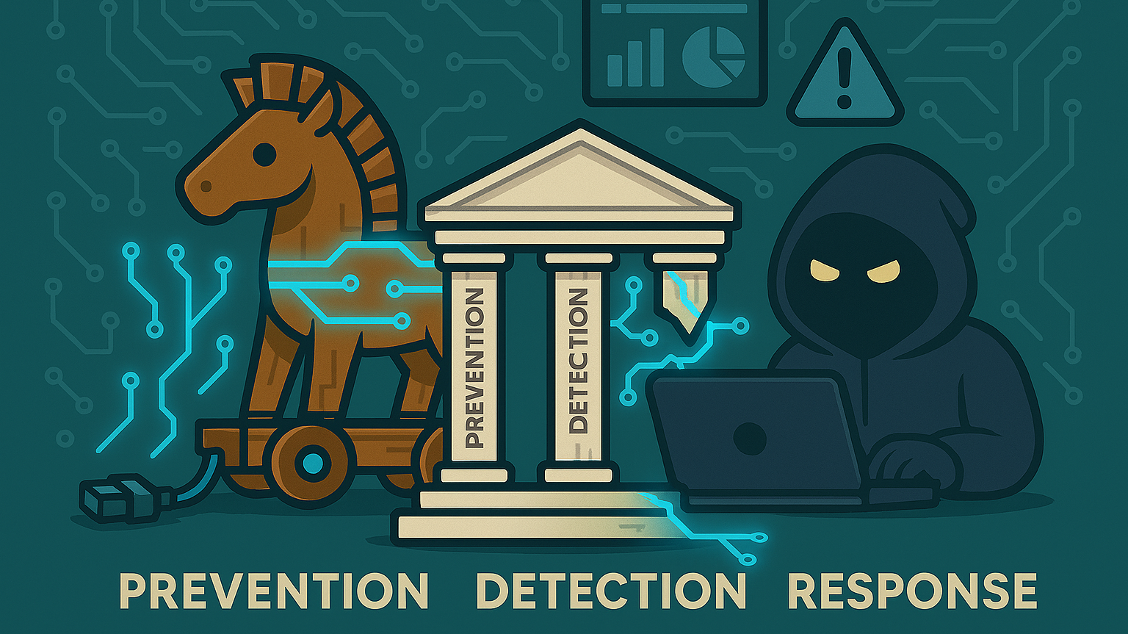

Slide 5

Beware of Greeks bearing gifts..
Or how attackers leverage deception
ASYNCing Feeling: When Your Download Comes with Something Extra | NCC Group

Slide 6
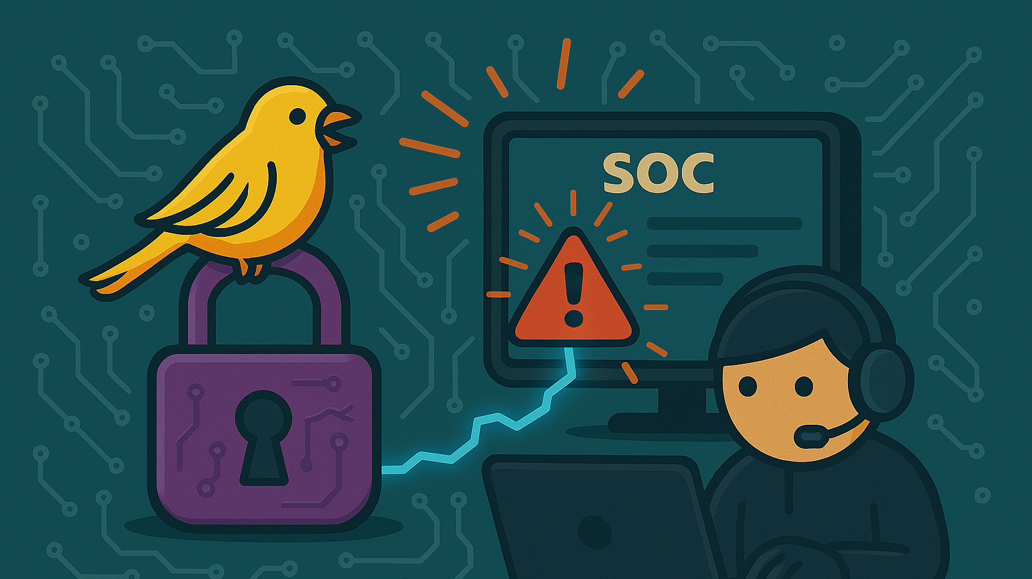

Slide 7
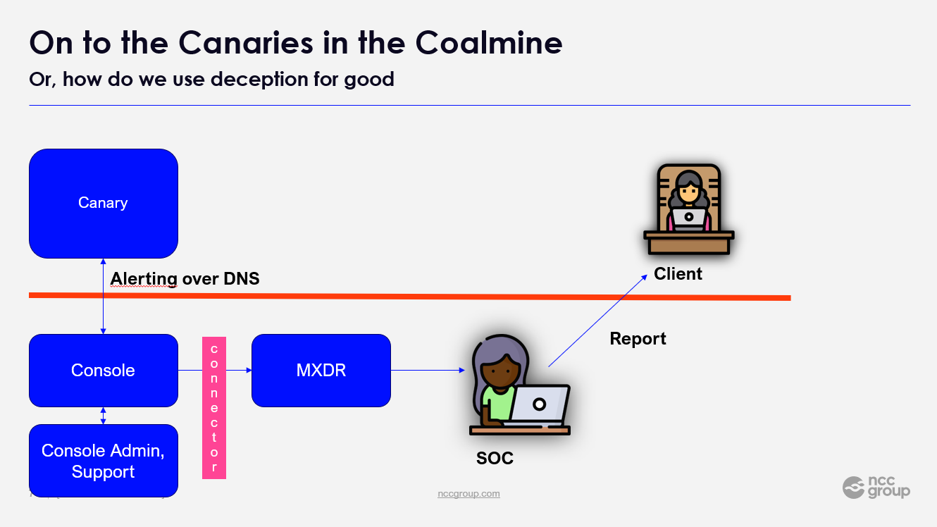

Slide 8
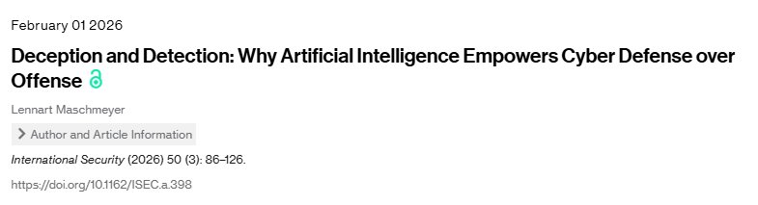
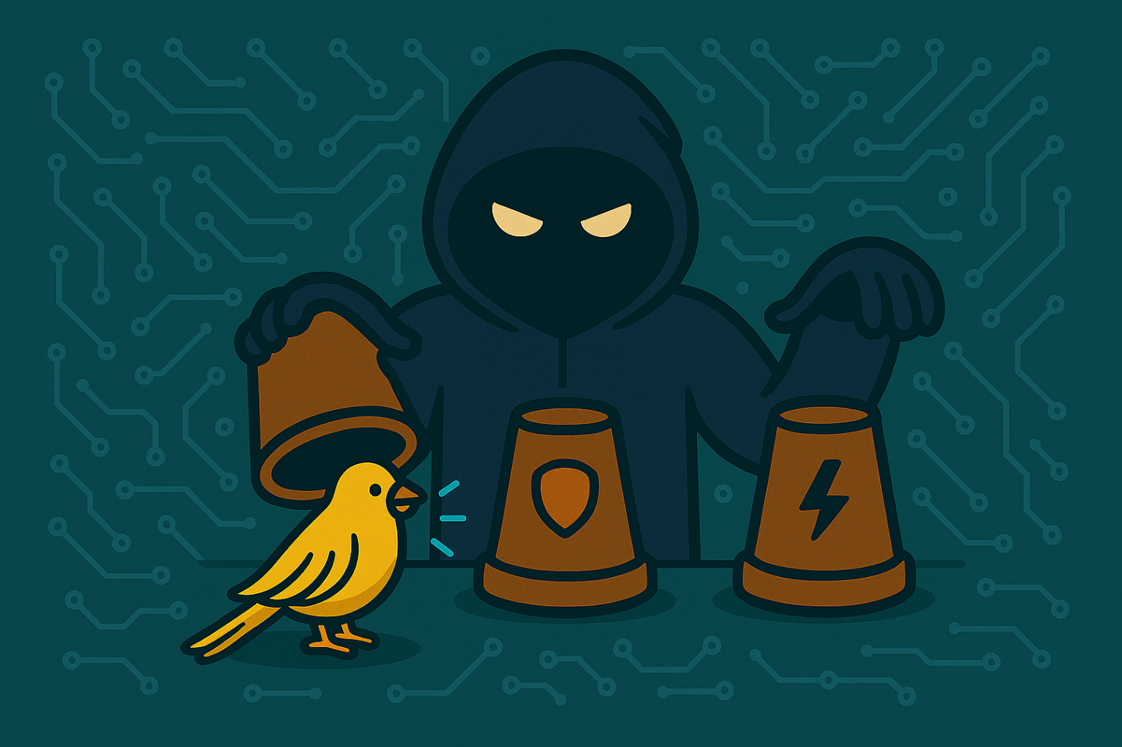
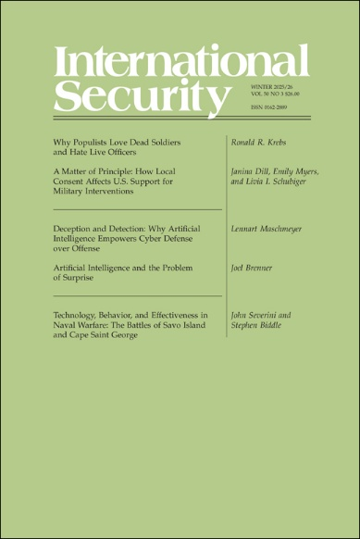
Is this not, literally, ancient technology?
The statement on AI
AI

Slide 9
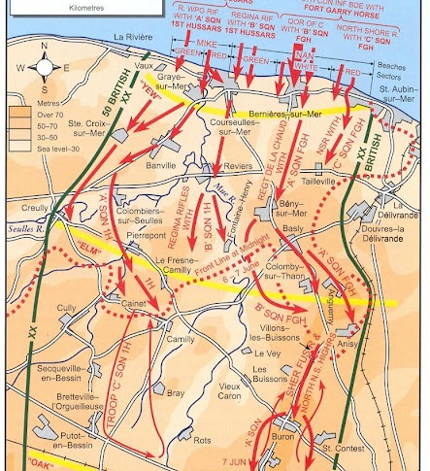
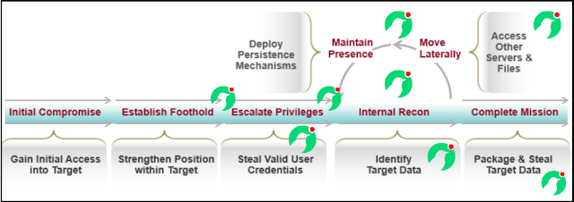
How do you employ this in a modern stack?
Not on it’s own!
Correlate Canary alerts with SIEM, EDR, NDR, EASM alerts
Canaries are stronger together!
Source: ThinkST Canary

Slide 10
Two education use cases
Use Case #1:
The research university and the sensitive data
Scenario: sensitive (perhaps dual-use) research data, which should be accessible by researchers (e.g. visiting PhD candidates) but should not be copied, or deleted.
Benefit: Helps in detecting malicious activities by insiders who may have legitimate access but nefarious intentions.
Use Case #2:
The early-warning system
Scenario: Use Canary Tokens to monitor web scraping of organization websites with the aim of setting up a fake website and forms.
Benefit: Early warning of website spoofing attempts, allow for takedown efforts and warning users.

Slide 11
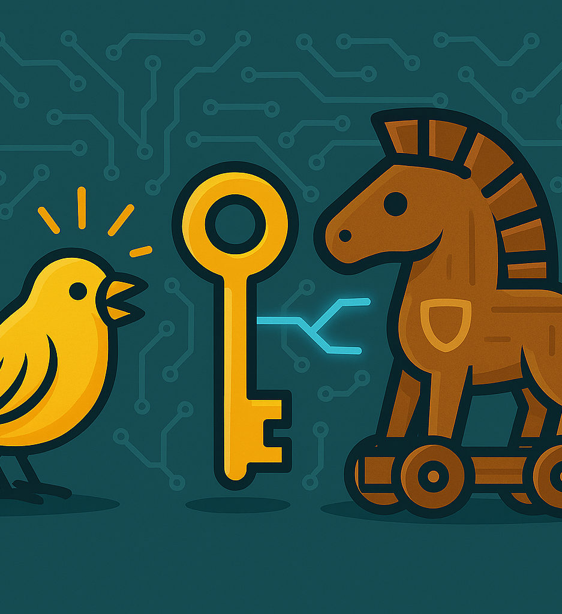
Key Message
Make sure deception is harnessed for good in your organization!
Decrease MTTD
Effective against insider threats
High true positive %
Insight in TTPs
Waste attacker time and resources

Slide 12
Thank you.
Together we're creating a more secure digital future
© 2025 NCC Group. All rights reserved.
Please see www.nccgroup.com for further details. No reproduction is permitted in whole or part without written permission of NCC Group.
This content is for general purposes only and should not be used as a substitute for consultation with professional advisors.

