Slide 1
RAG-Powered
SOC Assistant
Nicolò Thei

Slide 2


Who am I
Dr. Nicolò Thei
Cybersecurity Researcher
University of Parma - Italy
Focus Topics:
SIEM Systems
Security Operations
AI/ML Detection
Notes:
From zero knowledge
And now I’ll be talking about the issues I faced once I began working inside the University…

Slide 3
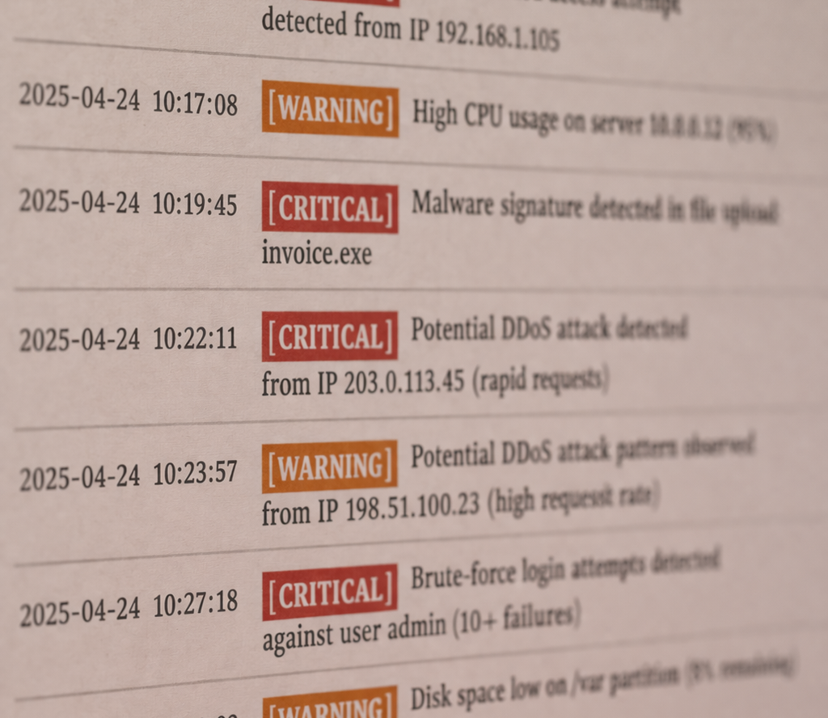
General Issues
Too many logs
  From different platforms
Too many alerts
  Lack of contextual understanding
High MTTD and MTTR
  High manual investigation process
Notes:
Firewalls, endpoints, cloud platforms everything generates logs.
The problem is that more data does not necessarily mean more visibility.
Analysts are overwhelmed by alerts, often lacking the context needed to understand what is really happening.
This leads to high Mean Time To Detect and Mean Time To Respond.

Slide 4

Specific Issues
Limited budget
  Long purchase timelines (12+ months)
Small to no security team
  Team separation
  Permission barrier
Heterogeneous systems
  Legacy-heavy
Need for automation
Notes:
The project was developed in a university environment, where constraints are very real.
There is no budget for enterprise grade SIEM solutions, the security team is small, and the infrastructure is highly heterogeneous.
This means different log formats, different technologies, and no centralized visibility by default.
Automation becomes essential, not optional.

Slide 5



Project’s High-Level Architecture
High Volume of Data
Centralized Platform
Attack Detection
Notes:
This is the high-level architecture of the system.
Logs are collected from multiple sources, normalized, and indexed into Elasticsearch.
On top of that, I implemented analytics, detection rules, and visualization layers.
The goal was to create a modular and scalable architecture that could evolve over time.

Slide 6
Project’s High-Level Architecture
High Volume of Data
Objectives:
Operational Efficiency
Reduce Response Time
Regulatory Compliance
Corrective Actions
Anomaly Detection
Centralized Platform
Attack Detection

Slide 7
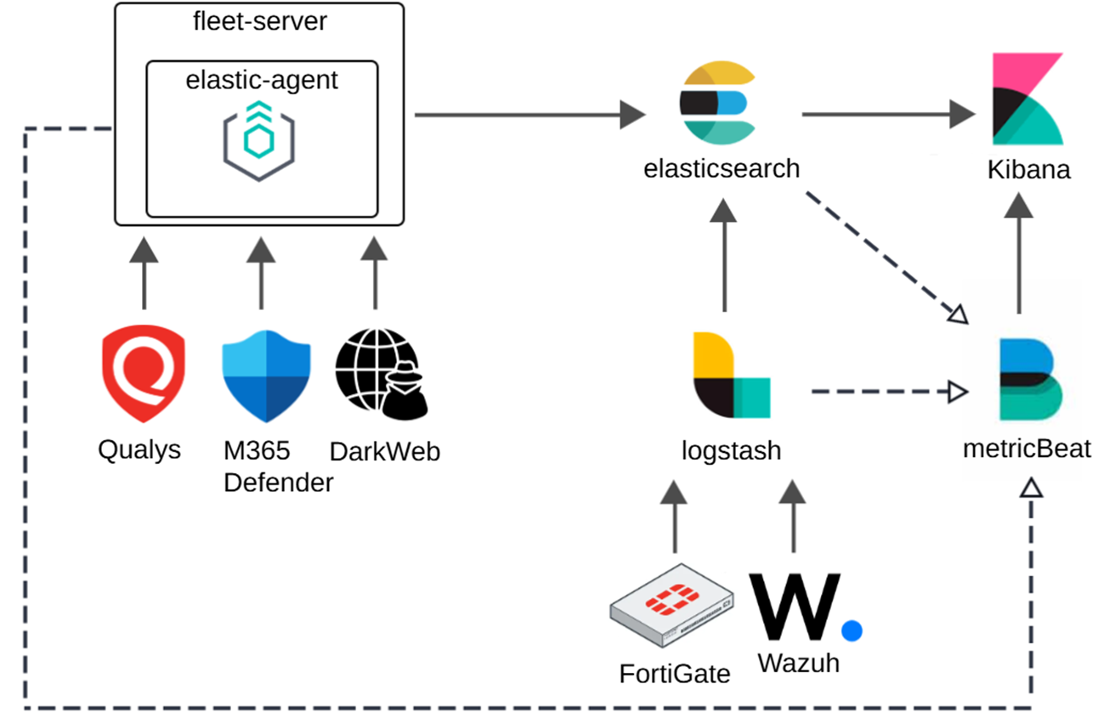
Project’s High-Level Architecture
Notes:
Qualys VMDR Vuln Management and Detection and Response

Slide 8
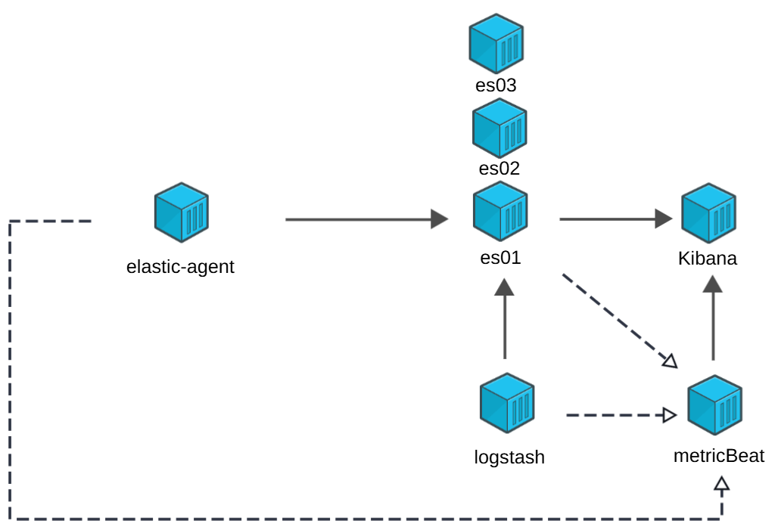
Project’s High-Level Architecture

Slide 9
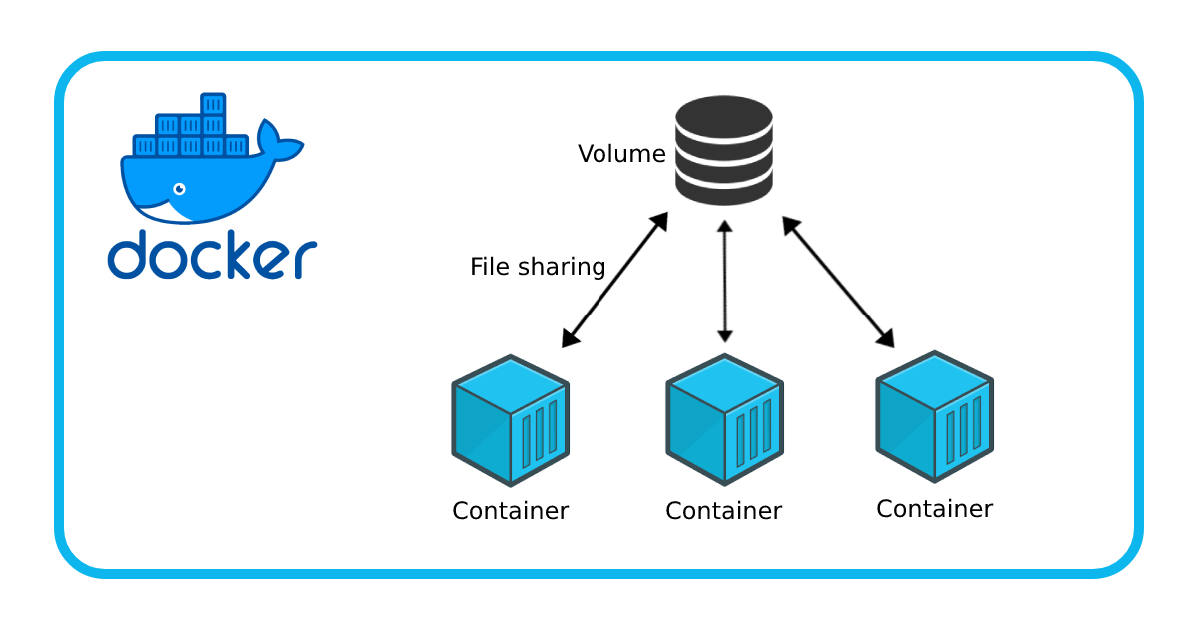
Project’s High-Level Architecture

Slide 10
From Correlation to Interpretation
Alerts are structured (key:value) -> Perform correlation
  ESQL querys & rules: JSON logs
Analysts need context + decision support
  Contextualized RAG Pipeline: Natural language narratives
SOLUTION:
Using RAG to merge Semantic Search with LLM reasoning

Slide 11
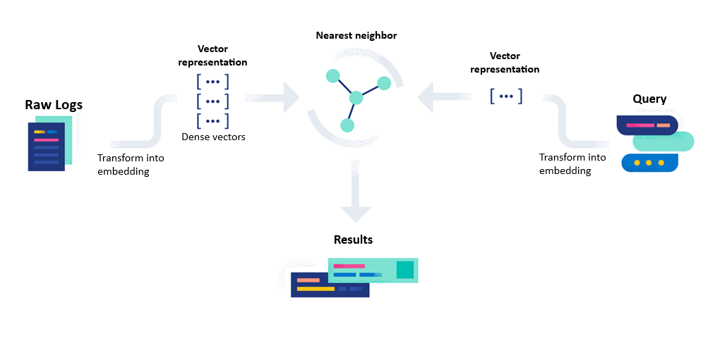
SIEM + Vector Search
Notes:
Each Log is converted into a Dense Vector embedding using a Semantic embedding model.
This allows us to perform semantic search and retrieving contextually similar events.
For example, failed logins on different servers can be matched even if log messages differ syntactically.

Slide 12
Log Embeddings & Vectorization
Full_Log Concatenation (current approach):
  Selection of the most valuable parameters -> fuse them together (append)
  Creation of a "sentence" out of the log
PRO:
  Contextualization
  Simplicity: one vector per log
  LLM Friendly
CONS:
  Diluition: specific relationships might lose importance (less weight)
  Loss of Precision
Notes:
Contextual Unity: The embedding model "sees" the relationship between the IP and the action in one pass.
Simplicity: You only store and query one vector per log. This saves significant storage and compute (crucial for your limited budget).
Natural Language Friendly: LLMs respond better to these "stories" during the RAG retrieval phase.
Dilution: If the log is very long, the "signal" of a specific IP might get drowned out by noisy text.
Loss of Precision: You can't easily ask the vector index for "Similar logs, but only where the source IP is exactly X."

Slide 13
Log Embeddings & Vectorization
Separated Parameters – Multi-Vector
  Embedding each field (User, IP, Action, Payload) separately
PRO:
  High Precision: can tune different weights
  Better for Analytics: great for finding "similar IP behavior"
CONS:
  Resource Heavy: storing 5-10 vectors per log
  Complexity: need to combine all vectors during search
Notes:
High Precision: You can weight fields differently (e.g., "Give more importance to the process.name than the log.offset").
Better for Analytics: Great for finding "similar IP behavior" regardless of the action.
Resource Heavy: Storing 5–10 vectors per log entry will explode your Elasticsearch RAM/Disk requirements (Linear Scalability issues).
Complexity: Your RAG pipeline would need a complex "scoring script" to combine these vectors during a search.

Slide 14

Log Embeddings & Vectorization
Embedding model: thenlper/gte-small
  General Text Embedding
  Used for: information retrieval, semantic textual similarity
Via a .ipynb script the SIEM downloads the Model
  eland_import_hub_model
Target Index and Ingest pipeline creation
  index_name = "fullogs_embeddings"
Re-Index logs to trigger embedding
  source_index = […], target_index = […], pipeline_id = […]
Notes:
There is also ELSER in Elastic
Run inference Locally at index time. So the model is imported once, then Elasticsearch uses it for live document inference.

Slide 15
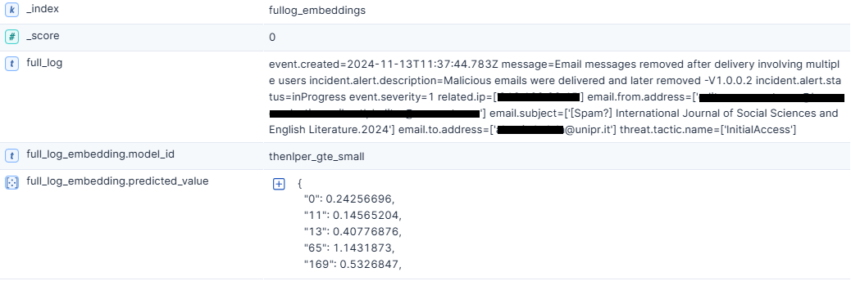
Log Embeddings & Vectorization

Slide 16
Vector Search
Query: "show me all the event spikes of Bob"
  "spikes" will be mathematically near "anomaly", "increase" or "peak"
  ! Labelling can be performed using Unsupervised ML (Anomaly Detection)
The search: KNN (cosine similarity)
  ! Size
  ! Bad at "exact" identifiers
Output: The Top-K raw logs with the highest vector proximity to the query
Notes:
The vector database compares your query vector against all the log vectors stored.
KNN = Algorithm
It looks for the top K nearest neighbors using a distance formula.

Slide 17
Vector Search
Query: "show me all the event spikes of Bob"
  "spikes" will be mathematically near "anomaly", "increase" or "peak"
  ! Labelling can be performed using Unsupervised ML (Anomaly Detection)
The search: KNN (cosine similarity)
  ! Size
  ! Bad at "exact" identifiers
Output: The Top-K raw logs with the highest vector proximity to the query

Slide 18
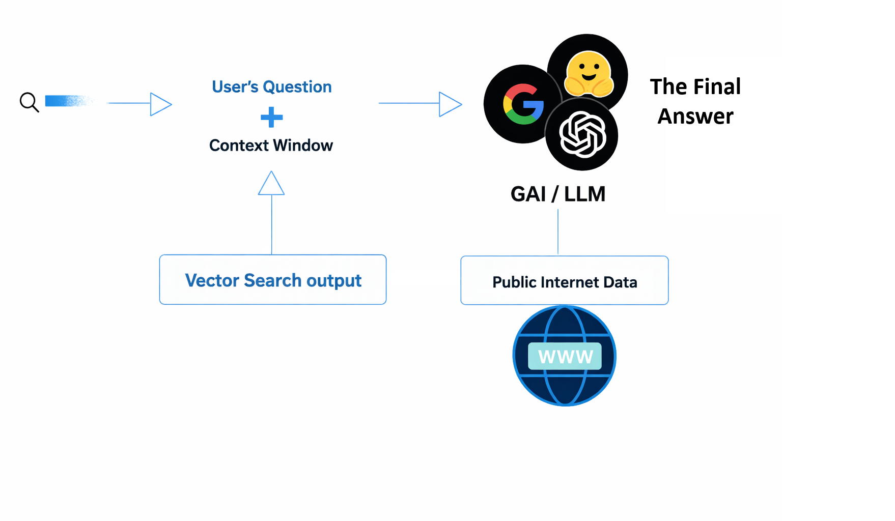
RAG Lifecycle

Slide 19
LLM Context Window
User’s query is the same as the Vector Search one
  Or provide model instructions
  Need prompt engineering for Security context
Context is sorted chronologically
  ! Might need chunking (to fit model’s token limit) or a smaller K
Notes:
LLM -> Performs Comparative Analysis and Reasoning
Vector Search -> Semantic Retrieval
Logs are aggregated chronologically and chunked to fit the LLM’s context window This way, the model can reason about sequences of events, not just isolated messages.

Slide 20
LLM Context Window
Models:
  Gemma (gemma-3-27b-it) free API requests (anonymized logs)
  GOAL: use ollama locally
LLM relies on Public Internet Data to interpret the context and to provide insights:
  Can produce a narrative description of what has happened
  Can interpret technical indicators to map ATT&CK
  Can provide a summary highlighting anomalies and suggest response
  […]

Slide 21

Limitations & Challenges
Hallucinations: LLM may invent connections
  In case of few/too many logs
General Knowledge is NOT Cybersecurity fine-tuned
Computational overhead: using local LLM
Data Quality is the Key
! Model Inversion, Adversarial Attacks, Prompt Manipulation […]
Notes:
sensitive data

Slide 22
Thank You!
Any question?
Nicolò Thei
University of Parma
nicolo.thei@unipr.it

