Slide 1

Title slide
TALON2026

Slide 2
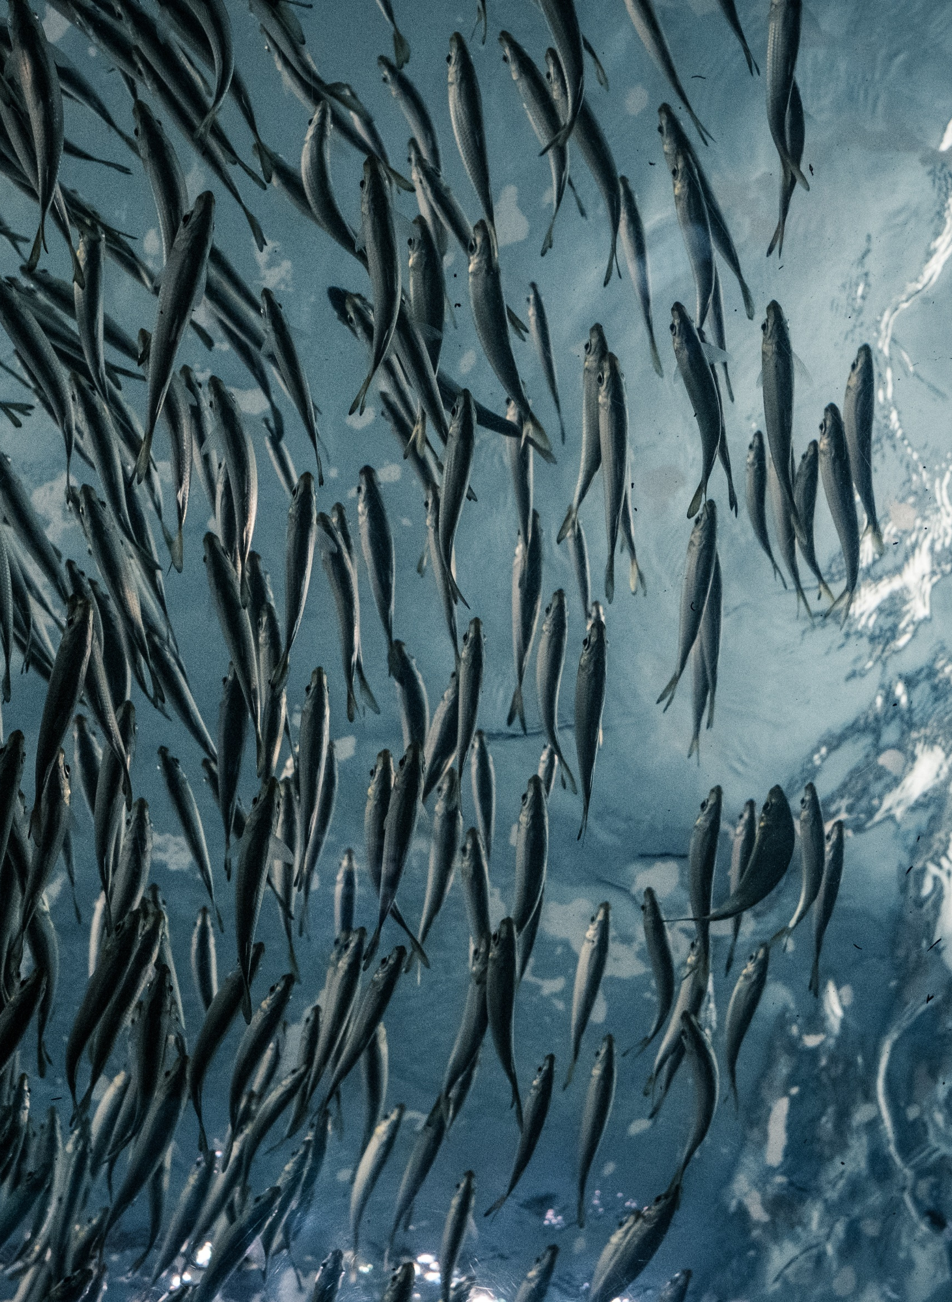
What is TALON?
International crisis exercise with 10 organisations
Every organisation exercises their own escalation and crisis process
And we exercise how we work together when a crisis hits us all
In total more than 150 individuals participated in TALON

Slide 3
Setup prep exercise
Core team TALON
Tech team
Comms team
Exercise leader
Asiera
Exercise leader
ACOnet
Exercise leader
Belwü
Exercise leader
DeiC
Exercise leader
CYNET
Exercise leader
Jisc
Exercise leader
SURF
Exercise leader
Switch
Exercise leader
Restena
Exercise leader
GÉANT

Slide 4
Preparation
        Last prep injects and briefing participants
        February and March 2026
        Online onboarding exercise leaders
        September 2025
        Working session 2 with exercise leaders
        February 2026
        First brainstorm scenario
        May 2025
        Working session with exercise leaders
        December 2025
        TALON Exercise
        March 19, 2026
Notes:
Ending in a networking crisis scenario

Slide 5
Crisis communication goals
Test timely, appropriate and empathetic communication at the early stage of a potential crisis (“we know, we do, we care”)
Ensure all internal and external stakeholders receive consistent and timely information, maintaining trust and protecting the NREN’s reputation
Test communication procedures and tools, including decision-making, approval flows and message dissemination.
Establish clear spokespersonship: decide who speaks for the organisation, at what level and through which channels.
Manage information pressure and social media noise, including misinformation and speculation.
Share information and align messaging across NRENs: ensure that all participating NRENs work towards a shared set of key messages.
Trigger strategic discussions: e.g. on prioritisation of certain organisations

Slide 6
TALON technical overarching goals
Test escalation of technical problems to crisis
Train problem solving skills and creative thinking while in a stressful situation with external pressure
Establish proper roles within the technical team/test processes: decide who delegates, who is a liaison to management who is analysing and who is fixing
Manage data, observations and noise, including red herring and irrelevant intel.
Share information and technical analysis results across NRENs: IoCs, observed attack patterns, solutions, etc.
Trigger strategic discussions/decisions: e.g. on prioritisation of certain organisations

Slide 7

Prerequisites scenario
Impacts all participating NRENs
Tests escalation
Poses technical, communicational and strategical dilemmas
Is adaptable to the exercise needs of each NREN
Pushes NRENs to work together
We need to be able to simulate the scenario

Slide 8

Scenario

Slide 9
Nordunet
CERN
Asiera
Belwu
DeiC
Switch
Jisc
Cynet
Géant
SURF
Non-playing NRENs
AMRES, Arnes, Belnet
ACOnet
RESTENA
Libanon NREN

Slide 10
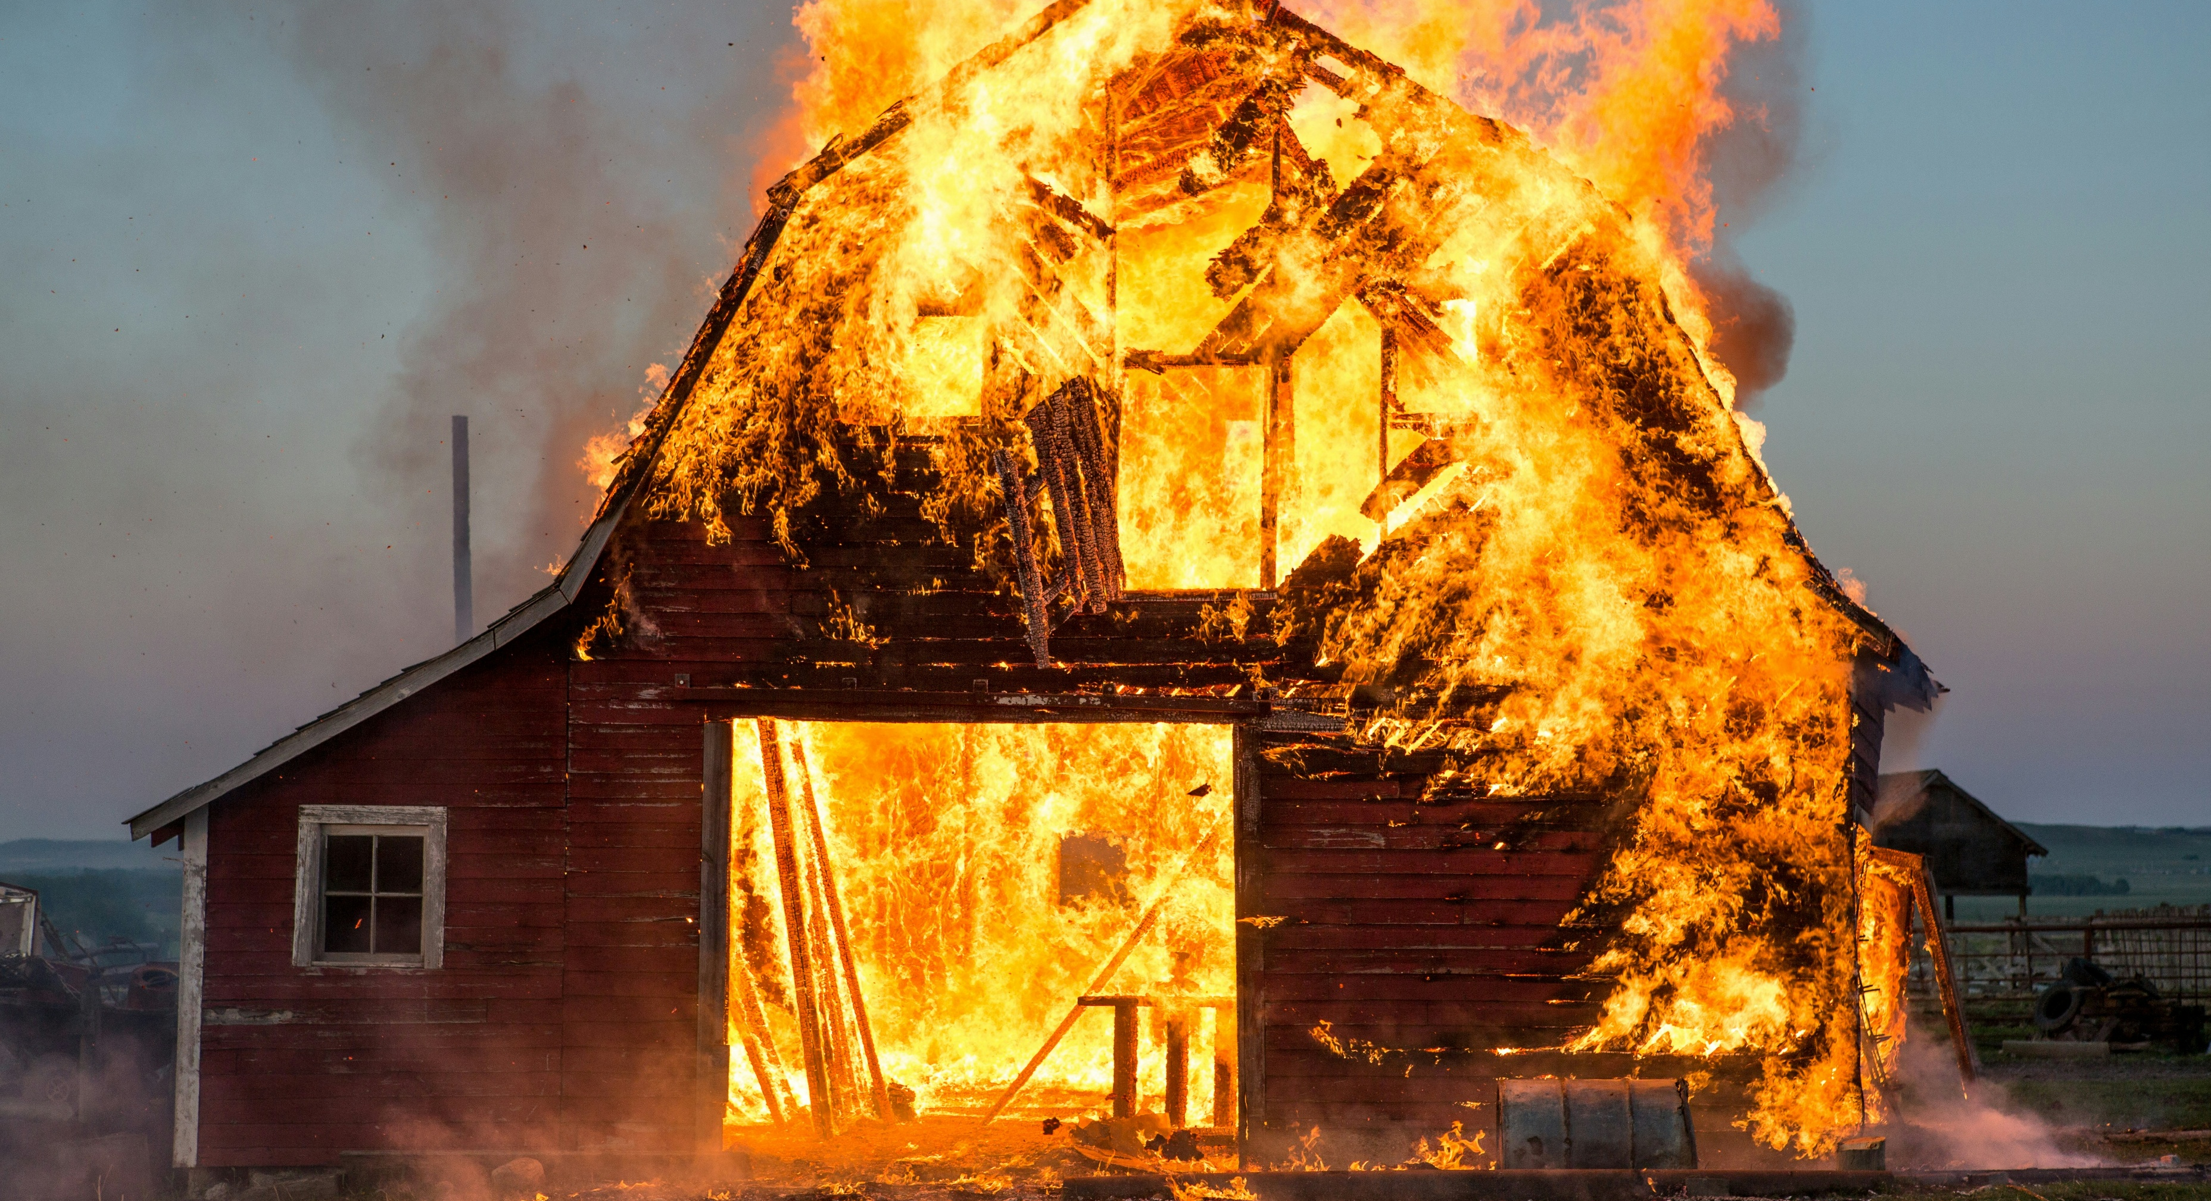
During the exercise

Slide 11
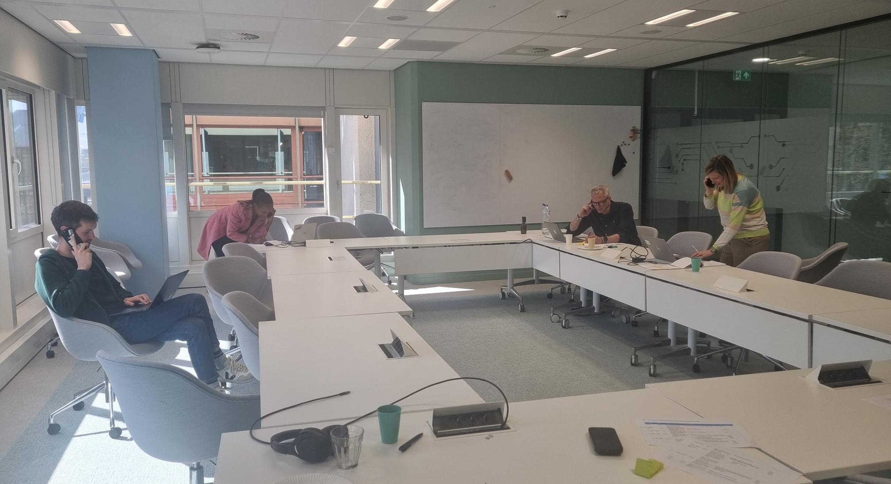
We played journalists

Slide 12
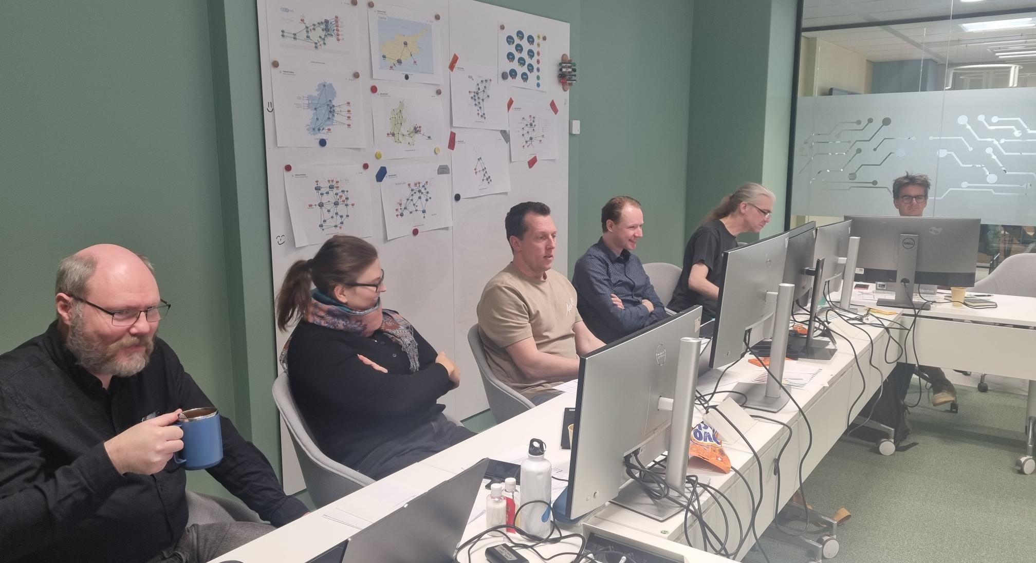
And we were the ‘log oracle’

Slide 13
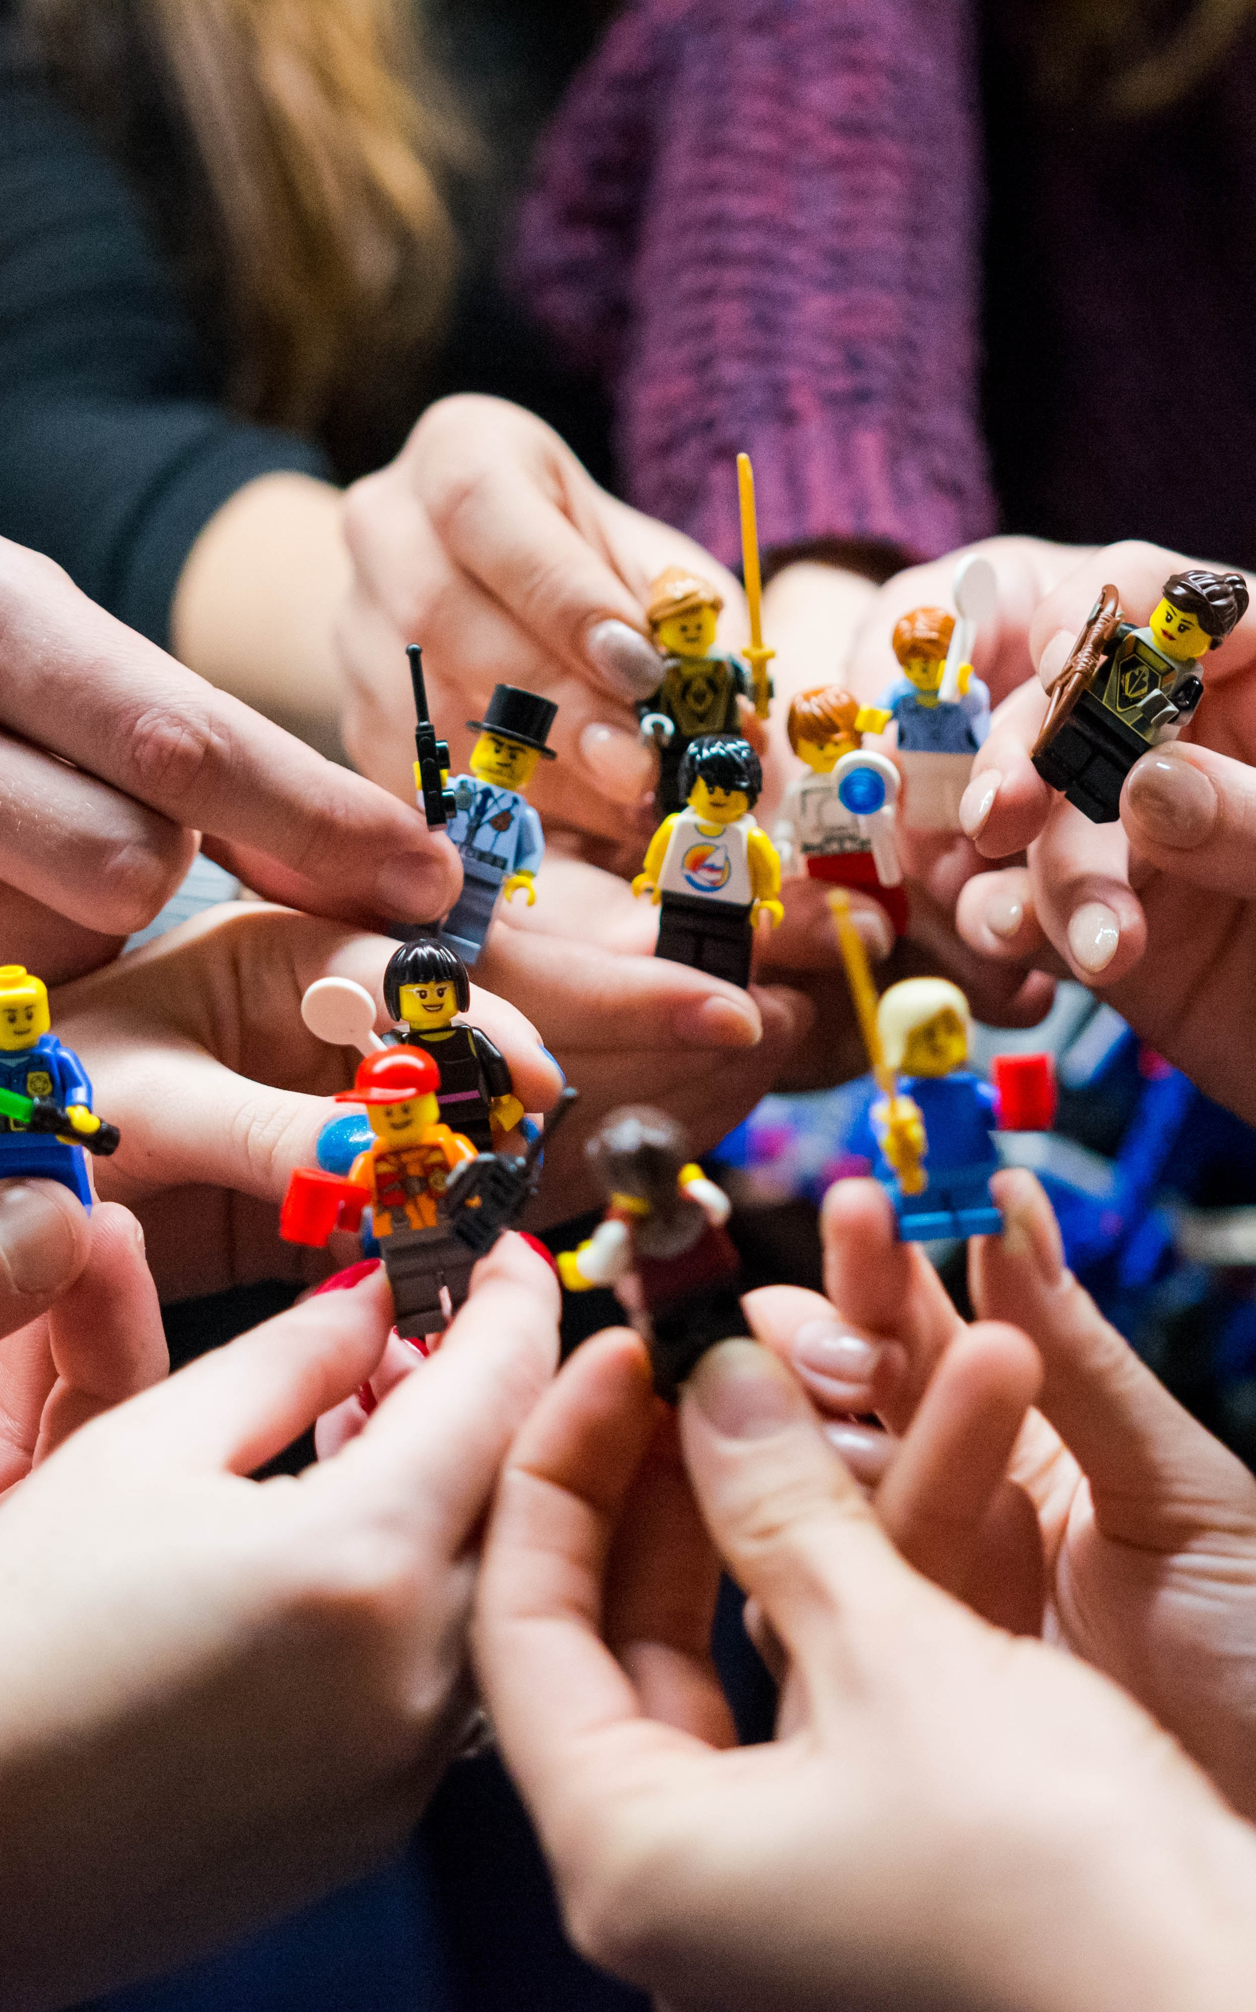
What we saw: collaboration
09:30 DeiC reaching out to Nordunet
10:16 Asiera reaching out to Jisc and GÉANT
10:50 Belwue invites Switch (and maybe others) to a VC call
11:14 Asiera reaches out to NORDUnet
12:00 GÉANT sends out email to APMs + GA
12:08 GÉANT starts a channel in NREN slack with all crisis teams -> mainly contact between RESTENA and SURF
12:15 GÉANT Board notified by Lise (all the way from Japan)
First indications: security people are the most collaborative

Slide 14
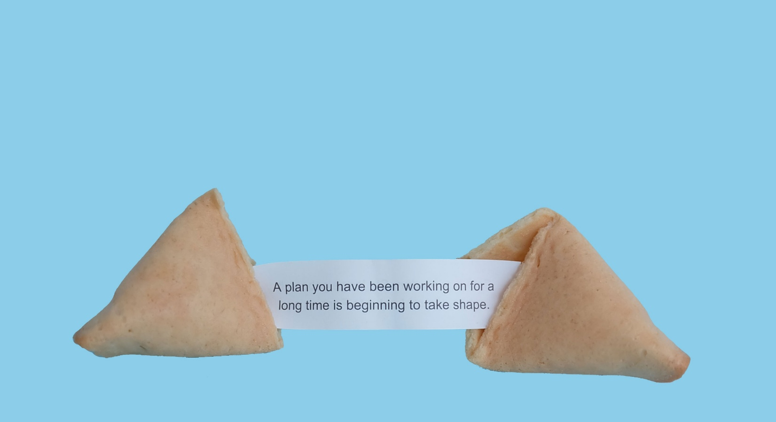
Evaluation made and published in coming months

