Slide 1
How to be just the right amount of paranoid (Cybersecurity Edition)
Denim LATIĆ – Restena Foundation

Slide 2
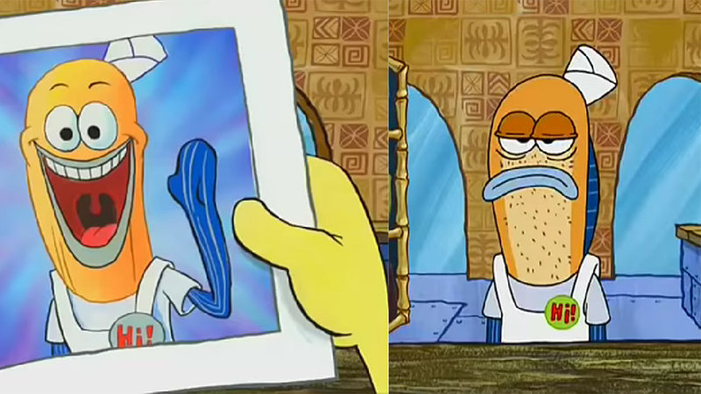
How did it come to this?
Started cybersecurity 5 years ago
Learned how to use a cmd
Learned how to hack and defend

Slide 3
How did it come to this?
Password manager
VPN
Easy to be hacked
Tor?
Paranoid???

Slide 4
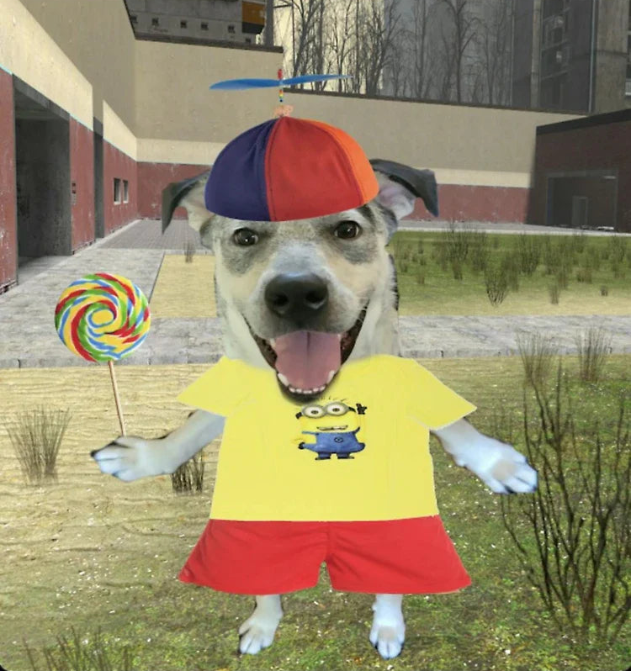
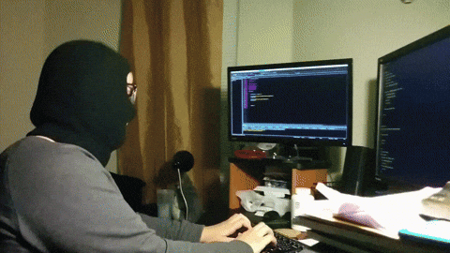
Security Mindset Scale

Slide 5
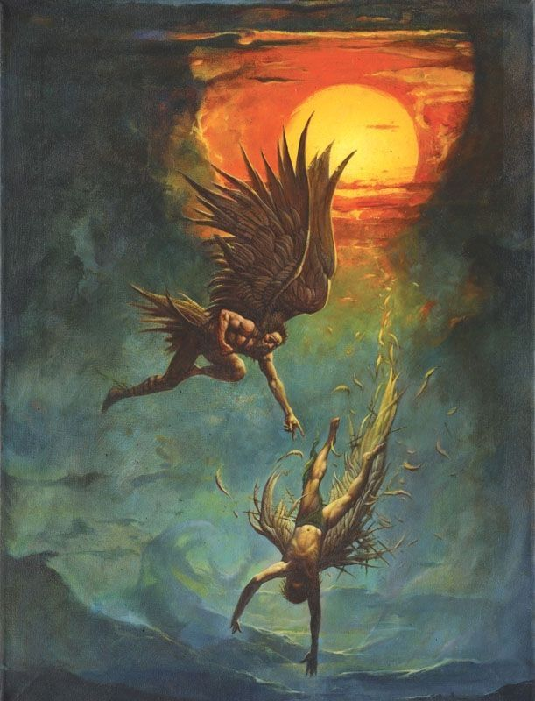
Is there a golden middle way?
Notes:
Daedalus warned Icarus not to fly too high, because the heat of the Sun would melt the beeswax that held his feathers together, nor too low, because the sea foam would soak the feathers and make them heavy and he would fall.

Slide 6
Thank you!
Let’s talk about this more together!

