Slide 1
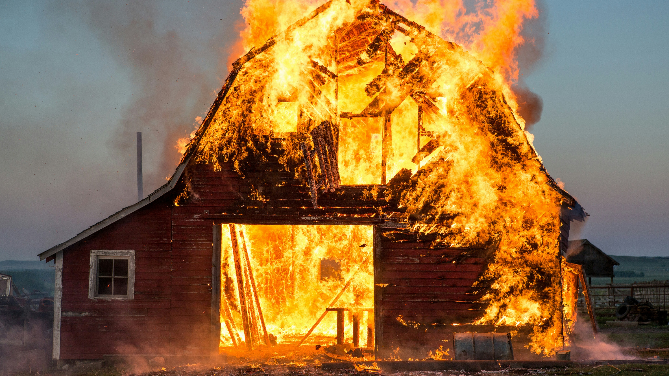
Title slide
What are our greatest fears?

Slide 2
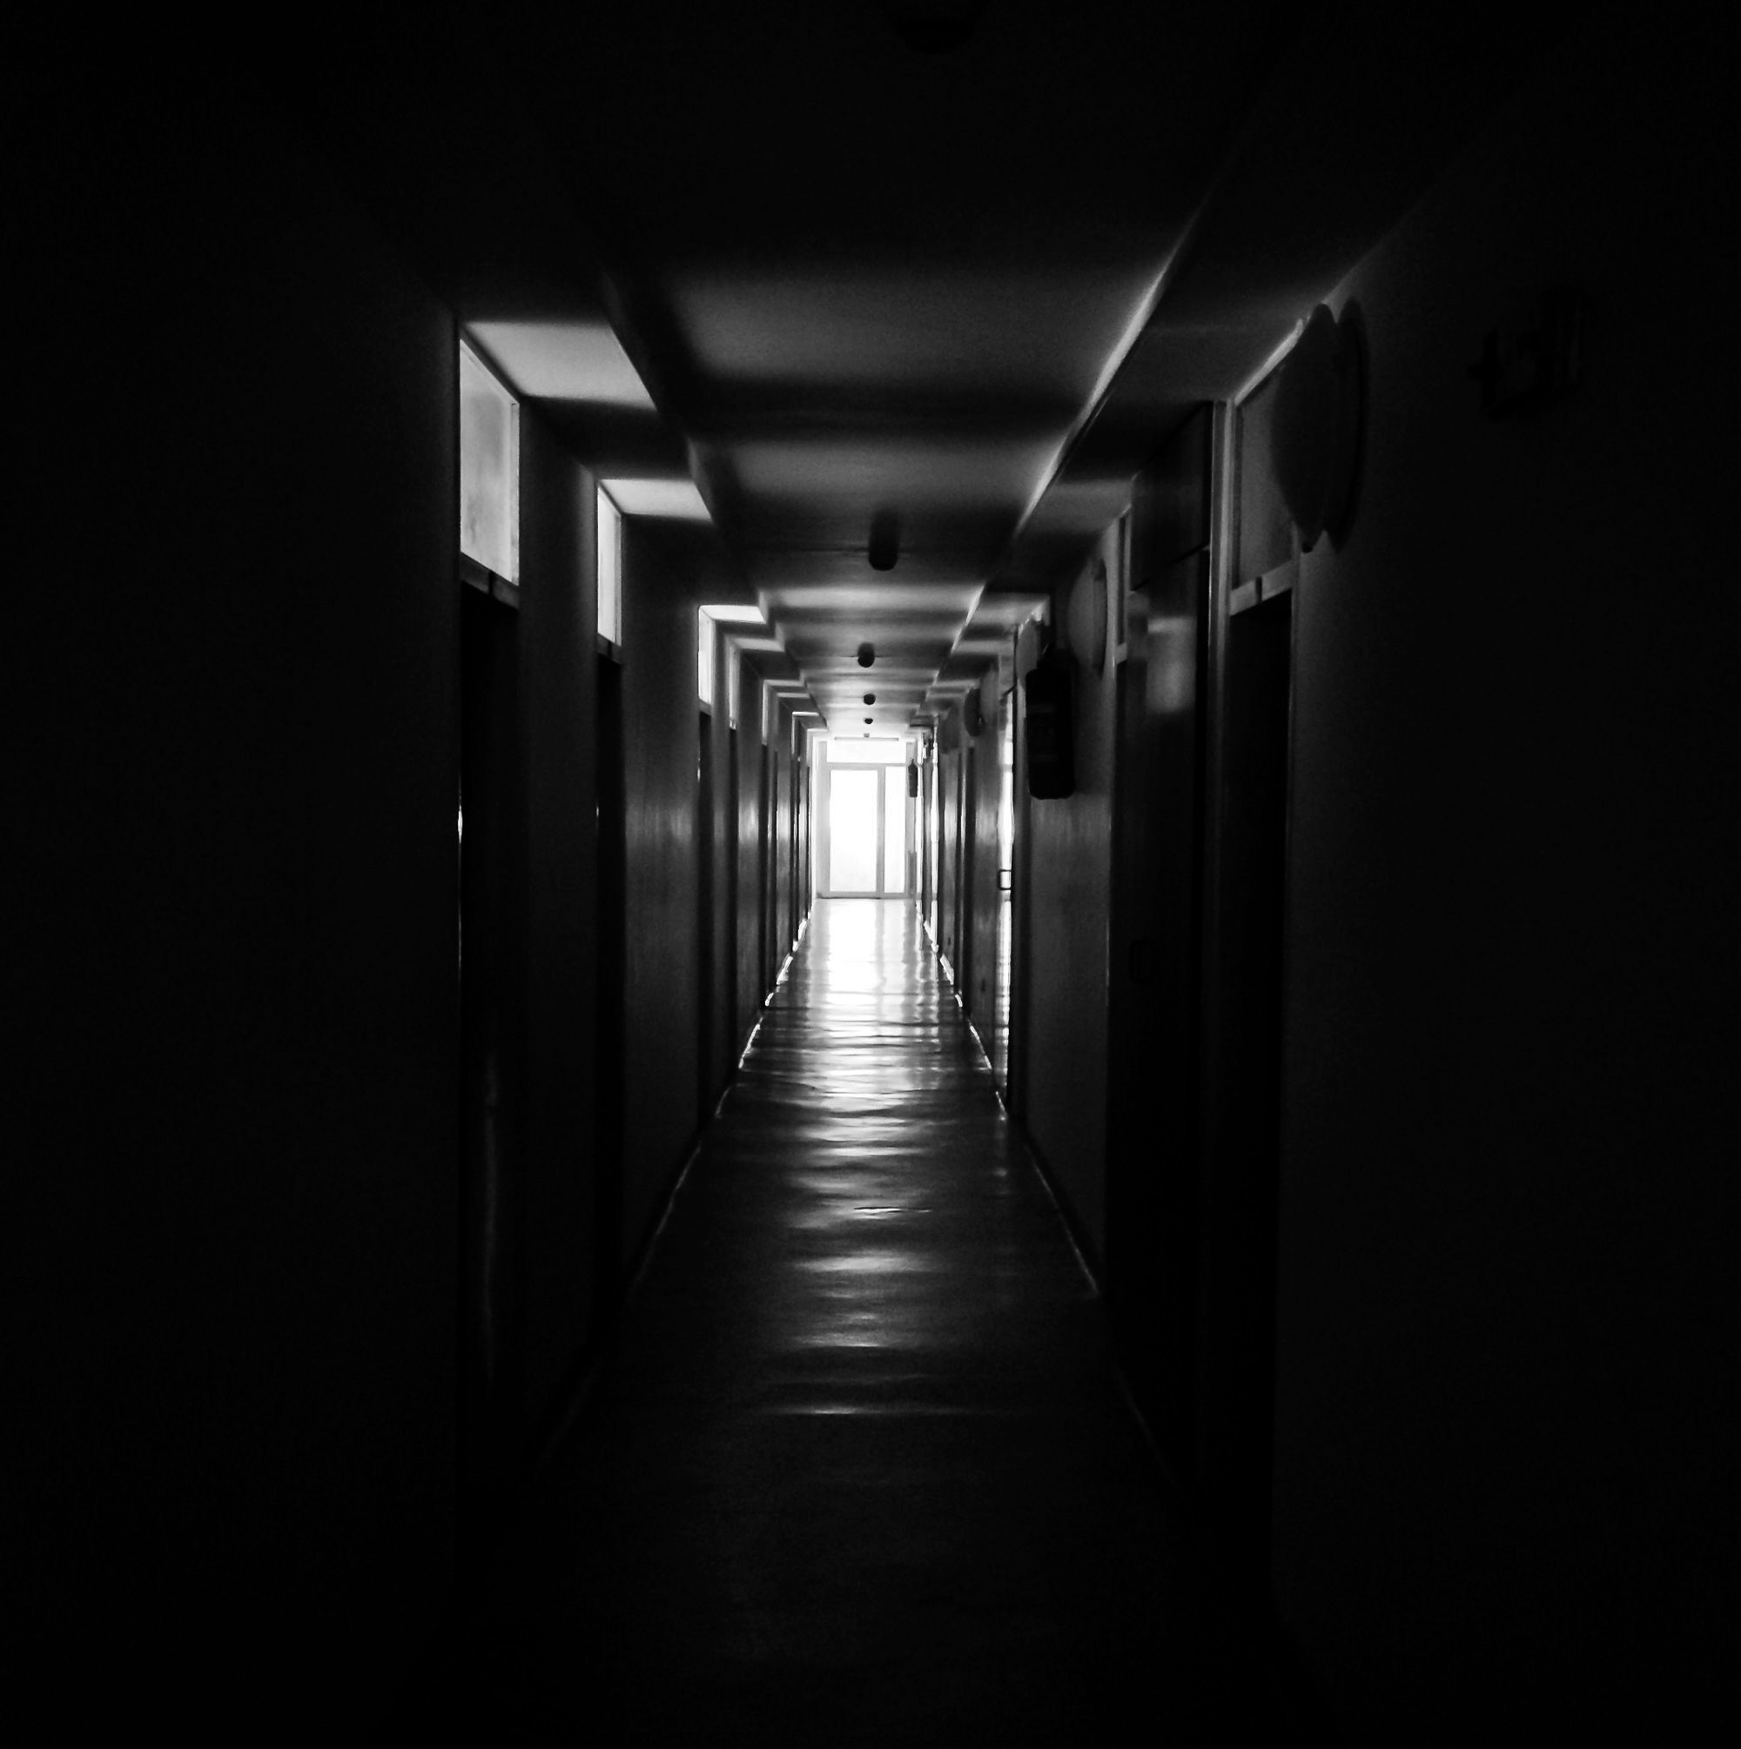
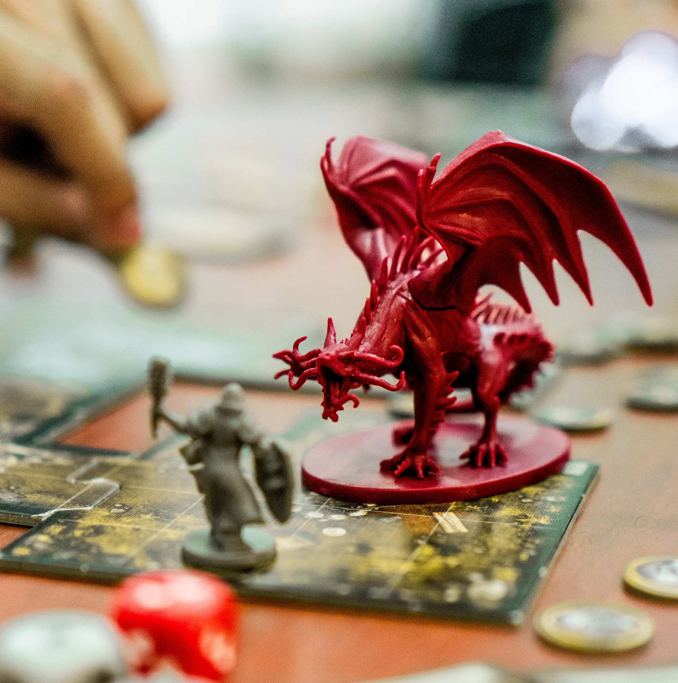
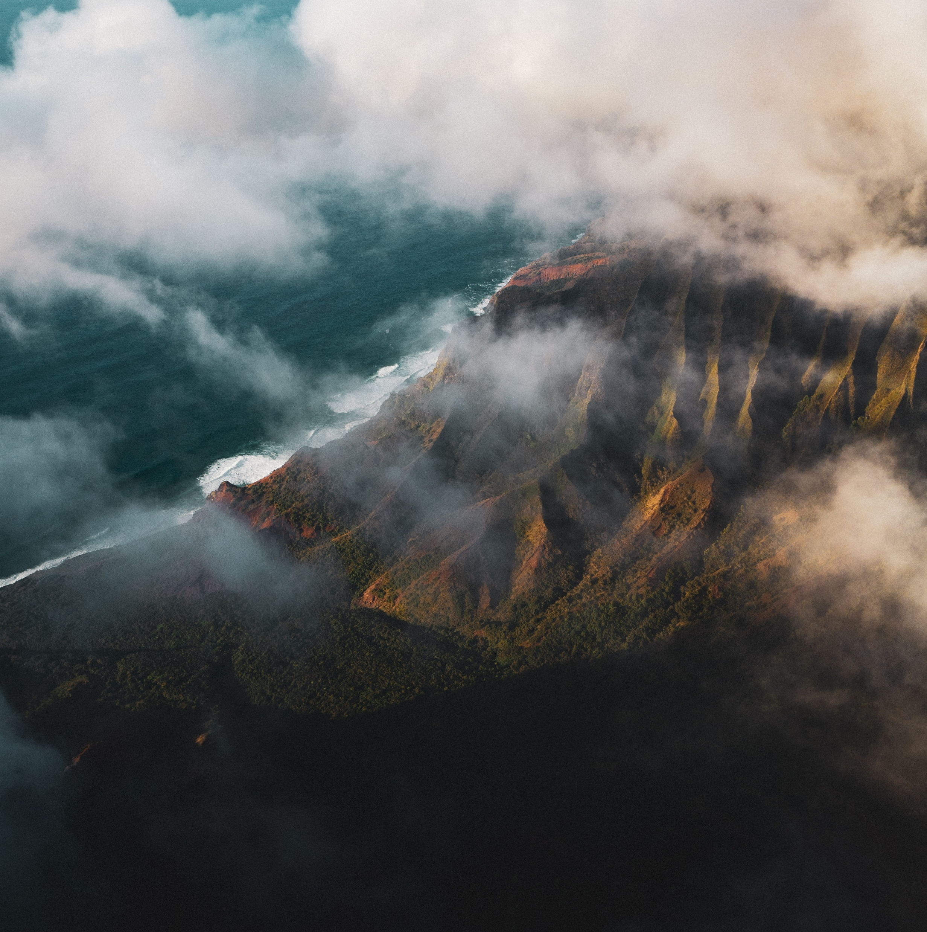
Things I think about
What if the US president turns of the lights?
What if the war goes beyond Ukraine?
What if the next power outtage takes weeks instead of days?

Slide 3
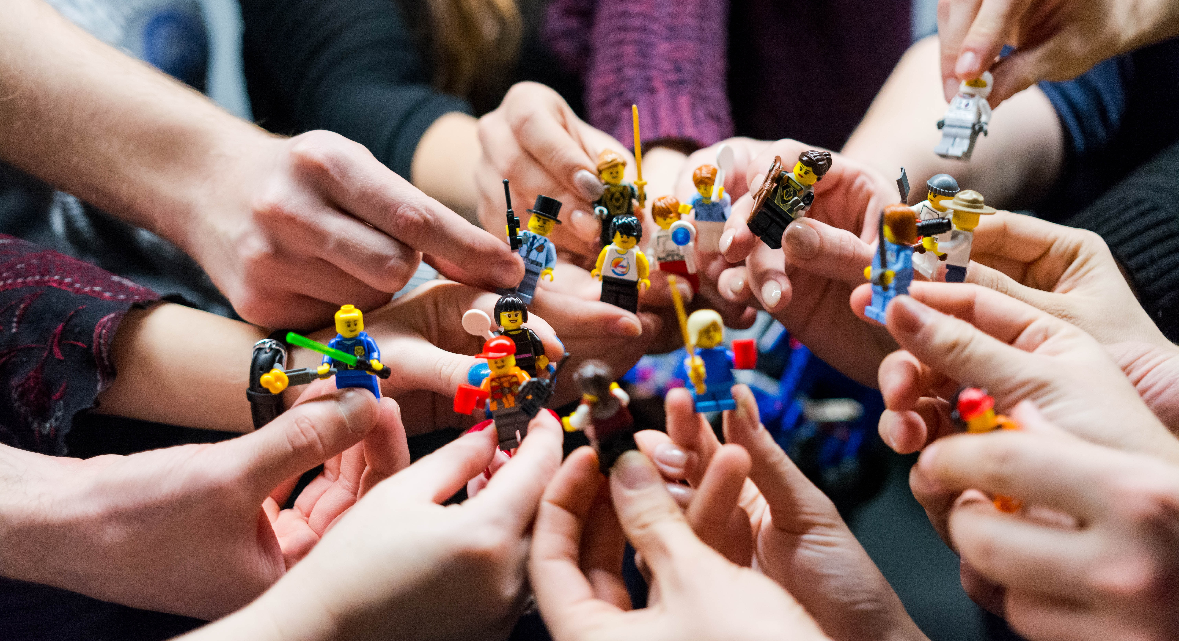
Form groups: by region and/or expertise
Notes:
Eerst rondje in de zaal: hebben we een logische verdeling met netwerk/security/IAM kennis of andere expertises? Of juist een verdeling in Benelux, Nordics etc

Slide 4

10 mins to think of a scenario with your group

Slide 5

15 minutes: pitching the scenarios and voting

Slide 6
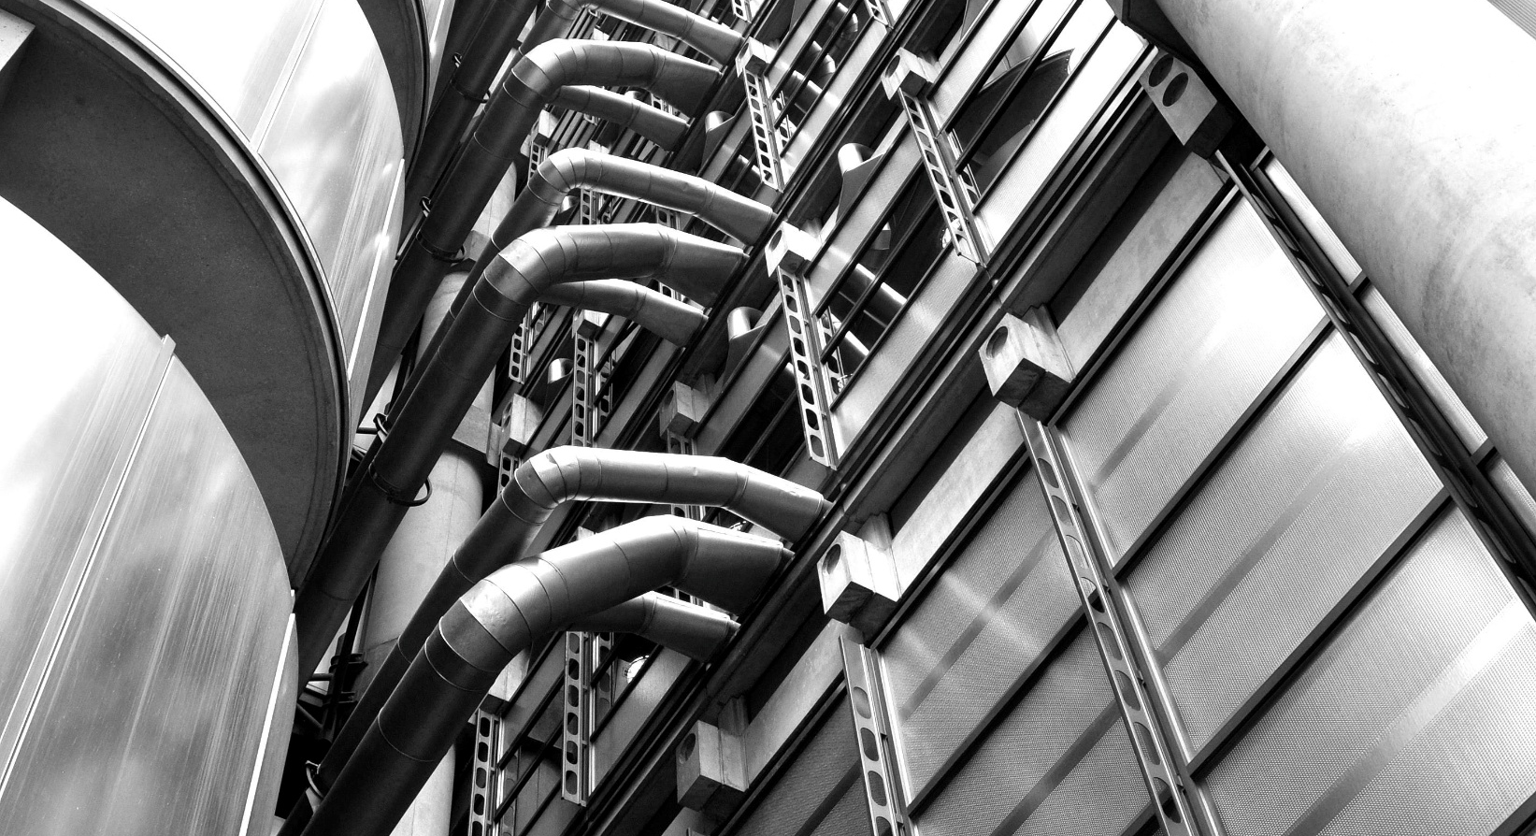
What would happen in the first week?
Notes:
10 minutes to make a first estimation with your group
10 minutes to show each other and see if there are cascading problems that we didn’t think of

Slide 7

What adjustments would we be able to make? How much time would that take?
Notes:
10 minutes to write this down
10 minutes to show each other

Slide 8
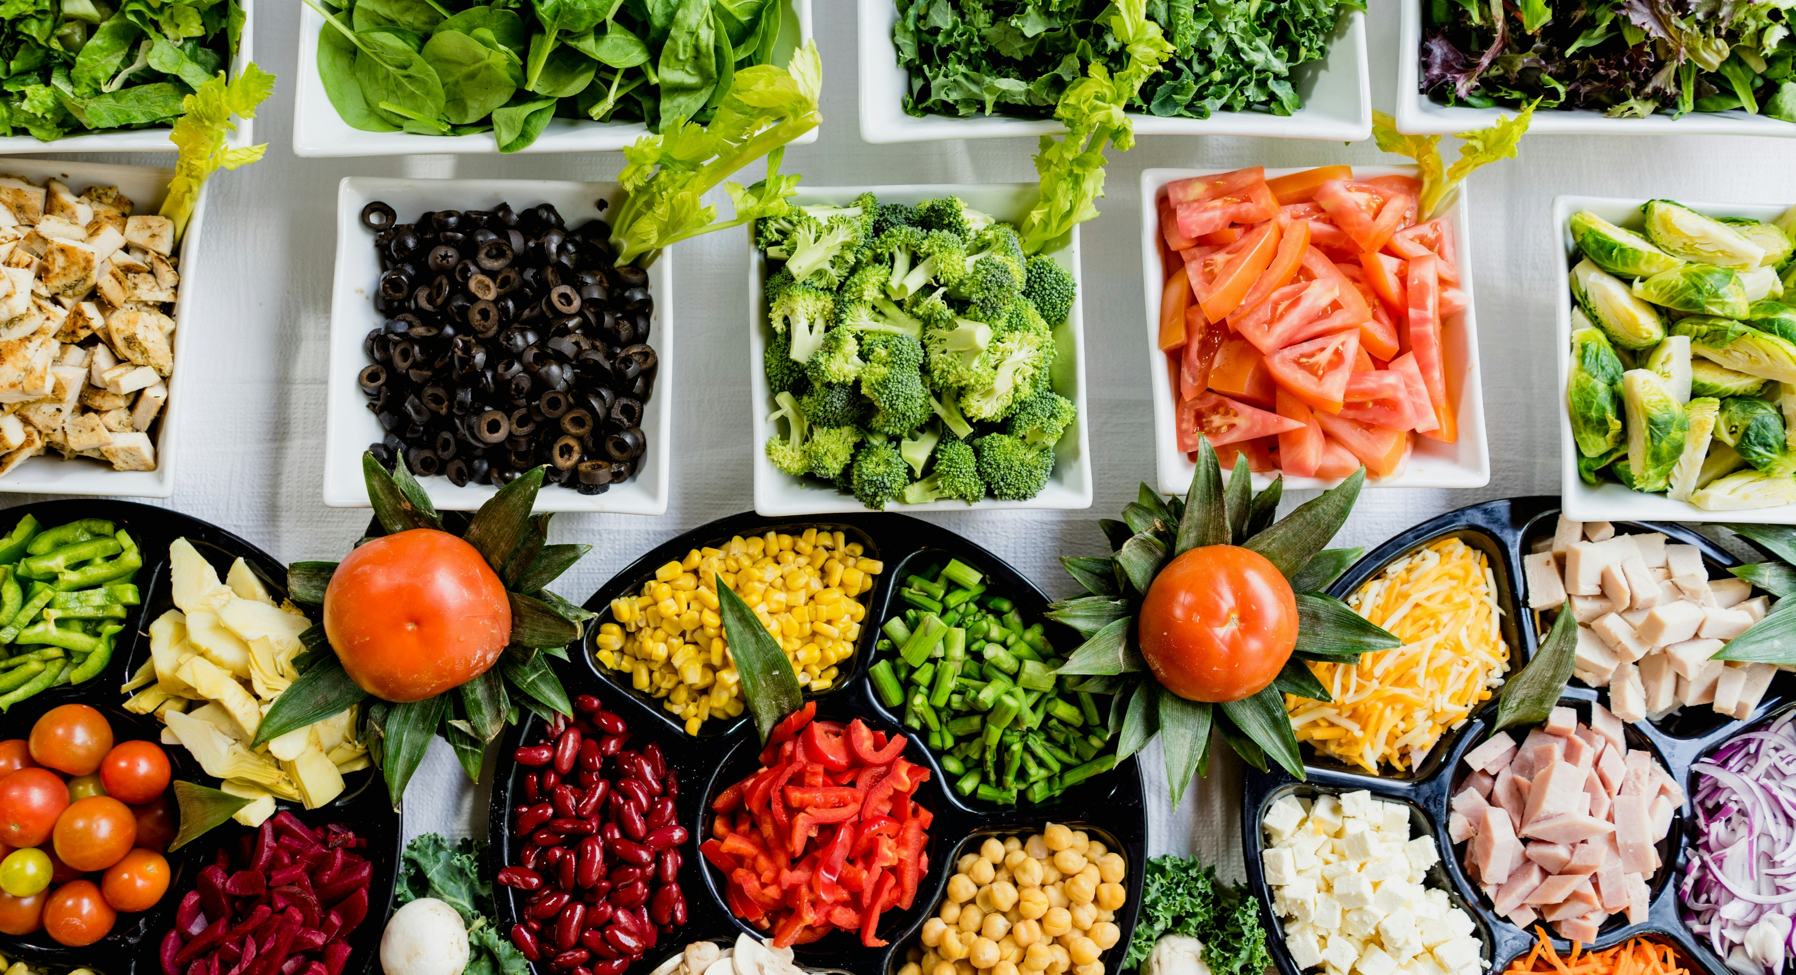
Are there things we could do this year to help mitigate this scenario?
Notes:
10 minutes to write this down per group
10 minutes to tell each other

