Slide 1
The power of community
Mark Tysom, Jisc

Slide 2
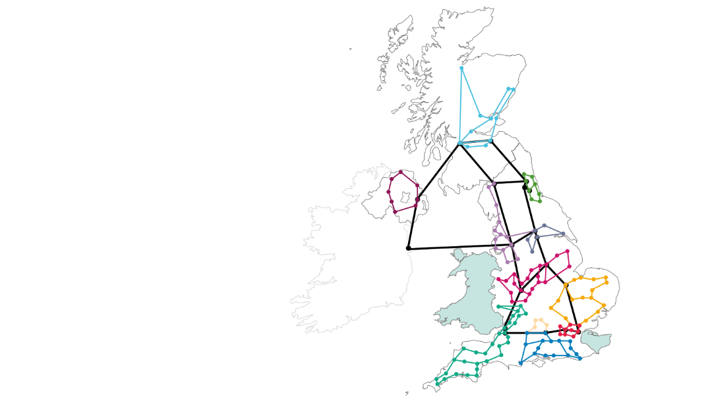
The UK education and research sector
164 universities
359 colleges
24 research organisations
4 nations: England, NI, Scotland, Wales
Huge variation in size, staff, skills and budget
How can we create a community of security professionals?

Slide 3


The aims
To create a forum for sharing security-related information with Jisc members
To create a safe-space for our members to ask security-related questions
To foster a community culture of collaboration and self help

Slide 4
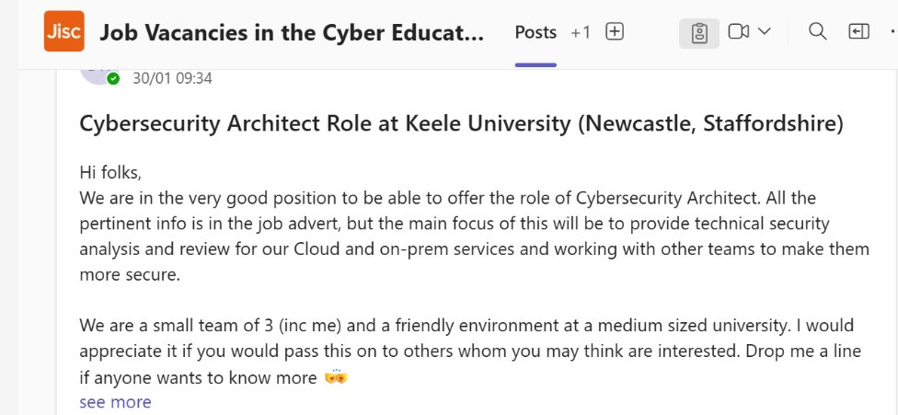
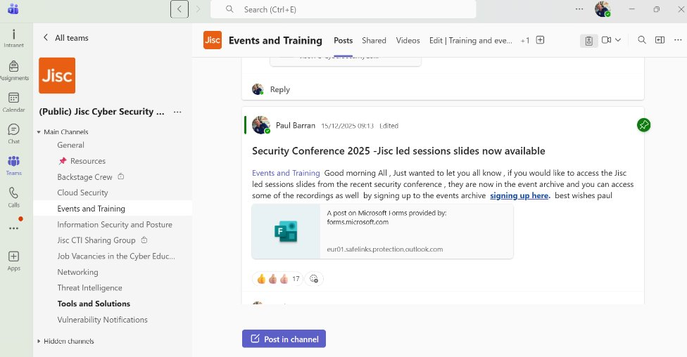
We built a community
Launched MS Teams channel in 2023
Started slowly: Jisc-led, sharing threat intel etc
Has grown to over 3000 individuals
11 channels covering different topics
Now with dedicated roles within Jisc to support
Notes:
We aim to host regular webinars delivered by Jisc staff or members of our community

Slide 5
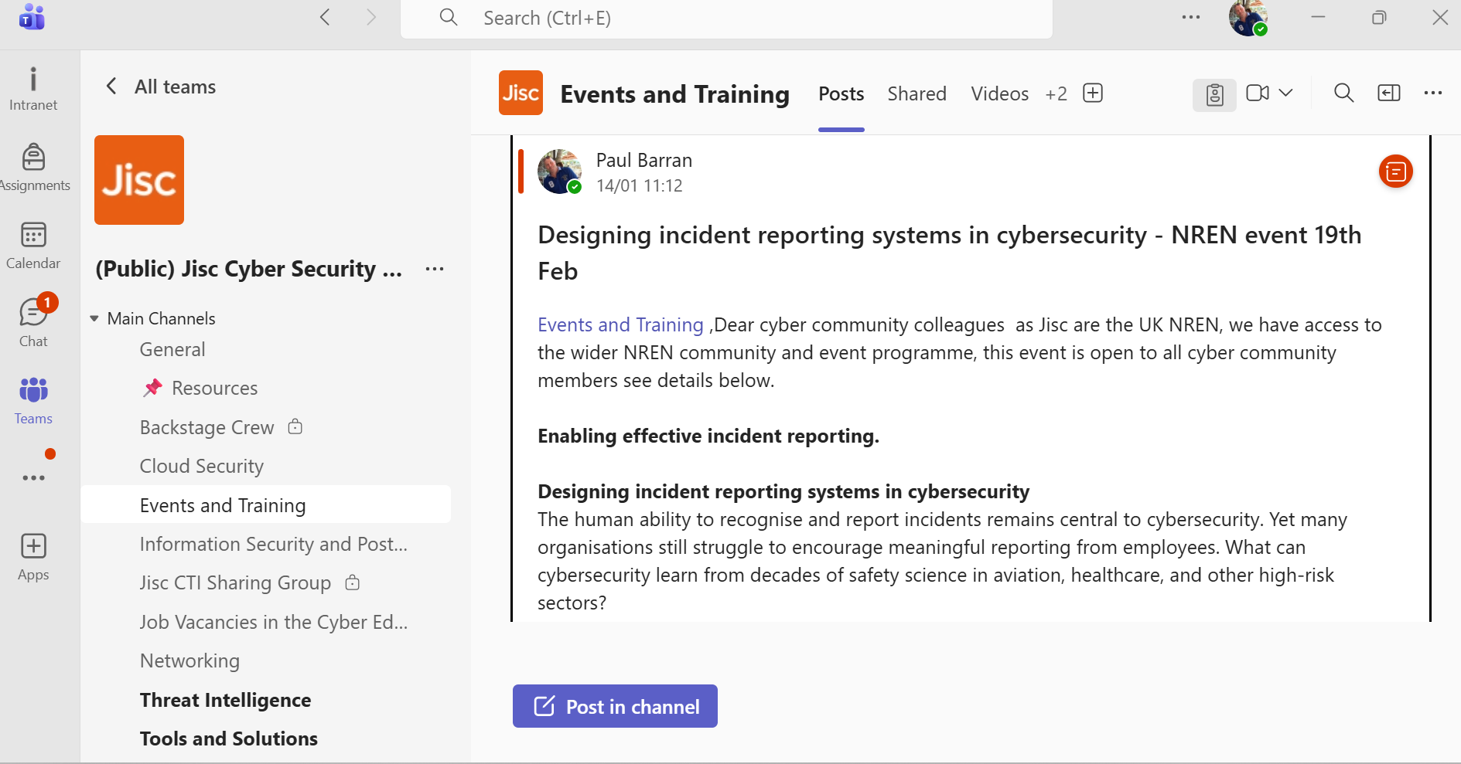
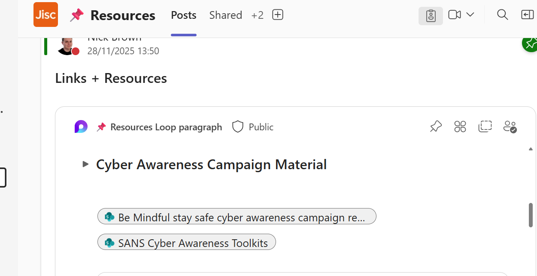
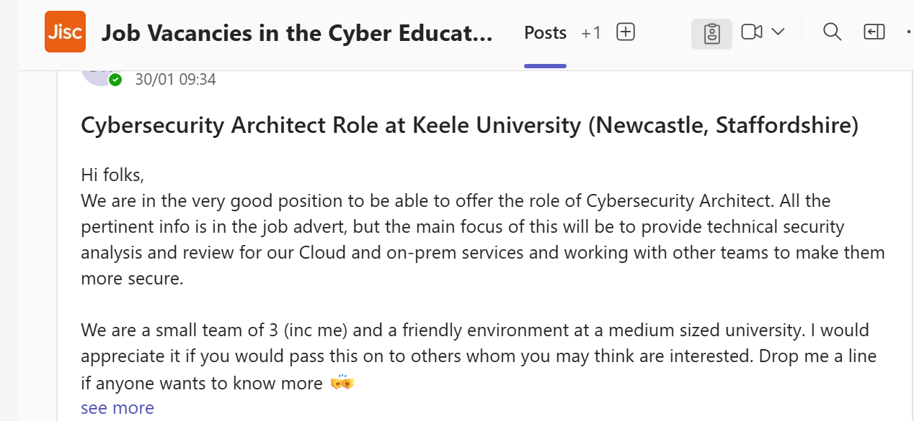

Notes:
Add a screenshot of the jobs channel

Slide 6
Regular webinars
Session Discription ​ | Numbers of attendees ​
Ddos Mitigation services -new features update including CSP GEO blocking ​ | 387​
Threat Modelling 101 ​ | 423​
Q4 threat briefing 2025​ | 506​
Payment fraud and security risk in education ​ | 368​
IR quarterly clinic Dec ​ | 299​
Filtering and monitoring by David Wright ​ | 474​
Q3 threat briefing 2025​ | 449​
Building your cyber security roadmap -ingredients for success​ | 383​
Beyond PingCastle : offensive and defensive AD mapping with bloodhound ​ | 482​
IR quarterly clinic ​ | 376​
Q2 threat briefing 2025​ | 398​
Harmonising IT recovery and business continuity to improve resilience ​ | 372​
Unmasking scattered spider tactics,techiques and retail sector attacks ​ | 610​
Thinking about clearing ? Don’t sweep DDOS attacks under the carpet ​ | 110​
JNRS Jisc's protective DNS ​ | 359​
Q1 threat briefing 2025​ | 296​
Defence In-depth with Microsoft Defender for Identity​ | 519​
Unifying update infrastructure the Azure Arc advantage​ | 347​
Q4 threat briefing 2024​ | 573​
Learning together - working with the regulator- ICO​ | 247​
Notes:
We aim to host regular webinars delivered by Jisc staff or members of our community

Slide 7
What are you doing?
  Who is doing something similar?
  Who has thought about doing something like this?
  Is anyone interested in sharing experiences and exploring collaboration opportunities?
  If so, let’s talk ☺
Notes:
We aim to host regular webinars delivered by Jisc staff or members of our community

