Slide 1
Cybersecurity Treasure Hunt
Jakov Kiš
Croatian Academic and Research Network – CARNET
Croatian National CERT

Slide 2
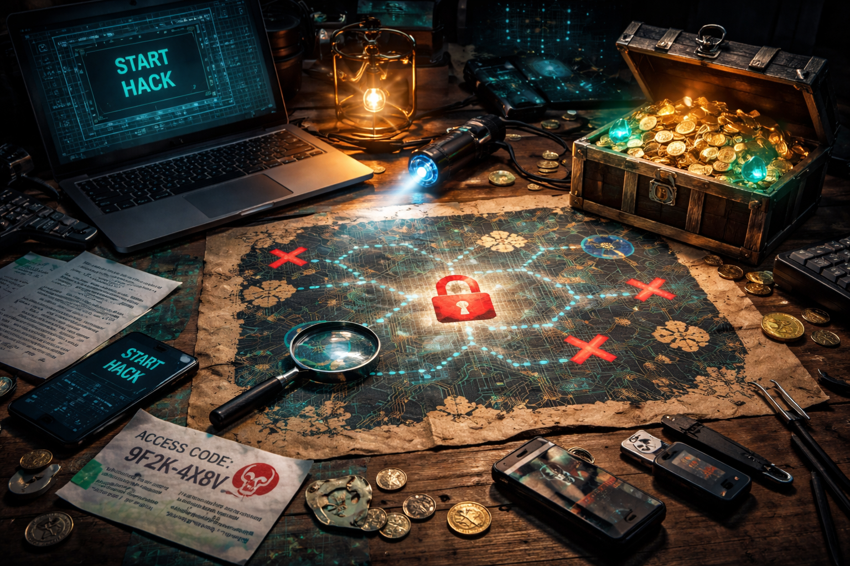
Content:
IP
Index page
Algorithm (emojicode)
Key (steganography)
Cipher (crossword puzzle)
Solution

Slide 3


START – Pop a baloon
Start with an exciting activity to entertain and interest participants
Attract the attention of others = more participants
Inside a balloon – a piece of paper
xxx.53.xx.1x3
16x.xx.114.xxx
https://pixabay.com/vectors/balloons-decoration-party-decor-25737/

Slide 4
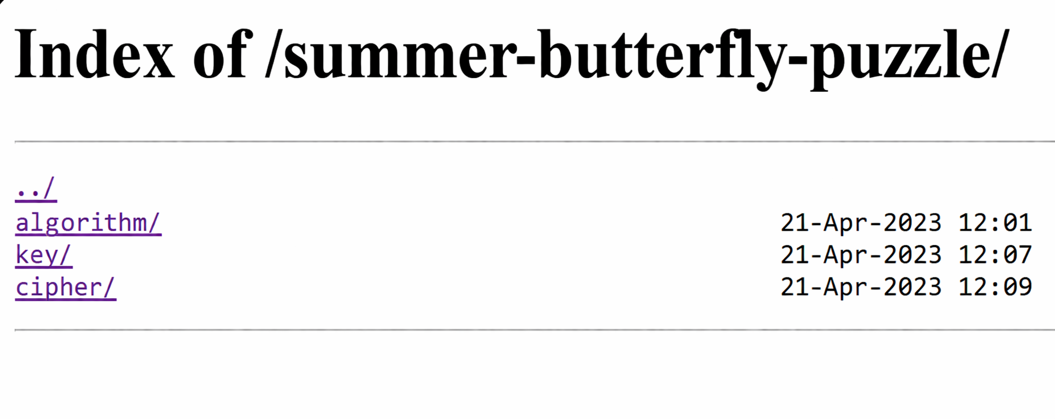
IP address leads to a webpage

Slide 5
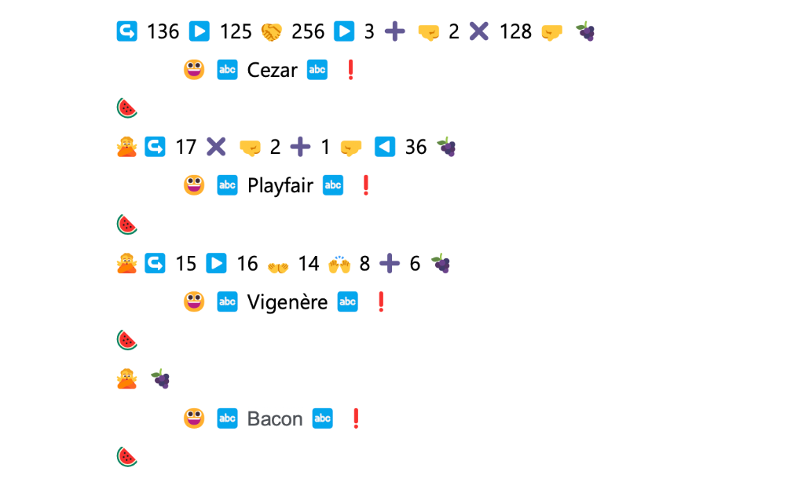
ALGORITHM – Emojicode

Slide 6
ALGORITHM – Emojicode

Slide 7
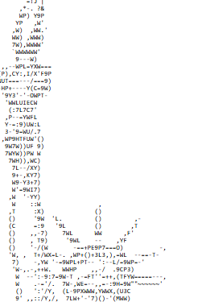
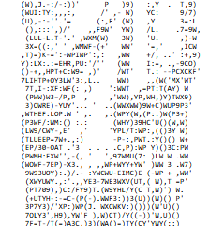
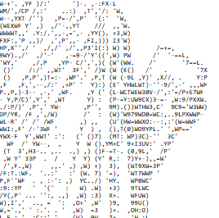
KEY - Steganography

Slide 8

KEY - Steganography

Slide 9
KEY - Steganography
HINT: hammer

Slide 10
CYPHER - Crossword
National CERT
The European Union Agency for Cybersecurity
Malicious software
A vulnerability that was not previously known until after it was successfully hacked
Cross Site Scripting

Slide 11
CYPHER - Crossword
National CERT
The European Union Agency for Cybersecurity
Malicious software
A vulnerability that was not previously known until after it was successfully hacked
Cross Site Scripting
N | C | E | R | T
E | N | I | S | A
M | A | L | W | A | R | E
Z | E | R | O | - | D | A | Y
X | S | S

Slide 12
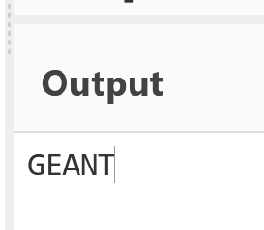
SOLUTION
ALGORITHM + KEY + CIPHER
Vigenere + hammer + NEMZX →

Slide 13
Available for questions during a break.

