Slide 1

My cloud vendor is compliant, how does that help me?
Shiyona Keenakkottil
SURF Vendor Compliance
John Segers
SURFcumulus
GÉANT Security Days
April 9, 2026
Notes:
John

Slide 2

Agenda
01
02
Context
Cloud compliance
03
04
05
Key findings
Recommendations
Next steps
Notes:
John:

Slide 3



Our scope is OCRE IaaS-PaaS cloud for SURF
SURF created a service SURFcumulus around OCRE
We deliver add-on services to our institutions, e.g.
Professional Services (via a DPS)
Prescriptive security baseline
Assistance with administration and governance
Cloud Delivery Service for research projects
Vendor compliance checks
Shiyona Keenakkottil
John Segers
Security & Compliance Specialist
Cloud Governance Specialist
shiyona.keenakkottil@surf.nl
john.segers@surf.nl
Notes:
John

Slide 4
Cloud security is a shared responsibility Cloud providers secure the cloud, customers secure the data they put in it
Notes:
John

Slide 5
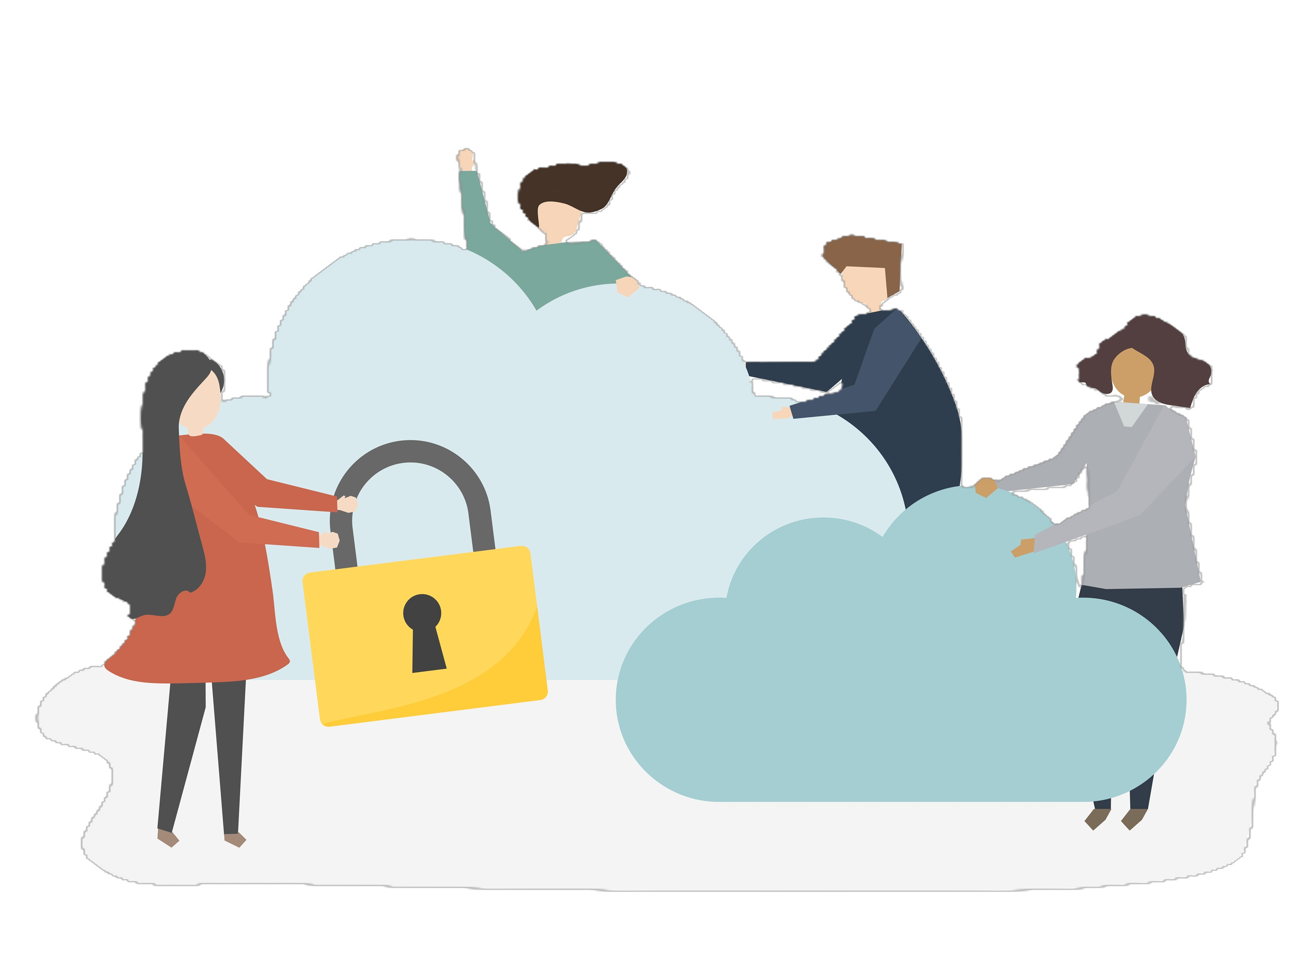
How does my cloud provider’s compliance help me? And what do I need to do myself?
Your cloud provider secures the cloud (and we check this)
Securing the data you put in it requires you to
Classify your data and determine what can go into the cloud
Manage identities & access
Encrypt data as required by our data security policies
Secure your cloud networks
Monitor data access and use in the cloud
Etc.
Notes:
Shiyona

Slide 6
Why and how do we check?
Why?
How?
Verify promises
Check certificates
Help members
Check SoA
Standardize
Notes:
Shiyona.

Slide 7

For increased assurance we look beyond ISO 27001
Check for other ISO 27000-series certificates and their SoA: ISO 27017 (Cloud Security), ISO 27018 (Cloud Privacy), ISO 27701 (Privacy Information Management System).
Analyze and summarize SOC 2 Type II reporting and auditor’s findings (if any).
Check C5 certification level.
Check CSA STAR certification level and reporting (if available), map to ISO 27001.
Notes:
Shiyona

Slide 8
Our process
Obtain documentation
Check completeness
Engage vendor for clarification
Write/update draft report
Publish report
Follow up with vendor for QA
Notes:
John

Slide 9
Result summary
Vendor | ISO 27001, -017, -018 | ISO 27701 | SOC 2 Type II | CSA STAR | C5
AWS | ✅ | ✅ | ✅ | Level 2 | Basic + Additional
Google Cloud | ✅ | ✅ | ✅ | Level 2 | Basic
MS Azure | ✅ | ✅ | ✅ | Level 2 | Basic
Vancis | ✅ | - | ✅ | - | -
Notes:
Shiyona

Slide 10
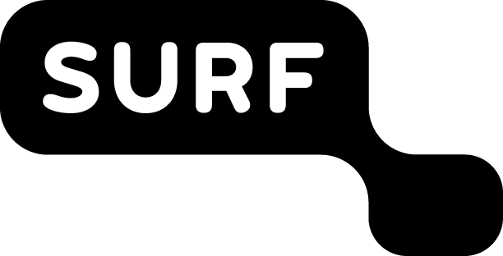
Key findings
AWS
Google Cloud
MS Azure
Vancis
Process maturity
Very high
High
High
Sufficient
Security posture
Strong
Sufficient
Questionable
Sufficient
ISO SoA coverage
Complete
Complete
Complete
Incomplete
Vendor engagements
Good
Disappointing
Disappointing
Good
Notes:
John

Slide 11
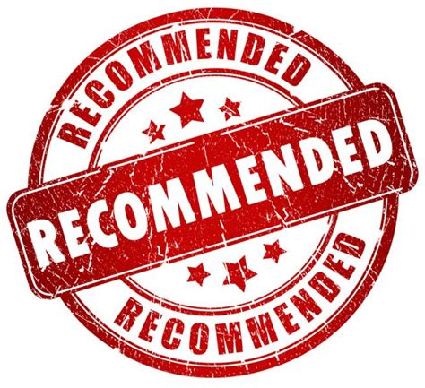
Recommendations
Consider security frameworks/standards before deciding which vendor to use for a workload.
Build compliance for your application from the ground up, using your vendor’s compliance. You have responsibilities as well!
Shared responsibility model: define which security controls are managed by vendor and institution. Ensure boundaries of responsibility are clear.
Assume breach. No matter how many security certifications are in place, there will be vulnerabilities. Implement defense in depth to secure your data even when there is a breach.
Reach out to us for any clarification or help
Notes:
Shiyona

Slide 12

Next steps
We will assess Oracle Cloud Infrastructure next (in progress).
We will repeat the assessments periodically.
In future iterations we intend to assess compliance of the resellers as well.
We will reassess which compliance frameworks/standards to consider in our scope.
Notes:
John

Slide 13

Closing slide
Thank you for your attention!
Shiyona Keenakkottil, shiyona.keenakkottil@surf.nl
John Segers,
john.segers@surf.nl

