Slide 1
Designing community engagement: bringing security and privacy together across borders
Davina Luyten, Belnet

Slide 2

Security and privacy
Intrinsically connected
Even more pronounced in R&E
But: often still operating in parallel
How can we build this gap and better support collaboration?

Slide 3

SURF: Community for Information Security and Privacy (SCIPR)
Since 20 years
+ 700 members
Working groups and quarterly meetings
Yearly 2-day conference

Slide 4
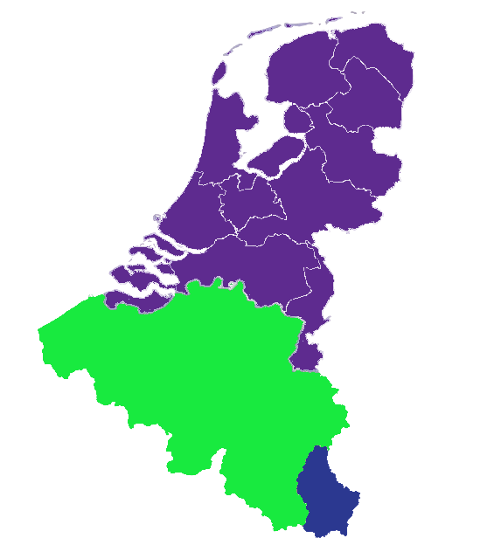



Extend the idea across borders
The idea emerged to build a Benelux-wide initiative, bringing together privacy and security professionals from three NRENs (SURF, Belnet and Restena) around shared challenges.

Slide 5
Why?
Stimulate collaboration across national borders and across professional domains
Not through formal coordination, but through peer-to-peer engagement

Slide 6
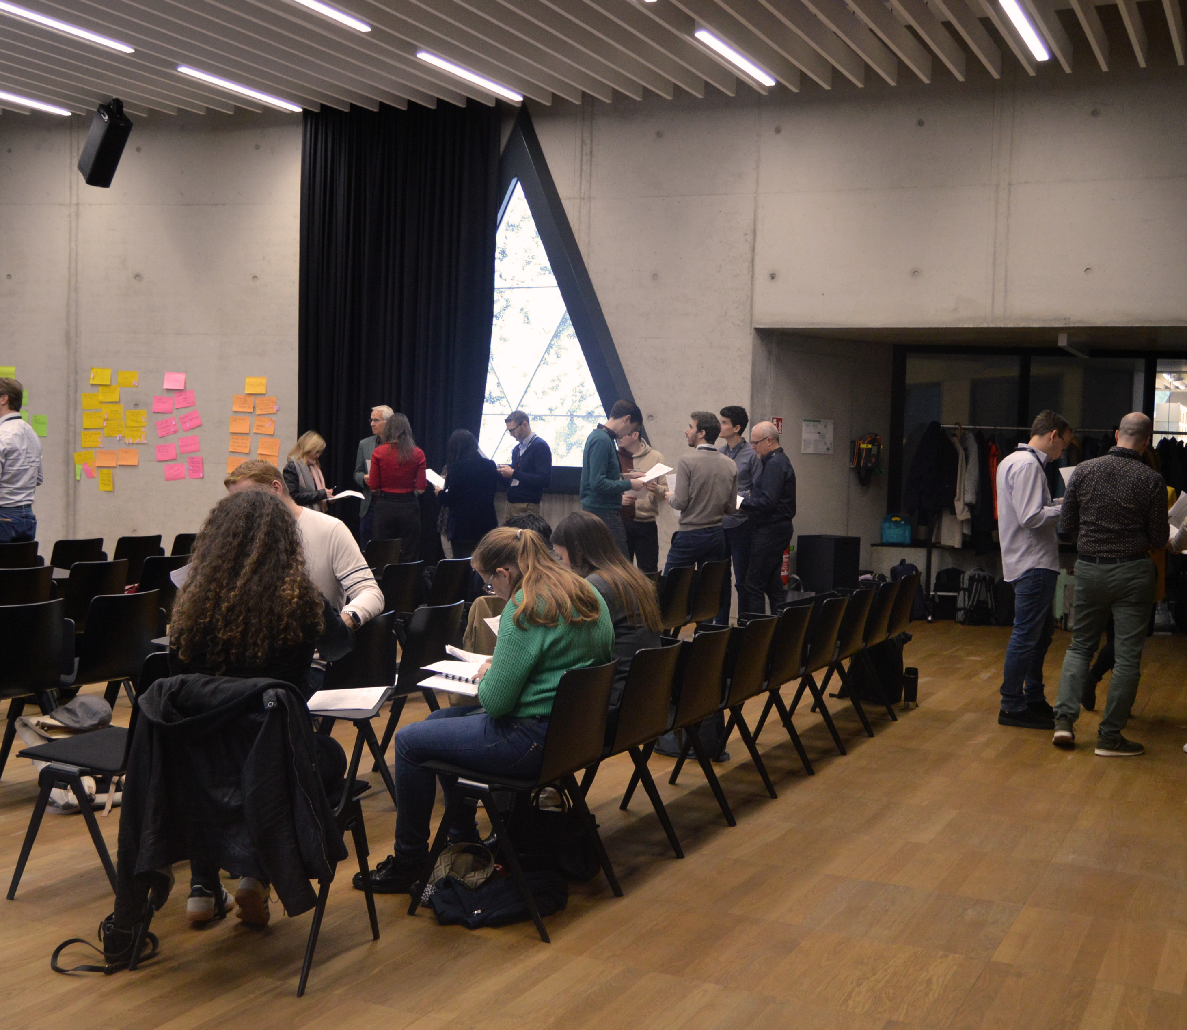
How?
Programme defined by the community itself
Small groups
Interactive sessions

Slide 7
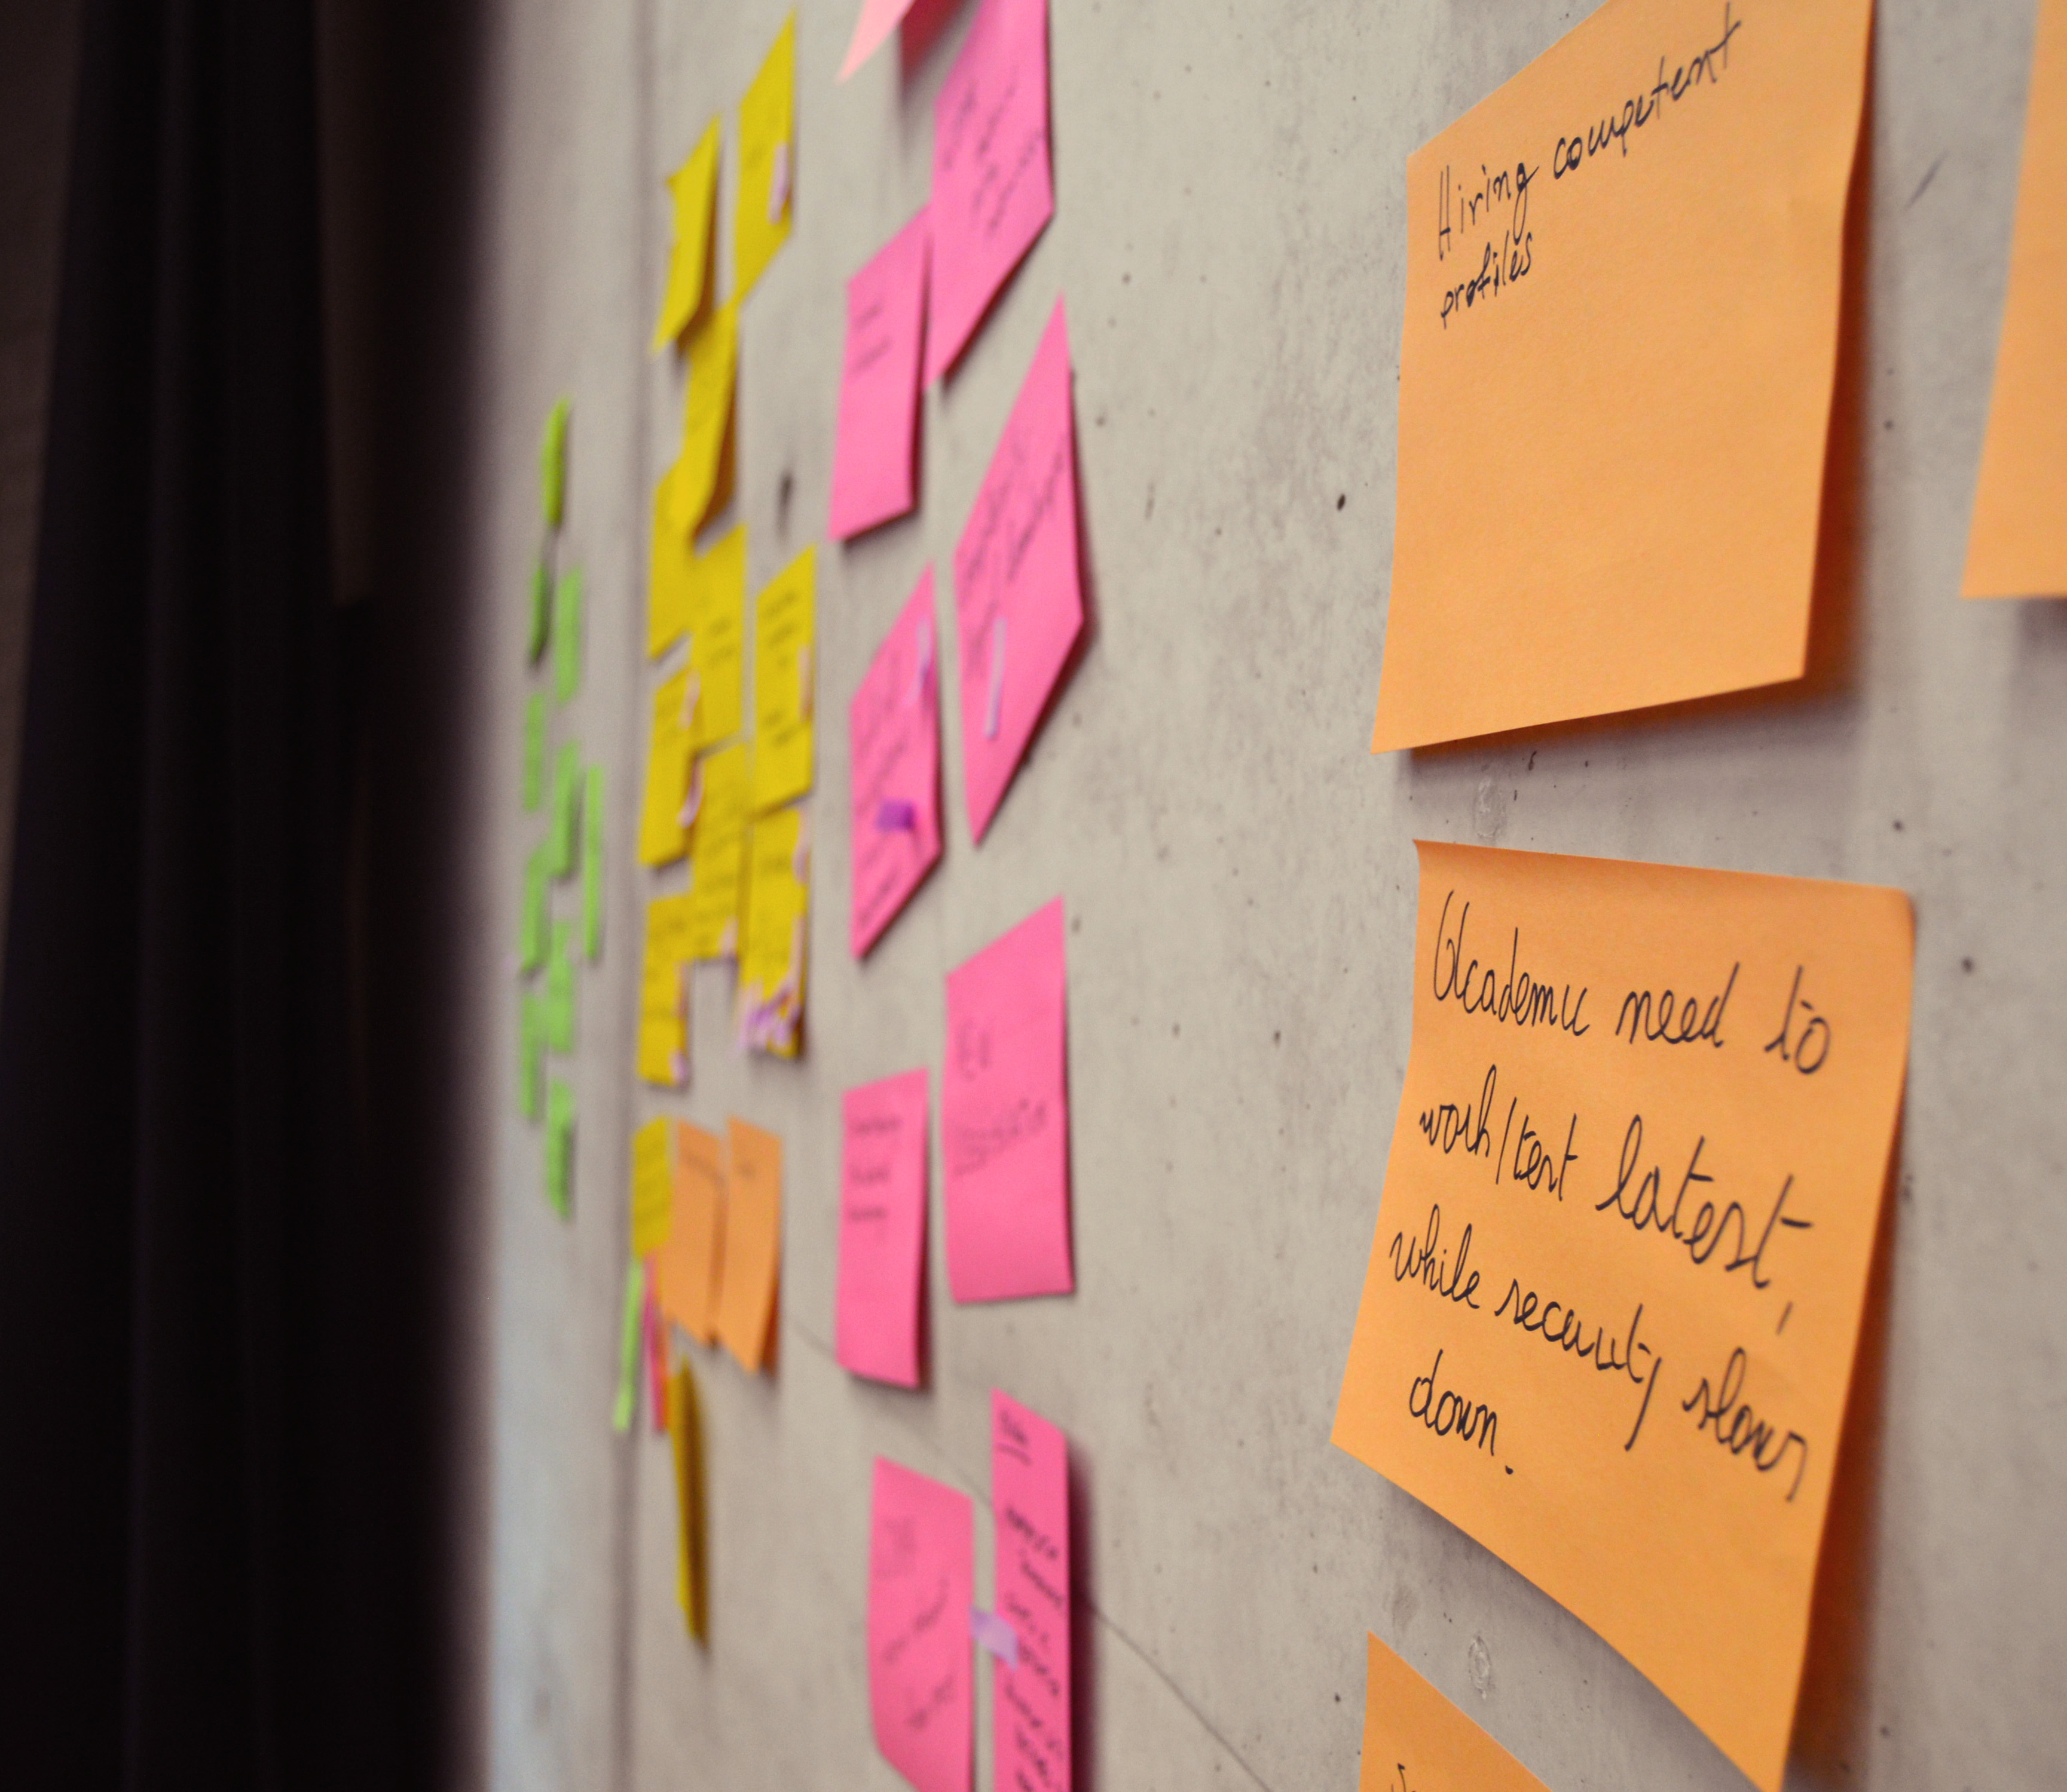
Topics
Everything at the intersection of security and privacy
Security incidents and data breaches
DPIA’s
Emerging technologies like AI and quantum communication

Slide 8
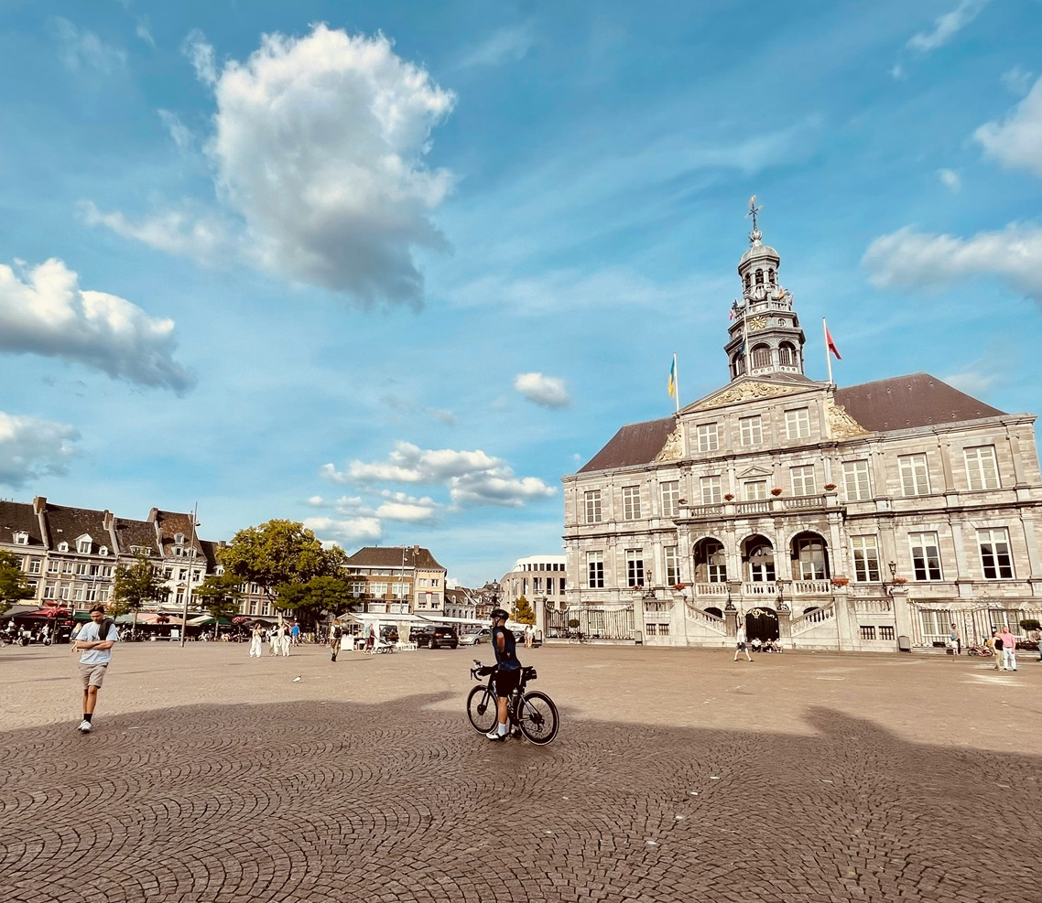
When?
Pilot in Brussels (October 2024)
Second edition in Luxembourg (October 2025)
Upcoming edition in Maastricht (NL) on 28-29 September

Slide 9
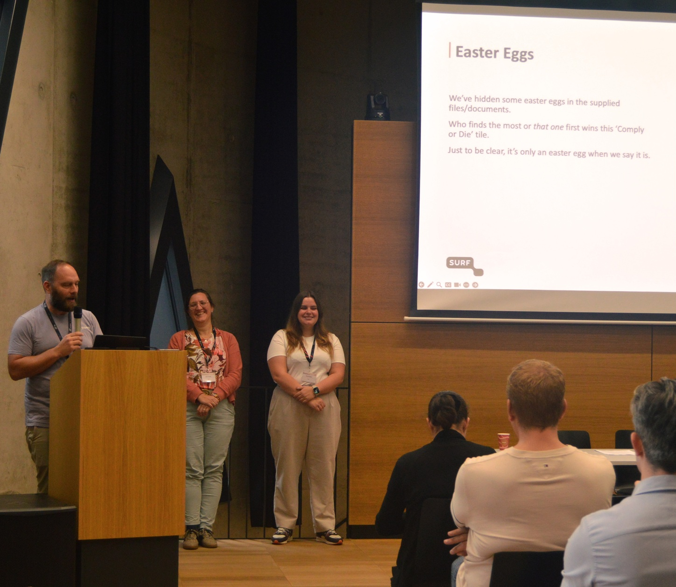
Result
Concrete outcomes
Potential synergies around security & privacy services for Belnet’s constituents
Community engagement can be designed, it does not happen by accident

Slide 10
And now?
Should we not involve privacy more structurally in forums like the GÉANT Security Days as well?

