Slide 1
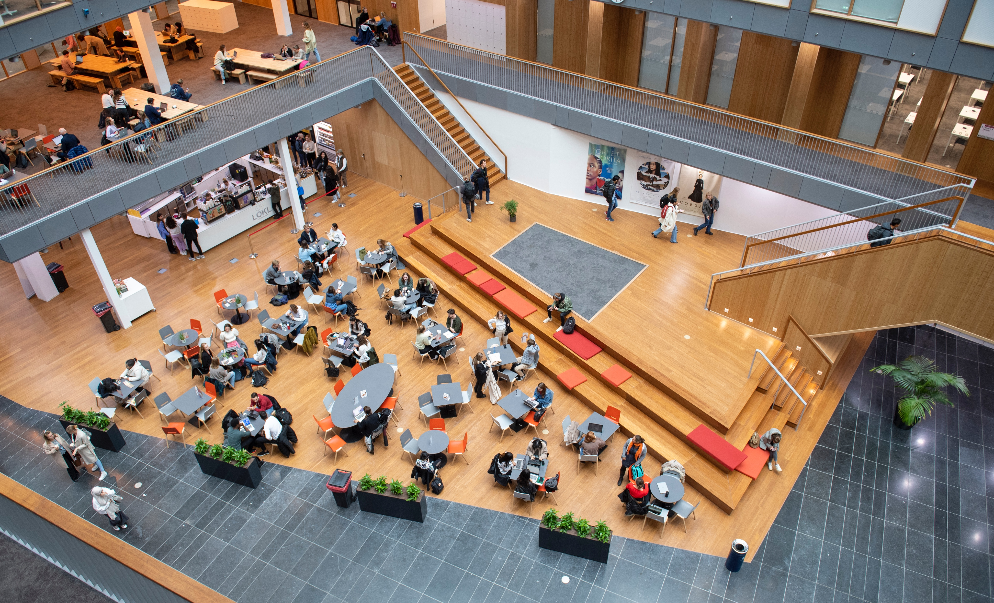
Title slide
Offensive Security Testing Unconference
Joost Gadellaa

Slide 2

Chapter blue
What thoughts or questions do you have about Offensive Security Testing for NRENs?

Slide 3
What are we going to do?
What is an Unconference?
Anyone who wishes to do so may soon suggest a topic for discussion or a question
Together we’ll draw up a schedule: where + when + who proposed it
4 principles and 1 rule

Slide 4
Chapter Green
Introductions

Slide 5
What are we going to do?
What is an Unconference?
Anyone who wishes to do so may soon suggest a topic for discussion or a question
Together we’ll draw up a schedule: where + when + who proposed it
4 principles and 1 rule

Slide 6
Chapter Orange
1. Whoever comes are the right people

Slide 7
Chapter yellow
2. Whatever happens is the only thing that could

Slide 8
Chapter Blue
3. Whenever it starts is the right time

Slide 9
Chapter Green
4. When it’s over, it’s over

Slide 10
Chapter Orange
The law of two feet
Notes:
Butterflies and Bumblebees

Slide 11
The schedule
Come to the front: write your name and the subject or your question on a Post-it note
Briefly state your name and your topic or question (in one sentence!)
Stick your Post-it note in a time slot
The schedule remains open!
Notes:
The organiser also shares a few thoughts afterwards

Slide 12
Chapter blue
What thoughts or questions do you have about Offensive Security Testing for NRENs?

