Slide 1
Fusion teams - breaking down barriers between areas
Humberto Forsan – RNP - Brazil

Slide 2
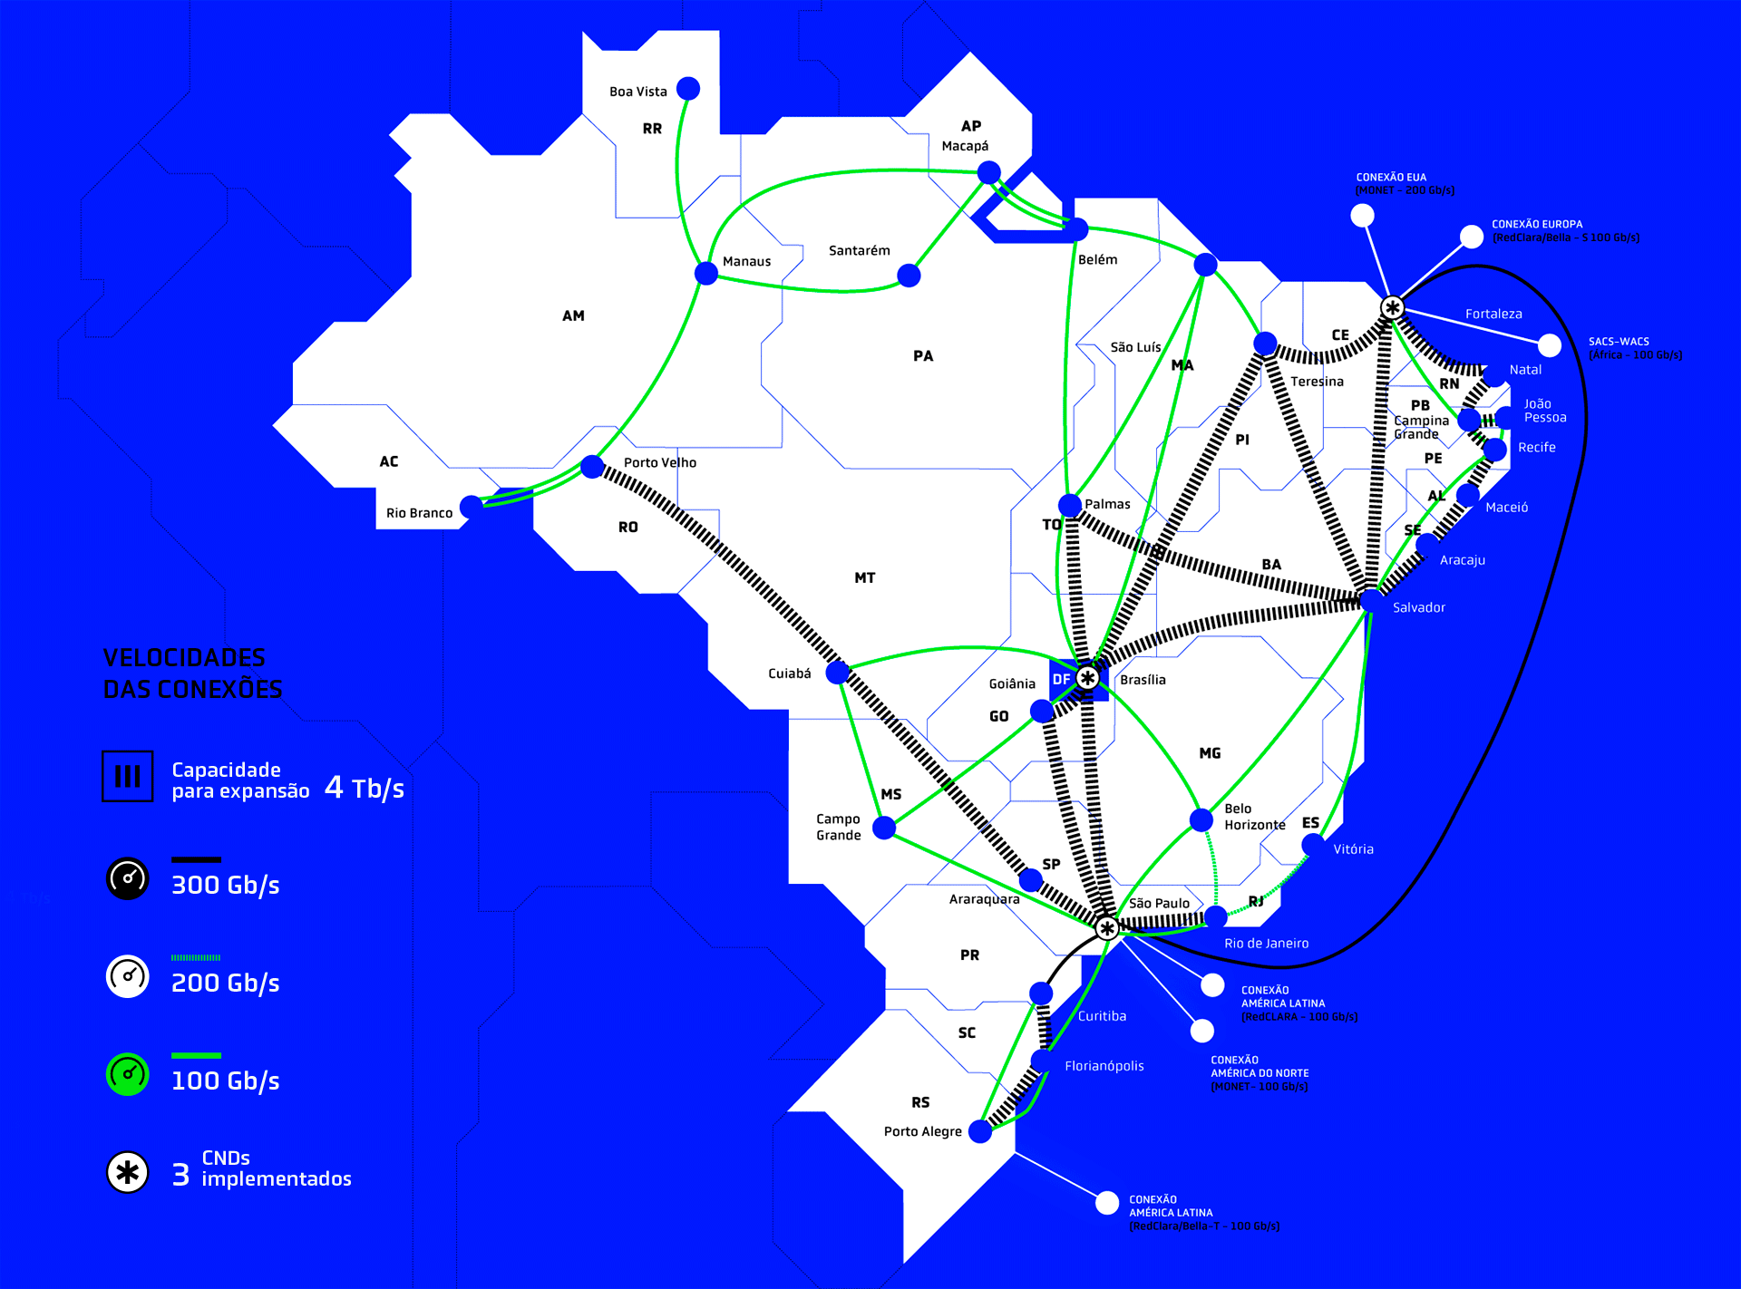



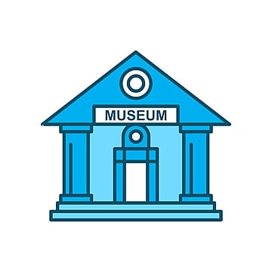

About
Brazilian National Research and Education Network (RNP).
Created in 1989.
1800 institutions connected (RedeIpê)
27 Points of Presence (PoPs)

Slide 3
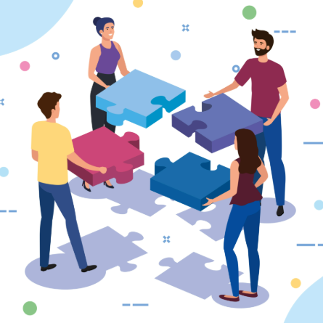
What are Fusion Teams?
Origin: The term used by Gartner (around 2019/2020).
Original Definition: It is a multidisciplinary delivery unit that focuses on business outcomes, rather than specific functions.
The concept of multidisciplinary teams exists in Agile and DevOps methodologies, Gartner formalized the "Fusion Team" to describe teams that combine Business Technologists (professionals from outside IT who create technology) with technical specialists.
The Fusion Teams there a focus in delivery PRODUCTS

Slide 4
Fusion Teams = Product-Based
Business Area Staff
IT Staff
Fusion teams are multidisciplinary teams that blend technology and business domain expertise and share accountability for business and technology outcomes.
Staffed as a Minimum-Viable Team: Teams ideally consist of 8-12 members (i.e., “the two pizzas rule”); large initiatives managed by teams of teams.
Matrix structure: Product owners assign tasks, functional leaders manage talent, and the team manages its own activities.
Focus on Results: Performance metrics monitor the achievement or adoption of business results, not just meeting deadlines, scope, or budget.
Continuous learning: The team acquires the ability to incorporate lessons learned and experimentation into the accumulated work.
Illustrative Fusion Team Composition
1
2
Dedicated resources
Product owner
3
Scrum master
Developer
4
5
Flex Resources
Developer(s)
Domain expert(s)
Cross-Cutting Experts

Slide 5

Fusion Teams in Numbers (Projects x Products)
Examples of business outcomes of delivery transformations from Gartner case studies
Speed
EX and CX
Cost Efficiency
Talent
Time to market
Customer Net Promoter Score
Facilitator-
to-doer
Self-service asset reuse & development
IT employee engagement
>500 days
Year 0
1:3
p10%
p30%
Year 5
1:5
▲20-60%
End goal
1:10
<45 days
Projects
Products
Projects
Products
Projects
Products
Projects
Products
Time to deploy new features
Employee Net Promoter Score
Digital customer growth
Annual cost savings
(Per platform)
8x
p50%
Lead conversion
$500K-$850K
6x
Customers using digital channels
Automation of nonfunctional requirements
Reuse of
platform components
>60 days
<7 days
29%
Sales through digital channels
Projects
Products
Projects
Products
Source: Adapted from Ally, Banco Popular of Colombia, Cepsa, Teach for America, Nationwide Building Society, Northwestern Mutual, Repsol, TD, Türkiye İş Bankasi (İşbank) and Watercare

Slide 6

... And Fusion Teams at RNP
SILOS
Corporate or Internal
Why so dangerous?
Lack of systemic vision: Each area is only looking out for itself, and no one realizes or knows what the ultimate goal is.
Rework and slowness: Information takes too long to cross the "barriers." When IT finishes a project, it discovers that it needs to adapt information security items.
Internal Conflicts: A "us versus them" mentality is created, where areas compete for resources instead of collaborating for the company's success.

Slide 7
... And Fusion Teams at RNP
Architecture
GRC
We detected a problem with internal silos
Awareness and Education
Projects
Awareness
and
Education
Blue Team
One team
3 Management levels
5 Coordination levels
11 Disciplines
60 Employees
Innovation Hub
Information Security Engineering
Offensive and
Defensive
Security
Red Team
HUB
CAIS
Research and Development
Research and Development
Information Security Operation
CSIRT
Privacy Coordination
SOC Coordination
A challenge for management and integration.
Privacy
SOC

Slide 8

... And Fusion Teams at RNP
In 2025, the Information Security team introduced a new concept for project management, based on products: Fusion Teams.
We changed the original idea to introduce the concept within the security team as an experiment…
… before taking it to other areas.
This concept integrates different technical areas of CAIS RNP to work collaboratively to deliver results
The idea is to create a product with governance, sustainability, and continuous improvement.
With this approach, we were able to carry out 3 products where we had members working from the following teams:
Blue Team
GRC
Red Team
Architecture
Projects
CSIRT
SOC

Slide 9
... And Fusion Teams at RNP
Product 1: Suricata Sensors at PoPs
Objective:
• Build the Suricata IDS sensor cloud on the administrative networks of RNP's Points of Presence;
Mission:
• Provide resources to identify indicators of compromise in the internal environment.
• Implement and operationalize the 27 Suricata sensors distributed across RNP's POPs, creating an integrated process for implementation, identification, and threat handling;
• Evolve the information security maturity of CAIS RNP in threat detection and prevention of incidents, intrusions, or data breaches;
• Create documentation and processes for implementation and operation;
• Implement 24x7 monitoring and incident response;
• Implement an solution to automate activities and eliminate false positives;
• Create a process for continuous improvement and operation.
Team:
•Technical Lead
•Architecture Analyst
•Defensive Security Analyst
•Governance, Risk and Compliance Analyst
•SOC Analyst (Level 1)
•SOC Analyst (SOC-Core Team)
•CSIRT Analyst
•Project Analyst

Slide 10
... And Fusion Teams at RNP
Product 2: Google SECOPS
Objective:
• Detect and mitigate threats in real time, ensuring constant monitoring of RNP's corporate assets and the RNP system institutions connected to the SOC;
Mission:
• Centralize security logs and alerts on a single platform;
• Correlate events to identify anomalous behaviors and potential malware infections;
• Automate security and incident response processes, gaining agility in threat response time;
• Offer greater agility in incident response, protecting sensitive data and ensuring business continuity;
• Use artificial intelligence to improve detections and performance indicators;
• Document and create processes for the use, continuous improvement, and onboarding of new items to be monitored.
Team:
•Technical Lead
•Architecture Analyst
•Defensive Security Analyst
•Governance, Risk and Compliance Analyst
•SOC Analyst (Level 1)
•SOC Analyst (SOC-Core Team)
•CSIRT Analyst
•Project Analyst

Slide 11
... And Fusion Teams at RNP
Product 3: Implementation and Operation of the WAZUH
Objective:
• Implement the Wazuh Open-Source tool for brute-force detection and anomalous behavior in RNP domains.
Mission:
• Detect scope/group/user password modifications and accesses via local AD or Office 365, and administrative actions in the Office 365;
• Anomalous detections in Office 365 products (Sharepoint, OneDrive, Teams, PowerBI, Power Apps…)
• Implement and operationalize monitoring and response to incidents identified by Wazuh;
• Evolve the information security maturity of CAIS RNP in detecting threats and preventing incidents, intrusions, or data breaches;
• Create documentation and processes for implementation, operation and continuous improvement;
• Implement an AI solution to automate activities and eliminate false positives.
Team:
•Technical Lead
•Architecture Analyst
•Defensive Security Analyst
•Governance, Risk and Compliance Analyst
•SOC Analyst (Level 1)
•SOC Analyst (SOC-Core Team)
•CSIRT Analyst
•Project Analyst

Slide 12
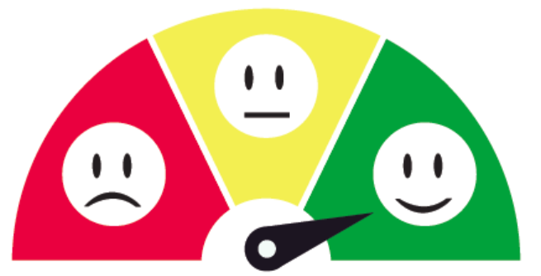
Results
Improved communication
Development of new leaders
Team integration
Sense of ownership
Process (they understood the need)
Challenges
Fusion Teams vs Activities (We are not a software factory... We don't have a team for each product)
Management (Difficulty delegating)... Some managers want to decide or participate in everything
Experience with management (We working with a technical leader... Not a manager)
Difficulty in self-management of team members
In the final… we have a good experience, and we open more 6 “projects\products”

