Slide 1
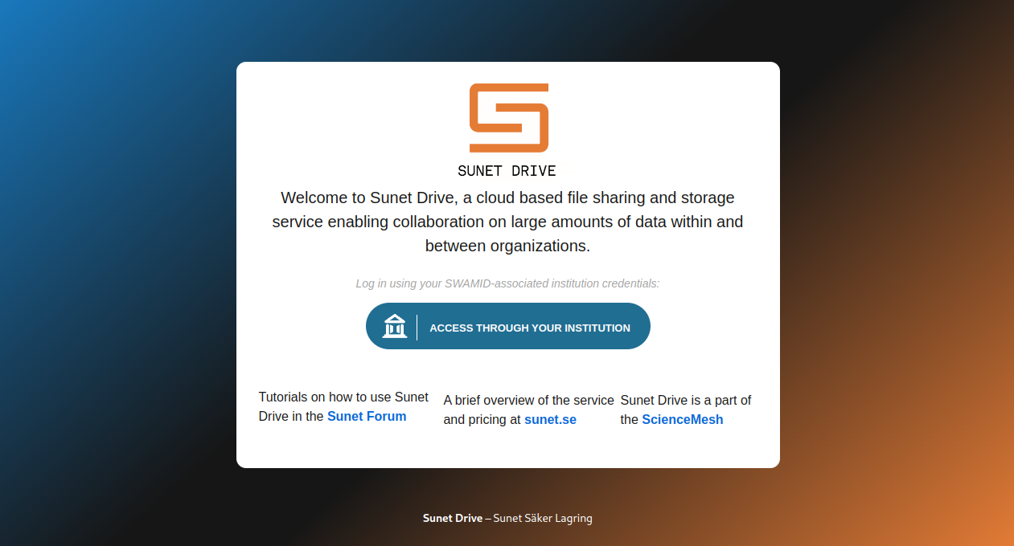
Sunet Drive
An OCM-compatible EFSS prepared for EOSC
SIG-CiSS 2025 - Bologna
2025-12-04 – SIG-CiSS 2025

Slide 2
Sunet Drive – Road to EOSC
Sunet Drive
  Current and future architecture
  FAIR Academic Toolbox
  Function, Efficiency, Innovation
  Separation of concern
  Where is EOSC?
  OCM – Practical considerations
  Maturity meets Sovereignty
  Fragmentation
2025-12-04 – SIG-CiSS 2025

Slide 3
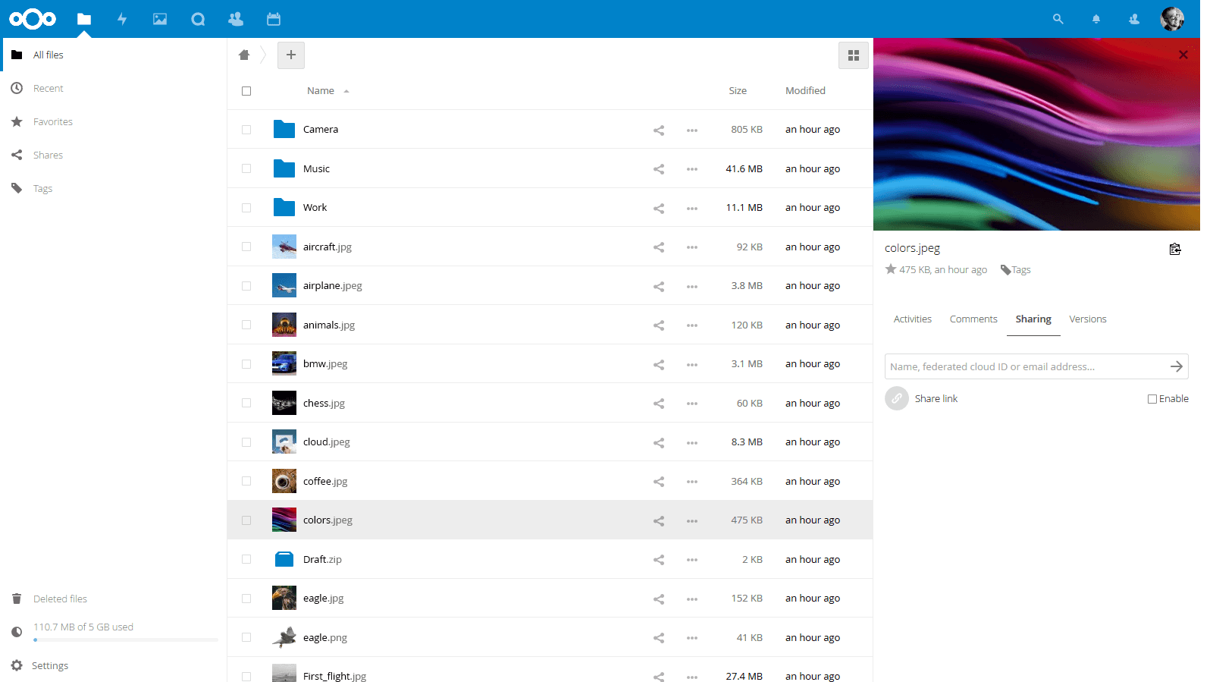
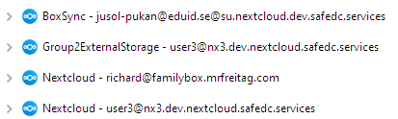
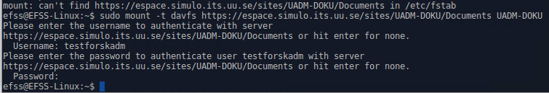
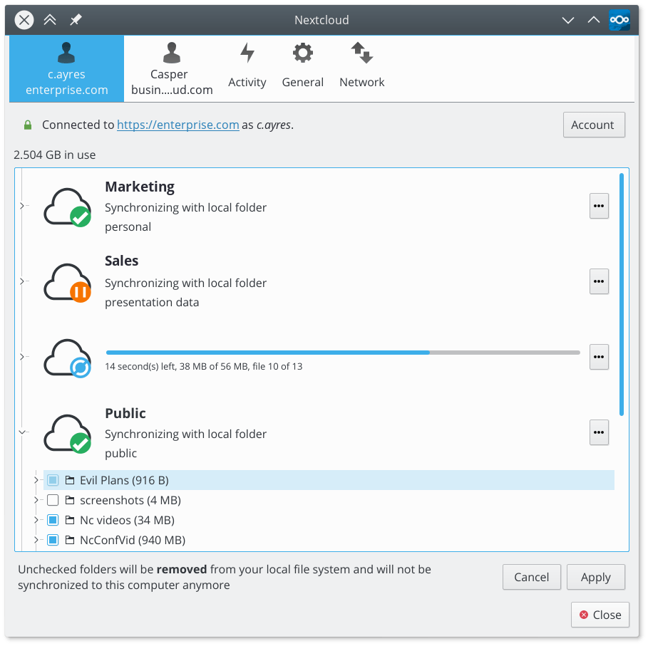
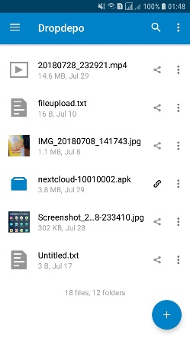
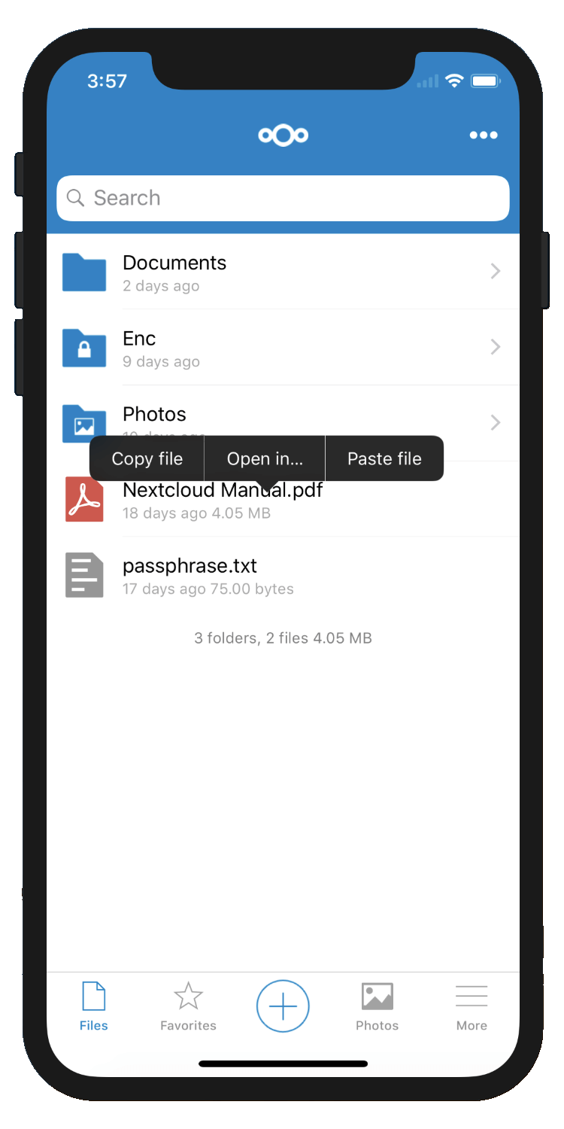
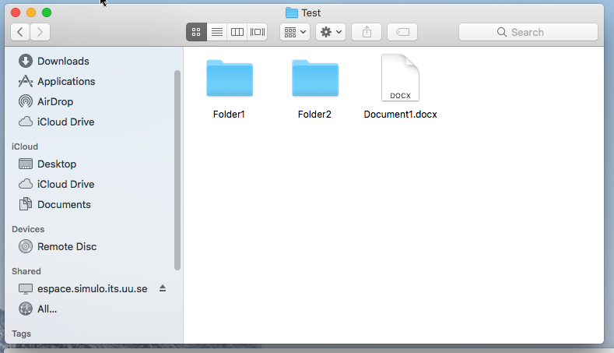
Sunet Drive – Current Architecture
Primary data sources
Access
UV-Vis
IVIUM
Storage (S3)
…
PIA
IPCE
2025-12-04 – SIG-CiSS 2025
Notes:
‹#›

Slide 4
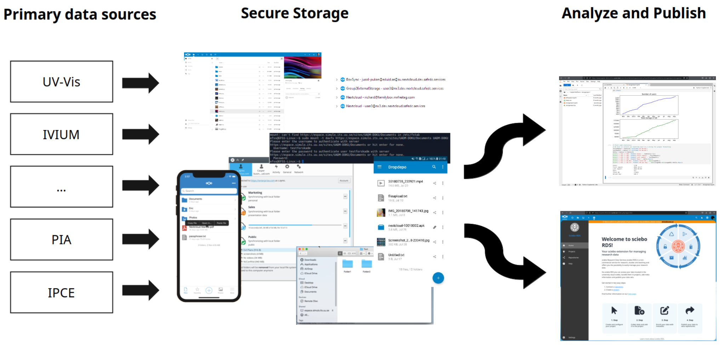
Sunet Drive – Future Architecture
2025-12-04 – SIG-CiSS 2025
Notes:
‹#›

Slide 5
Sunet Drive – Future Architecture
An Academic Toolbox
following FAIR principles
2025-12-04 – SIG-CiSS 2025
Notes:
‹#›

Slide 6
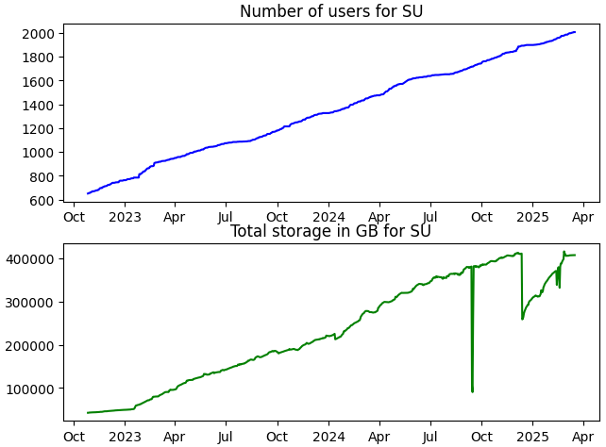
Sunet Drive
development & projects
Sunet drive today
2x54 nodes on 300+ servers in three two data centres
100% powered by green energy
21 paying customers (+1)
854TB data stored with >0.5TB added daily
5782 users
Team size: 5
JupyterHub & BridgIT
SURF Research Cloud
Secure Zones/MFA/Step-up Authentication
Security Audit
Devops: Third data centre & Kubernetes
AI Assistant with “Ethical AI”
Function
OCM Compliance
Efficiency
Kubernetes
Innovation
Surf Research Cloud

Slide 7
FEI - Function, Efficiency, Innovation
  FEI Principles
  Function – Sunet Drive provides the core functionality to all of its users. Example: file storage, versioning, backup.
  Efficiency – A university can effectively and efficiently manage the system with thousands of users and projects, owning millions of objects and files.
  Innovation – New functionality benefiting the users is added to the system and integrated seamlessly. Example: JupyterHub, MFA-Zones, SeamlessAccess, eduid connect.
The challenge: Any innovation becomes a function, often increasing the complexity of the system, while its efficiency needs to be maintained over time.
2025-12-04 – SIG-CiSS 2025

Slide 8
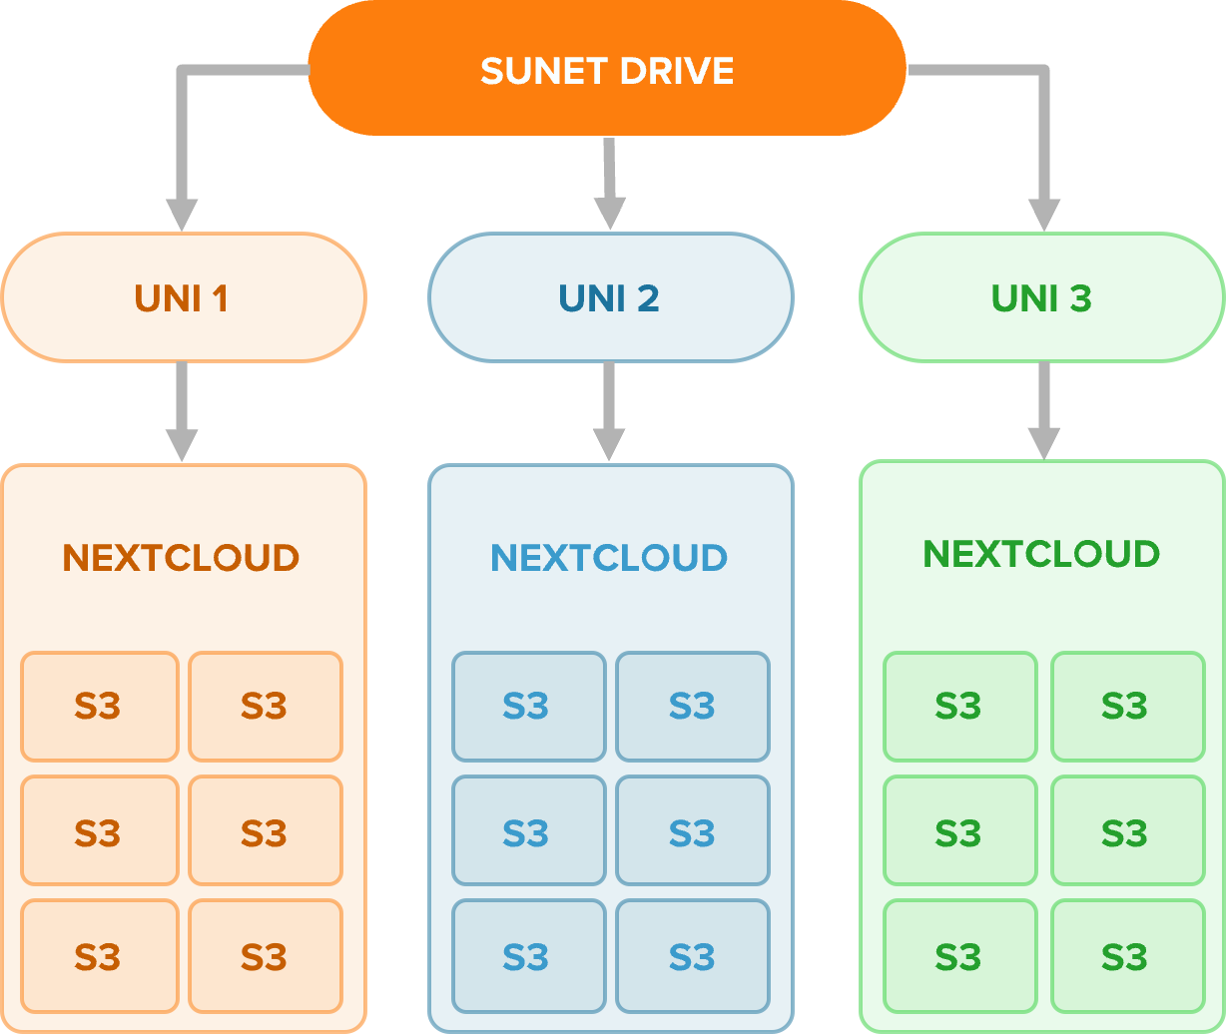
Separation of Concern
Co-Management of EFSS nodes
SSO-login to affiliated node
Catch-all for external collaborations
S3 as project storage entity
Separation of access and ownership
“Follow your data”
2025-11-04 – Sunetdagarna 2025

Slide 9
Where is EOSC?
2025-12-04 – SIG-CiSS 2025
Notes:
‹#›

Slide 10
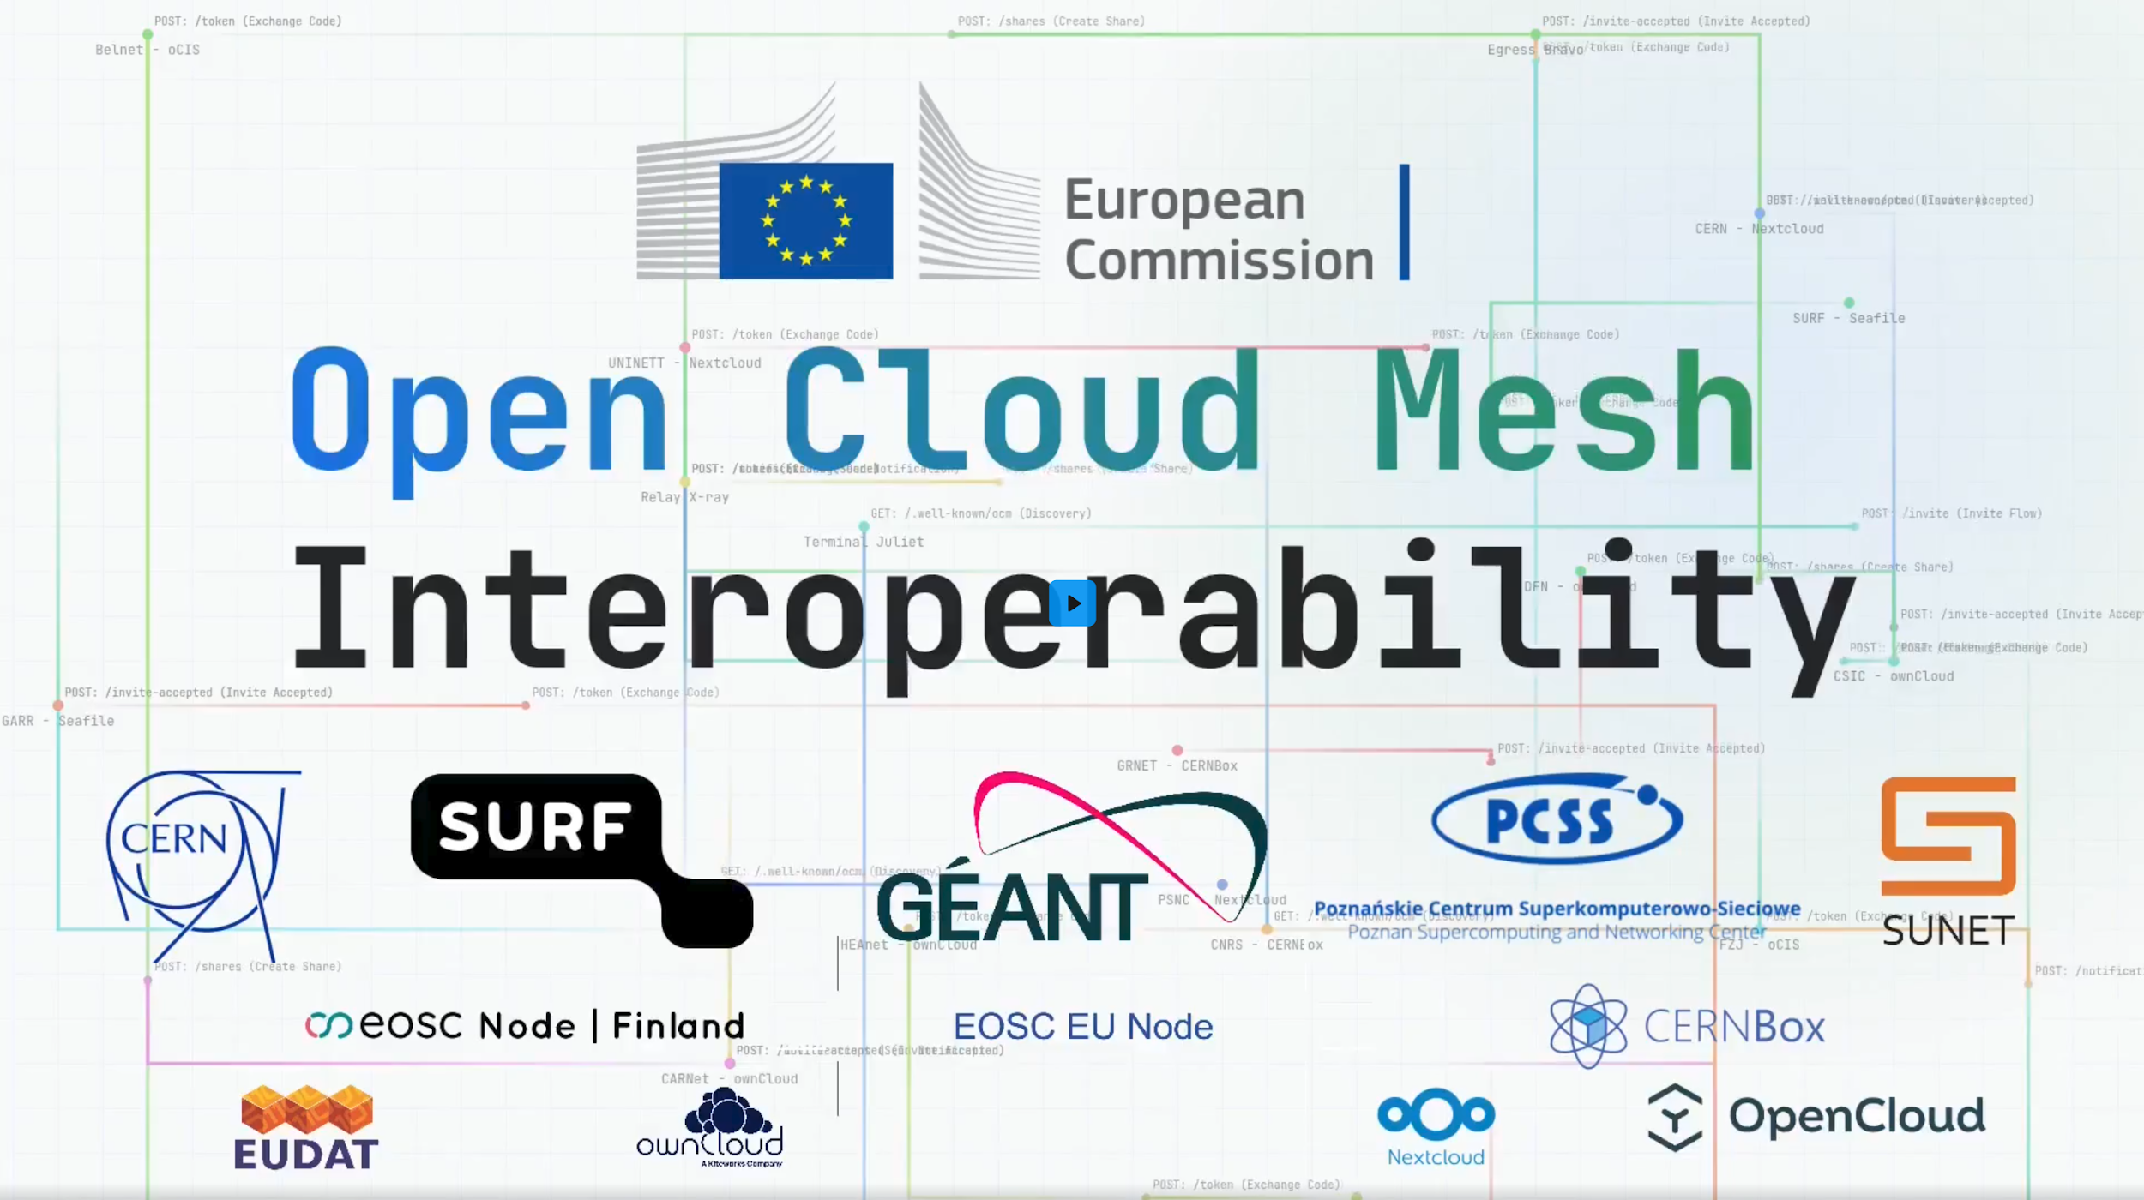
How close is Sunet Drive to EOSC?
2025-12-04 – SIG-CiSS 2025

Slide 11
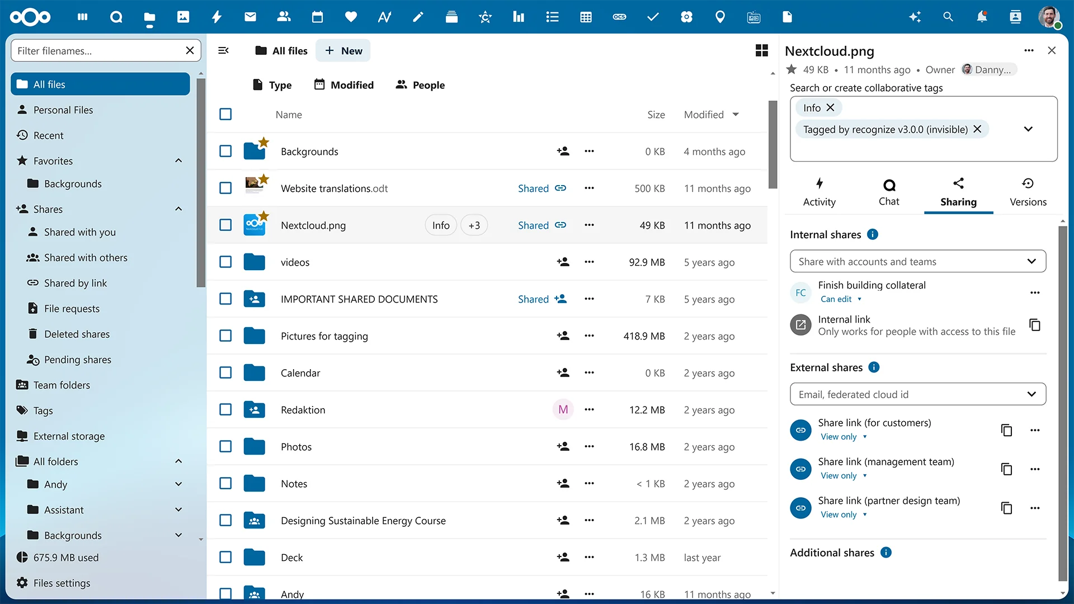
OCM and sharing – Practical feedback
OCM is largely invisible to the end user
Practical implementations support usability
  Internal shares
  External shares
Users and organizations want to be in controls
  Sharing reports
  Enforced MFA
  Concern about delegated sharing
2025-12-04 – SIG-CiSS 2025
Notes:
‹#›

Slide 12

Maturity meets Sovereignty
SEAL – Sovereignty Effectiveness Assurance Level
Strategic
Legal
Data & AI
Operational
Supply Chain
Technology
Security & Compliance
Environment
https://commission.europa.eu/document/download/09579818-64a6-4dd5-9577-446ab6219113_en
2025-12-04 – SIG-CiSS 2025
Notes:
‹#›

Slide 13

Fragmentation – Curse or blessing?
Sunet Drive
Same technology for all nodes (Nextcloud/S3)
Individual configurations, but in line with larger view
Regressions happen and can be hard to spot
Need to ensure compliance and compatibility with other EOSC OCM-nodes
2025-12-04 – SIG-CiSS 2025
Notes:
‹#›

Slide 14
Tack! Frågor?
Anders Nilsson
anders@sunet.se
Richard Freitag
freitag@sunet.se
Micke Nordin
kano@sunet.se
Rikard Danielsson
richir@sunet.se
Lars Delhage
lasse@sunet.se
2025-12-04 – SIG-CiSS 2025

