Slide 1




From Control to Sharing: The evolution of European Regulation on Biological Data and the ELIXIR Experience¶
Nadina Foggetti
CNR IBIOM
ELSI Officer Elixir-IT

Slide 2
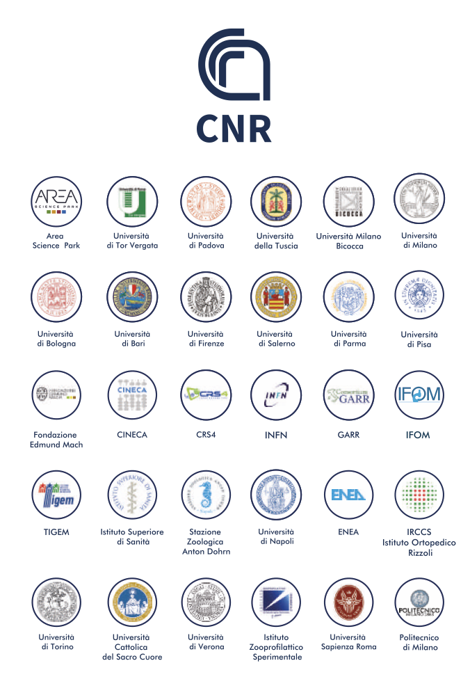
ELIXIR-IT
The Italian Node of ELIXIR (ELIXIR-IT) is formally established as as a Joint Research Unit (JRU) through a specific agreement among the coordinating organization (National Research Council, CNR) and the other 30 members. Apart from the CNR, the largest public research institution in Italy, the other members are composed of Universities, and scientific and technological institutes that, in most cases are leaders in the country in their respective fields of expertise (e.g. CINECA and INFN in supercomputing, ISS in public health, GARR in IT infrastructure for research, TIGEM for rare diseases).
The leading Institution (CNR) has been designed by the Ministry of University and Research.
The organisational layout of the node has three layers: 1) policy and oversight; 2) coordination; and 3) operational. The General Assembly (GA), advised by an international SAB, is the main body of the Node, leaded by the HoN (designated by the President of CNR) and including delegates designated by the legal representatives of participating institutions. The coordination and operational layer, including the staff involved in all ELIXIR-IT activities includes both in-kind and full-time staff (about 20 FTE in 2023).
31 Members

Slide 3

EU Legal Framework
Legal framework tra cyber security by design
Nis e Nis 2
Cyber security Act
Cyber Resilience Act
Legal Framework for sharing data
Data Governace Act
EHDS
Data Act
GDPR
AI Act

Slide 4

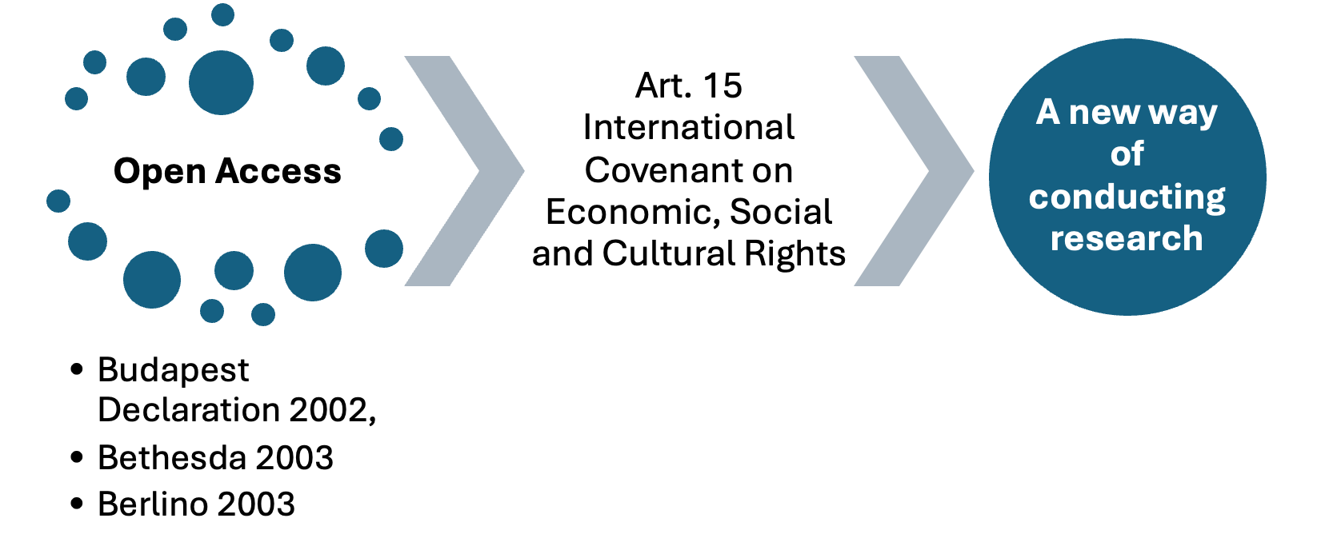
Human Right and Open Science

Slide 5


Principle of Data Altruism (DGA)
1. What it is
Voluntary sharing of data — without receiving any reward — by individuals or organizations for general interest purposes (research, health, environment, public services, etc.).
The DGA formalizes this practice, providing a legal and secure pathway for the reuse of personal or non-personal data.
How it works
Data altruism organizations: nonprofit entities, transparent, secure, respecting donors’ rights.
Consent / permission: data donors authorize reuse according to standardized European procedures.
Purpose: data used for general interest objectives, e.g., scientific research, healthcare, public policies.
Importance for ELIXIR / data infrastructures
Provides a stable and transparent legal framework for sharing sensitive data while protecting privacy and rights.
Enables creation of large-scale data pools for genomic, epidemiological, and AI-driven analyses.
Supports a federated, responsible, and collaborative governance model, aligned with FAIR principles and ethical data reuse.

Slide 6


Data Sharing for Research & Data Altruism: Key Challenges (EDPB)
European Data Protection Board
1. “Anonymisation”
According to the EDPB, data can be considered truly anonymised only when re-identification of individuals becomes technically impossible in practice, even when combining multiple methods or datasets. This sets a very high threshold.
2. “Research purposes”
The EDPB often interprets “research purposes” as referring to a specific research project, meaning that the usual legal basis (typically consent) can only authorise the processing of personal data for that one clearly defined study, not for broad or future research uses.

Slide 7


Not just lights: the shadows (and risks) for personal data protection
“Data controller” vs. “controller” under the GDPR;
The DGA adopts a “proprietary” conception of data, which is, however, foreign to the GDPR’s understanding of personal data;
Lack of coordination with the GDPR;
Uncertain equivalence between pseudonymized and anonymized data (only the latter are excluded from the GDPR regime: Deloitte Judgment C-413/23 P (EDPS v. SRB));
The concept of “data sharing” and its compatibility with the principles of privacy by design and by default;
The regulation of “data altruism”: need for greater clarity in consent collection and in defining purposes.

Slide 8

Sandboxes for Responsible Artificial Intelligence
1. “Regulatory sandboxes ”
Article 54 states that AI Act regulatory sandboxes: ‘shall provide a controlled environment that facilitates the development, testing and validation of innovative AI systems for a limited time’
2. “What are the benefits and shortcomings of regulatory sandboxes? ”
Regulatory sandboxes make it possible to test new technologies transparently and contribute to evidence-based lawmaking. From a market actor perspective, one of the main benefits is the additional flexibility in terms of regulatory burden. In addition, the controlled environment of regulatory sandboxes is particularly accommodating to products and services that do not easily fit the traditional regulatory framework.

Slide 9


possible points of conflict
1. “Artice 54 of AI Act ”
Article 54 on the further processing of personal data provisions for developing certain AI systems in the public interest in the AI regulatory sandbox. Are these provisions intended to apply as lex specialis (and thus override the General Data Protection Regulation (GDPR)) or merely to complement the existing provisions in the data protection legislation?
2. “Digital Omnibus on AI - Proposal 19/11/2025”
the package includes a digital omnibus that streamlines rules on artificial intelligence (AI), cybersecurity and data, complemented by a Data Union Strategy to unlock high-quality data for AI and European Business Wallets that will offer companies a single digital identity to simplify paperwork and make it much easier to do business across EU Member States

Slide 10

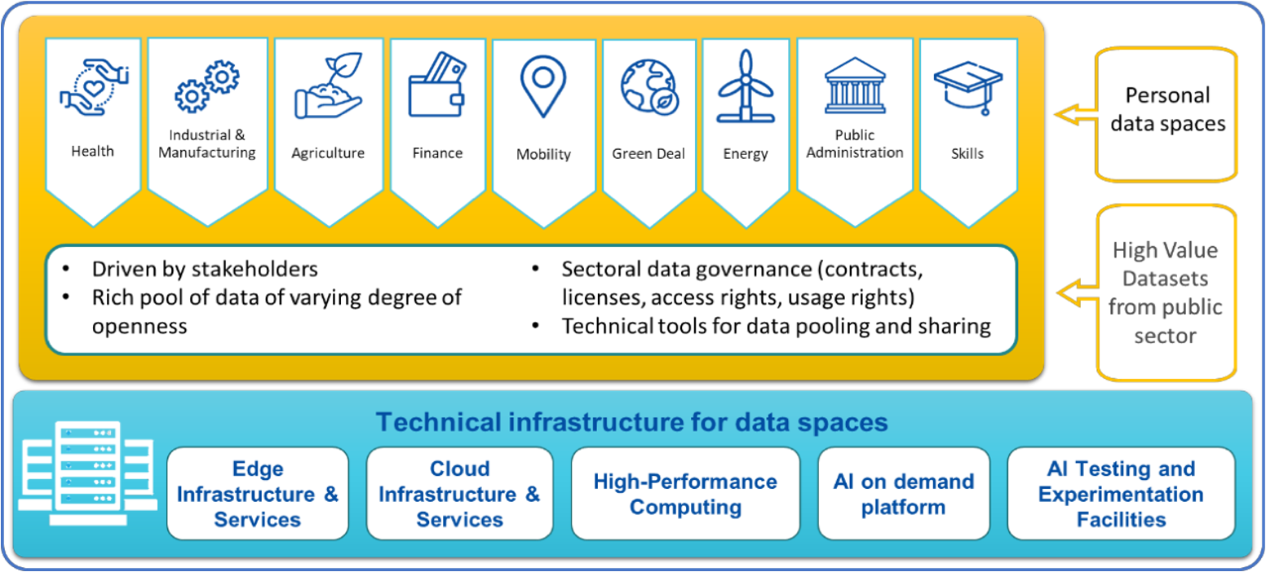
EHDS –the first European Data Space specifically dedicated to the healthcare sector

Slide 11


EHDS
to enable individuals to access, control, and share their electronic health data across borders in order to facilitate the provision of healthcare (primary use of data)
Objective #1
to enable the safe and trustworthy reuse of health data in areas such as research, innovation, policymaking, and regulatory activities (secondary use of data)
Objective #2
To promote a single market for electronic health record systems, supporting both primary and secondary use.
Objective #3

Slide 12









Project in which ELIXIR-IT is involved
Objective
Pillar I:
Governance: Decentralized with short-term and long-term models
Definition of Access Models
Definition of Access Policies
Connection with EHDS
Privacy and Trust
FAIRness
Diversity
Definition of workflow for Access
Input
Objective
WP5 (ELSI Expert Group)
Partecipazione WP4 Task 4.2 - ELSI checks subtask
Metadata standards & Quality checks
Clarify terminology
Standard Operating Procedures (SOPs)
Node task plans
WP2: Stakeholder Engagement:
stablishing legal and policy frameworks:
Building long-term sustainability
Developing data standards:

Slide 13


Balancing Legal Compliance and Open Science in Access to ELIXIR-IT Services
Compliance by Design
#1
Structured and Tiered Access
#2
Governace trasparente
#3
Modularity of Documentation
#4
Principle of “Open as Possible, Protected as Necessary”
#5
Technical Tools for Balancing
#6
Training and ELSI Support
#8

Slide 14


Elixir-IT
Best Practices developed in the ElixirXNextGenIT project

Slide 15


Work Flow accesso ai servizi Elixir-IT
Workflow
Work Flow

Slide 16
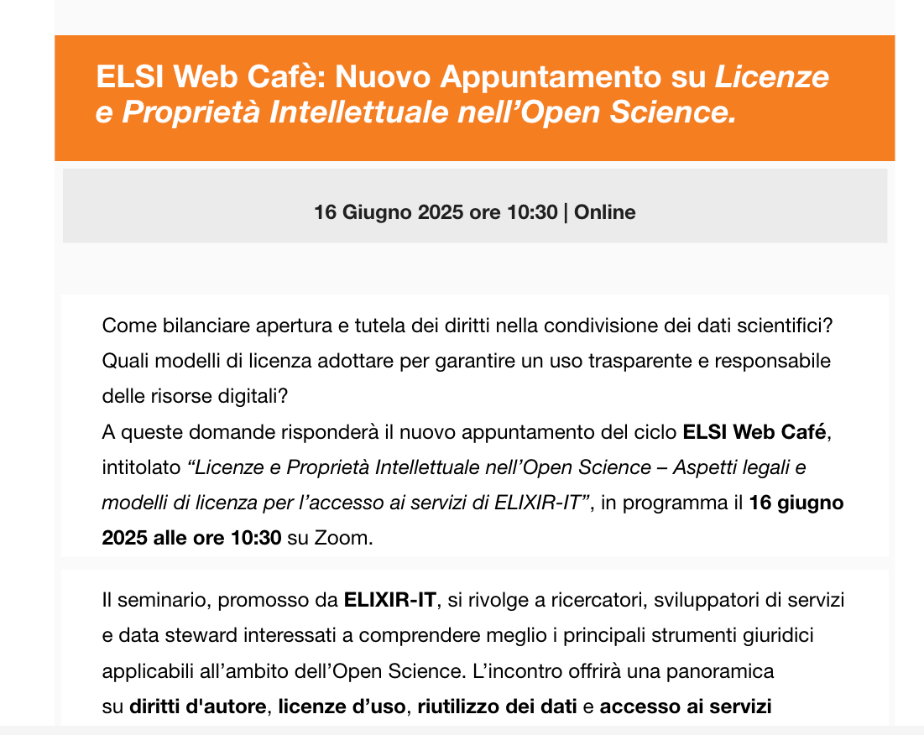
Elixir-IT
ELSI Web Cafè

Slide 17



Work Flow accesso ai servizi Elixir-IT

