Slide 1
Understanding academic sensitive data research and Secure Processing Environments at the age of European Health Data Space (EHDS)
@ 16th SIG-CISS
2025-12-04 Heikki Lehväslaiho, CSC, FI

Slide 2
European Health Data Space (EHDS)
European Union mandatory regulation on the exchange and use of electronic health data
  Entered into force 26 March 2025
  Long implementation phase
Primary use: Availability of health data across EU for citizens
Secondary use: Data holders are obligated to share electronic health data for specified secondary purposes (incl. research)
  Rules for sharing information about available datasets
  New data controller, Health Data Access Body (HDAB), for each member state
  Mandatory use of Secure Processing Environment (SPE)

Slide 3
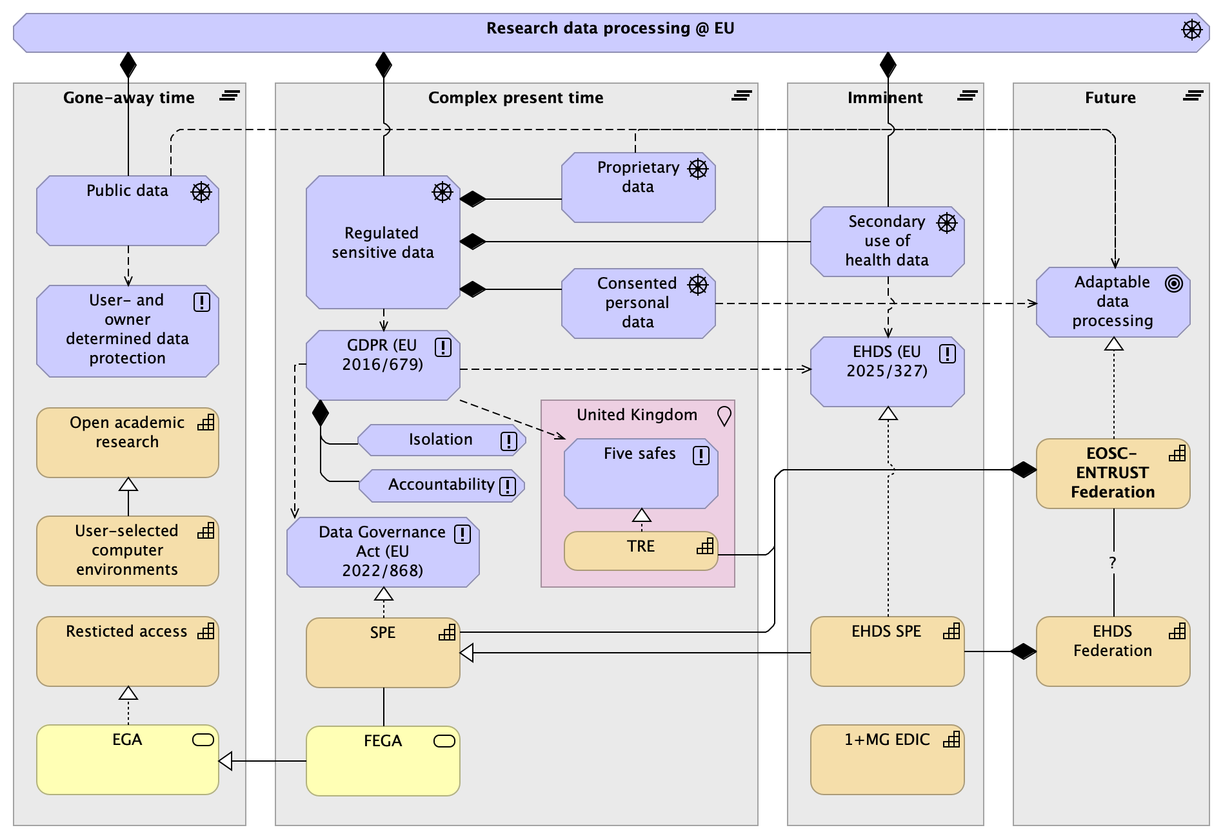
Timeline for research data processing
@ EU

Slide 4
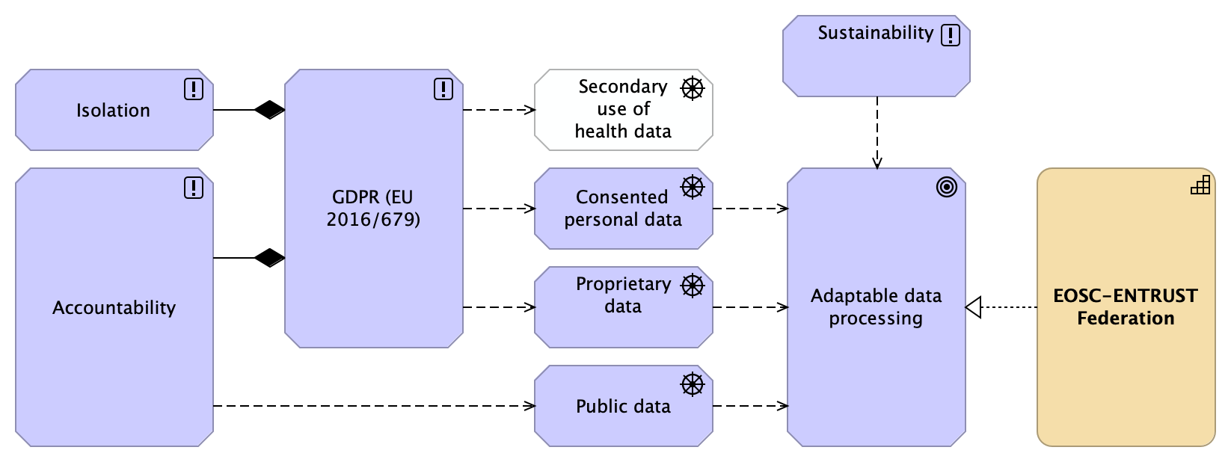
EOSC-ENSTUST Federation
(~ independent academic computation)

Slide 5
Secure Processing Environment (SPE) definition in Data Governance Act (EU 2022/868)
the physical or virtual environment and organisational means to ensuring compliance with the requirements of Regulation (EU) 2016/679, in particular data subjects' rights, intellectual property rights, and commercial and statistical confidentiality, integrity and accessibility, ensuring compliance with applicable Union and national law, and allowing the entity providing the secure processing environment to determine and supervise all data processing actions, including to display, storage, download, export of the data and calculation of derivative data through computational algorithms

Slide 6
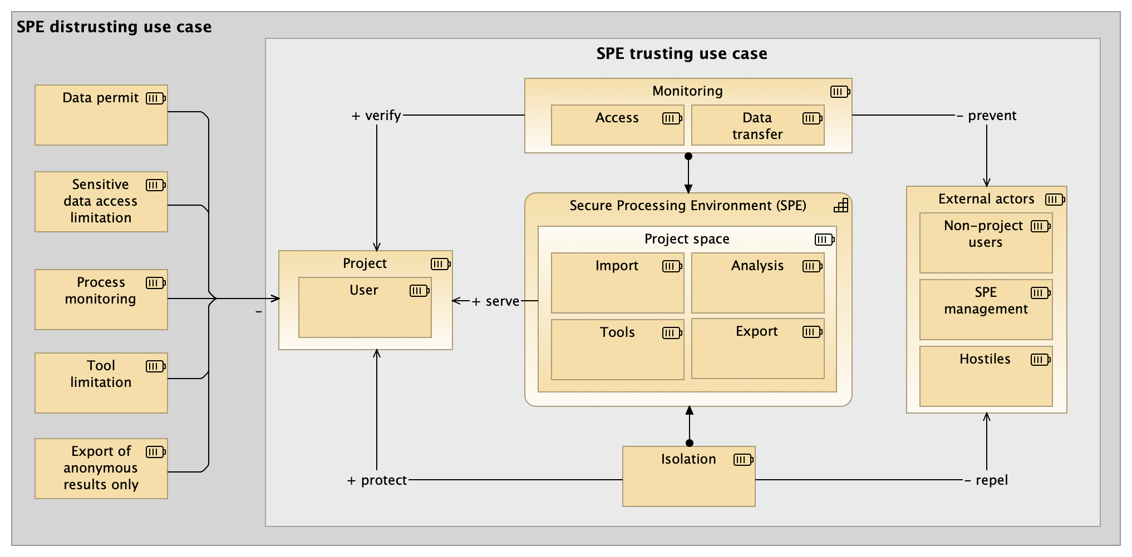
Secure processing Environment (SPE)

Slide 7
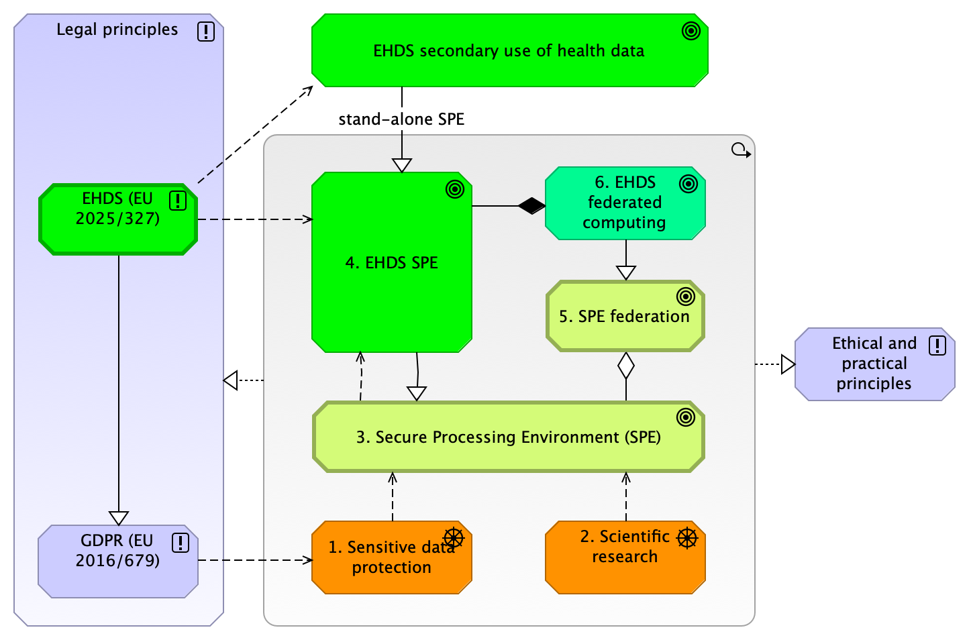
SPE in EHDS

Slide 8
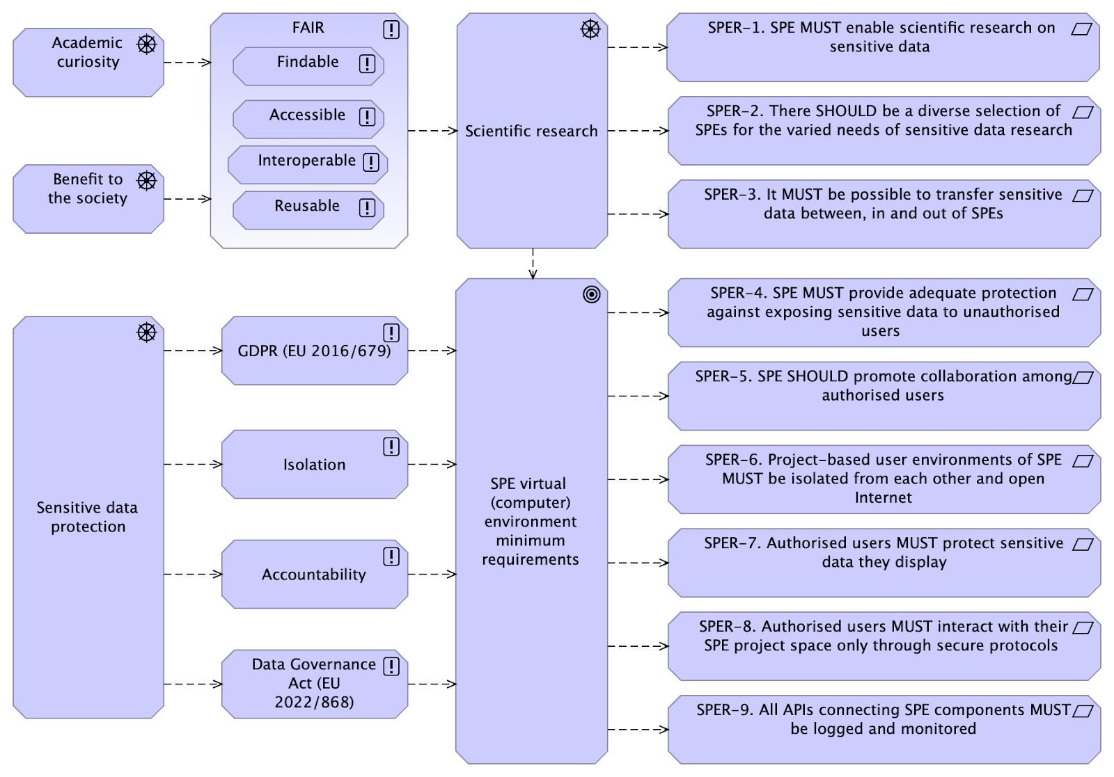
Preliminary, requirements for SPE (in TEHDAS2, EHDS)

