Slide 1
EOSC4ALL
Providing a low barrier way to join the EOSC Federation
Mark van de Sanden, GÉANT/Data and Research
27 November 2025
Public (PU) / Project Participants Sensitive (SEN)

Slide 2
EOSC4ALL Vision
The EOSC4ALL project envisions a truly inclusive EOSC Federation, where deploying an EOSC Node is simple, fast, and accessible to all eligible organisations. By lowering entry barriers, EOSC4ALL aims to empower researchers and institutions to access, share, and discover services and research outputs seamlessly and securely across institutional, national, and disciplinary boundaries.

Slide 3
Identified challenges
C1: Implementation: Implementing and operating an EOSC Node poses technical, financial and operational challenges
C2 Interoperability: EOSC Federation members must commit to common standards and protocols to ensure their systems work together to provide a seamless user experience
C3 Trust framework: Trust is a cornerstone in any federated infrastructure. In a federated infrastructure such as the EOSC Federation, establishing trust requires robust frameworks to securely authenticate and authorise users.
C4 Sustainability of EOSC Nodes and the federated capabilities: Sustaining an EOSC Node and other federated capabilities requires significant effort, skills, and long-term commitment and funding.
C5 Governance: The transition from a prototype EOSC Federation to a production EOSC Federation requires agreements on sustainability, governance, cybersecurity, and quality assurance, whilst ensuring that each member (e.g. countries, research infrastructures) retains control of its own resources and local governance.

Slide 4
Objectives
PO1: Lower the barrier for entry into the EOSC Federation through the GÉANT Digital Research Environment (GDRE), a multitenant managed platform (WP2, WP5).
PO2: Take over, maintain, enhance and scale up the EOSC Authentication and Authorisation Infrastructure (AAI) Federating Capability and deliver a managed solution for the AAI Node Core Capability (WP3).
PO3: Create a cross-node, cross-border, interdisciplinary collaborative space by extending the initial EOSC EU Node File Sync & Share (EFFS) solution to an EFSS generic Node capability available in the GDRE and by offering a new EOSC Federating Capability to enable interoperability of EFSS services across nodes (WP4).
PO4: Define a sustainability plan for the EOSC4ALL key exploitable results (KERs) to ensure continuity (WP6).

Slide 5


















Partners

Slide 6
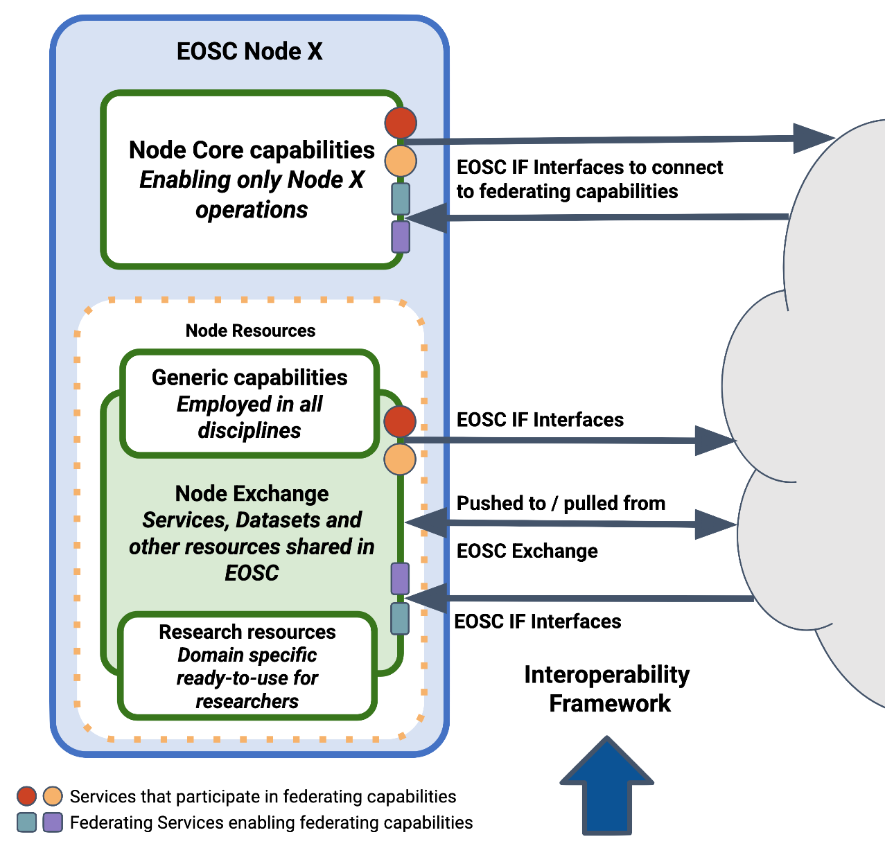
EOSC Node Reference Architecture
Node Core capabilities that enable the operations of the Node (e.g. AAI, Helpdesk, Monitoring, etc.).
Node Resources: services, data and other research products, usually listed in a catalogue, that end-users of this Node can access directly. These are split into three categories:
Node Generic Capabilities: employed in the vast majority of scientific disciplines (and therefore relevant to all EOSC Nodes) to perform everyday tasks related to research data management (e.g. a data transfer service or a cloud infrastructure).
Node Research Resources: domain specific services, datasets and other research products ready-to-use only for researchers of the Node (e.g. domain-specific datasets or an application to process thematic datasets). See Chapter 5 for a description of Research Resources to be provided by EOSC Nodes.
Node Exchange: subsets of the generic capabilities and Research Resources a Node makes available to the EOSC Federation. They contribute to the collective EOSC Exchange.
Services enabling or participating in Federating Capabilities.
EOSC
Federation

Slide 7
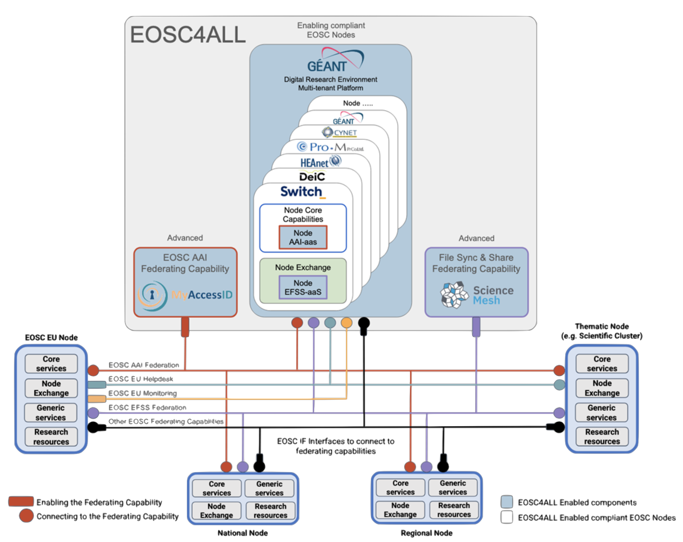
High-level architecture

Slide 8
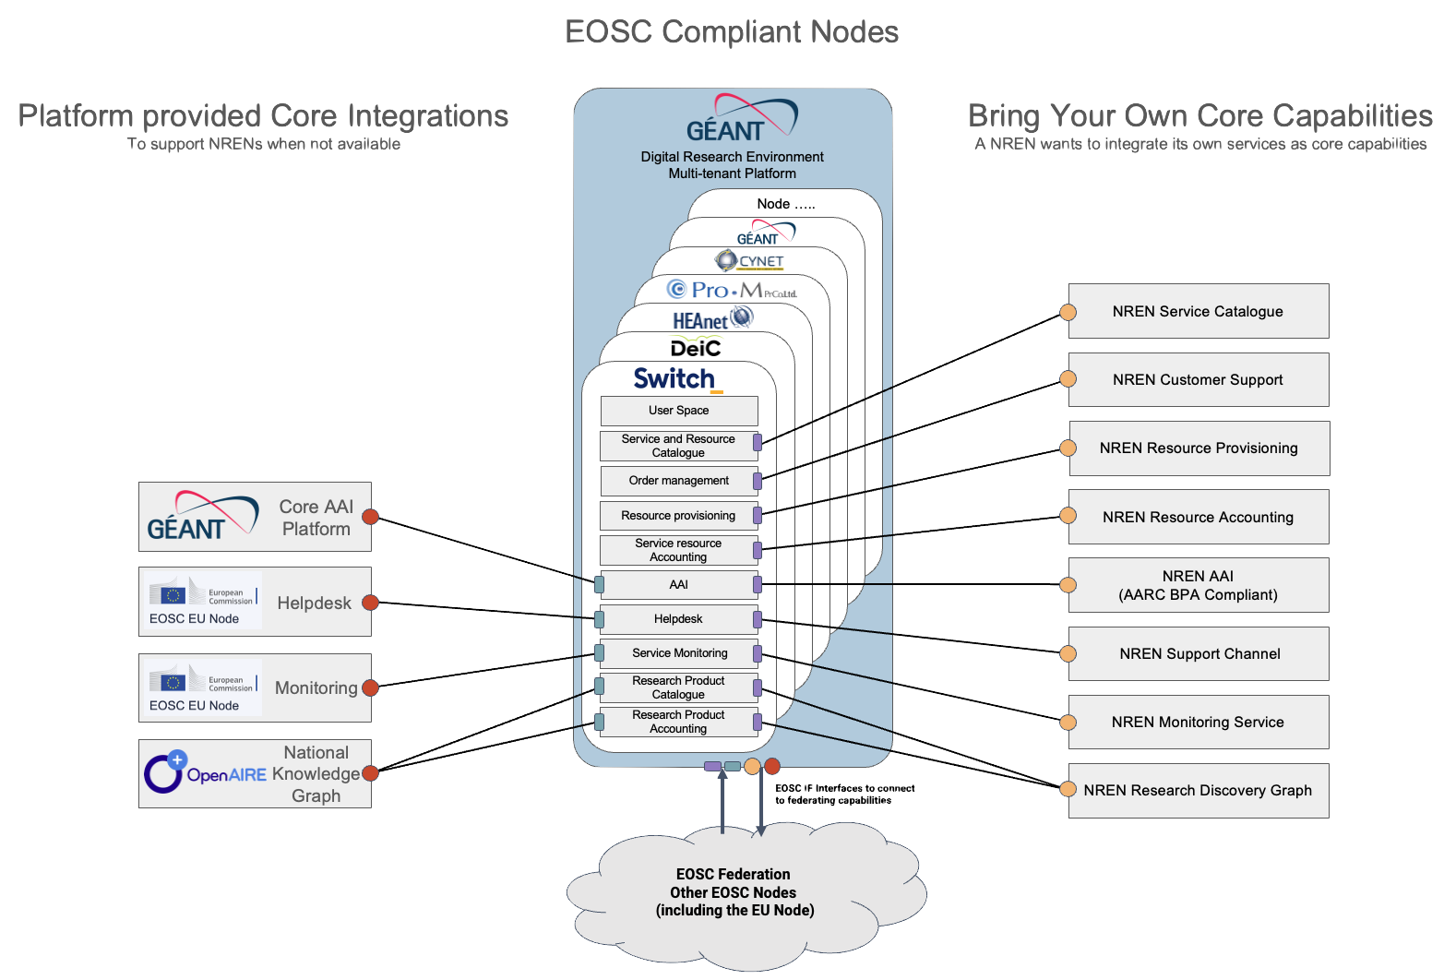
GÉANT DRE – Node Core Capabilities

Slide 9
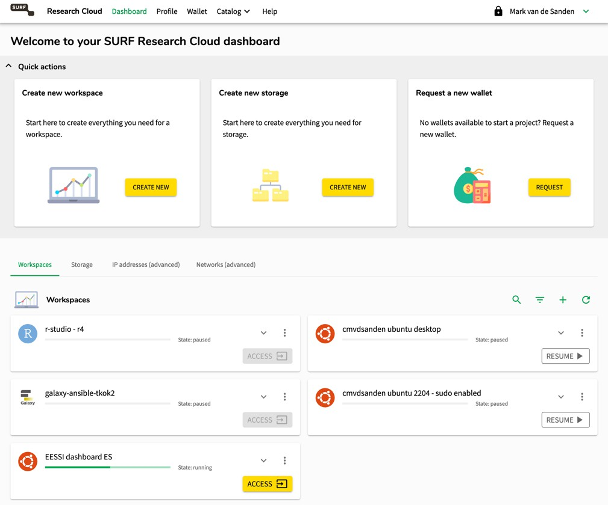
Example: Building up a National Node

Slide 10

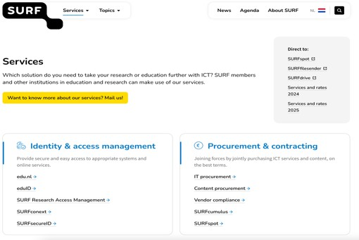

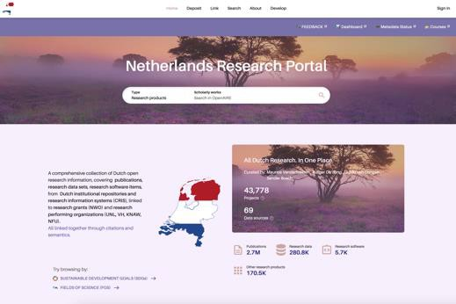
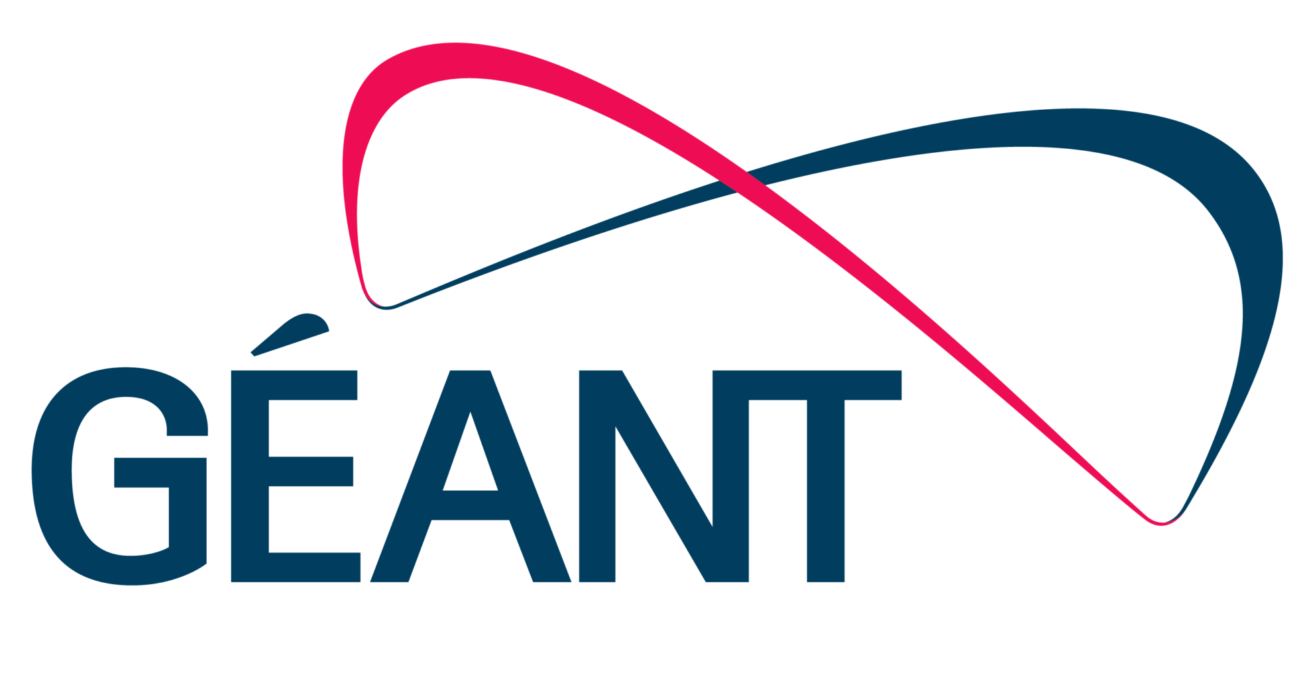
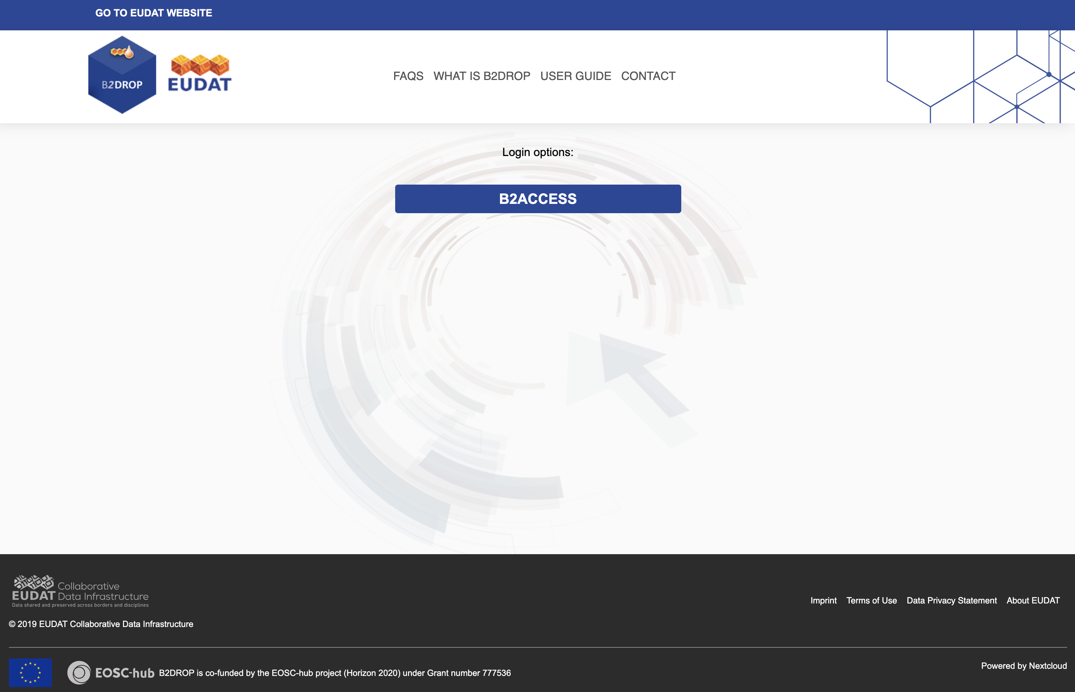
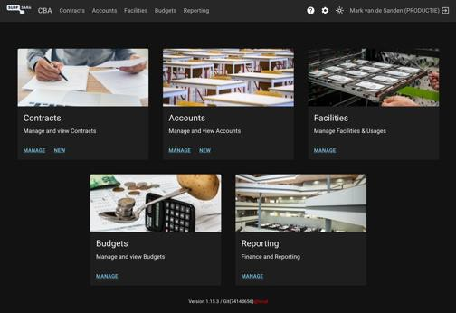
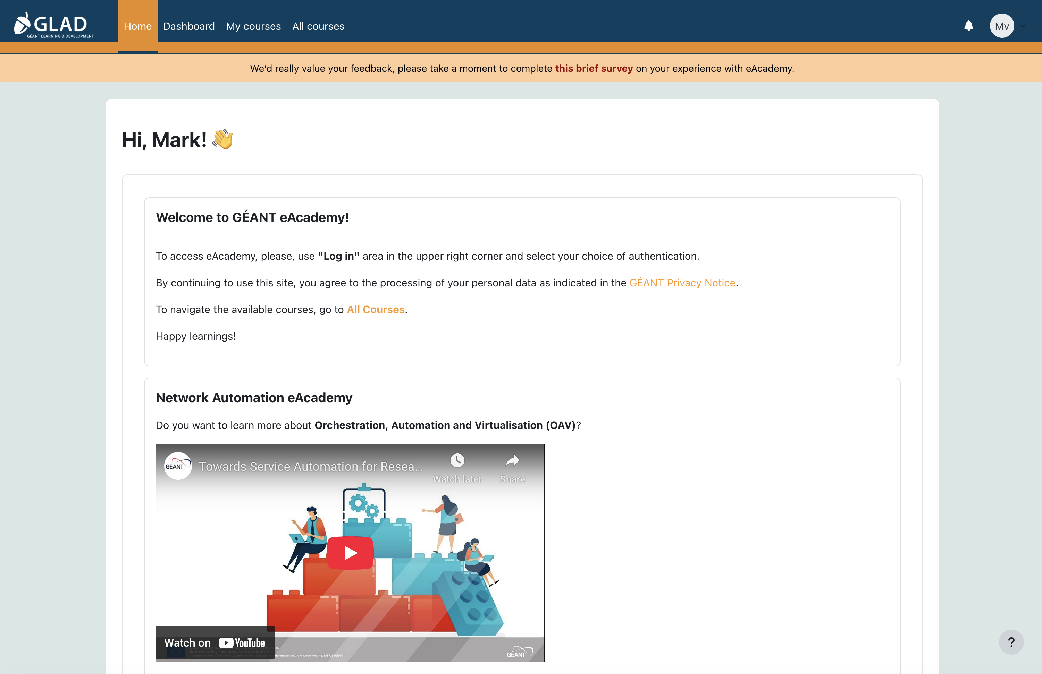
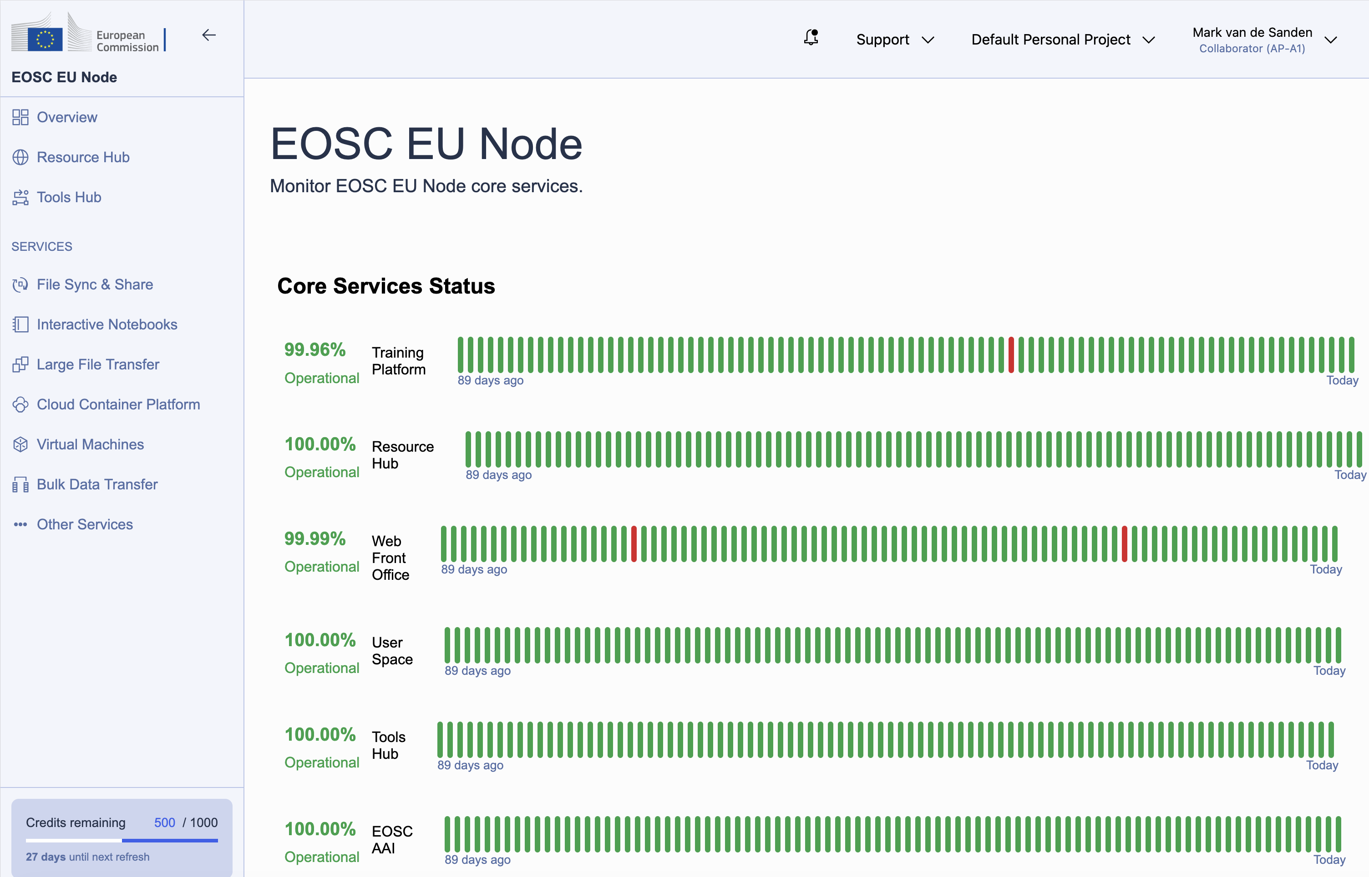
Example: Building up a National Node
Helpdesk
NREN Service Catalogue
Helpdesk
Core AAI Platform
OpenAIRE Connect
https://portal.live.surfresearchcloud.nl/ (Cloud VMs, Containers, Jupyter Notebooks)
Access Management
EUDAT B2DROP
File Sync & Share Service
SURF Research Cloud Wallets
GÉANT e-Academy
Service Monitoring

Slide 11
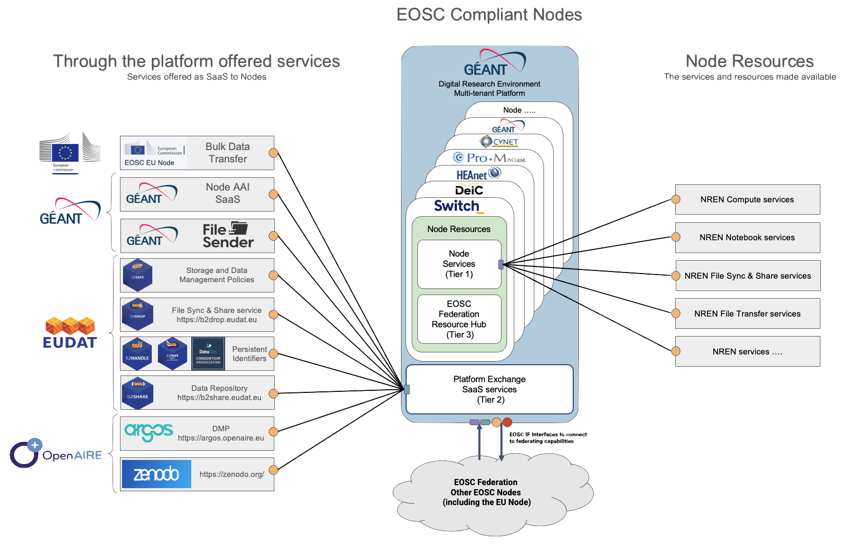
GÉANT DRE – Node Generic Capabilities

Slide 12
EOSC4ALL EOSC AAI Delivery and Evolution
Delivery of the AAI EOSC Federating Capability – Provide the central hub using MyAccessID to deliver the Trust and Identity Layer across the EOSC AAI Federation, deliver the EOSC AAI Federation Registry and support OAuth 2.0 and OpenID Connect protocols
Delivery of the AAI Node Core capability – Implement and deliver as a service the AAI capability that a Node requires in order to participate in the EOSC AAI Federation, support for Infrastructure Proxy and Community AAI, compliance with EOSC AAI Federation requirements, including support for AARC guidelines (G069, G061, G083) and security frameworks (Sirtfi, REFEDS DPCoCo)
Node onboarding and Support Services – Develop onboarding processes and documentation for EOSC Nodes joining the AAI Federation, provide technical support and guidance and establish monitoring and operational procedures for federation health and performance
Evolution towards advanced Federation Models – Research and pilot OpenID Federation for full-mesh topologies, investigate EUDI Wallet integration, collaborate with the AARC WGs and plan migration strategies from the initial hub-and-spoke and advanced federation technologies

Slide 13
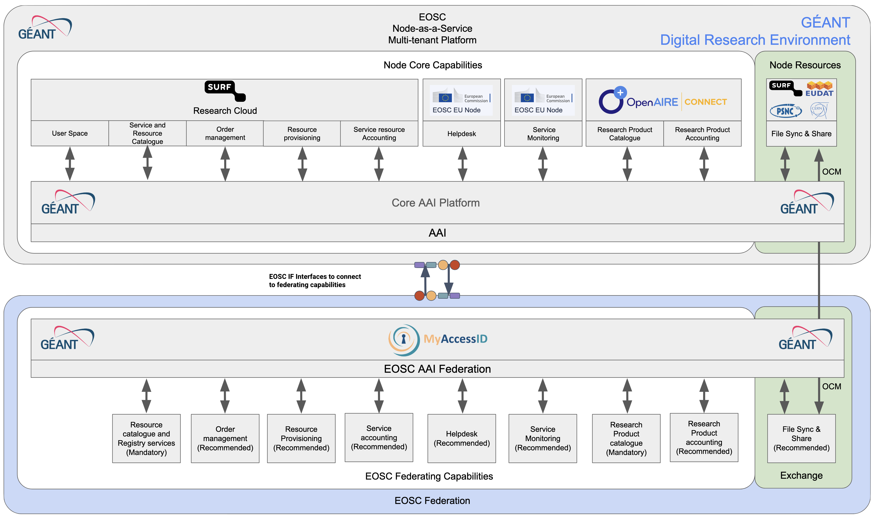
EOSC4ALL EOSC AAI Delivery and Evolution
EOSC4ALL
Support onboarding
Deliver
AAI EOSC Node Core Capability
Deliver
AAI EOSC Federating Capability

Slide 14

Enterprise File Sync & Share
Enterprise file synchronization and sharing (also known as EFSS and enterprise file sync and share) refers to software services that enable organizations to securely synchronize and share documents, photos, videos and files from multiple devices with employees, and external customers and partners. Organizations often adopt these technologies to prevent employees from using consumer-based file sharing apps to store, access and manage corporate data that is outside of the IT department's control and visibility.
Key characteristics
EFSS applications are often characterized by having most or all of the following features and capabilities:^{[3][4][5][6]}
Sync files stored in corporate storage to user desktops and devices
Send links to large files with support for multiple file extensions and protocols
Integration to existing business applications via APIs, plugins and mobile apps
Built-in file creation, editing and previewing
User access permissions to files and folders
Protection of files stored and transferred by encryption, antivirus scanning, and DLP (data loss prevention)
Publish links to files with the ability to set a login requirement to access data
Authentication options for Active Directory, SAML, Azure Active Directory, etc.
Schedule and automate file transfers from automated systems and repositories^{[7]}
Audit and report file activities and system actions

Slide 15


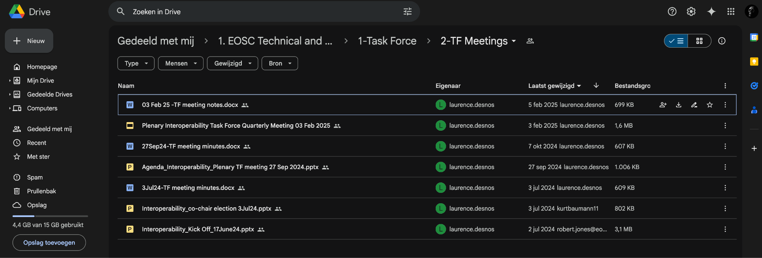
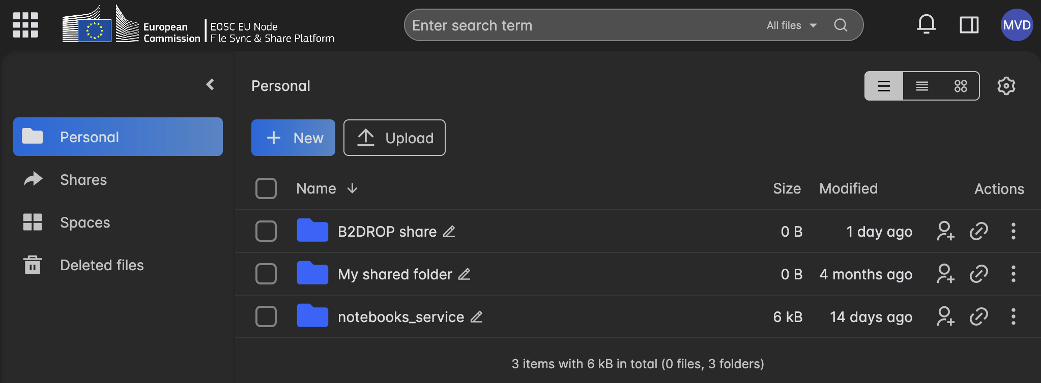


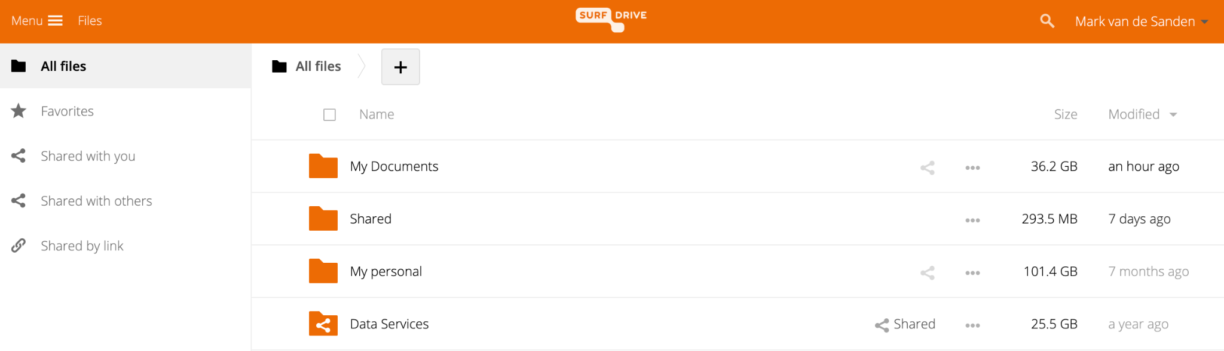
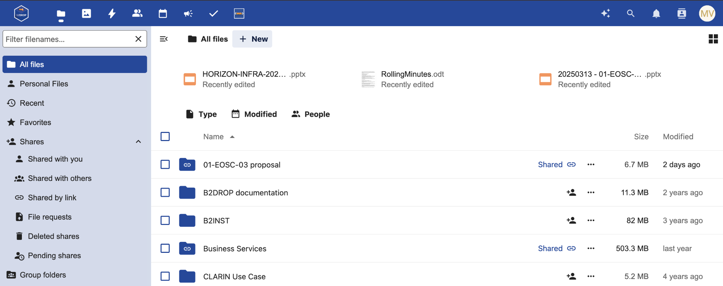
EFSS Examples

Slide 16
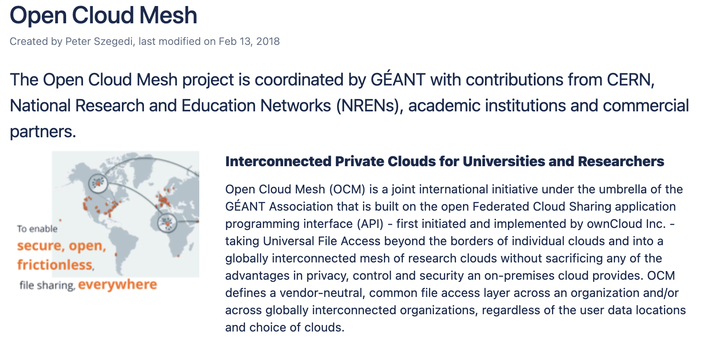
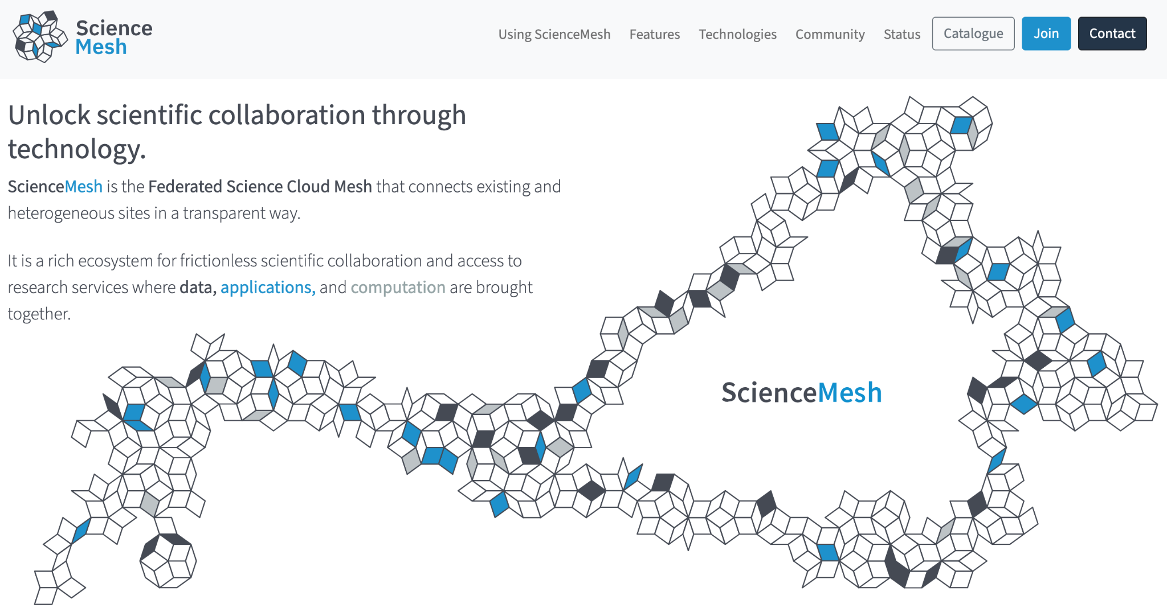
Open Cloud Mesh – Federating EFSS services
Mid-2010s many organisations started with setting up private clouds
To offer a secure private cloud storage solution for researchers and/or employees
With more control on the data and data location independent from Big Tech
Initial concept of the Open Cloud Mesh was first distributed on 23 July 2015 by Christian Schmitz (ownCloud)
This led to the Open Cloud Mesh project on 22 October 2015, project was co-managed by Peter Szegedi (GÉANT), Jakub Moscicki (CERN) and Christian Schmitz (ownCloud)
This resulted in the standardisation of the OpenCloudMesh API, supported in ownCloud, Nextcloud, Seafile, OCIS
IETF OCM working group to standardize OCM as an RFC
And the forming of the CS³ community and the idea of the ScienceMesh

Slide 17
EOSC4ALL Enterprise File Sync & Share
Building EOSC EFSS federation – Enabling site discovery and registry and invitation workflow federating capabilities and establish the EFSS federation among the EOSC4ALL nodes
Enabling data federation capabilities for EOSC Nodes – Provide a ”ready-to-use” EFSS-in-the-Box bundle, including EFSS engines (e.g. Nextcloud, OpenCloud, CERNbox), OCM support, support for various storage backends, and tools for monitoring and accounting
EFSS Groups and AAI integration – Integrates and harmonises the existing EFSS Group functionality with the EOSC Federation Group mechanism based on the EOSC AAI
Support for FAIR data and knowledge systems – facilitate bi-directional, seamless data flow among EFSS services and data repositories which are indexed, findable and made discoverable again through knowledge systems
Data security in federated EFSS – define security requirements, perform audits and assessments (penetration testing, configuration and code reviews), and verify compliance

Slide 18


Planned EOSC Ready Nodes
Prospective Node | Resource Added on the Tenant | Scientific Use-Case addressed
 | Data Sources: 8 Repositories, Data.gov.cy Services: Sensitive Data Service Infrastructure: National HPC, Institutional HPC | Contributing to the creation of the National EOSC Node by integrating community and central resources, enabling seamless access to research infrastructures, and creating a sustainable framework that enhances national research excellence and accelerates academia–industry collaboration.
 | Data Sources: DeIC Dataverse, Datavejviser , Earth System Science Data, Bioimaging, social science data. Infrastructure: DeIC OpenStack | Three scientific use-cases applying EOSC4ALL DRE data management, repositories and data storage, which will contribute to the creation of the National EOSC Node by integrating community and central resources. DeiC sees data management, repositories, and data storage as fundamental to the EOSC vision of a federated digital environment. DeiC has singled out its national data repository (DeiC Dataverse) with the clear ambition of aligning it completely with the EOSC vision. DeiC aims to promote convergence on common metadata schemas, ontologies, and controlled vocabularies to ensure machine-actionability as well as global interoperable machine-accessibility.
 | The GÉANT Node will deliver the AAI and EFFS EOSC Federating capabilities, along with Node Core and Generic Capabilities (i.e AAI service, EFFS in a box,etc. as a starting point. | As the GÉANT Node will be providing the AAI and EFSS Federating Capabilities, it will support all the scientific use cases across the EOSC Federation that require these federating capabilities. In addition, it will directly contribute the cross-node use cases described in this proposal.
 | Service: NextCloud Infrastructure: OpenShift Platform Kubernetes (Dublin City University) | QuarryLink: A federated edge-to-cloud data pathway for industrial-academic collaboration. The QuarryLink Use Case offers a real-world demonstration of how federated research infrastructures can effectively bridge the gap between academic research, industrial needs, and public digital services.
 | Data Sources: ARP (HUN-REN), Hungarian Language Corpus (ELTE); Services: Pro-M Drive (NextCloud), Infrastructure: National HPC (DKF), C4E OpenStack Platform: National AAI Training: Videotorium | Contributing to the development of the Hungarian National EOSC Node by integrating community and central resources, enabling seamless access to research infrastructures, and creating a sustainable framework that enhances national research excellence and accelerates academia–industry collaboration.
 | Data Sources: DaSCH Service Platform (DaSCH), SWISSUbase (FORS), Open Data Navigator (catalogue of metadata) Services: Renku 2.0 (ETHZ/SDSC), CHORUS (CHUV), Living Earth in a Box (University of Geneva), ZHAW Swiss-AL Corpus Platform | Building on Switch’ contribution to the national project “Swiss EOSC Node Prototype”, Switch aims to enroll relevant community resources for the long-tail of researchers in Switzerland.

Slide 19
Thank You
mark.vandesanden@geant.org

