Slide 1



Building the EOSC AAI:
MyAccessID and Cross-Node Interaction
Irina Sidorova
IT Delivery Manager
Core AAI, Trust & Identity GÉANT
Co-funded
by the European Union
© GÉANT Association

Slide 2
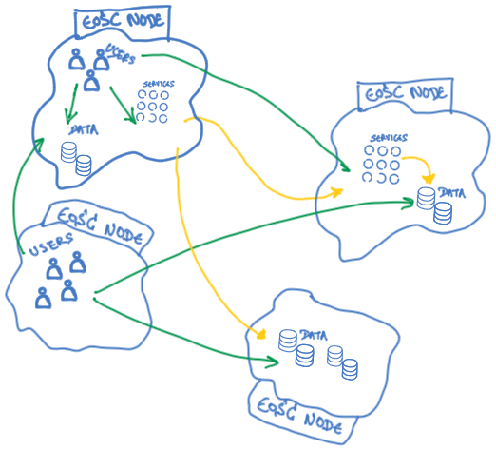
EOSC Authentication & Authorisation Infrastructure
For researchers:
Secure access with their own IdP
For service providers:
Consistent way to authenticate users and authorise access

Slide 3
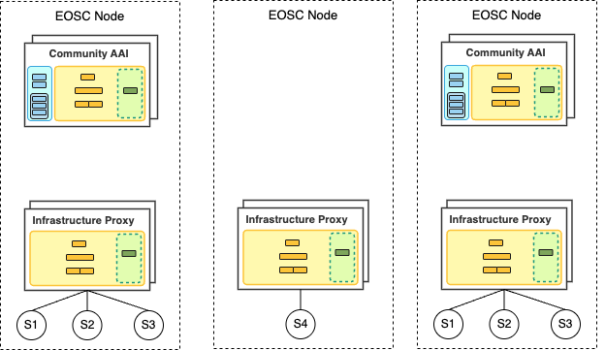
EOSC AAI Nodes
Federated Authentication
SSO across Nodes
Cross-Node Collaboration
Persistent Identity

Slide 4
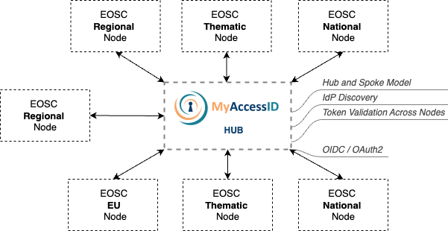
EOSC AAI Federation model

Slide 5
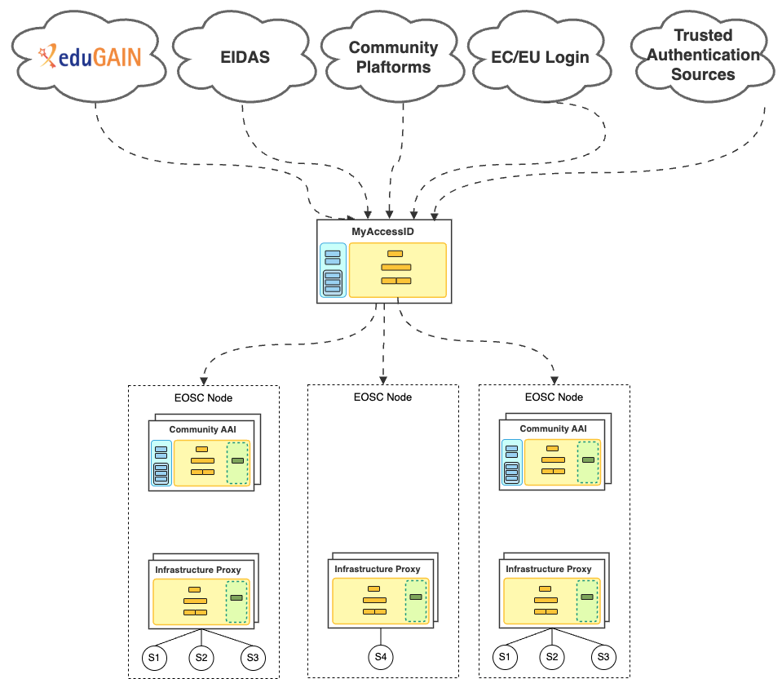
EOSC AAI Federation
Identity Layer

Slide 6
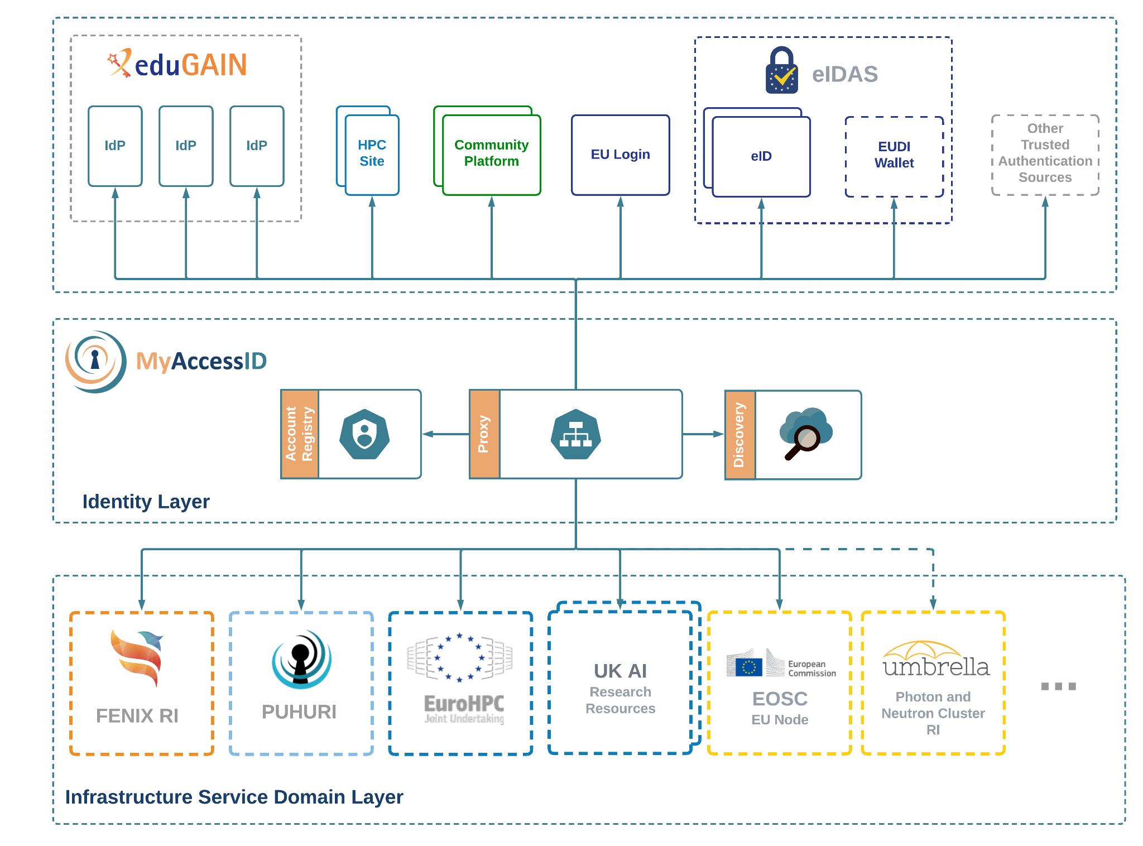
MyAccessID: A common Identity Layer for Science
Identity Layer

Slide 7
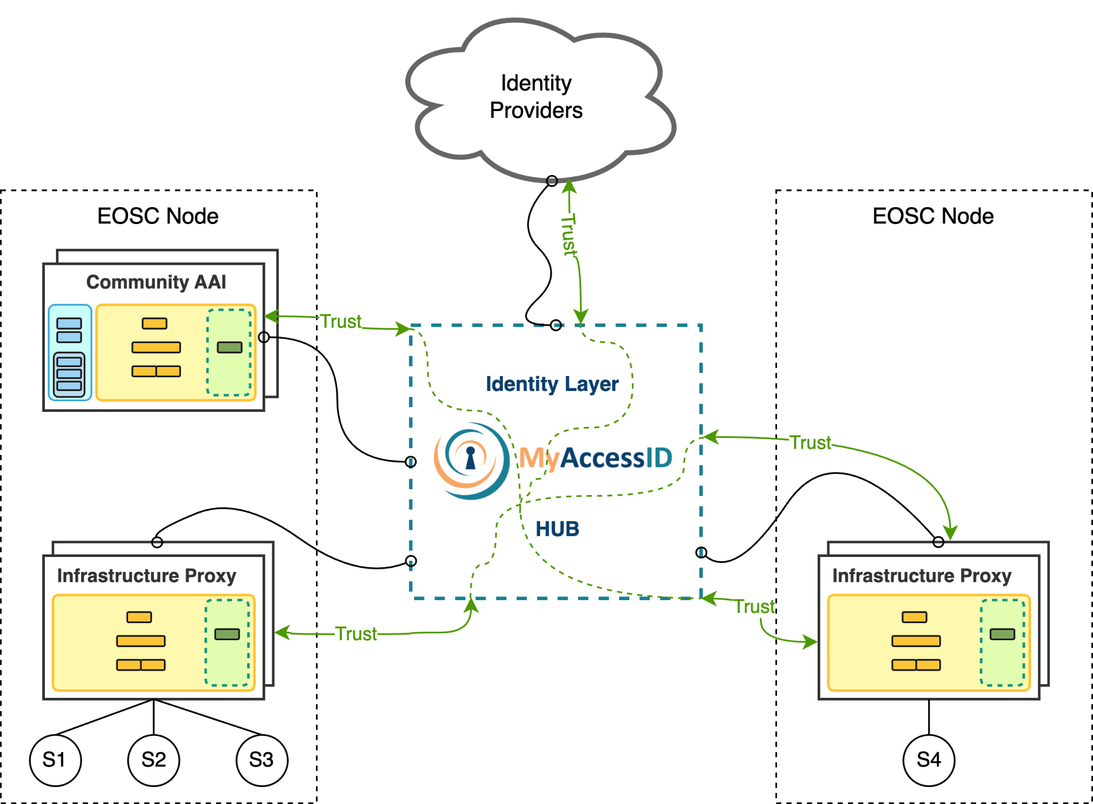
MyAccessID in the EOSC AAI Federation model
The Hub

Slide 8
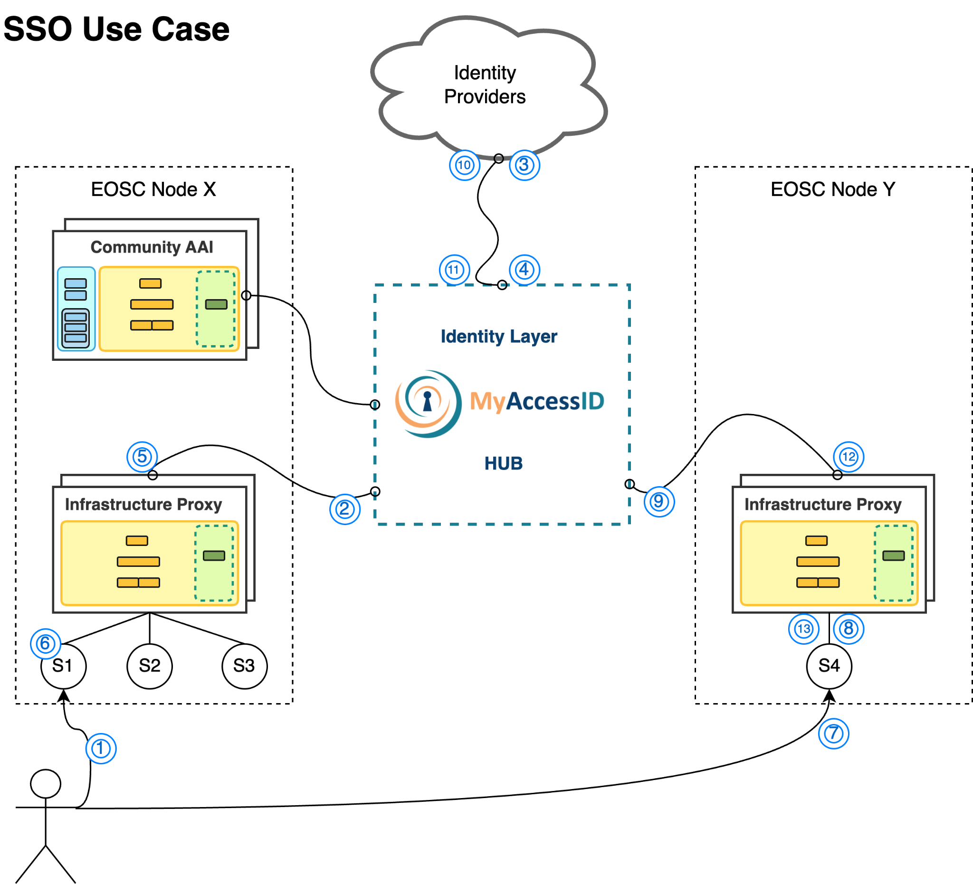

Slide 9
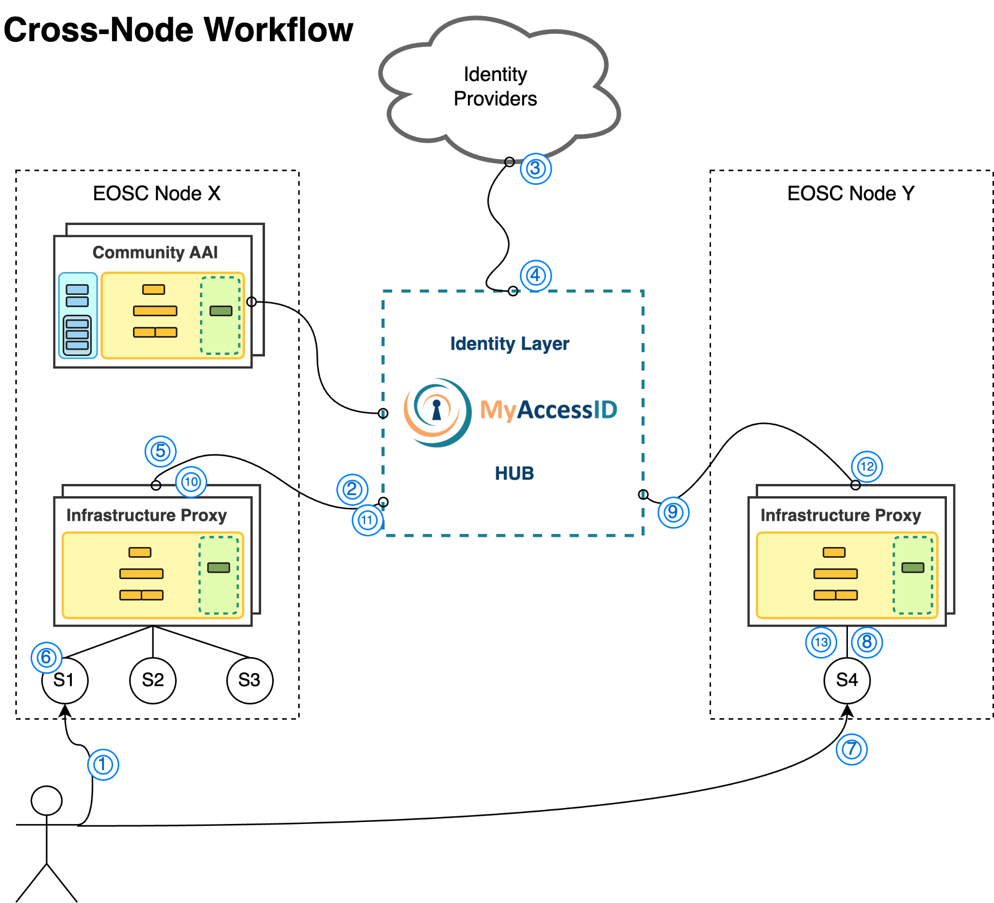

Slide 10
How to join the EOSC AAI Federation
Services do not connect directly to the Federation
Services are onboarded to EOSC Nodes
Nodes handle integration, policy, and access enforcement
Authentication via MyAccessID → Node’s Infrastructure Proxy

Slide 11
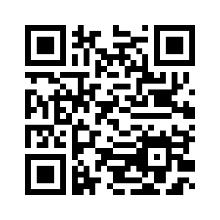
EOSC AAI Federation-ready Infrastructure Proxy
Connect to MyAccessID as an OIDC Relying Party
OIDC Discovery
OAuth2 Token Introspection endpoint
Proxied Token Introspection
EOSC AAI claims & scopes
Process groups & roles → AARC-G069
Security baselines:
REFEDS Sirtfi
AARC-G084 Security Baseline
REFEDS CoCo v2 (GDPR-aligned)
EOSC AAI Architecture 2025

Slide 12


May tanong?
Questions?
¿Preguntas?
Вопросы?
سوالات
Thank you!
प्रशन
კითხვები?
Vragen?
Questões?
Ebibuuzo?
Maswali?
Frågor?
Kysymyksiä
有問題嗎？
Domande?
Fragen?
Ερωτήσεις?
irina.sidorova@geant.org
www.geant.org
Co-funded by the European Union
© GÉANT Association

