Slide 1
The EUDAT Node
Yann Le Franc, PhD
Head of EUDAT Secretariat
04/12/25 - SIG-CISS Workshop

Slide 2
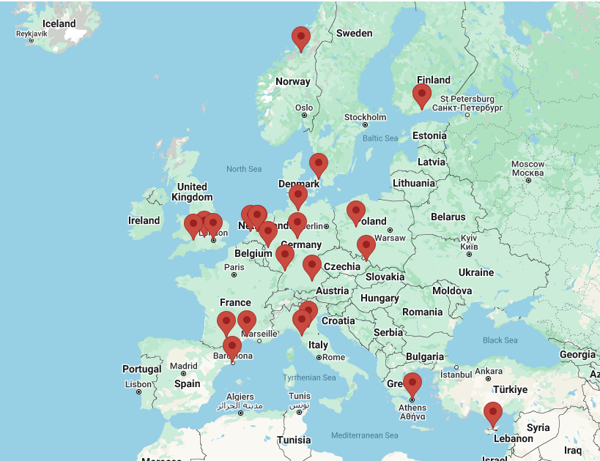
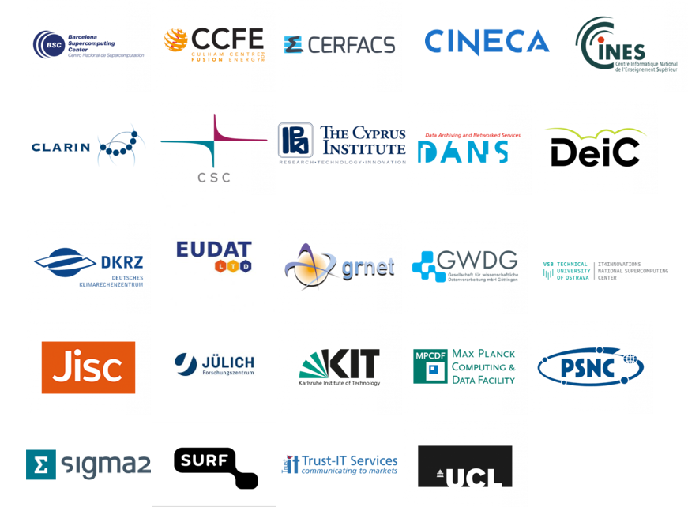
EUDAT in a nutshell
The EUDAT Collaborative Data Infrastructure (EUDAT CDI) is one the major e-infrastructures supporting research in Europe
EUDAT is a membership organisation supported by EUDAT Ltd., a not-for-profit company
It is a growing network of over 20 European organizations
EUDAT’s vision:
Data is shared and preserved across borders and disciplines

Slide 3
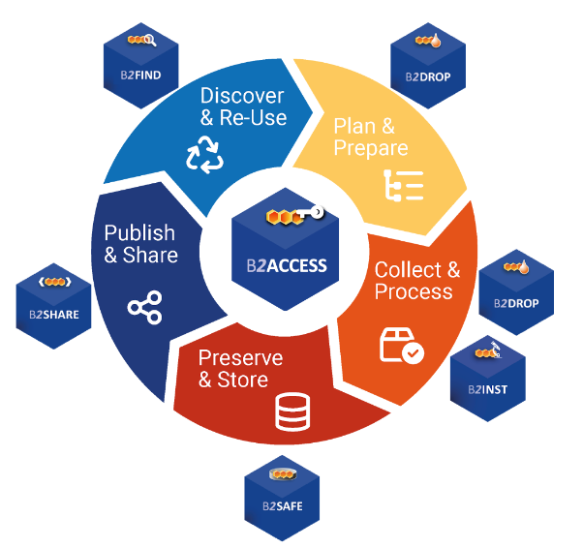
EUDAT service offer
According to the vision, EUDAT provides:
a trusted environment for European researchers from any research discipline to preserve, find, and access data
a set of interoperable data management services that support European researchers in different steps of the research data life cycle and the process of making their data FAIR
essential infrastructure services such as storage and long-term preservation to support the capacity scaling of research infrastructures
consultancy and training services to support organisations in their endeavour to build reliable, trustworthy and FAIR enabling data infrastructures

Slide 4
Why to become an EOSC Node?
Involved in structuring EOSC Projects either directly or indirectly through our members: EOSC Pilot, EOSC-Hub, EOSC-Enhance, EOSC-Future, DICE, EOSC Beyond, EOSC Entrust, FAIRCORE4EOSC, FAIR IMPACT
Involved in EOSC related WGs: EOSC Architecture WG, EOSC Interoperability TFs, EOSC PID TF, EOSC Opportunity Areas
Our ambition: propose a transnational collaborative FAIR enabling data management space connected with domain specific services
Provide a backbone infrastructure for ERICs to support scalability needs and focus development on domain specific services.

Slide 5

EUDAT as an EOSC Node
EUDAT selected as candidate node part of the first build-up phase of the EOSC federation
Ambition:
Offer a transnational collaborative FAIR enabling data management space connected with domain specific services
Connecting services to create a unique collaborative environment

Slide 6

Improving EUDAT Federation
EUDAT
Management WG
EUDAT Technical WG
Infrastructure and organisational management
Service delivery process
Governance and Business model
Legal/contractual aspects
Infrastructure interoperability
Service integration
Node architecture
Design of the EUDAT node portal

Slide 7
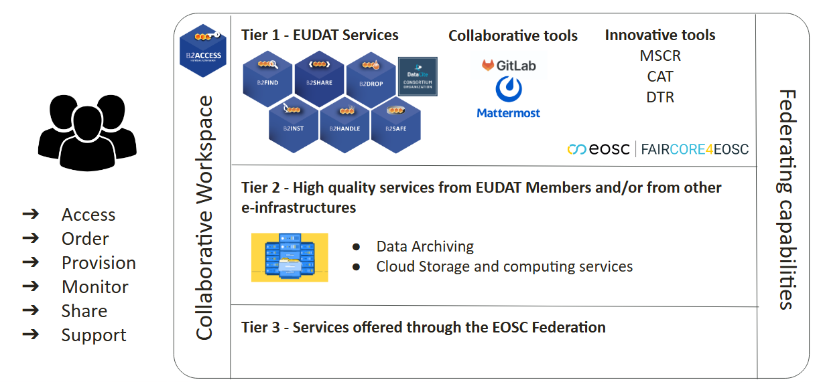
EUDAT EOSC Node: general principles
EUDAT EOSC Node proposes a three-tiered approach to:
Provide a central access point for users to access and manage EUDAT services usage
Providing services working on top of a pool of transnational resources offered by EUDAT CDI Members and other e-Infrastructures
Connecting to service offered by other nodes of the EOSC Federation

Slide 8
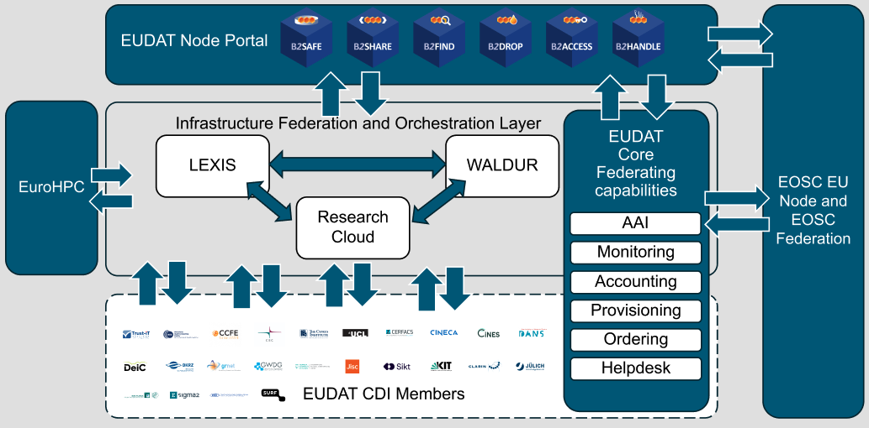
EUDAT EOSC Node: general principles
The EUDAT node architecture relies on the federation and orchestration of the services and resources provided by the EUDAT members, including the integration of the EOSC Federating Capabilities (monitoring, helpdesk, …)

Slide 9
Alignment with EOSC federating capabilities
Identity management:
EUDAT AAI service B2ACCESS partially integrated to EOSC AAI
Ongoing work to finalise update for token introspection
EUDAT Service accessible through the EOSC AAI.
Resource Catalogues and Registry services
Integration of EUDAT Service Catalog with EOSC EU Node Service Catalog.
4 Services registered
NOTA: Add a figure showing the service in the EU Node interface
Data registry (EUDAT service B2FIND) harvested by OpenAire
Further integrations planned for helpdesk, monitoring, accounting, and order management

Slide 10
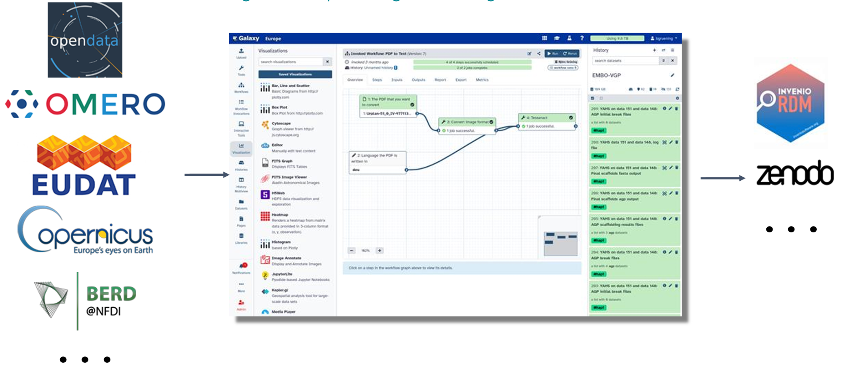
Data connected to compute
From Björn Grüning, Presentation at the EOSC Symposium 2025 - “Galaxy goes EOSC: an NFDI use-case”

Slide 11
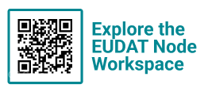
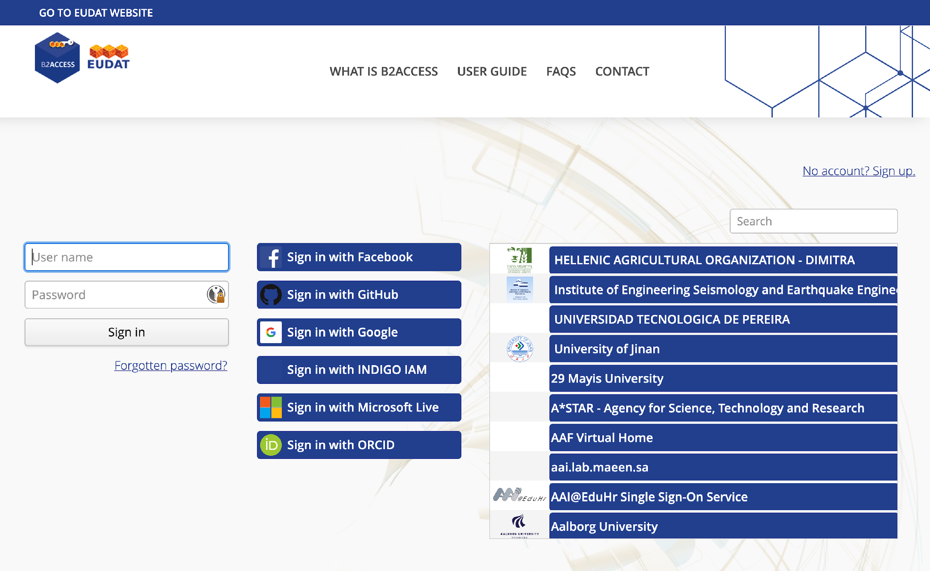
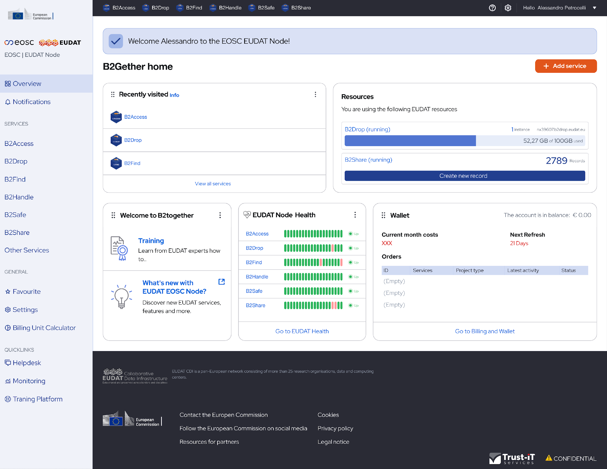
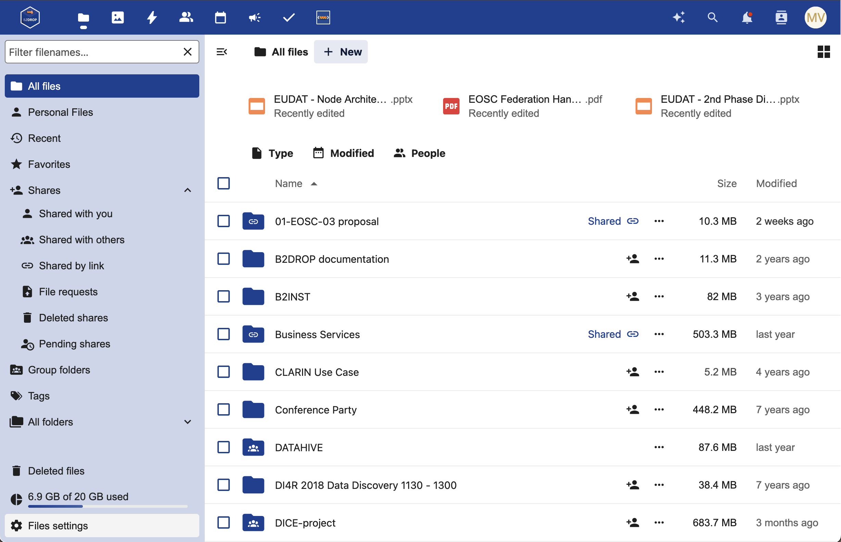
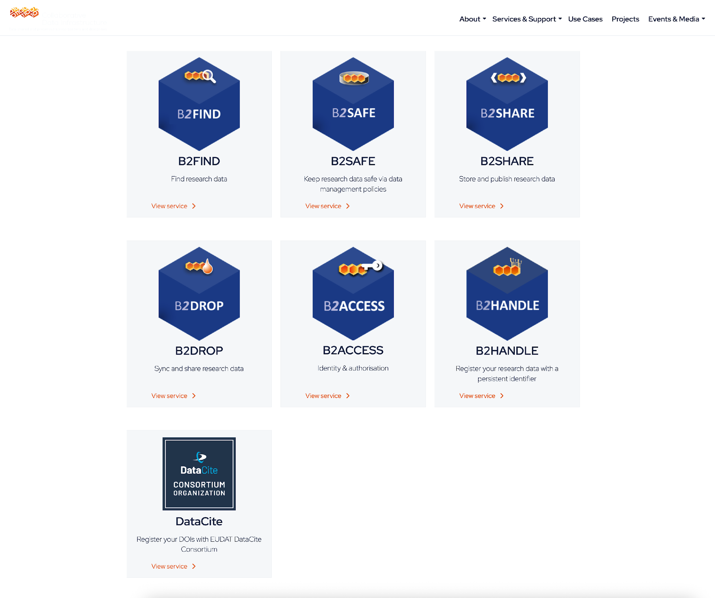
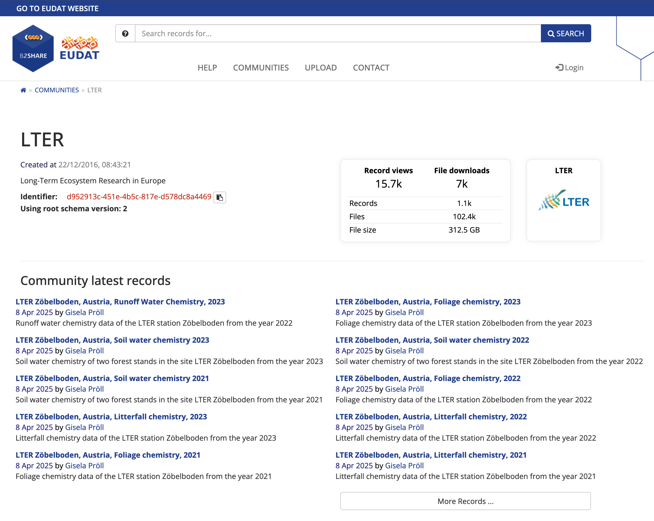
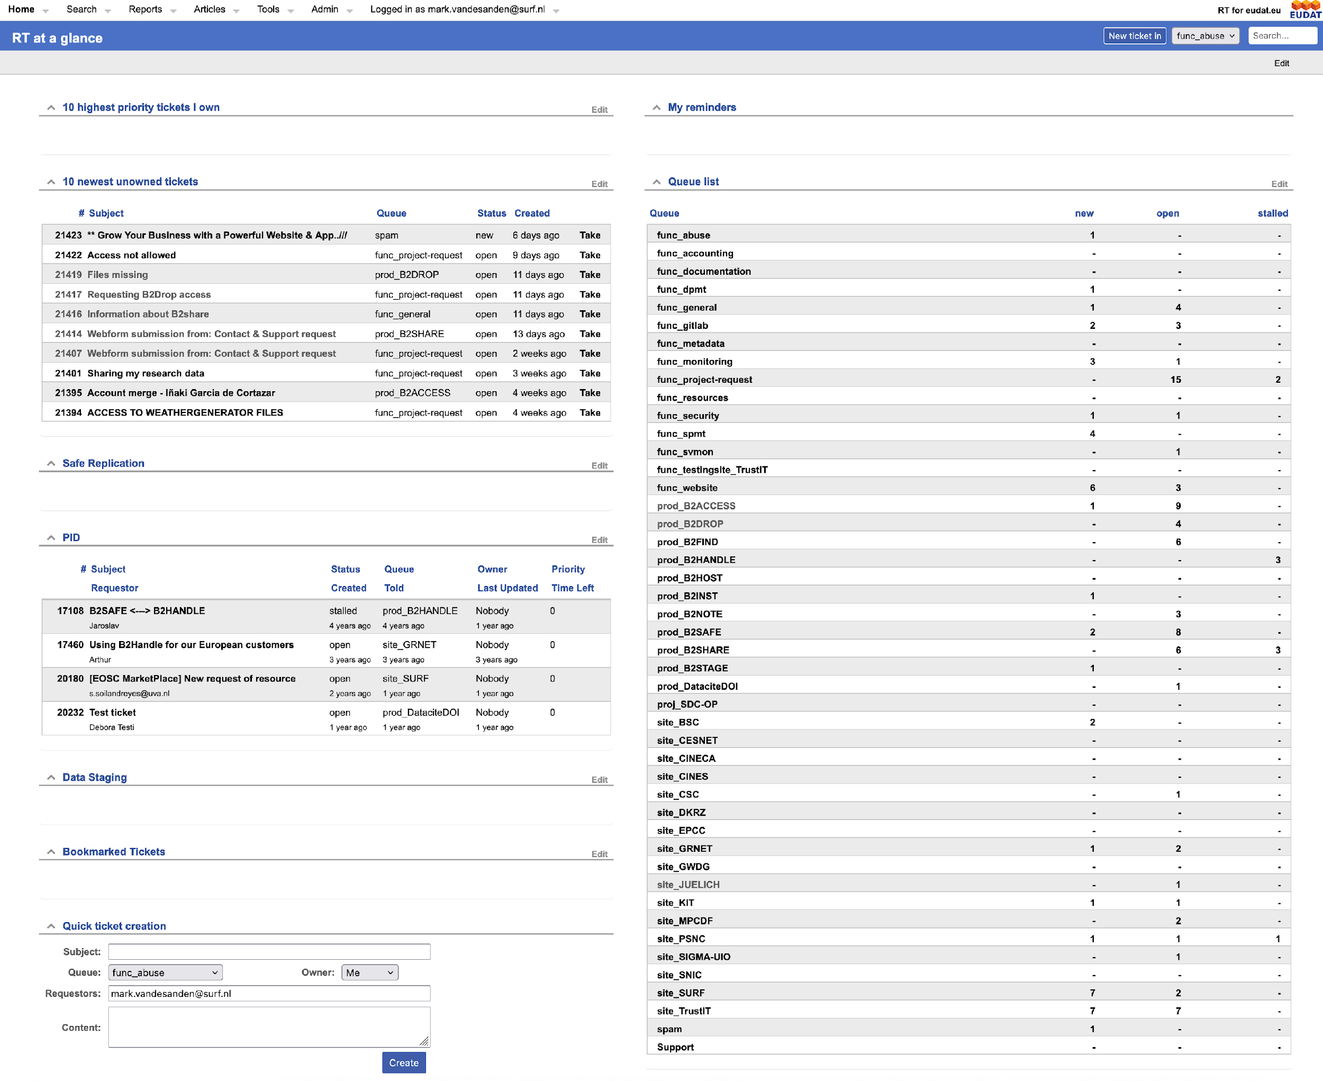

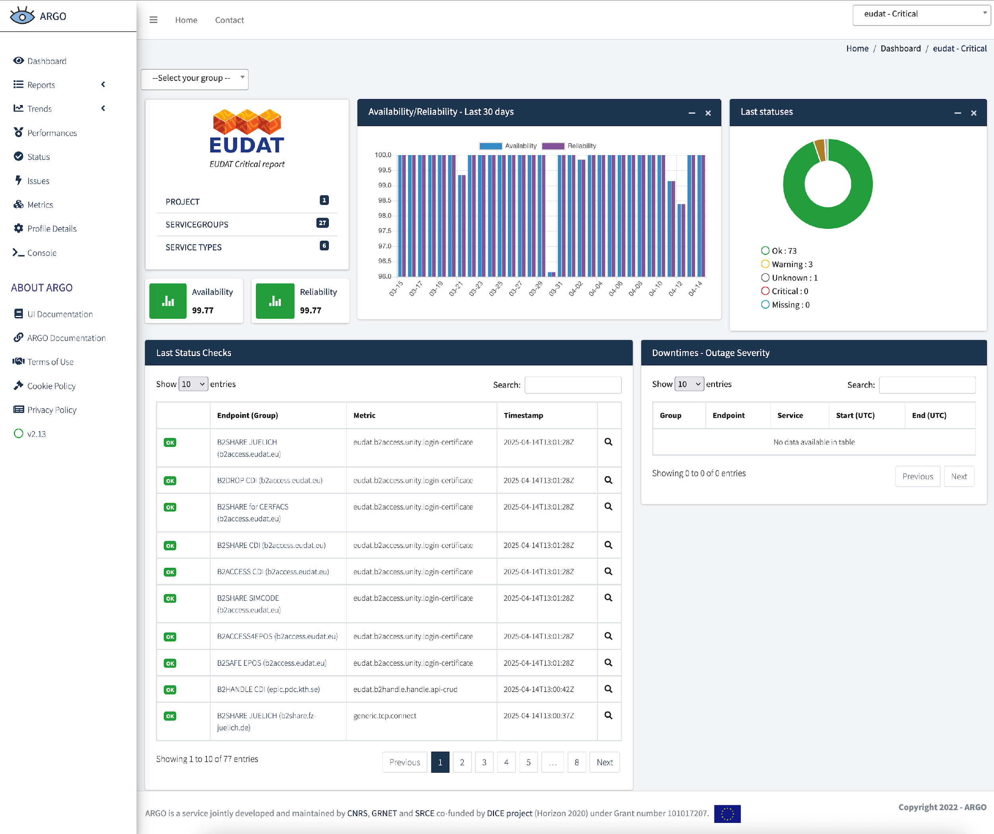

EUDAT node portal - central point of access
AAI - SSO
Service Accounting
Service Catalogue
Helpdesk
Research Product Accounting
Monitoring

Slide 12
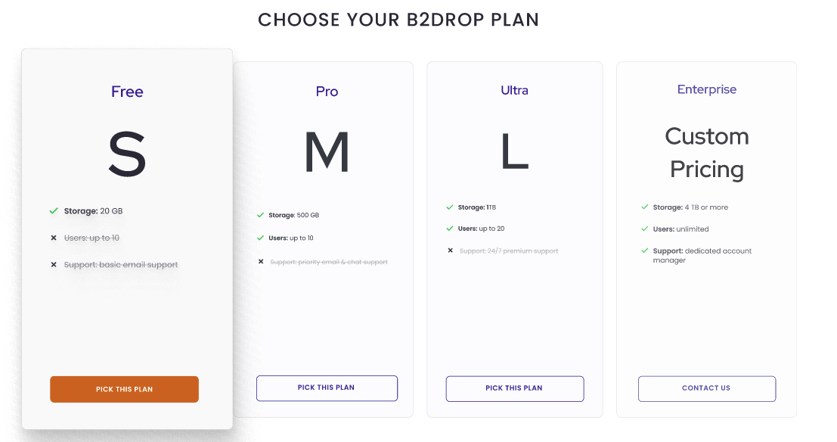
EUDAT Business Model
Service free with resources limitations
Plan to extend resource usages
Plan to have own organisational service

Slide 13
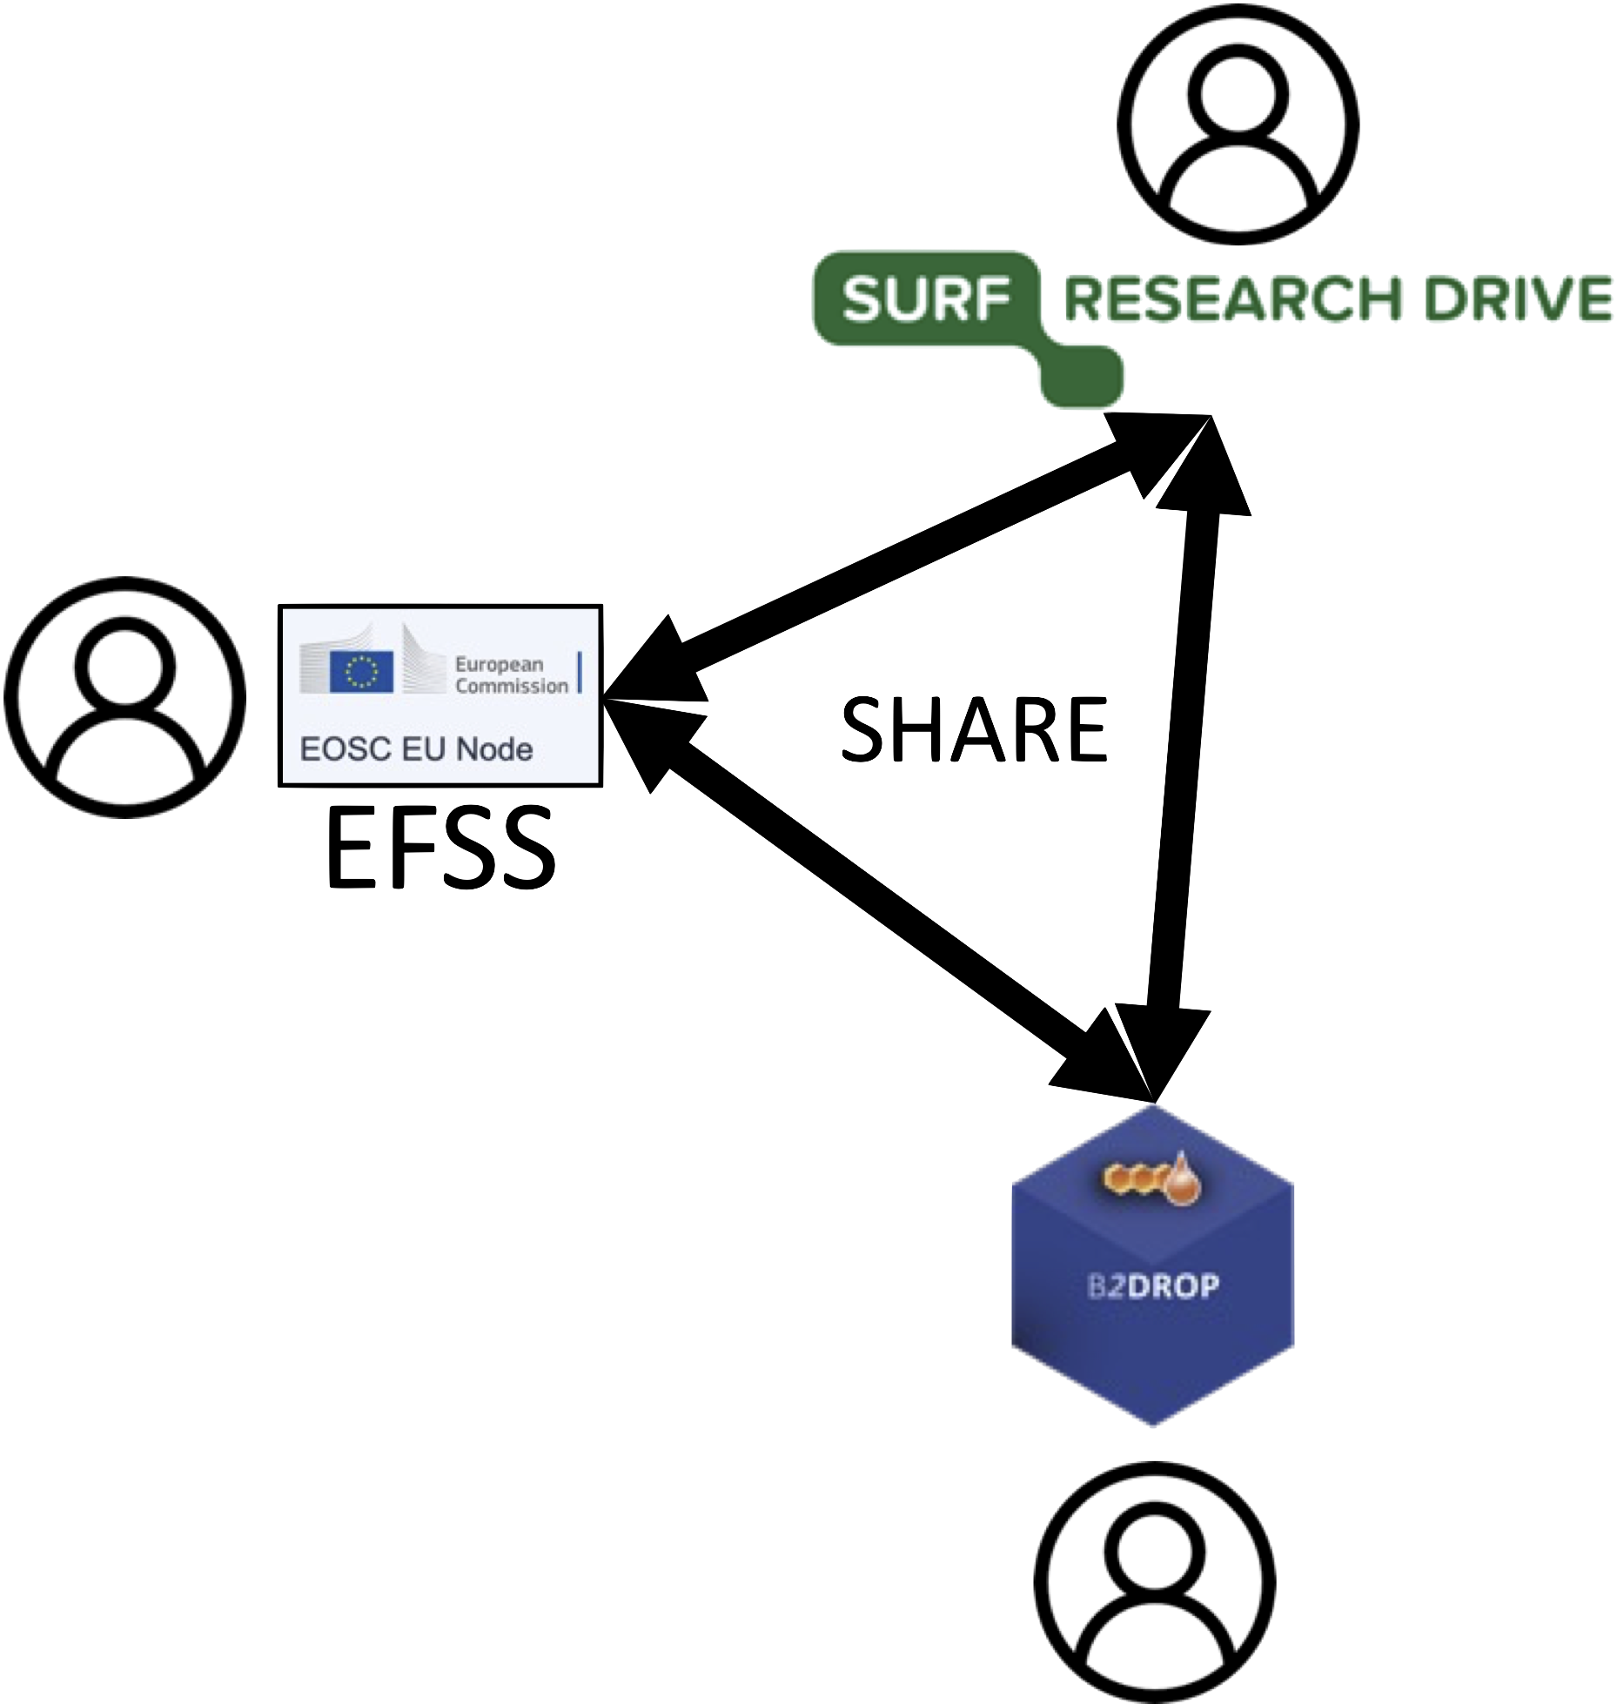
Contributing to EOSC Federation: EFSS Federation
As one of our initial core use-case, sharing folders and documents across the different EFSS service enables to create a virtual transnational storage and an efficient collaborative environment for EU collaboration.
EUDAT contributes to the development of OCM compliant functionalities and is committed to its further development through the EOSC4ALL project.

Slide 14
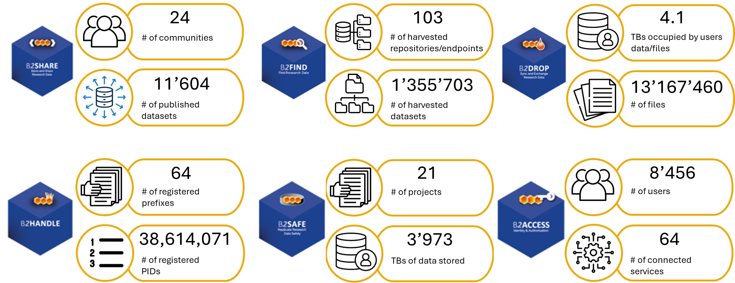
Contributing to EOSC Federation: Transnational services

Slide 15
Contributing to EOSC Federation: Transnational services
Various users of our services across Europe:
B2DROP (FZJ, Germany)
HEAnet: providing B2DROP to Irish University
Swiss Institute of Bioinformatics: using B2DROP for collaborations
Archiving and PIDs (IT4I, Czech Republic and SURF, the Netherlands)
Integrated Carbon Observation System (ICOS): dataset long term preservation and identification (PIDs).

Slide 16
Sustainability and transnational access
Sustainability is essential for the long-term success of the EOSC Federation
Ensuring persistent, reliable data management services
Maintaining access to services and resources for more than 10 years is key
Transnational access is a core objectives of EUDAT
Cross-border access to resources (storage and compute) is limited and is still a challenge to solve with the EOSC Federation
Cross-border access poses additional requirements towards sustainability
EUDAT is committed to shaping sustainability strategies within the EOSC Federation

Slide 17
What is the value of joining the EOSC Federation?
User perspective:
A central point of access to and management of the services
Better integration of services from other nodes supporting scientific work (e.g. Galaxy, Jupyter4NFDI,...).
Infrastructure perspective:
More interoperability between the different infrastructures both e-Infrastructures and Thematic infrastructures.
Redefining our service offer for other Research Infrastructure.

