Slide 1
Blue-Cloud 2026 project – establishing the Marine thematic EOSC node Dick M.A. Schaap – MARIS (NL) Blue-Cloud Technical Coordinator 16th SIG-CiSS Agenda - ICSC Bologna, Italy, 3 – 4 December 2025

Slide 2
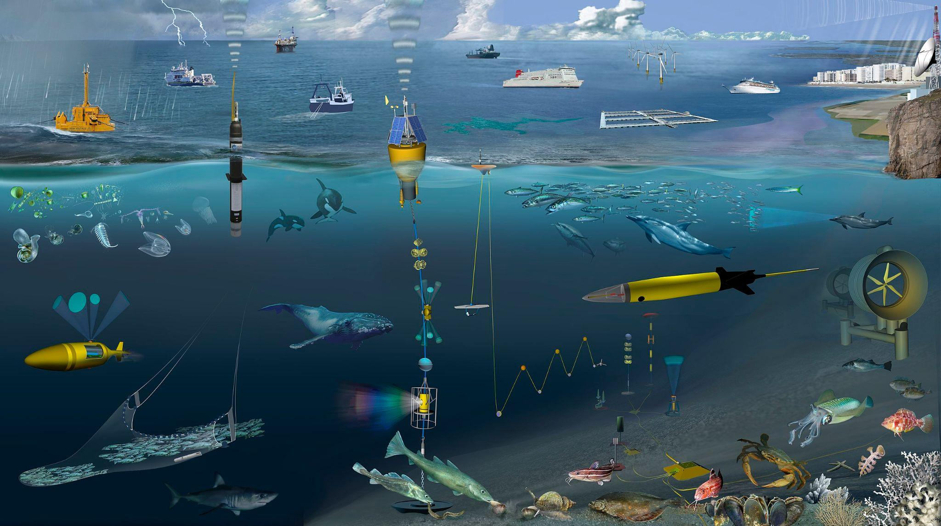

Acquisition of marine and ocean data
Scientific Research to gain knowledge and insight
Modelling (including hindcast, nowcast, forecast)
Economic activities: shipping, offshore industry, dredging industry, fisheries, tourism, engineering ..
Environmental Management: monitoring and assessment (water quality, climate status, stock assessment)
Marine Conventions and Directives, in Europe: Water Framework Directive (WFD), Marine Strategy (MSFD), Marine Spatial Planning (MSP), Coastal Zone Management
EU Strategies, such as Green Deal, Blue Environment, Blue Economy
In Europe, we spent circa 1.4 Billion Euro a year in marine data acquisition (1.0 BE in-situ; 0.4 BE remote sensing)

Slide 3
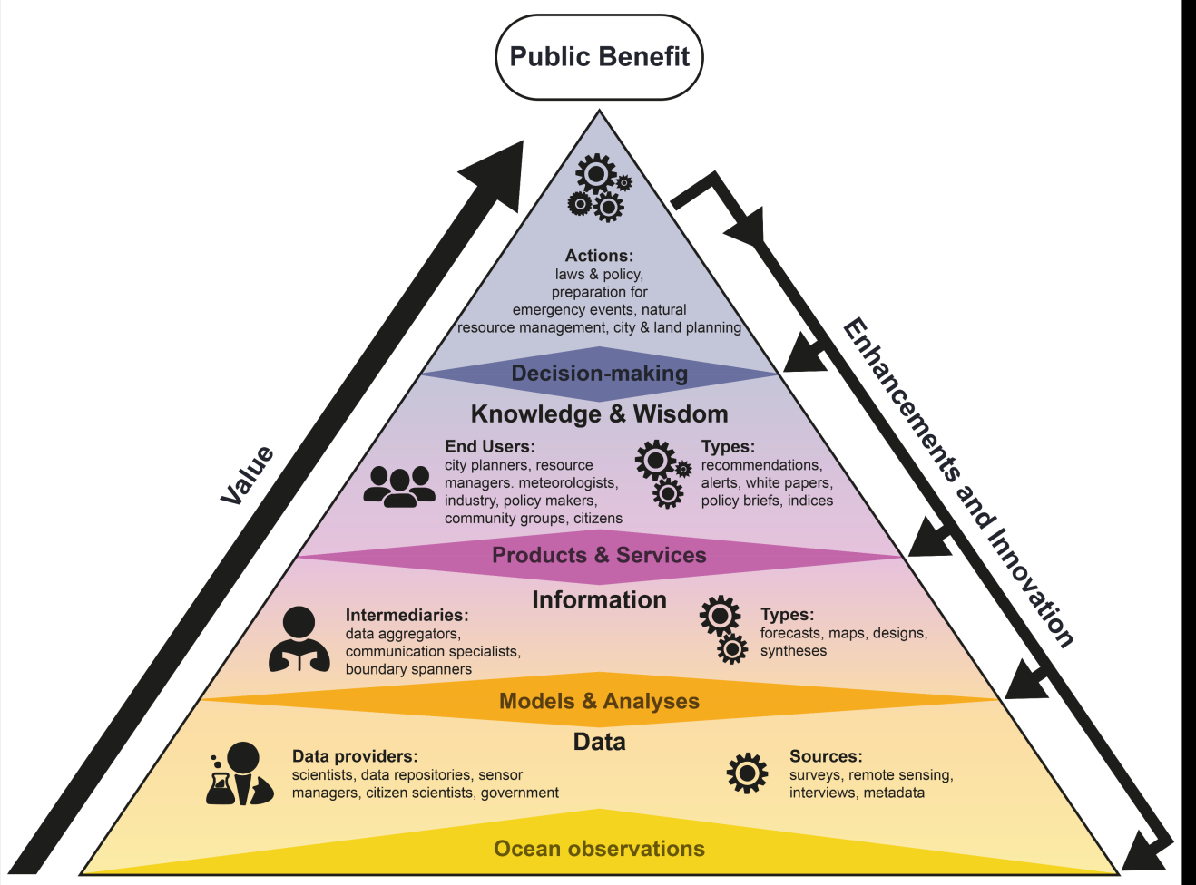
Marine knowledge value chain
In situ: data and samples collected for atmosphere, water, seabed, fauna and flora, with diverse instruments and platforms. Samples are further analysed. In situ data are complemented by remote sensing observations.
Observations: ocean, seas, coastal waters, estuaries, river mouths; physics, chemistry, biology, bathymetry, geophysics, and geology
Value chain: steps from sensor data and samples to information to knowledge and benefits - with feedback loops
Public Benefit: Accessible data, High Quality data products, and Knowledge of use for Blue Economy, Resource Management, Ocean Health, Hazards, and Advancing Science
Image: EMB

Slide 4




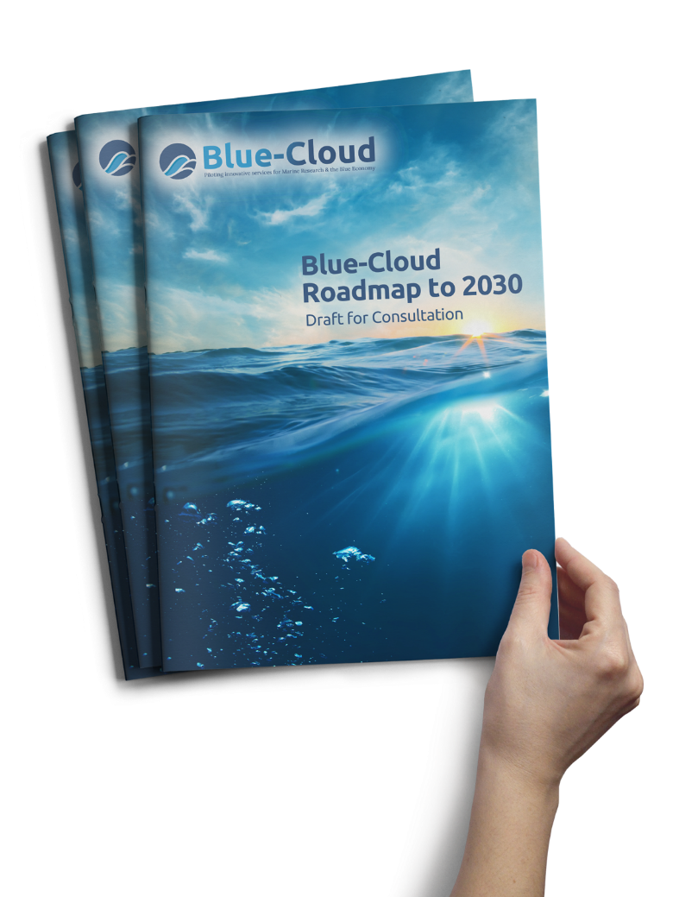



Blue-Cloud – EOSC developments
To explore and demonstrate the potential of cloud based open science supporting research for ocean sustainability, and UN Decade of the Oceans and G7 Future of the Oceans
To deploy a cyber platform with smart federation of multidisciplinary data repositories, analytical tools, and computing facilities
Successful Blue-Cloud pilot (2019-2023) and ongoing Blue-Cloud 2026 (2023-2026), delivering extensive and powerful Virtual Research Environment with multiple Vlabs and WorkBenches and new ways for federating and accessing major data repositories

Slide 5
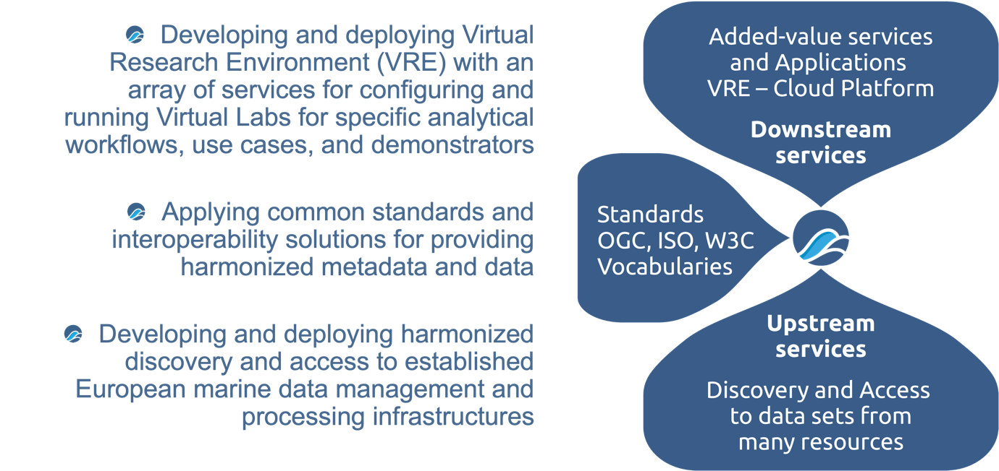
Blue-Cloud overarching concept

Slide 6
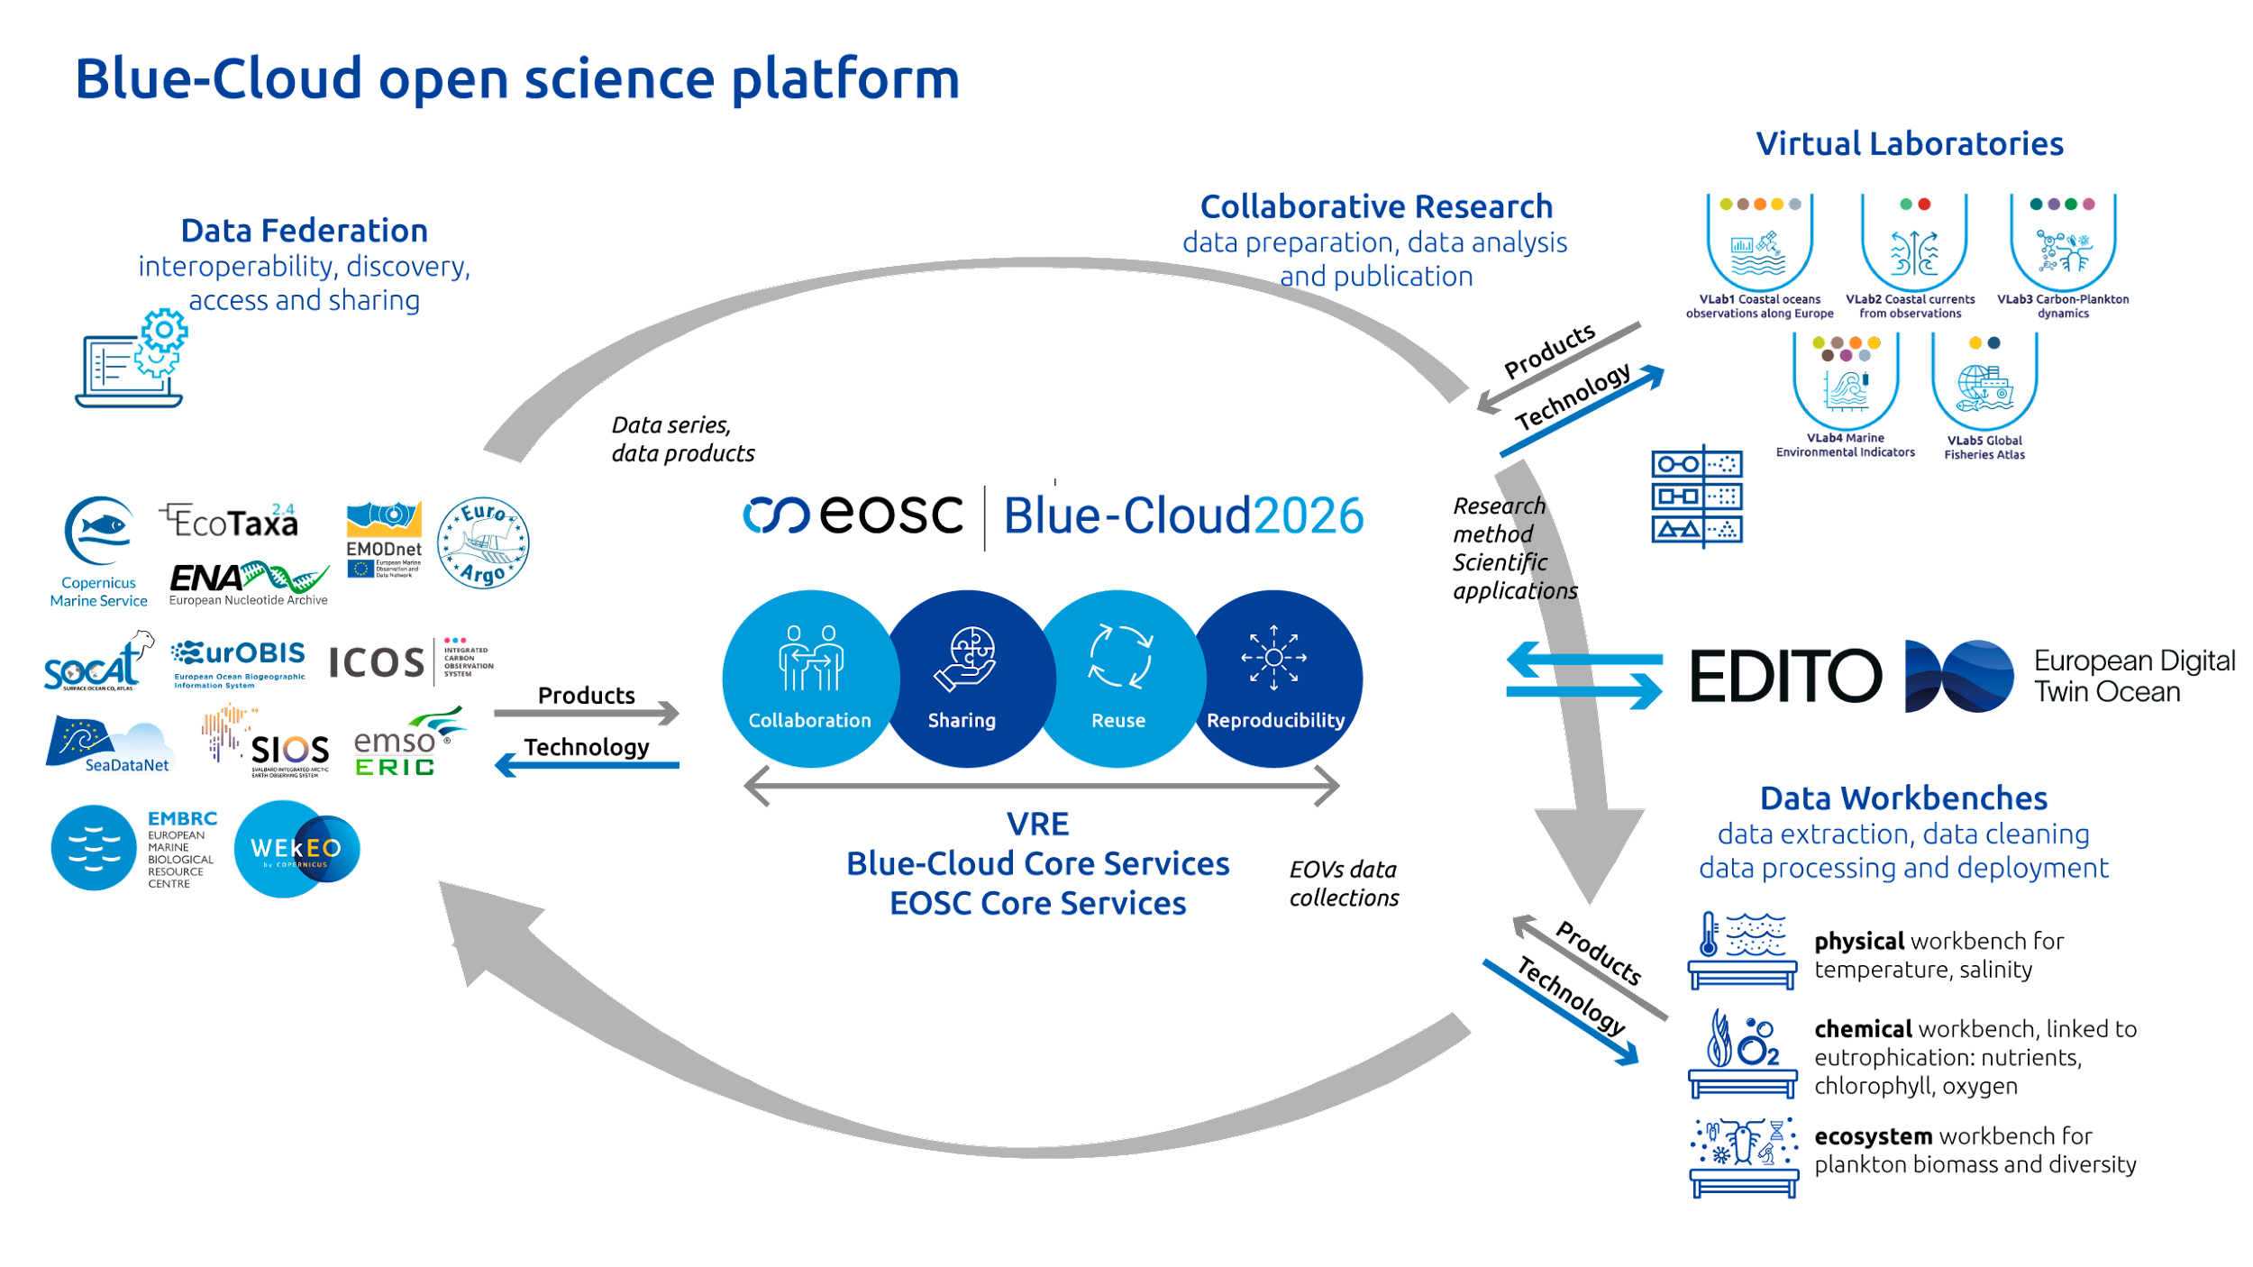
The Blue-Cloud Open Science Platform

Slide 7


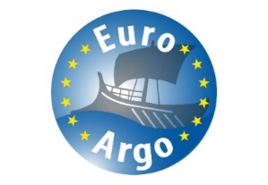

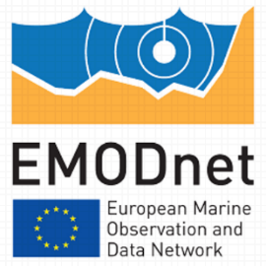










Blue-Cloud federation of major infrastructures
Blue Data infrastructures
E-infrastructures
Blue-Cloud Data Discovery & Access service

Slide 8
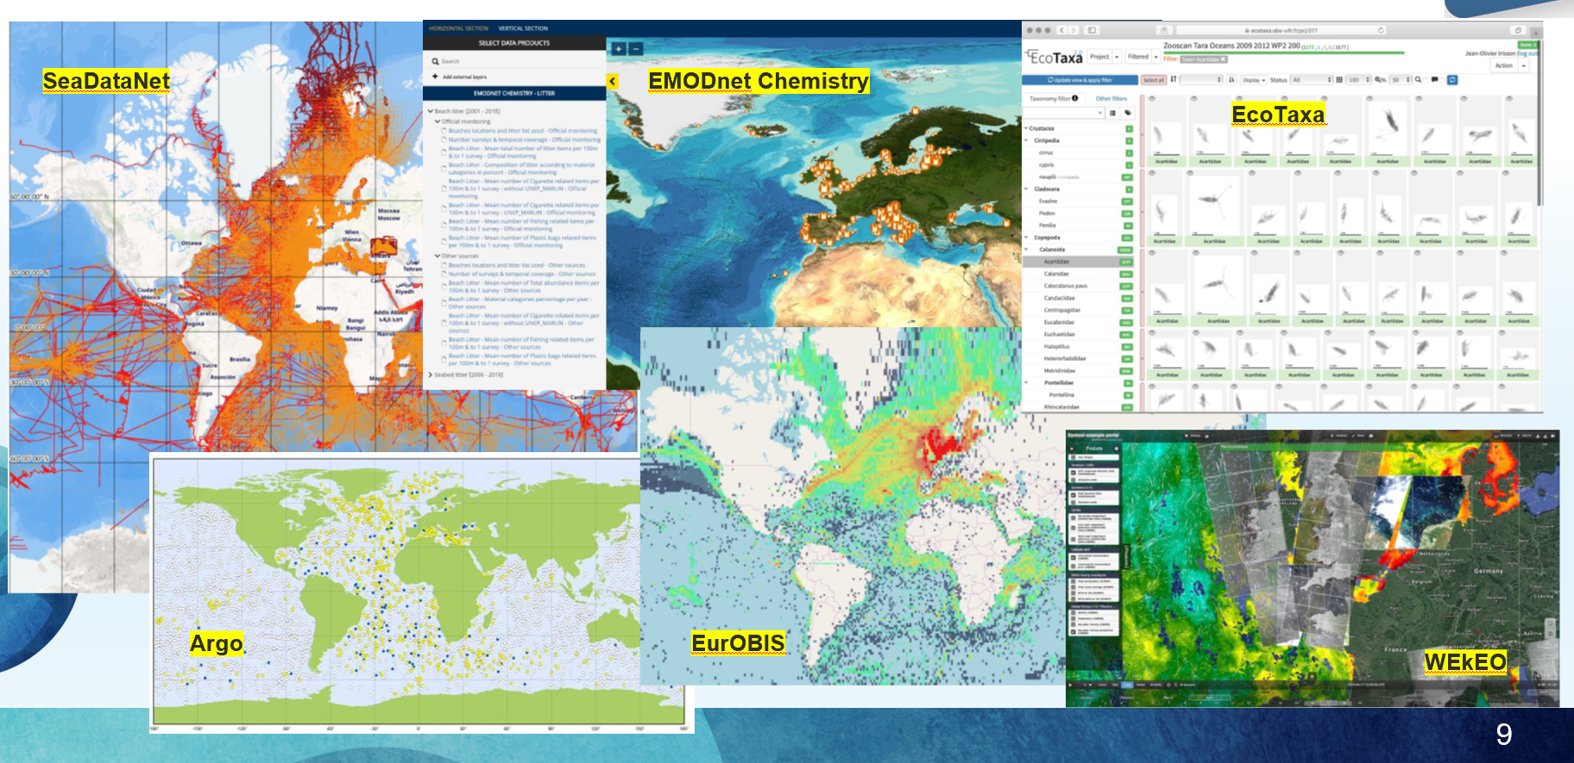
Illustrations of data coverage

Slide 9
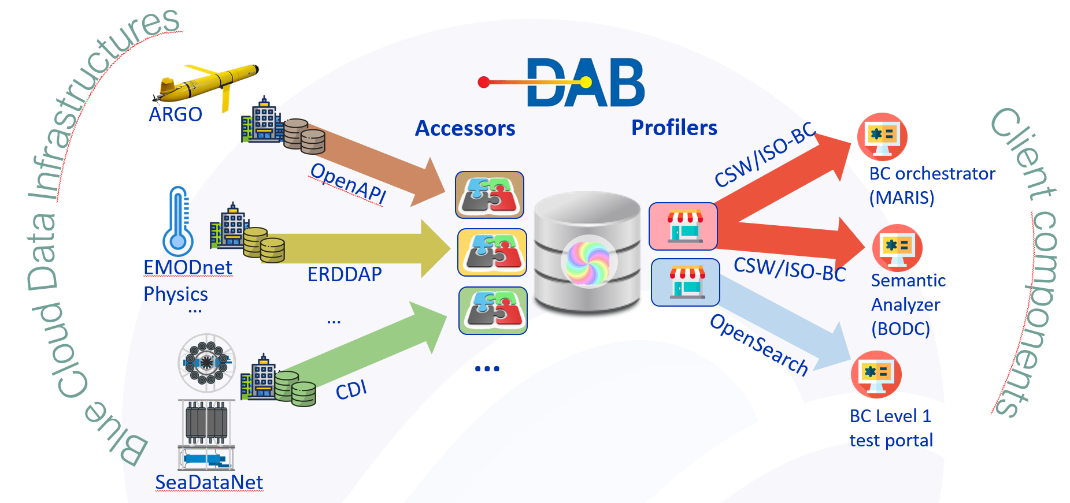
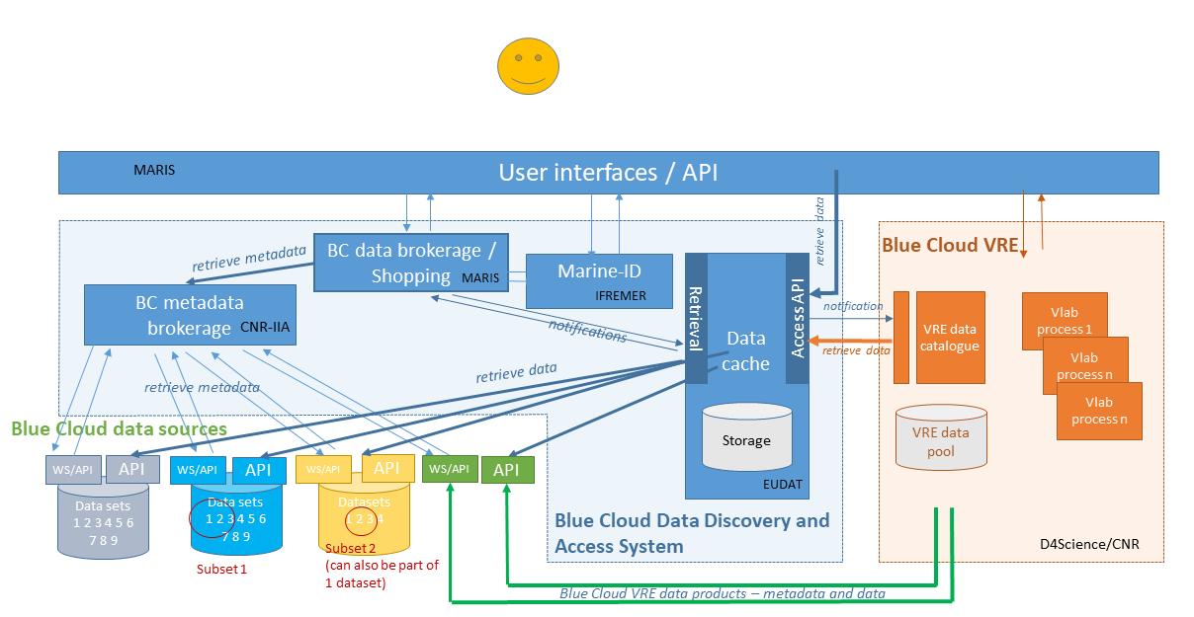
Blue-Cloud Data Discovery & Access Service
Providing an internal data gateway for the Blue-Cloud VRE users and developers
Machine-to-Machine interaction with web services and APIs as provided and operated by the BDIs
DAB service functions as Metadata Broker at common collection level; interaction with individual BDI web services at granular data level
Harmonising and expanding functionality of web services as operated by each BDI for discovery and access
Uptake of controlled vocabularies and semantic brokering
Impact: optimizing FAIRness and content of BDI web services

Slide 10
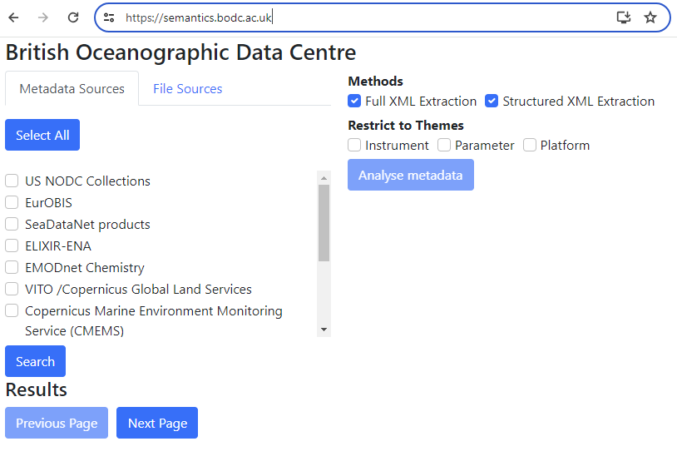
BODC’s Semantic Analyser
Developed for the FAIR-EASE project
Tool to analyse the semantics of metadata and data files
Mappings across multiple domains (atmospheric, marine, terrestrial)
Has been adapted to BC-2026 requirements

Slide 11
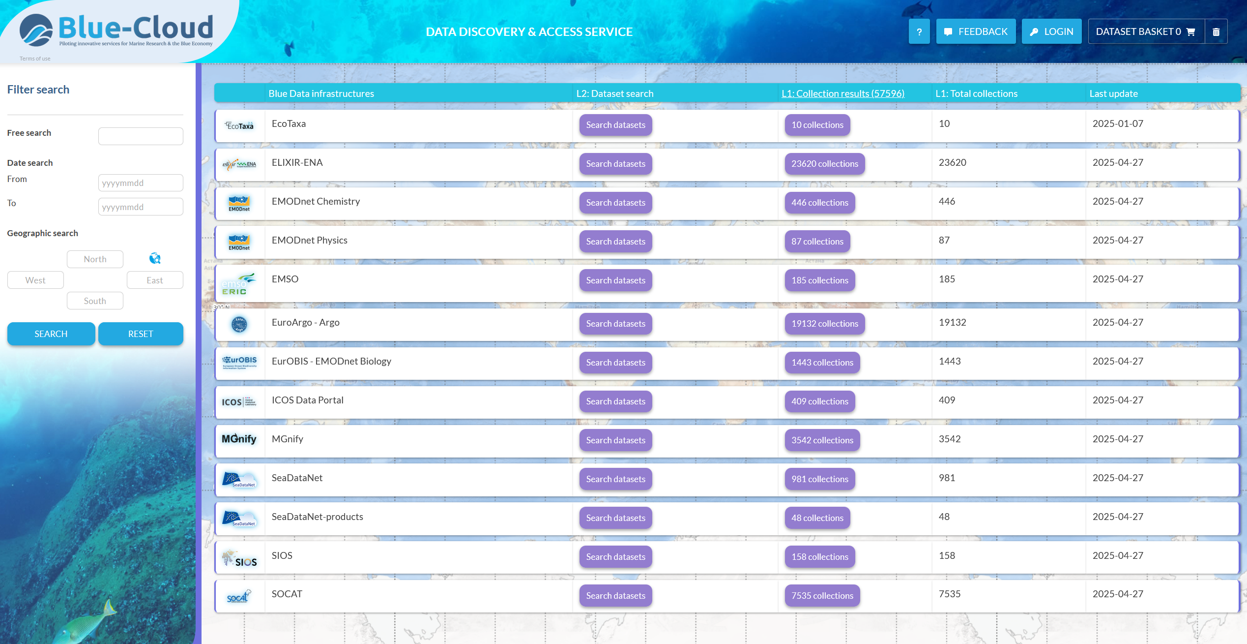
Blue-Cloud Data Discovery & Access Service

Slide 12
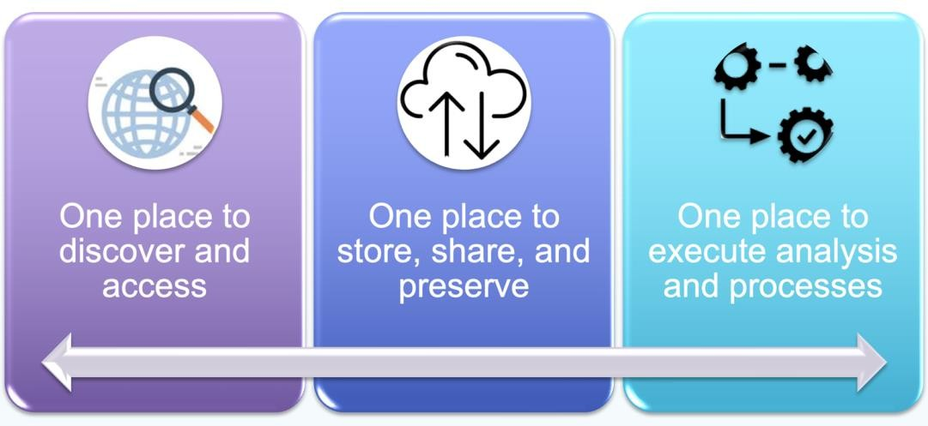
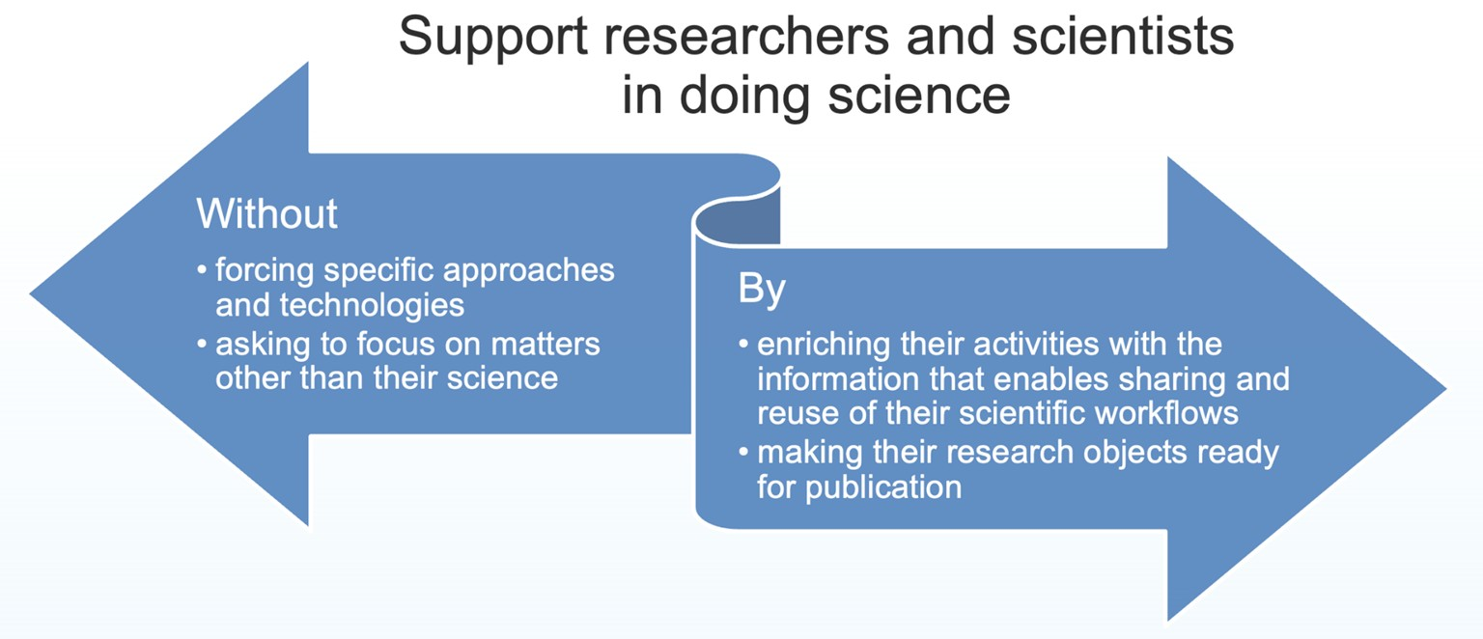

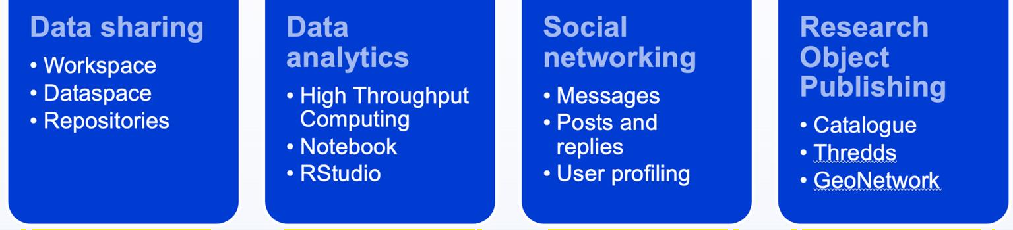
Blue-Cloud Virtual Research Environment
Virtual Laboratories

Slide 13
Blue-Cloud VRE
Collaboration
Sharing
Reuse
Reproducibility
Blue Cloud VRE promotes Open Science

Slide 14

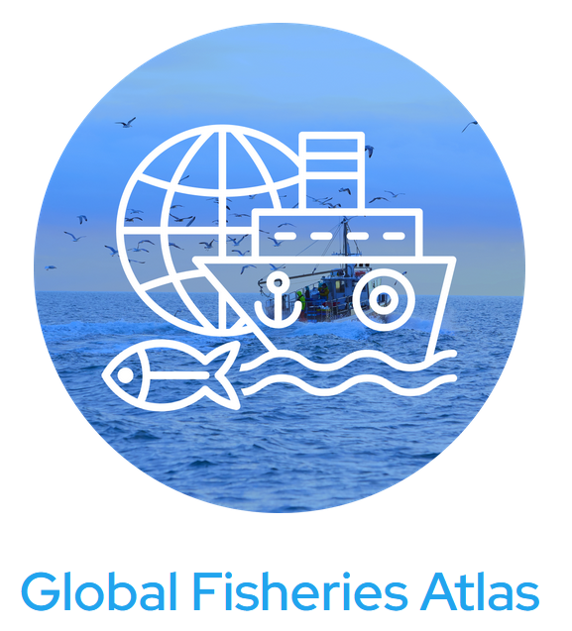
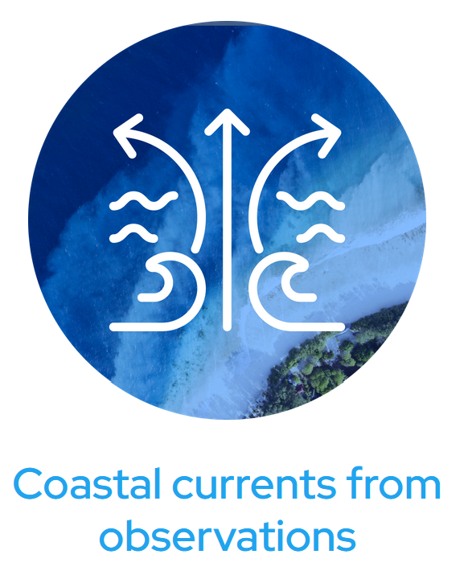
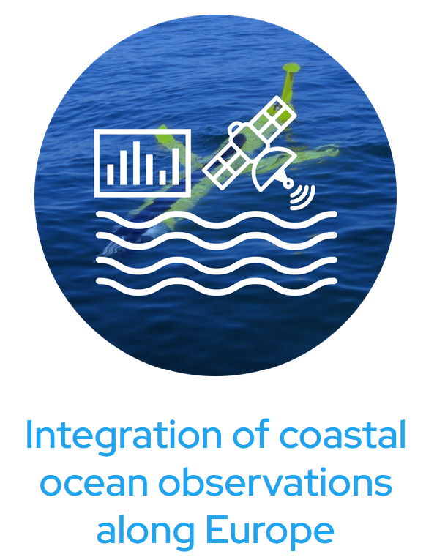
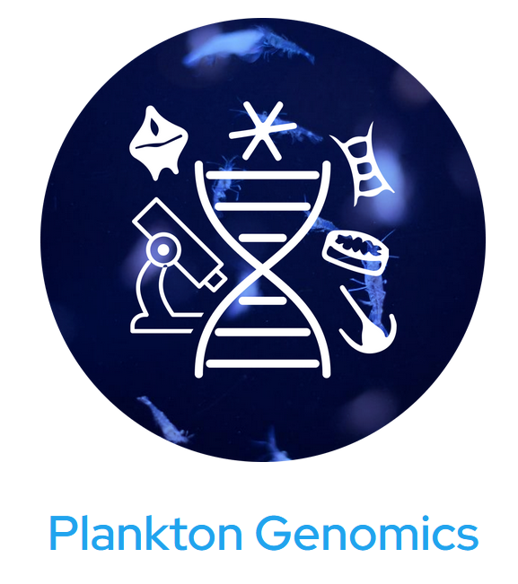
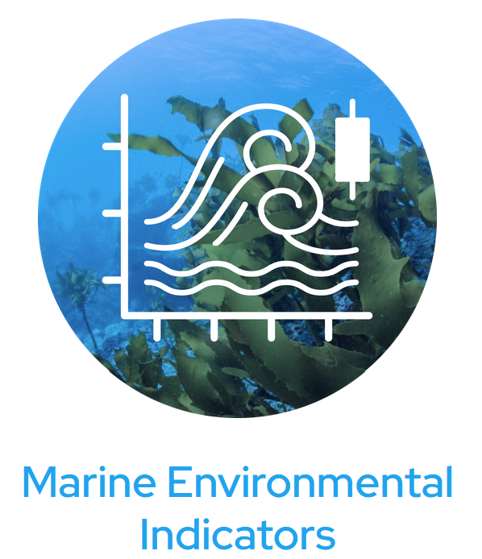

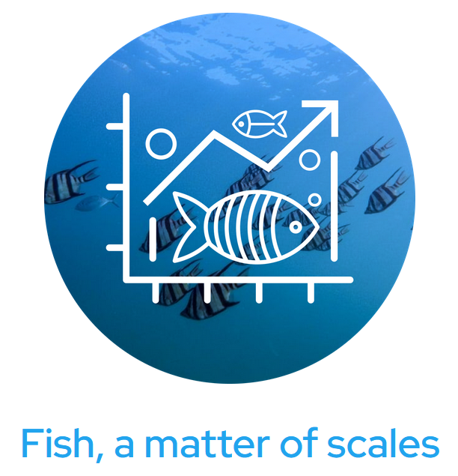
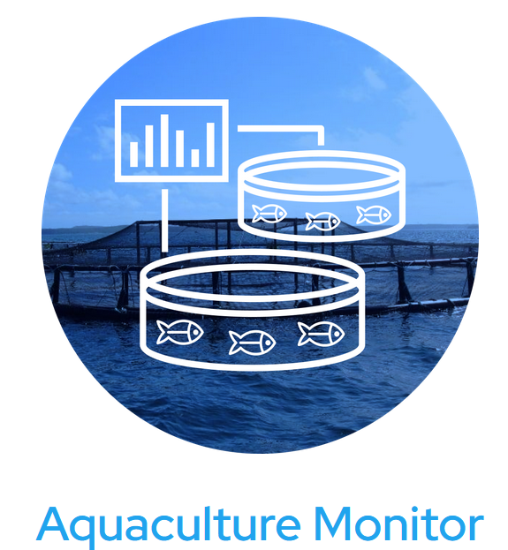
Blue-Cloud Virtual Labs at the VRE

Slide 15

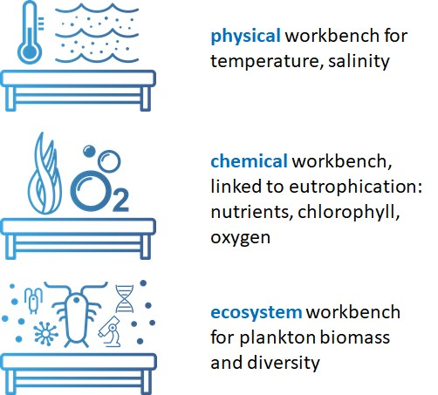

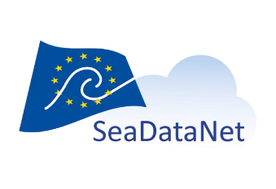


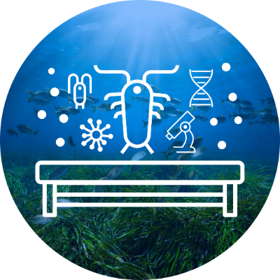

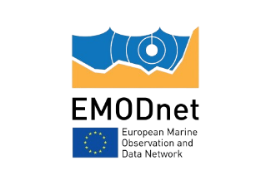





Implement cloud-based workflow or analytical pipelines to generate harmonised, validated and high-quality EOV, ECV and EBV data collections with data from multiple sources These pipelines can be adopted, when proven, in EMODnet and Copernicus Marine Service Experts from EMODnet, Copernicus Marine and from the biological community working together Data from:
Blue-Cloud 2026 WorkBenches
One of the challenges: how to have fast and unified access to the various data sources per WorkBench => set up of Data Lakes

Slide 16
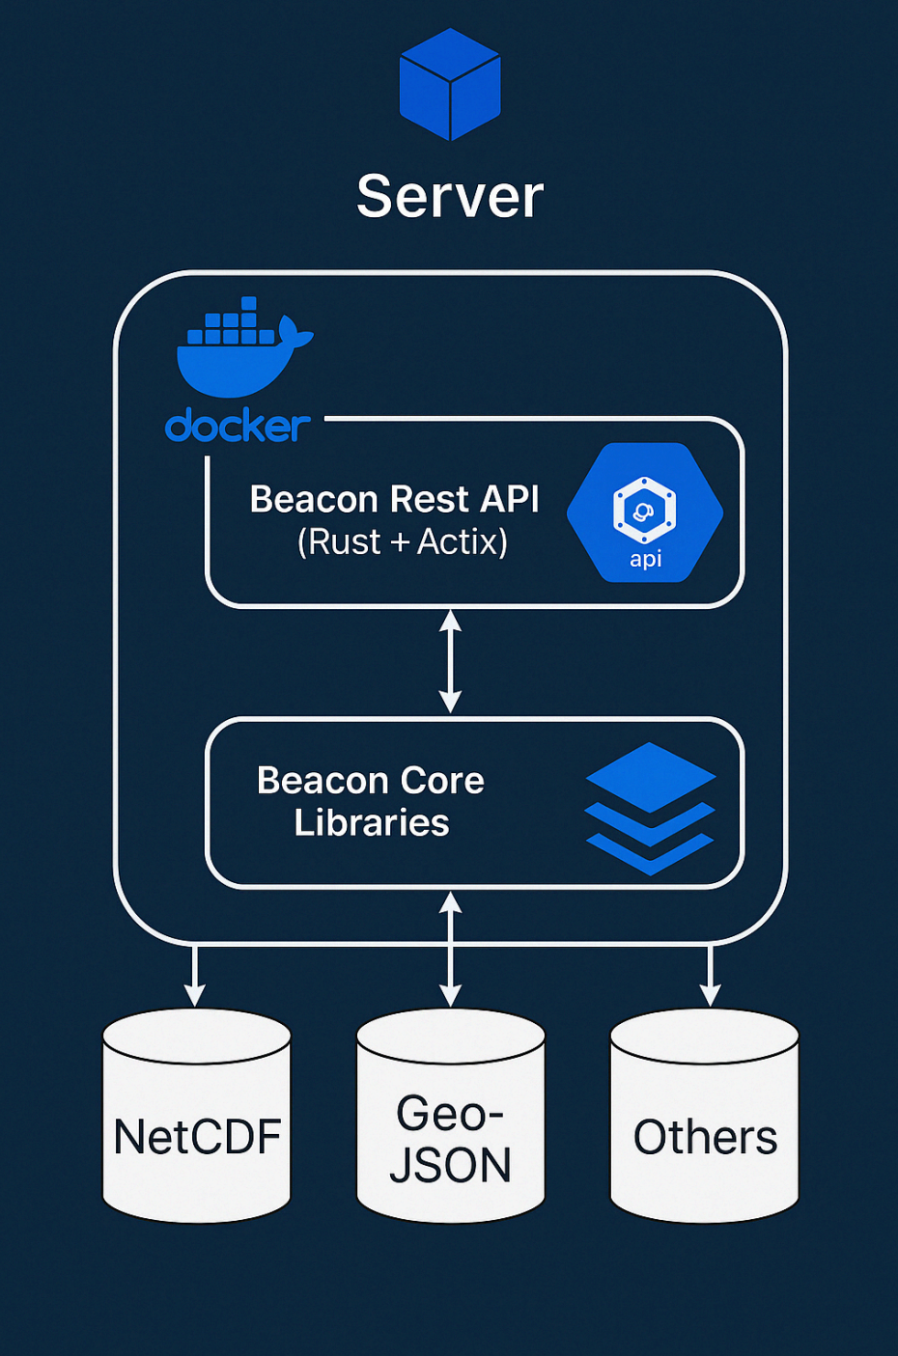
BEACON technology for data lakes
Challenge:
Repositories can contain millions of data files
How to optimize Machine2Machine access to subsets, enabling easy access to Jupyter Notebooks and other applications.
How to go from files to serving applications as an actual “Data Lake”?
Example:
Request: ‘Give me all the temperature data in the North Sea, from 2010-2020, in degrees Celsius, at a depth of 0-50 m’.
Response: One NetCDF file containing exactly this data, which is then on the fly, directly usable in a Jupyter notebooks and for HPC.
Written in Rust + C
High Performance Data Lake
Runs on:
Linux
Windows
MacOS
Docker Containers
Consists of:
Rest API
Core Libraries
Real-Time sub-setting
Data harmonization (single output file)
Dynamic Chunking
Produces different output formats:
NetCDF
CSV
JSON
GeoJSON
IPC (Apache Arrow)
Parquet
WebODV ASCII
BEACON is developed to provide an easy-to-use, fast, reliable, and scalable solution for storing, processing, and retrieving data from large amounts of data files
16

Slide 17

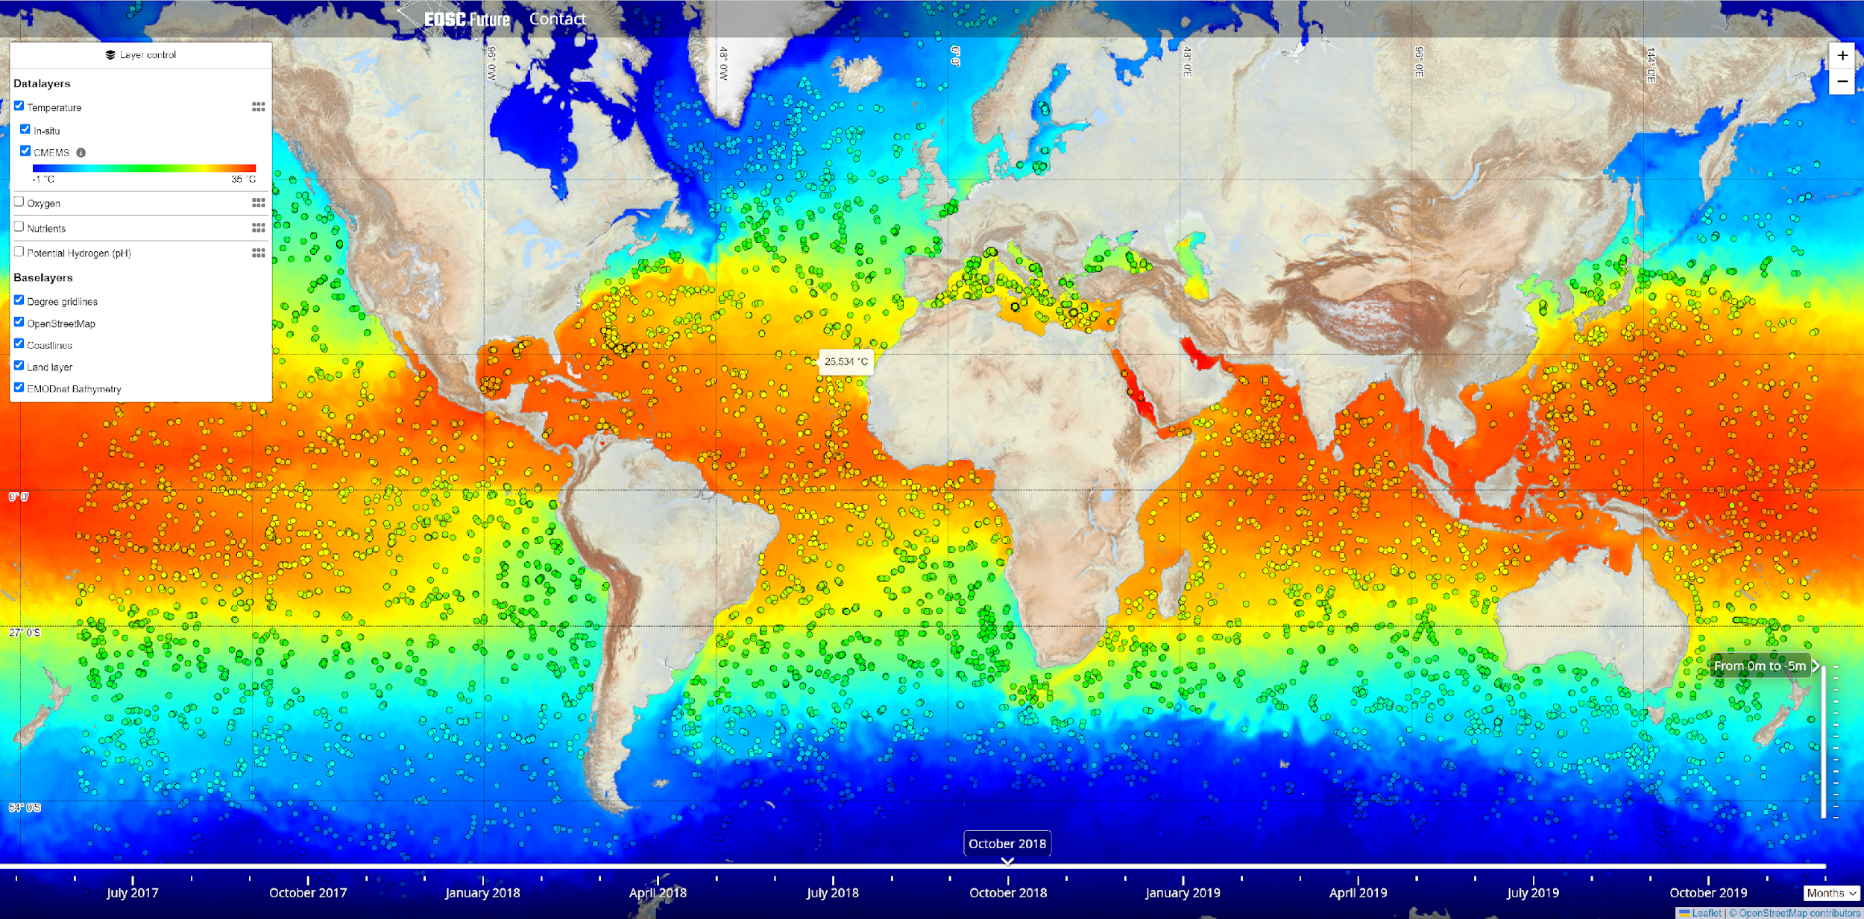
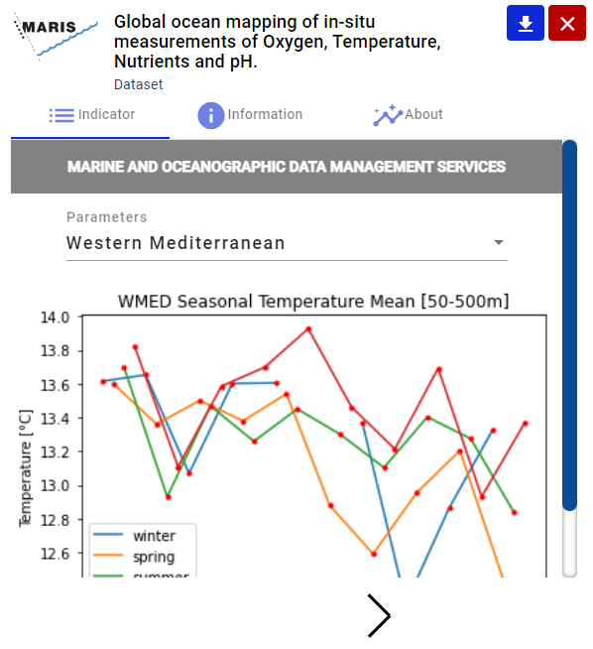
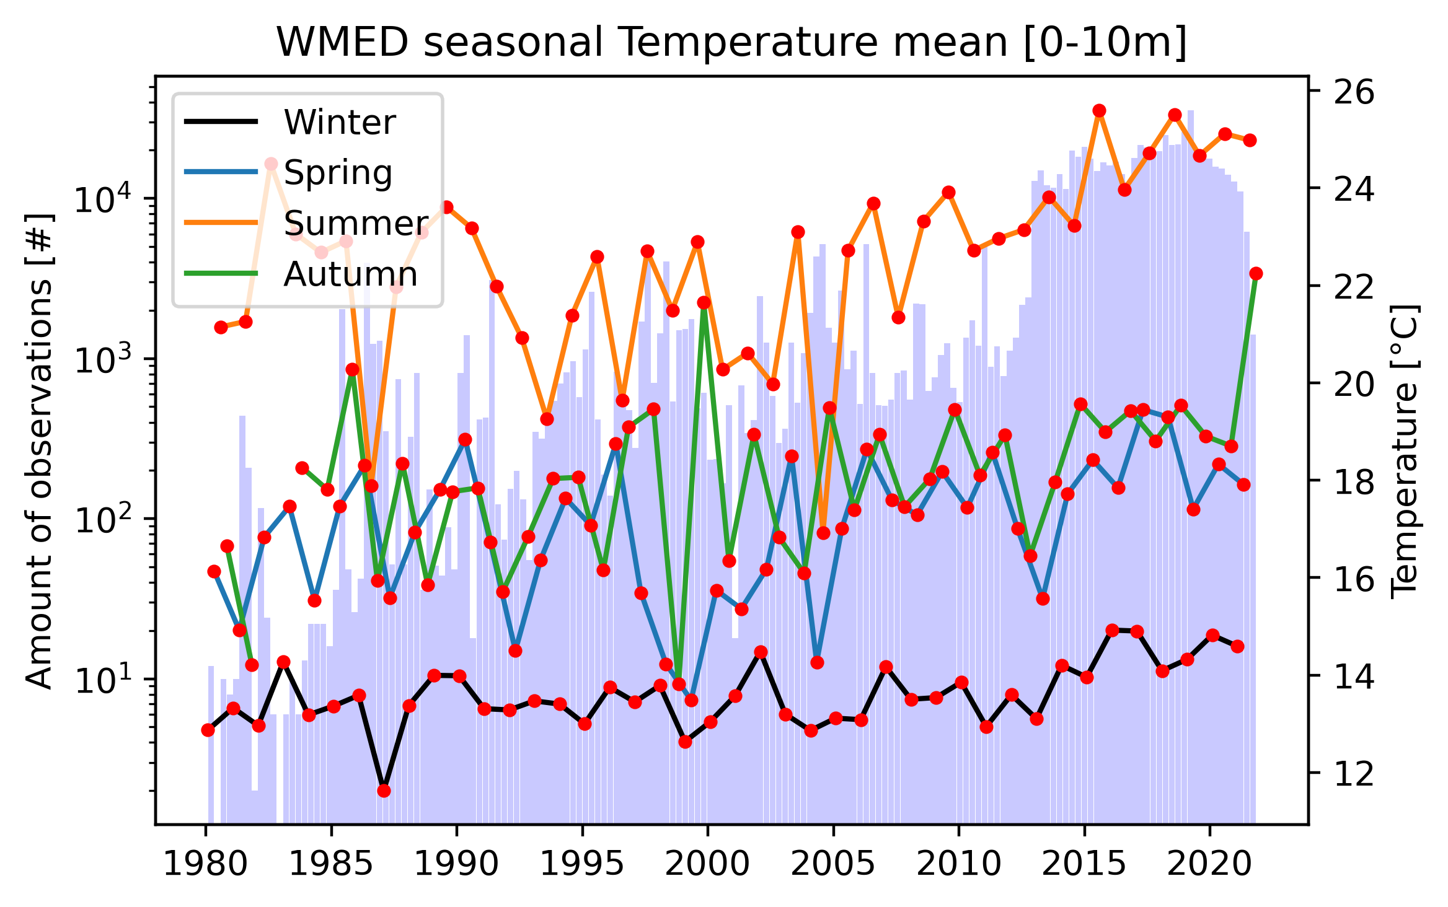
EOSC-Future science case
Beacon as data lake and engine, giving instantaneous access to data values from EuroArgo-Argo and SeaDataNet, co-located with Copernicus Marine data products
Level 1: Ocean indicators
Level 2: Co-location data values as-is Map Viewer
Sliding by depth, time period, parameters, and geo location
Map Viewer

Slide 18
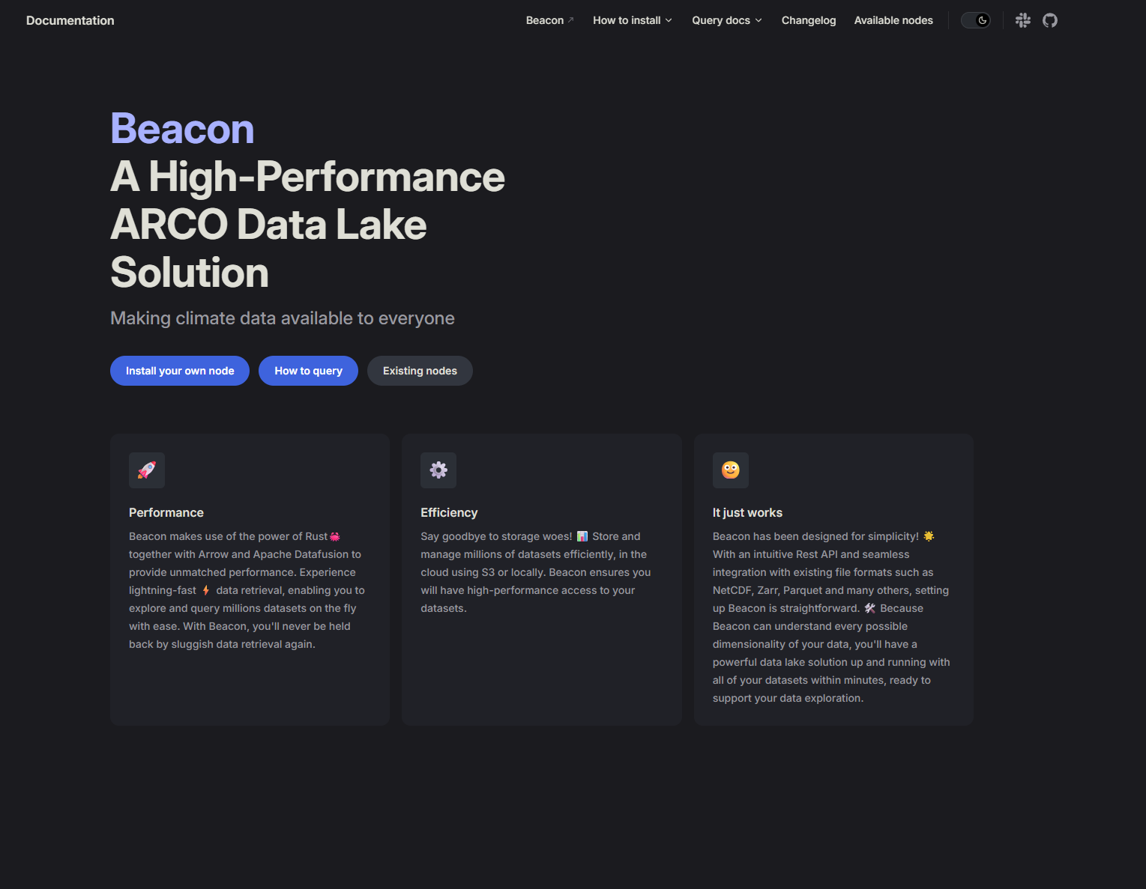

Beacon software
Available Open Source 🔓💻
Beacon available at :
Docs: https://maris-development.github.io/beacon/
GitHub Repository: https://github.com/maris-development/beacon
Example setup:
A guide for setting up a Beacon instance
https://github.com/maris-development/beacon-example
Set-up multiple Beacon instances
With example notebooks
See also: https://beacon.maris.nl
18

Slide 19
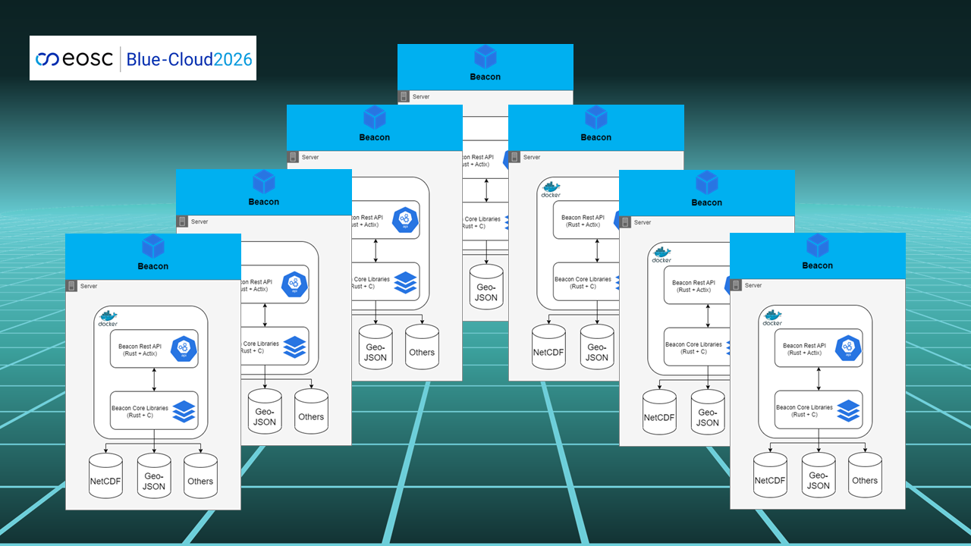
Monolithic and Merged BEACON Instances deployed
Euro-Argo data
Copernicus Marine - CORA Profile data
Copernicus Marine - CORA Timeseries data
EMODnet Chemistry data
SeaDataNet CDI TS data
EMODnet Chemistry data
Copernicus Marine - BGC data
World Ocean Database (WOD) data
Merged Beacon instance for T&S
Merged Beacon instance for Eutrophication
Including harmonization of parameters, units, core metadata, making use of BODC semantic analyser and I-Adopt approach
Deployed at Blue-Cloud VRE
19

Slide 20
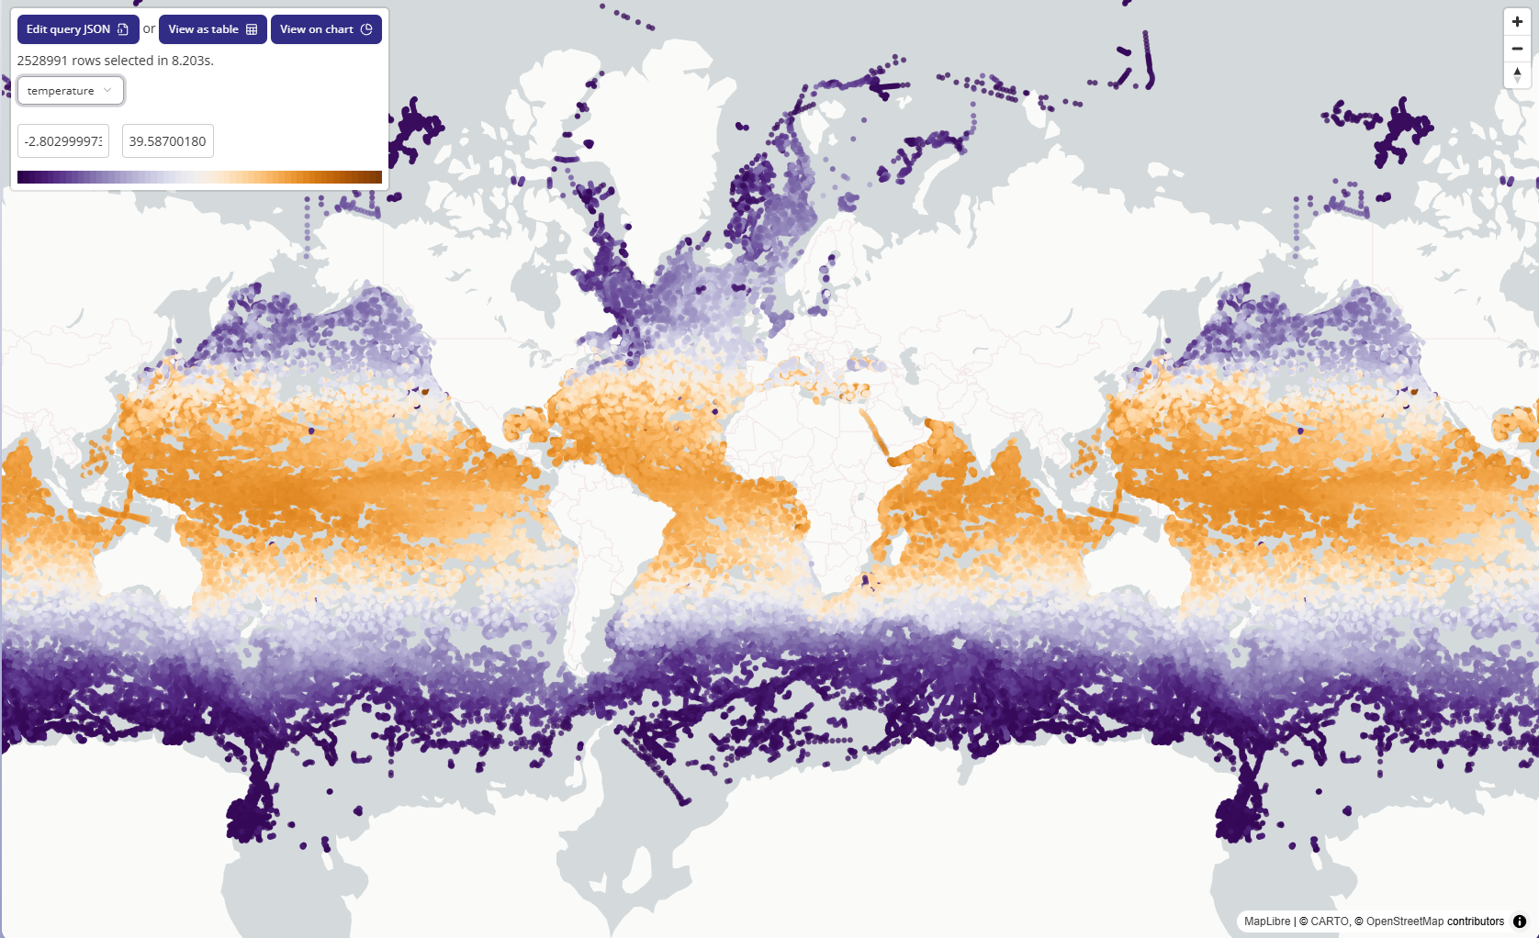
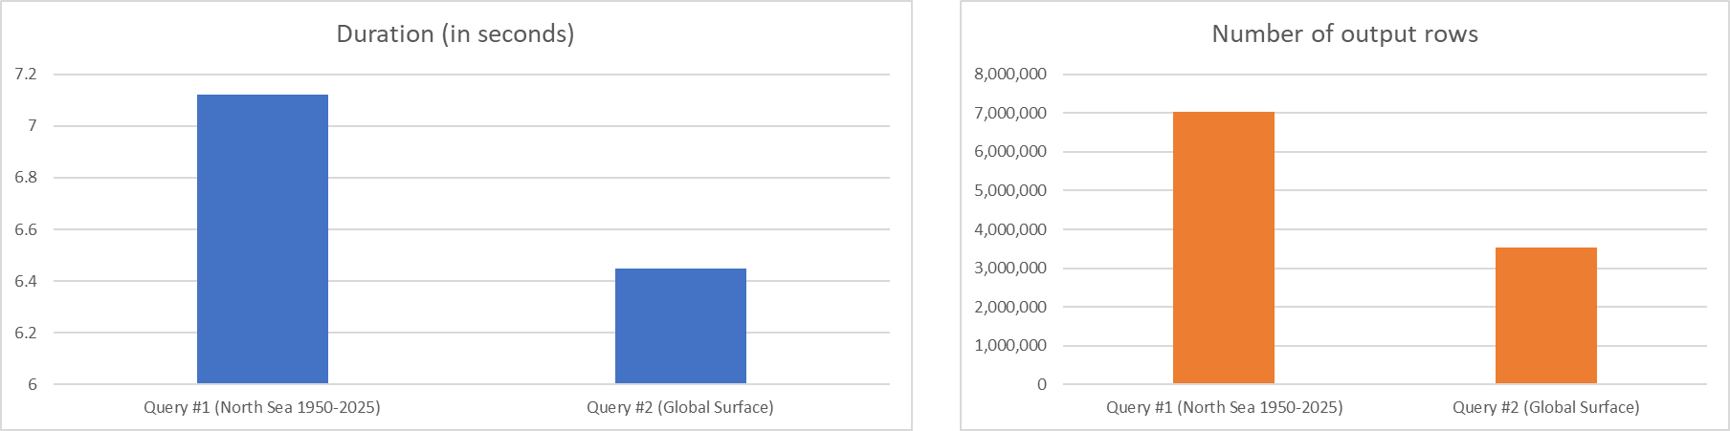
Beacon In-Situ Performance 🚀
World Ocean Database
~20 Million individual NetCDF Files
~600GB of data, compressed to 50GB BBF files inside a Cloud Bucket
Benchmark Queries
Selected Columns:
Temperature + QC
Longitude
Latitude
Depth
Time
Platform
Institute
Query #1 Range: North Sea, 1950 - 2025
Query #2 Range: Global Surface Level (0-10m)
20

Slide 21
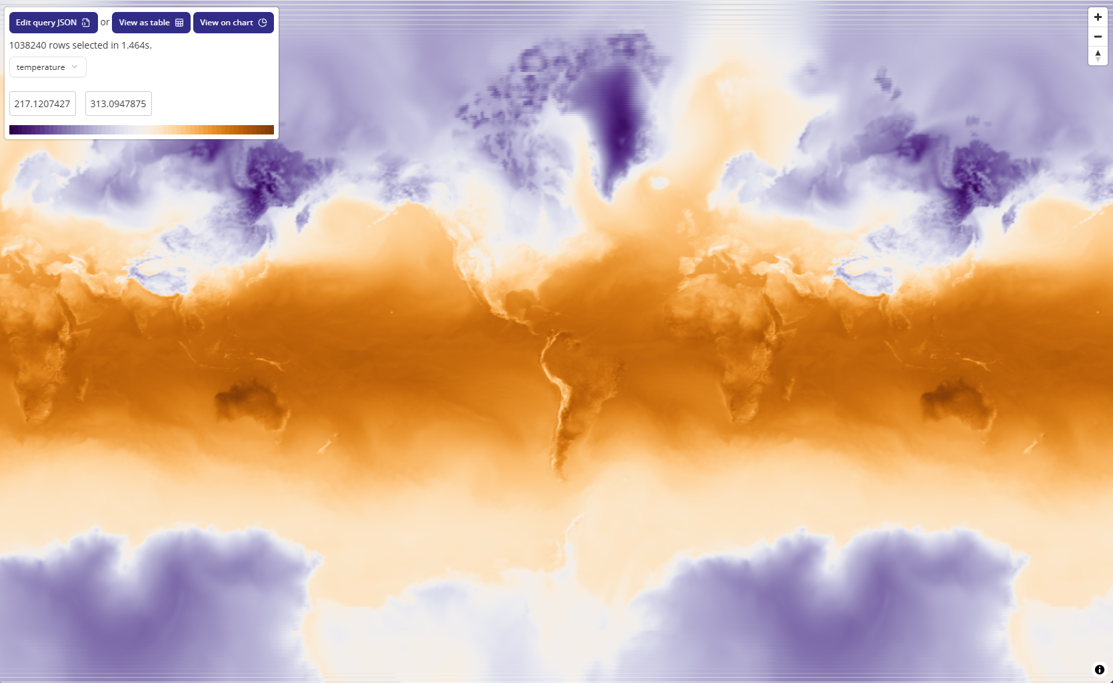
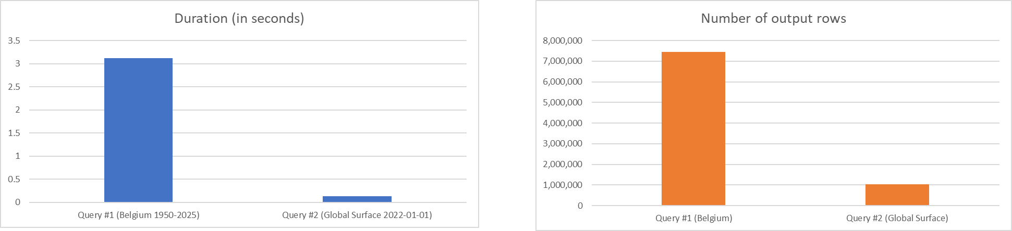
Beacon 🤝 Zarr Performance ⚡
ERA5 Daily Reanalysis
Stored as ZARR files inside a Cloud Bucket
Multiple TB’s (Global, 1950 - 2025)
Benchmark Queries
Selected Columns:
Temperature
Longitude
Latitude
Time
Query #1 Range Belgium, 1950 - 2025
Query #2 Range Global for a Single Day
21

Slide 22
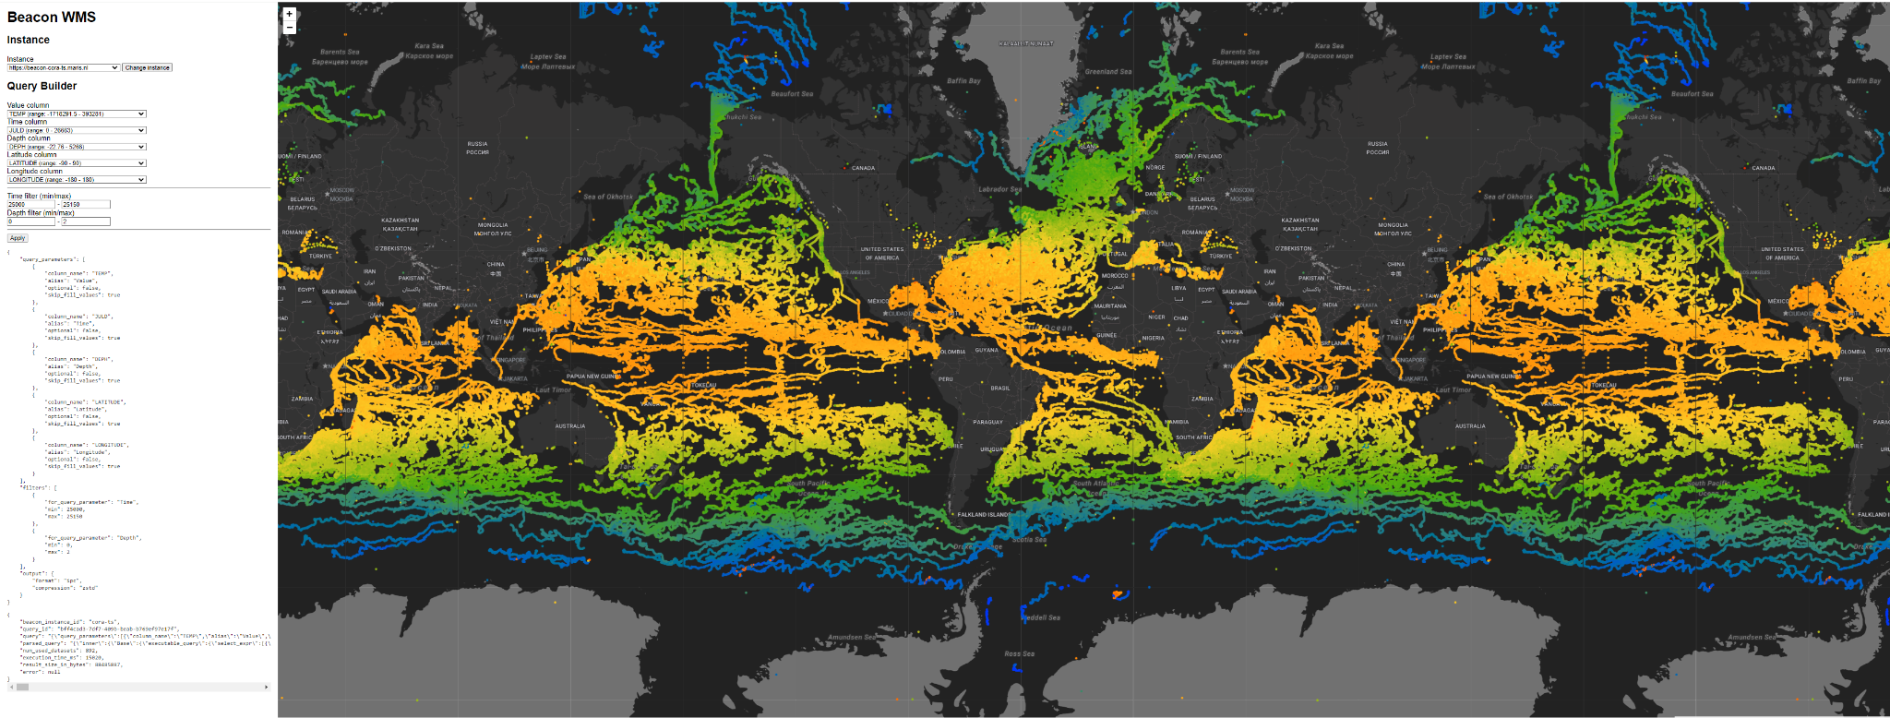
Example: (drawing 20M temperature points from CMEMS CORA)
22

Slide 23
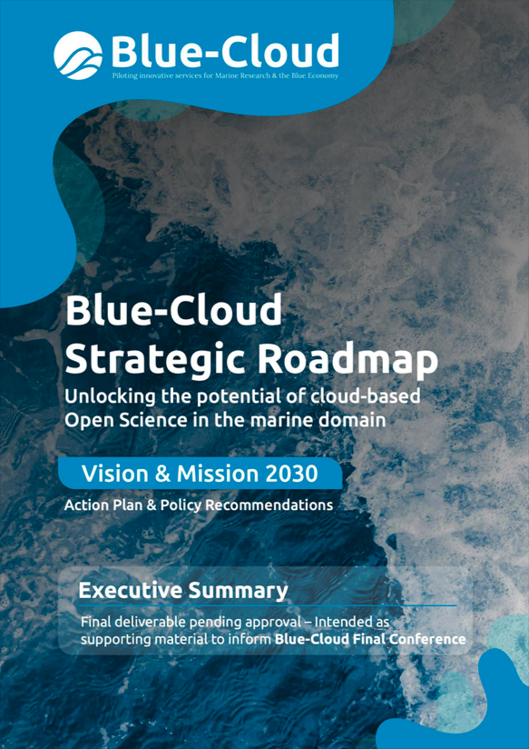
Blue-Cloud Strategic Roadmap
Blue-Cloud Mission to 2030
Blue-Cloud evolves as a key component of Europe’s FAIR marine digital knowledge ecosystem, building and engaging a community of practice and being an incubator for data analysis and modelling methods in support of applied research of the ocean, European seas, coastal and inland waters.
This supports the EU Green Deal, UN Agenda 2030, and the EU Mission Ocean:
Making ocean & freshwater digital commons accessible to the wider scientific community via EOSC
Supporting the development of analytical services and/or Digital Twins that add value to the core European Digital Twin of the Ocean (EDITO)

Slide 24
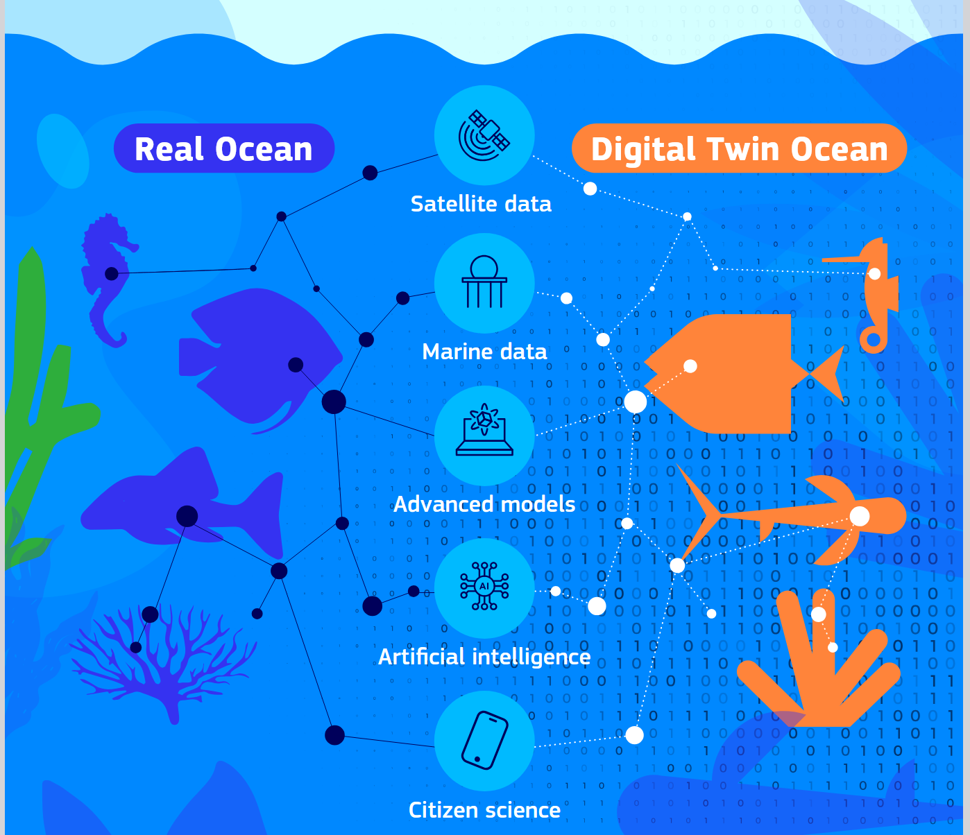


Digital Twin of the Oceans (DTO) programme
Connecting data and models in applications for scientists, marine experts, policymakers, citizens, and entrepreneurs to run and assess different scenarios.
In support of science and decision making
‘What-if’ models for instant answers and advice
DTO will be very ‘data hungry’ and for this rely on the European pyramid of data infrastructures from national to regional to European
Various EU RTD projects and global cooperation
EU initiative: EDITO

Slide 25
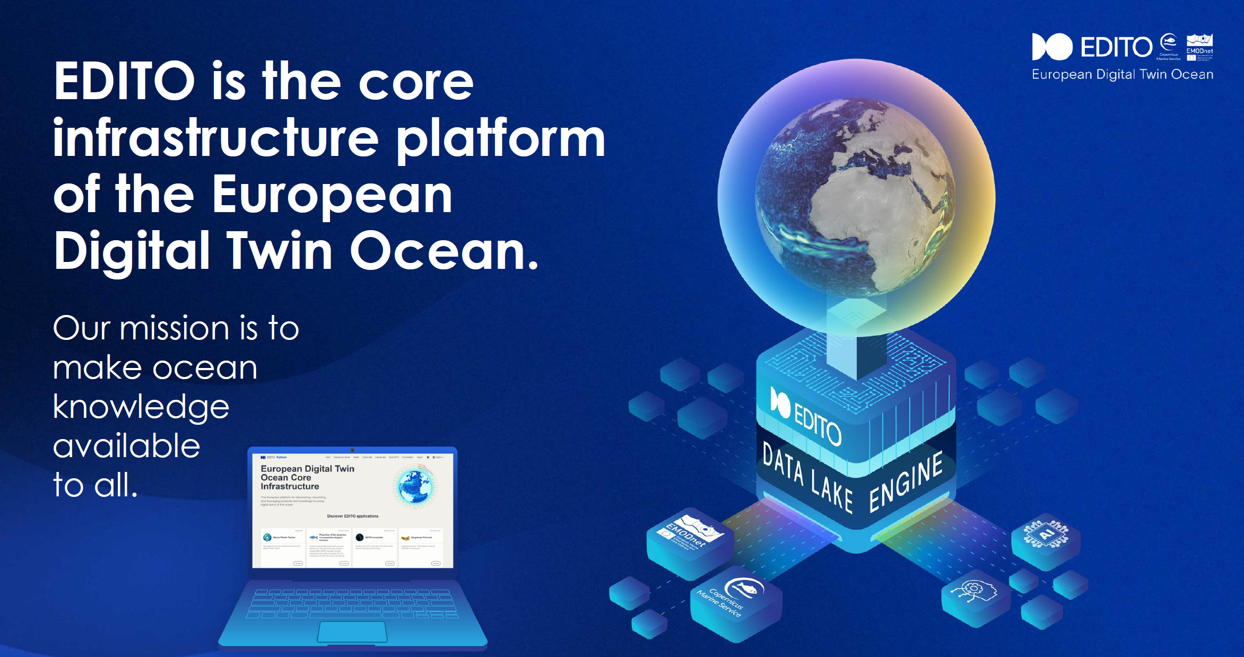
EDITO
EDITO Modellab has launched a VRE and several analytical applications
EDITO Infra Data lake is loaded initially with data products and collections from EMODnet and Copernicus Marine Service

Slide 26
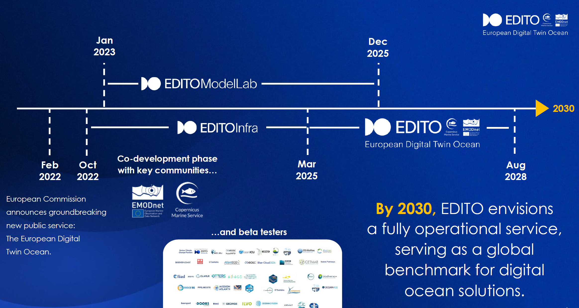
EDITO planning
EDITO Modellab has launched a VRE and several analytical applications
EDITO Infra Data lake is loaded initially with data products and collections from EMODnet and Copernicus Marine Service

Slide 27
Blue-Cloud federation: towards an EOSC marine thematic node
The EOSC Federation will consist of multiple EOSC Nodes that are interconnected and can collaborate to share and manage scientific data, knowledge, and resources within and across thematic and geographical research communities.
There is already the EU EOSC node.
As the decision-making body for EOSC, the EOSC Tripartite Governance oversees the structure, governance and operations of the EOSC Federation.
A process was started to select early adopters. Blue Cloud has successfully applied and is now one of the 14 candidates of the 1st wave

Slide 28
Towards EOSC node | Digital Twin of the Ocean
In the current European marine data landscape, there are now three EU funded long term initiatives: EMODnet (the in-situ data service), Copernicus Marine (combining satellite images and in-situ data in numeric models for forecasting and hindcasting), and EDITO on top of EMODnet and Copernicus Marine with on-demand capabilities for what-if questions. All are sheltering under the overarching DTO programme which is also horizontally connected to the Destination Earth (DestinE) programme
The EOSC marine thematic node application of Blue-Cloud is supported by the EU stakeholders of EMODnet, Copernicus Marine, EDITO and EOSC (DG MARE, DG RTD and DG DEFIS)
Serving the EOSC and DTO aims, Blue-Cloud is being transformed into the EOSC node | Digital Twin of the Ocean. It will be the DTO component representing EDITO in the EOSC Federation and interacting with EOSC communities and resources.
The Node’s role is to ensure EDITO services are not only discoverable by EOSC users but fully EOSC-compliant
A smart federation of EDITO and the EOSC node is currently underway at VRE level, while action is also planned at Data and Metadata level.

