Slide 1


Democratizing and scaling data analysis by Bring Your Own Storage and Data
16th SIG-CISS: Fed.Storage and Storage Infrastructure Workshop - GÉANT-INFN-ICSC Bologna
Björn Grüning, on behalf of the Global Galaxy community
CORDI 2025, 27th August 2025
@bgruening bgruening

Slide 2
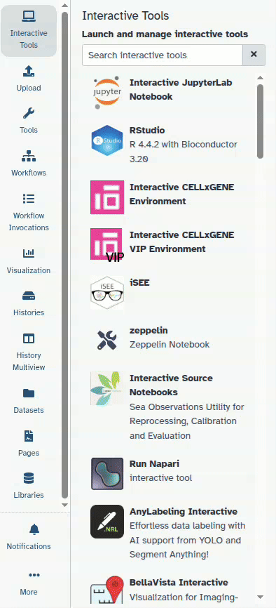

Focus on reproducible, transparent research since 2005
Open Source framework (every component)
First version 20 years ago
Accessing & Sharing data, tools, workflows
4000 tools, 50 VREs on the European Galaxy server
Cross-discipline
Multiple interfaces
intuitive webportals for scientists without programming skills
unified API for bioinformaticians
International: 300+ public instances, 150.000 users

Slide 3
The big picture
Users
Tool1
User data
Tool2
Galaxy
Reference data
…
ToolN
Models
Infrastructure

Slide 4
The big picture
Users
Tool1
User data
Tool2
BYO - Data
Galaxy
Reference data
…
ToolN
Models
Infrastructure
BYO - Storage

Slide 5
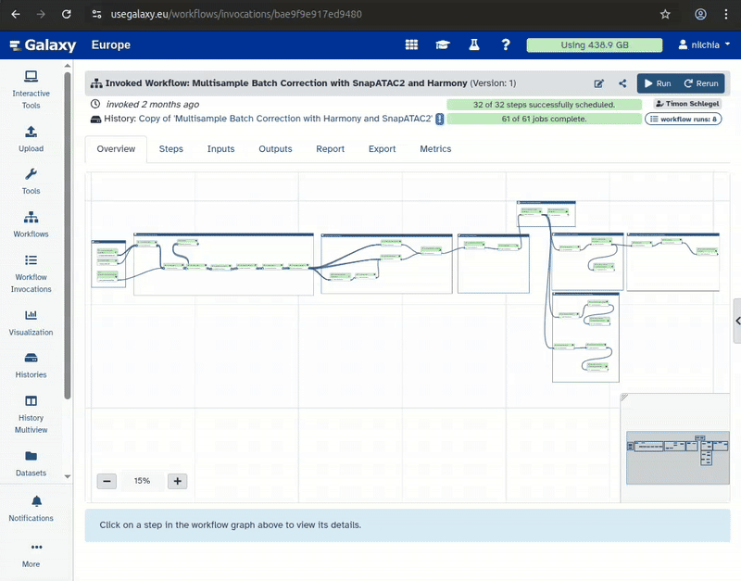
BYOS / BYOD

Slide 6
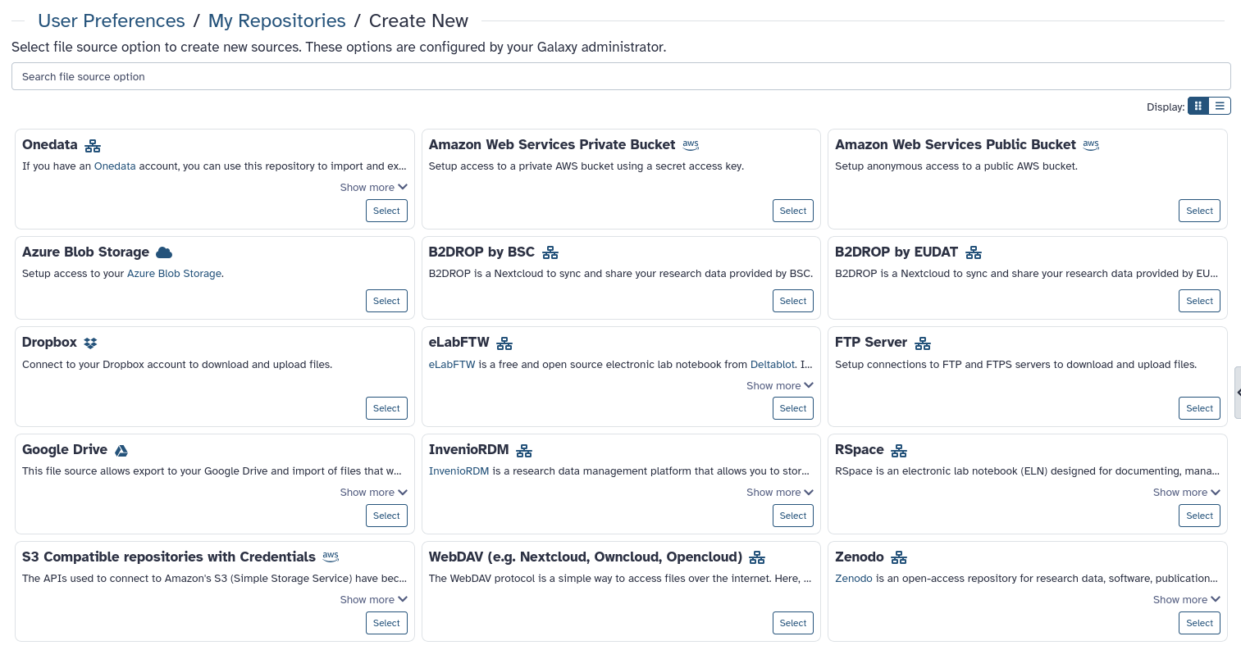
BYOS / BYOD

Slide 7
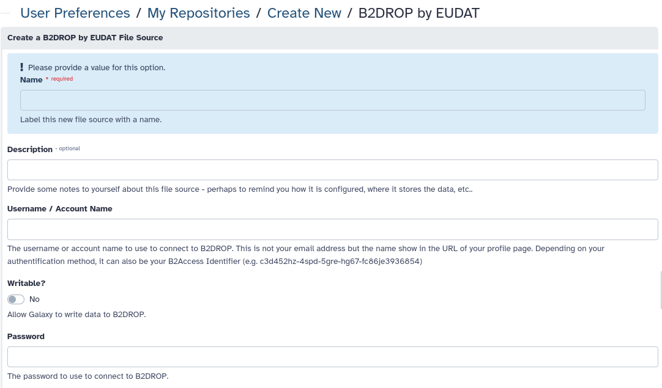

Slide 8




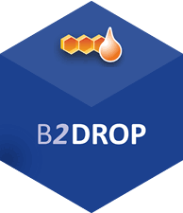







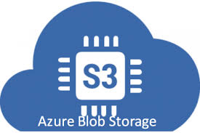


Bring Your Own Storage and Repositories

Slide 9

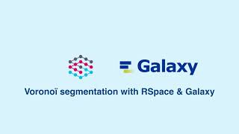
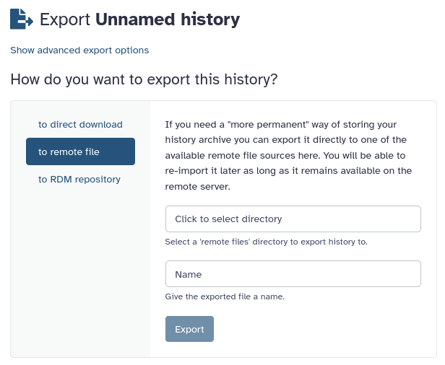


ELN to Galaxy - Galaxy to ELN

Slide 10
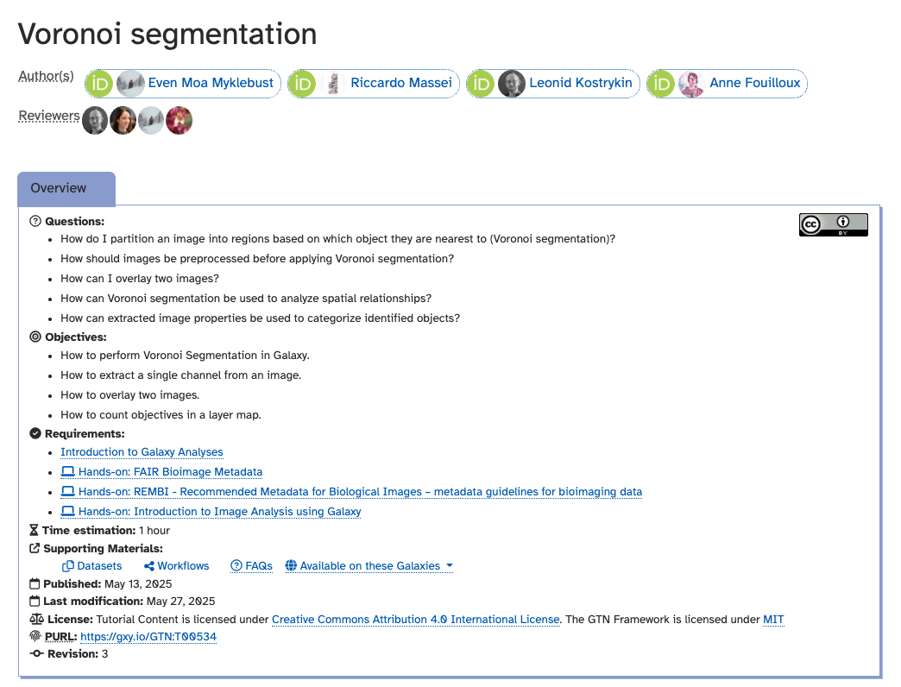
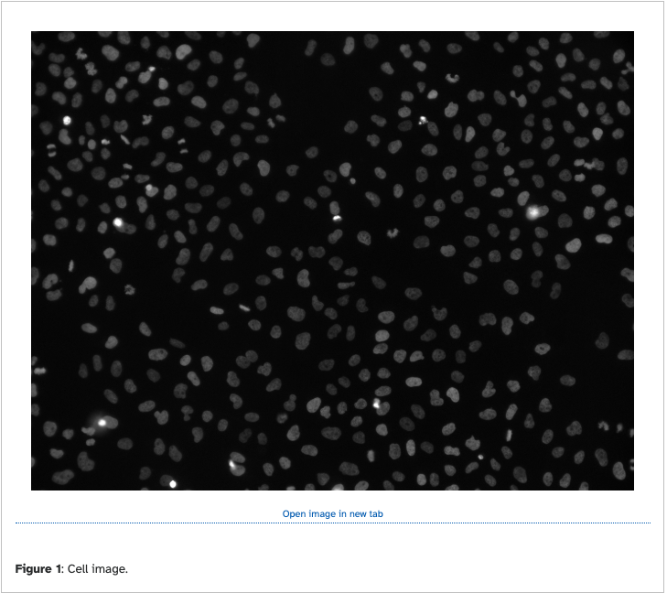
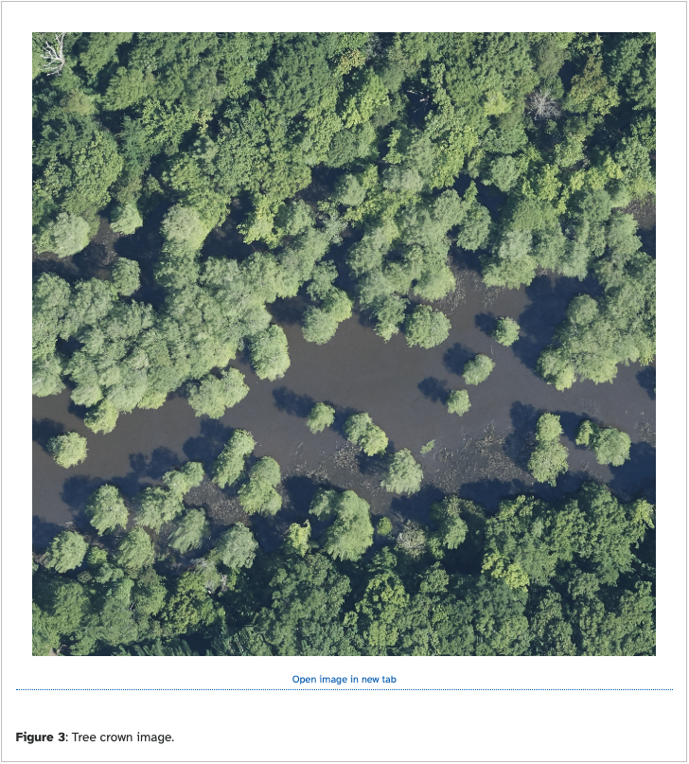
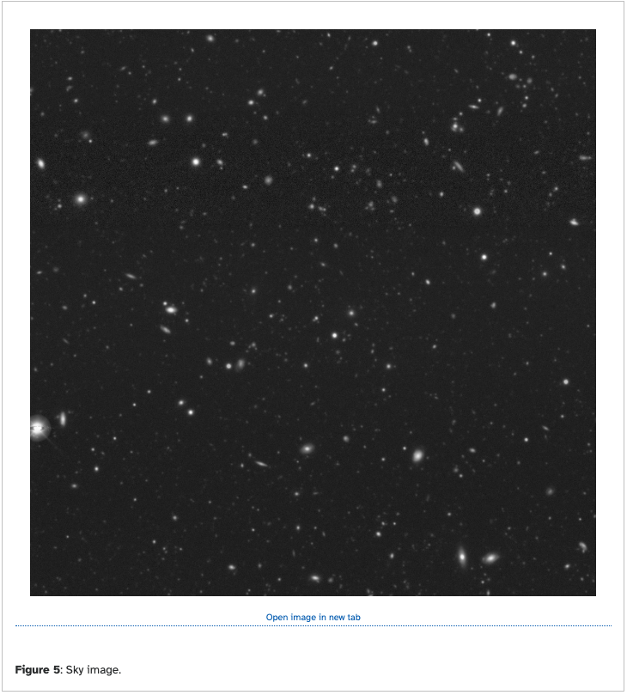
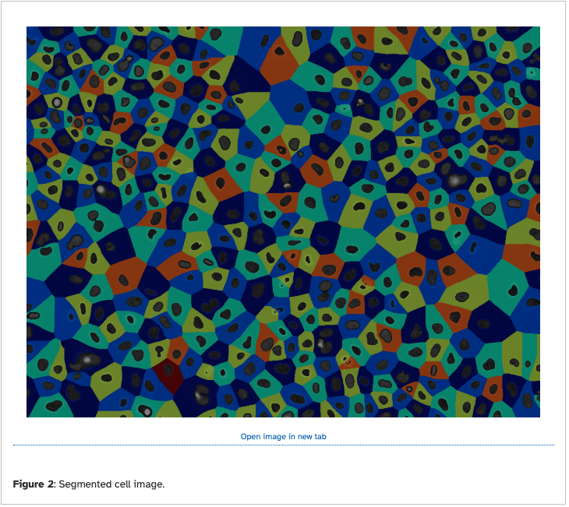
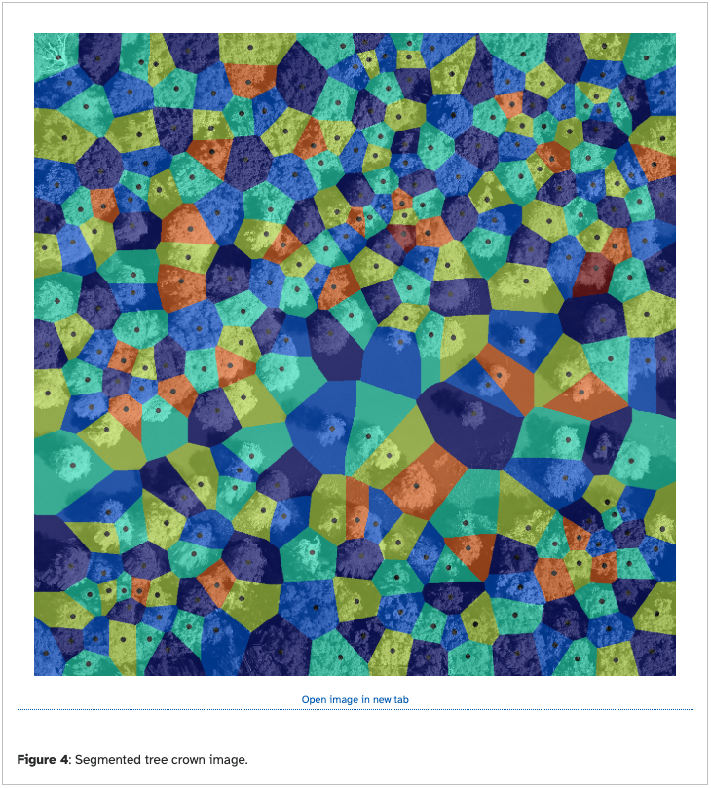
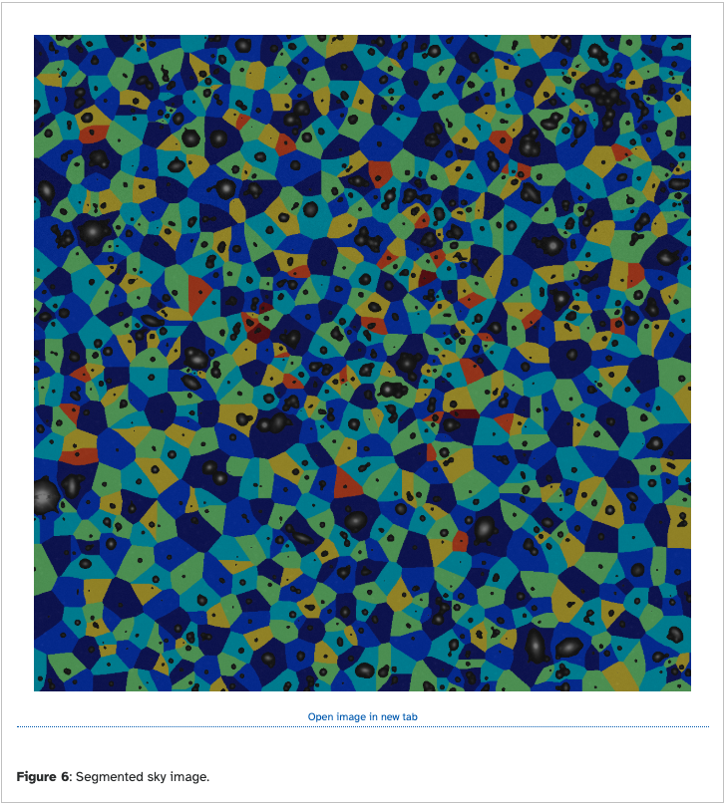
Reusing … the other way …

Slide 11
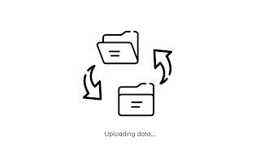

Slide 12


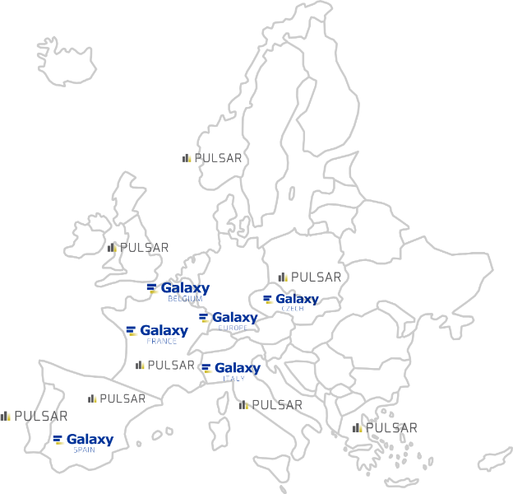
Compute (BYOC)
The most innovative computing centers across
Europe are sharing their remote computation power to support the UseGalaxy.* load:
DE, de.NBI cloud
IT, ReCaS-Bari
BE, Vlaams Supercomputer Centrum (VSC)
PT, Tecnico ULisboa
ES, Barcelona Supercomp. Center (INB-BSC )
NO, University of Bergen
CZ, CESNET
FI, CSC
UK, Diamond Light Source
FR, GenOuest
https://pulsar-network.readthedocs.io/en/latest/project/partners.html

Slide 13
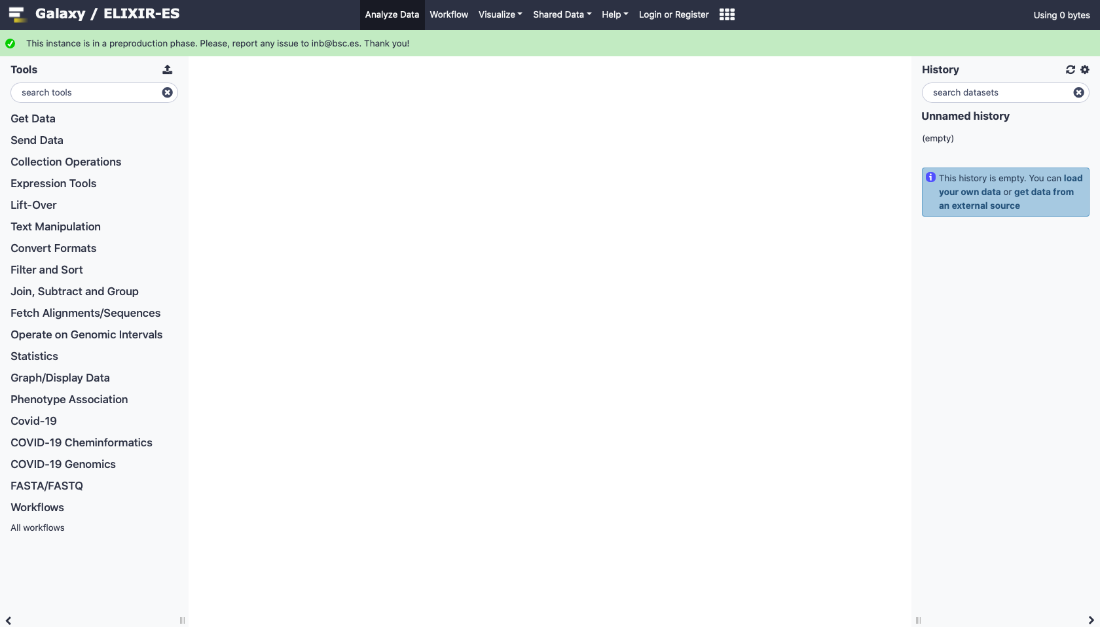
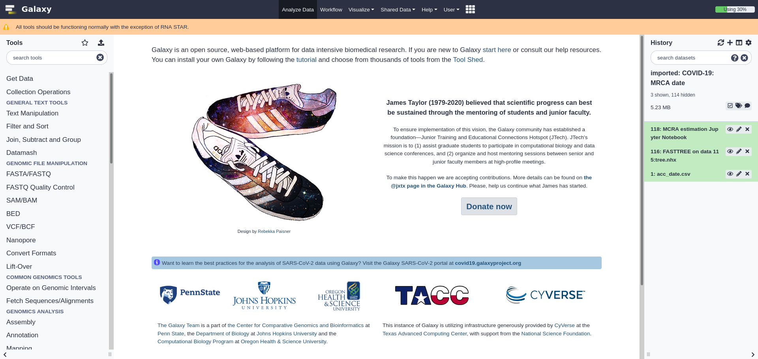
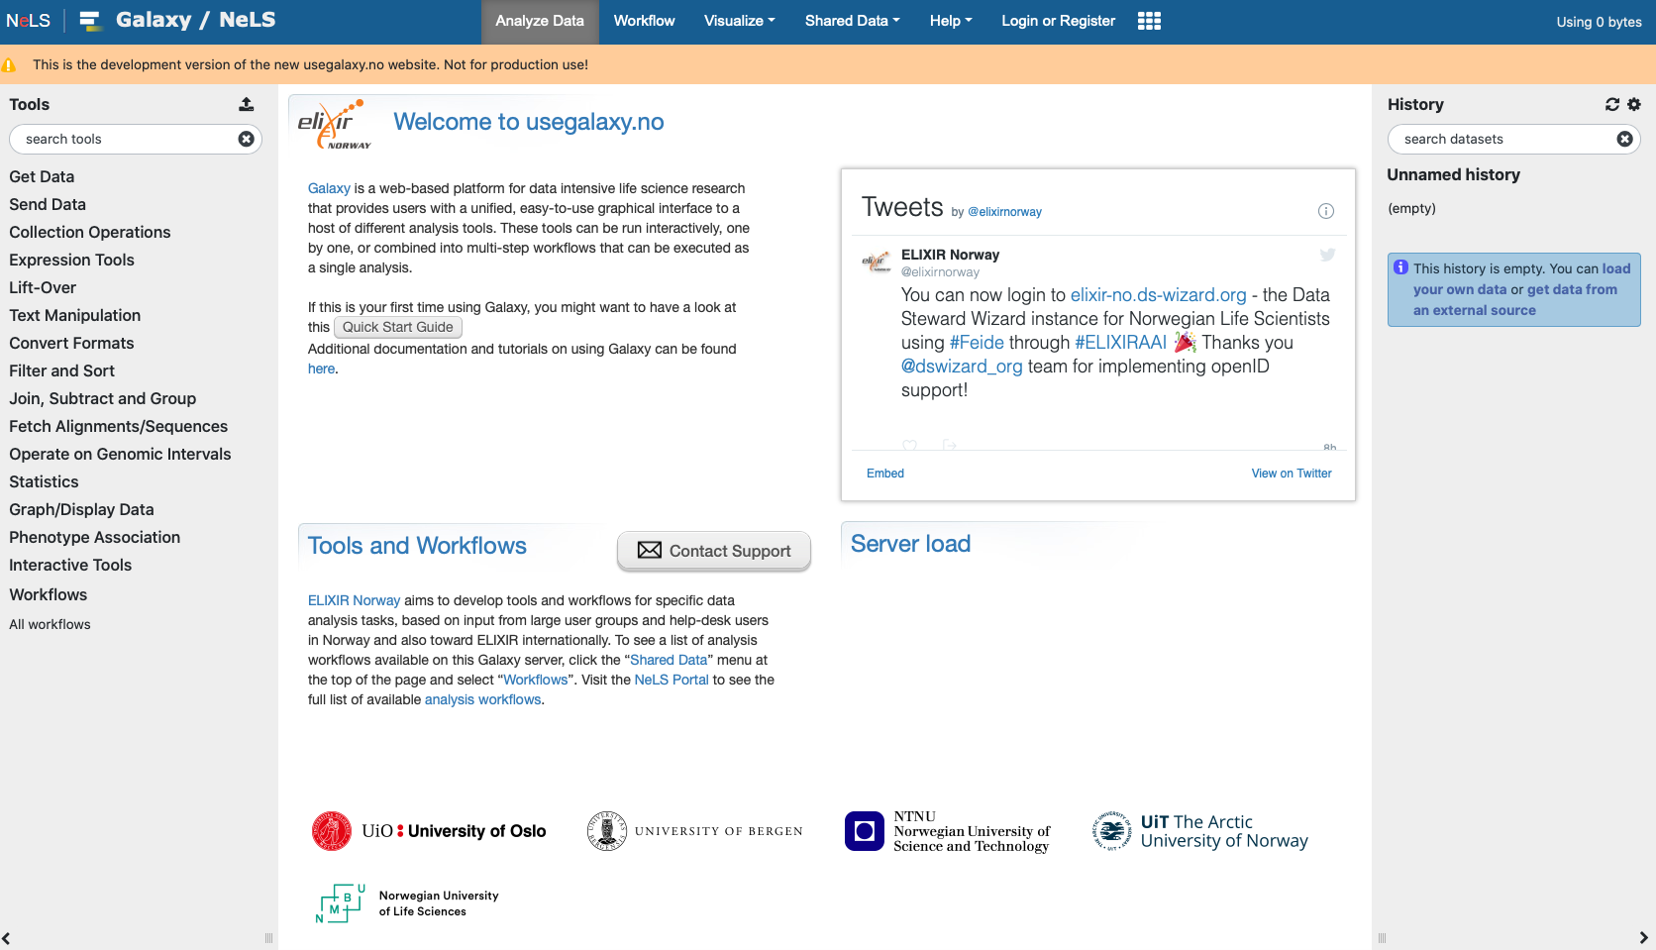
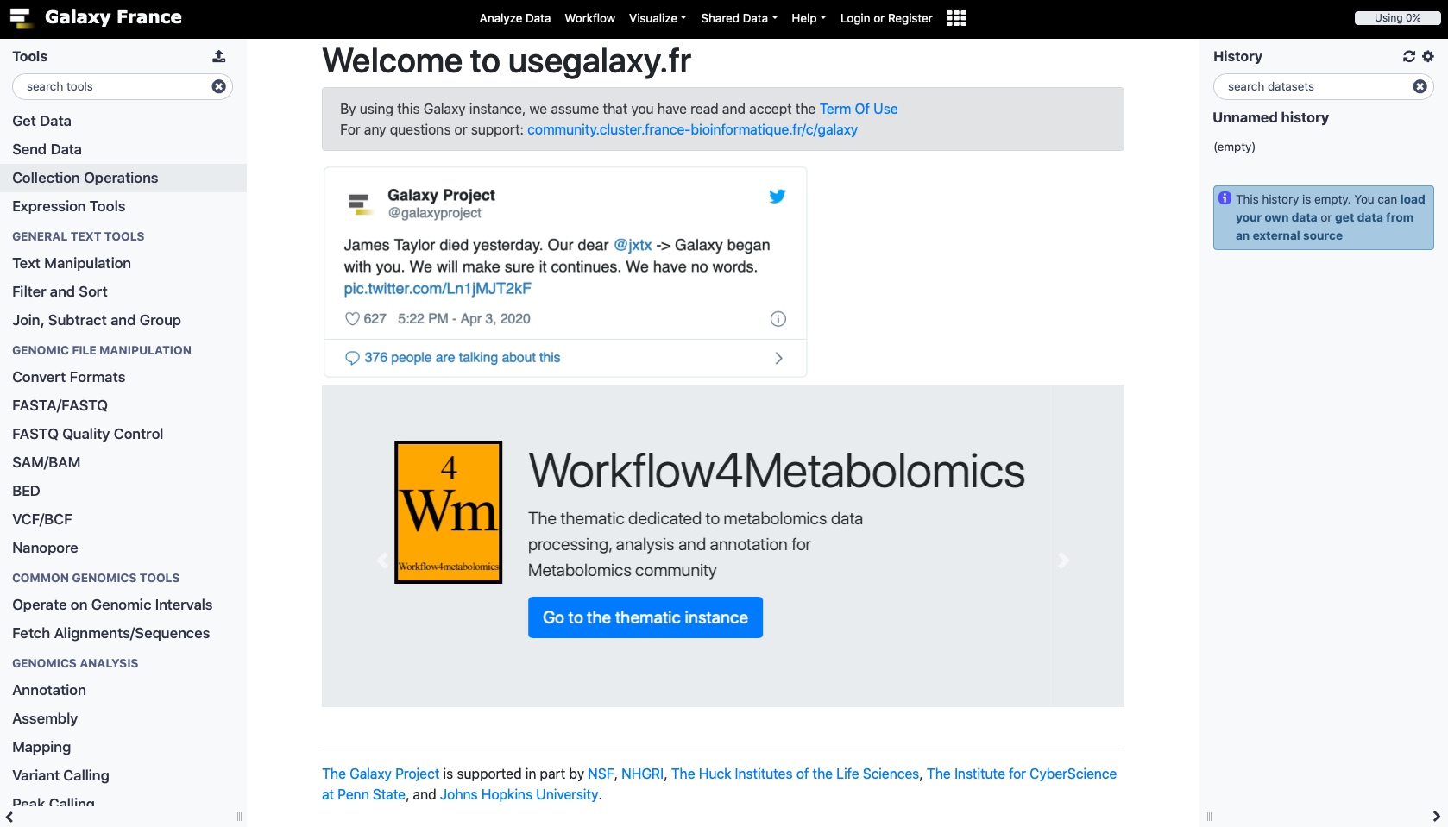
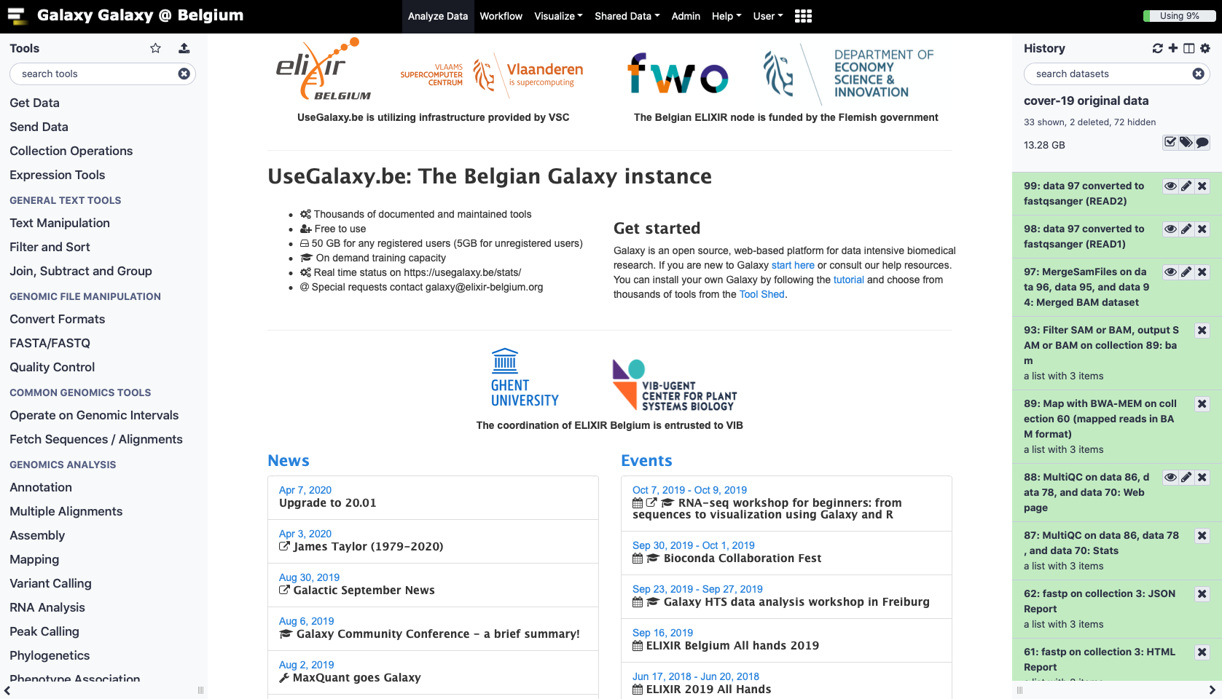
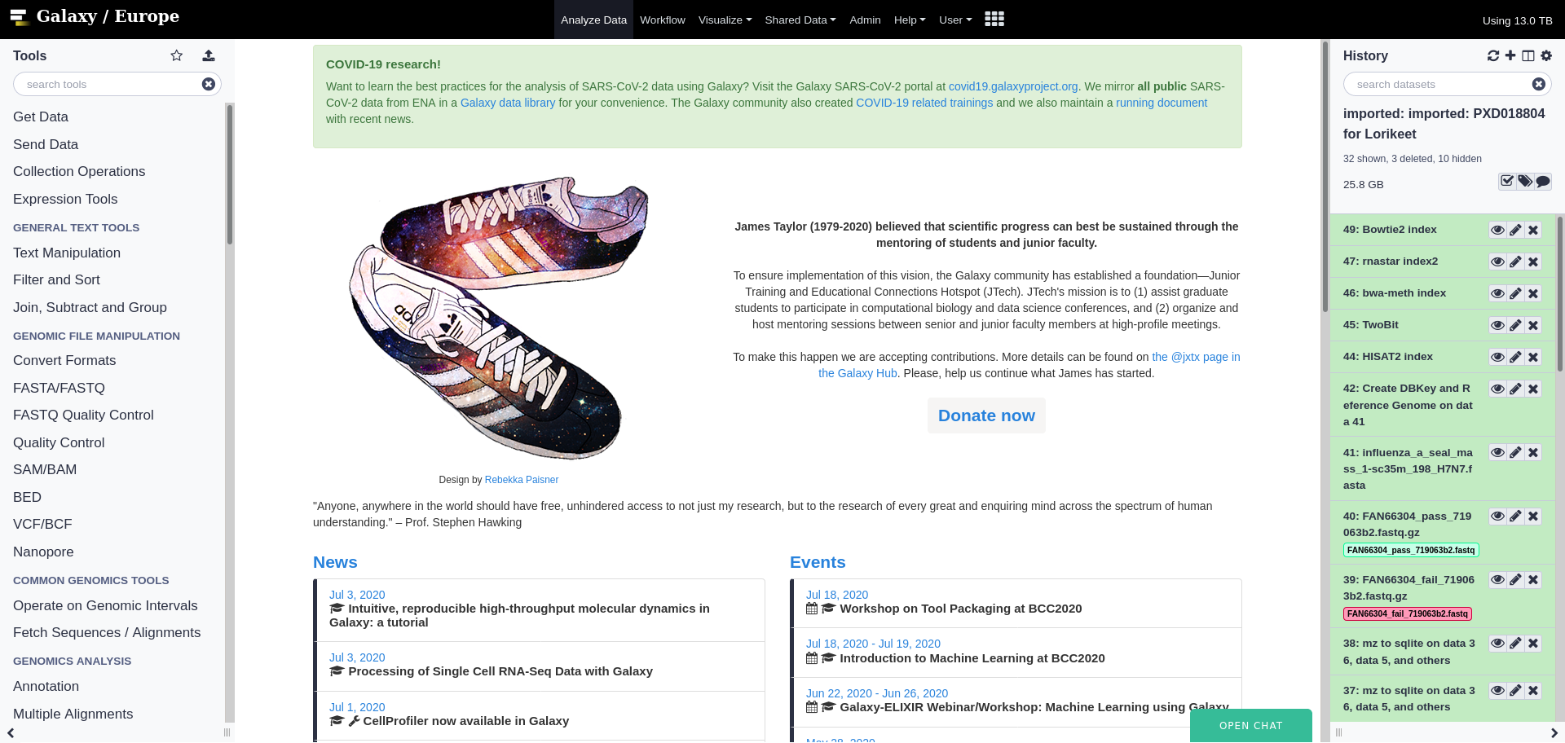
Whats next?
More national servers, more communities, 300.000 users!
usegalaxy.eu
usegalaxy.fr
usegalaxy.it
usegalaxy.be
usegalaxy.es
usegalaxy.cz
usegalaxy.ch
Notes:
In addition to national research infrastructure based servers deployed in an increasing number of countries, there were 138 additional servers freely available, each with tools installed for specific kinds of analyses.

Slide 14

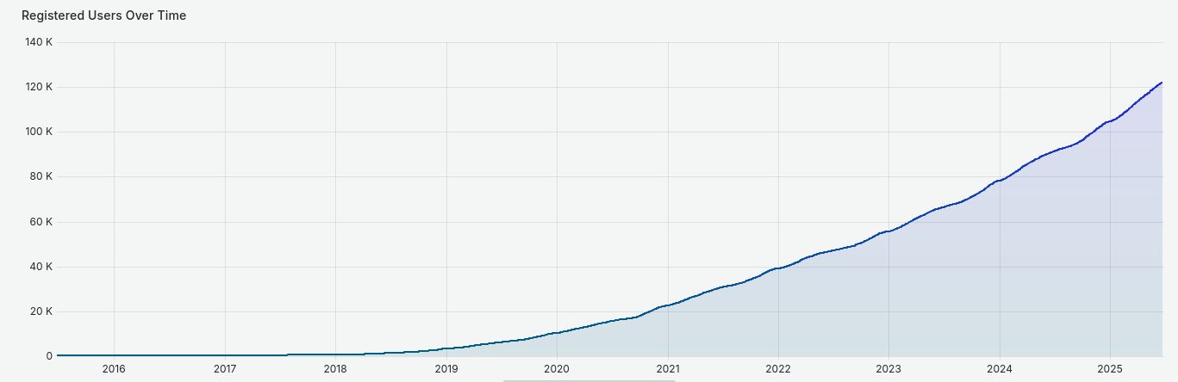
















An EOSC timeline & What’s next?
700
17.000
26.000
50.000
100.000
BC

Slide 15
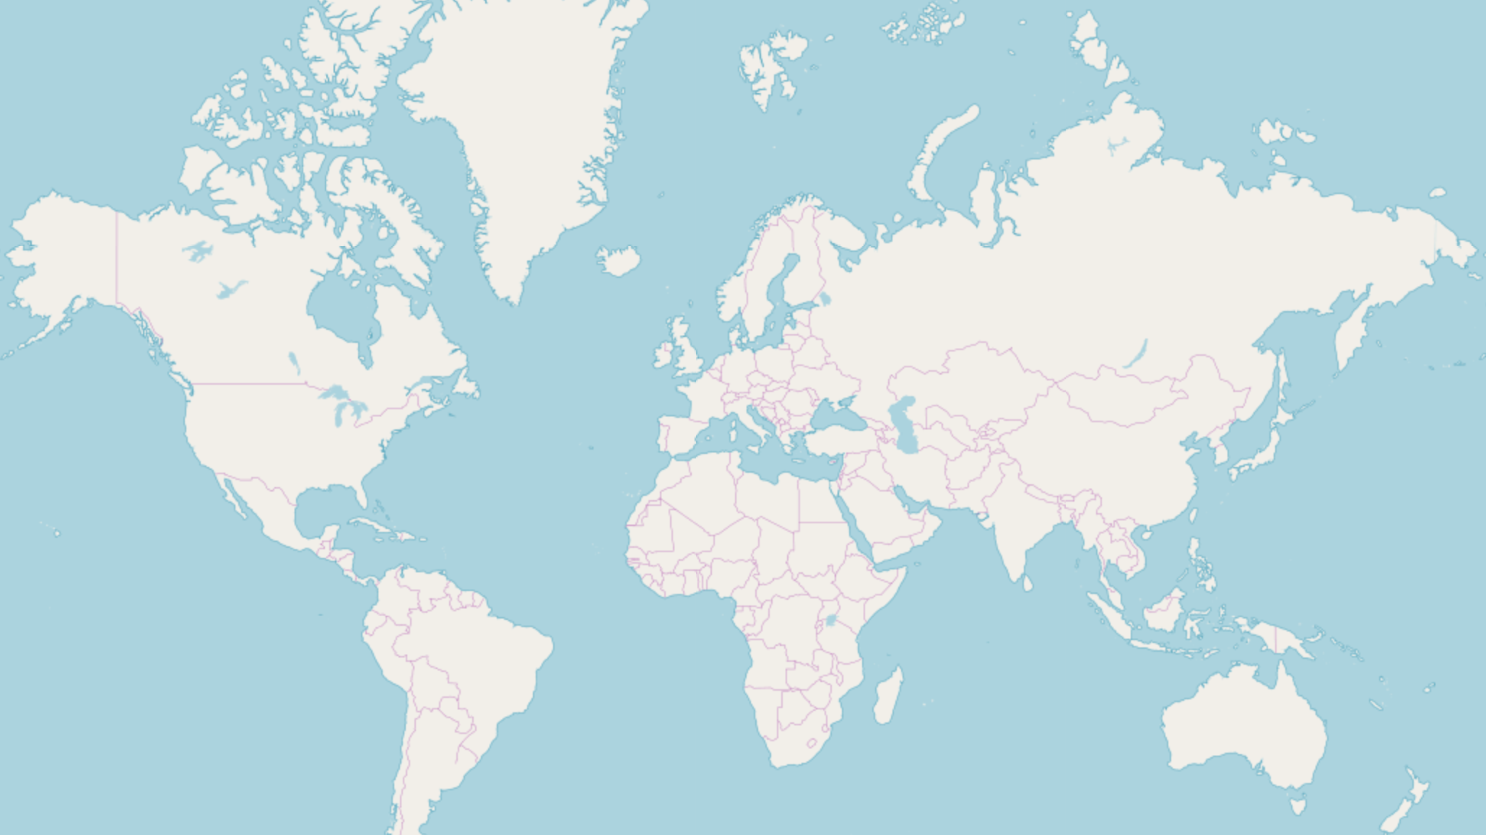




Slide 16
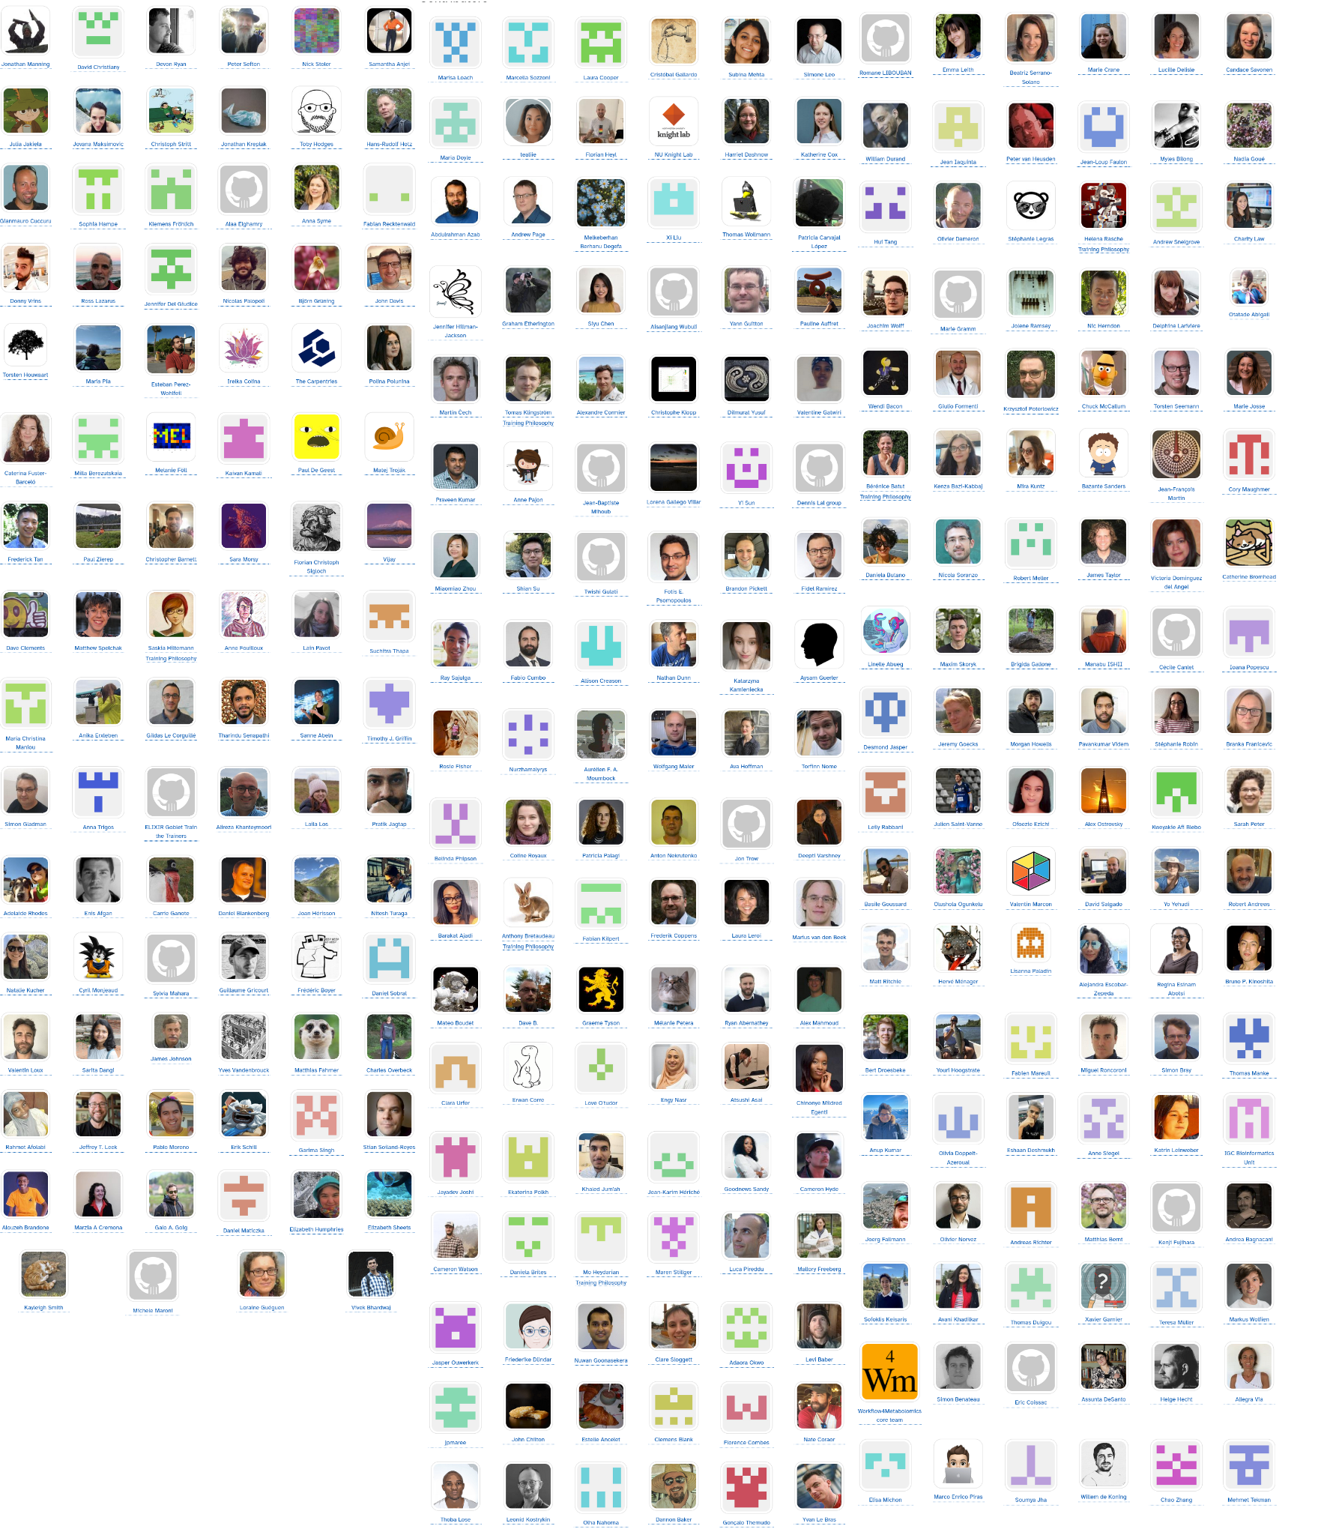
Thanks!

Slide 17
1 slide: Title + list of contributors
2 slides: Scientific challenge (the context) - why this UC is scientifically relevant (the perspective should be the one of scientists / researchers NOT OTHER NODES OR SERVICE PROVIDERS)
1 slide: Current technical issues - why the UC cannot be addressed now? (e.g too costly, data is missing, too time consuming, etc)
Max 2 mins pre recorded video with live commentary – short demo of the implemented solution - The demo should show how the EOSC Federation is enabling the use case thus you need to show the multi node aspects + the EOSC Federating capabilities etc. You need to show that this is only possible because of the EOSC Federation
1 slide: Recap how the EOSC Federation contributed to the case (e.g. nodes utilised, fed capabilities etc.)
1 slide: Closing message on how the UC can scale up or be replicated in other contexts to maximise its impact and bring even more benefits to end users (and if fitting explain how the use case can help the EOSC Federation evolve)
1 closing slide: Logos / links]

Slide 18
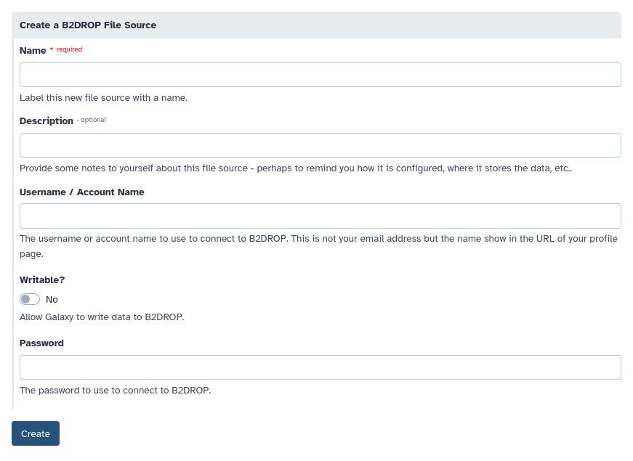
BYOD - Integration of Data (e.g. B2Drop) in Galaxy

Slide 19
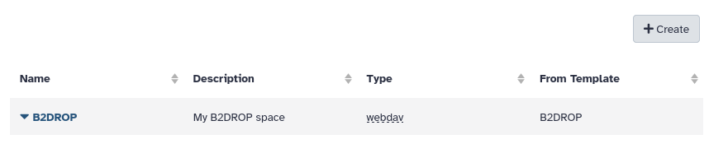
BYOD - Integration of Data (e.g. B2Drop) in Galaxy

Slide 20
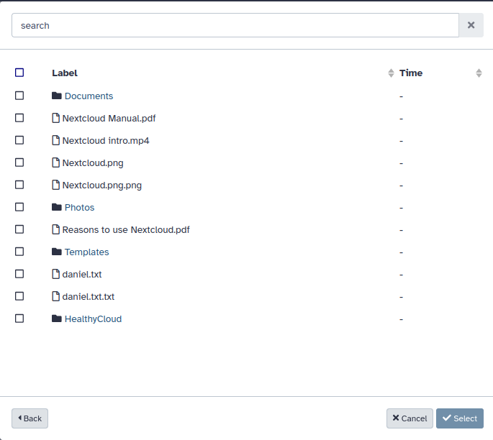
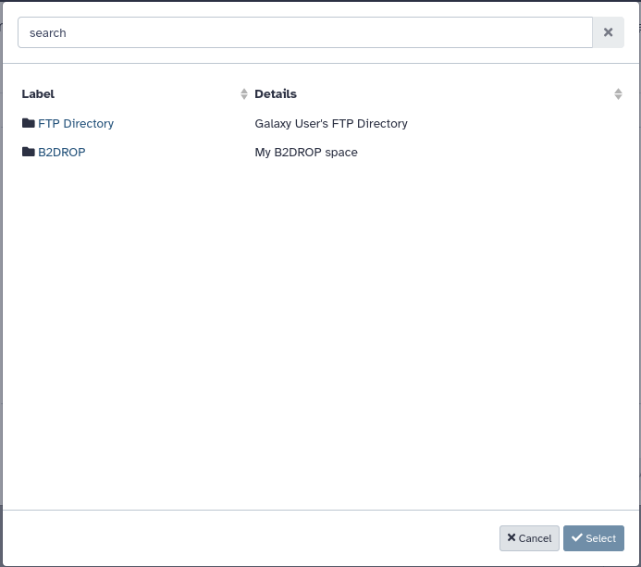
BYOD - Integration of Data (e.g. B2Drop) in Galaxy

Slide 21
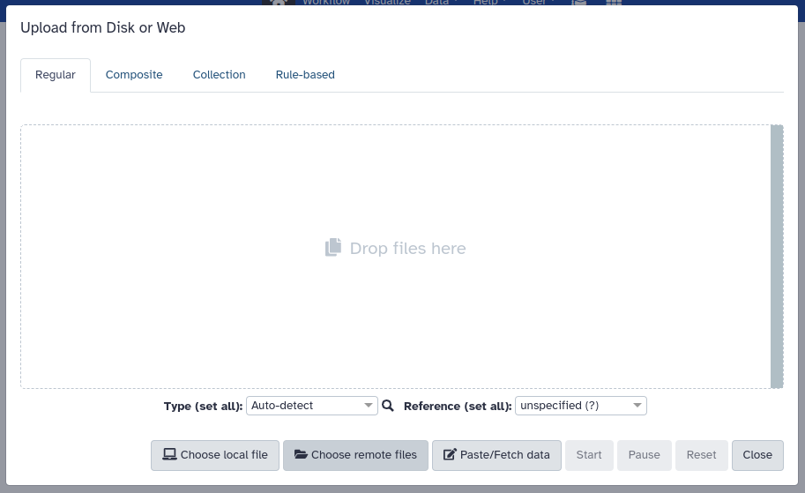
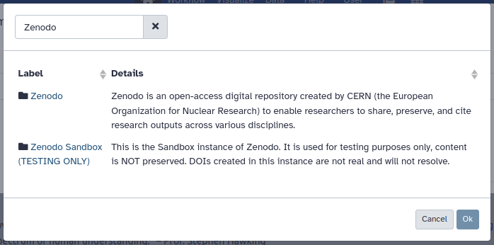
Zenodo/Invenio with DOI!

Slide 22
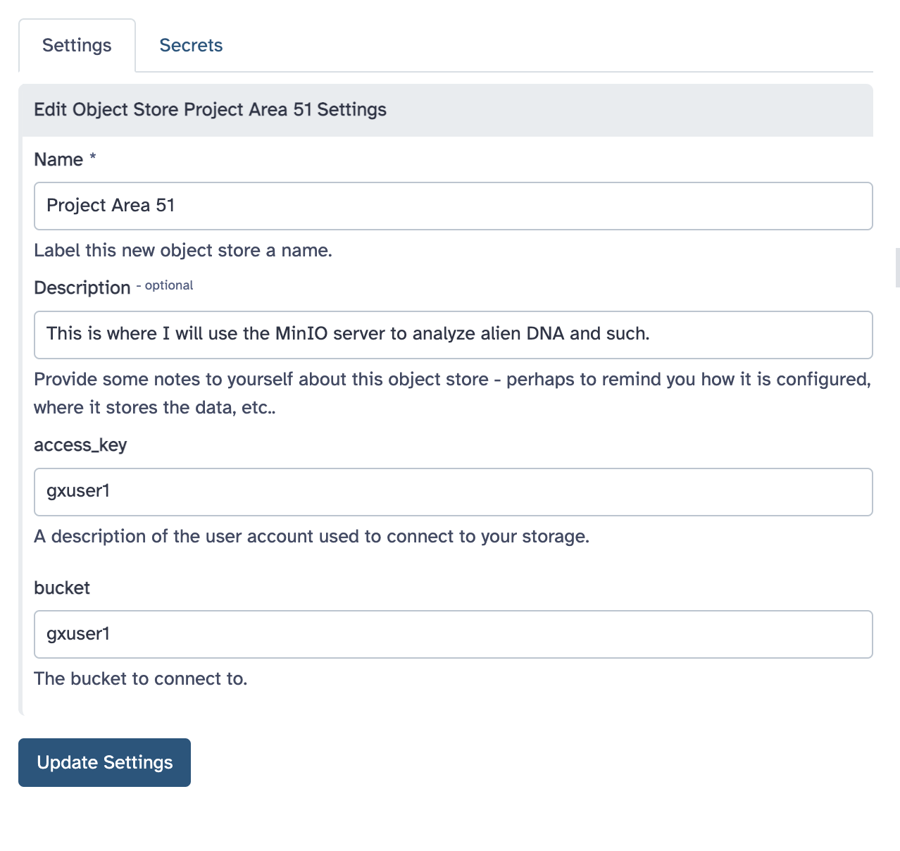
BYOS - Integration of Storage in Galaxy

Slide 23
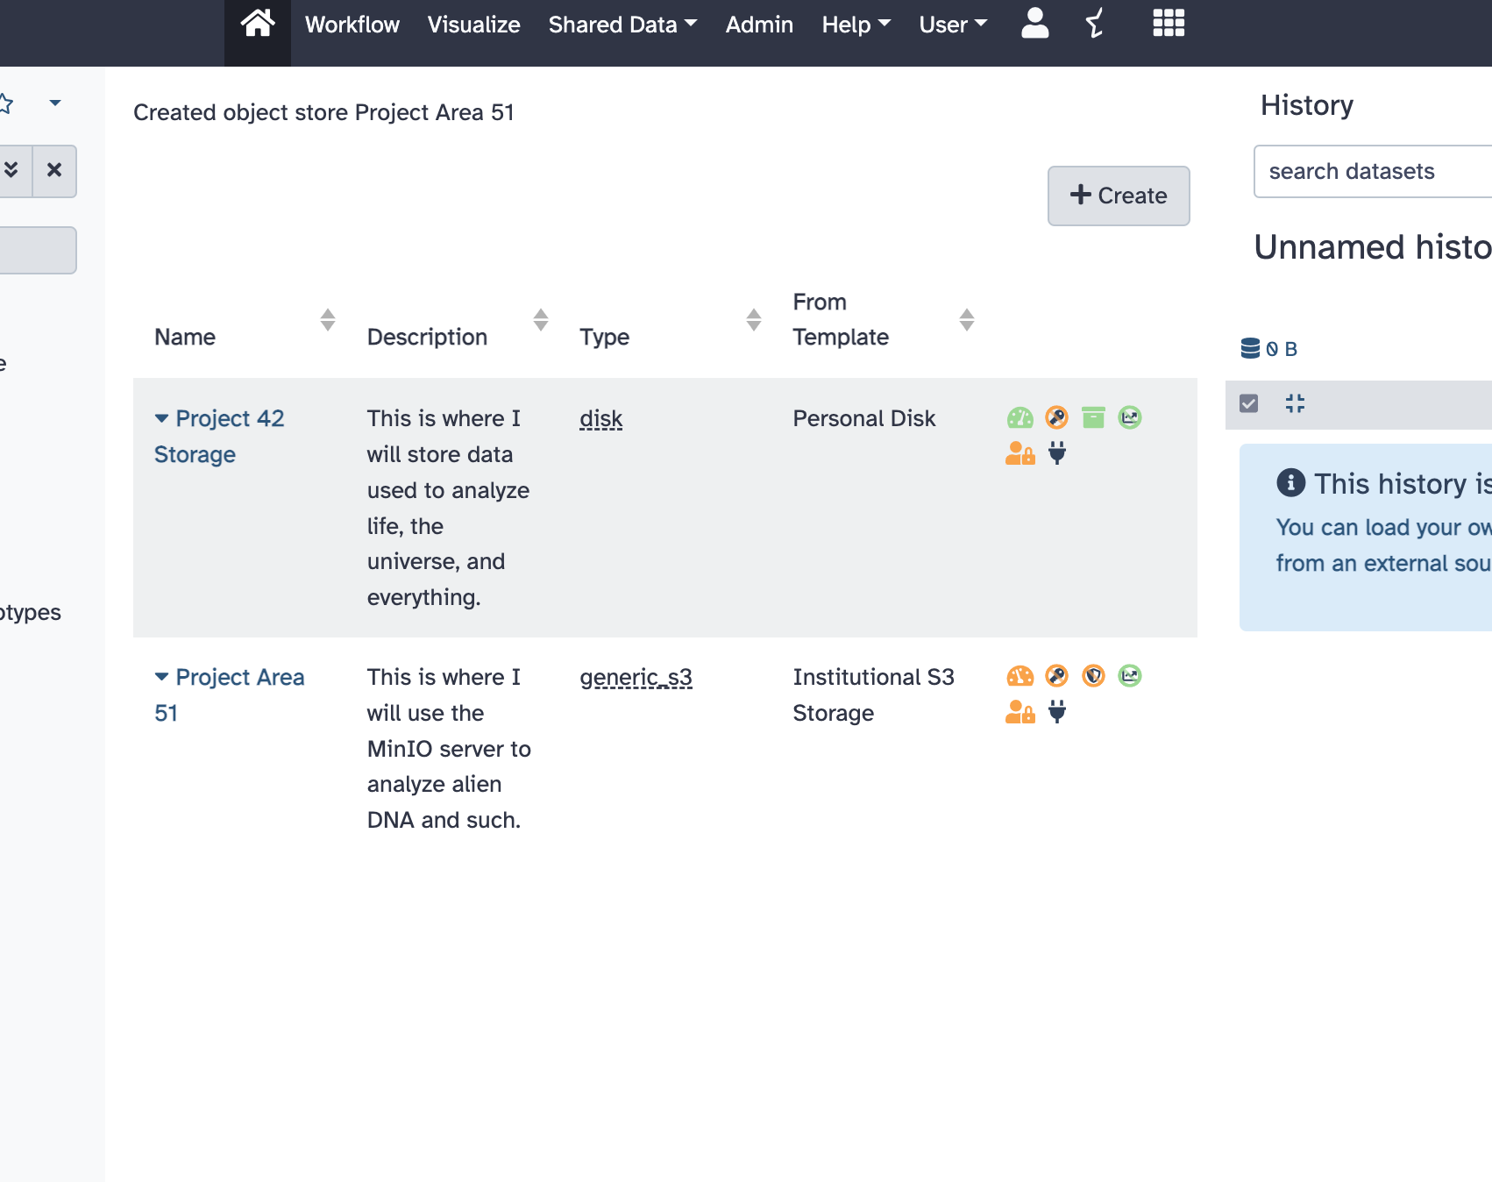
BYOS - Integration of Storage in Galaxy

Slide 24
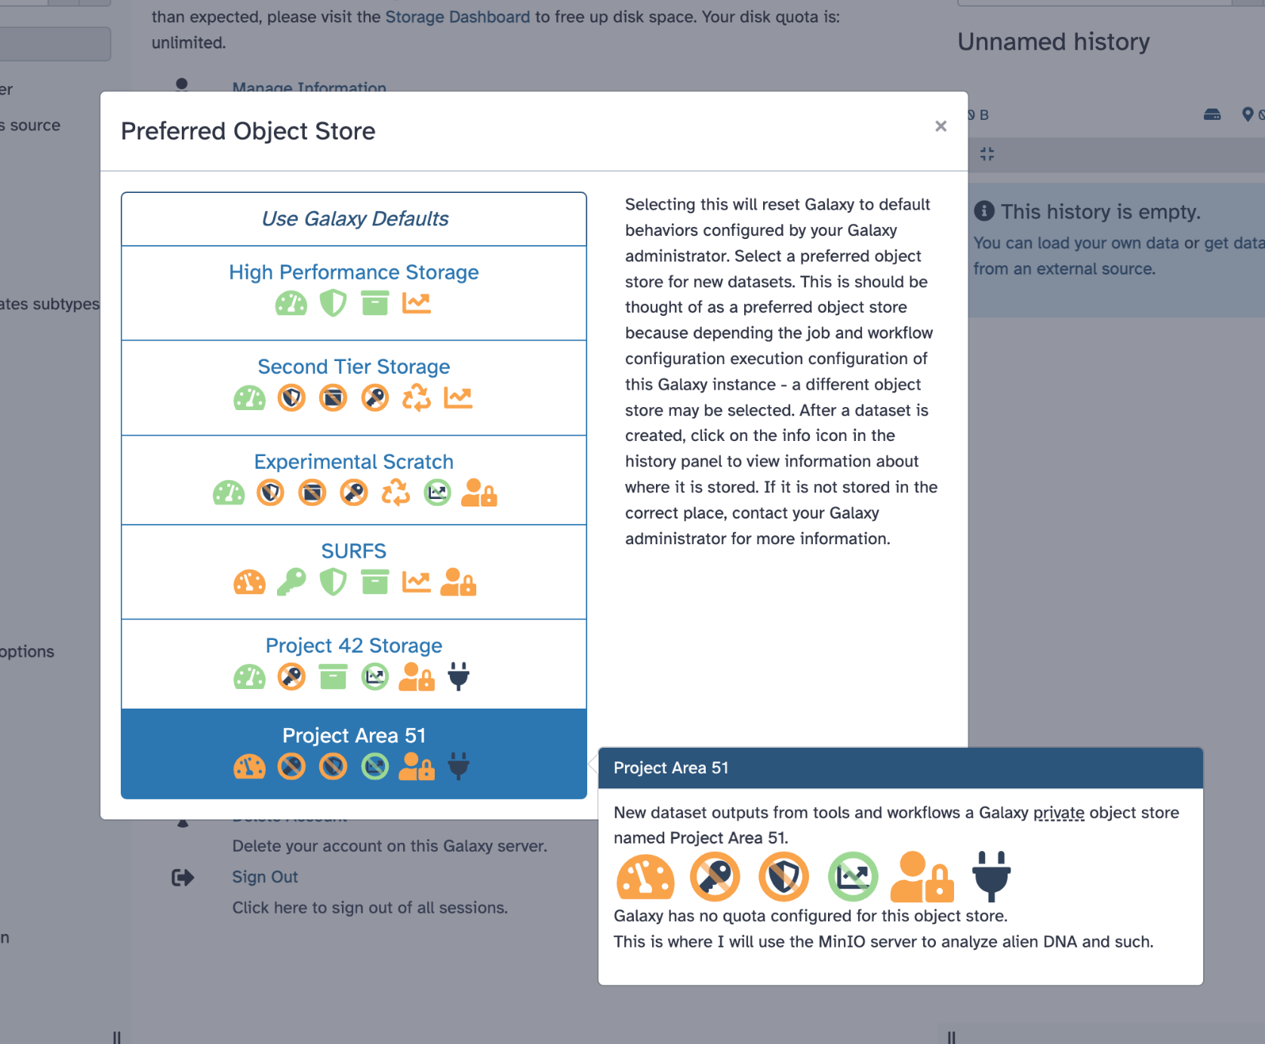
BYOS - Integration of Storage in Galaxy

Slide 25
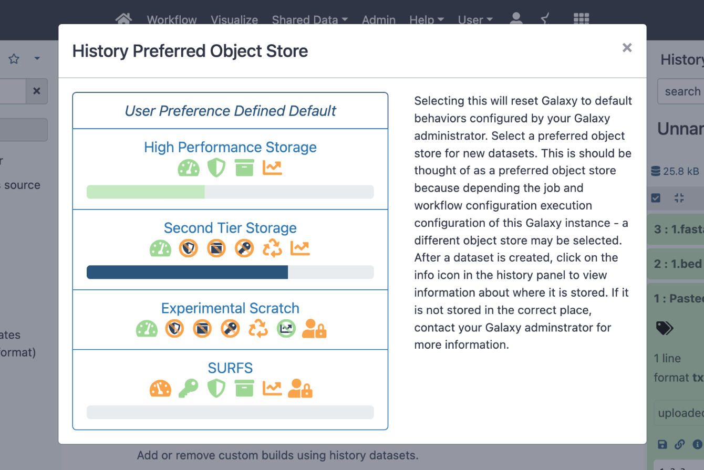
BYOS - Integration of Storage in Galaxy

Slide 26
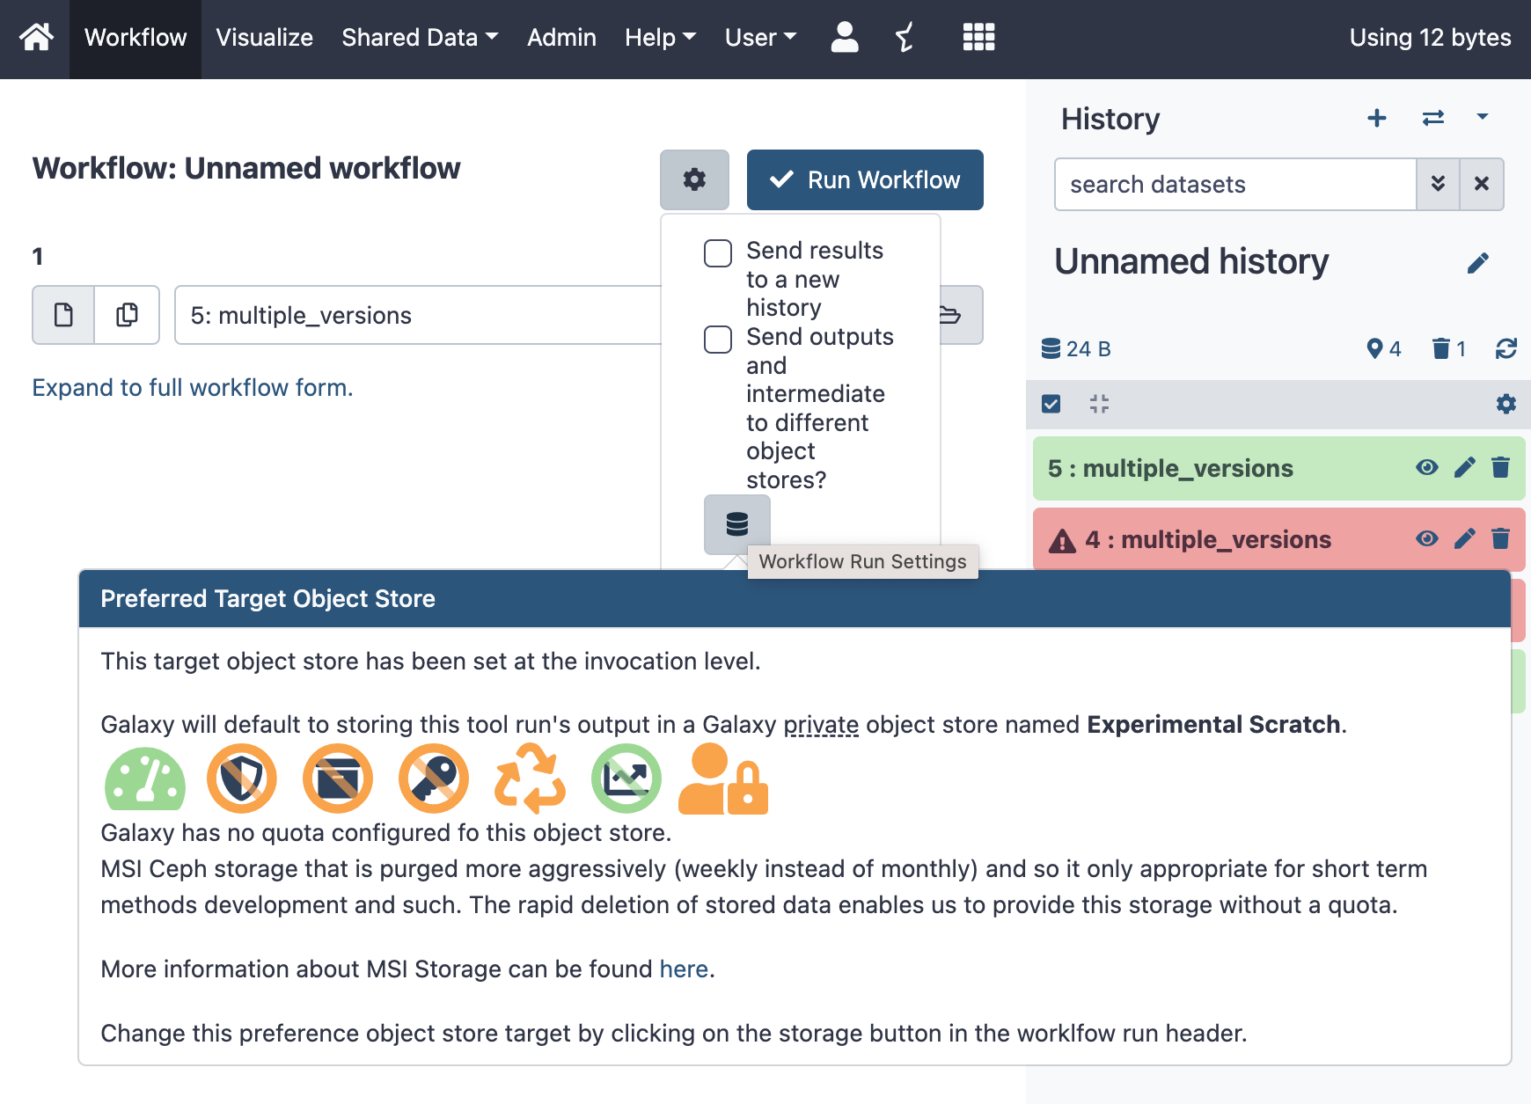
BYOS - Integration of Storage in Galaxy

