Slide 1
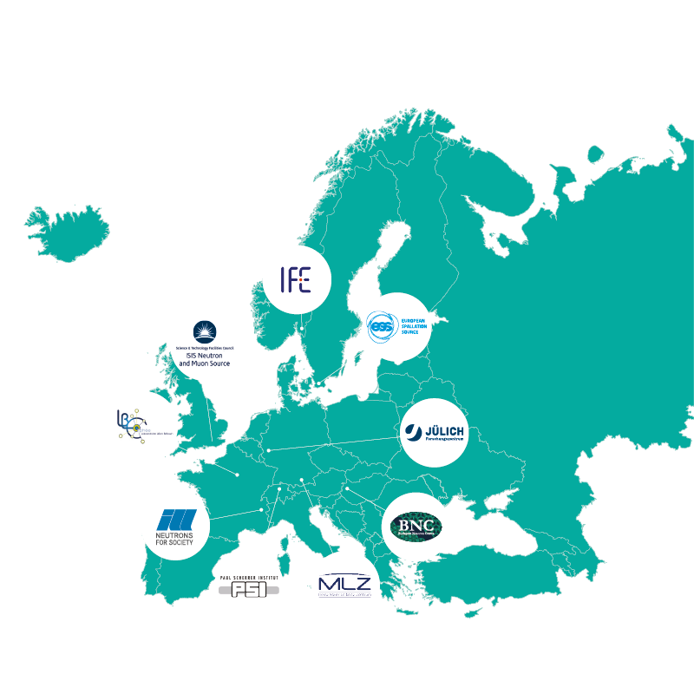
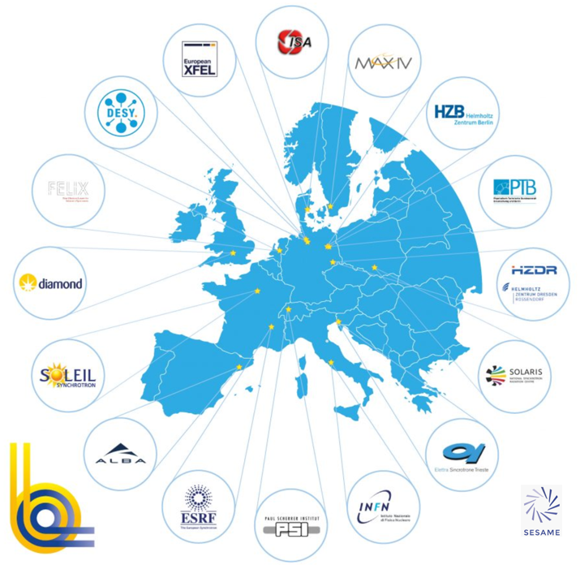
PaNOSC EOSC Node
EOSC, the PaNOSC perspective
Jean-Francois Perrin (ESRF) on behalf of the PaNOSC Community
16th SIG-CISS meeting | Bologna | 4th Dec 2025

Slide 2
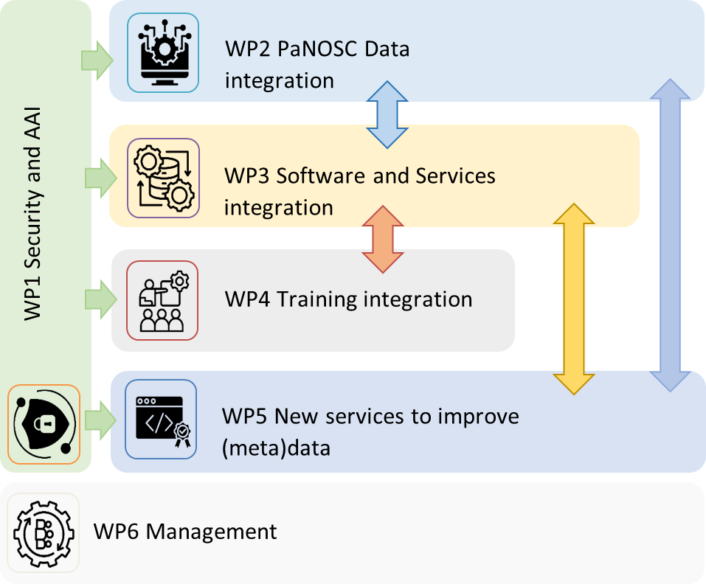
PaNOSC Node, brief 2025
Organisational
PaNOSC EOSC Node 11 partners (ESFRI and National RIs)
ESRF as coordinator and legal entity of the Node
Project planning
Converted the Project Charter into a Project Plan with 6 Work Packages
Main activities
Governance – Project organisation and MoU between the partners
AAI – working with AAI-WG, close collaboration with GÉANT (since 2020)
Data catalogues – work on improving the search engine for FAIR data
VRE – work ongoing on the VISA and extending it to EOSC users
Users – working with the User Community to implement OSCARS Use Cases for Open Science
Training platform
Cybersecurity
Motivation
Increase the impact of the Open and FAIR datasets of the community
Building the PaNOSC node will help the scientific community profit from Open Science
Internal funding but we have submitted a proposal for INFRA-EOSC-01

Slide 3
Photon and Neutron RI typical environment
Access to instruments/RIs based on scientific excellence of the proposal
Large user community (+50 000 users) with heterogenous profiles:
Scientific field: biology, material science, chemistry … astronomy, archaeology, nuclear physic, HEP
Academic and industrial users
Quite often very limited IT support in the users’ home organisation
Datasets volume vary from 10s of GB to few PB
Yearly data production from 1PB to 100s of PB per RI
Common Data Policy Framework: Data are openly accessible after a 3 years embargo period and preserved for 10 Years (could vary form RI to RIs).
Relatively small RI’s IT teams, mainly focused on data production (i.e. experiments) support and integration of existing solutions

Slide 4
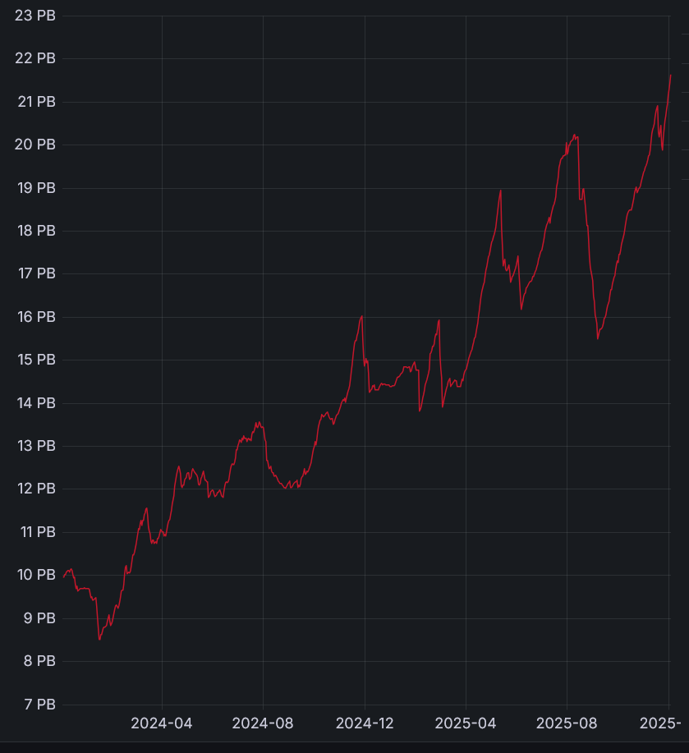
ESRF 2025 to illustrate
90 days staging area for acquisition and analyses.
22 PB as of today.
46 instruments.
+10K users.
Data production double every year.
Largest dataset to date: 1.5PB
Computing resources: 16K cores, 330 CGPUs (v100 to H200).
50 PB (Posix) for experimental data storage.
200 PB archive capacity (400 PB in 2026).
Paradigm shift: users have to process data on ESRF infrastructure due to lack of appropriate resources available for them.

Slide 5















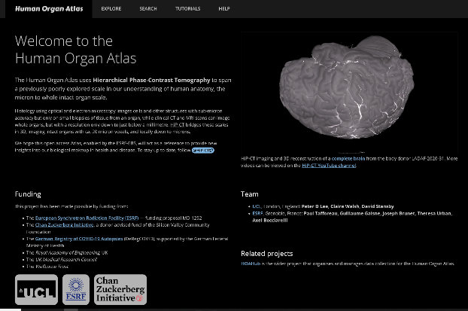




PaNOSC – Dissemination
CSD
open chemistry DB
Research Institutions
species geographic distributions
species
species
raw data
Paleobiology Database (PBDB)
ESRF
data repository
species
Species & occurrences
(plants, animals...)
Museum
collections
dedicated thematic UI
Species
& occurences
ESRF data dissemination as an example

Slide 6
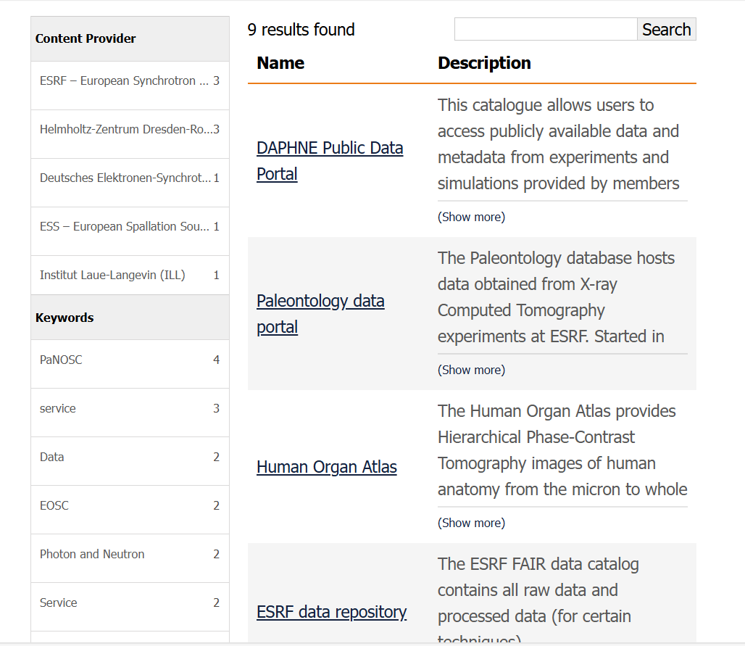
PaNOSC EOSC Node services
EOSC AAI integration ready
Data, VRE, training services production ready
Few services in Pilot phase
Proposal submitted to INFRA-01-EOSC-2025 with Astro community to support the development of the node.
https://www.panosc.eu/panosc-eosc-node/

Slide 7

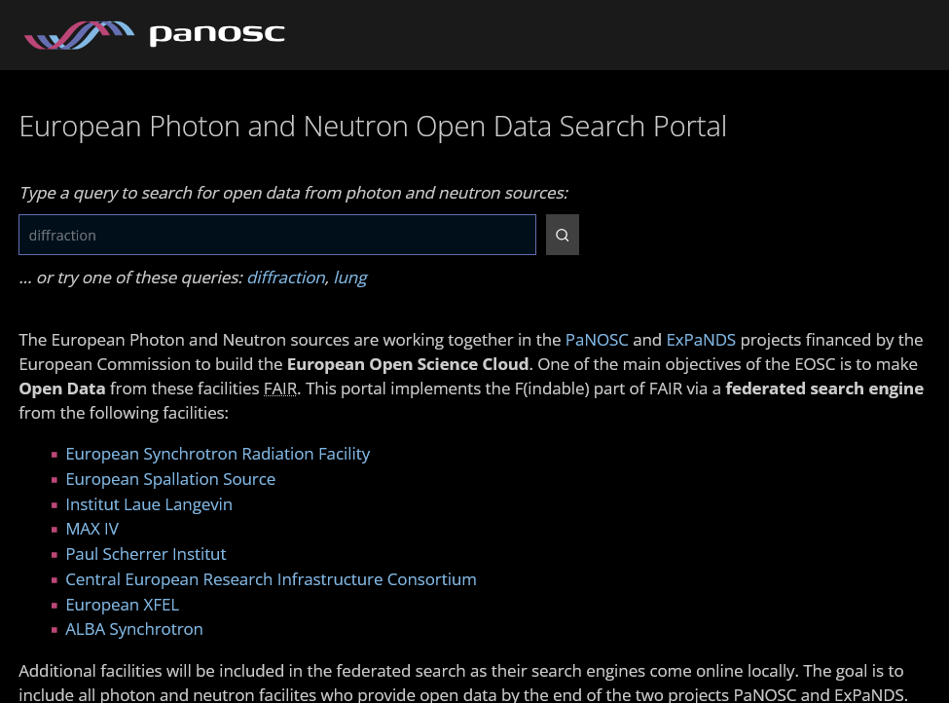
Federating capabilities – data repositories
PaNOSC data repositories:
All RI data repositoreis implement OAI-PMH standard protocol
Metadata indexed by OpenAIRE
PaNOSC federating capabilities:
Can be ingested in the EU Node catalog
Federated API supported by all facility data portals e.g. Human Organ Atlas
Developments:
An AI-enabled search engine (RAG) PanFinder
Machine actionable searching and downloading of data
https://data.panosc.eu

Slide 8

PaNOSC Node - PaN-Finder Architecture (developed as part of OSCARS)
ESRF DB
Existing PaNOSC API + custom data scrapers
PaN-Finder Query
(natural language)
PaN Finder Backend
(AI/LLM…)
Vector DB
dataset metadata
DB
ILL DB
ESS DB
https://oscars-project.eu/projects/pan-finder-photon-and-neutron-federated-knowledge-finder
PaN Facility DB

Slide 9
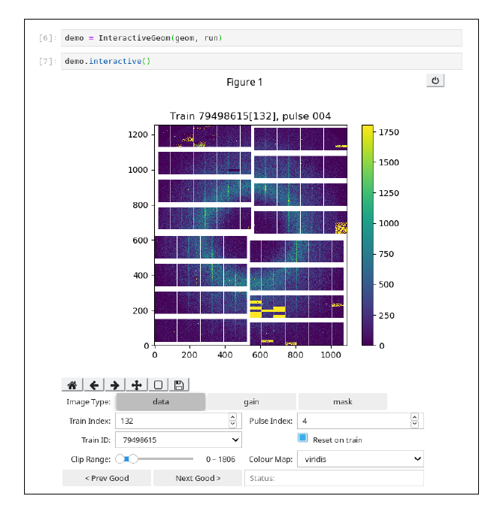
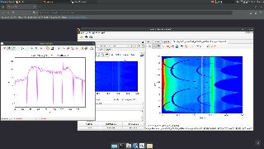
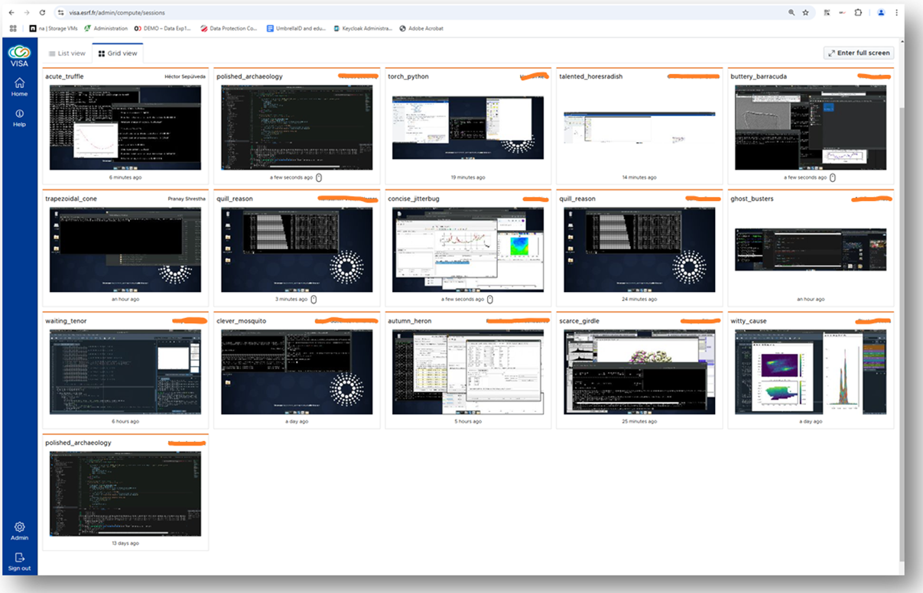
Data Analysis Services: VISA (VRE)
Jupyter Notebooks and Remote Desktop in Browser
Dedicated VM (or container) for processing data
Access to HPC resources
Remote display protocol developed for the needs of the community (e.g. ability to render 3D data over high latency network)
Enable collaborative work
Access to the data and software.
Open to EOSC users for PaN data processing. This is a specialised service, not a generic compute/storage offering.
Credit implementation?

Slide 10





Federating capabilities – software packaging
PaNOSC CVMFS service:
PaNOSC packages software for CVMFS as containers or modules
~200 software packages already
Shared with other PaN facilities
Future developments:
Share software packages with other EOSC Federation nodes
Provide CVMFS as a transversal service in the Federation?
Integration in SW catalogue

Slide 11
Data transfer solutions
HTTP (Download from the data portals + initiative to get machine actionable downloads)
SSH based services (rsync, scp, …)
Globus is heavily used in the scientific communities
Other services have been evaluated and fall short due to the diversity of the users’ communities and number of files/volume produced.

Slide 12
Cybersecurity
Hot topic in the RIs
PaN Cybersecurity Forum (38 RIs, 60 CISOs/Cybersecurity specialists).
Participate in the EOSC Federation Build-up group (Risk analysis, Policies, MFA, ID vetting, SW quality, audit for some central components, …)
High value services are only accessible after Id vetting and MFA authentication
Thank you for your attention.
Questions?

