Slide 1
The EOSC Federation Build Up Group and the Italian EOSC Node
Matteo Zanaroli
Coordinator of EOSC Node Italy
Ethics and Data Governance Manager at ICSC

Slide 2
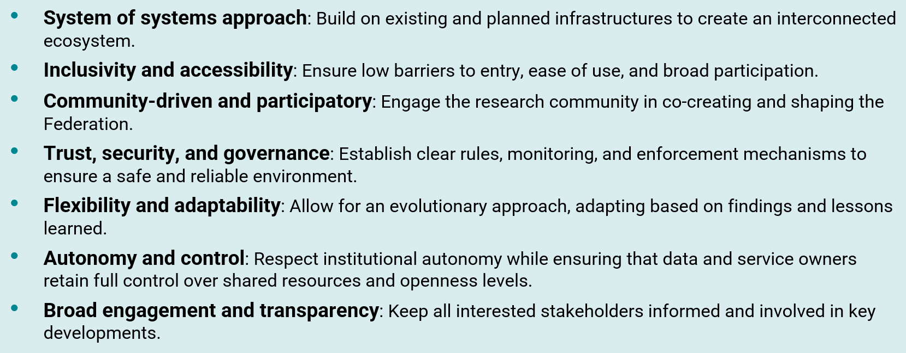
Building up the EOSC Federation
The vision for EOSC is to establish a system that enables researchers in Europe to store, share, process, analyse, and reuse FAIR research outputs—such as research data, publications, and software—across disciplines and borders.
ICSC Italian Research Center on High-Performance Computing, Big Data and Quantum Computing
Missione 4 • Istruzione e Ricerca

Slide 3
EOSC Federation
The EOSC Federation will consist of dozens of EOSC Nodes that are interconnected and can collaborate to share and manage scientific data, knowledge, and resources within and across thematic and geographical research communities.
The EOSC Nodes will be entry points for users to the EOSC Federation, with each node offering its own and possibly third-party services, including data reposing and accessing services.
The selection process started in August 2025 with more than 120 applications submitted and ended in early 2025 when 13 entities where invited to a build-up meeting in Brussels
ICSC Italian Research Center on High-Performance Computing, Big Data and Quantum Computing
Missione 4 • Istruzione e Ricerca

Slide 4

Nodes engaged in 2025
ICSC Italian Research Center on High-Performance Computing, Big Data and Quantum Computing
Missione 4 • Istruzione e Ricerca

Slide 5
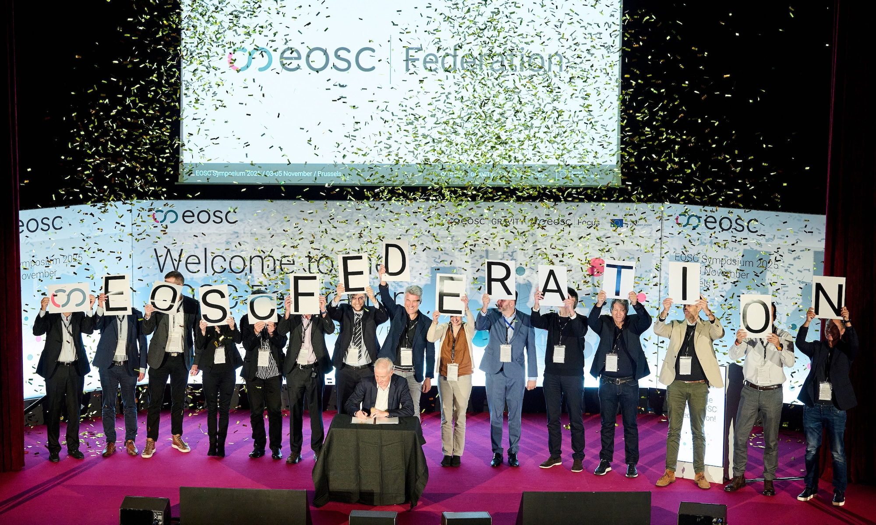
ICSC Italian Research Center on High-Performance Computing, Big Data and Quantum Computing
Missione 4 • Istruzione e Ricerca

Slide 6
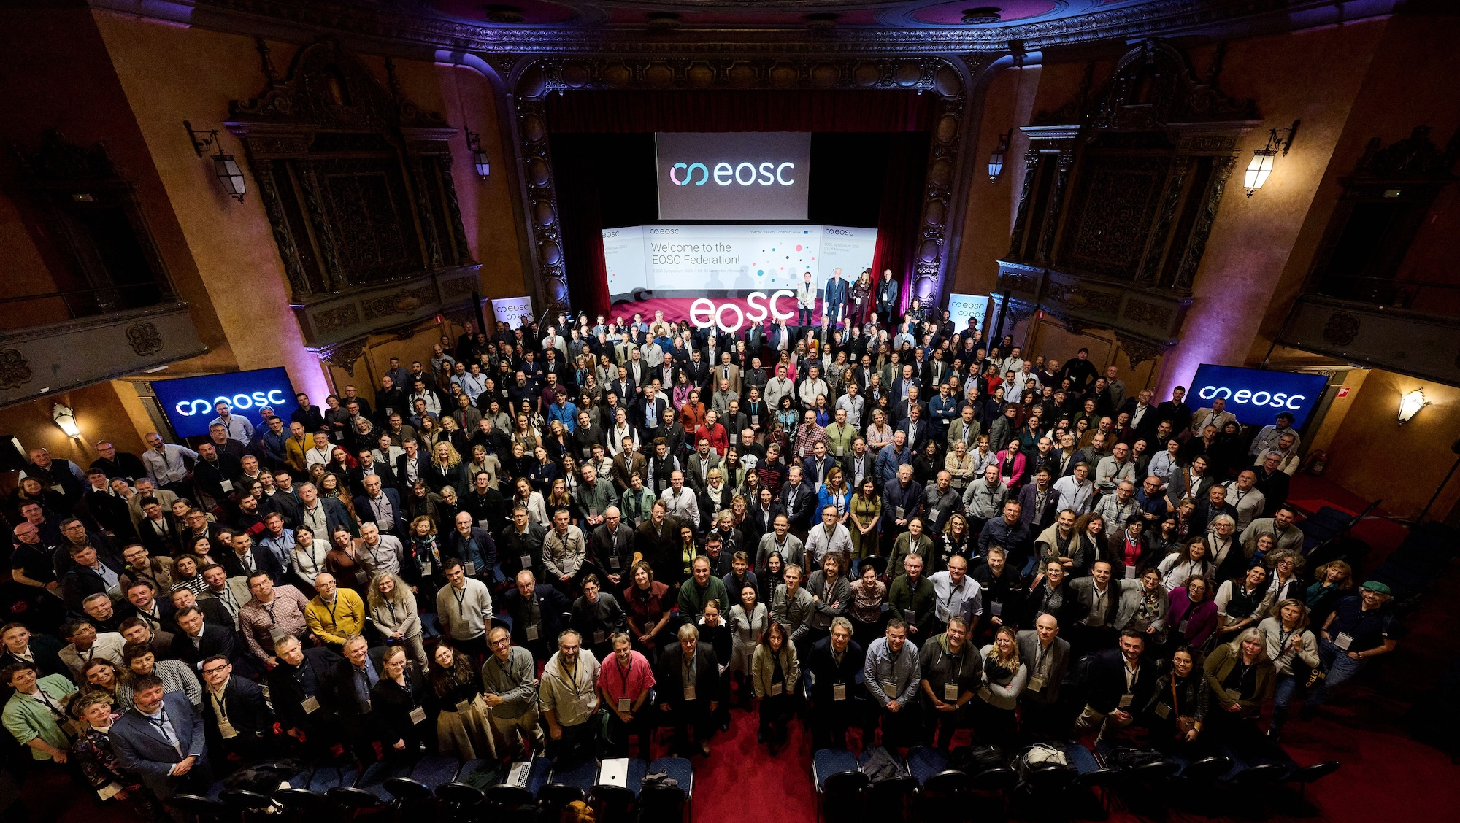
ICSC Italian Research Center on High-Performance Computing, Big Data and Quantum Computing
Missione 4 • Istruzione e Ricerca

Slide 7
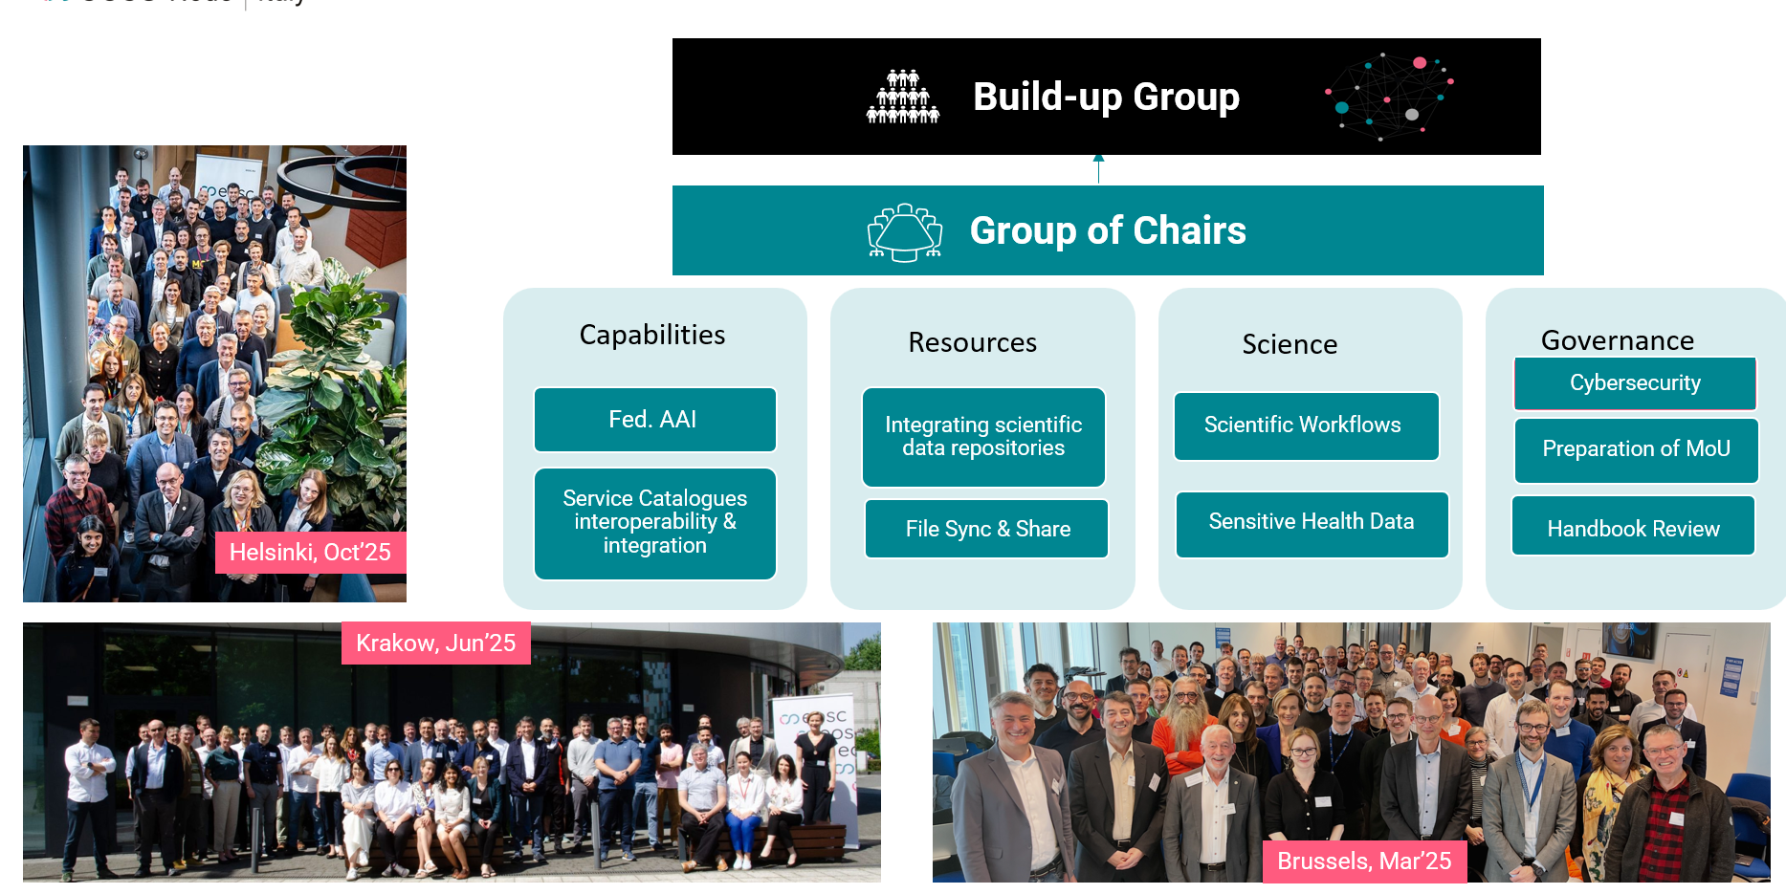
Outputs of the Build-up Group
ICSC Italian Research Center on High-Performance Computing, Big Data and Quantum Computing
Missione 4 • Istruzione e Ricerca

Slide 8
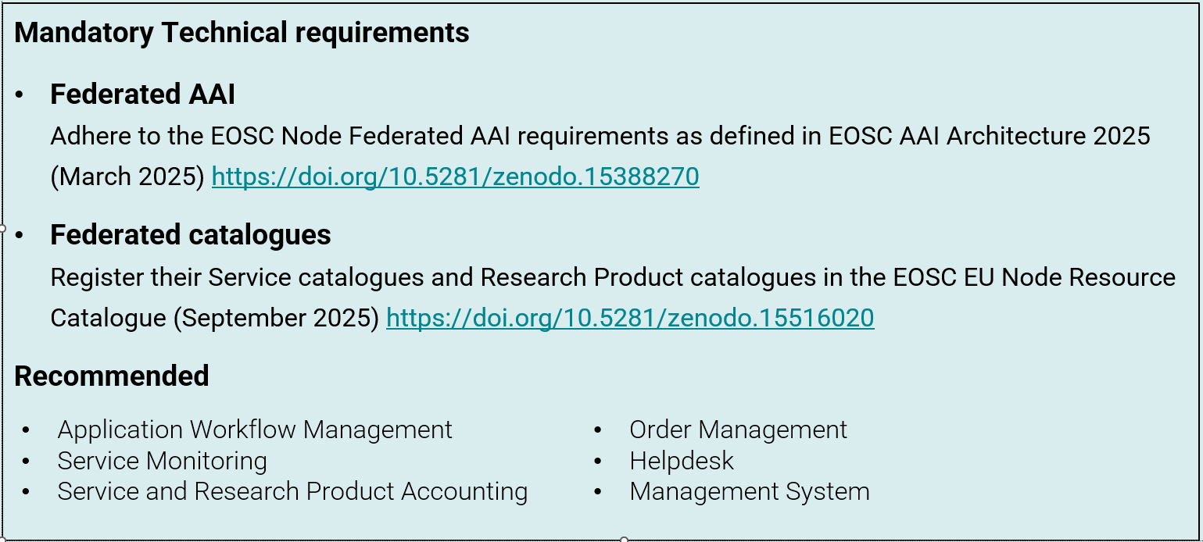
Outputs of the Build-up Group
ICSC Italian Research Center on High-Performance Computing, Big Data and Quantum Computing
Missione 4 • Istruzione e Ricerca

Slide 9
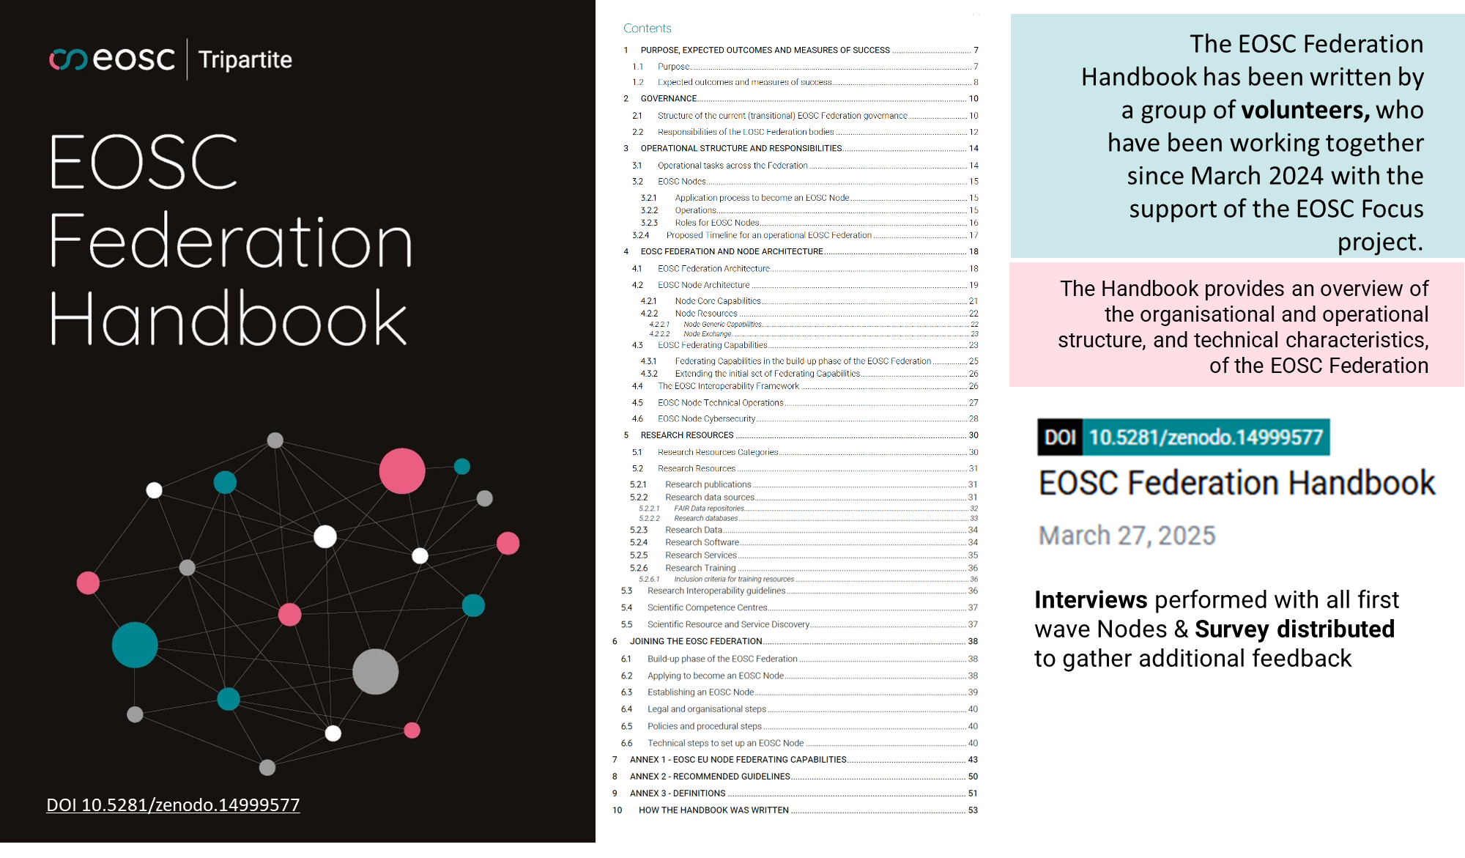
ICSC Italian Research Center on High-Performance Computing, Big Data and Quantum Computing
Missione 4 • Istruzione e Ricerca

Slide 10
Node Enrolment Criteria (1 of 2)
#1 Applicants must be interested in enrolling as a separate Node.
#2 Applicants must have the capacity or have a clear plan to develop the capacity to implement activities that enable the broader represented community to engage and participate in the EOSC Federation (e.g. to onboard 3rd party resources)
#3 Applicants must agree to comply with the mandatory technical specifications regarding integration in the EOSC Federation, in particular regarding integration in the EOSC Federated AAI and exposure of their resources through (a) common EOSC catalogue(s).
#4 The resources that applicants aim to make available to EOSC users via an EOSC Node must operate at minimum at Technical Readiness Level (TRL) 7
ICSC Italian Research Center on High-Performance Computing, Big Data and Quantum Computing
Missione 4 • Istruzione e Ricerca

Slide 11
Node Enrolment Criteria (2 of 2)
#5 Applicants must commit at least five individuals involved for the duration of the build-up phase, including the roles of coordinator, operations officer, a legal officer, a cybersecurity officer and a communications officer. Applicants must specify the names assigned to the aforementioned roles in their application.
#6 Applicants must agree with existing Node(s) or other applicants to align on and propose the development of at least one scientific multi-Node use case or one use case realising a concrete contribution to federating capabilities
#7 Applicants are willing to sign a Memorandum of Understanding (MoU) on preparing operational integration within the envisaged EOSC Federation
ICSC Italian Research Center on High-Performance Computing, Big Data and Quantum Computing
Missione 4 • Istruzione e Ricerca

Slide 12

EOSC Node Italy
ICSC Italian Research Center on High-Performance Computing, Big Data and Quantum Computing
Missione 4 • Istruzione e Ricerca
Notes:
Template e guide lines

Slide 13
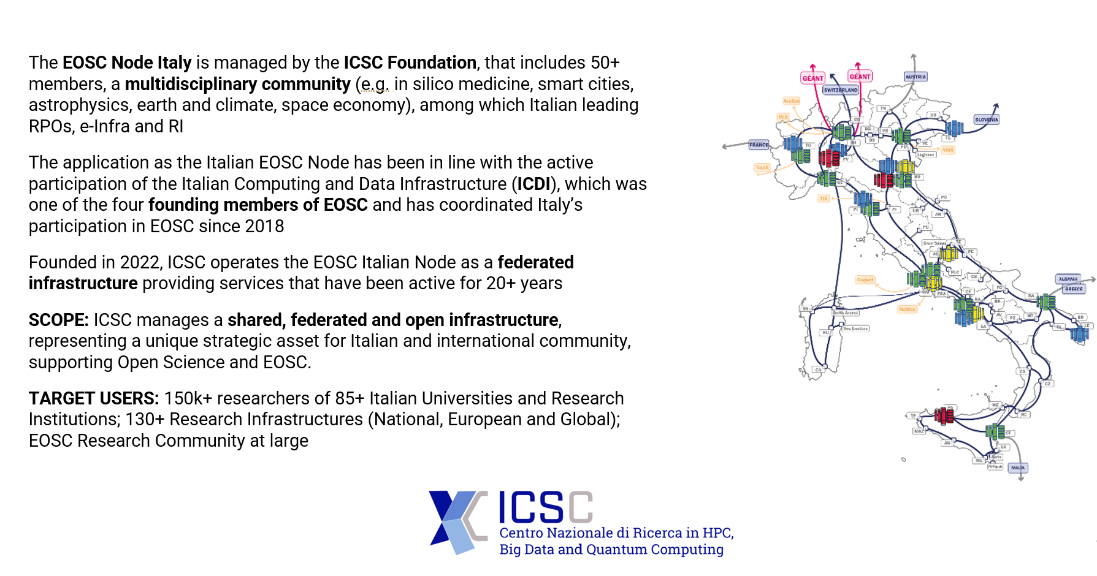
EOSC Node Italy – General Information
ICSC Italian Research Center on High-Performance Computing, Big Data and Quantum Computing
Missione 4 • Istruzione e Ricerca

Slide 14
Added value for the research community
Contribute to change the culture and make Open Science the new normal
Support a strong federation of infrastructures and data for data-driven research
Contribute to the EOSC developments and policies
Participate in projects aimed at developing services to exploit the full federation of EOSC Nodes
Increase the opportunities for Italian researchers and research communities
Having and giving access to high value multidisciplinary competencies and datasets
Access to Cloud and HPC infrastructures
Develop education and training programs
Synergy with EuroHPC key initiatives such as the AI Factory
ICSC Italian Research Center on High-Performance Computing, Big Data and Quantum Computing
Missione 4 • Istruzione e Ricerca

Slide 15
Resources available and main services of EOSC Node Italy
Federated AAI and integrated service catalogue
Cloud, HPC and storage federated infrastructure
Data Lake and HPC/Cloud federation of data centers
Data transfer services benefitting of GARR connection with hundreds of Gigabits per second
Data related services (data preparation, data creation, data analytics)
ELSI (Ethical, Legal and Social Implications) services, including the implementation of ISO27001 Cloud environment and Sandboxes for AI
Catalog of RPOs and SPOs data repositories using D4Science
Education and training programs
ICSC Italian Research Center on High-Performance Computing, Big Data and Quantum Computing
Missione 4 • Istruzione e Ricerca

Slide 16

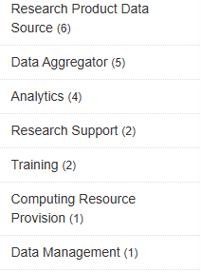
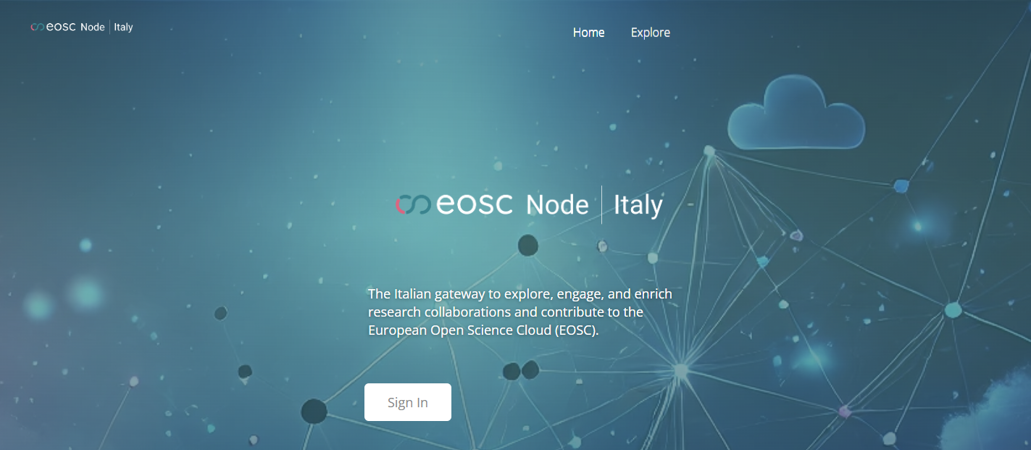

Status of Node development
The EOSC Node Italy is “Enrolled” on the EEN with a federated AAI
The service catalogue of the node is fully integrated with the EU Node and 18 services have been onboarded on the dev instance
A catalogue of 20+ services is already available on the EOSC Node Italy
Entities that have already contributed to the service catalogue:
Service provider for research
Research Performing Organizations and Universities
Italian nodes of Research Infrastructures
ICSC Italian Research Center on High-Performance Computing, Big Data and Quantum Computing
Missione 4 • Istruzione e Ricerca

Slide 17

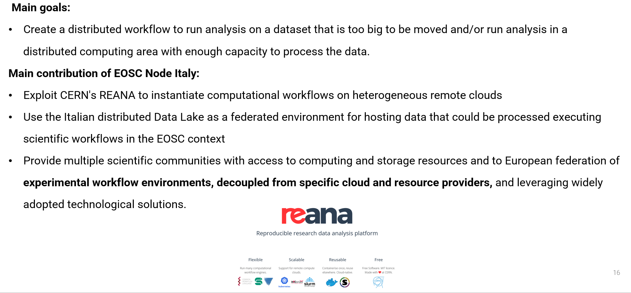

Use cases developed – CERN Reana
ICSC Italian Research Center on High-Performance Computing, Big Data and Quantum Computing
Missione 4 • Istruzione e Ricerca

Slide 18

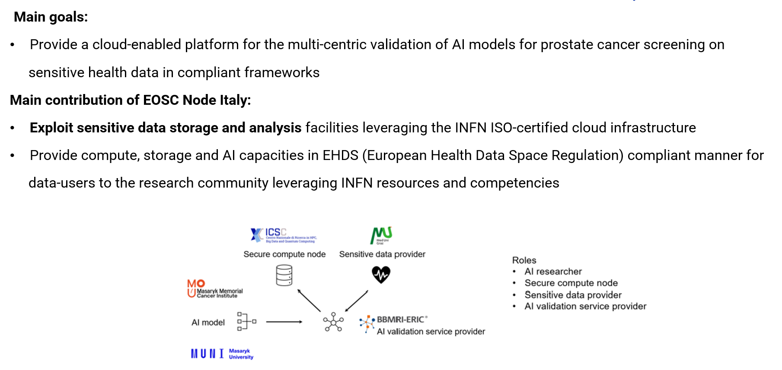
Use cases developed – BBMRI ERIC
ICSC Italian Research Center on High-Performance Computing, Big Data and Quantum Computing
Missione 4 • Istruzione e Ricerca

Slide 19
Grand challenges
Policy issues including agreements on access to services (i.e. on compute/storage services)
EOSC Node AAI local federation and adoption
From catalogue of catalogues to detailed catalogue
Cross-domain interoperability
The full engagement of the user-community
Continuous institutional support
ICSC Italian Research Center on High-Performance Computing, Big Data and Quantum Computing
Missione 4 • Istruzione e Ricerca

Slide 20
Main benefits so far
Strategy & Policy: alignment with EU Open Science vision; influence on policy
Technical: shared identity (AAI), interoperability
Collaboration: Cross-border projects
FAIR-by-design integration: National services become part of a wider ecosystem that adheres to the FAIR principles
Visibility: EOSC Italian Node enrolled in the EOSC EU Node and National services onboarded
ICSC Italian Research Center on High-Performance Computing, Big Data and Quantum Computing
Missione 4 • Istruzione e Ricerca

Slide 21
Thank you
Matteo Zanaroli
matteo.zanaroli@supercomputing-icsc.it
ICSC Italian Research Center on High-Performance Computing, Big Data and Quantum Computing
Missione 4 • Istruzione e Ricerca

