Slide 1
Sovereign European Object Storage
An invitation to debate the grand vision and first baby steps
Jan Meijer, co-Task Lead Service Concept Development
Credits Bo Bai, DeiC – Danish NREN
Recommendations collective cloud strategy GÉANT Association
https://zenodo.org/records/14793806
SIG-CISS, 3 December 2025, jan.meijer@sikt.no
Notes:
Establish cred – IT-architect at DeiC (3 years)
Before i joined DeiC i worked at a danish university where i have 20+ years of building research infrastructures
Both in central-IT (Storage, network and HPC) and in Labs (like a multi-rack mobile server cluster for data collection at rates exceeding a TB/s)
Main lesson: when you say NO to a researcher, it is simply taken as an invitation to go elsewhere for a solution
once that would be meant shadow it in cubbord.
Now it probably leads to some unprotected interactions with a cloud.
Today we'll be looking at how we could avoid that, at least where storage is concerned.
By providing a sovereign object storage through a cloudy service

Slide 2
GÉANT GN5-2 cloud work (January 2025 - June 2027)
Joint procurement of infrastructure cloud
Services strategy & Incubator
Service concept development
joint research cloud software
European data movement infrastructure
Sovereign European object storage infrastructure for research
co-leads Jan Meijer (Sikt), Morten Kjeldgaard (DeIC)
Bo Bai (DeIC), Maciej Brzezniak (PCSS)
Ron Trompert (SURF), Kalle Happonen (CSC)
Incubator – technical feasibility of potential architecture and organisation
service concept = technical plan + business plan + building roadmap + endorsement
= long term joint commitment

Slide 3
Agenda
Sovereign European Object Storage
Analysis from the user perspective
Key requirements for creating impact
How the GÉANT Association may be well positioned to address it
Design principles for a new infrastructure
High level architecture overview
Taking some baby steps
Notes:
1
The problem (or where the actual difference lies to the researcher)
Key requirements for impact
How GÉANT may be well positioned to address it
Design principles for a new infrastructure
High level architecture

Slide 4
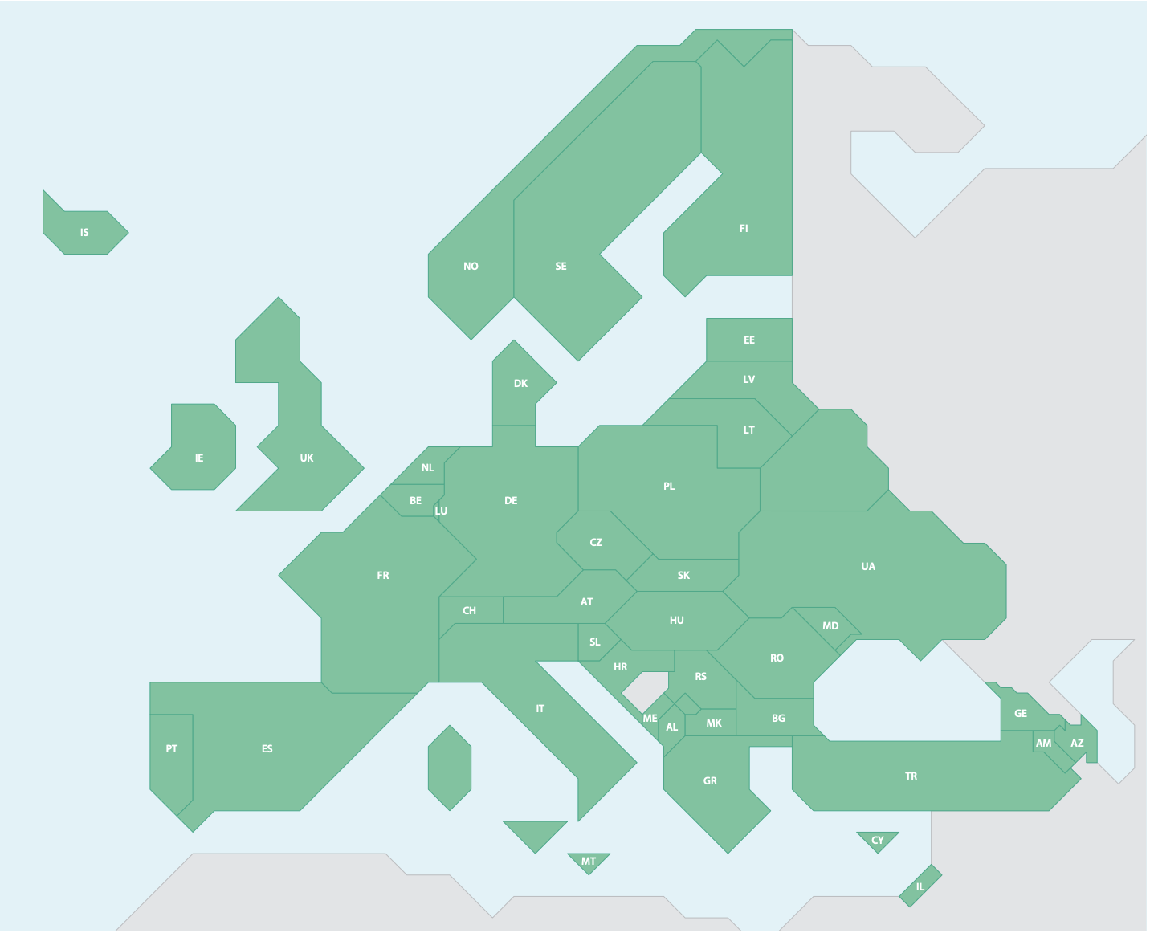
NREN perspective on current European research landscape
GEANT Association service delivery
43 NRENs + GÉANT organisation
4.100+ employees
€1.000M+ budget
now
delivery through institutional and national services
43 countries
- 5.000 research organisations
- 1.2M researchers
European Research Area
imagine something new
defragmented storage delivery?
single research storage cloud?
cheaper, better, more interesting?
- 50 pan-European RIs
- 150 large storage / processing plants
- 250 Trustworthy Data Repositories
institutions producing digital services
commercial providers
Notes:
Delivery through institutional and national services
Storage delivery is fragmented across Europe. What if we look at the landscape as a whole, and imagine something new?

Slide 5
Why now? Challenges for European NRENs and institutions
GEANT Cloud strategy recommendations: https://zenodo.org/records/14793806
limited economy of scale for as-a-Service delivery
changes in collective NREN customer base & context
increased expectations at national and European levels
no individual European NREN will be large enough to
provide cloudy services cost-effectively over time, at ever-increasing compliance, quality and
functionality levels.
Notes:
2
But still,
Individually we are challenged by
Reaching-economy of scale
Changes in the customerbase (compliance has become important, and it is expensive)
no individual European NREN will be large enough to provide cloudy services cost-effectively over time, at ever-increasing compliance, quality and functionality levels.
Growing requirements erode value.

Slide 6
Why now? Opportunity!
Technology matured
Organisations and expectationsmatured
Policy framework – European Research Area
EOSC as a unified organisational and technical channel to institutions
pressure from changing geopolitics
sovereign infrastructure
Notes:
2
But still,
Individually we are challenged by
Reaching-economy of scale
Changes in the customerbase (compliance has become important, and it is expensive)
no individual European NREN will be large enough to provide cloudy services cost-effectively over time, at ever-increasing compliance, quality and functionality levels.
Growing requirements erode value.

Slide 7

How much do we have?
Anders Sjöström, Luleå University:
Current amount of data owned by Luleå University, Sweden, ca 40-60 PB
Projected increase over 5 years from one infrastructure:
50-100 PB (conservative estimate)
money already in the system!!!!
Lightning talk
NORDUnet Community Workshop 2025
Notes:
Kindly donated by Anders Sjöström

Slide 8
New opportunties through joint infrastructure - economy of scope
Glacier
Data movement
Unified sovereign storage end-point embedded in cloudy services
researchS3.geant.org
Feeding the AI machine?
Future requirement X?

Slide 9
Data and storage from a customers perspective
Data needs protection
Researchers need
seamless collaboration
Institutions need
trusted data management
Research infrastructures need seamless data exchange
Everybody needs competitive pricing
Notes:
3
Storage is not enough, there are needs (at the consumer end)
Data requires protection:
What that means is solely determined by the controller of that data
Institutions require trusted data management
Compliance and certification
Sovereignty in governance
Researchers need easy collaboration
The barriers to collaboration must be lowered (through infrastructure combined with legalese)
Research infrastructures need seamless data exchange
To be sustainable any system has to be reasonably competitively priced
What will happen if we do nothing?
Laws and lawyers push the red (they will be enforced by limiting choice)
Research infrastructures can solve the problem for them selves by isolation into silos
But the seamless collaboration of the researchers, will suffer unless it is sharing an everything
The researchers are in a squeeze
No researcher should not need to break the rules to carry out her research
But she will if she must!!
The real problem is that to meet al needs ALL OF THIS need to be solved at the same timeWe have to solve all of it, but the remaining needs are where we could make a difference.
To the community and not least to the researcher.
The assumption is that the best way to solve this is through a storage federation.
Can we solve the challenges of going large together?

Slide 10
Key requirements for impact
Competitively priced storage
Economy of scale
One infrastructure for all data - including sensitive data
Compliance is included!
Trusted and sustainable (long-term storage)
Sustainability of GÉANT and its track record of sustaining federations
Notes:
5
By leveraging all of this the assumption is that we can make federation providing
Competitively priced storage
That must be usable for all data as far as possible
That must be trusted for long-term preservation of data (at least at some tier)
We achieve that trough:
Economy of scale
Pre-approving it for use by all the common data providers (compliance is included)
The demonstrated sustainability of GÉANT and its federations
We are primarily looking at high latency, high bandwidth, high reliability storage.

Slide 11
NREN perspective on current European research landscape
GEANT Association service delivery
43 NRENs + GÉANT organisation
4.100+ employees
€1.000M+ budget
43 countries
- 5.000 research organisations
- 1.2M researchers
European Research Area
- 50 pan-European RIs
- 150 large storage / processing plants
- 250 Trustworthy Data Repositories
institutions producing digital services
commercial providers
Notes:
I have borroved this from Jan’s talk yesterday.
Let’s take a look at the GÉANT community
It is not small!.

Slide 12
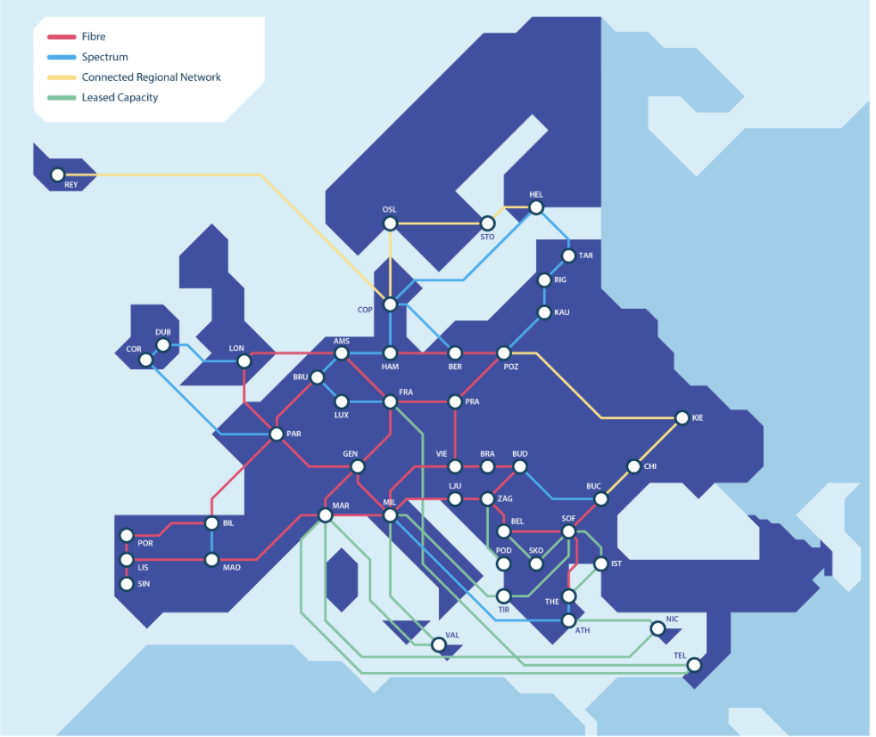
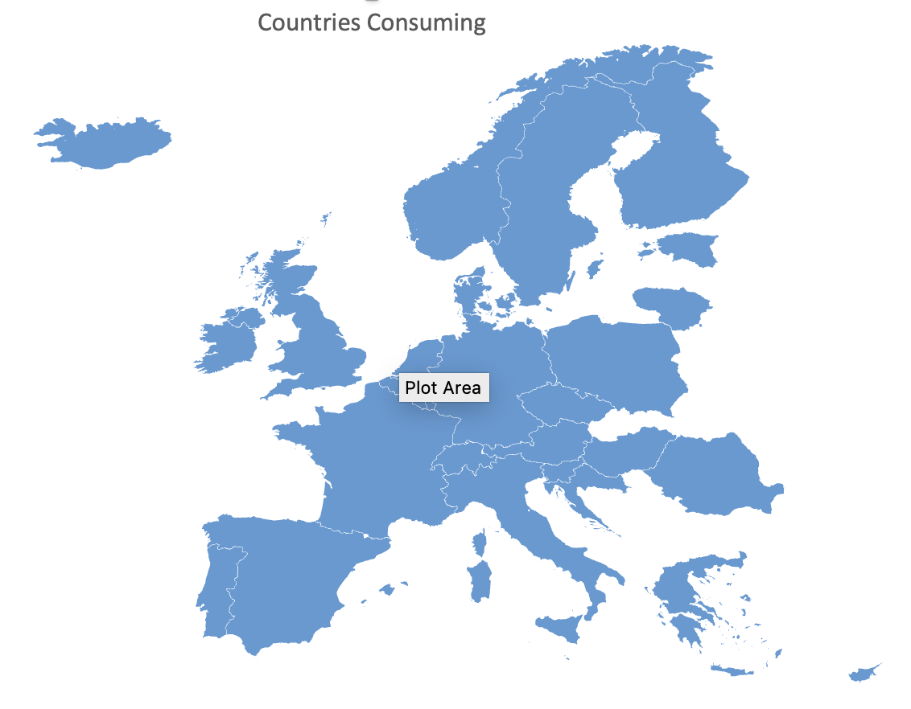
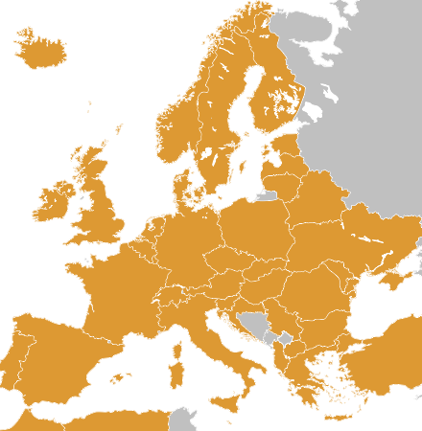

We can do this – e.g. GEANT Association
trusted federated
infrastructures
the main challenge is organisational
money
people
governance
perhaps GÉANT is right vehicle
perhaps different vehicle needed
for the _concept_ this does not matter
OCRE
procurement
unique assets & skills
European reach through strong national anchors
eduGAIN
sustainability
Notes:
5
Why GÉANT?
GÉANT has a proven track record
in building trusted federated infrastructures (identity, network)
It has the unique assests & skills required to work on this (through its members)
It not only connects, but through the NRENS engages with the both providers and users
It brings long term sustainability (which is central to storage)

Slide 13
Follow Good Infrastructure Principles
1
2
3
4
Build
Infrastructure
Assure
Compliance
Cut to the Core
Zero Configuration
Infrastructure is a building block for somebody else's service
The infrastructure must support the needs of an institution's compliance manager
Don’t internalise what could be externalised
The consumer end must use discovery for all configuration
Notes:
5
I have some principles I would like to follow.
Build infrastructure: to support the creation of services
In this case NREN’s or their customers can build their services
Assure Compliance: or become irrelevant
Only solve problems that owned by this infrastructure. Externalize/Delegate if possible.
Don’t solve a problem that isn’t yours. You will just do it badly.
Zero configuration: The consumer/client end must use discovery for all configuration
There is a network, use it!
Use the network to communicate configuration through robust and secure discovery.

Slide 14
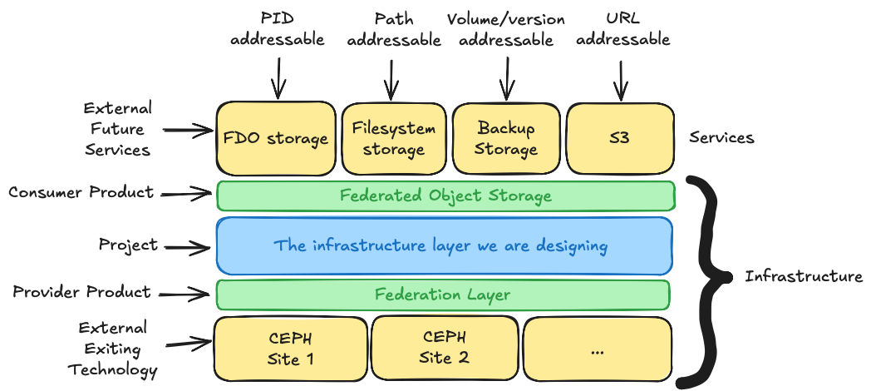
The making of an object storage federation…
Notes:
6
Here is a busy drawing.. Let me try to make some sense of it
At the bottom we have the large storage sites.
Having a scalable and resilient storage infrastructure is a solved problem
CEPH is an example that many sites deploy today
Technology exists for the providers to build and scale. But we need a way to federate across the community.
Provider product: A federation layer
At the top we have the services.
These will be made by others: NREN’s and their customers
FAIR Digital Object addressed by PID’s. (Useful for repositories and FAIR data)
Filesystem Storage: (paths are still a thing)
Backup storage: (off site backup, or replication, long term preservation put a tape archiver in …)
… (think for a second about how sharing could change if services utilize the fact that they share a storage layer)
… I can elaborate during questions if that is interesting
This is “only” an infrastructure.
Which is important! Producers and consumers are institutions == legal entities (in a fairly static landscape)
A legal framework can be established.
A prerequisite for pre-approval/certification of use with data controlled by an institution.
What we are looking at designing is blue part. What do we need to put thus together, and would it create value?
What would be in the blue part:
Technical
Aggregation
Data release
Metadata for ensuring compliance (examples)
Externalized -> REFEDS
AAI
Credentials for data release, needs its own infrastructure

Slide 15
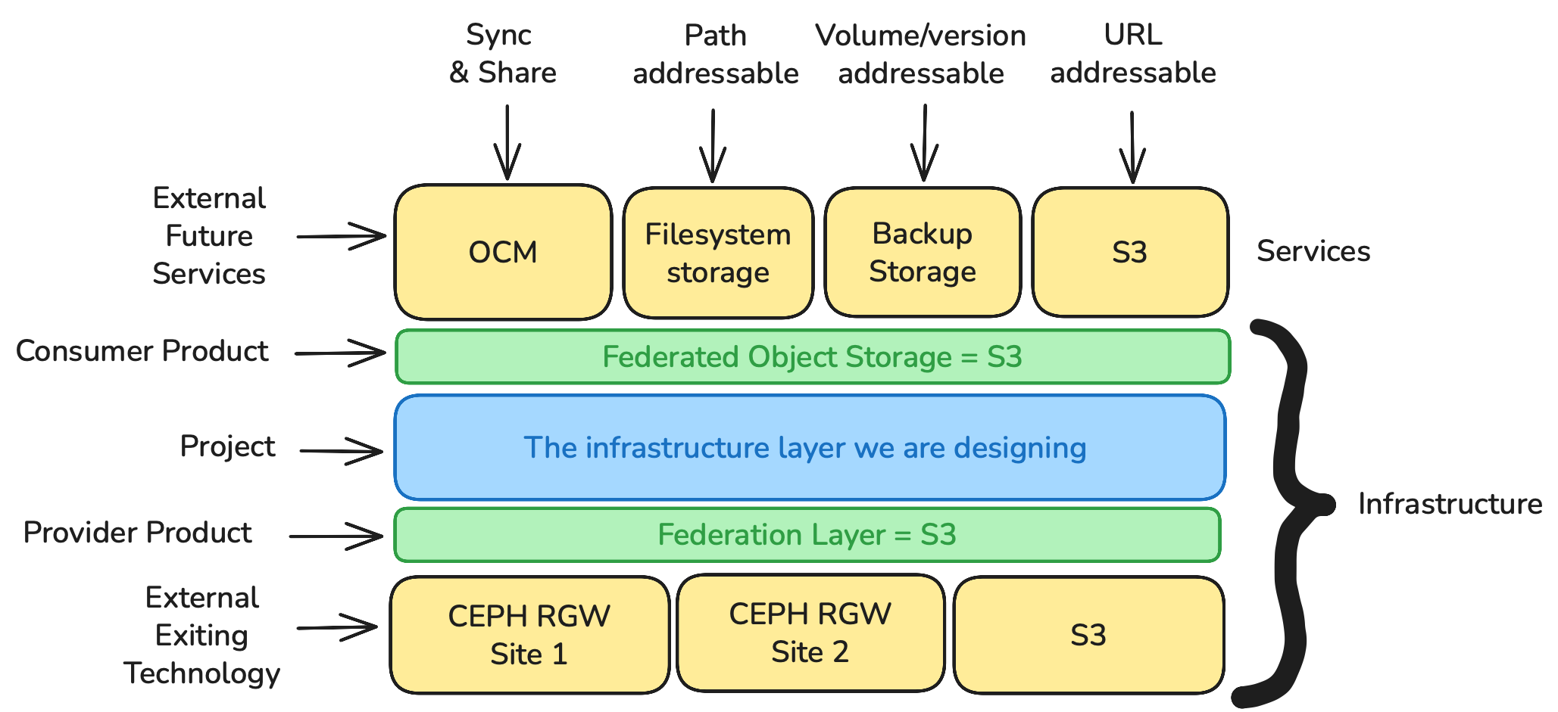

We have to start somewhere…
Existing technology
Notes:
What is possible if we just go with S3 on all layers?
It is easy to get started
It will support the simpler use cases, with little effort
Open to commercial providers?

Slide 16
Babysteps - Incubator (2026) – Feasibility study object storage cloud
Possible? Problematic? Needs development?
customer DeIC
3 storage producers
CSC, PCSS, SURF
1 storage consumer
DeIC
Technical architecture
Long distance cross-border replication feasibility
Identify organisational challenges
Input to phasing plan – not a green field
pan-European object storage cloud
SURF
netherlands
PCSS

Slide 17
The time seems right for a community-led, open, large-scale initiative. do you want to be part of it?
Questions?
Jan Meijer – Sikt – jan.meijer@sikt.no
Morten Kjeldgaard - DeIC – morten.kjeldgaard@deic.dk
Bo Bai - DeIC - bo.bai@deic.dk
Kalle Happonen – CSC - kalle.happonen@csc.fi
Ron Trompert – SURF - ron.trompert@surf.nl
Maciej Brzezniak PCSS - maciekb@man.poznan.pl
Recommendations collective cloud strategy GÉANT Association
https://zenodo.org/records/14793806

Slide 18
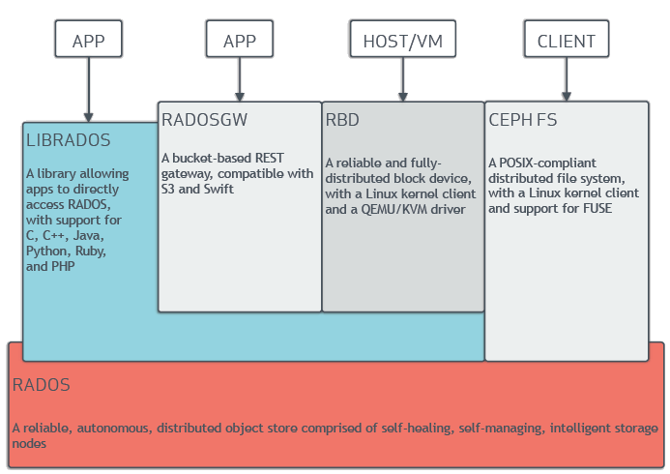
CEPH

Slide 19
Taking some baby steps (if you can walk in an incubator?)
Trying to use only existing CEPH functionality
What is possible
What is problematic
What is not possible and may need development
Integration on the RADOS Gateway layer
CSC, PSNC, SURF, (DeiC)

Slide 20
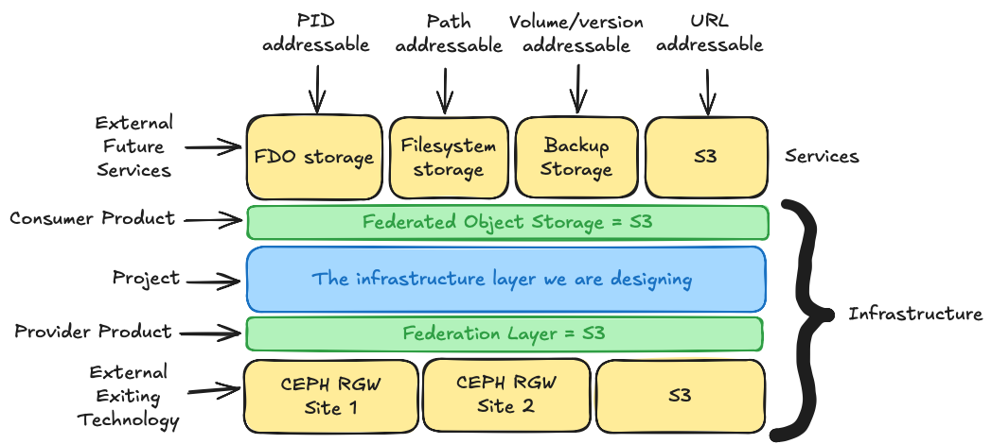
We have to start somewhere…
Notes:
What is possible if we just go with S3 on all layers?
It is easy to get started
It will support the simpler use cases, with little effort
Open to commercial providers?

Slide 21
Adding metadata to buckets to enable compliance
Attach data protection requirements to buckets to ensure compliance
Sovereignty requirements (jurisdiction, certification)
Actionable process for requesting access (a hook)
Call out for granting access (through some AAI SP or a Wallet Relying Party)

Slide 22
Federate and integrate existing large object storage installations across Europe
Provide a shared object storage layer for the European research community
Support data-centric infrastructure as a foundational layer for research and collaboration
Focus on scaling, resilience, cost-effectiveness, and compliance

Slide 23
Example: large European sovereign S3 object storage infrastructure
Itch: how to produce cost-effective sovereign cloudy infra competitive over time
Hypothesis: single technical platform, jointly produced, cheaper & better
single coherent service
one technical platform – joint operations – business layer
sovereign deployment
joint financing, governance
common blueprints for storage pod
joint procurement components
single technical platform
operations
finances
sales
complexity & benefits
low
high

Slide 24
Investment proposal prep GN5-2: large European object storage infrastructure
Early observations
GEANT Association
43 NRENs + GÉANT org
4.100+ employees
€1.000M+ budget
technical: can be done, “just engineering”
producers & consumers
challenge: organising, business layer, politics
up-front federation
likely key customers: research data repos
economy of scale & scope
risk vs. reward?
start with coalition of willing and grow
make it more interesting to join than invest in new local infra, when that time comes
43 countries
–5.000 R&E organisations
–1.2M researchers
European Research Area
–50 pan-European RIs
–150 large storage / processing plants
- 250 Trustworthy Data Repos
- ? institutions producing digital services
Notes:
different solution paths for different problem spaces
where is the storage, where are the processing sites? Consolidation seems key

