Slide 1
A federated distributed S3 storage for Italian Universities and Research centers
Fabio Farina - GARR
Bologna, 3-4 december 2025
SIG-CISS

Slide 2
Outline
  The requirement that led us to Edustorage
  The current service pilot
  Future strategy
Alignment to the SIG-CISS topics
  Impact of federated storage solutions and their integration with public or private wide area networks
  Data access and data management at the Edge

Slide 3

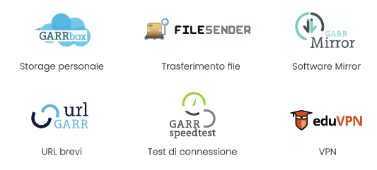

Quick recap of current GARR Storage Services
Community-facing Services
  GARRbox Sync and Share – personal, small teams, daily file management
  Filesender for large file transfer
  Cloud S3 object storage based on Ceph
Internal Services
  For VMs & Pods backup, time series databases,
  logging and network flows data lakes, backend for other services
  Many MiNIO S3 clusters
  Redundant ZFS storage, with sync among sites

Slide 4
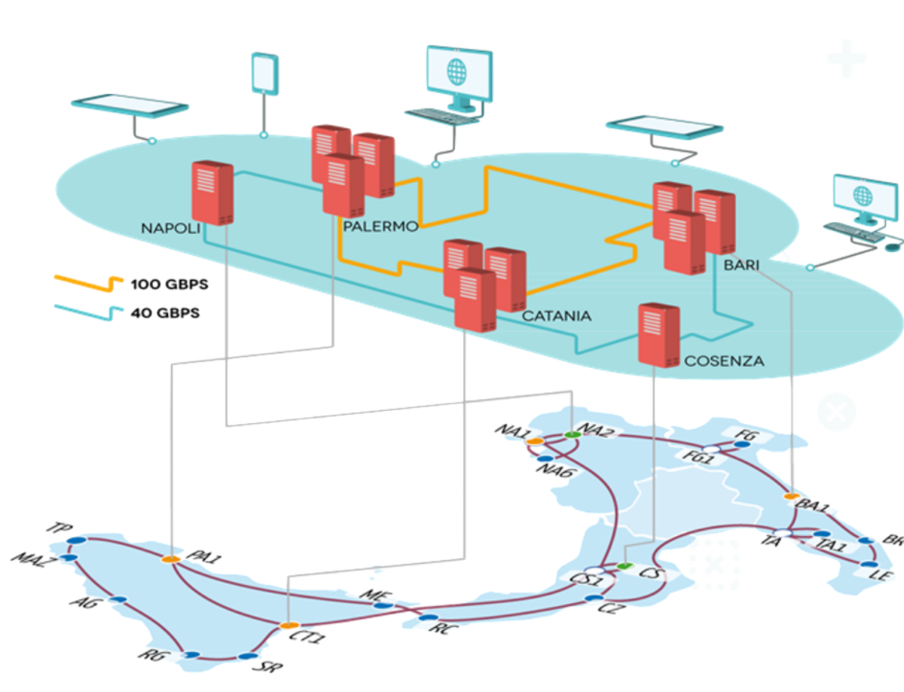
Current resiliency and limits
Local Infrastructure: Rack and site-level protection (VMs live migration + SAN)
Data and Services: Active-passive/Active-active replication (Kubernetes)
The Gap: go beyond the single data center
  Storage that continues to function even when sites fail
The Data Management Challenge
  Expensive commercial solutions for long-term
  archiving of always increasing research data
  Managing large-scale storage with many 9’s is hard

Slide 5
Why Federated Storage: requirement analysis
  GARR’s role
    Not a fee-based provider, but an aggregator in joint development and implementation
    Cost planning, developing internal expertise, and supporting specific research needs
    GARR is an interested user
  Advantages of storage federation
    Geographical resilience, continuity, ease of use
    Security and compliance. Collaboration and innovation
    Resource and cost optimization, operational effort reduction, scalability to multiples of 100 PB
  Design pillars
    Availability - data persistency when entire sites fail
    Reliability - protection against component failure
    Protection of data with encryption, immutable copies, versioning

Slide 6
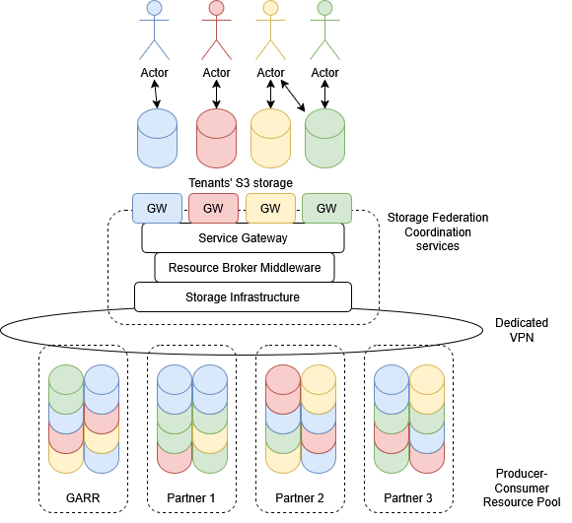
Objectives + Service Model Vision
Edustorage.it – 2024 GARR technical workshop
  3 layers architecture, off the shelf storage
  S3 tenants, software orchestration
  AAI by design, dedicated DMZ VPN
Federated control and management
  Operational autonomy for end-users
  Multi-organization hierarchical delegation
    Team leaders can set collaborator quotas
    within upper-level (organization) constraints
  Independent redundancy levels
  1+1, 3+1, immutable copies, …
Notes:
Layer 1 (Base): Hardware storage resources located at participating Organizations (Sites).
Layer 2 (Middleware): Homogeneous, distributed logic layer for replication and HA/Availability policies.
Layer 3 (Delivery): Allows Institutions to provision storage areas for their users and for Tenants (multi-organization/shared areas).

Slide 7
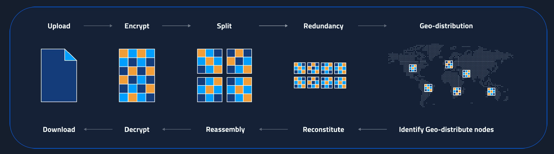
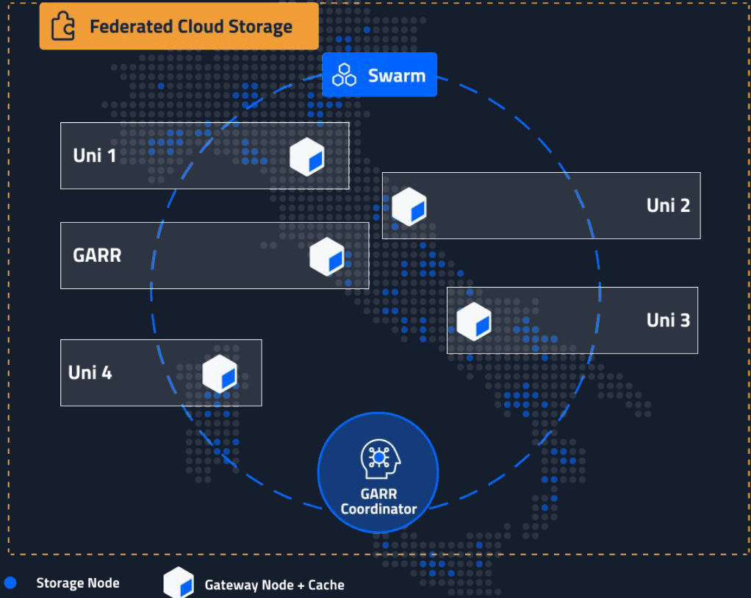
Enabling Technology: Cubbit
Cubbit, European company born in Bologna
DS3 a S3-compatible storage solution with a new data distribution model
  Sovereignty + on-premise + ISO, NIS2, DORA, GDPR ready
  Ransomware Protection + Multi-Tenant + Zero-Knowledge
  1000s Nodes, N x 10 PBs hardware agnostic deployments
  Edge nodes close to the users

Slide 8
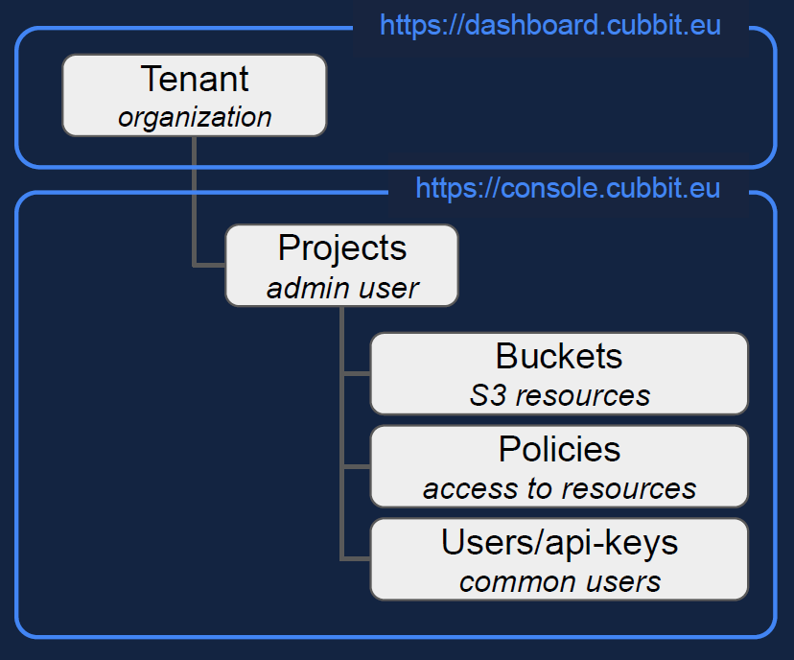
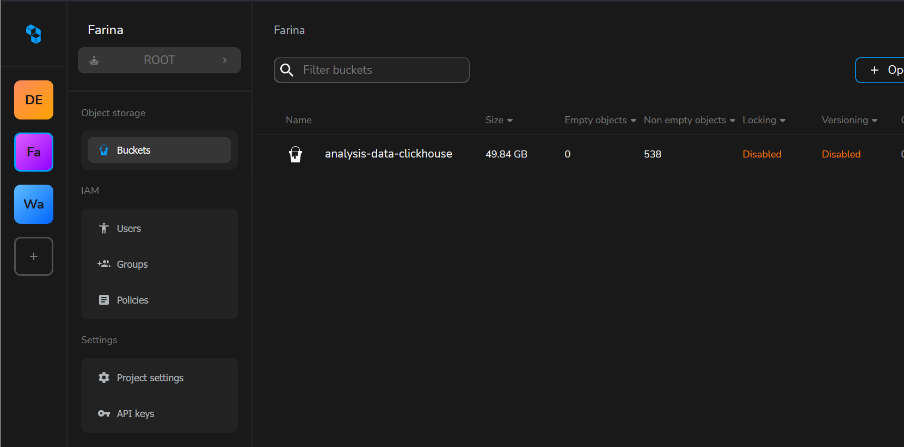
Cubbit resource hierarchy
Orchestrator
(replication policies, delegation)
Tenants gateways
(federated AAI)

Slide 9
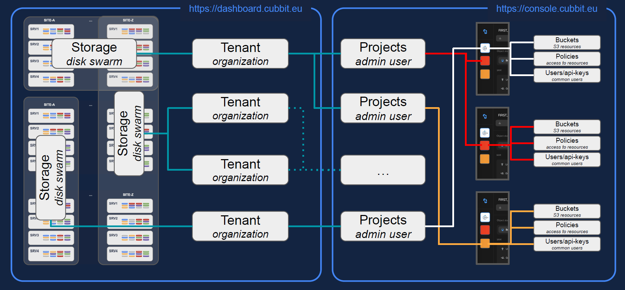
Under the hood
Disk Agents
Orchestrator
Gateways + Tenants

Slide 10
Development phases
0 – Scouting with GARR internal pilot
  Cubbit cloud coordinator, GARR storage in Frascati and Bologna
  Assessment with S3 clients and data movement workflows, benchmarking suite
1 – Service prototype (today)
  Federation definitions: governing bodies, processes, sustainability
  Producers of resources and consumers of the same
  Edustorage.it : On-premise Coordinator on multi-site kubernetes at GARR
    Storage at University of Bologna, University of Milano-Bicocca, GARR data-centers
    750 TB per site, 5 servers, initial (1+1) redundancy then (3+1 erasure code)
    Dedicated DMZ VPN maximizing data access

Slide 11
Early use cases and near-term developments
Gateways up & running, with IDEM AAI and dedicated URLs for tenants
Use Cases
  Data movement across the network and telemetry data lakes
  Vertical solutions for each tenant
    Sync and share
    Remote backup
    Collaboration suite
Immediate Actions, next week or so
  Coordinator upgrade to the next LTS release
  Rack migration from Turin to Naples, both GARR data centers
  Storage setup in Milano-Bicocca and Bologna

Slide 12
Then, consolidation and extension
Consolidation
  From pilot to production, more GARR regions, more partners
  Federation operation processes, onboarding, policies
Extension
  Interactions with the association of Italian Universities (CRUI) for a Request for Information
  Blueprint architecture for simplified tender of hardware and software
  Planning for a public tender, open also to other solutions

Slide 13
Thanks / Grazie
Thanks on behalf of all the people involved in Edustorage
s3fed-wg@lists.garr.it
GARR
Pasquale Mandato
Vincenzo Caracciolo
Gianni Marzulli
Marco Lorini
Matteo Di Fazio
Giancarlo Viola
University of Bologna
Stefano Benassi
Riccardo Dodi
the APM team
Andrea Giovine
University of Milano-Bicocca
Ettore Virzi
Rosario Agreste

