Slide 1
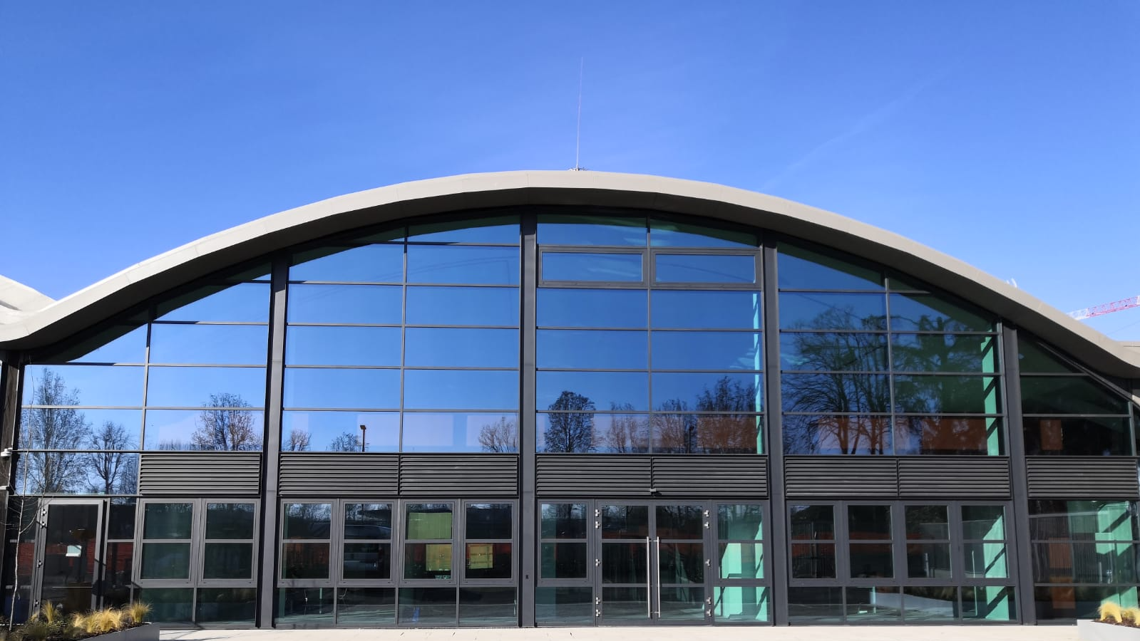

INFN Data processing services for high energy physics and beyond
Alessandro Costantini, INFN-CNAF
16th SIG-CISS: Fed.Storage and Storage Infrastructure Workshop
3-4 December 2025

Slide 2
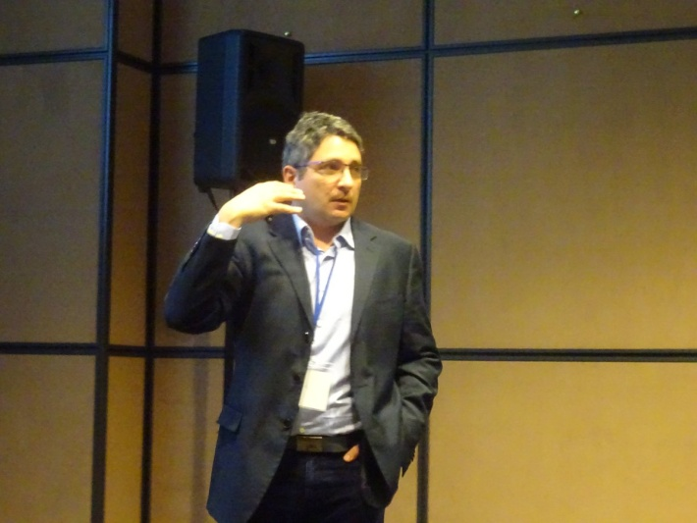

On behalf of
Picture!
alessandro.costantini@cnaf.infn.it
National Institute for Nuclear Physics (INFN)
Cloud expert
Involved in cloud-oriented project management
Based in Bologna, Italy
Head of Distributed Systems Unit @ INFN-CNAF
https://www.cnaf.infn.it

Slide 3
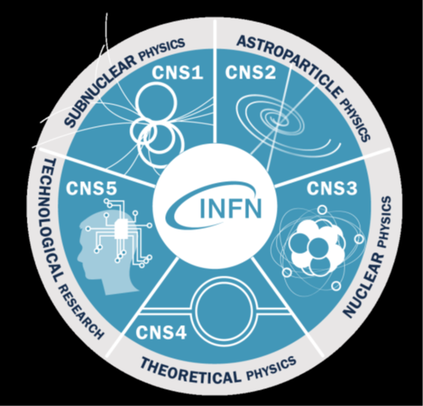
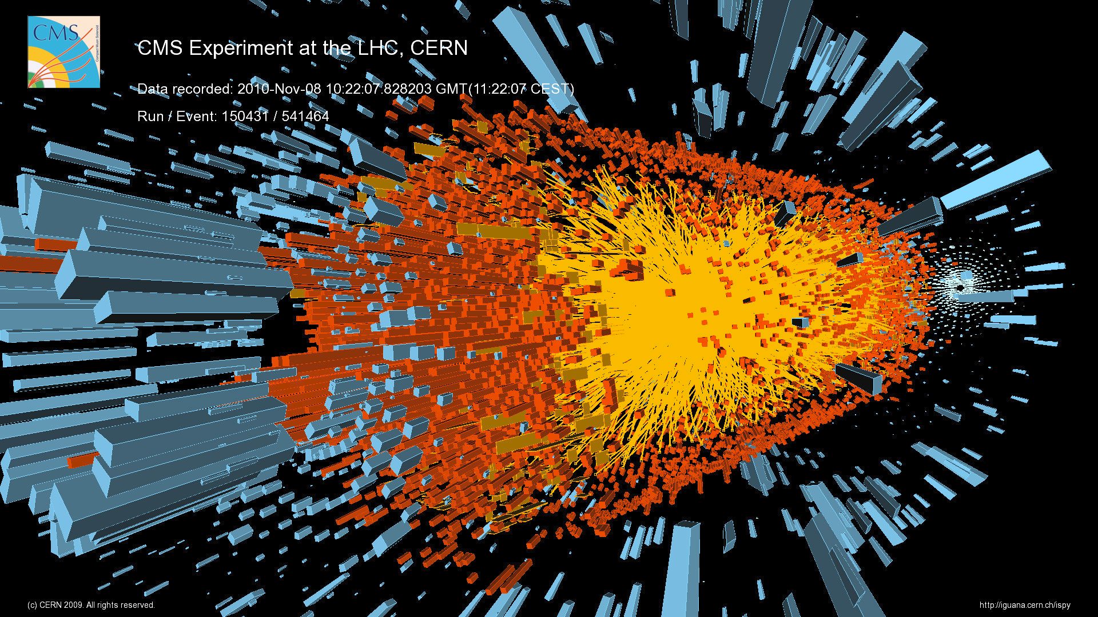
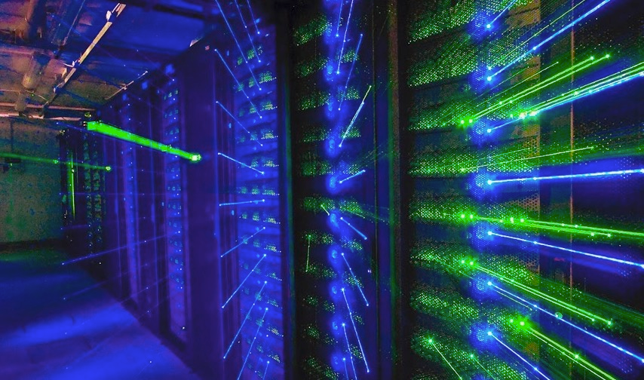
National Institute for Nuclear Physics
Worldwide-recognized expertise in state-of-the-art distributed IT technologies and solutions, from the first small clusters to Grid and Cloud-based computing.
INFN is not interested in computing per-se, but as an essential way to support its research and mission.
INFN develops and operates Grid and Cloud services based on its own infrastructure, the largest for research in Italy

Slide 4
Computing infrastructure
Distributed infrastructure first established more than 20 years ago, and recently renewed (spaces, power, cooling) with a major investment
New site for the Tier-1 at Tecnopolo (CNAF)
9 Tier-2s upgraded
Upgrade of the Gran Sasso Data Centre for Disaster Resilience
New Space Economy Data Centre in Frascati
INFN computing infrastructure is part of the global distributed computing network for LHC experiments (WLCG)
35 M€ from MUR, EuroHPC
21.5 M€ from NRRP(*)
(*) EU National Recovery and Resilience Plan

Slide 5
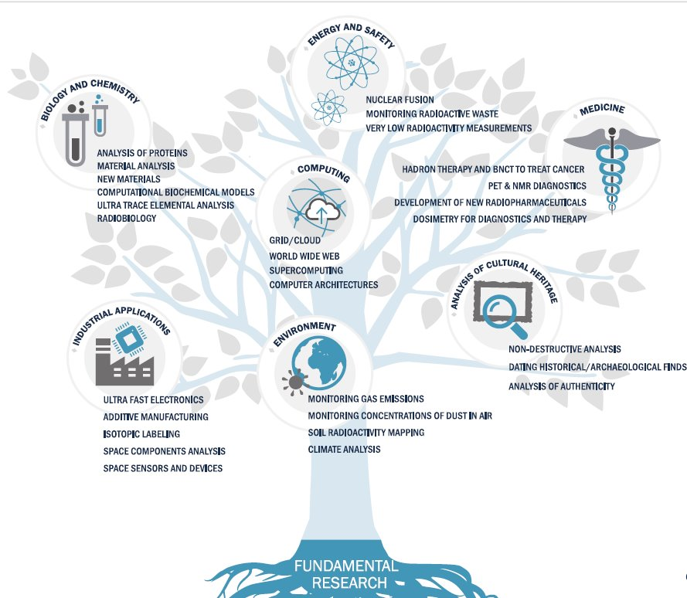
Computing infrastructure
Not only WLCG: this computing infrastructure also addresses the needs of many other INFN research projects both internal (60+ from CSN’s) and external (regional, national and international projects)
Including collaborations with institutions operating in the bio-medical, genomic and oncological sectors
Including Cultural Heritage preservation and analysis
Most of the data is currently archived (and elaborated) at CNAF
Not only INFN: now setting-up a national “data lake” in the framework of ICSC to enable transparent access to all resources
Main players: INFN, CINECA (HPC) and GARR (network)
INFN is the only Italian entity with a large distributed computing infrastructure (the Grid)
Main drive: INFN DataCloud initiative

Slide 6
Some figures
Computing
90.000 cores (Tier-1) + 100.000 cores (Tier-2s)
~2.1 MHEPscores in total
~50% of Tier1 HTC computing power provided by Leonardo@CINECA
200 GPUs (Tier-1) + 148 GPUs (Tier-2s) for HPC applications (“TERABIT HPC Bubbles”)
Cloud-based HPC clusters instantiated via user-friendly interfaces​
Intermediate step between the Cloud and extreme-scale supercomputers​
Also, alternative architectures such as FPGA, and ARM are available to explore ways to improve the energy efficiency of the data centers
Storage
Disk: 100 PB (Tier-1) + 90 PB (Tier-2s)
Tape: 200 PB (Tier-1 only)
ISO27000 certified
A subset of these resources in 3 sites (CNAF, Bari, Catania) are ISO27000 certified to manage bio-medical and genomic data
Business continuity
A small, fully redundant infrastructure (replicated between CNAF and LNL) is also in operation for INFN ICT services.
2024-2025 resources
funded (34 M€) by NRRP

Slide 7
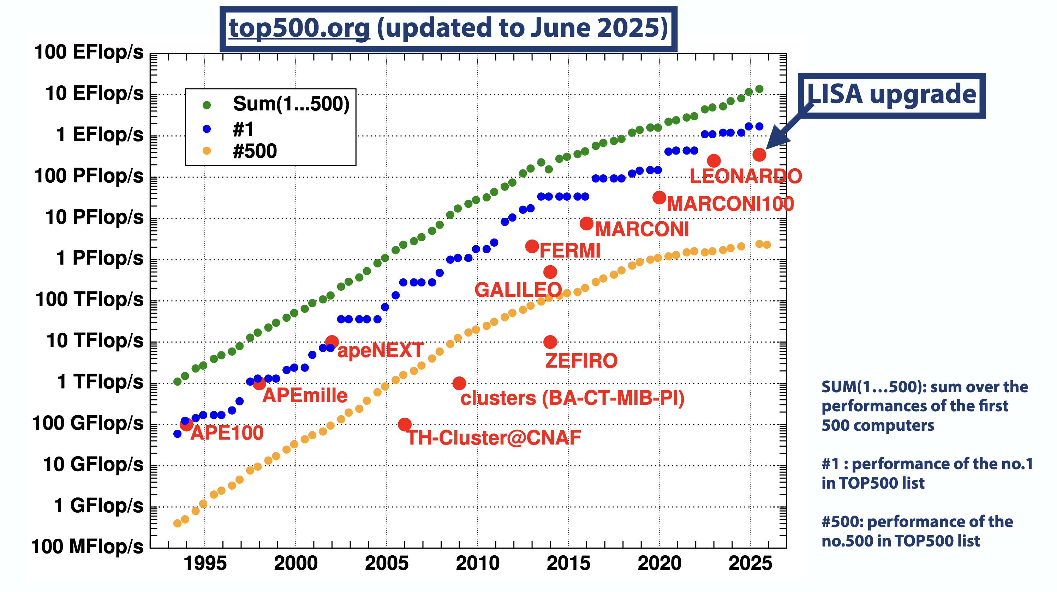
Some (other) figures
INFN also uses HPC systems (CINECA) for tasks requiring high parallelization, typically for theoretical physics
2024: ~9.8 MGPUhours
Top500.org – November 2025
GPU
Log scale
2024: ~157 Mcorehours
TERABIT HPC Bubble@INFN-CNAF
#439
CPU

Slide 8




DataCloud
DataCloud is the cornerstone of the emerging Italian Cloud Federation in the framework of ICSC consortium
The ultimate goal is to build a data lake for research including resources from other entities such as HPC machines at CINECA (e.g., preexascale Leonardo)
INFN infrastructure of Tiers is evolving into the Cloud Federation
Resources are being made available through Cloud interfaces
Traditional (Grid and batch system) access remains as needed and when convenient
Hosting Resources for other communities (ICSC, Terabit) in INFN data centers
Uniform (and intuitive) interfaces needed
E.g., common Authentication&Authorisation (AAI) infrastructure, …
Collaboration with CINECA to allow full interoperability of resources and services
Follow-up in the European Open Science Cloud (EOSC) and EuroHPC contexts

Slide 9


National Federated Cloud
IDP
CINECA
INFN Cloud for CINECA (and others) resources access
Main difficulties on AAI policies (and in turn on access via PaaS). Work started but not completed within the project. Will be addressed in the future
First Proof of Concept
(INDIGO IAM for INFN and CINECA identity federation)
( INDIGO PaaS Orchestrator for access to OpenStack-based resources)
InterLink offloading to reach CINECA HPC resources
RUCIO for INFN and CINECA storage system federation
Activities to be carried on in the European context (EOSC)
Leonardo/Lisa
Galileo100
Work in progress
IAM
➾
IDP
INFN
Federation
Services
Tier1/Tier-2 Federation

Slide 10
Where it happens
CNAF (Bologna) is the National Center of INFN dedicated to Research and Development on Information and Communication Technologies
CNAF has a strong involvement in NRRP-funded initiatives (ICSC, TeRABIT, DARE, ECOSISTER)
Funding for resources (storage mainly)
Funding of a significant number of temporary staff
CNAF is participating in several other projects (current and proposed)
Spectrum initiative (to enhance the integration of computing resources across Europe)
Projects related to EOSC (Skills4EOSC, AI4EOSC) and contribution to setting-up the Italian EOSC node together with ICSC
Projects for AAI (AARC TREE, RI-Scale)
Cultural Heritage (Artemis)
Health and Medicine (Allianz Against Cancer, MMBRI-ERIC, Elixir, Italian IRCCS)

Slide 11
Tecnopole: the innovation Hub
One of the added values of CNAF for INFN is the new data center at Tecnopolo
Several opportunities offered by the new location
Higher electrical power availability (up to 10 MW) and large room space (~3000 m²) allow for a robust increase in installed resources beyond the HL-LHC requirements
Proximity to CINECA data hall facilitates the exploitation of Leonardo and other future machines (e.g., LISA, Quantum Computers, AI Factory…)
Notes:
Slide di strategia

Slide 12
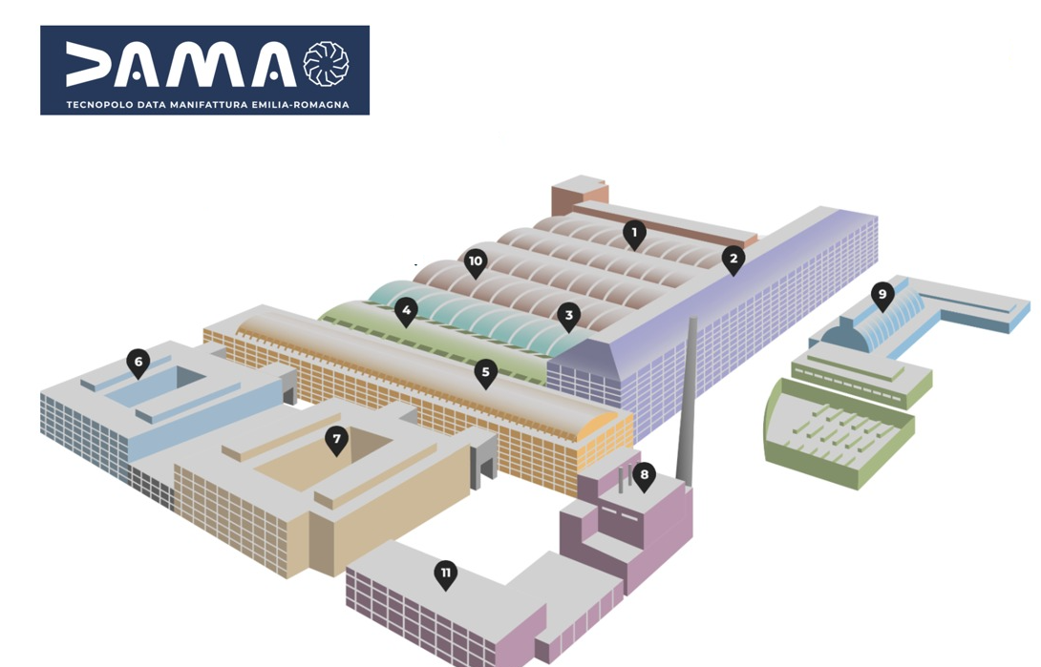


“DAMA” Technopole
The CNAF headquarters is still at the Physics Department: in the near future it will be moved to Tecnopolo
Data Center ECMWF
Entrepreneurship Hub
Data Center INFN-CNAF
Data Center CINECA
ENEA
International Research Area
Landing spot for companies and research activities
Technopole Square (Catering and services)
“Magazzino del sale” (Conference area)
Botte B4 (Conference area E-R Region)
Citizen Science

Slide 13

Inaugurated May 10, 2024
Migration of the Tier-1 data center to Tecnopolo completed during Spring 2025 without service interruption

Slide 14
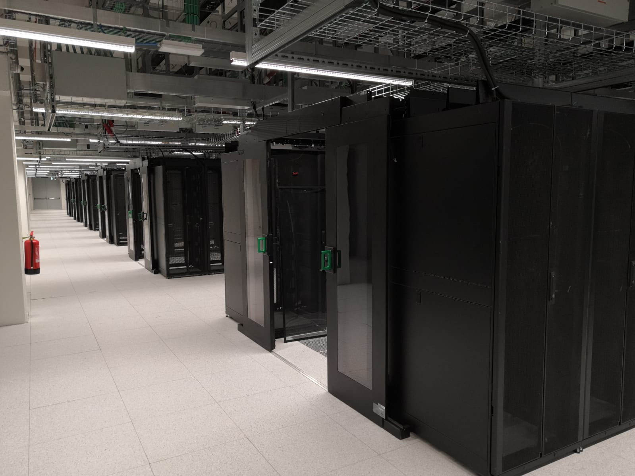
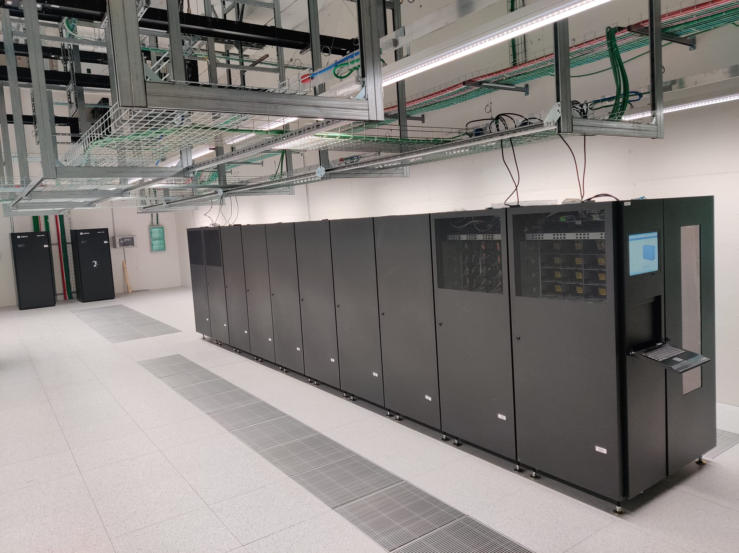
Tecnopolo: the INFN-CNAF data center
It can accommodate resources for HL-LHC and other (future) scientific collaborations also beyond INFN traditional domain
ISO 27001 certified cloud infrastructure (EPIC) for managing biomedical and genomic data
It hosts a database with O(1000) genomes
INFN ICT services
Housing of resources for other institutions (ENEA, INGV, Destination Earth, ICSC)
Notes:
Slide di strategia

Slide 15


What’s Next
Consolidation of the INFN infrastructure thanks to the NRRP founding
Huge increase in resources (beyond HL-LHC requirements)
DataCloud is proceeding with the creation of the national data lake
Further steps to finalize the federation with non INFN resources will continue, after the end of NRRP projects, in the framework of EOSC and EuroHPC
The data lake will allow to access in a transparent way resources at CINECA, besides Leonardo, such as Quantum computers and the AI Factory (It4lia)

Slide 16

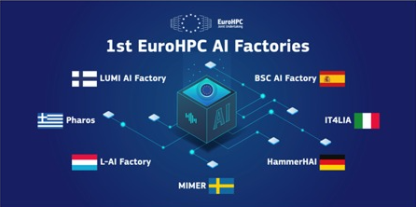
IT4LIA: the AI Factory
Italian proposal selected for EU funding
7 approved proposal in total in the first phase
400 M€ (exascale machine) +30 M€ (applications)
Public-private consortium
ICSC primary actor
INFN contributed with 10 M€
Strategic initiative at the national and European level
Accelerating Al adoption and creating a competitive European ecosystem

Slide 17
BACKUP

Slide 18
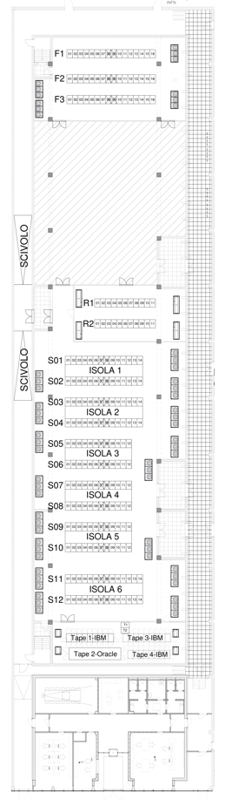
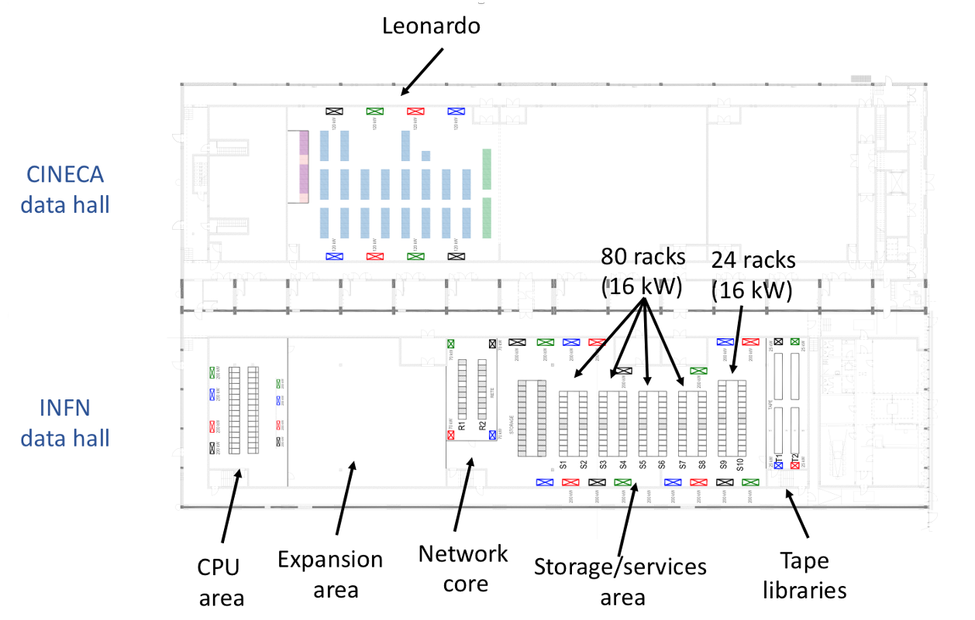
The new Data Center at Tecnopolo
LEONARDO
Low density area with 132x16 kW racks
44 racks for storage (400 PB)
2 options for racks in High density area:
40 kW racks (with cooling plenum)
Racks with DLC (80-90 kW) in Phase 2 (up to 3.4 MW, 4 MHS06)
Up to 4 tape libraries O(EB) with the current technology
Network links:
GARR GP and LHC OPN/ONE uplinks
1.2 Tb/s LAN extension with CNAF
1.6 Tb/s LAN extension with Leonardo
4x100 Gbps DCI with CERN
Large expansion area: characteristics (and use) still to be defined.
CINECA
Data Hall
C2
132 racks
(16kW)
INFN
Data Hall
B5
DLC 80kW
CPU
area
EXPANSION
area
NETWORK
core
STORAGE/SERVICE
area
Tapes
libraries

Slide 19
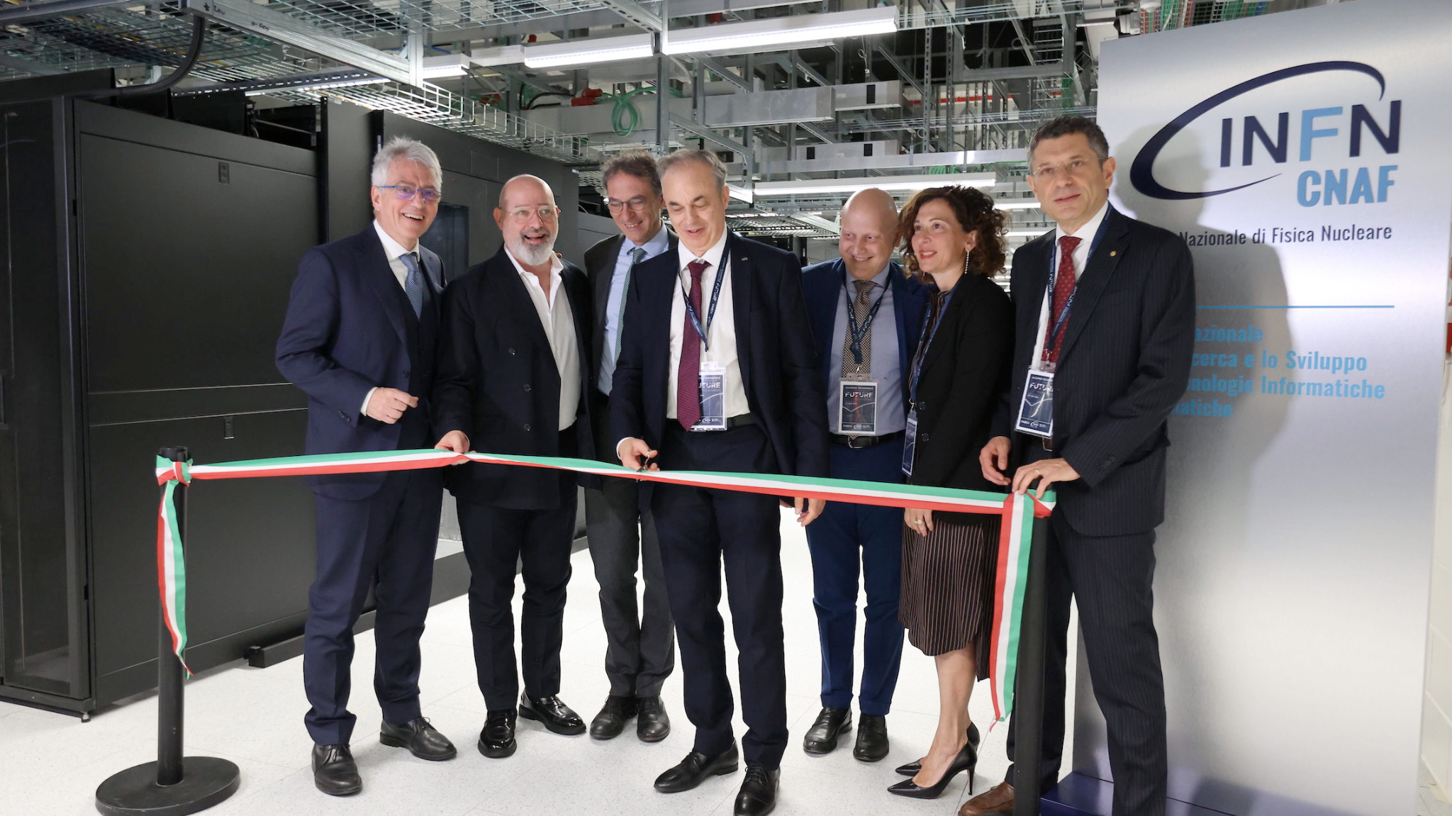
May 10, 2024: “inauguration day”

Slide 20





INFN - Acquired IT resources
Commissioned HTC servers and storage (by ICSC):
~900 kHS06 (Tier-2)
~55k CPU core
~80 (Tier1) + 40 (Tier-2) PBN
Library + 143PB tapes
Being installed now:
HPC Bubbles by TeRABIT, ICSC, DARE
160 CPU nodes
61 GPU nodes
10 FPGA nodes
118 storage nodes
Coming:
~50 PBN (Tier-2)
CPU node
192 physical cores
1.5TB RAM DDR5
IB NDR 400G
20TBL (SSD) + system disks
GPU node
As CPU + 4x NVIDIA H100 SXM5
with 80GB and HBM2e memory
FPGA node
32core
RAM 768GB DDR5
IB NDR 440G
4 x XILINX U55C o 4 x TerasicP0701
Storage node (CEPH Bricks)
64 physical cores
1TB RAM DDR5
384 TBL HDD + 25.6 TBL NVMe
Accessories
Switch IB, Switch ETH
cables IB, cables ETH
Transceivers
20

Slide 21
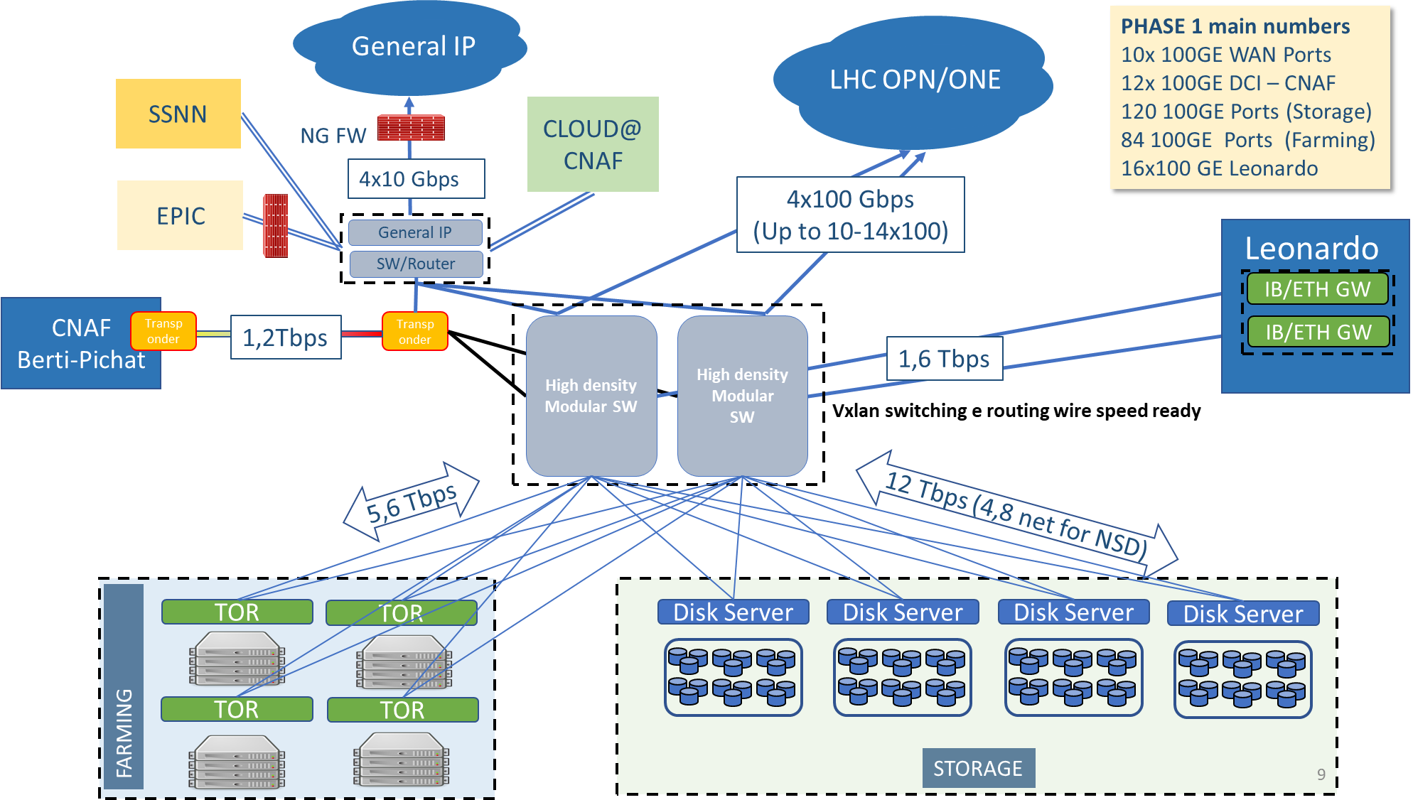
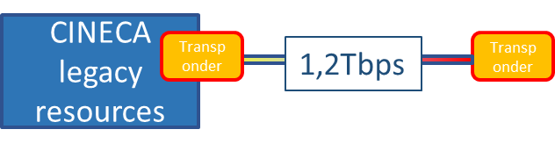
Networking Infrastructure
Currently 2x100Gbs
Currently 8x100Gbs
1.6Tbs
Currently 4x100Gbs
CERN DCI

Slide 22
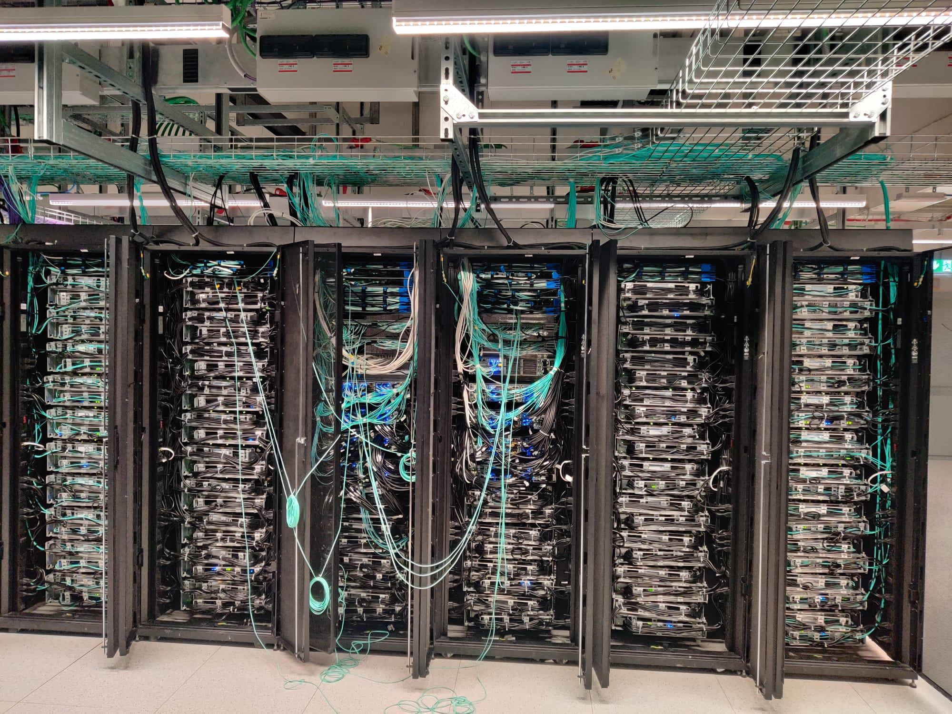
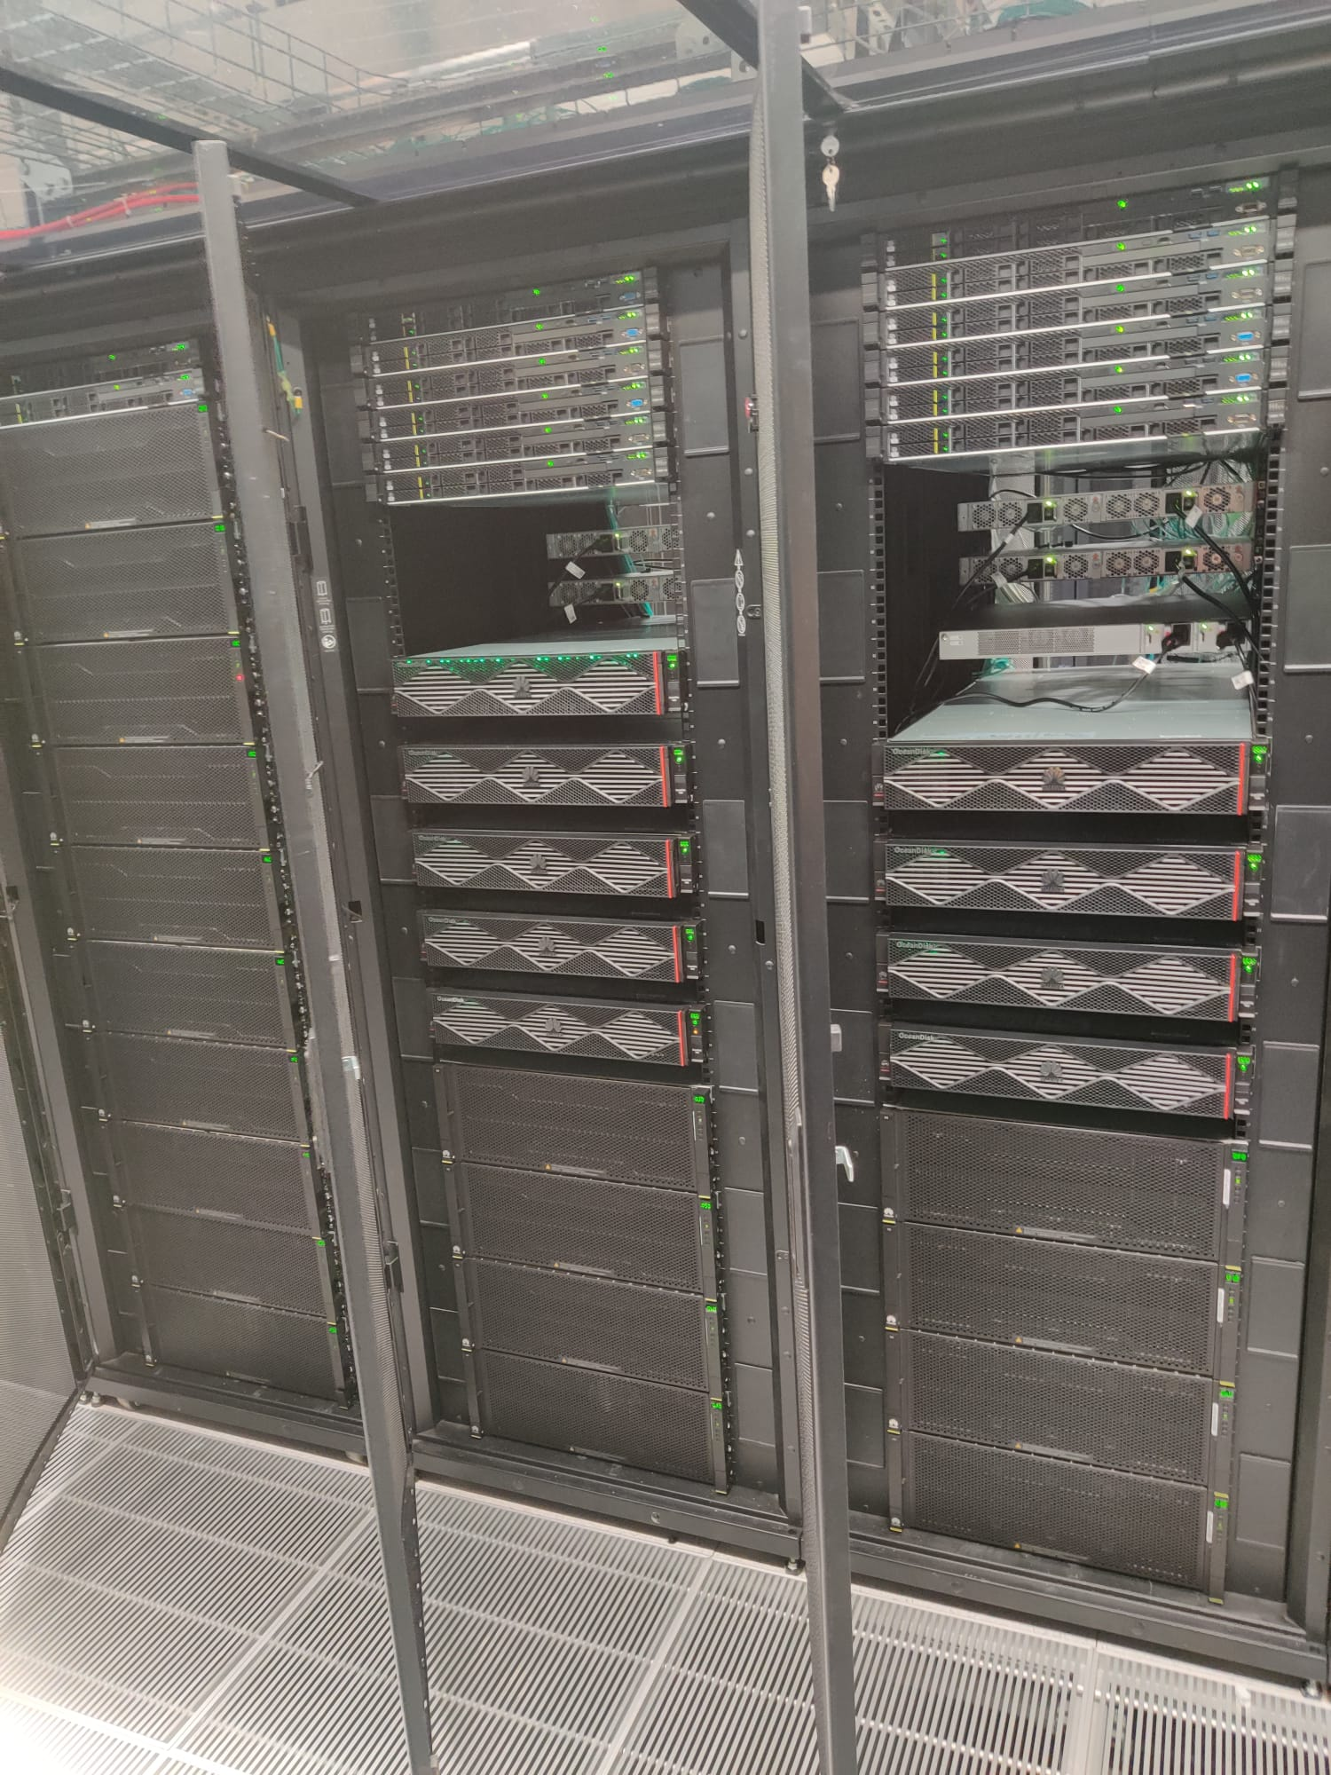
Disk storage (Fr. Ag. 2023-2024)
New tape library

Slide 23
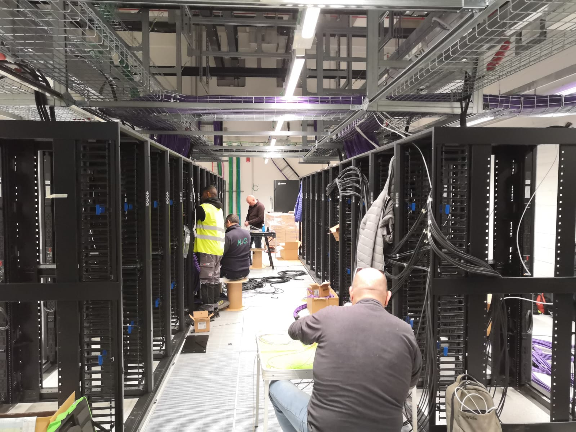
K
Network zone
Low density zone

Slide 24
EPIC infrastructure
Cloud infrastructure for managing biomedical and genomic data
ISO 27001 certified
ACC (see next slide)
Harmony - exploiting Big Data to develop more personalized treatments for blood cancer patients
Planet – search of possible correlations between Covid-19 disease and environmental factors

Slide 25
ACC
Alliance Against Cancer (Alleanza Contro il Cancro-ACC) is the largest Italian organization for oncological research
Established in 2002 by the Italian Ministry of Health
Network of 28 high standard institutes for comprehensive cancer patient care and research (IRCCS)
ACC's goal is to make innovative clinical trials accessible, including personalized medicine ones (“genomics”)
CNAF contributes to the design and management of the ACC Big Data Platform, helping ACC researchers in dealing with both technical and regulatory issues
Currently ~4 TB-N used out of 125 TB-N available
Short-medium term: ~40 TB-N/year

