Slide 1
16th Special Interest Group on Cloud Interoperable Software Stacks (SIG-CISS)
Joint ICSC-INFN-GÉANT Workshop on Federated Storage and Data management infrastructure
Introduction to the SIG-CISS
Mario Reale
Senior Research Engagement Officer – GÈANT
December 3-4, 2025 - Bologna
Public (PUB)

Slide 2
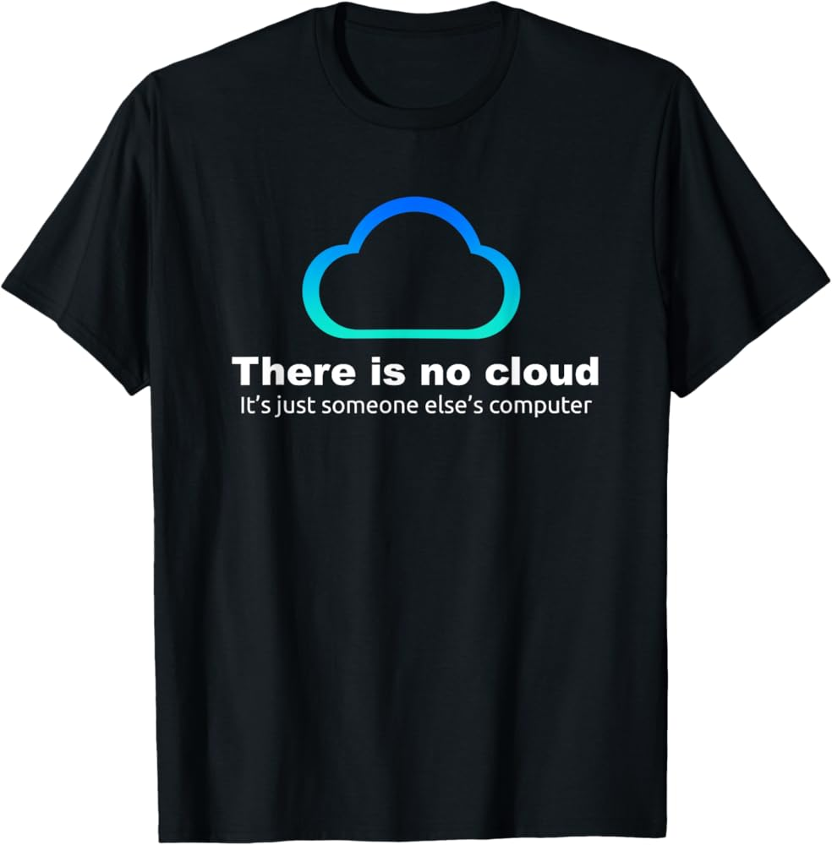
Welcome
Everybody
to SIG-CISS n. 16 !
A Workshop jointly co-organised by ICSC, INFN and GÉANT
devoted to Data Management and
Federated Storage within the Community

Slide 3
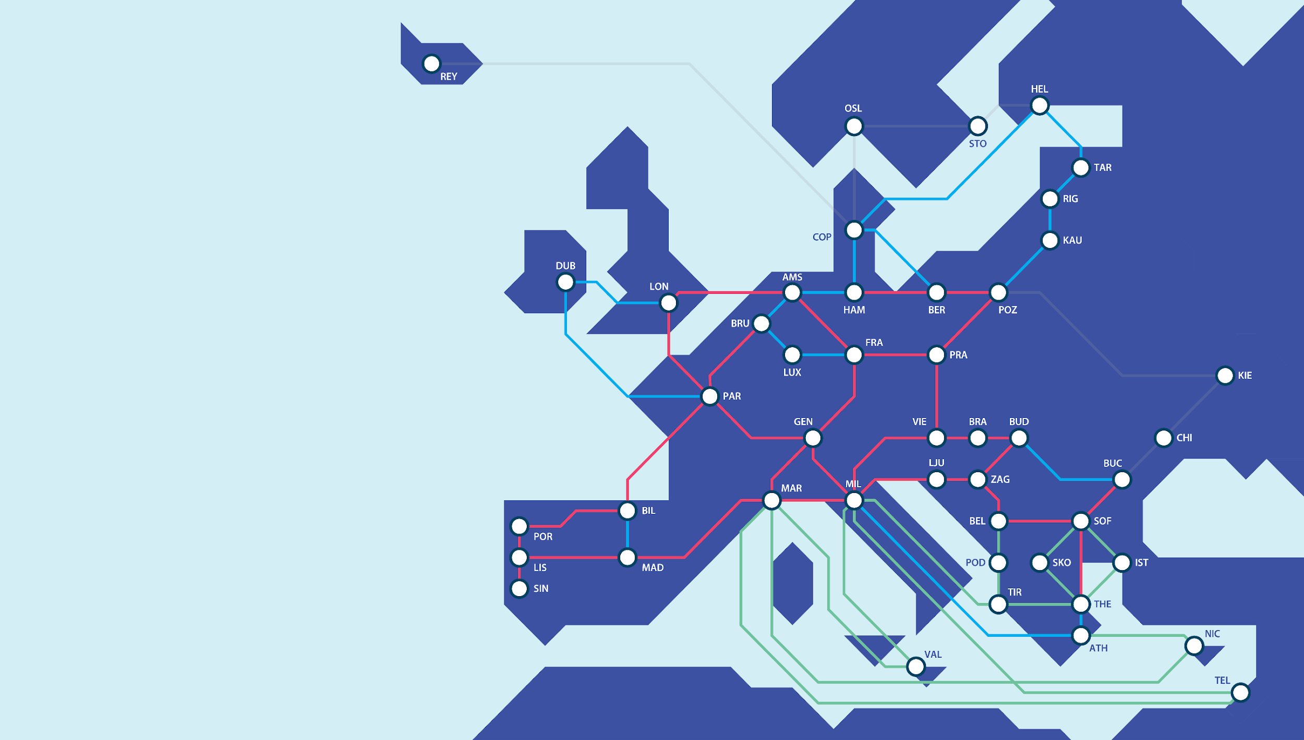
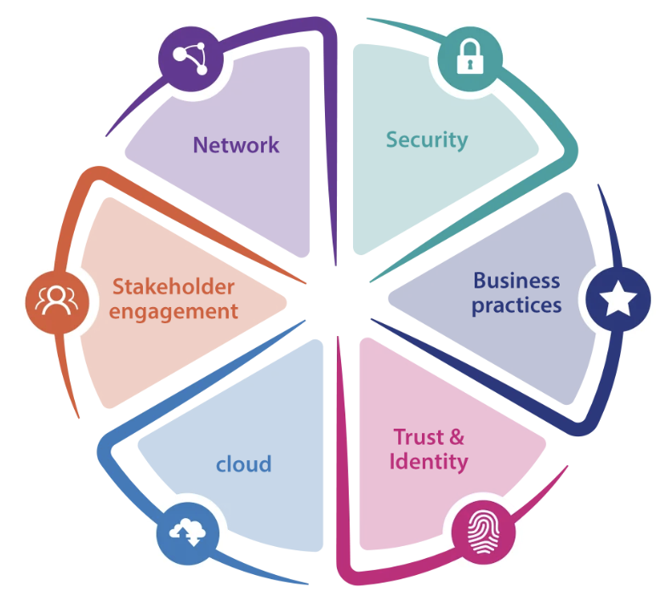
GÉANT Vision
To collaborate to deliver the infrastructures and services that enable the R&E community to excel.
GÉANT Community Programme:
https://community.geant.org

Slide 4
The original charter (2017), ToRs and goals for the SIG-CISS 1/2
Gathering and exchanging experiences, ideas and knowledge on the development, deployment, testing and standardisation of cloud infrastructure software stacks, platforms and workflows
To share deployment and operations best practices about all the pillars of the cloud infrastructure
Be the primary community forum in the confluence of computing, storage and networking
Leverage the existing focus groups including CS3 (CERN) on sync&share and storage and OSO (SWITCH) on Infrastructure-as-a-service and OpenStack operations
To improve awareness of software and hardware solutions available on the market and infrastructures, platforms and services provided by NRENs in the area of (federated) cloud computing, IaaS, PaaS, SaaS, data storage, management, automation and big data, and act as a launch pad for joint procurements and/or brokering thereof as appropriate and necessary
To help identify current and future requirements and workflows of the scientific/academic community related to computing, storage, data management infrastructure, platforms, services and applications as well as preparing NRENs to address these needs

Slide 5
The charter (2017), ToRs and goals for the SIG-CISS 2/2
Disseminate about local developments and specific technical solutions and feedback them upstream to the main branch of open source projects
Leverage the critical mass of the Research and Education community to steer and lobby/provide useful feedback to all key stakeholders around us:
  Large open-source Cloud IT projects and platforms
  European Commission and the EU regulations impacting on the providers and consumers of Cloud services in the Academia
  Large public cloud providers
Support and adopt interoperable solutions based on community adopted standards, enabling to scale up and integrate multi-domain resources
To provide an interface among operators and owners of the cloud computing and storage infrastructure (IT experts) and the actual users i.e. individuals, academic institutions, communities and collaborations (domain experts), that enables mutual understanding of needs and capabilities as well as challenges and opportunities
To define, stabilise and promulgate mutually agreed upon APIs as exported by NREN cloud stacks, preferably globally recognised APIs that cloud users can rely on to build their use case upon, and be guaranteed that their use case will in fact work, and be as portable as possible among NRENs

Slide 6
What topics we typically deal with
https://wiki.geant.org/display/CISS/SIG-CISS+Home
Cloud services for the R&E community
Interoperable software stacks implementing cloud services
  OpenStack
Hybrid cloud approaches
  Integrating private and public cloud to enable flexibility and response to peak demand
User Experience
  Integration with AAI solutions and user management
New storage platforms, cloud implementations, hardware
Integration/Interoperability with key R&E community initiatives
  EOSC Nodes , e-Infrastructures
Trusted Research Environments and handling sensitive data

Slide 7
What have we been focusing on at the last SIG events:
How do NRENs implement Infrastructure-as-Code (Munich, March 2025)
Trusted Research Environments for handling sensitive data
How to the NREN community implement hybrid Cloud Use Cases (Trieste, June 2023)
NRENs building cloud (several times)
Openstack challenges and issues, common approaches, solutions (Reykjavik, September 2023)
Liaising with other GN5-2 WPs and tasks about plans / strategy / goals
Updates from key projects and initiatives (e.g. CS3, CS3MESH4EOSC..)

Slide 8
What I think we as SIG should keep on doing (my unrequested opinion)
Keep focussing on our user community and keep adopting their perspective
  On the things that work for us and for our users
Thrive to provide them with the means to carry out excellent scientific research:
  User Experience first
  Provide them with seamless cross-domain, cross-infrastructure, high capacity, secure services
Collaborate, share, exploit synergies to the best we can, at all levels:
  We are the still the lucky minority here, the few ones not to be profit-driven in a world of huge GAFAM commercial competitors all around us
Maintain our free, critical, independent spirit, basing our user-centric focus and interoperable standards
Keep an eye on emerging trends in IT and the Cloud domain specifically
Probably focus more on Security than what we’ve done so far
Lobby together towards the other stakeholders:
  Would there ever be a free pan-European market for R&E digital services

Slide 9
Next SIG-CISS (17th )
Hybrid - March 16, 2026 - co-located with CS3 2026 conference
https://www.usit.uio.no/english/about/events/cs3
https://indico.cern.ch/event/1601837/ Oslo, March 17-19 2026
Considering the possibility to pick one of the following topics
  How do we implement Security to protect our infrastructure, services and users
  Artificial Intelligence in action to secure, optimise and customize cloud services
  Providing services to EOSC Nodes / Federation developments
  HPC / EuroHPC
  Introspective SIG session: updating our charter / model our interactions with stakeholders around us / plan
We could organise a joint SIG with other SIGs from the Community Programme:
  E.g. SIG-AI, SIG-DHD, SIG-ISM
  Any other ideas ?

Slide 10
sig-ciss@lists.geant.org
Thank You

