Slide 1


GÉANT Community Programme Intro
SIG-CISS, Bologna
3 December 2025
Public

Slide 2








The GÉANT Association is driven by Eight Strategic Goals
Network We are the trusted partner for pan-European and global advanced R&E networking.
Security We provide a safe and secure information ecosystem for researchers, educators, and students.
New 2026-30 strategy in development
Innovation We continually evolve key infrastructures, innovate, and develop new services in order to fulfil the needs of the R&E community in a sustainable way.
Community We are acknowledged worldwide as a leader for developing and supporting R&E networking communities, and global REN development.
European Union We are seen by the EU as an indispensable partner for their vision.
Stakeholders We forge relationships with other e-infrastructure providers, research infrastructures (RIs), and other stakeholders, to benefit the R&E community.
Governance We have a governance structure that is agile and benefits from the diversity of our membership.
Funding We will ensure financial sustainability to benefit our members.

Slide 3
GÉANT Community Programme
WHAT DO WE DO?
We create a connected, collaborative and harmonised research and education networking community by providing optimal conditions for the R&E networking community to collaborate both face-to-face and virtually.
HOW DO WE DO IT?
Task Forces/Special Interest Groups
Collaborative Projects
Community Principles
Innovation Programme
Community Hub at TNC
Community Award

Slide 4
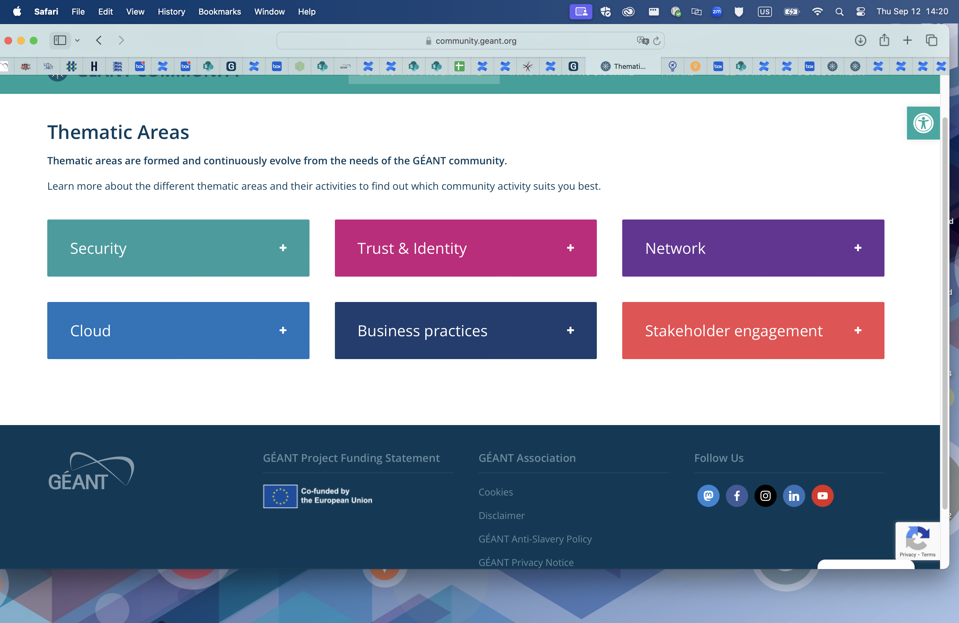
Thematic Areas
Special Interest Groups (SIGs)
Enable collaboration across the commun​ity for the development of the next generation of networking technologies and services.​
Explore emerging issues in research and education networking, develop strategies and solutions to address them.
Produce and test fresh and innovative ideas applied through specific research activities and initia​tives.
Welcome grass roots and world experts.
community.geant.org

Slide 5
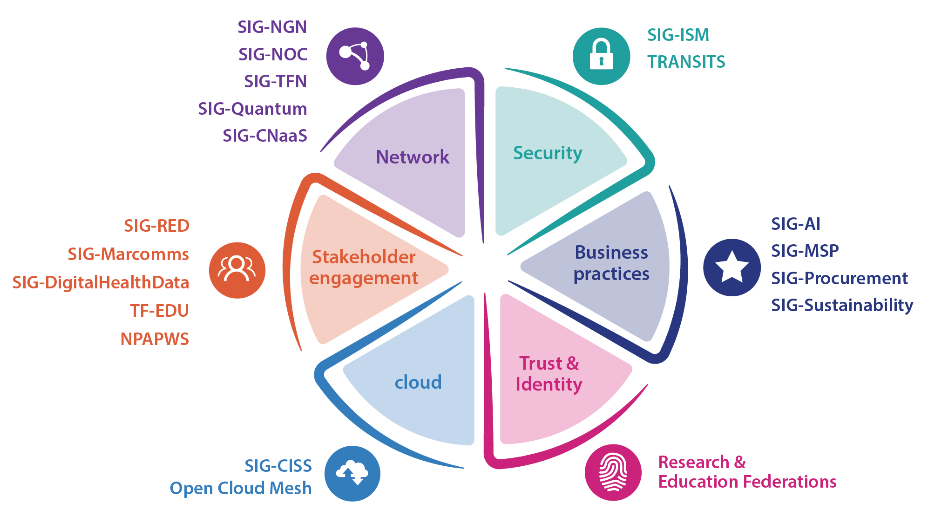
Thematic areas
NEW!
SIG-Policy & Public Affairs

Slide 6
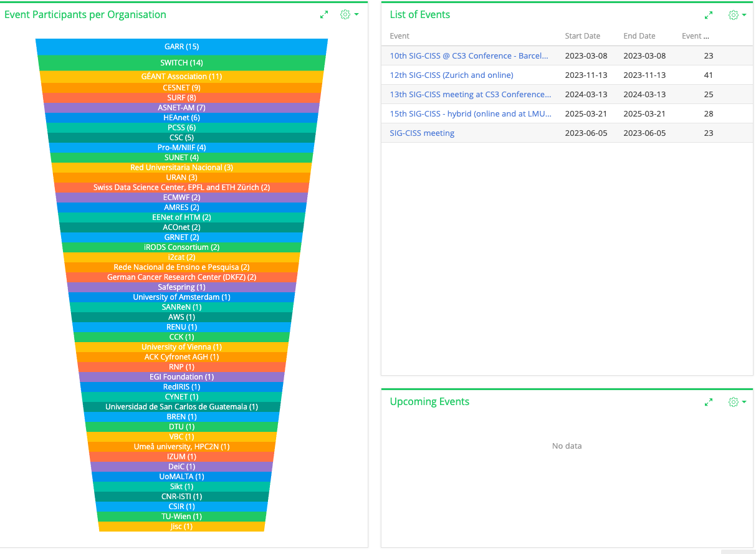
SIG-CISS activity 2023-2025
26 Countries
48 Organisations
99 unique participants represented at SIG-CISS

Slide 7
Innovation Programme
Total number per year
WHAT IS IT?
A unique opportunity to enable initial development, establish a proof of concept or testing of new ideas, with lightweight administrative constraints.
The GÉANT Association has reserved EUR300k yearly (since 2021), as part of the GÉANT Community Programme.
WHO CAN APPLY?
Research projects to be carried out by the GÉANT Community, i.e. GÉANT Member NRENs, universities, research institutions/institutes or other such legal entities to which a GÉANT Association Member NREN provides services.
The call for proposals is for research project funding of up to EUR50k, for a duration of no longer than 6 months.
 | Submitted | Approved
2024 | 66 | 6
2023 | 36 | 10
2022 | 42 | 10
2021 | 10 | 10
2026 proposals in! 24 submitted from 15 countries.

Slide 8
Innovation Programme – recent projects
Cloud
Network
Trust and Identity
Business Platform for OpenStack Clouds
Georgian Research and Educational Networking Association - GRENA - Georgia
Effective Multi-Laser-Beam Transmission for Satellite-Airborne Backhaul Networks
University of Bradford - UK
----
Mobile App Network trAffic Nutrition fActs (MANANA)
Università degli Studi di Napoli Federico II - Dipartimento di Ingegneria Elettrica e delle Tecnologie dell'Informazione - Italy
Design User Experiences for Digital Identities
University of Málaga (UMA) - Spain
Education
Innovation Programme 2025: Multi-tenant GÉANT Digital Research Environment (DRE)
SURF, w/POCs HEANet, Switch, Sikt, MREN
ZoomIn4PinkHats - promoting cyber security skills among young women in the education system.
Croatian Academic and Research Network – CARNET - Croatia
Security
Explainable AI for DNS Security in Privacy-aware NREN Federations - FedXAI4DNS
Institute of Communication and Computer Systems – ICCS – Greece

Slide 9
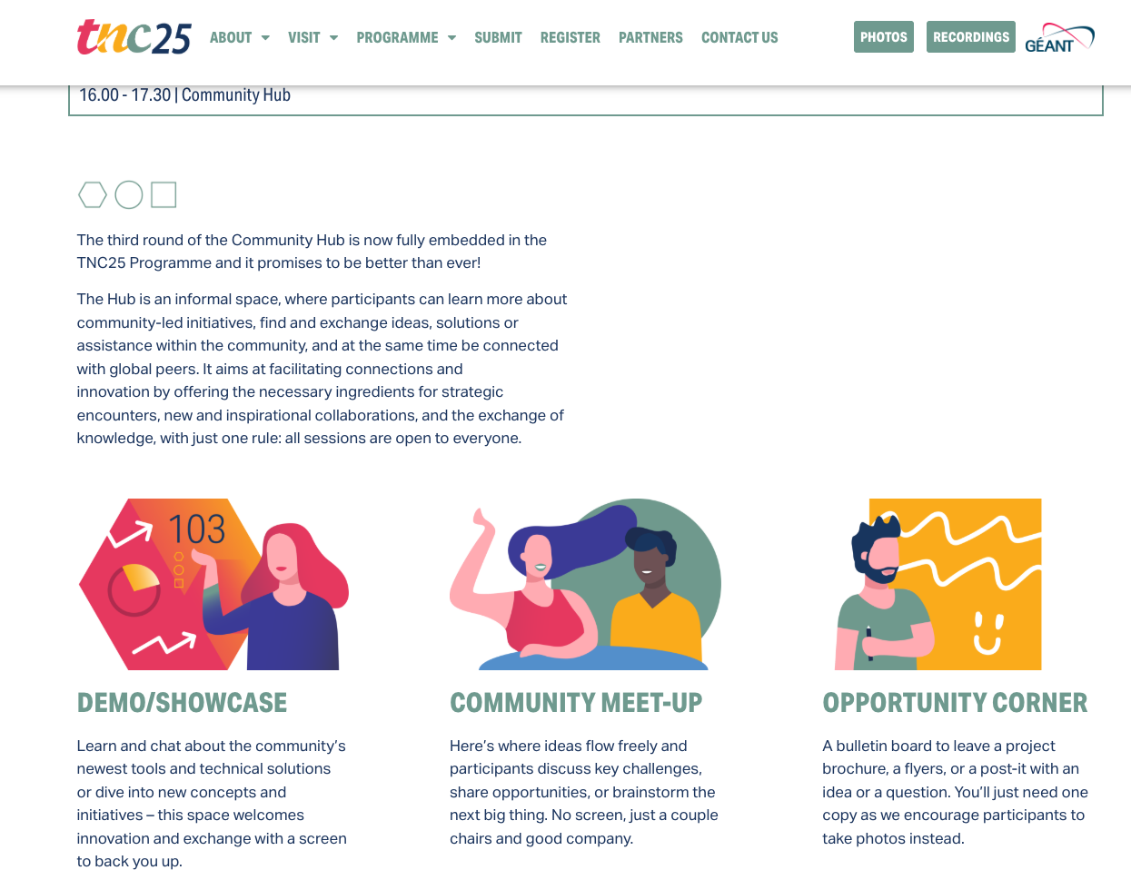
Community Hub-TNC 2026
How will SIG-CISS engage?
Call for proposals open 4 Feb!!!

Slide 10

Thank You
Any questions?
www.geant.org

