Slide 1


Marina Dimić Vugec, CARNET

Slide 2

Sounds strange?
Capture the Flag (CTF) competition for students
Jeopardy style competition
Goal: to interest young people in cybersecurity

Slide 3
We love numbers…
18 teams of 5 = 90 students
  14 different faculties
48 hours & 6 categories
  Web app security
  Binary exploitation
  Forensics
  Cryptography
  Misc
  Reverse engineering
40 challenges/6000 points
  1st team scored all points
30 students engaged in bootcamp & qualifiers for national ECSC team
National team = 10 players aged 15-25

Slide 4
Building legacy for future
Hackultet.hr
  repository of challenges
  Open to public
  Educational materials
    Writeups
    Tools and documents
    Other CTF platforms
    Wiki page
Discord CTF community
current, future and alumni players = 130 members
Networking
Participation in other CTFs
Event and knowledge sharing

Slide 5
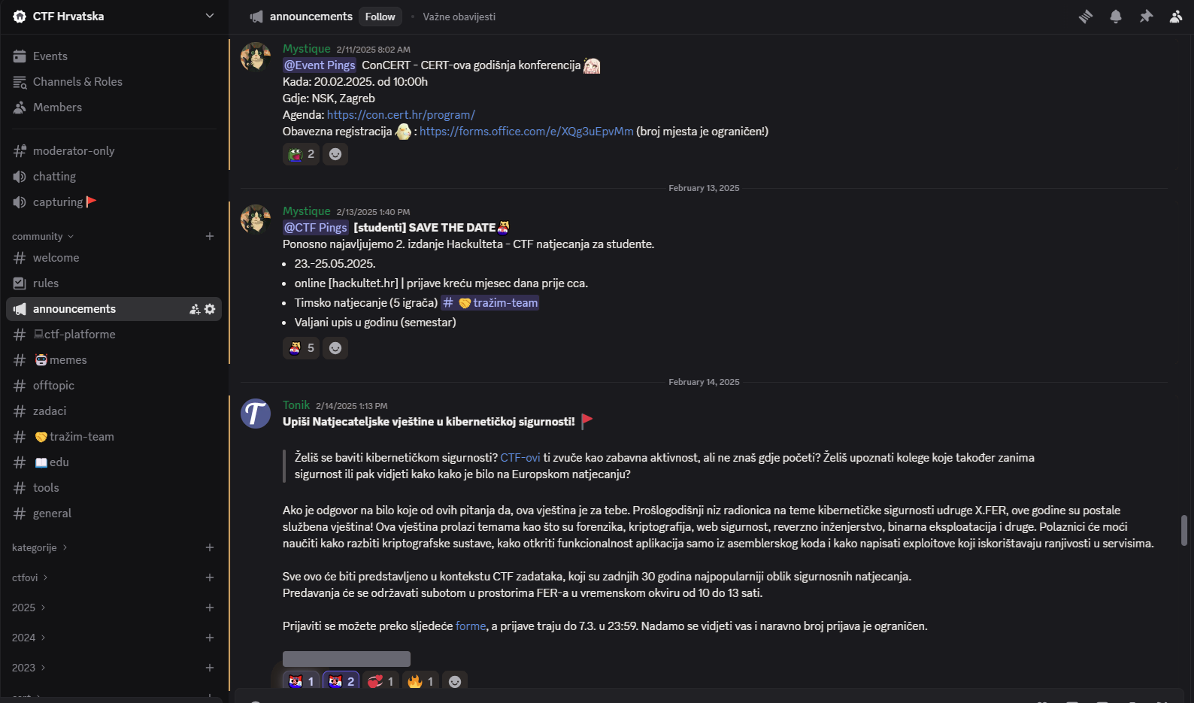
Building legacy for future

Slide 6
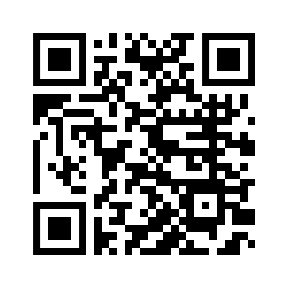
For more info:
marina.dimic.vugec@carnet.hr

