Slide 1


Who Owns the Internet?
(and why should we care)
Nicole Harris
Senior Trust and Security Manager
Security Days 2025
10th April 2025
Public

Slide 2
What is Ownership?
The right or state of being an owner / The legal right to use, possess or give away a thing /
The fact of taking responsibility for a thing
Building / Infrastructure
Land / Location / Jurisdiction
Responsibilities
Rights

Slide 3

“outer space is not subject to national appropriation by claim of sovereignty”
Treaty on Principles Governing the Activities of States in the Exploration and Use of Outer Space
Notes:
Who Owns Space?
The Outer Space Treaty, formally the Treaty on Principles Governing the Activities of States in the Exploration and Use of Outer Space, including the Moon and Other Celestial Bodies, is a multilateral treaty that forms the basis of international space law. Negotiated and drafted under the auspices of the United Nations, it was opened for signature in the United States, the United Kingdom, and the Soviet Union on 27 January 1967, entering into force on 10 October 1967. As of March 2024, 115 countries are parties to the treaty—including all major spacefaring nations—and another 22 are signatories
outer space is not subject to national appropriation by claim of sovereignty
Basically – every country is responsible for their own stuff
But then……

Slide 4
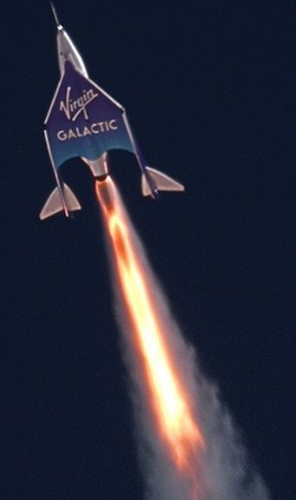
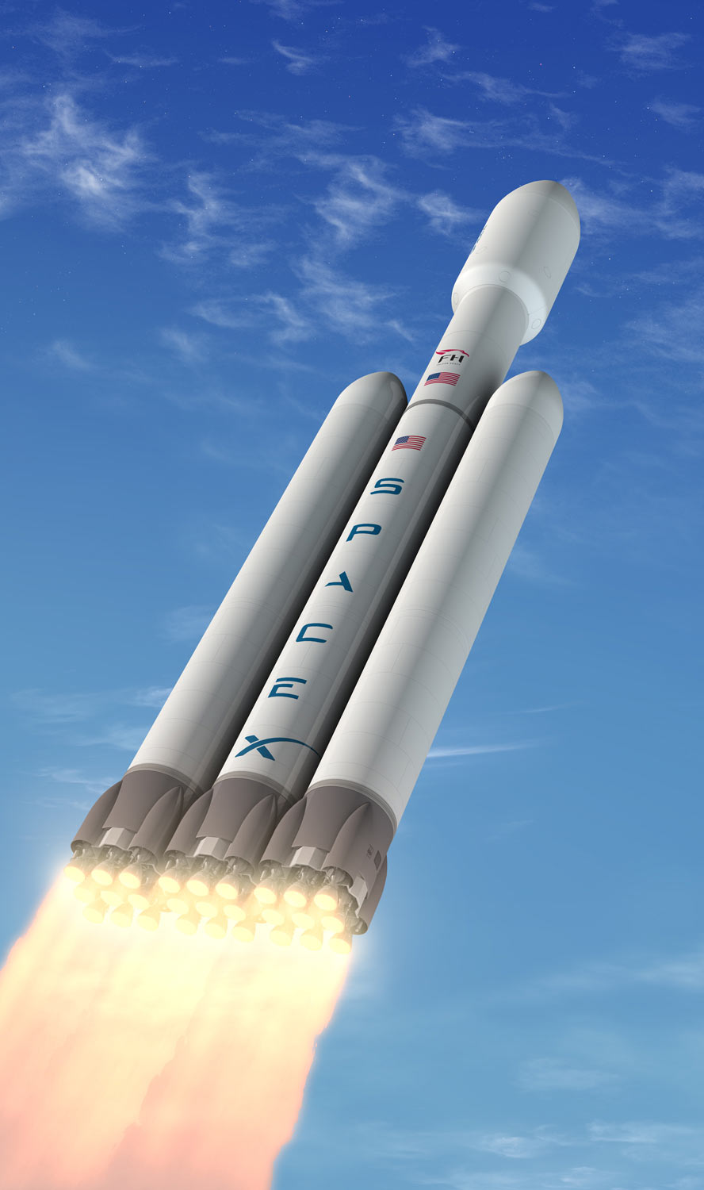
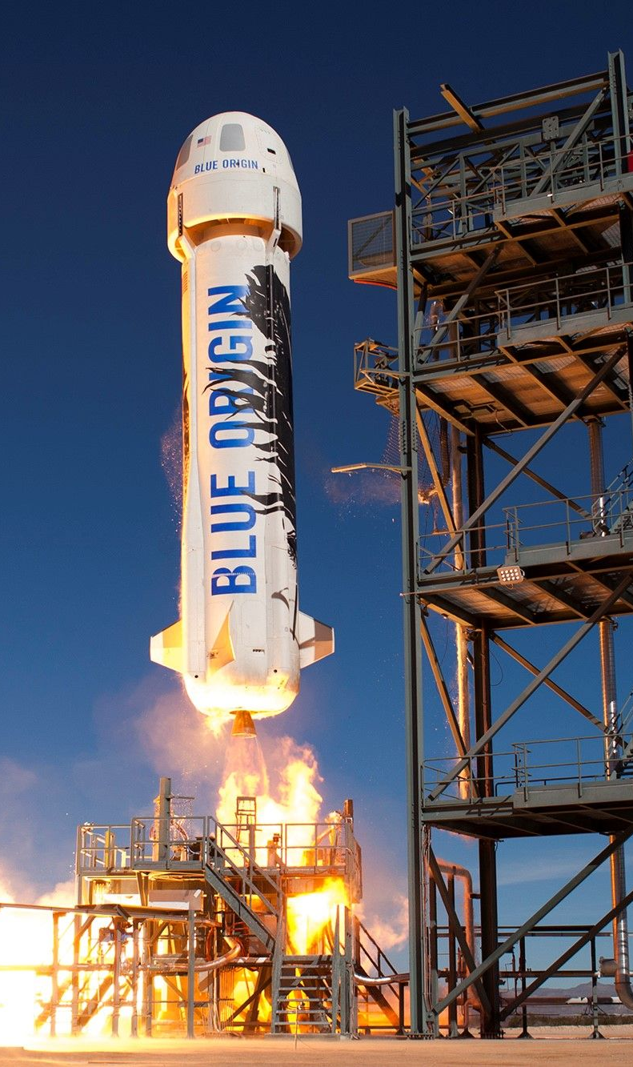
Notes:
There are over 10,000 satellites in orbit now. Over 60% of them are owned by Elon Musk
When concerns were expressed over clutter in the sky blocking our ability to see the stars – Elon said he had asked scientists to make his satellites less shiny….so never fear!

Slide 5

“the ocean is the common heritage of humankind…no State shall claim or exercise sovereignty or sovereign rights over any part of the Area or its resources”
United Nations Convention on the Law of the Sea
Notes:
Who Owns the Oceans?
The seas and oceans are considered to be a ‘global commons’, which means that they belong to everyone and no one at the same time.
However, countries do have the right to claim ‘exclusive economic zones’ (EEZs) up to 200 nautical miles from their coastlines. Within these zones, countries have special rights to explore and exploit natural resources, such as fish, oil and gas
Outside of these zones, both vessels and countries are subject to maritime law.
One of the principles of maritime law is the freedom of the high seas. This principle means that all countries have the right to use the oceans for navigation, fishing and other activities without interference from others. The ocean is free for all.
But there is a counter to this. The United Nations Convention on the Law of the Sea, adopted in 1982, recognises that the ocean is the ‘common heritage of humankind’, and that ‘No State shall claim or exercise sovereignty or sovereign rights over any part of the Area or its resources’.

Slide 6
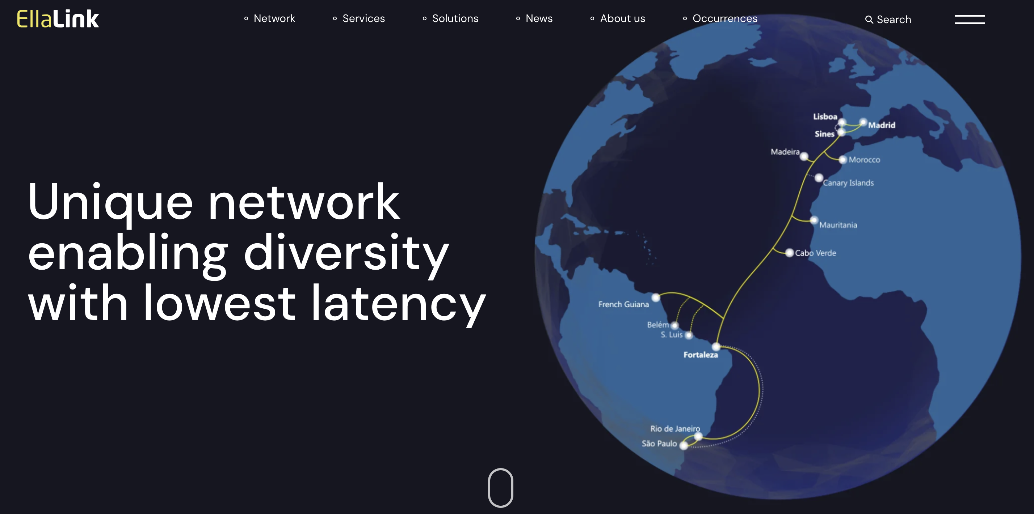

Slide 7
Jurisdiction

Slide 8
True or False:
the Internet is not geographically bound?
“The Internet was designed without any contemplation of national boundaries. The actual traffic in the Net is totally unbound with respect to geography.” Vint Cerf
Notes:
https://www.nytimes.com/2001/03/15/technology/welcome-to-the-world-wide-web-passport-please.html#:~:text=%22The%20Internet%20was%20designed%20without%20any%20contemplation,to%20geography.%22%20The%20only%20passports%20on%20the

Slide 9

2006
Tim Wu and Jack L. Goldsmith
ILLUSIONS OF A BORDERLESS WORLD

Slide 10
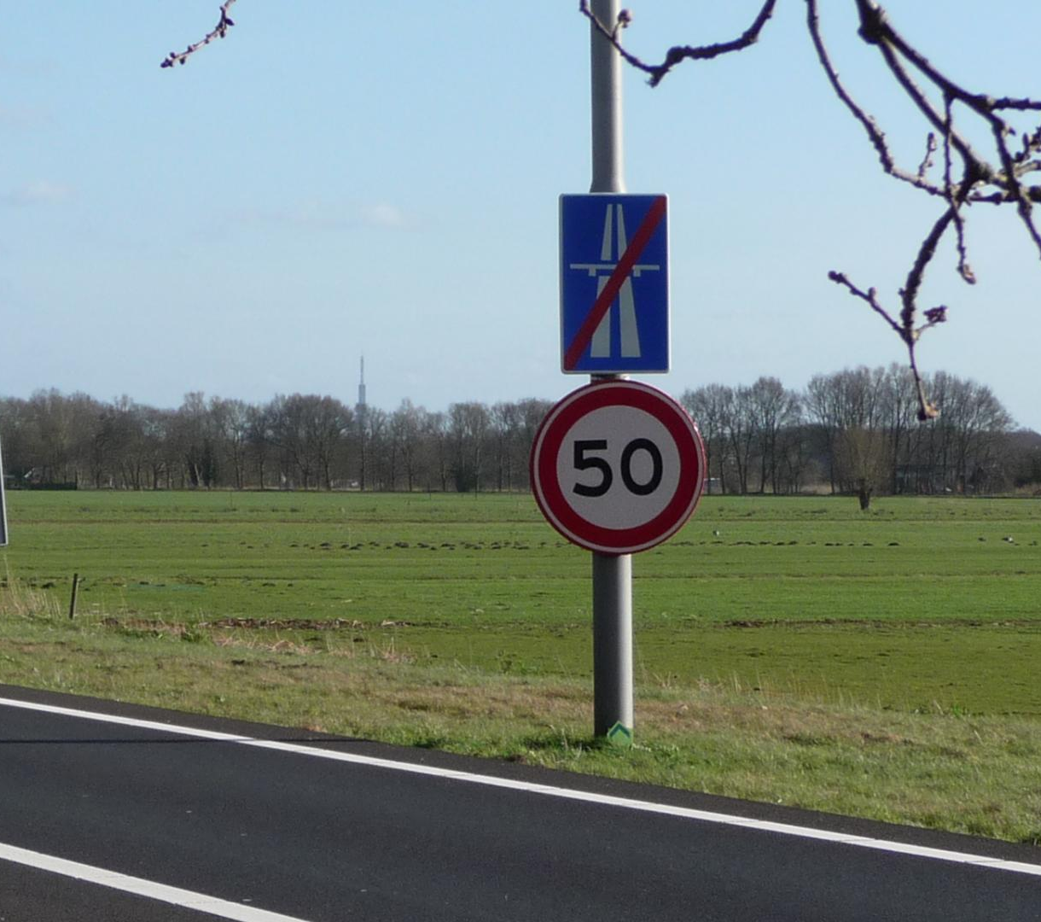
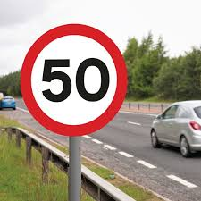
Notes:
How we interpret legislation in different environments matters.

Slide 11




Why is Geography Important Online?
Language
Filtering Information
Cultural Norms
Regional Internet Registries (pragmatic organisation)
Local Currency / Support
Bandwidth Limitations
Notes:
In the late 1990s over 80% of online information was in English - now it is less then 50%
Geography is not of course the only way to filter information to us, but it is a simple one
IP addresses in theory reveal little about a user’s physical location but the information packets sent do

Slide 12
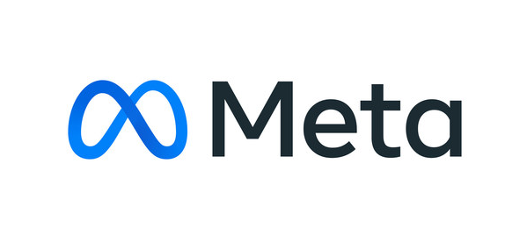
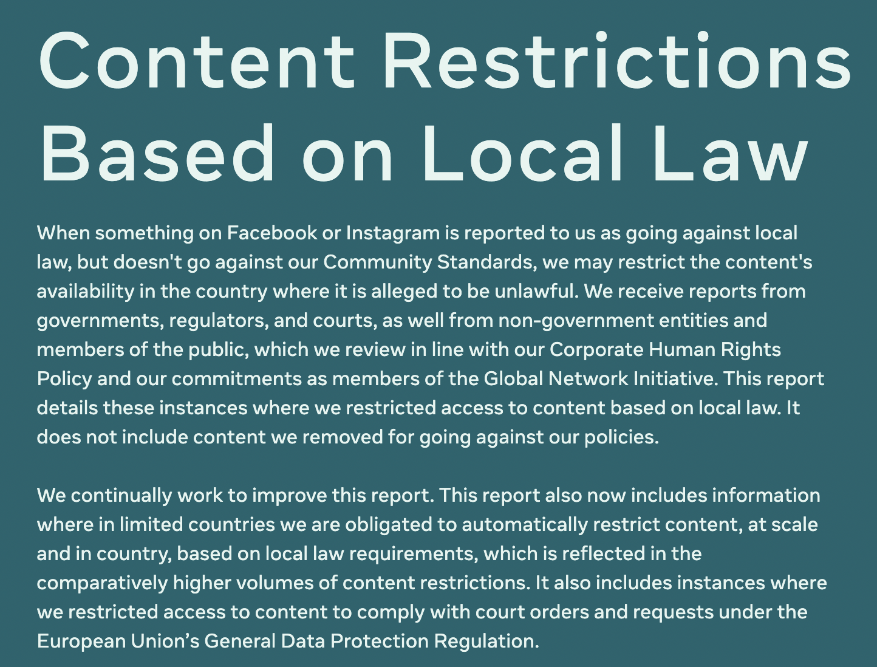
Restricting Access to Content
Indonesia | 148,617,572
South Korea | 118,621
Taiwan | 49,232
Malaysia | 37,206
Argentina | 32,299
United Kingdom | 18,233
Thailand | 16,987
Mexico | 15,534
Philippines | 15,380
Brazil | 14,713
“We restricted access globally to 1 item in response to a court order from a State Court of Appeals in Brazil and to 37 items in response to a court order from the Austrian Supreme Court for defamation. While we respect the law in countries where we operate, we strongly oppose extraterritorial legal demands such as the one resulting in these restrictions and consider all options to appeal the orders.”
Notes:
https://transparency.meta.com/reports/content-restrictions/
Indonesia – mostly gambling – and sexualized content, misinformation, blasphemy, terrorism, regulated goods, and divisive political speech
South Korea – mostly regulated goods and fraudulent financial services
United Kingdom – mostly posts and comments (no further details)

Slide 13
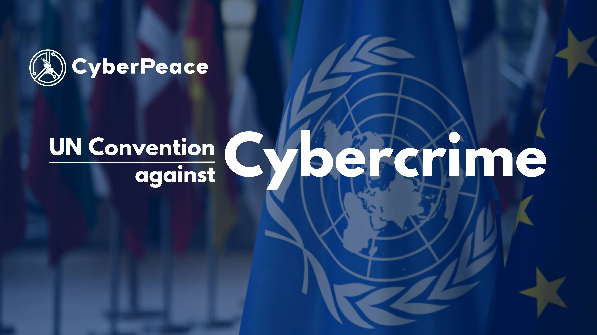
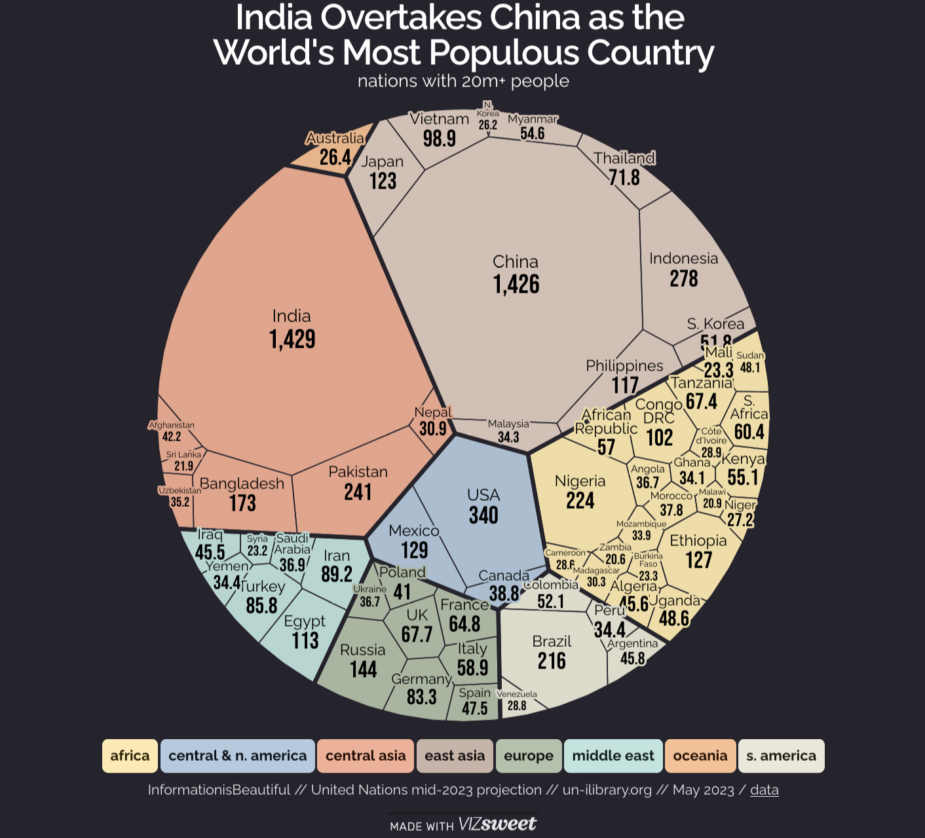
Notes:
Russia and backed by some of the world’s most repressive regimes, including Belarus, Cambodia, China, Iran, Nicaragua, Syria and Venezuela.

Slide 14
Infrastructure

Slide 15
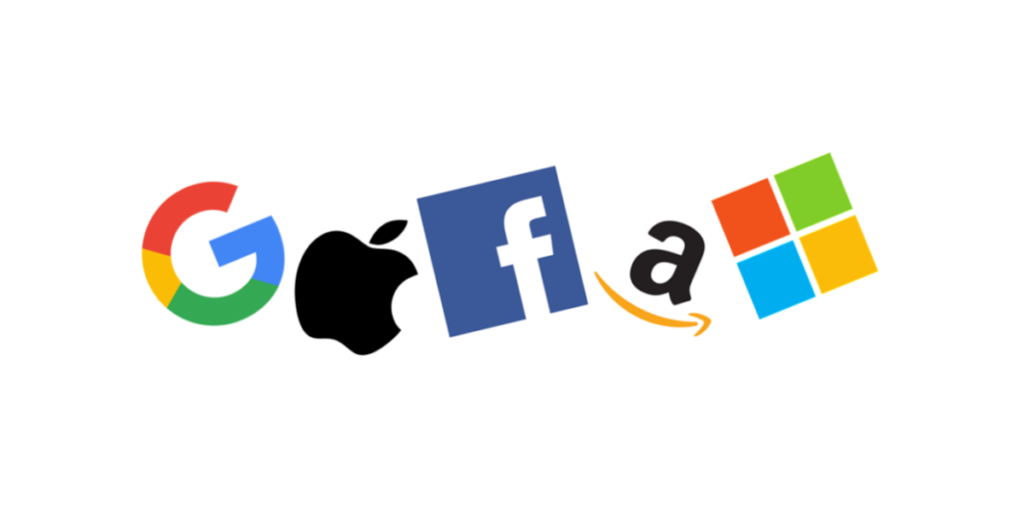




Notes:
Digital Markets Act: https://digital-markets-act.ec.europa.eu/potential-gatekeepers-notified-commission-and-provided-relevant-information-2023-07-04_en. Under the EU's Digital Markets Act (DMA), "gatekeepers" are large digital platforms providing core platform services (CPS) that act as a gateway between business users and consumers, and have a significant impact on the EU's internal market
Tools like slack and whatsapp lock us in - slack does not use XMPP or IRC.

Slide 16
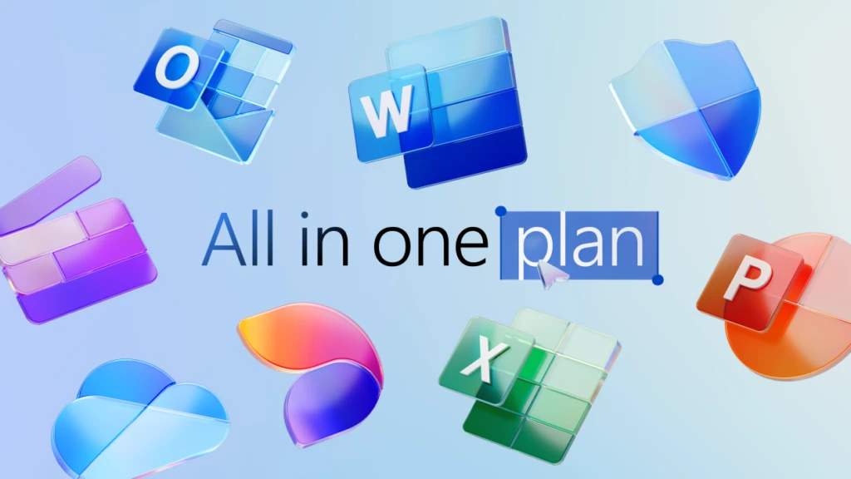

Slide 17
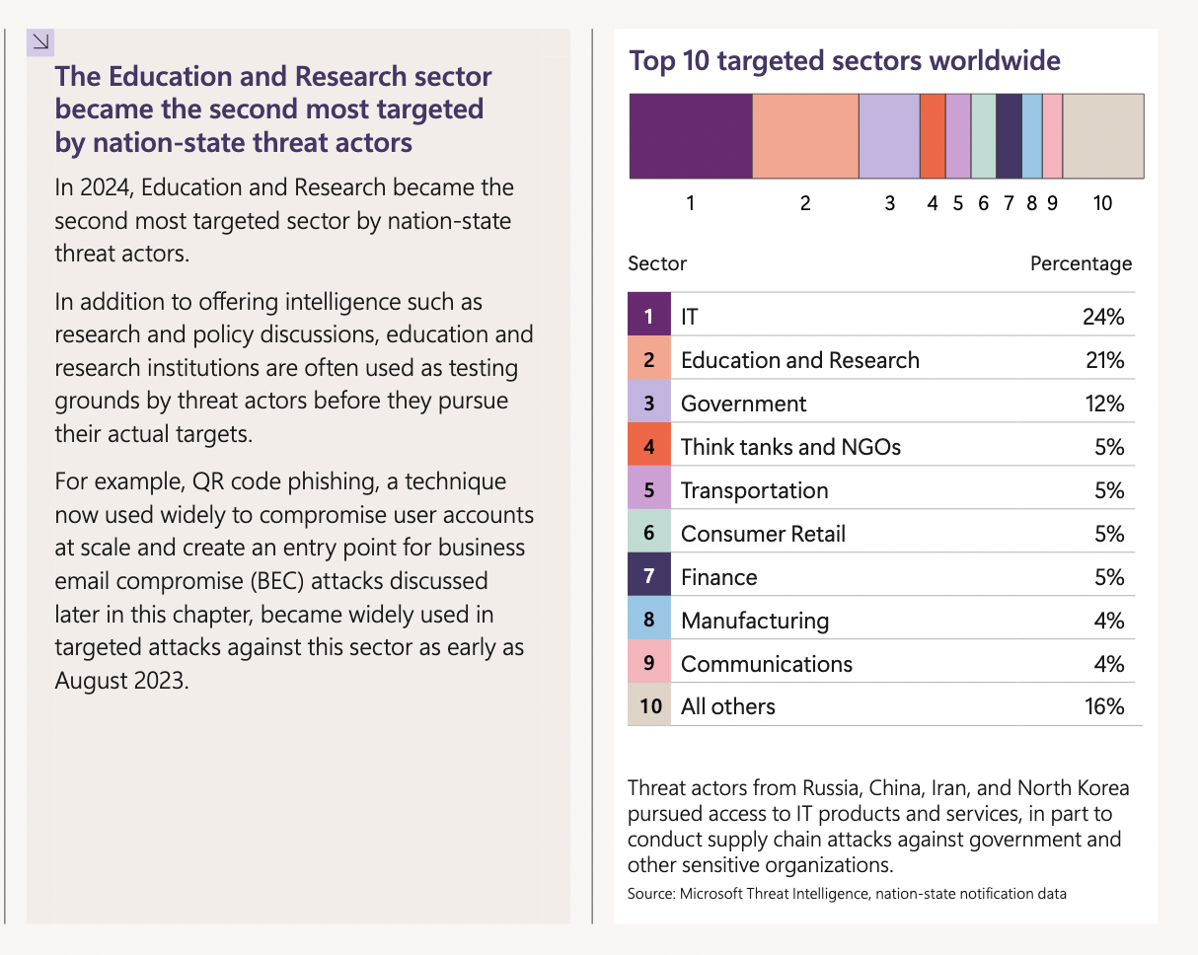
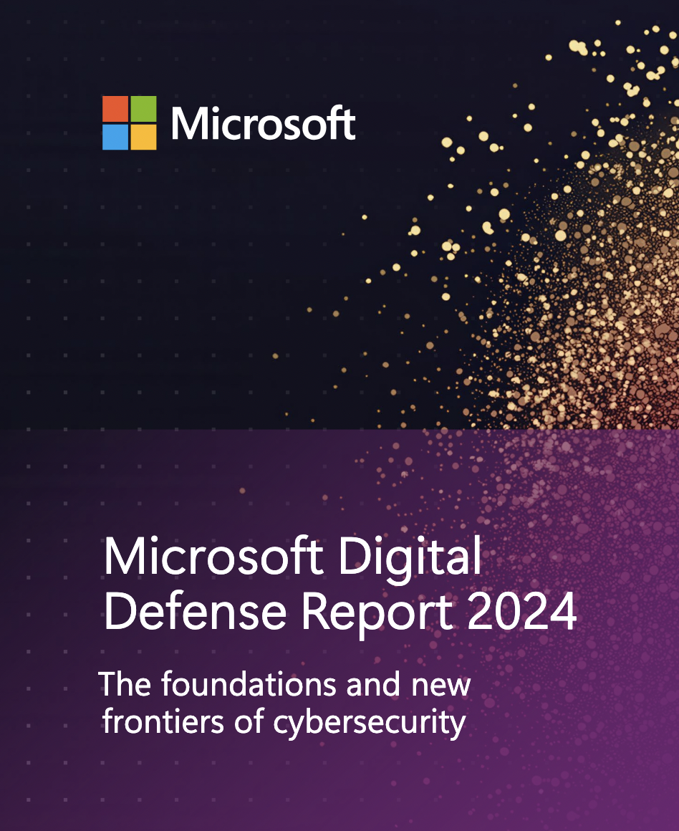
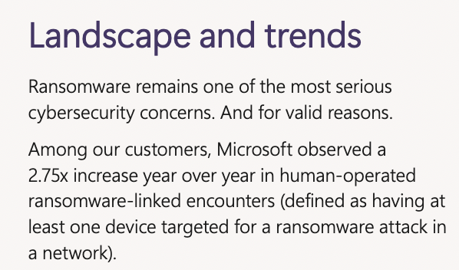
Notes:
https://cdn-dynmedia-1.microsoft.com/is/content/microsoftcorp/microsoft/final/en-us/microsoft-brand/documents/Microsoft%20Digital%20Defense%20Report%202024%20%281%29.pdf

Slide 18
The Wonderful World of Certificates
August 2019
February 2020
June 2020
September 2020
CA/B Foum Ballot SC22 on one year certificate validity periods FAILS
Apple announces plan to implement one year validity requirement regardless
Google also announces plans to reduce one year validity requirement
CA/B Forum includes in Baseline Requirements
September 2018 – browsers stop supporting the “green SSL bar” indicator
June 2021 – eIDAS Article 45.2 attempts to require browsers to support QWACS
Notes:
qualified trust service provider (QTSP)
Qualified web authentication certificate (QWAC)

Slide 19
Rights

Slide 20
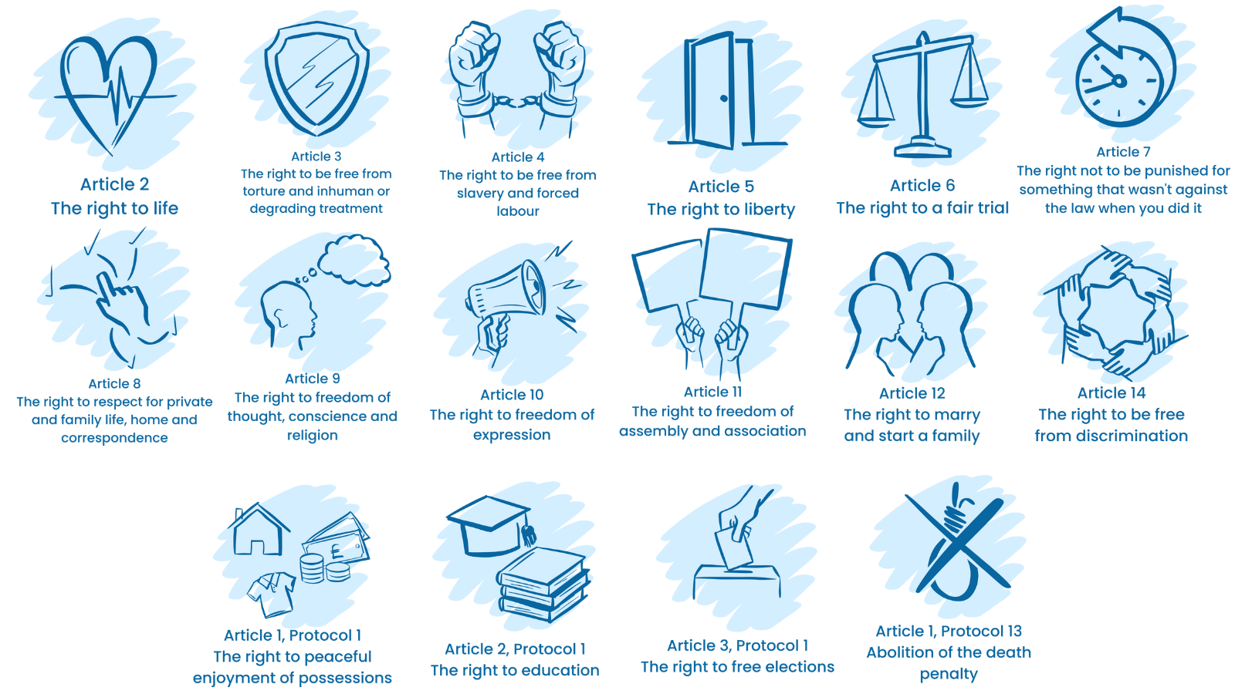
Is Internet Access a Human Right?
Notes:
existing online is not specifically different from existing in the real world – and indeed many

Slide 21
Social Contract or Protectionism?
Right to be informed
Right to restrict processing
Right of Access
Right to data portability
Digital Sovereignty
Digital Autonomy
Right of Rectification
Right to object
Right to erasure
Right to no automation

Slide 22
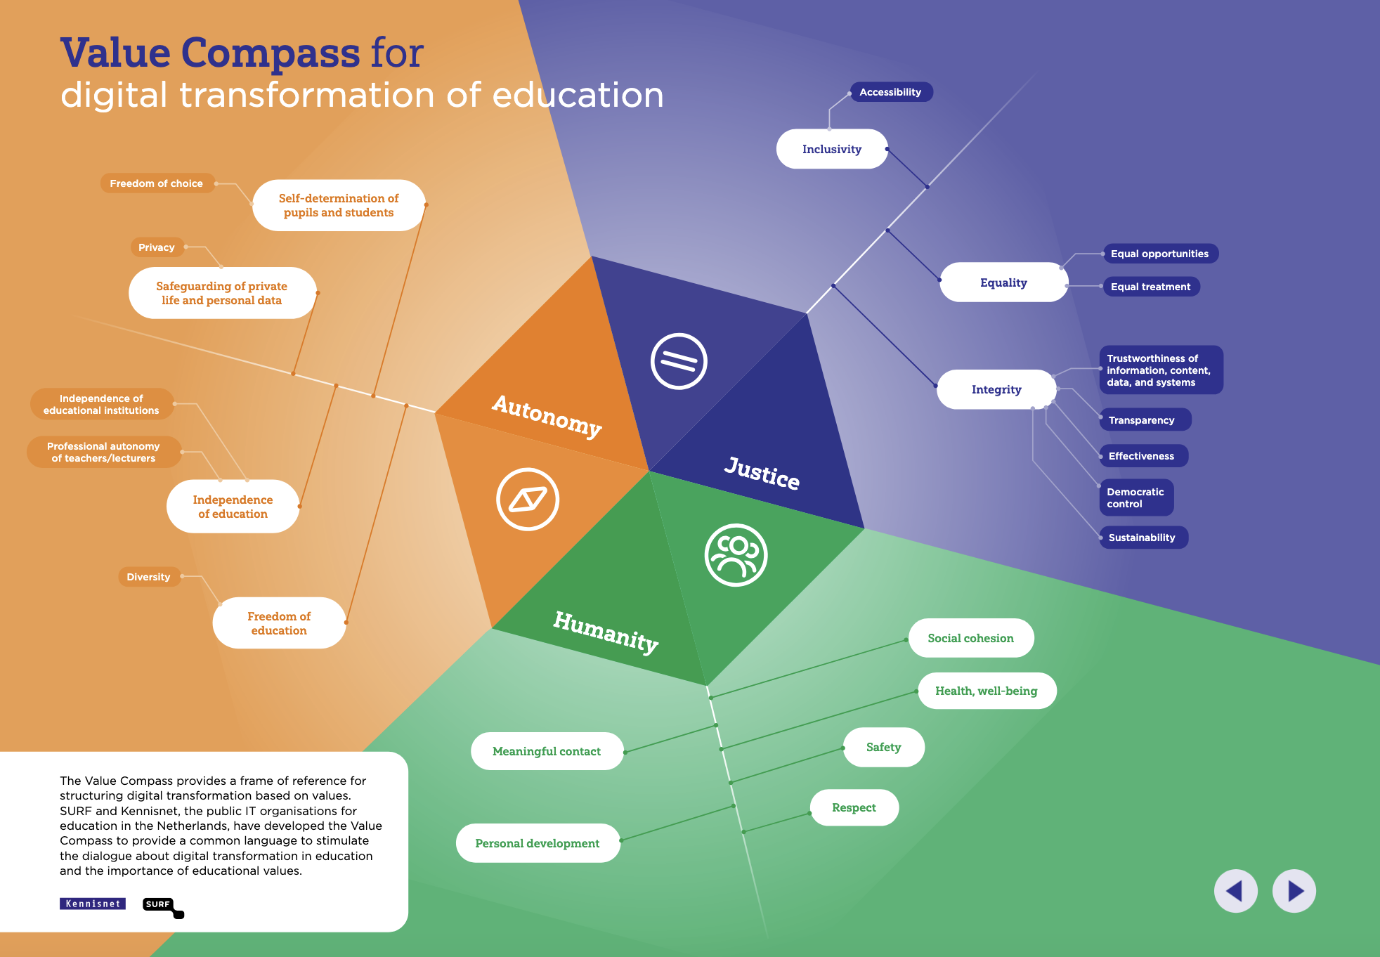

Slide 23
Responsibilities

Slide 24



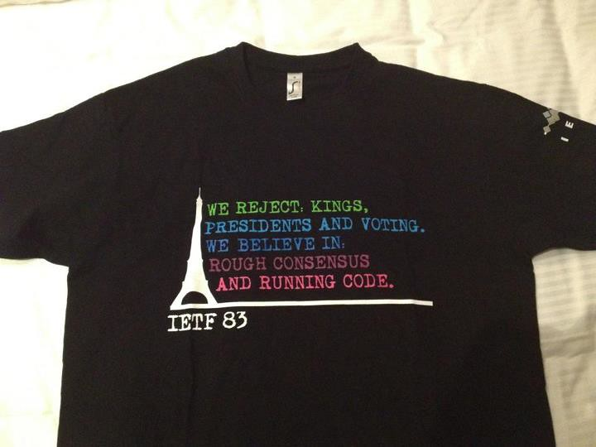

Notes:
The Internet Corporation for Assigned Names and Numbers (ICANN /ˈaɪkæn/ EYE-kan) is a global multistakeholder group and nonprofit organization headquartered in the United States responsible for coordinating the maintenance and procedures of several databases related to the namespaces and numerical spaces of the Internet, ensuring the Internet's stable and secure operation
Dave Clark's 1992 plenary presentation [Clark] regarding how we make decisions in the IETF: We reject: kings, presidents and voting. We believe in: rough consensus and running code.

Slide 25
“Four ground rules were critical to (Robert) Kahn’s early thinking:
Each distinct network would have to stand on its own and no internal changes could be required to any such network to connect it to the Internet.
Communications would be on a best effort basis. If a packet didn’t make it to the final destination, it would shortly be retransmitted from the source.
Black boxes would be used to connect the networks; these would later be called gateways and routers. There would be no information retained by the gateways about the individual flows of packets passing through them, thereby keeping them simple and avoiding complicated adaptation and recovery from various failure modes.
There would be no global control at the operations level.”
“
https://www.internetsociety.org/internet/history-internet/brief-history-internet/
Notes:
Robert Kahn and Vint Cerf
But is it really possible to have no control?

Slide 26
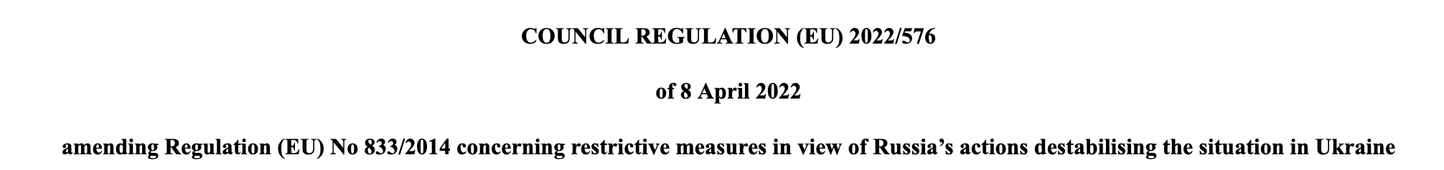

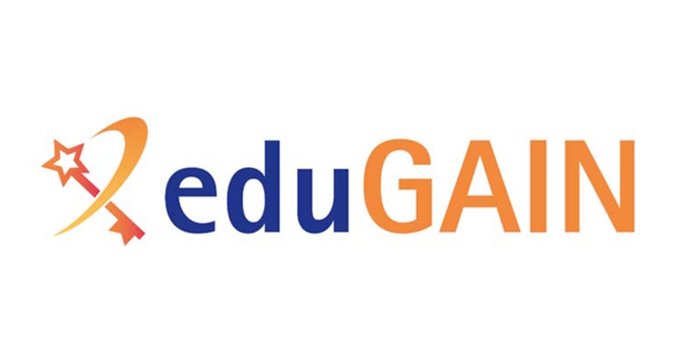
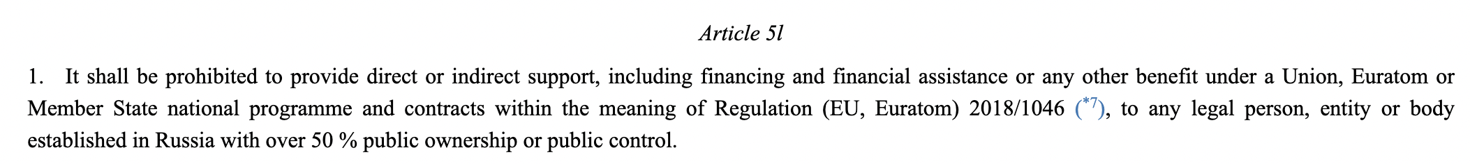
What happens…
when consensus is negated?

Slide 27
SO…why should we care?

Slide 28
NRENS?
1
Big Tech
2
3
Community Governance
Legislation

Slide 29
The World is Changing Quickly In unpredictable ways
How can we change the conversation?
The narrative around Internet Governance is not evolving
We represent a significant community of organisations with a specific remit for public values
NRENs have lost their voice and influence in governance spaces
Big Tech is ignoring traditional governance and ignoring legislation

Slide 30
Thank You
Any questions?
www.geant.org

