Slide 1
Building Resilience: The Role of NIS2 in Education
Ivana Jelačić, Croatian Academic and Research Network - CARNET
Marina Dimić Vugec, Croatian Academic and Research Network - CARNET

Slide 2
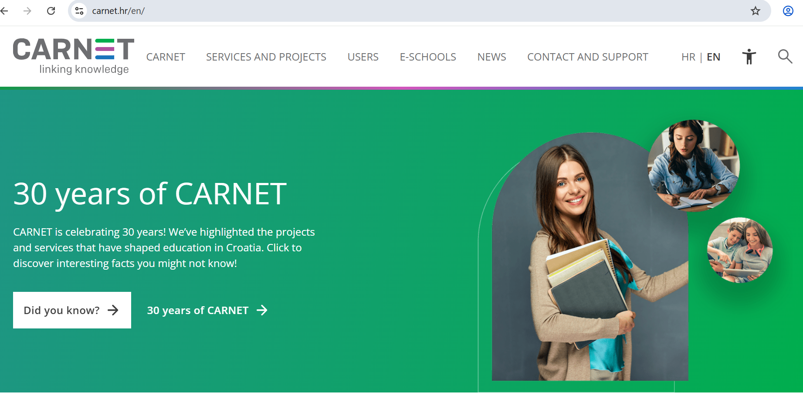
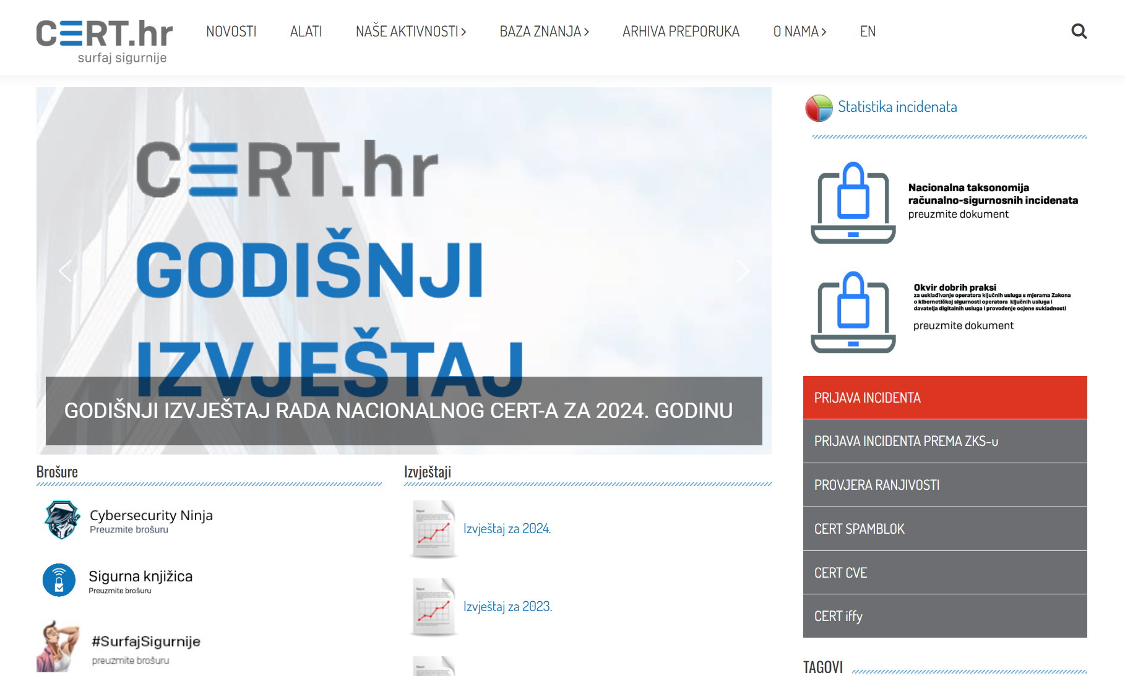
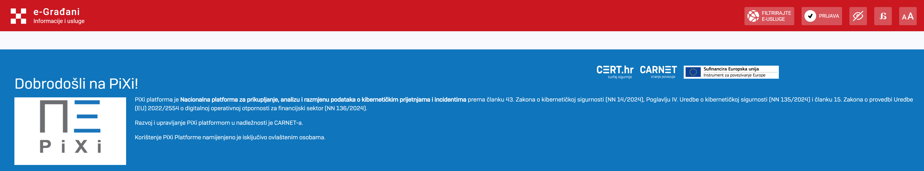
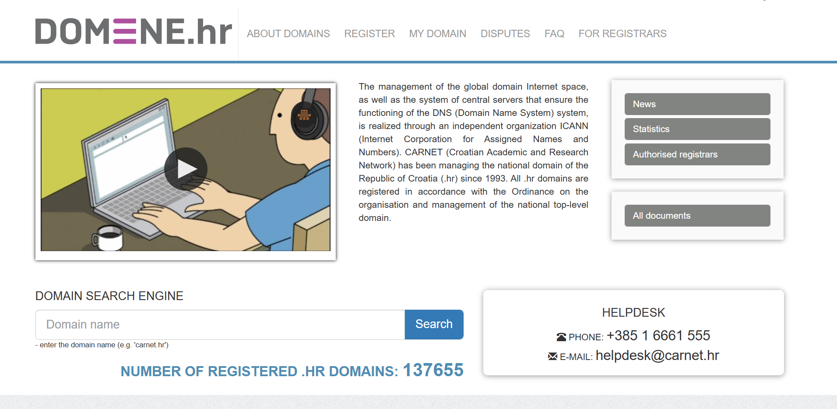

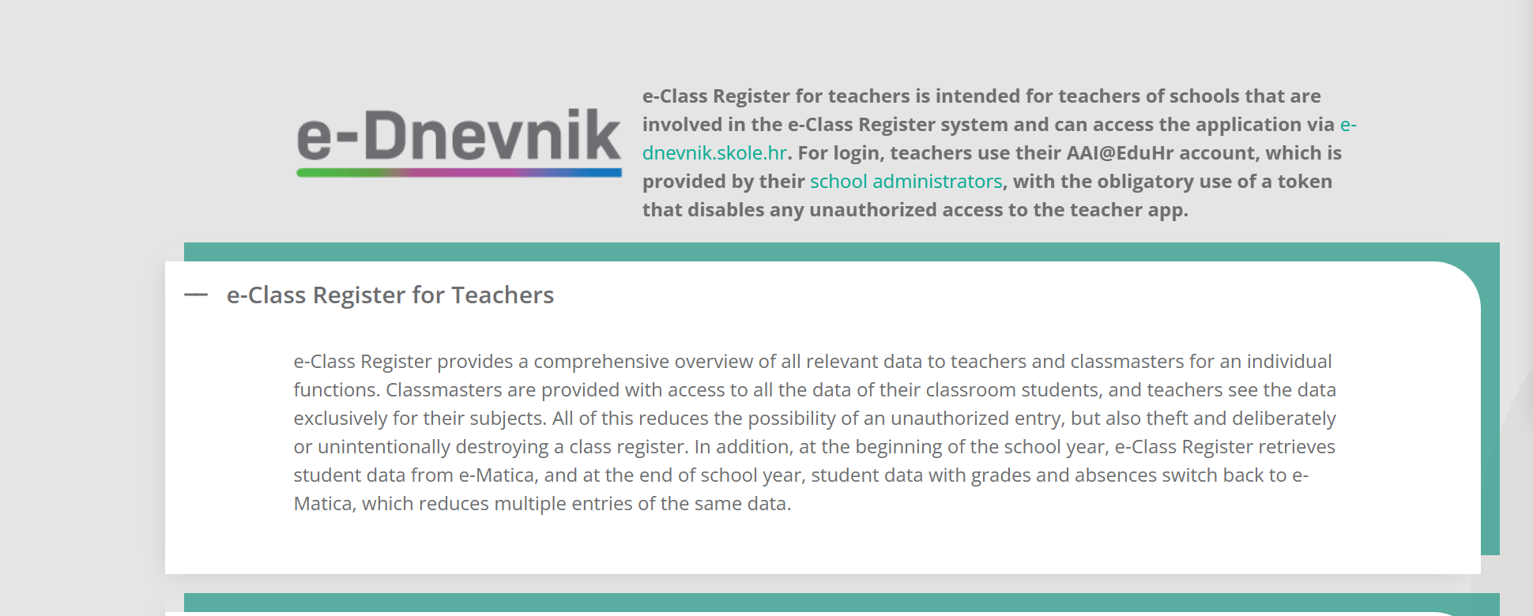
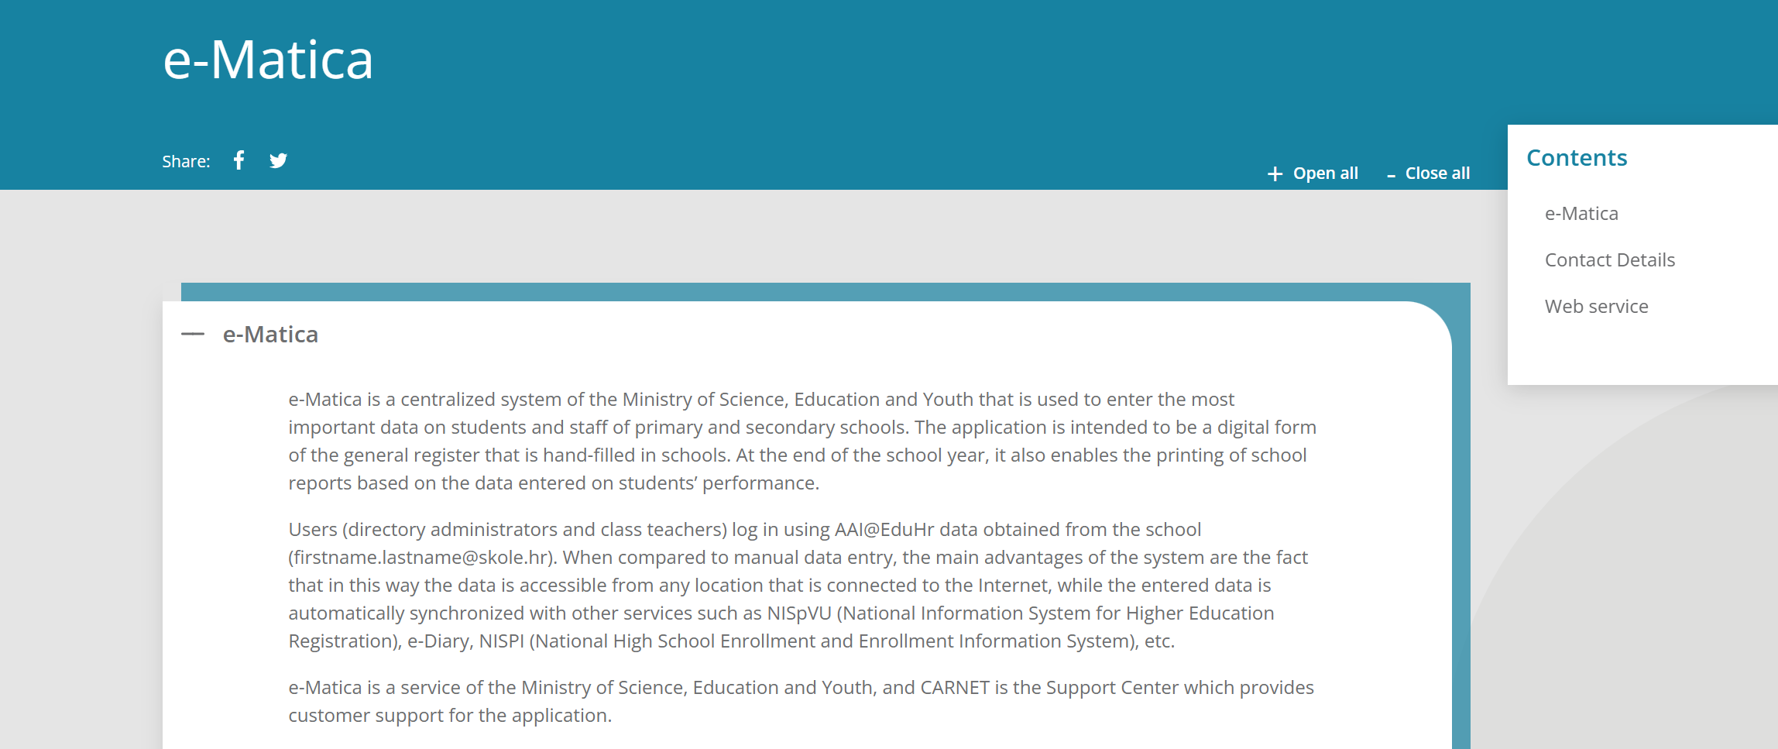
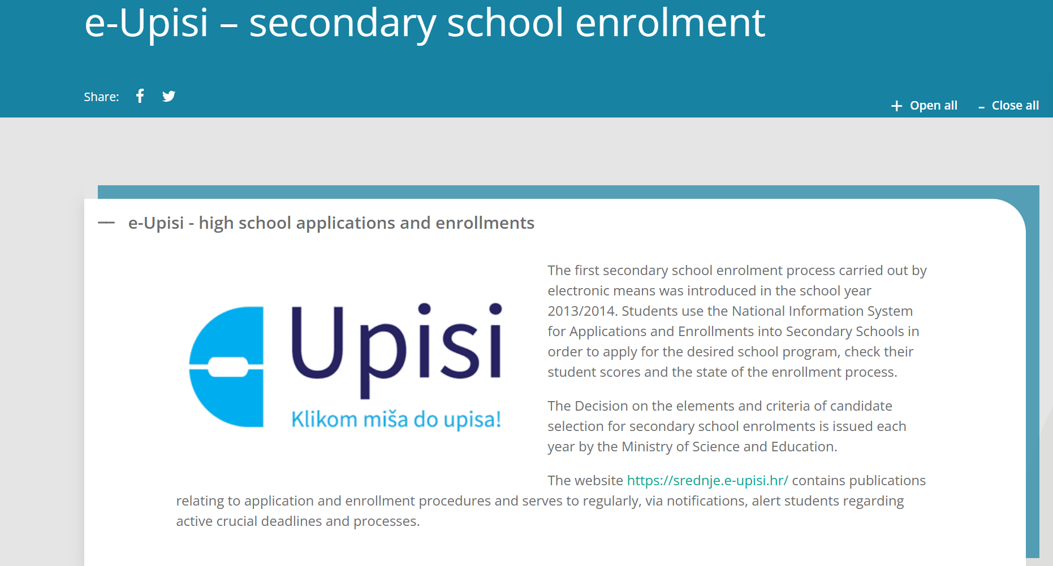
About CARNET
Croatian Academic and Research Network - CARNET
Public institution
Ministry of Science, Education and Youth
CARNET key services:
National CERT - www.cert.hr
Management of the national TLD - .hr – www.domene.hr
National Coordination Center for Industry, Technology and Research in the Field of Cybersecurity (NKS) www.nks.hr
e-Dnevnik – e-Class Register school and class record in electronic form
e-Matica - data on students and staff of primary and secondary schools
PiXi platform - National Platform for the collection, analysis and exchange of data on cyber threats and incidents – NIS2 and DORA
Not key but matters - CERTiffy - service for checking online stores
250 fulltime employees and around 100 students at HD

Slide 3

National CERT – Competent CSIRT Role
Highly Critical Sectors
  Banking
  Financial Market Infrastructure
  Digital Infrastructure – for TLD Name Registry
Other Critical Sectors
  Research
  Education system
CERT for public and private entities (all uncategorized), the academic and educational community and citizens

Slide 4
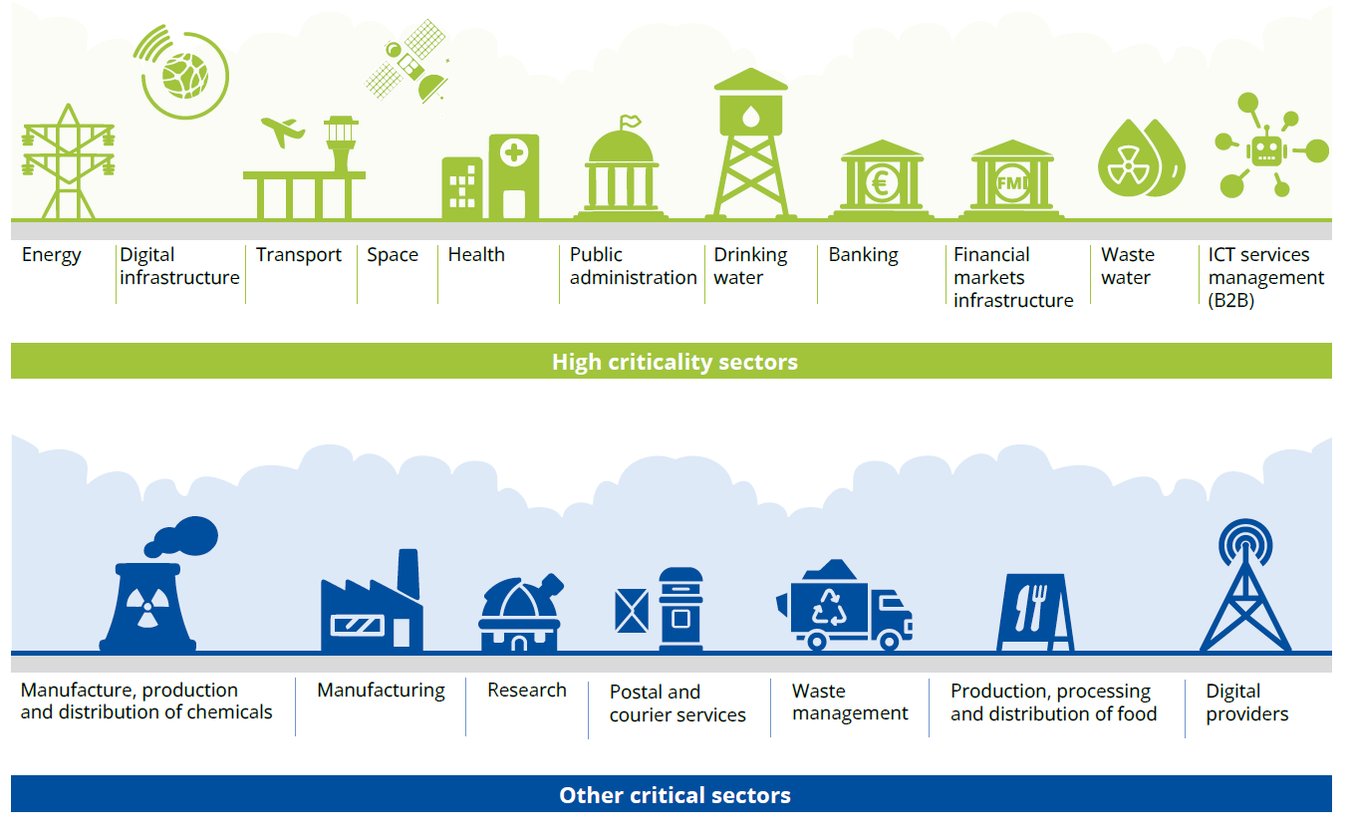
NIS2 sectors in scope
+ Education system

Slide 5
CARNET / National CERT – NIS2 Roles
CSIRT for 5 sectors
Development and management of the PiXi platform
Supporting Ministry in implementing CS requirements for the Research and Education System
CARNET – essential entity

Slide 6
NIS 2 Transposition in Croatia
Croatia has implemented the NIS2 Directive into national legislation
„one of the few”
Transposition process - legal framework:
2/24
12/24
5/25
3-4/25
Cyber Security Act
Cyber Security Regulation
Identification and Categorization process
Incident Reporting

Slide 7

Education system - nationally added sector
WHY? a critical sector –– Croatian education is highly digitalized compared to other public services
The goal
„enhance cyber resilience and security awareness”
The education system includes:
  early and preschool education,
  primary education,
  secondary education,
  higher education,
  monitoring, evaluation and development of the system,
  implementation of programs
Subjects in education system / sector are important entities
Competent authority is Ministry of Science, Education and Youth

Slide 8

Who are categorized subjects - entities?
Criteria for categorization - if they meet at least one of the following criteria:
not all educational institutions are included - only those of national or regional importance
they provide e-services of national information systems significant for the education system
they represent a HEI that conducts applied scientific research for the purpose of innovation and technology development, regardless of the founder of the institution
they represent a HEI that provides information systems services significant for the education system
they represent a public institution that conducts external evaluation in the education system and examinations based on national standard

Slide 9

Role of Educational Institutions
Act as a bridge between research, industry, and public institutions
Support the development of innovative cyber security solutions
Increase the resilience of the education sector and society

Slide 10
Resilience of Educational Institutions
Compliance is not just marked checkbox
ability of an educational institution to:
  anticipate,
  withstand,
  respond to,
  recover from cyber threats and incidents.
educational institutions must
  implement cybersecurity measures to ensure their systems, data, and networks remain secure

Slide 11

Key Cybersecurity Measures in Higher Education
Risk Management & Prevention – Identifying threats, conducting risk assessments, implementing security policies
Incident Response – Monitoring, reporting, and responding to cyber threats
Cyber Hygiene & Awareness – Training students and staff on safe internet use
Regulatory Compliance – Applying security standards

Slide 12

CARNET’s Role in Cyber Security
Encourages higher education institutions to apply cybersecurity risk management measures
Supports universities through the e-Universities project providing:
  education, materials, guidelines, templates and consultation in the process of harmonization with requirements and setting up of CS measures

Slide 13




e-Universities
"Digital transformation of higher education"
VALUE | DURATION | AIM | ELEMENTS
€ 84.013.537,73 Funding: National Plan for Recovery and Resilience 2021-2026 (Recovery and Resilience Facility – RRF) | 2022-2025 | Digital Transformation of Higher Education (HE) by: Improving the digital teaching infrastructure Introducing digital teaching tools Strenghtening the digital competencies of teachers for teaching in digital environment | Network computer infrastructure Services Education
Notes:
Some basic information about the project e-Universities. It is the project of digital transformation of higher education in Croatia. The digital transformation of public institutions in higher education will be approached systematically.

Slide 14

National CERT Mission for HEI
Raise cyber security awareness
Train cybersecurity experts through specialized programs
Promote digital literacy for secure network use
Educational institutions should lead by example in cybersecurity management

Slide 15

CS Educational Materials
Topics covered in cybersecurity training:
  NIS2 Directive
  Cyber hygiene & responsible internet use
  Security policy implementation in universities
  Cyber threat identification
  Incident reporting & resolution
  Secure university infrastructure

Slide 16

CTF - Cyber Security Competitions
Hackultet CTF competition
A cybersecurity challenge for students
Promotes careers in cybersecurity
Strengthens student expertise
Learn more Today
16:00 or 4PM
Lightning Talk

Slide 17
Conclusion and Time for Questions…
Cyber security is essential in education for resilience and protection
CARNET & National CERT play a key role in cybersecurity improvement
Continuous education and competitions empower students and institutions

Slide 18
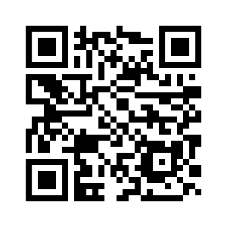
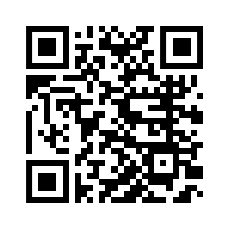
For more info:
ivana.jelacic@carnet.hr marina.dimic.vugec@carnet.hr

