Slide 1
Improving Security 'from the ground up'?
Jeroen Wijenbergh
09 April 2025

Slide 2

https://encrypted-tbn0.gstatic.com/images?q=tbn:ANd9GcRh_a-aOOiZama3xpPJrl-xv5N836sCuejAww

Slide 3
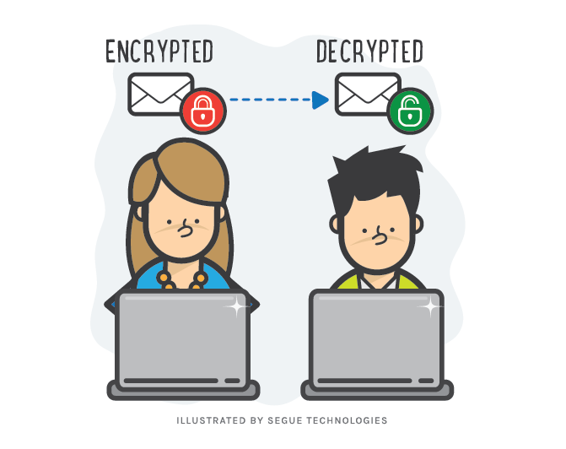

https://www.seguetech.com/wp-content/uploads/2015/01/segue-blog-Email-Encryption-Enterprise.png
https://www.keyfactor.com/wp-content/uploads/iStock-1252346549-1.jpg

Slide 4


https://connect.geant.org/wp-content/uploads/2023/10/eduvpn-article.png
https://images.photowall.com/products/51818/tunnel.jpg?h=699&q=85

Slide 5

From the ground up?
https://www.pitara.com/media/why-does-cutting-onions-make-us-cry.jpg

Slide 6
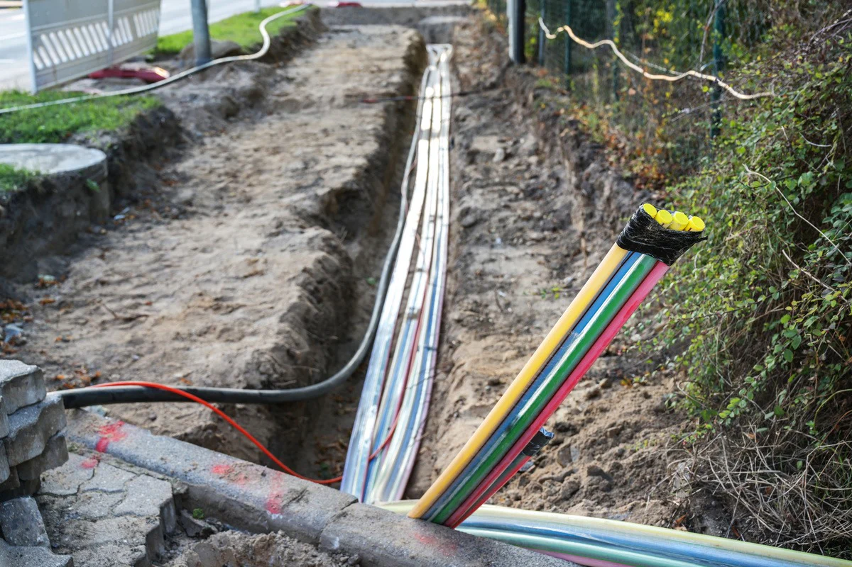
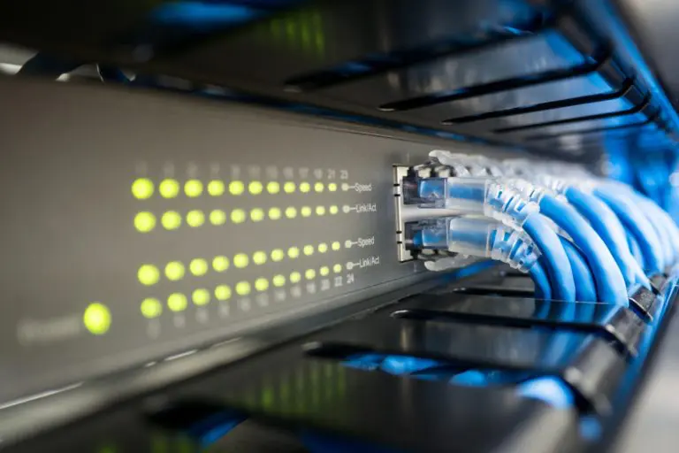
MACsec or OTNSec?
https://www.critterguard.org/cdn/shop/articles/Pros-and-Cons-of-Underground-Fiber-Optic-Cable.jpg
https://dataspan.com/wp-content/uploads/2018/01/shutterstock_407198587-768x512.jpg

Slide 7
Thank you!
Any questions?

