Slide 1
Hybrid Cyber Response Exercises – Halfway to Full Scale
Tor Gjerde
Sikt – Norwegian Agency for Shared Services in Education and Research

Slide 2
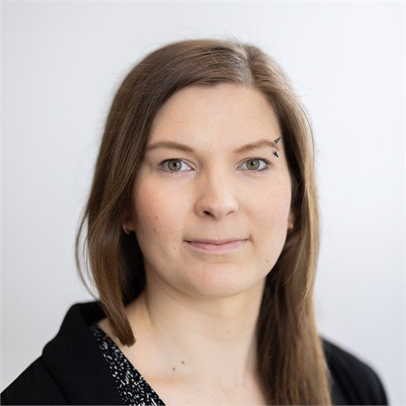

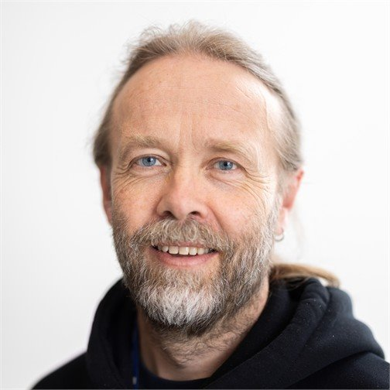

Our team
Made Ziius
Ingrid Moen
Øyvind Eilertsen
… and me

Slide 3
Our organisation
Sikt is a government agency delivering digital products and services to the academic sector, and encompasses the National Research and Education Network
Within Sikt, eduCSC is both the national sectoral CERT and a security service vendor, spanning from the bits and bytes of NetFlow to threat reports, advise on Information Security Management Systems, and cyber security exercises
We have established a network of Incident Response Teams (IRTs) at our customers, and while these are of wildly varying size and maturity, we act as a hub where they get assistance from us and each other, while we maintain a running overview of the security landscape

Slide 4
Our challenges
We have a special responsibility to the IRTs in our sector, as well as unique knowledge about their specific situation
We lack central funding for exercises, and are dependent on the willingness of our customers to cover the expenses in a time of shrinking budgets
… but the requirements for our customers to participate in cyber security exercises only address crisis management and business continuity
Hence, we need to demonstrate our exercises’ high levels of quality, relevance and cost-effectiveness to the customers

Slide 5
Our response
To achieve this, we focus on exercises that include both IRT and crisis management personell – and instead of treating this as an obstacle, we use the interplay between them as a source of dynamics in the exercises
We craft unique scenarios for each exercise, based on the actual situation the sector is currently facing, including the threat landscape, attack surface and recent incidents
We enlist the assistance of other Sikt personnel with unique skillsets when that further strengthens the scenario or its execution

Slide 6
Options, options, options
Tabletop discussion exercises incur little cost and can easily be repeated for many customers
  When well designed they may be relevant to crisis management, but in our experience they tend not to be felt as sufficiently relevant by the technical staff making up our IRTs
Live cyber range exercises are expensive, but the cost scales well if we can get sufficiently many customers to participate
  These target IRTs almost to the exclusion of crisis management, but in our experience it is hard to adjust the challenge level to IRTs of varying skill levels, and the need to play in an artificial game world reduces the feeling of relevance

Slide 7
Our preferred middle ground, Hybrid exercises
The exercise is performed in realtime at the customers’ own facilities with each participant in their real-life role and using their own infrastructure
Single day exercise with a workshop on the day before; we recommend an evaluation and experience sharing session on the following day in addition to the quick debrief we provide at the end of the exercise day
For a single customer, our team can be on-site, but we can also coordinate simultaneous exercises at a small number of customers from our own offices with assistance of a local coordinator at each customer

Slide 8
What we bring to the party
The scenario, developed with input from the local coordinators
A clone of the secure chat service used for daily communications with IRTs; doubling as a way to stay in contact with the local administrators
One of the CERT members outside the exercise team playing themselves in the role as on-duty CERT officer, assisting IRTs and providing game inputs
One of us playing a journalist asking tough questions
The staff or local coordinators simulate any other entities the participants choose to interact with

Slide 9
Exercise goals
We find that stating goals for the exercise in the planning phase is valuable both for scenario design and for honest post-exercise evaluation
Typically, we set three groups of goals:
  for the IRT participants
  for the crisis management participants
  for the communication and other interplay between these groups
The goal are set in cooperation with the local coordinators, and may be adjusted somewhat as the scenario is developed

Slide 10
Game inputs (1: primarily for IRT participants)
Log events
  Any non-disruptive electronic activities we can perform that leave logged traces can be used as clues to be discovered and followed up on (this is the “gold standard”)
  If a needed log entry cannot be created in a non-disruptive way, we provide it in tabletop format once they search the relevant logs
  … or eduCSC may provide realistic logs from core network infrastructure
Advisories, warnings and technical indicators from eduCSC, the national CERT and a ficticious university
  These provide context and clues to what to look for

Slide 11
Game inputs (2: primarily for crisis management participants)
Reports from the IRT side will always be central in this format
  Communication between the two groups are central to the exercises; if needed the local coordinator may suggest that the crisis management ask IRT for updates
Phone calls from a journalist
  Questions are designed to be hard to answer, and to require that the communication personnel receive up to date information from the IRT
Pre-made news articles
  Sometimes we adjust these on the fly based on the participants’ responses to the journalist or what they choose to make public

Slide 12
Narrative arc
While the IRT is an entity designed to be ready to respond at any time, the crisis management only convenes when needed
  Sometimes the artificial exercise situation causes the crisis management to get involved long before they would have been in a real situation
  Conversely, it would be a waste of their time if they only become involved towards the end of the exercise
  We therefore tend to start with a situation that puts them on high alert
The scenario contains several threads, of which only some are connected
  This simulates real-life “fog of war” and necessiates prioritisation of attention

Slide 13
Participant inclusion
Pacing
  To ensure that the participants are neither overwhelmed nor bored, we may delay some inputs or add optional ones based on the judgement of the local coordinator
Rewards
  We attempt to present clues such that finding them and acting on them as much as possible feels like an achievement, similar to “capture the flag” type exercises, but with greater realism
Debrief
  After the exercise we quickly present the storyline including how things were connected to create a feeling of closure

Slide 14
… but does it work?
We get very positive feedback and evaluations from participants
Our own assessment is that participants engage deeply and find the experience relevant
The two participants in our previous exercise less than a year ago have signed up for the one currently being prepared ☺

Slide 15
Thank you for the attention!
Tor Gjerde <tor.gjerde@sikt.no>
Sikt – Norwegian Agency for Shared Services in Education and Research

